Slide 1
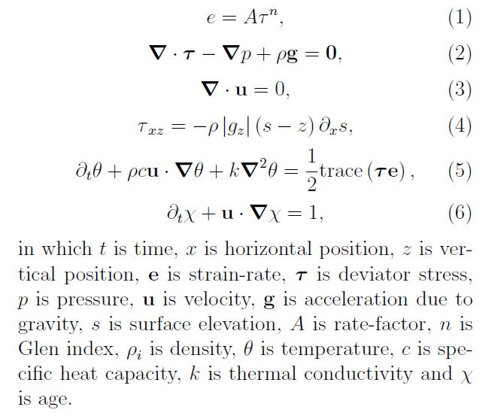
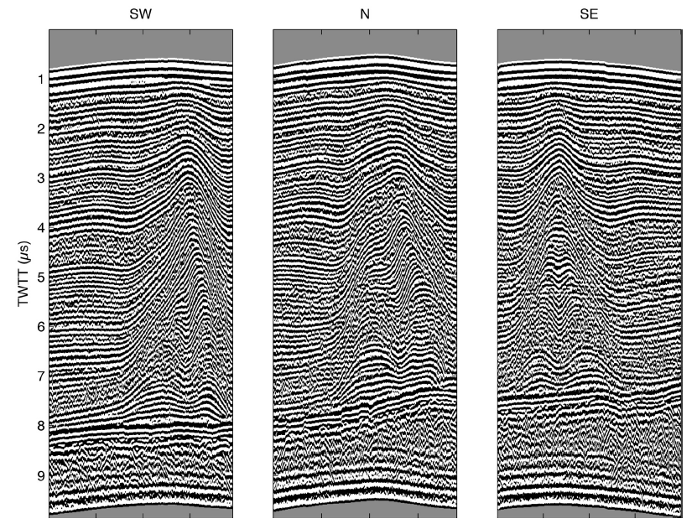
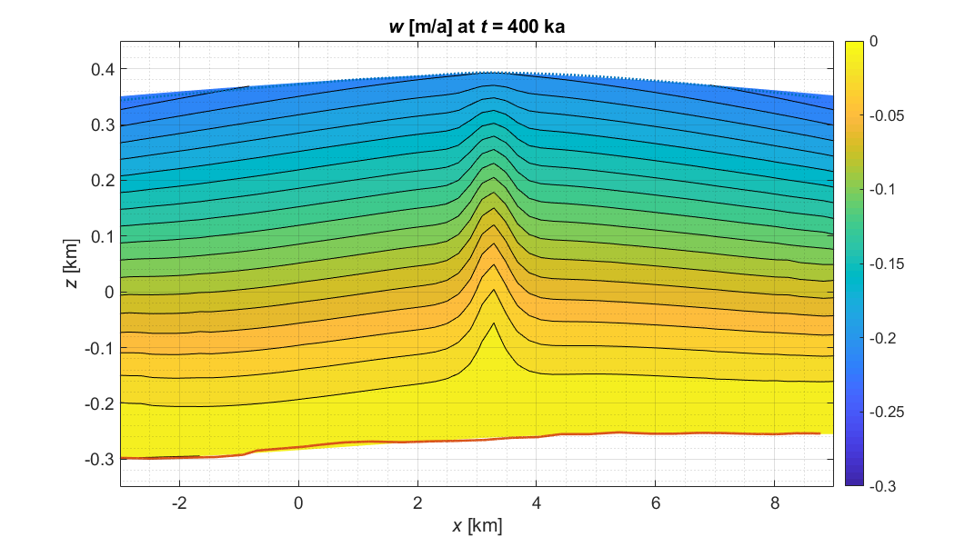
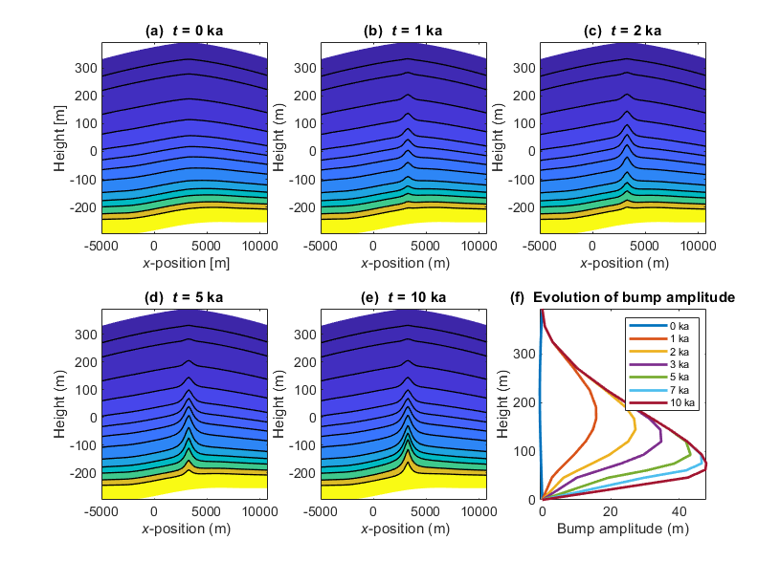
Geophysical Fluid Dynamics: Modelling Non-Linearly Viscous Ice-Flow to Obtain Dates of Flow Change
Richard C.A. Hindmarsh, British Antarctic Survey and Durham University
1: Ice Flow: Ice deforms viscously with a flow where strain-rate is proportional to the stress to power n ~ 3 (1): the viscosity depends upon the stress. The slow flow can be described by incompressible Stokes flow (2,3). The lubrication approximation (LA) states shear stress is proportional to the product of the depth and surface slope (4).
At ice divides the slope and shear stress are zero meaning the viscosity could become very high, obstructing deformation. Other stresses come into play, preventing the viscosity becoming very large. This is known as the “Raymond Effect” (RE). It can be modelled by solving the Stokes equations (2,3). Temperature θ and age χ are also solved for (5,6).
3: COMSOL: I used COMSOL Multiphysics™, the CFD Module™ and the Mixer Module™ to simulate plane ice flow around the divides utilising the observed geometry. At distances from the divide of more than a few ice thicknesses, the LA holds well, so boundary conditions are set accordingly; at the base the ice is frozen while the upper surface is traction-free. A useful hypothesis is that the ice surface geometry is unchanged since the divide relocation.
4: Bump evolution: The steady ice surface provides a surface geometry close to that seen in the field, and resulting COMSOL-calculated velocity fields are used in tracer calculations that compute isochrone. RA formation is predicted by the numeric solutions. RA amplitude depends on the divide relocation date, so we can estimate the date when the divide moved to its current location and make inferences regarding the history of ice-sheet area at several locations all around Antarctica.
4: Conclusions:
Raymond Effect Dating gives very useful constraints on ice-sheet history
It requires detailed radar surveys of areas a few km wide
It requires finite element modelling of the area
The Ray,ond Effect has been shown to be an explanation of anticline stacks
References:
Raymond, C.R., (1983), Journal of Glaciology
Matsuoka K. et al, (2015), Earth Science Reviews
Hindmarsh, R.C.A. et al., (2011), Journal of Geophysical Research F
2: Anticlines: The RE creates an observable feature at divides, seen by the radar surveys; a stack of buried anticlines (“Raymond Arches”, RA). These have width approximately equal to the ice thickness, and when fully grown have amplitude of between a quarter and a third of the ice thickness. Formation times depend upon the rate of snow accumulation and the thickness of the ice, and range between a few millennia to several tens of millennia. Predictions of steady/developing arch amplitudes can be made by numerical solution of the Stokes equations, giving dating of the repositioning of the divide and informs about ice-sheet evolution.

