Slide 1



Simulation of bi-material nano-second laser ablation
M. DALª, L. CARVALHO^{b}, A. SEMEROK^{b}, W. PACQUENTIN^{b}, H. MASKROT^{b}
ª PIMM-ENSAM umr CNRS 8006
^{b} Den – Service d’Etudes Analytiques et de Réactivité des Surfaces (SEARS)

Slide 2
Outline
Introduction
Physical Models
Results and validation
Analysis
Conclusion & complementary works

Slide 3
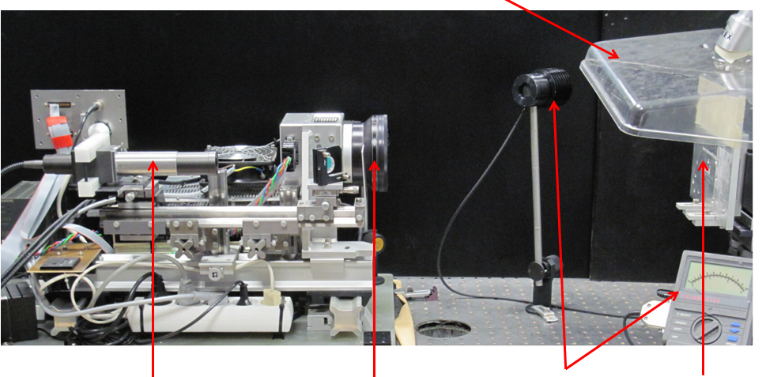
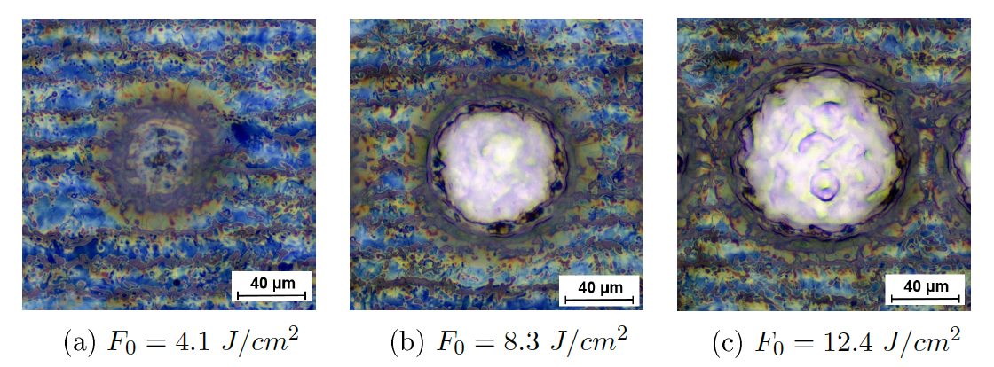
Introduction
Wavelenght: 1064 nm Gaussian beam
Beam size (1/e²) : 62 µm Impulsion duration : 110 ns
Frequence : 20 kHz Peak power : 10⁴ W
Topic :
Nanosecond laser ablation for nuclear decontamination
Context :
Experiment: cea
Simulation: PIMM
Simulation aims to:
Understand current mecanism(s)
Phase explosion
Solid cracking
Vaporization
Laser
Head
Diagnistics
Sample
Parameters | Min | Max
Laser fluence | 5 J/cm² | 12 J/cm²
Shots overlaping | 60 % | 90 %
Nb treatement | 1 | 10

Slide 4
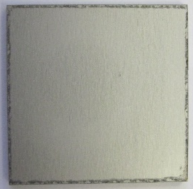
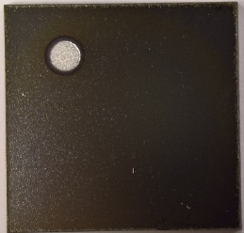
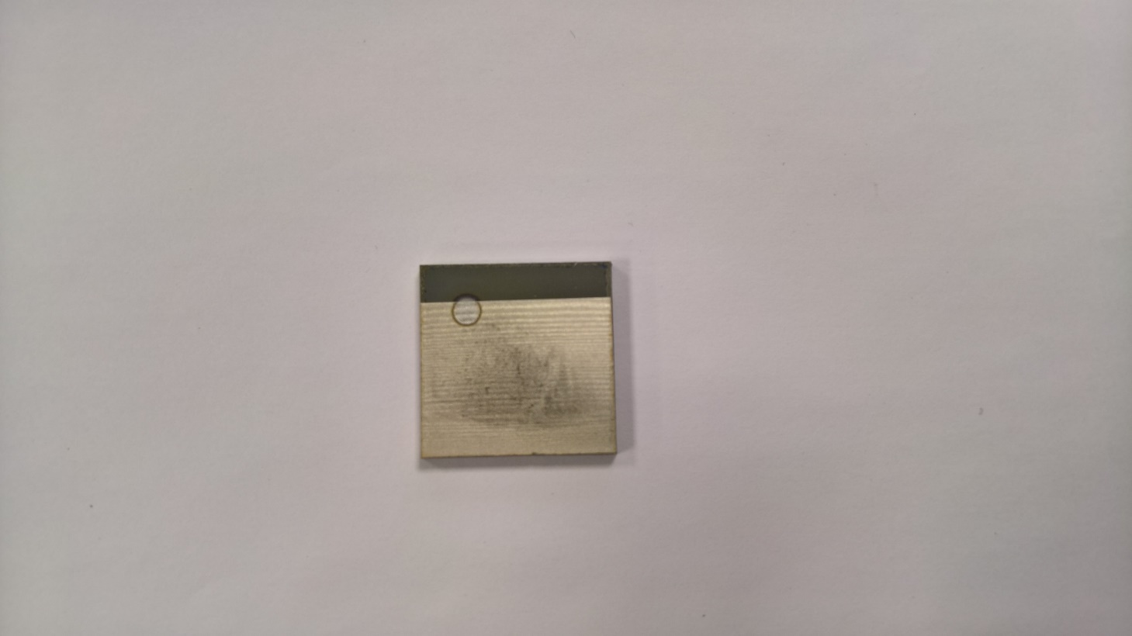
Introduction
Decontaminaion efficientcy
GDMS (1 track, 73 J/cm²)
Before decontamination
After decontamination
Satisfactory results but it still few cantaminant
Treat residual contamination
Understand mechanism to improve process
Optimisation des paramètres de décontamination
Paramètre | Min | Max
Fluence laser | 5 J/cm² | 12 J/cm²
Recouvrement spatial | 60 % | 90 %
Nombre de balayage | 1 | 10
Echantillon brut
Echantillon oxydé
Echantillon décontaminé

Slide 5
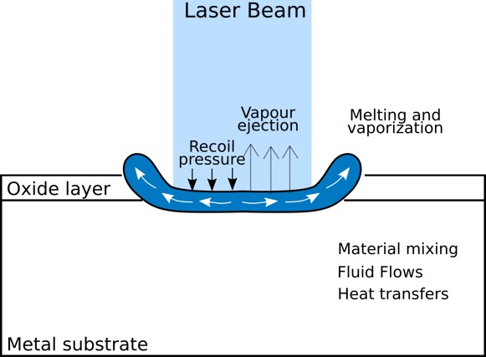
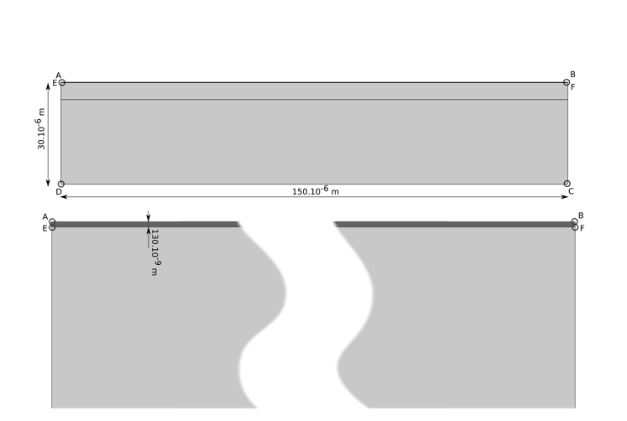
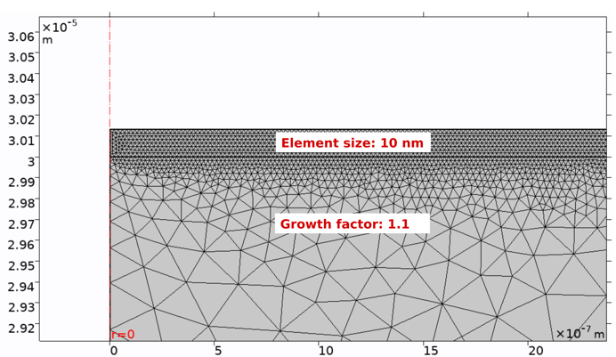
Physical models
Principle
Simulated geometry
Heat transfers
Fluid flows
Free boundaries
Chemical species transport

Slide 6
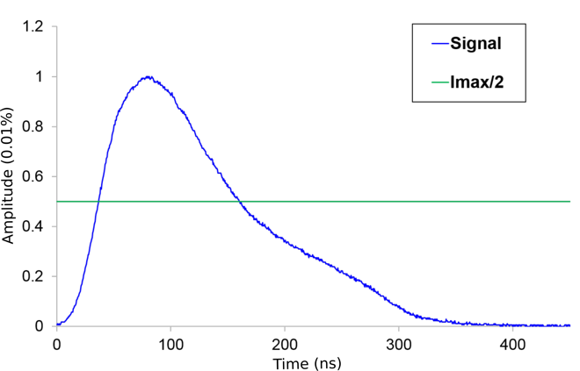

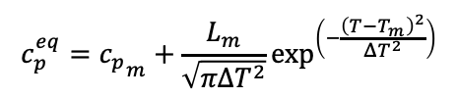
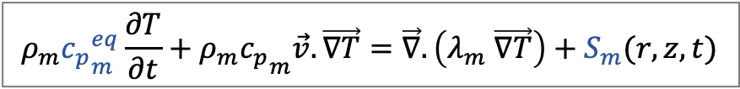
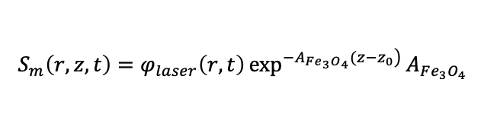
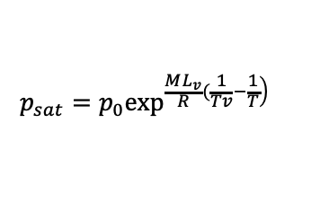
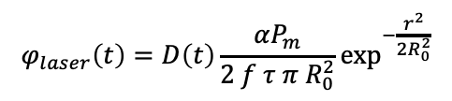
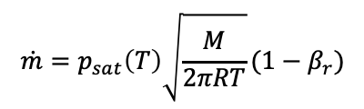
Physical models
Heat transfers
$$ρ_{m}{c_{p}}_{m}^{eq}\frac{∂T}{∂t}+ρ_{m}{c_{p}}_{m}\vec{v}.\vec{∇T}=\vec{∇}.\left(λ_{m} \vec{∇T}\right)+S_{m}(r,z,t)$$
$$c_{p}^{eq}={c_{p}}_{m}+\frac{L_{m}}{\sqrt{πΔT^{2}}}\exp^{\left(−\frac{{\left(T−T_{m}\right)}^{2}}{ΔT^{2}}\right)}$$
$$−λ_{m}\vec{∇T}.\vec{n}=−h_{cv}\left(T−T_{inf}\right)−εσ_{sb}\left(T^{4}−T_{p,inf}^{4}\right)−\dot{m}L_{vap}$$
$$S_{m}\left(r,z,t\right)=φ_{laser}\left(r,t\right)\exp^{\left.−A_{Fe_{3}O_{4}}(z−z_{0}\right)}{A_{Fe_{3}O_{4}}}$$
$$φ_{laser}\left(t\right)=D\left(t\right)\frac{αP_{m}}{2 f τ π{ R}_{0}^{2}}\exp^{−\frac{r^{2}}{2R_{0}^{2}}}$$
$$\dot{m}=p_{sat}\left(T\right)\sqrt{\frac{M}{2πRT}}(1−β_{r})$$
$$−λ_{m}\vec{∇T}.\vec{n}=0$$
$$p_{sat}=p_{0}\exp^{\left.\frac{ML_{v}}{R}(\frac{1}{Tv}−\frac{1}{T}\right)}$$

Slide 7


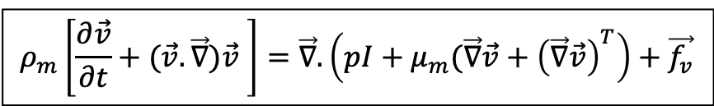




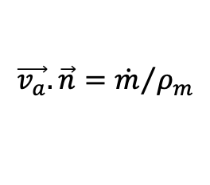
Physical models
Free boundary (ALE - hyperelastic)
Fluid flow
$$ρ_{m}\left[\frac{∂\vec{v}}{∂t}+(\vec{v}.\vec{∇})\vec{v} \right]=\vec{∇}.\left(pI+μ_{m}(\vec{∇}\vec{v}+{\left(\vec{∇}\vec{v}\right)}^{T}\right)+\vec{f_{v}}$$
$$v_{b}=\vec{v}.\vec{n}−\vec{v_{a}}.\vec{n}$$
Conservative
in mass
Not conservative
(material withdrawal)
$$\vec{∇.}\vec{v}=0$$
Ablation velocity
$$\vec{v_{a}}.\vec{n}={\dot{m}}/{ρ_{m}}$$
$$σ.\vec{n}=γ\left(T\right)κ+p_{rec}$$
$$p_{rec}=p_{0}+p_{sat}\frac{\left(1+β_{r}\right)}{2}$$
$$μ_{m}=\{\begin{aligned}&μ^{0} \\ &{1f}_{sol}\left(T\right) \\ {1.10}^{5}\left(T>T_{s}\right)\end{aligned}\begin{aligned}&\left(1\right) \\ &\left(2\right) \\ &\left(3\right)\end{aligned}$$
$$\vec{v}=\vec{0}$$

Slide 8
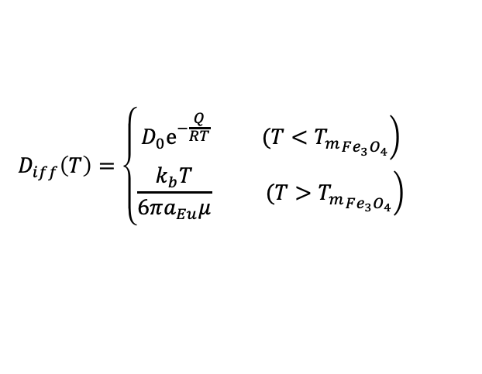
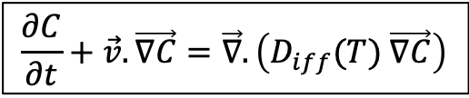


Physical models
Chemical species
Numerical aspects
Linear interpolations
Fully coupled problem
700 000 elements → 2 500 000 DOF
Nearly 8 hours to be solved
$$\frac{∂C}{∂t}+\vec{v}.\vec{∇C}=\vec{∇}.\left(D_{iff}(T) \vec{∇C}\right)$$
$$D_{iff}\left(T\right)=\left\{\begin{matrix}\left.D_{0}e^{−\frac{Q}{RT}} (T<{T_{m}}_{Fe_{3}O_{4}}\right) \\ \left.\frac{k_{b}T}{6πa_{Eu}μ} (T>{T_{m}}_{Fe_{3}O_{4}}\right)\end{matrix}\right.$$
$$Nj=0$$
Mass lost → ALE
$$Nj=0$$

Slide 9
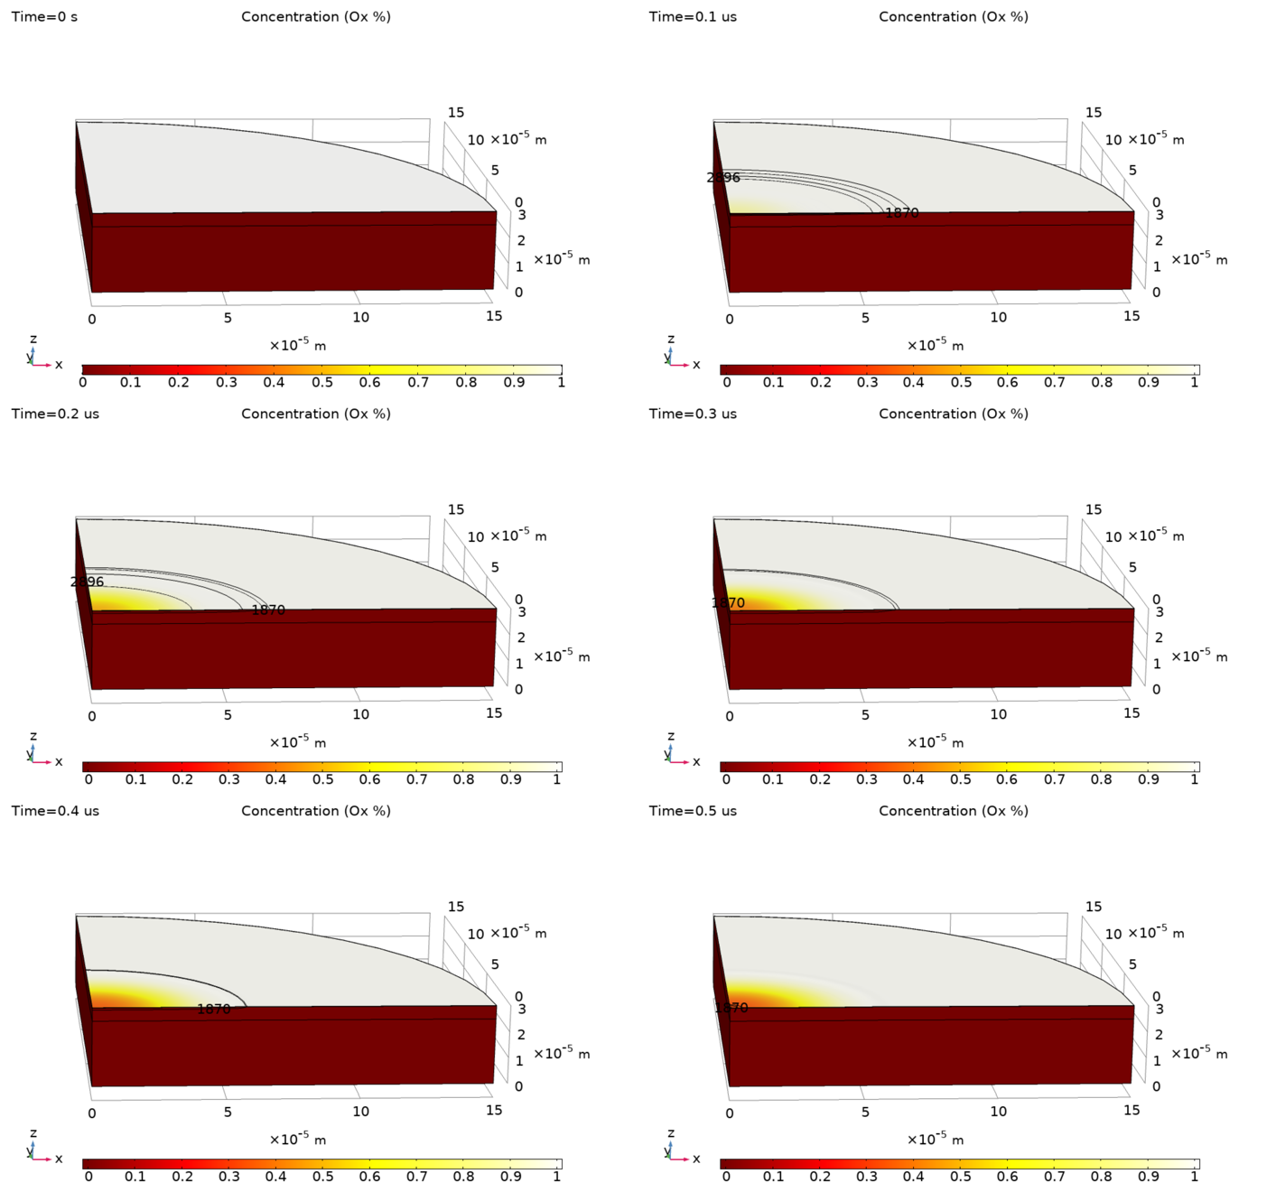
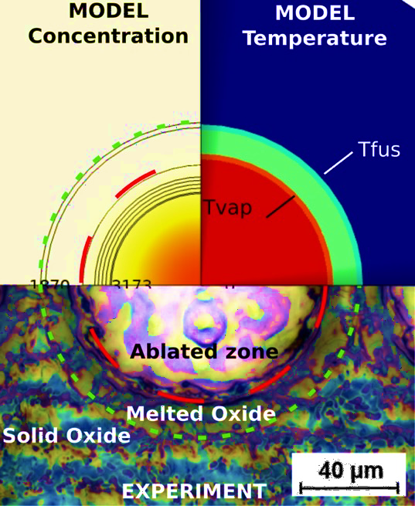
Results and validation
Experiment radius
Simulation radius
Radius (µm)
Residual Eu: 0.28 % Model vs 0.2 % Experiment
Ablated mass 3,3 mg vs 5,5 mg numerically
Reasons:
Shots overlap in experiment (not in simulation)
Material properties …
Laser Fluence (J/cm²)

Slide 10
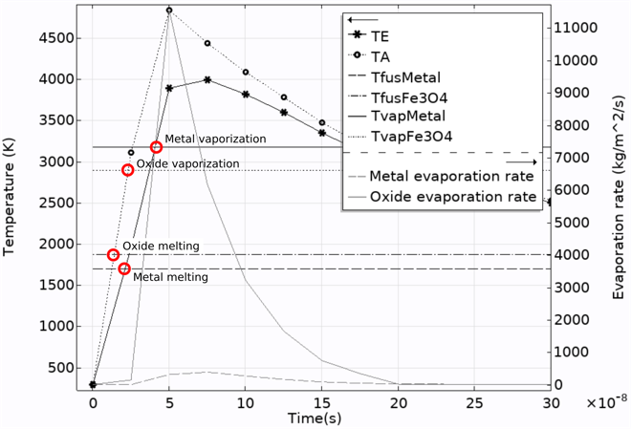
Analysis
Assumptions:
Phase explosion
Solid fracturation
Oxide vaporization
Remarks :
Oxide melts before metal
Oxide evaporates before metal
Oxide thermics is faster than metal
Oxide vaporization larger

Slide 11
Conclusion & complementary works
Ablation model (to improve)
Satisfactory results compared to experiments
This case is probably driven by vaporization - > increase the power
More [thèse L. Carvalho]
Mono impact without oxide
Heat transfers 3D
Complex geometries (noches)

Slide 12
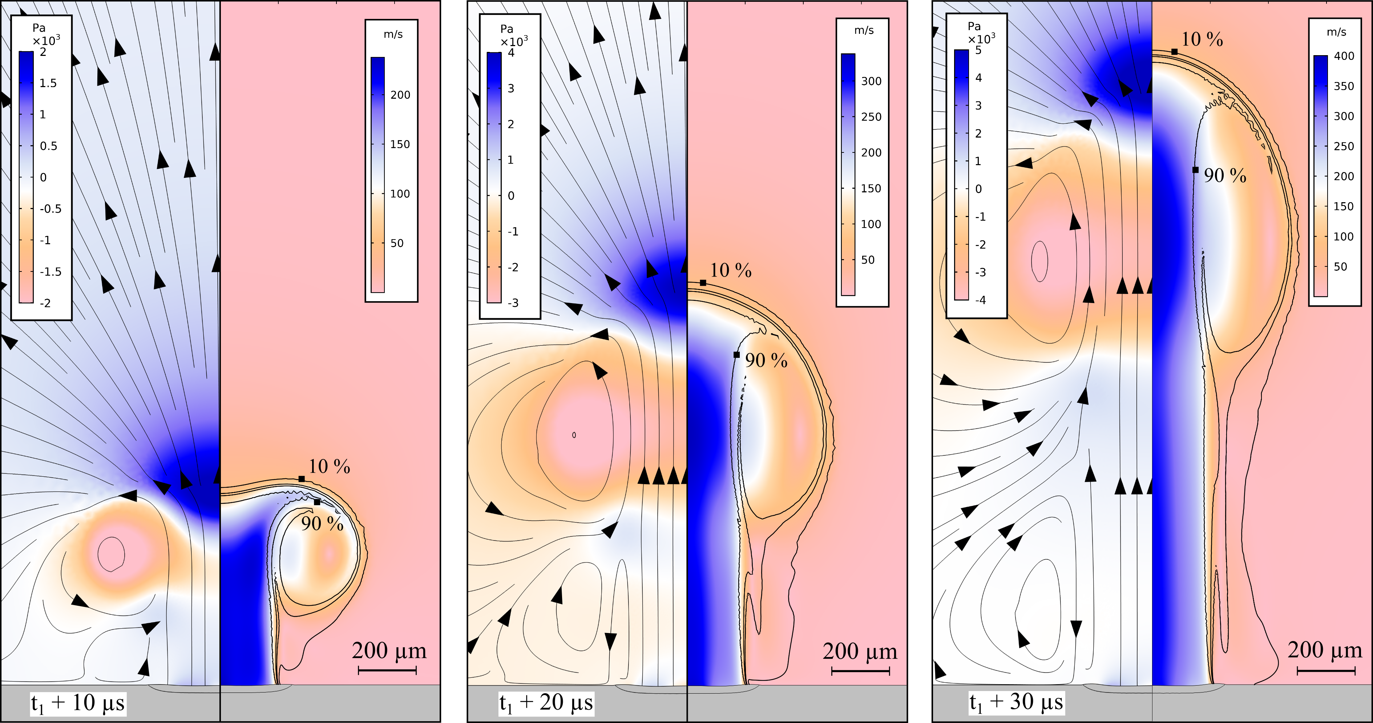
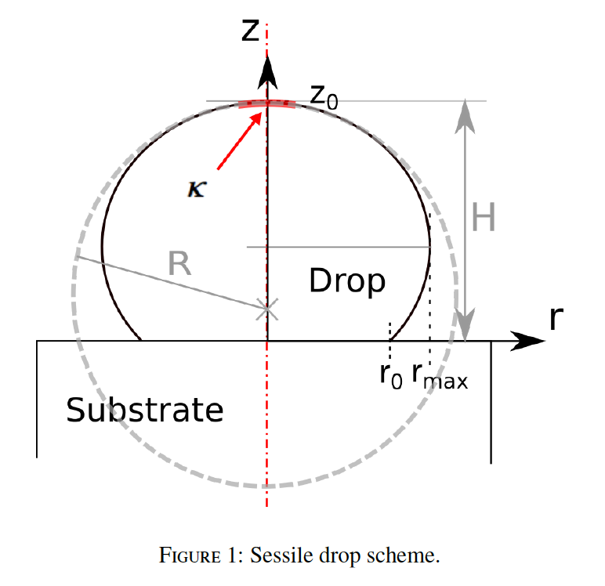
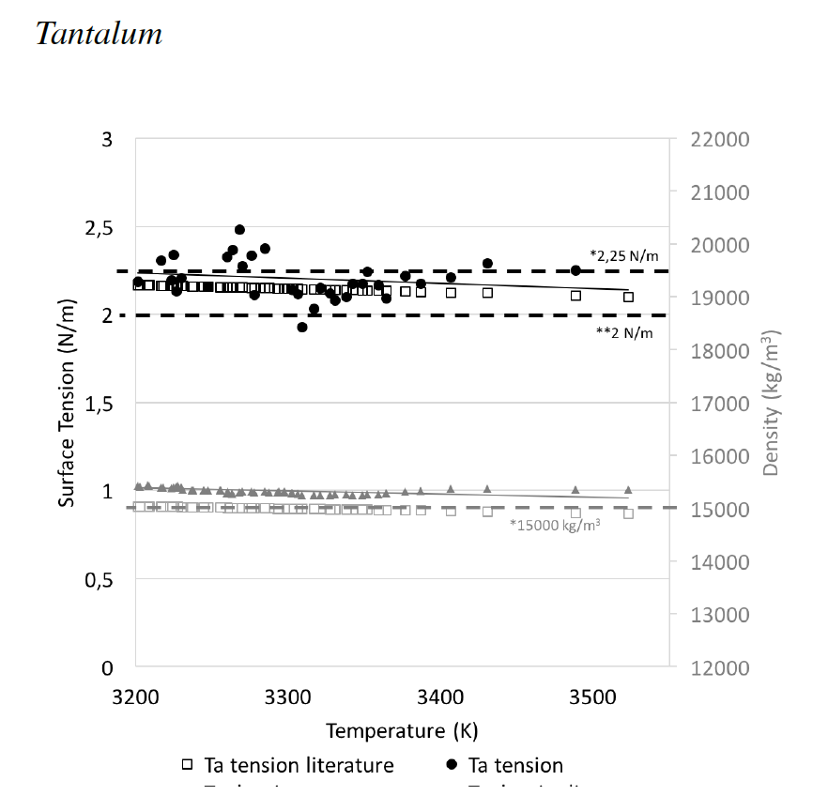
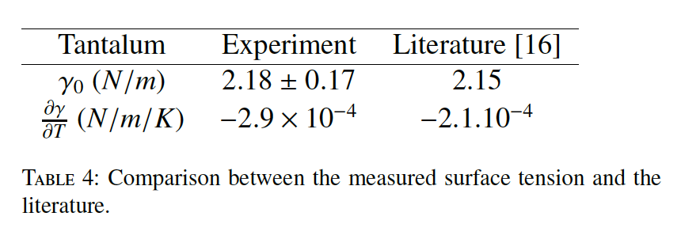
Conclusion
Perspectives
Vapour simulation ?
Material properties (Tvap, Lvap, …)

Slide 13
Annexes

Slide 14
Annexes

Slide 15
Results and validation
Solid phase only
Full model
Analytical model**
Analytical model**
COMSOL model
COMSOL model
Error (%)
Temperature (K)
Temperature (K)
Error (%)
Time (µs)
Time (µs)

