Slide 1
Acoustic Pitfalls of Impedance Tube Measurements
T. Graf
Lucerne University of Applied Sciences
Technikumstrasse 21
CH-6048 Horw
Switzerland

Slide 2
Impedance tube
Microphones
Speaker
Loudspeaker in the background
Mic lever
Sample
Mic lever

Slide 3
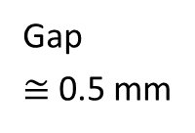
Sample preparation
Gap
$≅$ 0.5 mm
19 mm
Seal
Sample
spacer

Slide 4



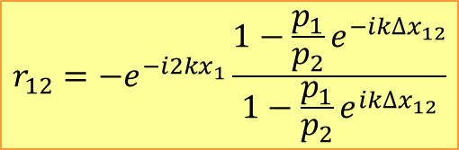



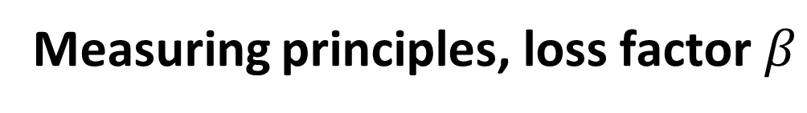
Measuring principles, loss factor $β$
Normal incidence:
$$r_{12}=−e^{−i2kx_{1}}\frac{1−\frac{p_{1}}{p_{2}}e^{−ik∆x_{12}}}{1−\frac{p_{1}}{p_{2}}e^{ik∆x_{12}}}$$
$${∆x}_{12}=x_{2}−x_{1}$$
Source
$$p_{1}$$
$$p_{2}$$
Source
$$x_{1}$$
$$0$$
$$β=1−{\left|r\right|}^{2}$$
It is possible to calculate $β$ of a diffuse sound pressure field from $β_{normal}$ (see Ingard)!

Slide 5
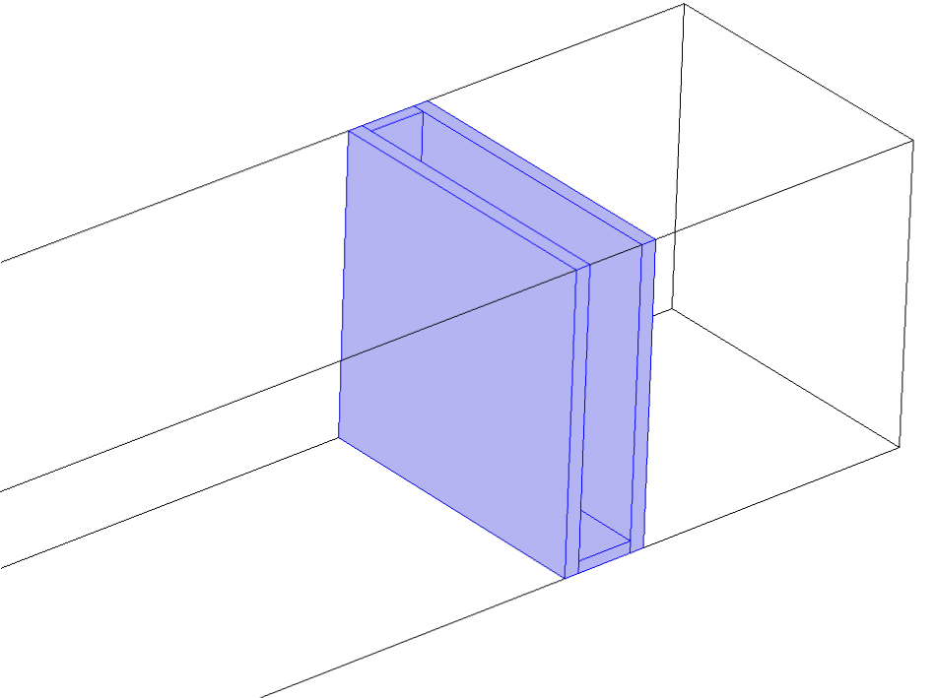
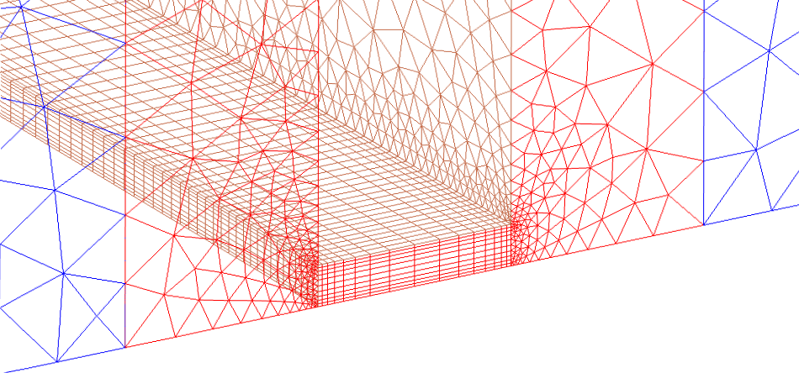
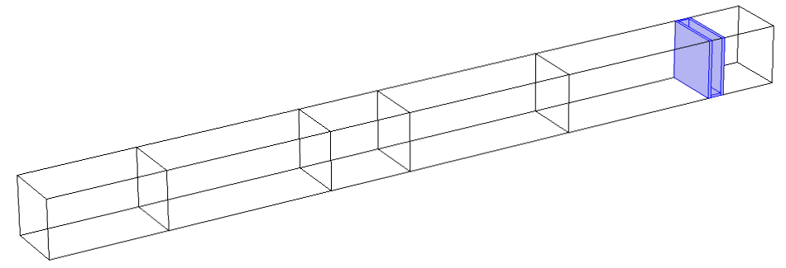
Numerical Setup, Mesh
Thermo-
viscous
domain
Mesh of narrow gap
Narrow gap
Gap
Front & top wall: symmetry BC
Bottom & back wall: sound hard BC

Slide 6
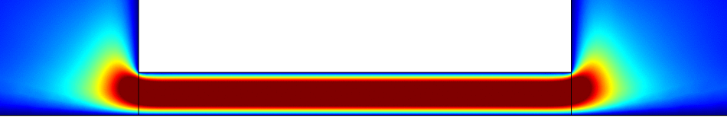
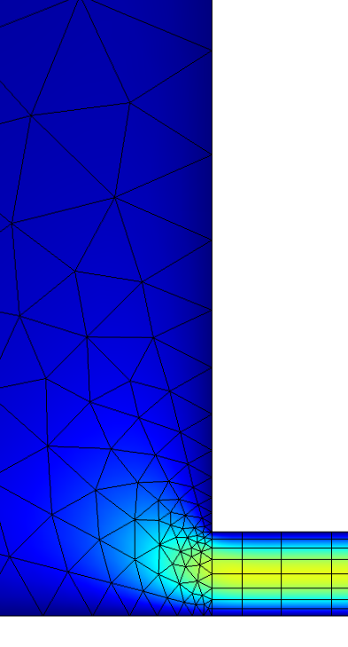
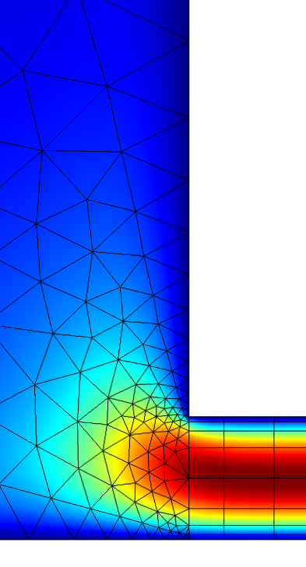
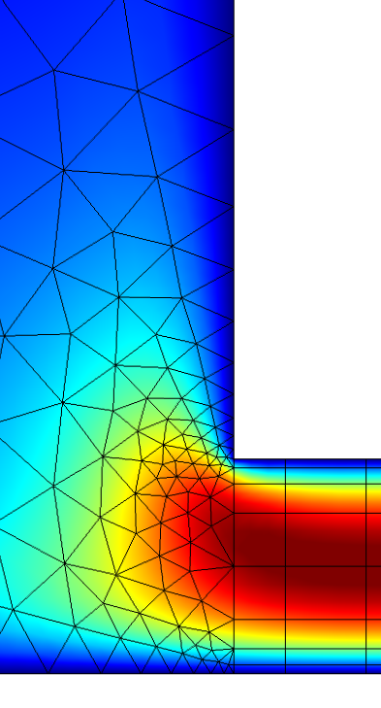
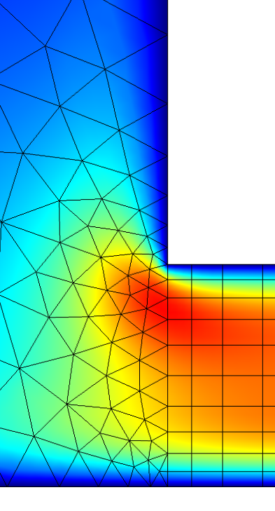
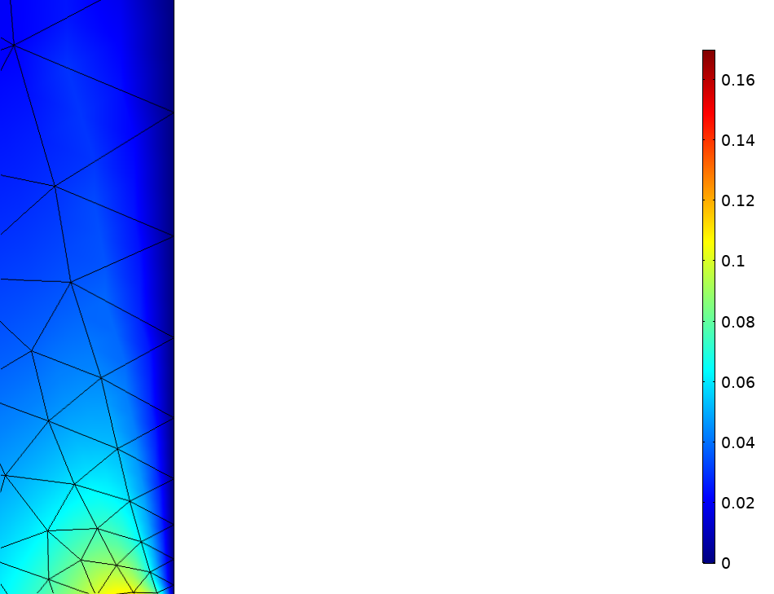
Velocity in 5mm board
0.5 mm
175 Hz
v_{inst}
145 Hz
175 Hz
197 Hz
225 Hz
v (m/s)
v_{RMS}
0.16
1.0
mm
0.7
mm
0.1
0.5
mm
0.3
mm
0.04
0

Slide 7


Beta of 5mm board
Circles: Thermoviscous Domain
Lines: Narrow Region Domain
Dashed lines: Compact model
$$β=1−{\left|r\right|}^{2}$$
0.5 mm
0.7 mm
The colors and the numbers indicate different gap widths
0.3 mm
1.0 mm
2.0 mm
$$f \left(Hz\right)$$

Slide 8
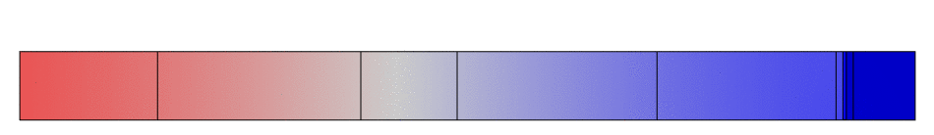
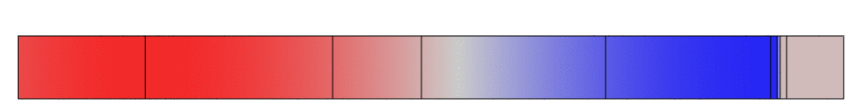
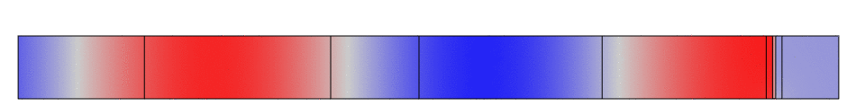






Wave propagation, 5mm board
100 Hz, propagation plus standing wave ("hopping")
$≅$ 0°
175 Hz, fully propagating wave, no reflection
90°
400 Hz, standing wave ("pumping"), almost no propagation
$≅$ 180°
$$β=1−{\left|r\right|}^{2}$$
0.5 mm
$$x_{1}$$
Gap
$$x_{2}$$
Source
plane
$$f \left(Hz\right)$$

Slide 9
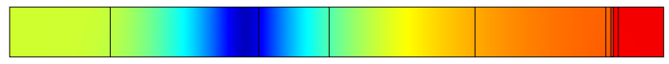
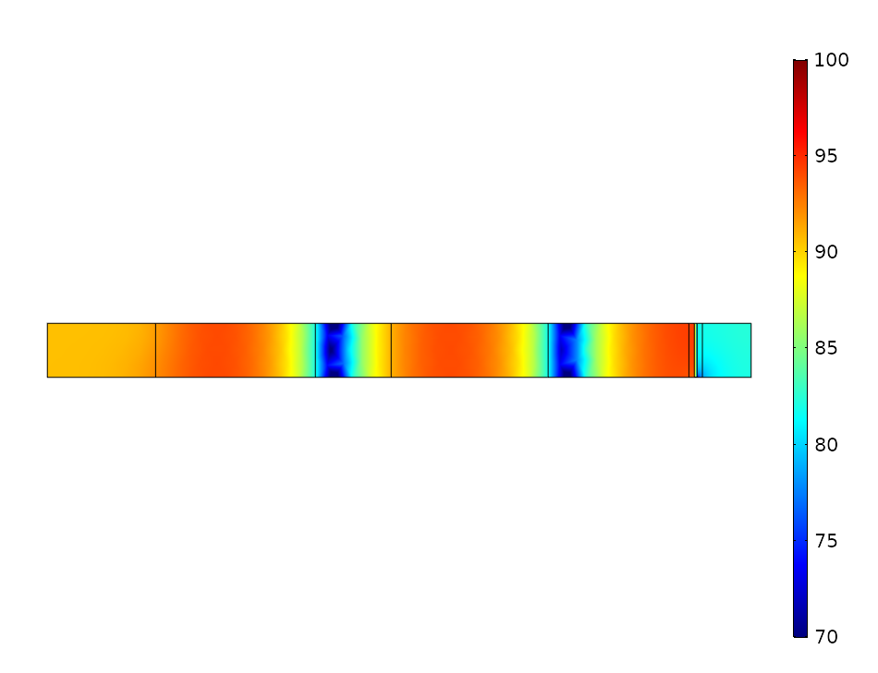
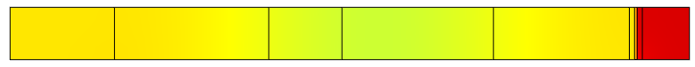


Wave propagation, 5mm board
100 Hz, "loudness" partially trapped in cavity
SPL (dB)
175 Hz, sound intensity completely trapped in cavity
400 Hz, hardly any loudness in cavity
$$β=1−{\left|r\right|}^{2}$$
0.5 mm
$$x_{1}$$
Gap
$$x_{3}$$
Source
plane
$$f \left(Hz\right)$$

Slide 10
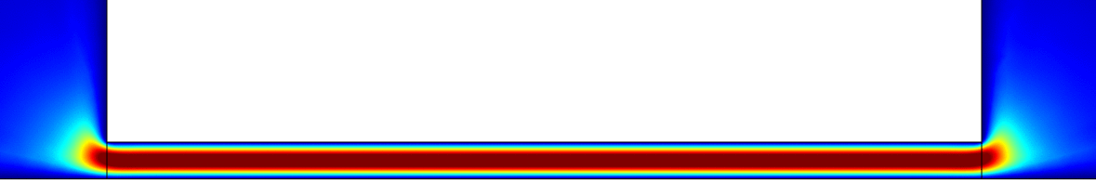
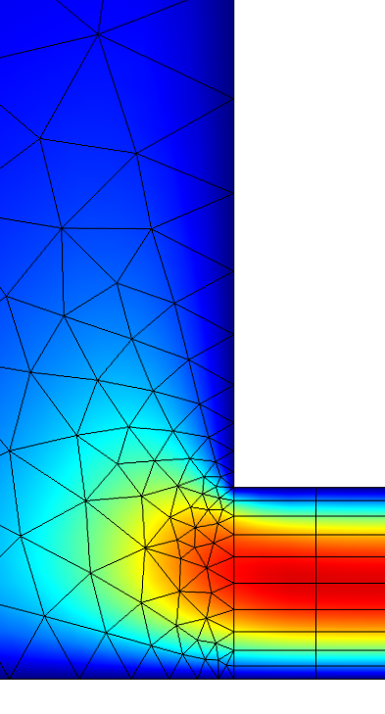
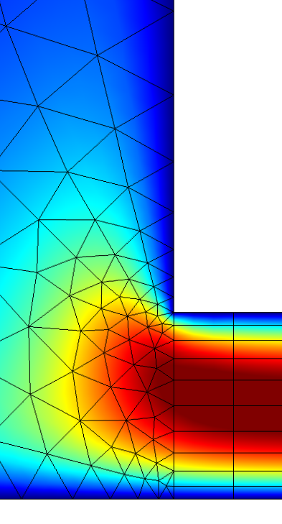
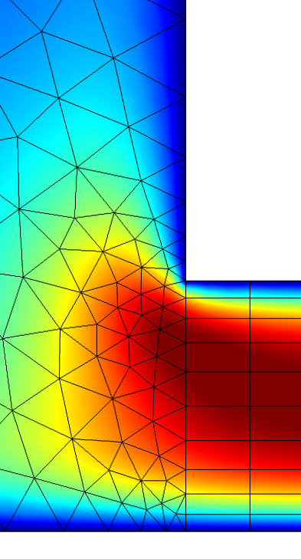
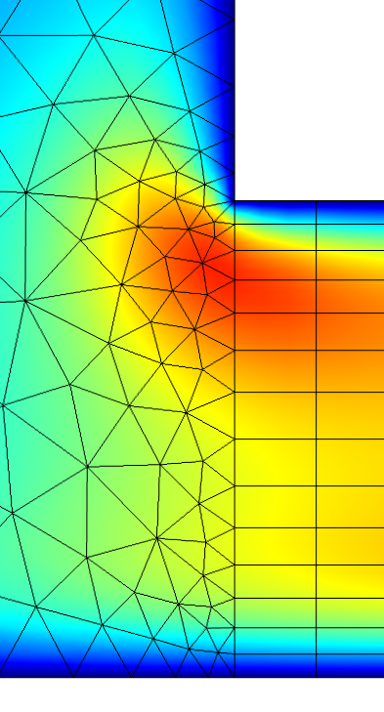
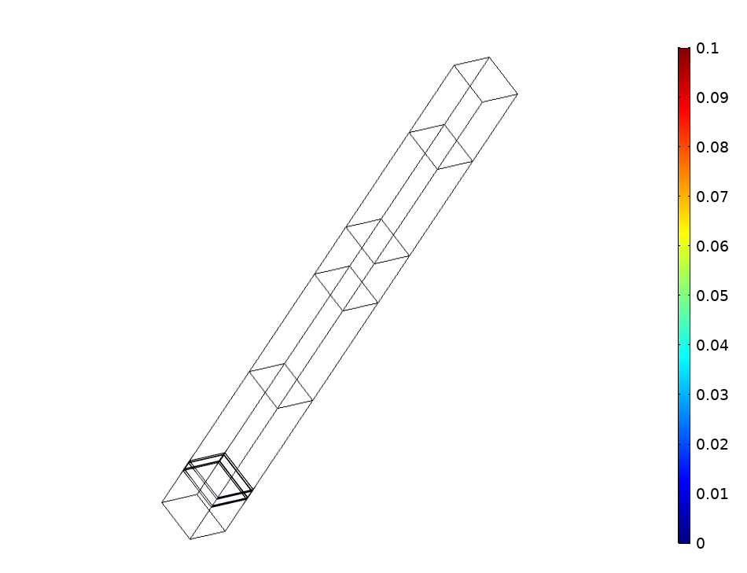
Velocity in 19mm board
19 mm
0.8 mm
130 Hz
v_{inst}
v (m/s)
116 Hz
130 Hz
146 Hz
175 Hz
1.5
mm
0.1
v_{RMS}
1.0
mm
0.8
mm
0.6
mm
0.05
0

Slide 11
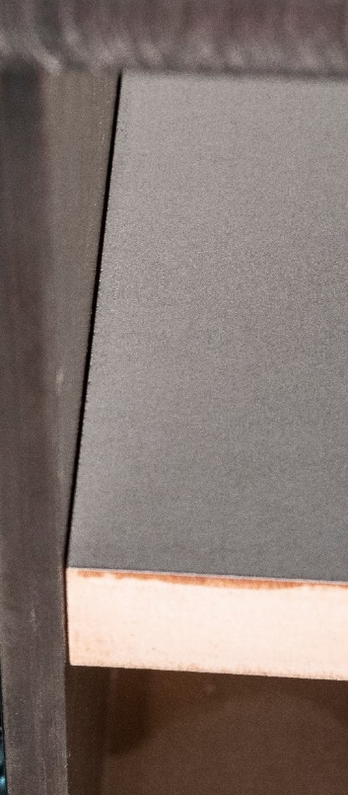
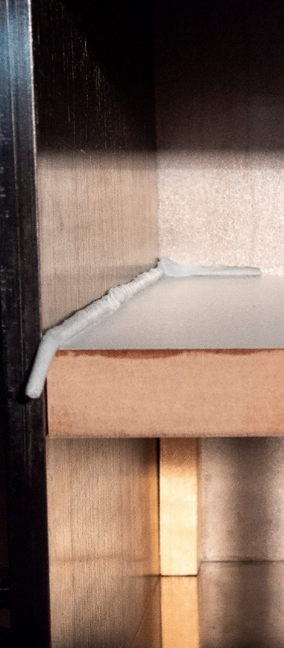
Beta of 19mm board
Circles: Thermoviscous Domain
Lines: Narrow Region Domain
Dashed lines: Compact model
Black symbols: Experiments
$$β=1−{\left|r\right|}^{2}$$
0.8 mm
1.0 mm
The colors and the numbers indicate different gap widths
0.6 mm
Gap
0.5 mm
1.5 mm
Seal
19 mm
$$f \left(Hz\right)$$

Slide 12




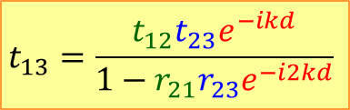
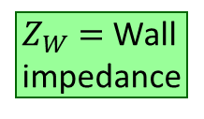



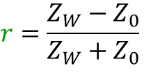

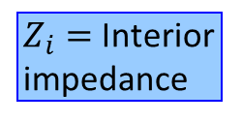






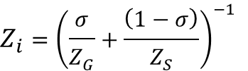



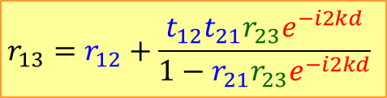




Gap impedance, transfer matrix
$Z_{i}=$ Interior
impedance
$$\left[S_{12}\right]=\left[\begin{matrix}t_{12} & r_{21} \\ r_{12} & t_{21}\end{matrix}\right]$$
$$\left[S_{d}\right]=\left[\begin{matrix}e^{−ikd} & 0 \\ 0 & e^{−ikd}\end{matrix}\right]$$
$$\left[S_{23}\right]=\left[\begin{matrix}t_{23} & r_{32} \\ r_{23} & t_{32}\end{matrix}\right]$$
$Z_{W}=$ Wall
impedance
$$r=\frac{Z_{i}}{2Z_{0}+Z_{i}}$$
$${p_{1}}^{\left(+\right)}$$
$${p_{2}}^{\left(+\right)}$$
$$r=\frac{Z_{W}−Z_{0}}{Z_{W}+Z_{0}}$$
$$\left[M_{12}\right]$$
$$\left[M_{d}\right]=\left[\begin{matrix}e^{−ikd} & 0 \\ 0 & e^{+ikd}\end{matrix}\right]$$
$$\left[M_{23}\right]$$
(III)
$$t=1−r$$
$${p_{1}}^{\left(−\right)}$$
$${p_{2}}^{\left(−\right)}$$
$$t=1+r$$
Air: $Z_{0}=ρ_{A}c=410\frac{Pa∙s}{m}$
(1)
(2)
$$d$$
(3)
Porosity
$$Z_{i}={\left(\frac{σ}{Z_{G}}+\frac{\left(1−σ\right)}{Z_{S}}\right)}^{−1}$$
(II)
$$d$$
Gap
impedance
Sample
impedance
$$0$$
$$x$$
$$0$$
(IV)
Airy's equations
Parabolic profile
Areal mass density, Maa
$$r_{13}=r_{12}+\frac{t_{12}t_{21}{r_{23}e}^{−i2kd}}{1−r_{21}r_{23}e^{−i2kd}}$$
$$t_{13}=\frac{t_{12}t_{23}e^{−ikd}}{1−r_{21}r_{23}e^{−i2kd}}$$
$$Z_{G}=12\frac{η∙t_{S}}{w_{G}^{2}}+𝒾2πfρ_{A}\left(\frac{4}{3}t_{S}+2.7[mm]\right)$$
(I)
Maa, 87
Fit
Loss factor
$$β=1−{\left|r_{13}\right|}^{2}$$

Slide 13
Compact model, 19mm, 0.6mm

Slide 14
Compact model, 19mm, 0.8mm

Slide 15
Compact model, 19mm, 1.0mm

Slide 16
Summary
A rigid plate surrounded by an air gap in an impedance tube behaves like a slit absorber
Experimental results can be reproduced precisely with FEM, utilizing either thermoviscous models or so-called Narrow Region acoustics
The experimental and the numerical absorption curves can be emulated with a spreadsheet calculation
For reliable impedance tube measurements it is necessary to seal the sample edges against the tube wall

