Slide 1



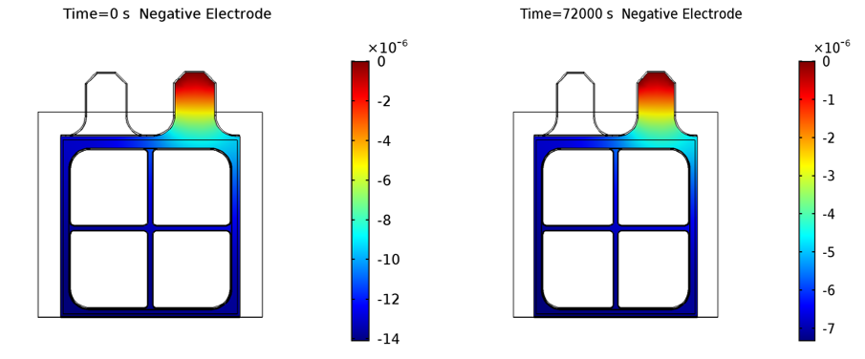
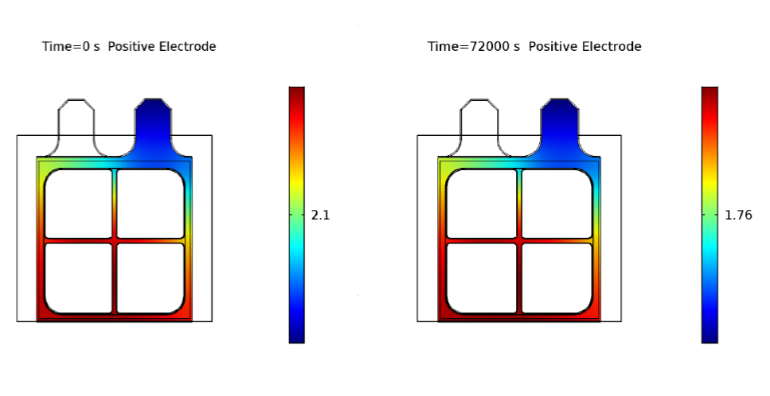
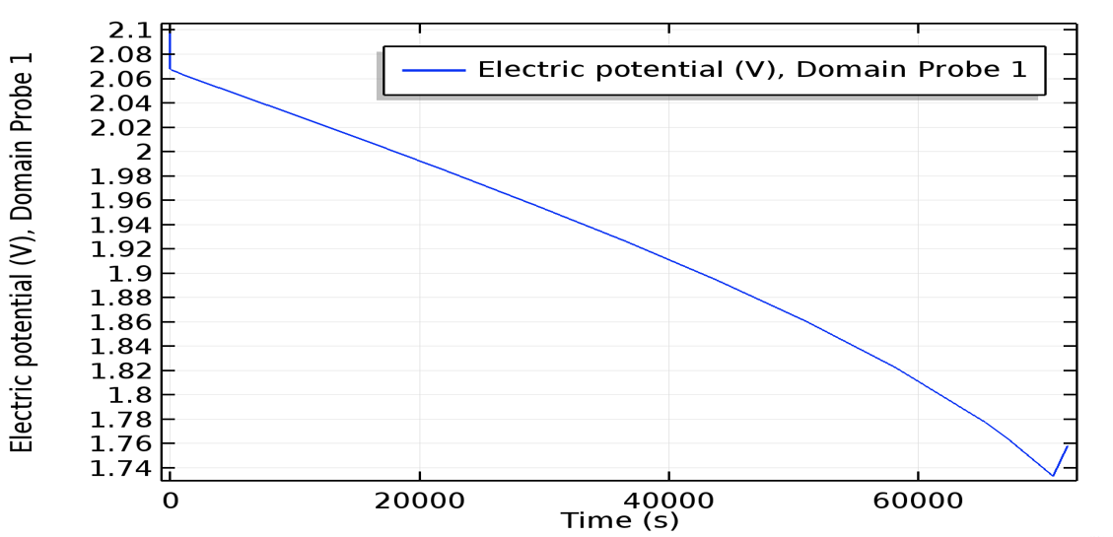
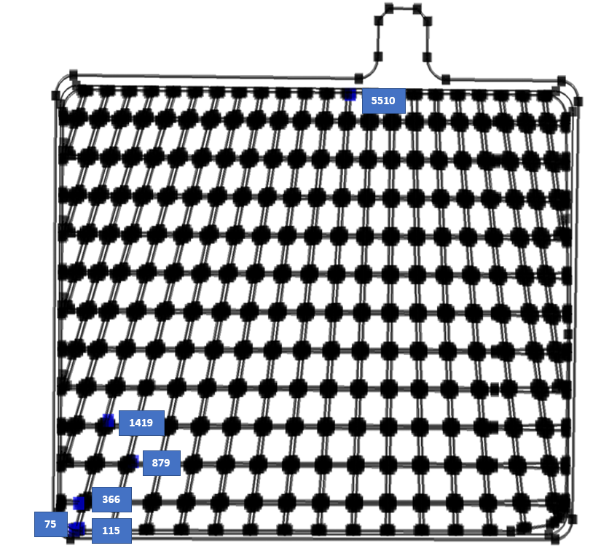
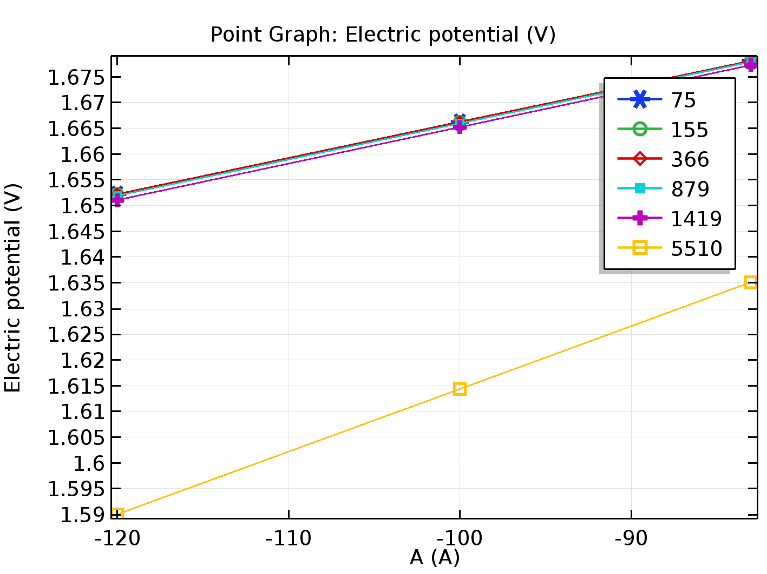
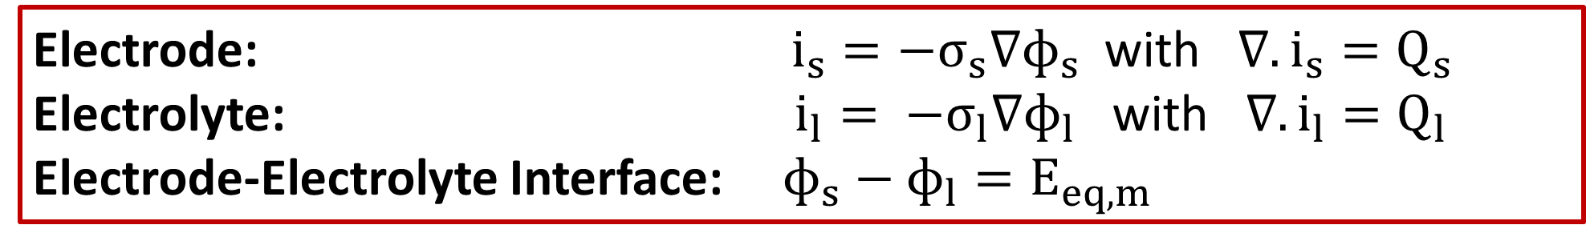
Please leave at least a 25mm margin on all sides to avoid cropping during printing. Remove this text box before submitting.
New Design and Analysis of Lead Acid Battery Grid
T. İşler, M. Mazman
Mutlu Akü ve Malz. San. A. Ş. , Turkey
INRODUCTION: The grid of lead acid (LA) battery plays two important roles which are current collector and current carrier. The current distributes from the lug located top of the grid frame. The aim of the study is improving the grid design of LA battery to increase LA battery performance and decrease the cost.
COMPUTATIONAL METHODS:
The 3D mathematical model of grid was simulated by the Primary Current Distribution Interface belongs to the Battery&Fuel Cells Module of the COMSOL Software. It uses Ohm’s law to deliver current with a constant conductivity, but it neglects the electrochemical reactions of kinetics and overpotential. In the model, 83 Ampere was applied orthogonal to the lug and the equilibrium potential of the electrode was assumed as 1.76 Volt.
The 3D cell of 2 volt was modelled and the discharge behavior was simulated during 20 hours by the Lead Acid Battery Interface belongs to the Battery&Fuel Cells Module of the COMSOL Software. The Butler-Volmer equation describes the electrode kinetics depend on the electrolyte concentration.
Figure 4. The electric potential distribution on the surfaces of new grid designs.
Electrode: $i_{s}=−σ_{s}∇ɸ_{s}$ with $∇.i_{s}=Q_{s}$
Electrolyte: $i_{l}= −σ_{l}∇ɸ_{l}$ with $∇.i_{l}=Q_{l}$
Electrode-Electrolyte Interface: $ɸ_{s}−ɸ_{l}=E_{eq,m}$
Figure 5. The electric potential distribution on the negative electrode.
Figure 6. The electric potential distribution on the positive electrode.
Please leave at least a 25mm margin on all sides to avoid cropping during printing. Remove this text box before submitting.
Butler-Volmer Equation: $i_{l}=i_{0}{\left(\frac{c_{l}}{c_{l,ref}}\right)}^{ɣ}\left(exp\left(\frac{α_{a}Fƞ}{RT}\right)−exp\left(\frac{−α_{c}Fƞ}{RT}\right)\right)$
RESULTS:
Figure 1 shows the points taken for the potential measurement on the grid surface.
The graph in figure 2 represents the potential drop of the critical points on the grid surface. The results provide us which points are ineffective. Therefore, the new grid designs shown the figure 3 were modelled by cutting from ineffective area.
Figure 7. The discharge behavior of 2 Volt cell during 20 h.
CONCLUSIONS:
The potential and the current distribution on the grid can be obtained more uniform and the potential and the current drop can be less by shortening current path with the optimum grid design.
As a conclusion, COMSOL Multiphysics provides a platform to determine the ineffective areas on the grid. The cost can be decreased by reducing lead. Also, the cell model of the 2 volts can ensure a prediction about the charge or the discharge behavior before installing the experiment setup. Therefore, it can be saved the time and the cost.
In the future, the cell model of the 2 volts will be modelled with the new grid designs.
Figure 1. The potential points on the grid.
Figure 2. The potential (V) on grid at various current.
REFERENCES:
1. A. Alagheband, M. Azimi, H. Hashemi, M. Kalani, and D. Nakhaie, “Optimization of grid configuration by investigating its effect on positive plate of lead-acid batteries via numerical modeling,” J. Energy Storage, vol. 12, pp. 202–214, 2017.
2. D. Nakhaie, P. H. Benhangi, A. Alfantazi, and A. Davoodi, “The effect of grid configurations on potential and current density distributions in positive plate of lead-acid battery via numerical modeling,” Electrochim. Acta, vol. 115, pp. 189–196, 2014.
3. T. İşler and S. Gül, “Modeling of Lead-Acid Battery Grid Geometry by Comsol Multiphysics,” in Advanced Automotive Battery Conference, 2019.
4. COMSOL Multiphysics, “Batteries & Fuel Cells Module User’s Guide.” pp. 1–526, 2018.
ACKNOWLEDGEMENTS:
This work was supported by the Scientific and Technological Research Council of Turkey (TÜBİTAK), Grant No: 3160706.
Figure 3. The comparison of the optimum and new grid according to electric potential and volume.
Excerpt from the Proceedings of the 2019 COMSOL Conference in Cambridge

