Slide 1


Slide 2
Randomization to tackle mid-frequency tones from wind turbines
Dr Brett Marmo, Technical Director

Slide 3
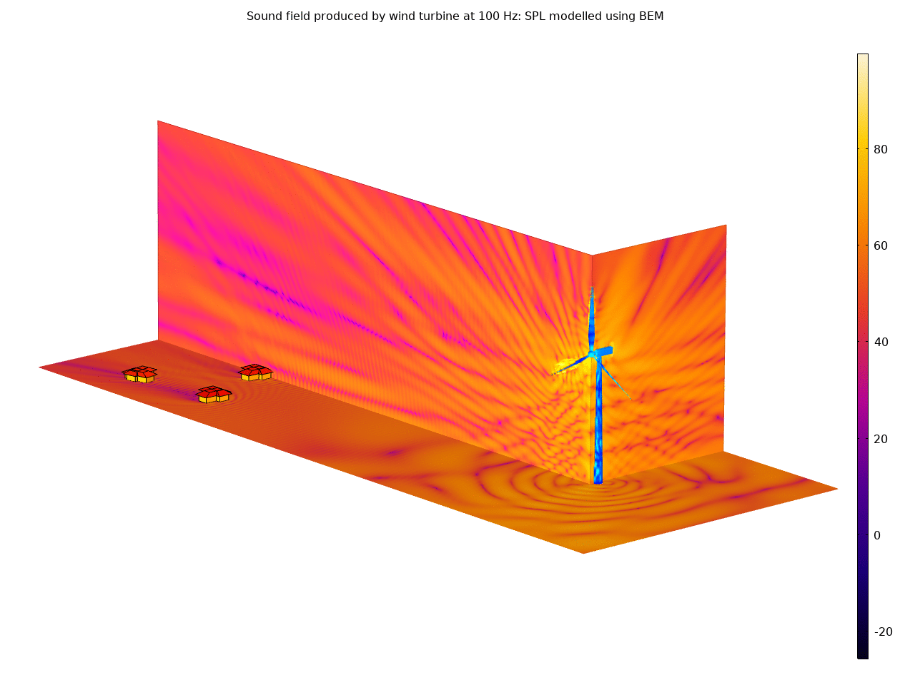
Introduction
Xi use COMSOL Multiphysics as virtual rapid prototype tool for a range of applications
One application where we have had great success is simulating the acoustic performance of wind turbines
FEA and BEM are good for low frequency problems and SEA is appropriate for high frequency problems
Here we explore and approach for the mid-frequencies

Slide 4
Overview
Why is tonal noise from wind turbines important and how to mitigate?
FEA and SEA approaches to simulation of structural dynamics and acoustics
How to implement a hybrid approach using randomization with COMSOL Multiphysics methods in the Application Builder
Some wind turbine applications that can now be tackled with COMSOL Multiphysics

Slide 5
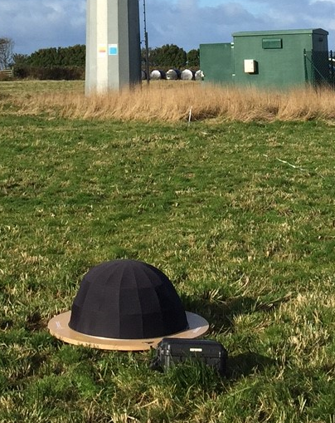
Introduction to Tonal Noise
Tonal noise is easily perceivable
Tonal noise caused by wind turbines is more likely to cause complaint
Strict regulatory penalties
Tonal noise can be caused by frequency matching between tower and rotating components in drive train
Tonal noise can be amplified through modal responses of the tower and/or blades

Slide 6
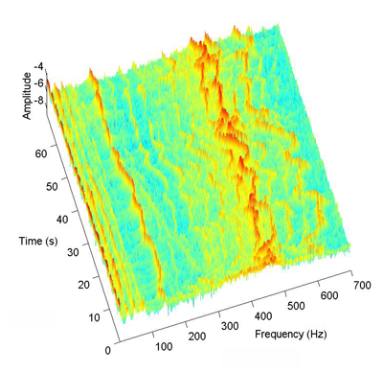
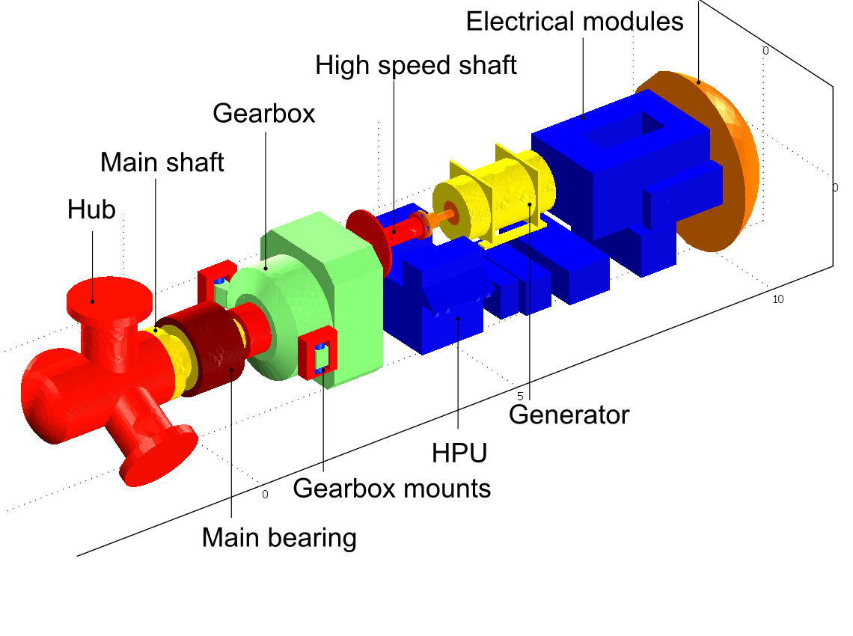
Mid-frequency tones related to gearboxes

Slide 7
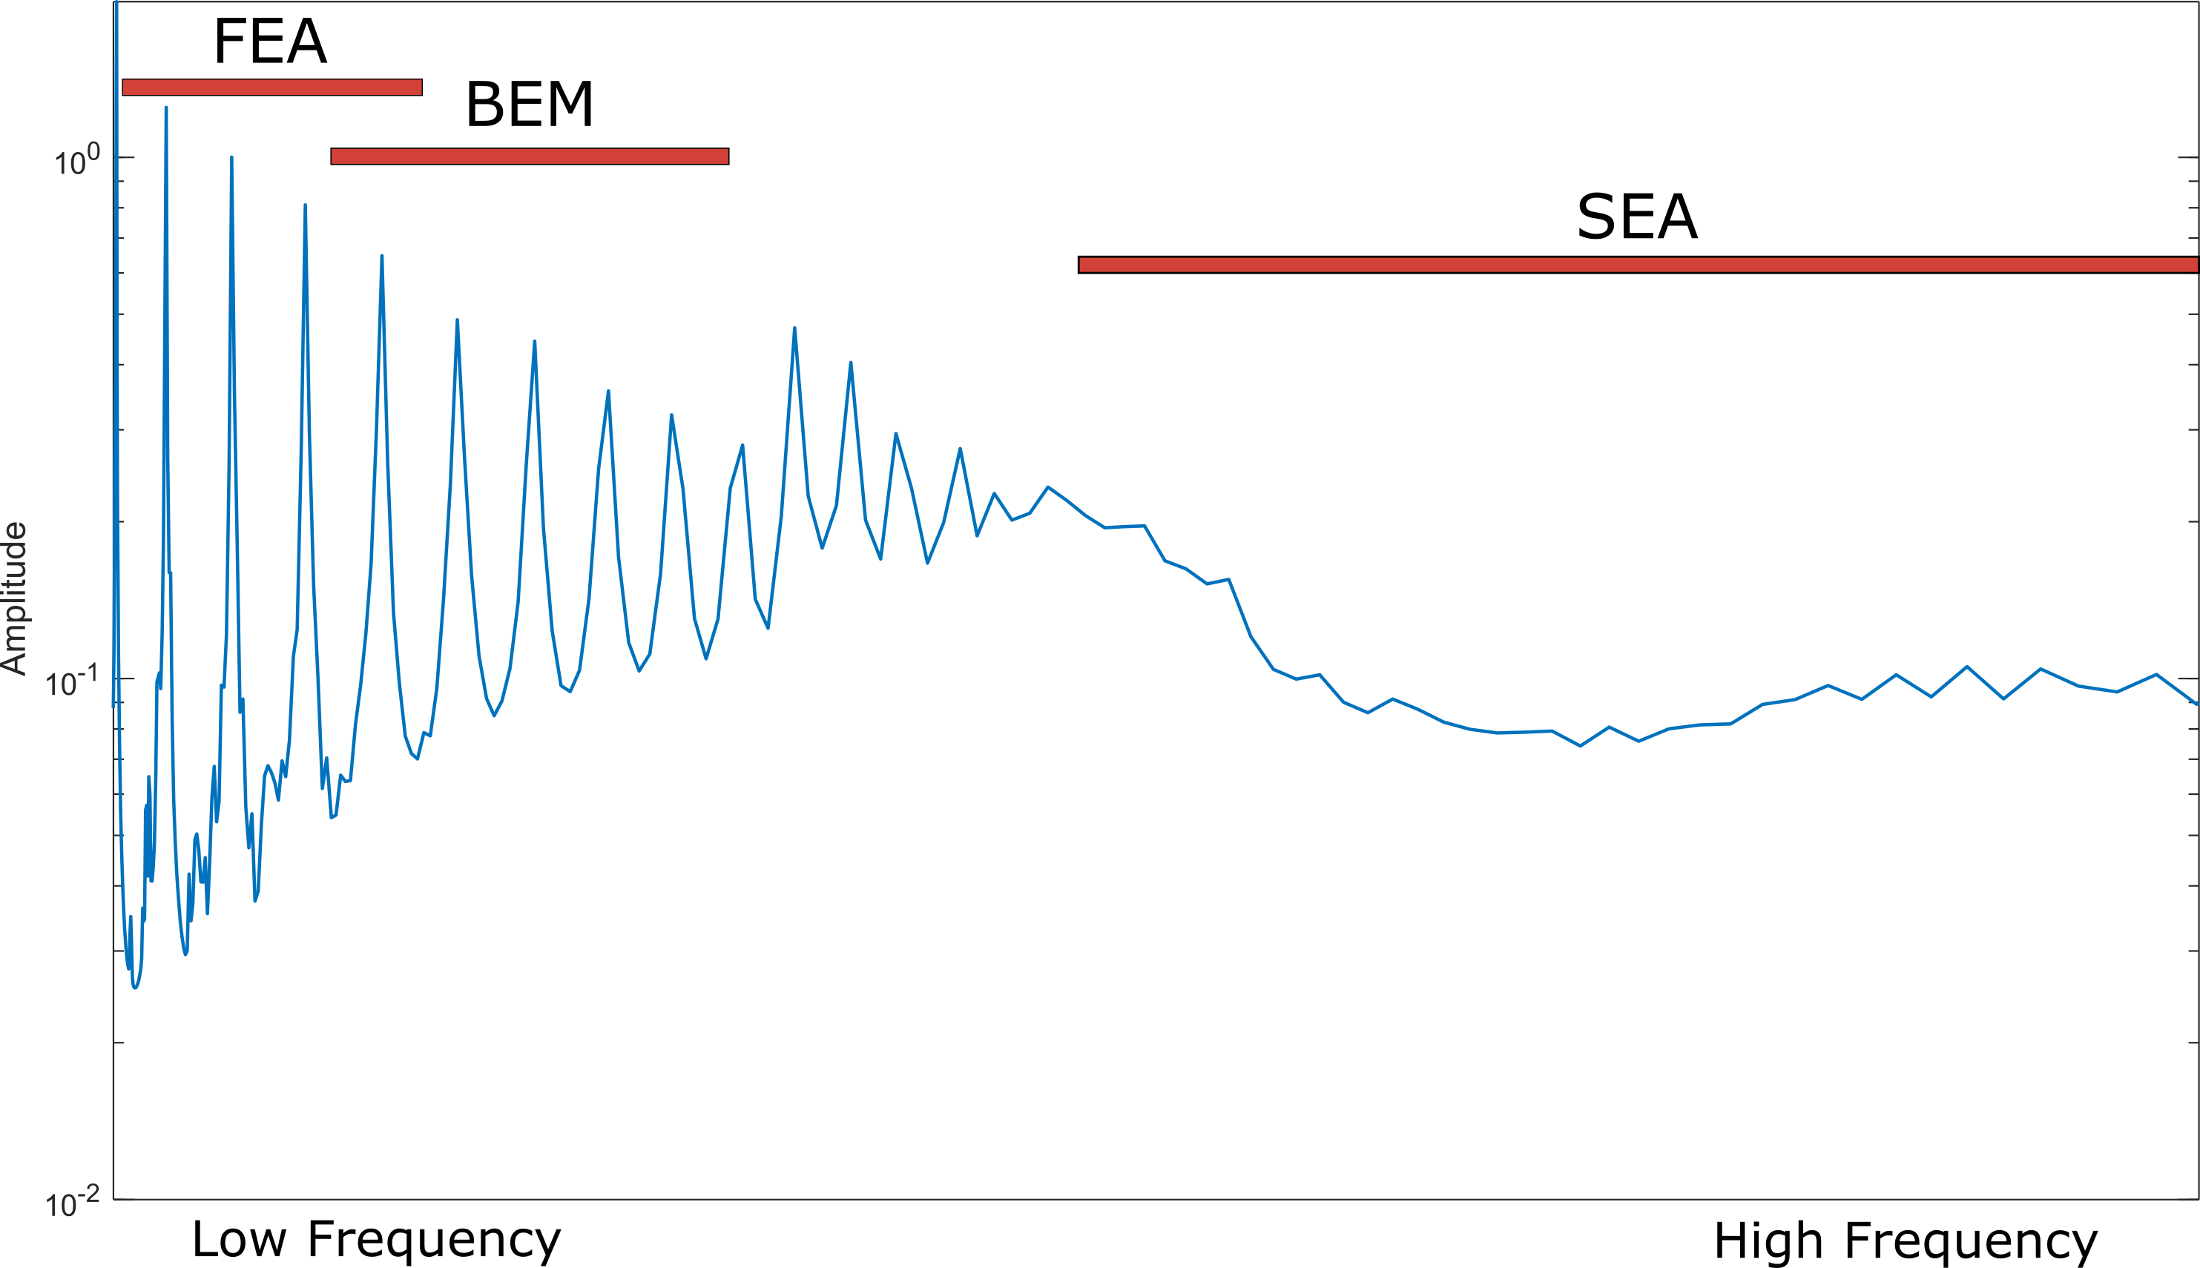
Mid-frequency challenges to simulation
The choice using finite element analysis, boundary element method or statistical energy analyse is driven by:
Mesh size requirements

Slide 8
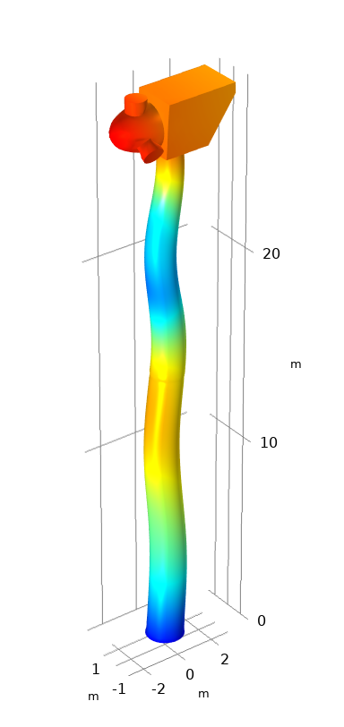
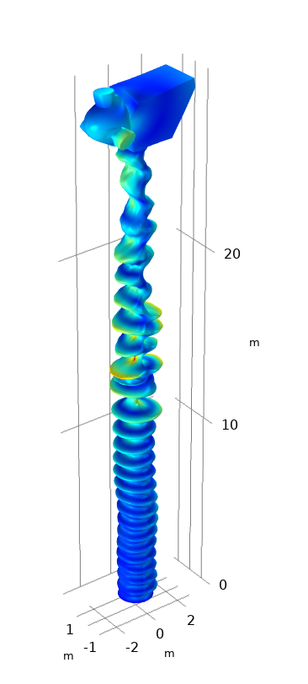
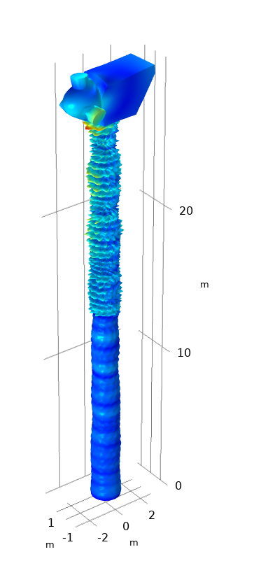
Mid-frequency challenges to simulation
The choice using finite element analysis, boundary element method or statistical energy analyse is driven by:
Mesh size requirements
Modal density

Slide 9
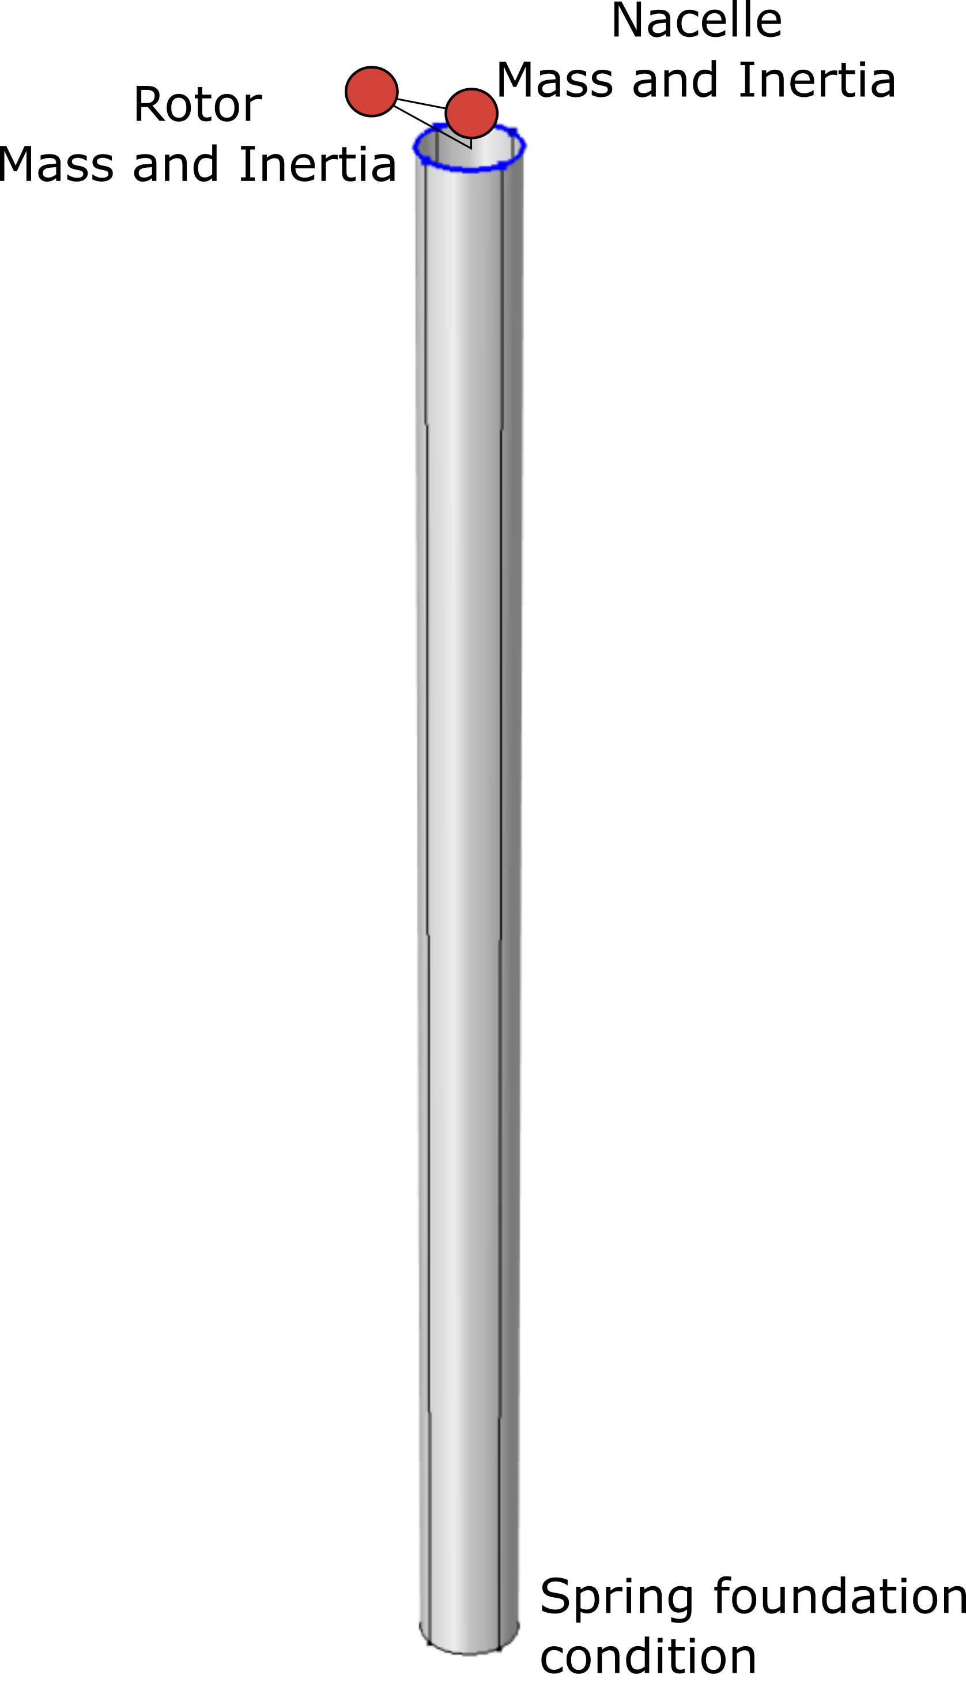
Randomization approach
Use methods in the application editor to code in randomization of some of the key design elements:
Tower masses distribution
Foundation stiffness
Damping
Top side masses and inertia
The model is randomized and re-iterated many hundreds of time, so the it essential to reduce complexity of the model

Slide 10
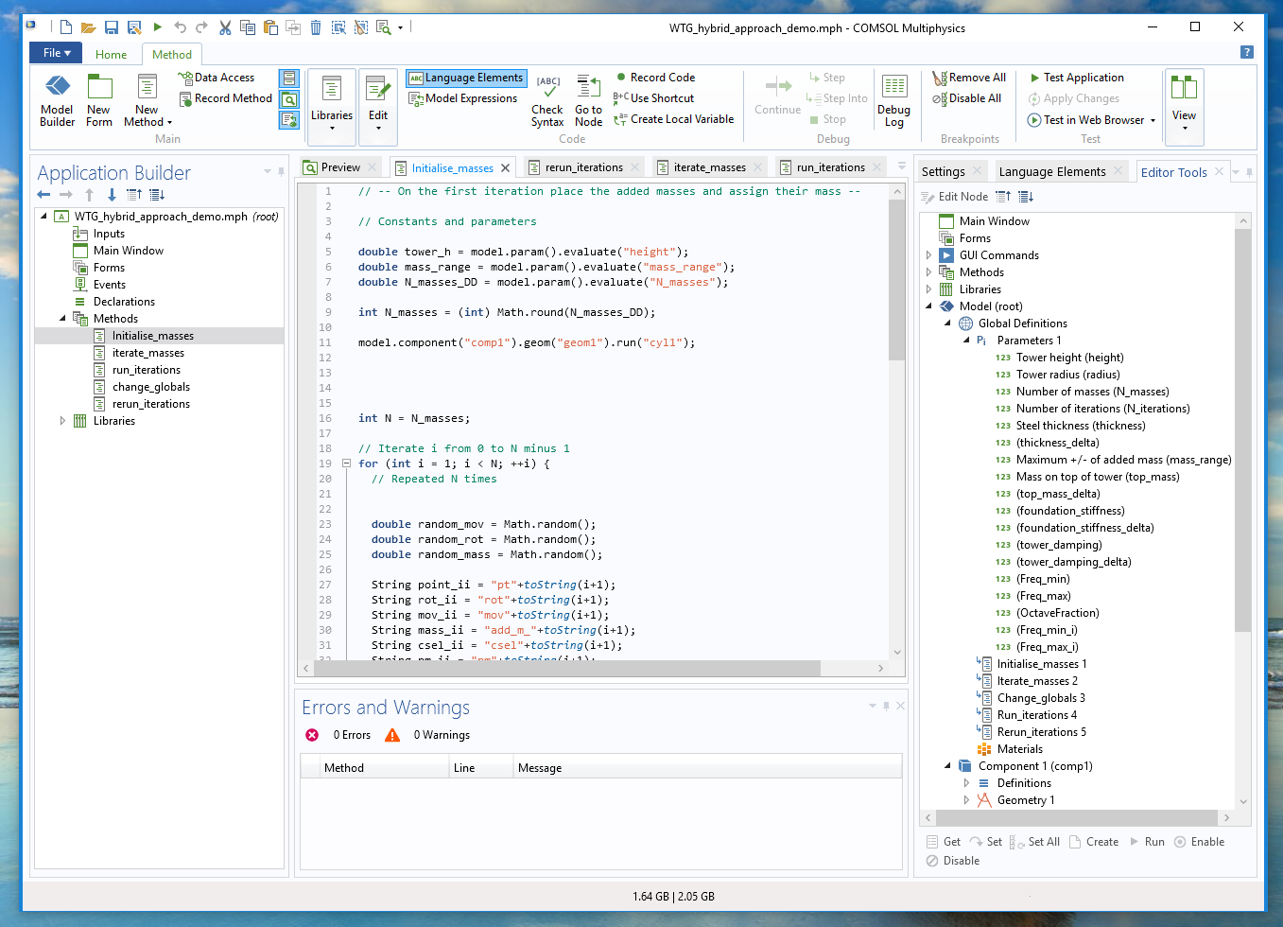
Methods in the Application Builder

Slide 11
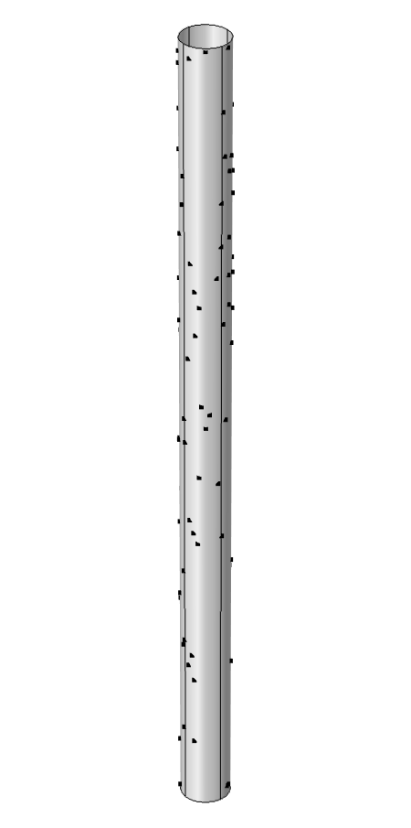
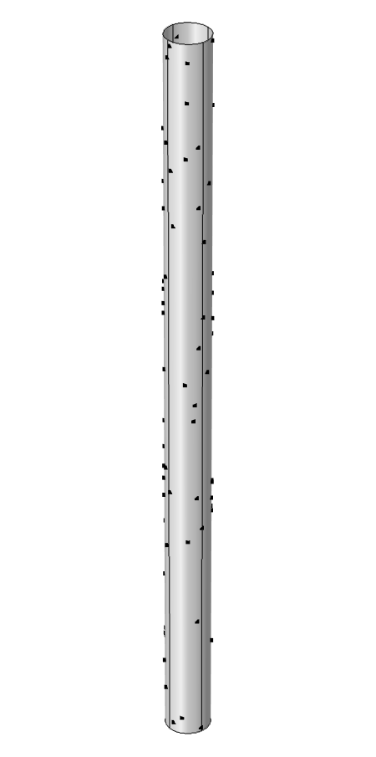
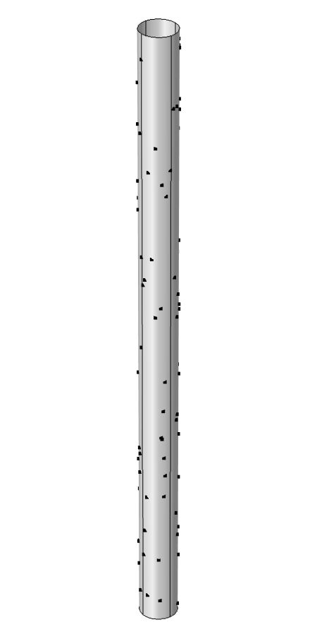
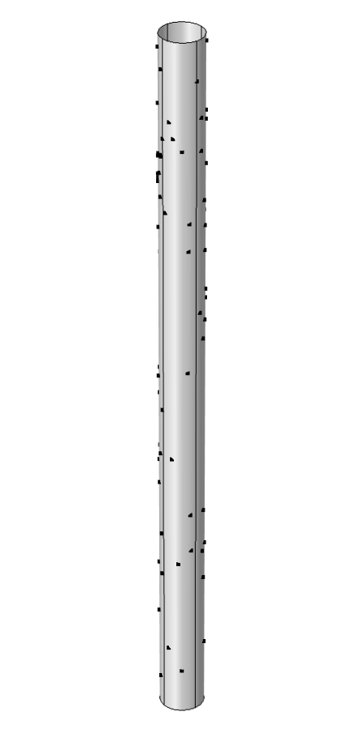
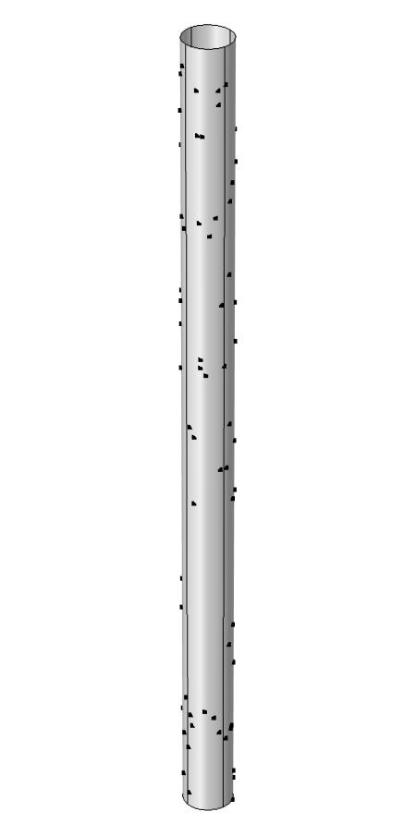
Randomization of tower mass distribution
Mass distribution on the tower employees added masses with randomized values between set limits

Slide 12
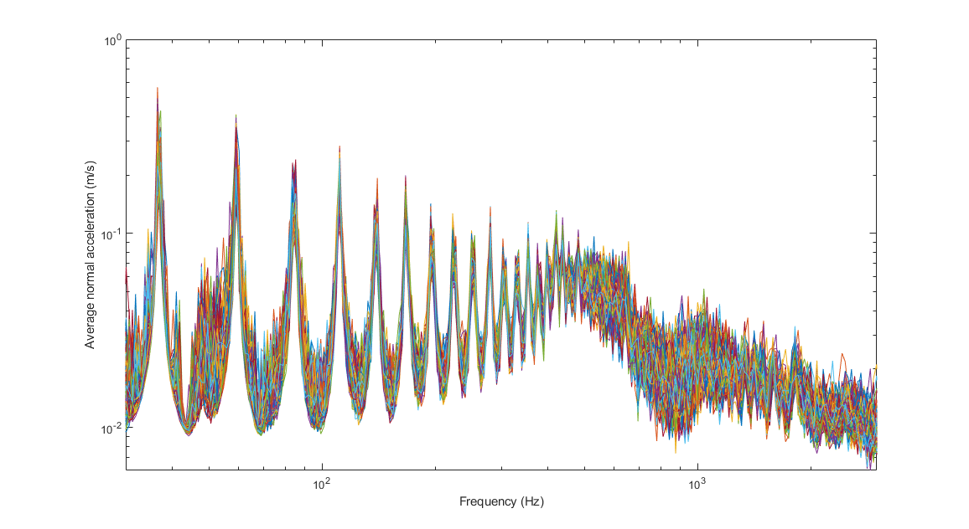
Resultant frequency response
The normal acceleration averaged over the surface of the tower is used as a proxy for far-field sound pressure level

Slide 13
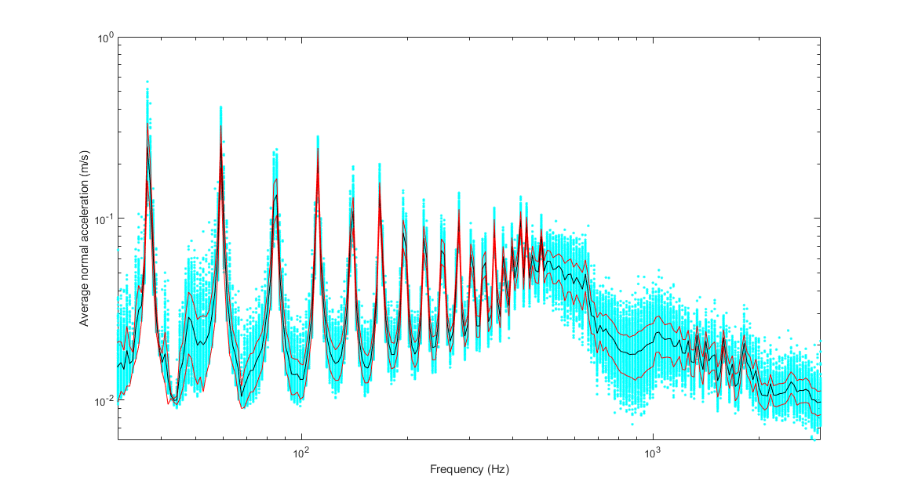
Statistical analysis
The normal acceleration averaged over the surface of the tower is used as a proxy for far-field sound pressure level

Slide 14
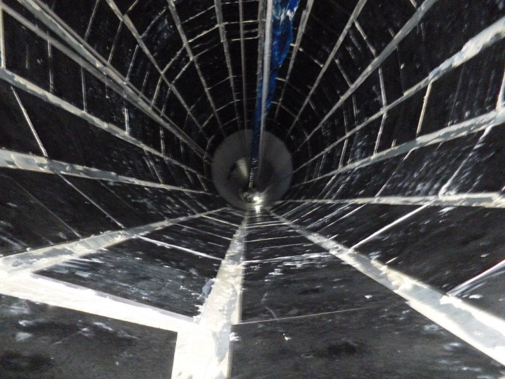
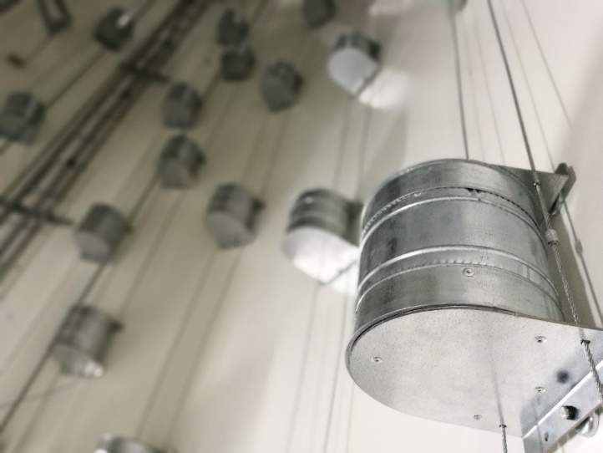
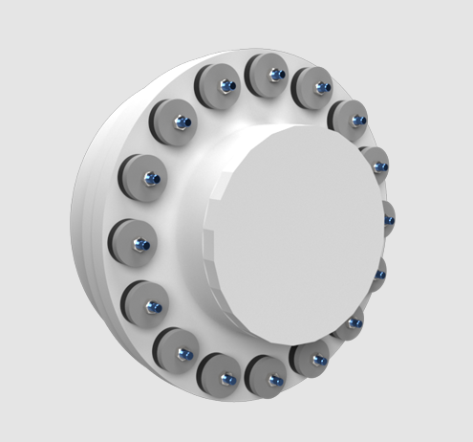
Tonal Noise Solutions: Increase Damping
Free Layer Damping (FLD) | Advanced Particle Damping | Isolation collar
Attach visco-elastic material tiles to tower Part of vibration energy is dissipated through material extension and compression | Custom granulated elastomer, different shapes and sizes; optimised for broadband damping of wind turbines Material housed in a soft or hard-shell container magnetically attached | Polymer-based isolator placed between nacelle and tower Care must be taken with the softness of isolation and affect on overall dynamics

Slide 15
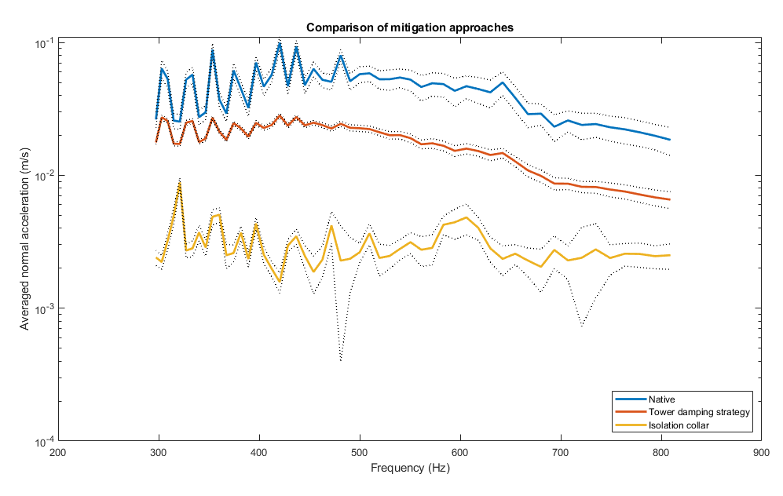
Statistical analysis
The normal acceleration averaged over the surface of the tower is used as a proxy for far-field sound pressure level

Slide 16
Next steps and applications
Couple the mid-frequency output with an efficient acoustic model
2D vertical section model
Apply a similar approach to mid-frequency tones from blades
Sensitivity analysis to inform design and engineering tolerances
Development of an application for wind turbine designers

Slide 17
Conclusion
COMSOL Multiphysics Methods in the Application Builder can be used to investigate mid-frequency tones in wind turbines
Useful in comparing mitigation strategies to tone noise problems
A similar approach could be applied to other applications where panel modes and the dynamics of underlying structures are important

