Slide 1
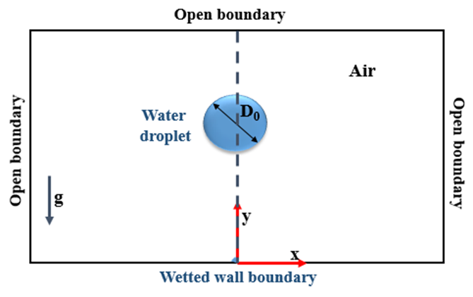
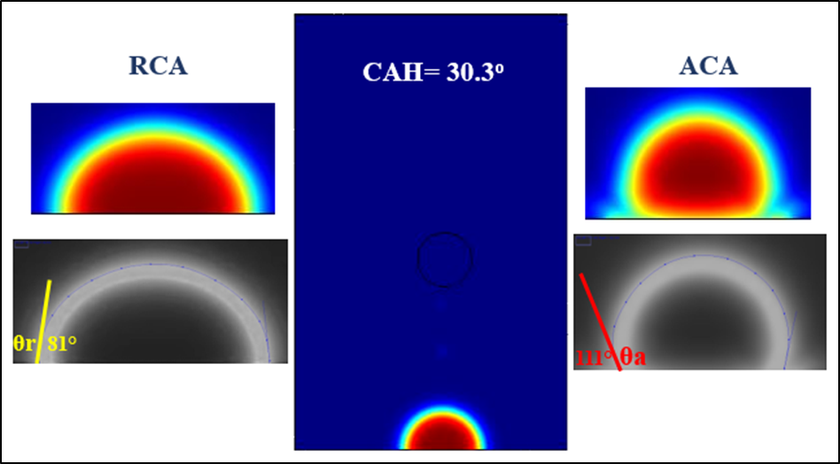
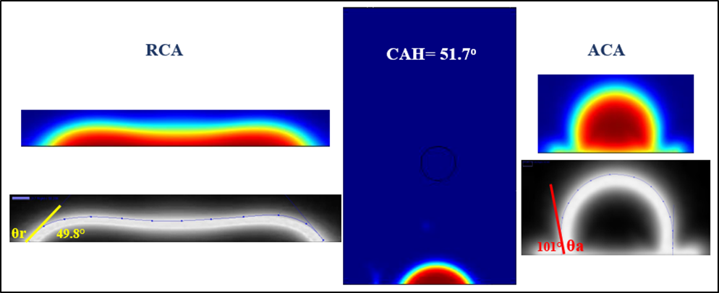
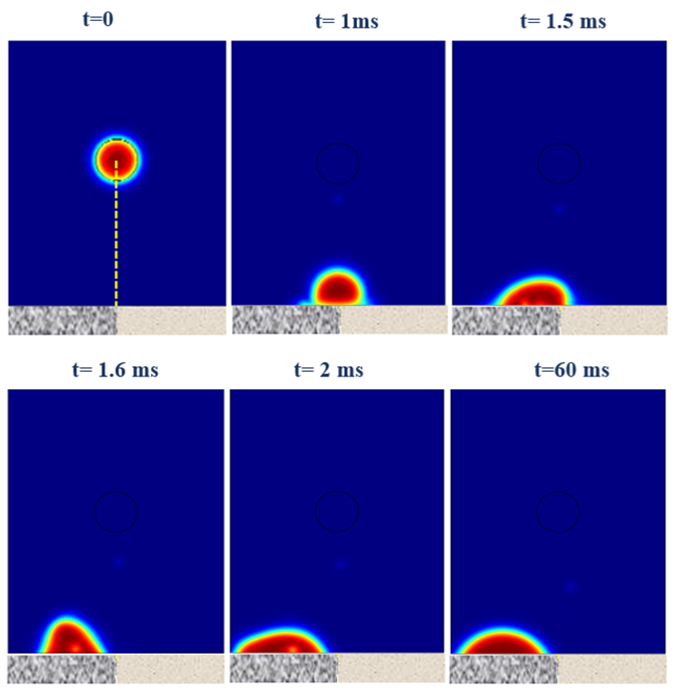
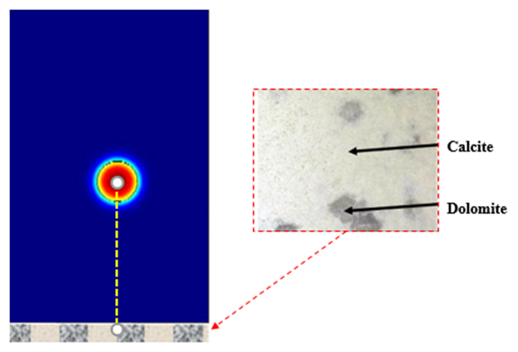
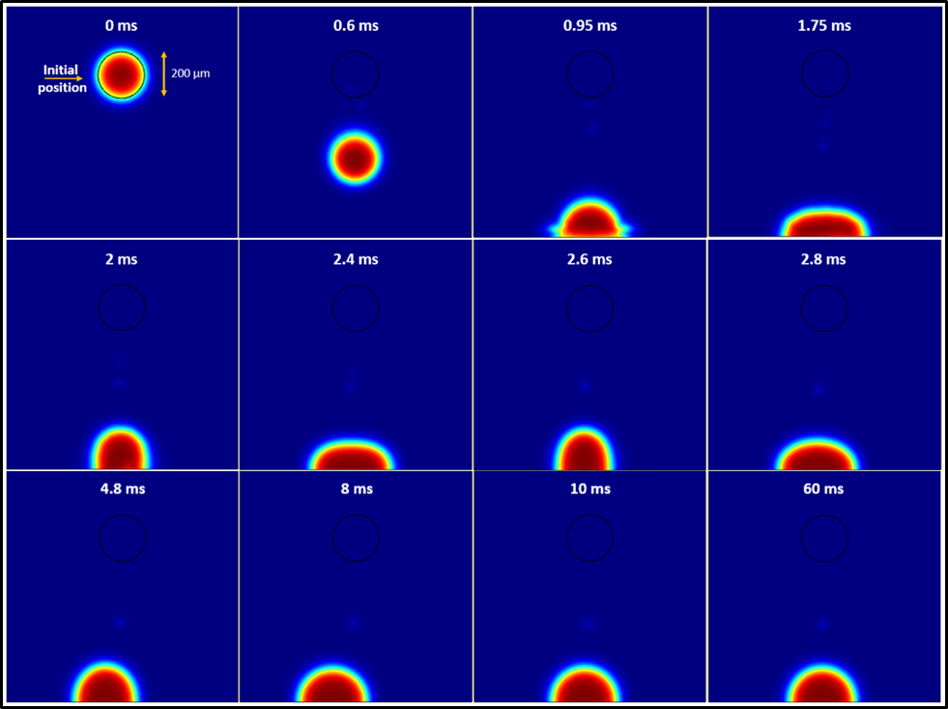
Please leave at least a 25mm margin on all sides to avoid cropping during printing. Remove this text box before submitting.
Experimental and numerical micro droplet contact angle hysteresis analysis on a heterogeneous Solid Surface: Application to carbonate
Mouna Zaidani^{1*}, Mohamed Sassi¹
1. Department of Mechanical and Materials Engineering, Khalifa University of Science and Technology, Abu Dhabi, UAE
INRODUCTION: In this paper, the contact angle hysteresis (CAH) of micro droplets on chemically heterogeneous substrates with different wettability was studied using a conservation level set method simulation, Our numerical model is applied to carbonate rocks which account for more than half of the world’s hydrocarbon reserves.
Application to calcite and dolomite: For the Calcite Fig.3a, the droplet tends to spread on the surface driven by the momentum, but due to the high contact angle the droplet has difficulty to spread further leading to a quick rebound. For the dolomite Fig.3b, due to the low contact angle the droplet spread further leading to a quick rebound and spread.
(a)
(b)
Figure 1. Schematic of droplet falling and computational domain.
Figure 3. Numerical results of the equilibrium, advancing and receding contact angle for dolomite and calcite
COMPUTATIONAL METHODS: we developed a multi-physics multi-flow numerical model using Comsol Multiphysics to predict the evolution of a droplet falling on a solid substrate [1]:
RESULTS: A dynamic process of a water droplet collides with a hydrophobic surface of 90º is illustrated in Fig. 2. Droplet tends to spread on the surface driven by the downward momentum, but has difficulty to spread further due to the high contact angle.
Application to heterogeneous surface
Please leave at least a 25mm margin on all sides to avoid cropping during printing. Remove this text box before submitting.
Figure 4. Schematic of microdroplet falling on heterogeneous surfaces formed by two different patches with dolomite and calcite.
CONCLUSIONS: The simulation results can provide a good understanding of the carbonate rock dynamic impingement process and provide insights on how the carbonate rock surface mineralogy and heterogeneity can affect the contact angle hysteresis. These findings aim to enhance our understanding of the mechanism of the CAH at the microscale and could help the oil industry to develop some new methods for enhanced oil recovery (EOR).
Figure 2. Numerical simulation of the droplet falling and positioning
REFERENCES:
COMSOL, A., CFD module user’s guide. 2015.)
Excerpt from the Proceedings of the 2019 COMSOL Conference in Cambridge

