Slide 1


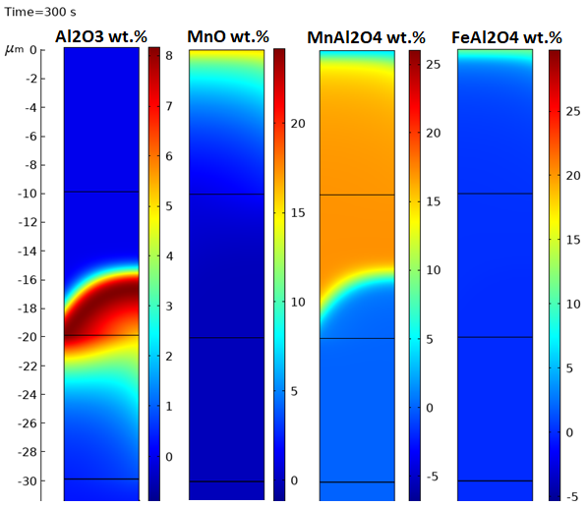
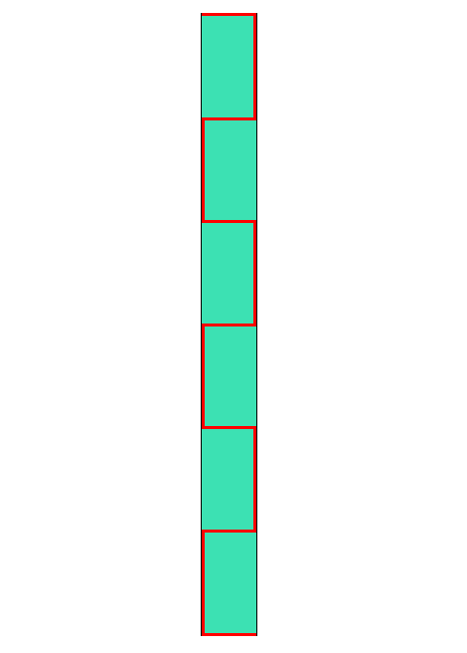
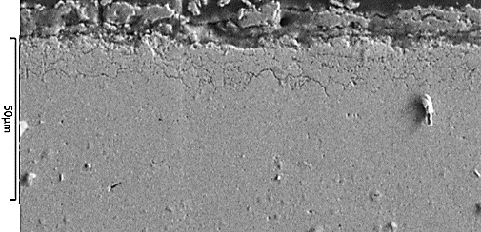
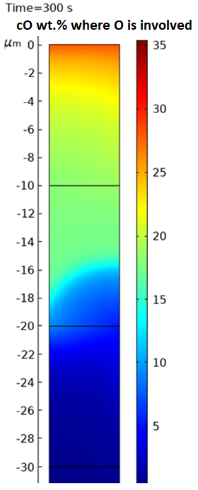

Modelling the Diffusion/Counter Diffusion of Oxygen
and Solutes in Low Density Steels
Jack Isaacs ¹, Shangping Chen ², Marga Zuijderwijk ², Michael Auinger ¹
¹ WMG, University of Warwick, Coventry, CV4 7AL ² Tata Steel Europe, Ijmuiden, The Netherlands
INTRODUCTION: COMSOL is used to study the oxidation behaviour of low density steels by the Transport of Diluted Species (Transport Phenomena) and Chemistry (Chemical Reaction Engineering) modules. The Transport module focusses on the diffusion of Oxygen from the surface, and solute (Al, Mn) diffusion from the geometry (bulk) which proceeds via Fick’s Laws. The Chemistry module is the basis of the reactions taking place with varying Oxygen concentration forming (Fe, Al, Mn) oxides. It is expected that more oxidation will occur in high diffusivity pathways such as defects, and interfaces like grain boundaries, and that the more stable oxides will form deeper into the sample where less oxygen is available ^{[2]}.
Figure 1.
Model geometry 60μm x 5μm. Homogenised grain structure: Grain (green)
Grain Boundary (red)
Figure 3. Comparison of Oxides wt.% (Al₂O₃, MnO, MnAl₂O₄, FeAl₂O₄)
RESULTS: The outputs are the concentration profiles of Al₂O₃, MnO, MnAl₂O₄, FeAl₂O₄ oxides. The results of the model show an oxide layering, which forms due to lower Oxygen concentration further into the geometry. The results can be compared to Fig. 4 in that the grain boundaries are the primary areas of oxide precipitation from the increased Oxygen flux.
COMPUTATIONAL METHODS: The main portion of this model is based around the iterative process of species diffusion then subsequent reaction ^{[1]}. The now established oxides can reduce the diffusivity of the oxidants and solutes; which will affect the depth, composition, and rate of further reactions. This concept is built around Fick’s Laws, with Flux (J), Concentration (c), and Diffusivity (D) ^{[3]}:
$J=−D\frac{∂c}{∂x}$
Where:
$D=D_{0} e^{\frac{−Q}{RT}}$
The model is to calculate the concentrations of the various Fe/Al/Mn oxides that form, which will vary according to the local available Oxygen content; calculated from FACTSAGE’s data with a relation to the oxides’ dissociation concentration.
Figure 4. SEM images of Fe-2Al-4Mn steel, Oxidised in Air at 900^{O}C for 10min. (Enhanced: Sharpness and Contrast)
CONCLUSIONS: The model can simulate duplex microstructure (Ferrite and Austenite) reasonably well; which takes into account their differing Oxygen solubilities, diffusivity variability, and solute concentrations.
The results fit within a reasonable agreement with experimental values given the complex chemistry and microstructure of industrial duplex-steel grades.
This project will assist companies/researchers in assessing the risk and extent of oxide formation in the development of high quality low density steels.
Figure 2. Oxygen wt.%, including all oxides
REFERENCES:
M. Auinger, R. Naraparaju, H. J. Christ, M. Rohwerder, “Modelling High Temperature Oxidation of Metals, 76, 2011, p247-258
D. J. Young, “High Temperature Oxidation and Corrosion of Metals” Second Edition, 2008
C. Wagner, “Passivity and inhibition during the oxidation of metals at elevated temperatures”, Corrosion Science, Vol. 5, No. 11, pp 751-764, 1965
Excerpt from the Proceedings of the 2019 COMSOL Conference in Cambridge

