Slide 1
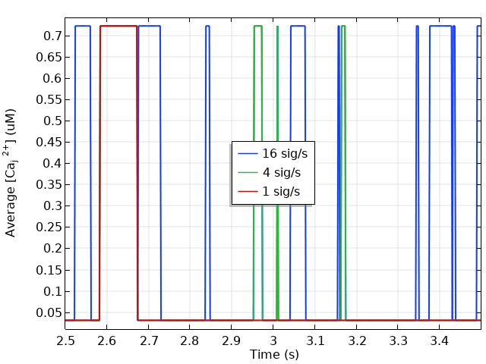
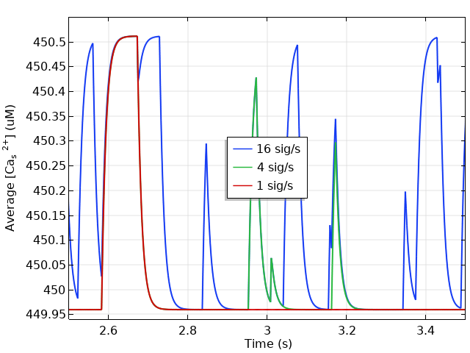
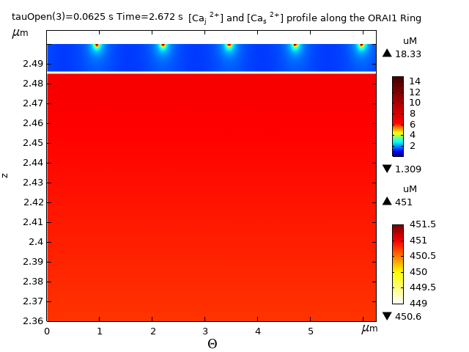
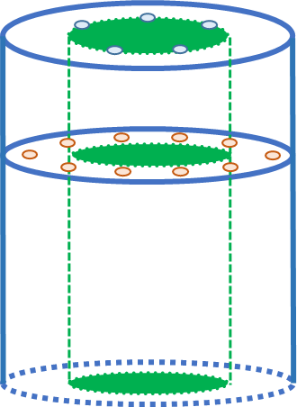
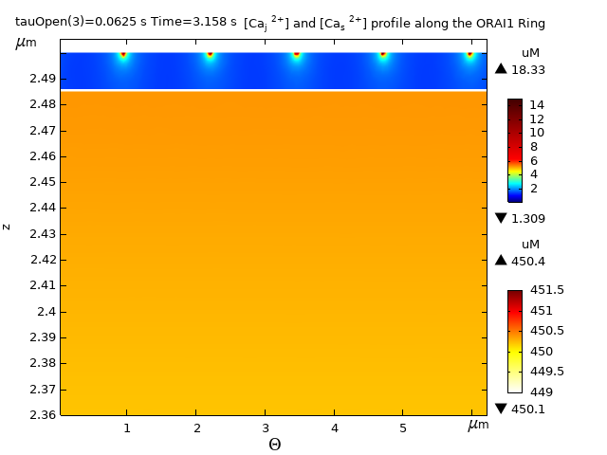
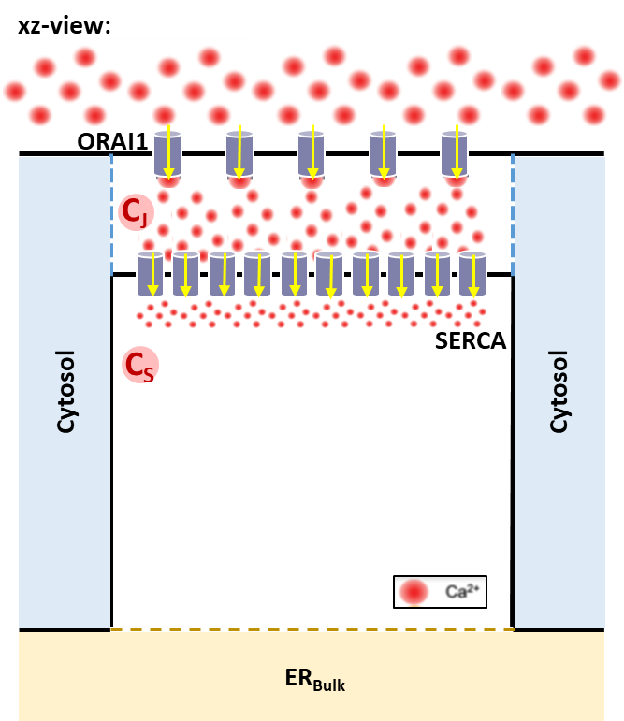
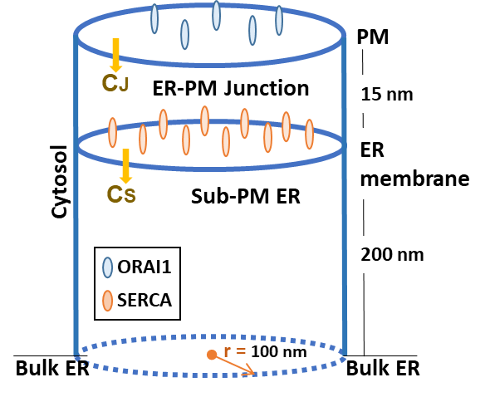
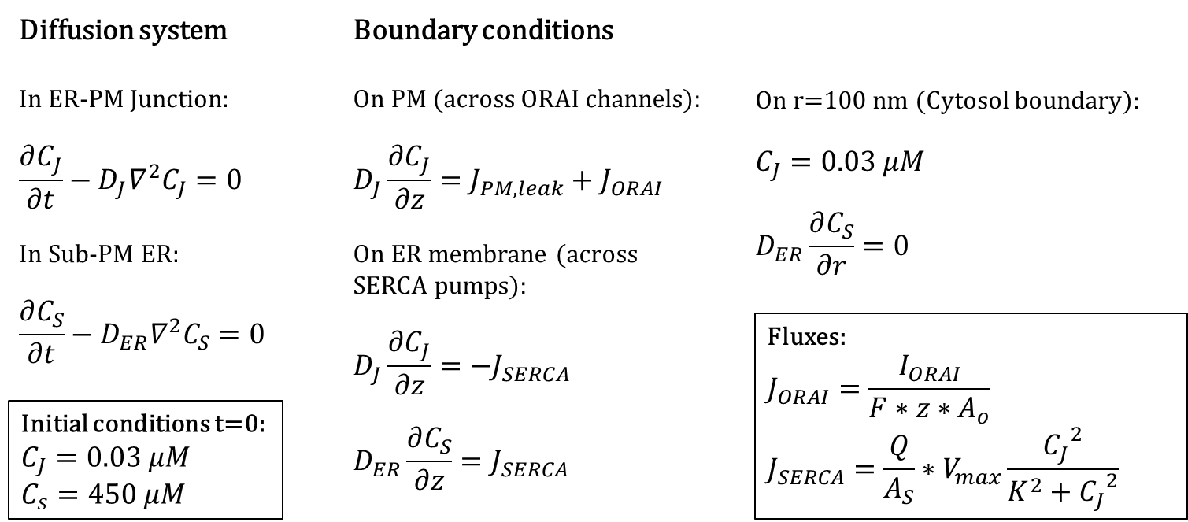
Spontaneous Calcium (Ca²⁺) Microdomains in Non-Stimulated T cells
D. C. Gil¹, A. Guse¹, G. Dupont²
1. Universitätsklinikum Hamburg-Eppendorf, Institut für Biochemie und Molekulare Zellbiologie, Hamburg, 20251, Germany
2. Université Libre de Bruxelles, Physical Chemistry and Theoretical Biology Unit, Bruxelles, 1050, Belgium
INTRODUCTION: Based on experimental data obtained via high-resolution imaging describing the Ca²⁺ dynamics in non-stimulated T Cells, we identify the appearance of random spontaneous Ca²⁺ microdomains inside the Endoplasmic Reticulum (ER) - Plasma Membrane (PM) Junctions, which are micro-regions in the cell cytosol, where Ca²⁺ enters mainly across ORAI1 channels.
We develop a diffusion model using COMSOL Multiphysics® to explore these results inside a 3D ER-PM junction of 15nm into the cytosol, where we try to cast some light onto the calcium concentration ([Ca²⁺]) dynamics modulations set by the different channels and pumps involved in the Ca²⁺ uptake processes.
RESULTS: The random opening of the ORAI1 is controlled by the meantime to open (0.25s or 4 signals/s) and close (25ms) observed in [1]. The simulated time is 5s.
A
B
Figure 3. Average [Ca²⁺] at t = [2.3,3.5]s. (A) In the ER-PM junction, C_{J}; (B) In the Sub-PM ER, C_{S}.
A
B
Figure 1. Spontaneous Ca²⁺ microdomains in non-stimulated T cells. Arrow heads indicate Ca²⁺ microdomains directly at the PM. [1]
COMPUTATIONAL METHODS: The domain is given by two united cylinders, the upper represents the ER-PM Junction where Ca²⁺ flows in from the extracellular space via 5 ORAI1 channels at the PM, then it will diffuse or be uptake by 10 SERCA pumps sitting at the inner boundary (ERM) with the lower domain representing a sub-ER region, where it continues to diffuse. There is not concentration change in the rest of the cytosol. The model is based on the work of McIvor E.^{[2]}
Figure 4. [Ca²⁺] profile along the ORAI1 ring. (A) 92ms signal, (B) 6ms signal.
Avg (nM) | Max (µM)
723 | 19.43
Table 1. Average and Maximum C_{J}. [Ca²⁺] inside the ER-PM Junction for 1, 4 and 16 signals per second.
CONCLUSIONS:
The amount of signals per second does not change the ER-PM Junction’s Calcium concentration while the ORAI1 are open, since given a diffusion coefficient of 220 um²/s its timescale is around 0.1ms, therefore after ORAI1 closes basal concentration will be always reached before it opens again. However, the duration of the signal will control the Ca²⁺ uptake by SERCA pumps into the Sub-PM ER significantly, where the diffusion coefficient is 10 um²/s, and signals close to each other will end up merging.
Spontaneous Ca²⁺ microdomains enable continuous low-level Ca²⁺ entry, resulting in a “basic excitability” of T cells. Its characterization sheds new light on the intricate interactions controlling Ca²⁺ signaling in T cells and the adaptive immune responses.
We aim at the end to create with the help of the Application Builder an app which can be used by the personnel working at our university labs, that helps them to optimize and improve the experiments planning and hopefully saves time and lab resources.
Figure 2. 2D and 3D representations. We assume 5 ORAI1 channels and 10 SERCA pumps per junction in concentric circles of 40 and 60 nm radius respectively.
The [Ca²⁺] inside the ER-PM junction (C_{J}) and the sub-plasma membrane ER (C_{S}) are governed by a system of two diffusion PDEs where the effects of buffers are neglected (no reaction forces), this is modelled using the Transport of Diluted Species Interface inside the Chemical Species Transport Module. The opening of ORAI1 is given by a time dependent random function connected to the Events Interface (via an Explicit Event) to simulate the random nature of the microdomains.
REFERENCES:
Diercks, et al. ORAI1, STIM1/2, and RYR1 shape subsecond Ca²⁺ microdomains upon T cell activation, Sci. Signal Sci., Vol. 11, 2 (2018).
McIvor E, Coobes S, Thul R. Three-dimensional spatio-temporal modelling of store operated Ca2+ entry: Insights into ER refilling and the spatial signature of Ca²⁺ signals, Cell Calcium, 73, 11-24 (2018).
Excerpt from the Proceedings of the 2019 COMSOL Conference in Cambridge

