Slide 1
Fluid-Structure Interaction of Coupled Valves in Sucker Rod Pump
Shreyas V. Jalikop^{(a)},
B. Scheichl^{(b)}, S.J. Eder^{(a,b)}
(a) AC2T research GmbH, Austria
(b) Technical University of Vienna, Austria
Notes:
1
COMET - Competence Centers for Excellent Technologies
Das Programm COMET fördert den Auf- und Ausbau von Kompetenzzentren, deren Herzstück ein von Wirtschaft und Wissenschaft gemeinsam definiertes Forschungsprogramm auf hohem Niveau ist; das COMET Programm ist die Fortsetzung des Kompetenzzentrenprogramms Kplus.
COMET - Das Programm
Aufbau gemeinsamer Forschungskompetenzen zwischen Industrie und Wissenschaft
COMET - Programmlinien
Das Programm COMET umfasst 3 Programmlinien
K1 vs. K2
Kplus
Kplus-Zentren: Zusammenführung industrieller und wissenschaftlicher Kompetenz zu international konkurrenzfähigen "Centers of Excellence".

Slide 2
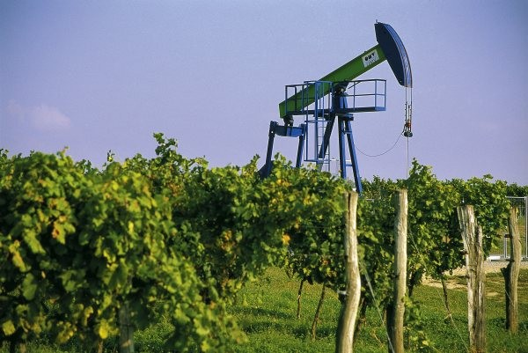
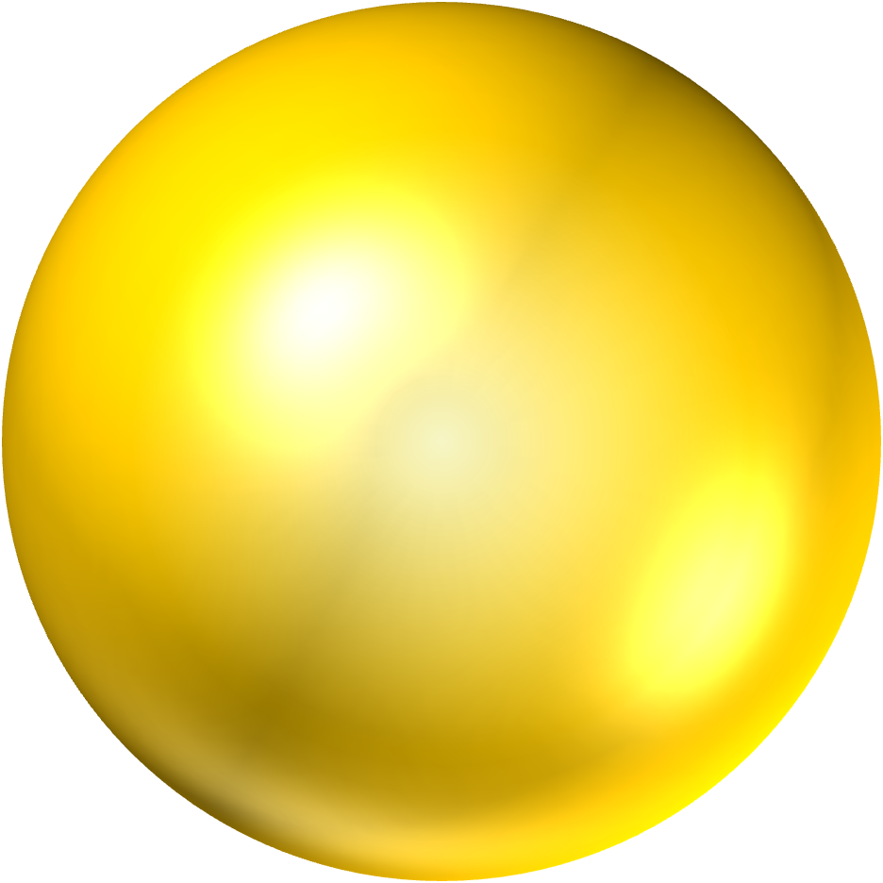

Introduction
Down hole pumps
Most widely used type of pumps in oil industry
Usually more than 1000m underground
Scarce measurement data from pumps
Multiple damage mechanisms: corrosion, impact, etc.
Realistic pump operation hard to predict
Fluid dynamic related pump damage not well understood
www.omv.com
Oil reservoir
Down-hole pump

Slide 3
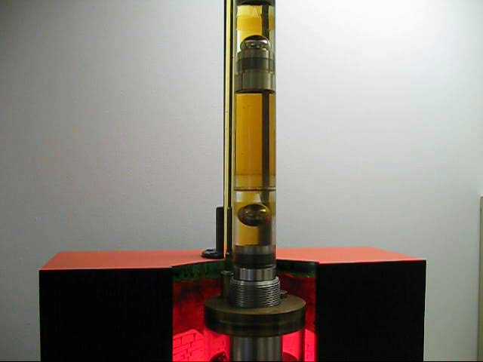
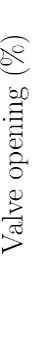
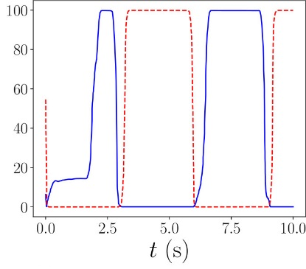
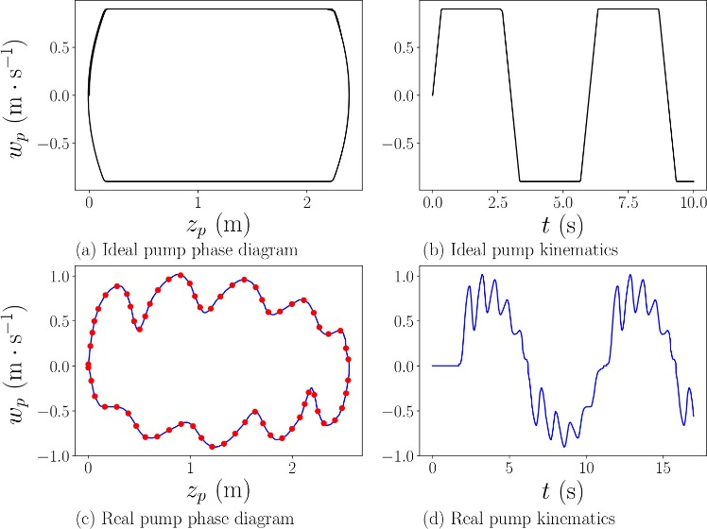
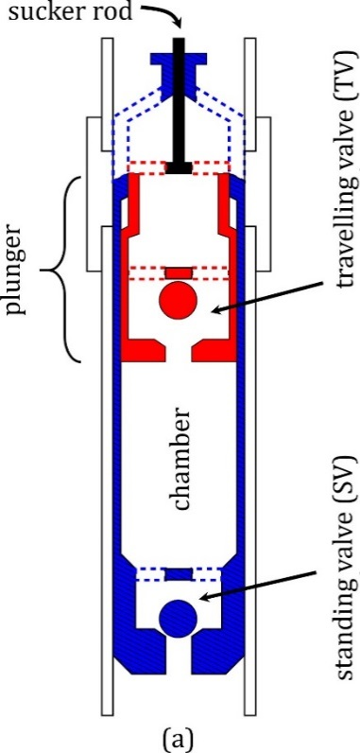


Sucker-rod pump operation (ideal conditions)
Ideal pump-card
Schematic of down-hole pump
OMV
Opening/Closing driven by fluid forces
Fluid structure interaction (FSI)

Slide 4
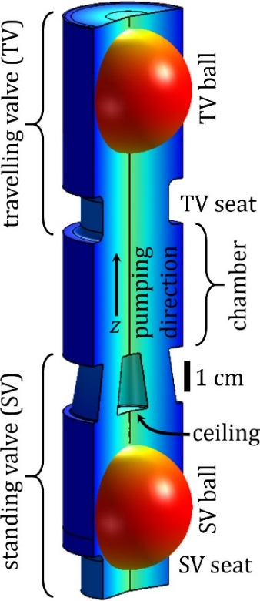
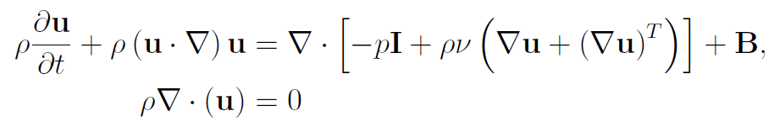
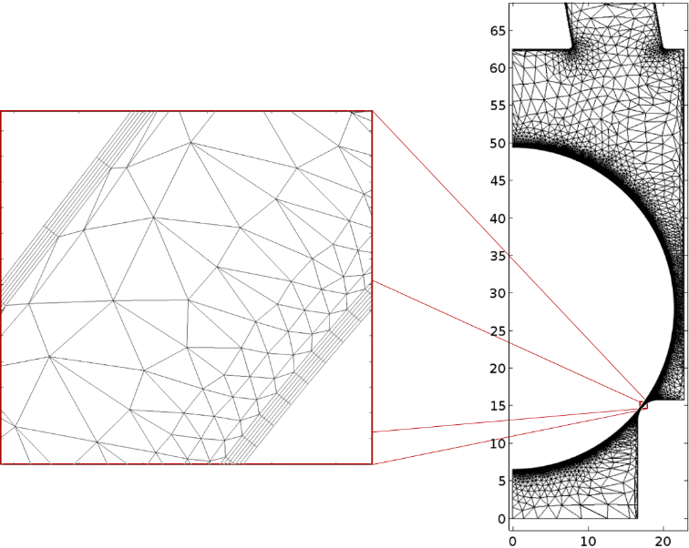
Model description
TP
Assumptions of the model
SPF module : No turbulence: laminar flow (justified for force calculations)
2D axisymmetric flow
Single fluid phase model
Rigid pump components
Plunger kinematics
Boundary conditions
Imposed PIP & TP
Imposed plunger kinematics
Computational model
Moving mesh (ALE)
Automatic remeshing (distortion)
6 boundary layer mesh
PIP
COMSOL model

Slide 5
Computational challenges
Moving boundaries
ALE module for moving mesh
Automatic remeshing
Valve closure
Avoided solid-solid contact
Artificial repulsive force
Ball dynamics
Implicitly solved using Global Equations node

Slide 6
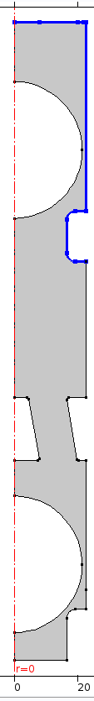




Computational challenges
Moving boundaries
ALE module for moving mesh
Automatic remeshing
Valve closure
Avoided solid-solid contact
Artificial repulsive force
Ball dynamics
Implicitly solved using Global Equations node
Prescribed Mesh Velocity
TV Ball
$$V_{r}=0$$
$V_{r}=w_{p}$(plunger speed)
Seat
Expanding
chamber
Prescribed Mesh Displacement
$$d_{r}=0$$
$d_{r}=z_{b}$(ball displacement)
SV Ball
Seat

Slide 7
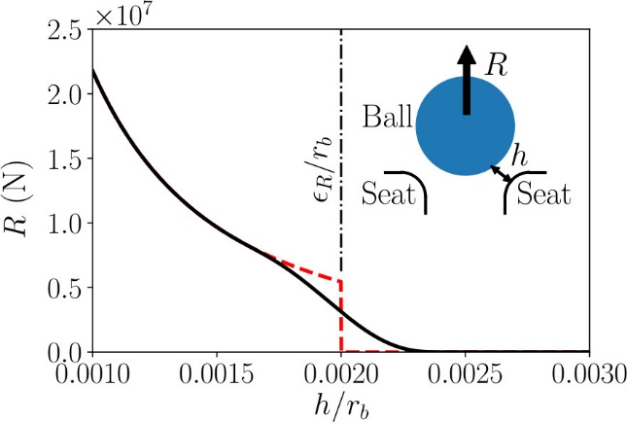
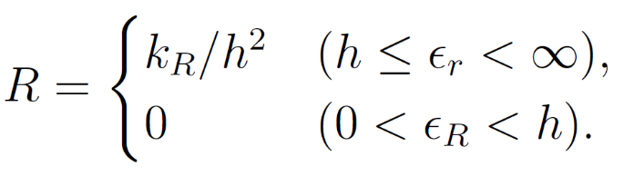

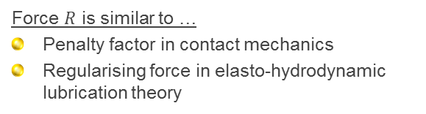

Computational challenges
Moving boundaries
ALE module for moving mesh
Automatic remeshing
Valve closure
Avoided solid-solid contact
Artificial repulsive force
Ball dynamics
Implicitly solved using Global Equations node
Artificial repulsive force model
$$R$$
$ε_{R}$: critical cut-off gap
$k_{R}$: sensitivity parameter
Force $R$ is similar to …
Penalty factor in contact mechanics
Regularising force in elasto-hydrodynamic lubrication theory

Slide 8
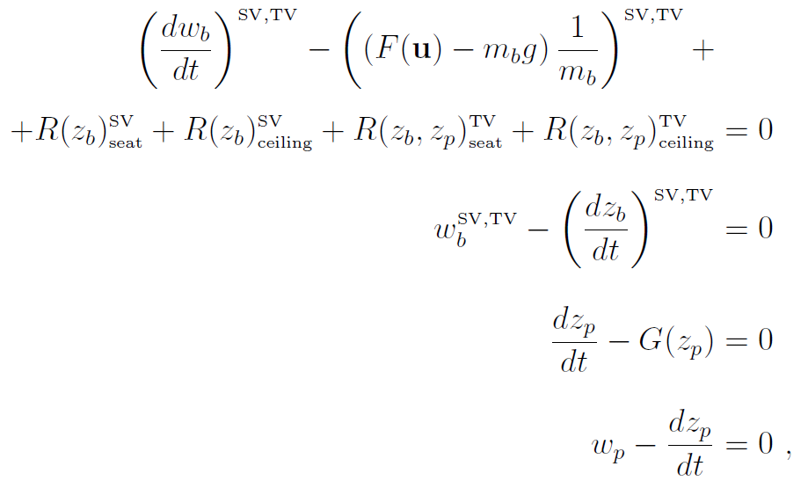
Computational challenges
Moving boundaries
ALE module for moving mesh
Automatic remeshing
Valve closure
Avoided solid-solid contact
Artificial repulsive force
Ball dynamics
Implicitly solved using Global Equations node
Coupled system of ODEs solved by Global Equations node
Solves ball kinematics
Solves plunger kinematics

Slide 9
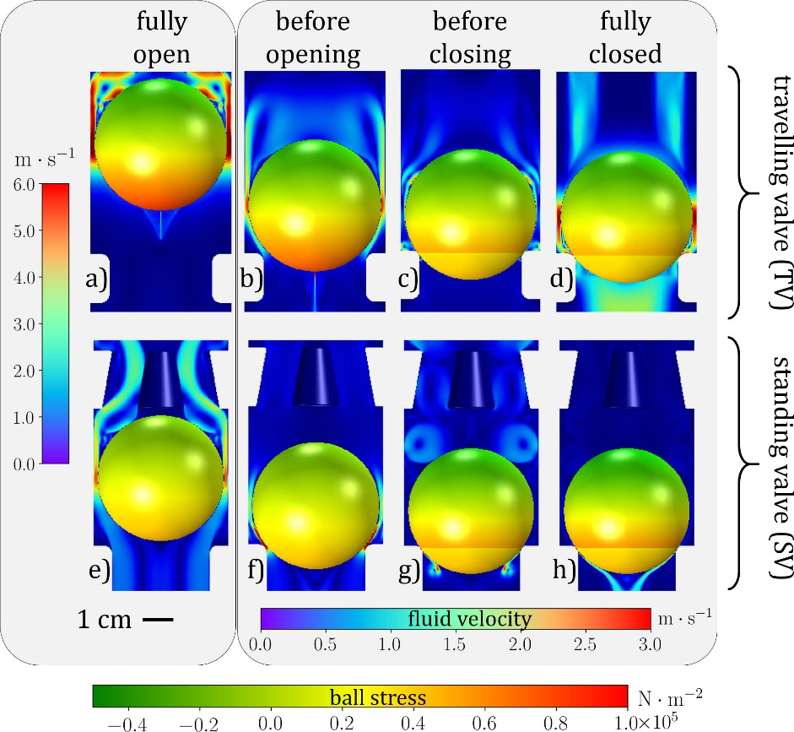
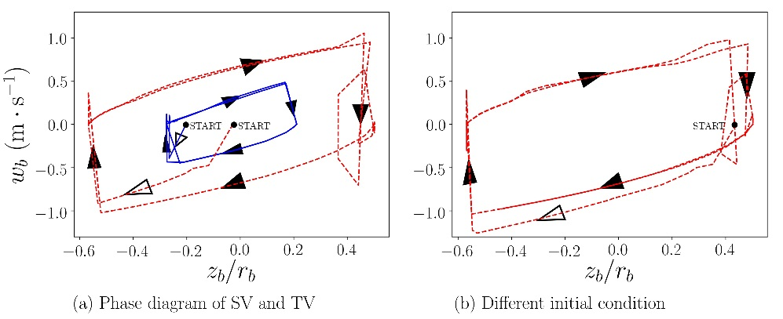
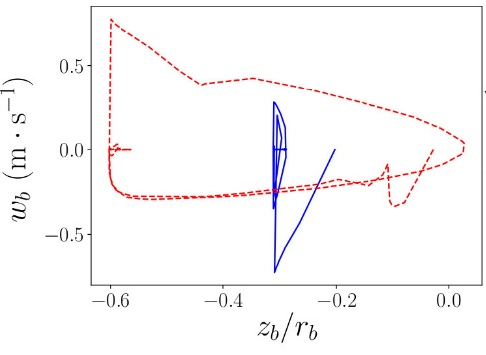
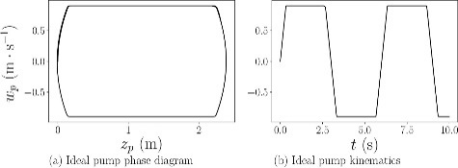
Results (ideal pump card)
SV
TV
Partially open valves

Slide 10
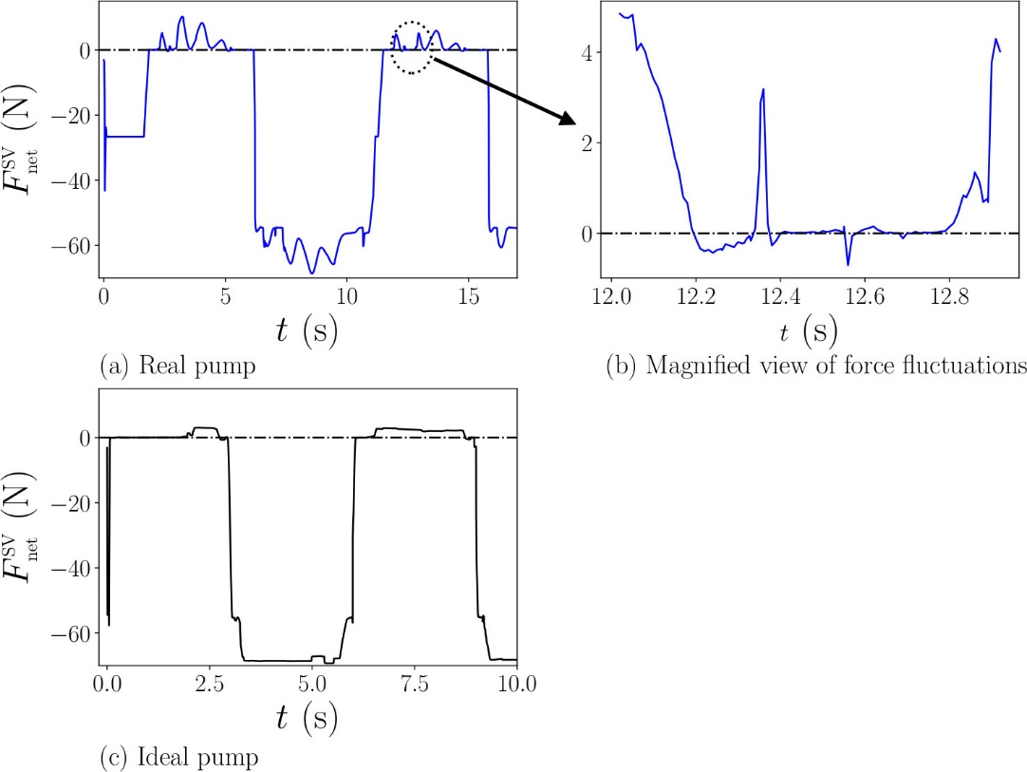
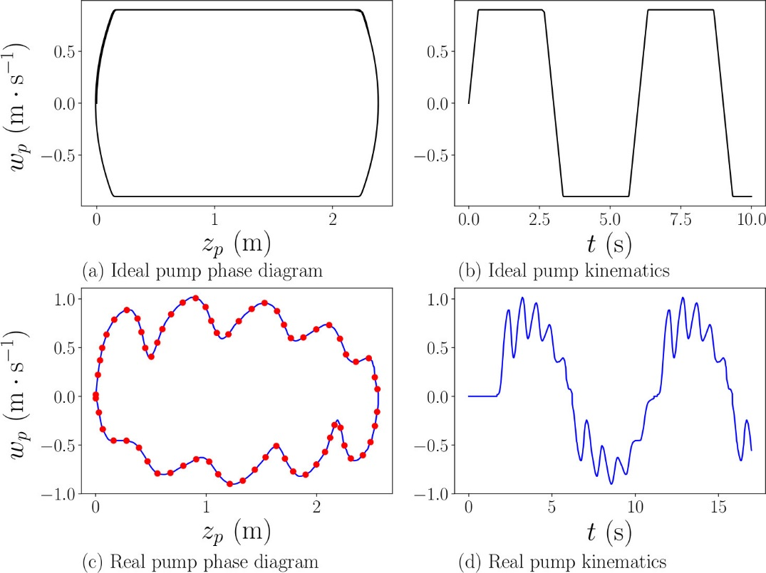


Ball dynamics (Net force)
Real
Net force = (Drag due to fluid flow) – (weight of the ball)
Ideal
$$=$$
$$m_{b}$$

Slide 11
Ball dynamics (Net force)
Real
Fluctuations in net force on the SV ball for actual pump card data due to fluctuations in plunger speed; whereas steady force on the ball in the ideal case
Zoom plot shows that net force goes below zero (indicating downward force on the ball) in regions where ideally it should be steady
These regions of negative net force can lead to mid-cycle valve closure!
Ideal

Slide 12
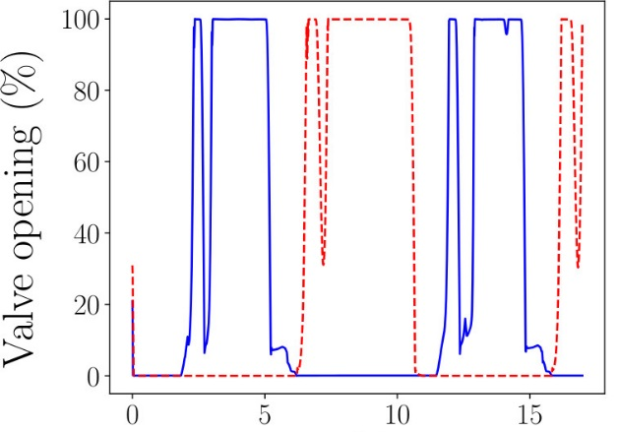
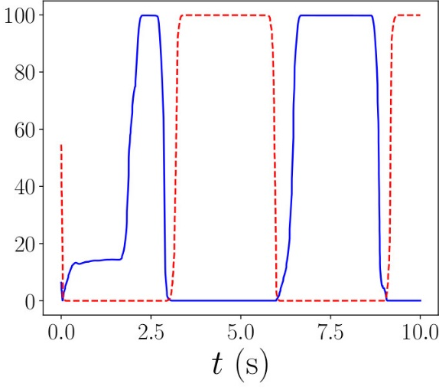
Valve opening
TV
SV
Mid-cycle valve closure is indeed observed!
Real
Ideal

Slide 13
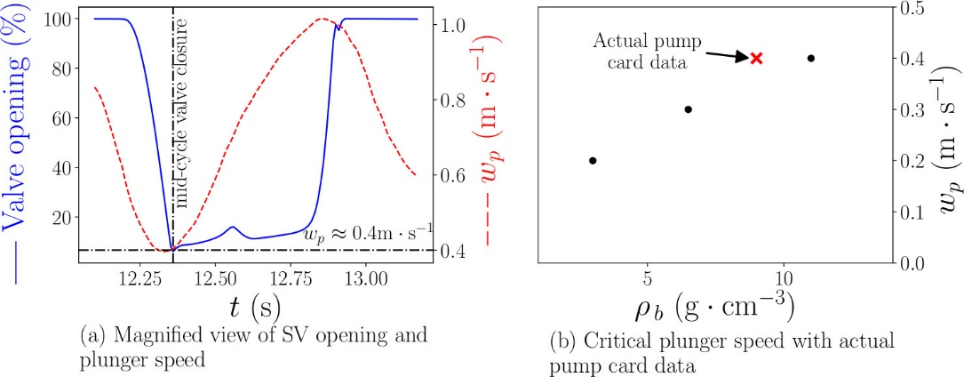
Valve opening
TV
SV
Real
Ideal
The valve closure correlates to a fluctuation in plunger speed

Slide 14
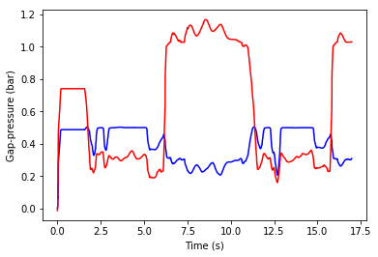
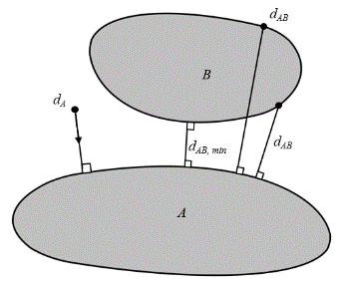
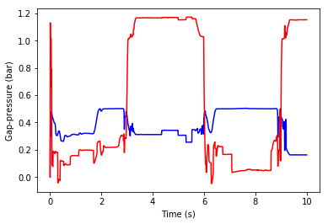
Gap pressure
TV
SV
Time dependent gap between ball and seat using General Extrusion
Ball
Real
Seat
Gap pressure computed at the mid-distance of the shortest line joining the ball and the seat
Ideal
COMSOL Blog by Walter Frei

Slide 15
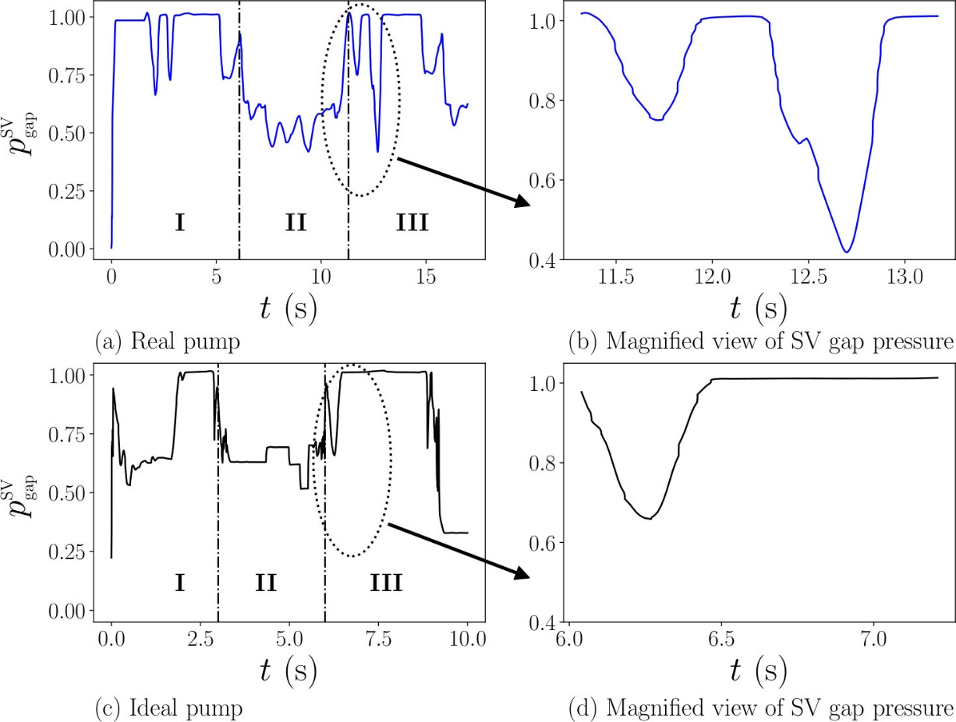
Gap pressure
TV
SV
Mid-cycle valve closure results in a sudden pressure drop.
The first dip is due to the valve opening process, and is also present in the ideal case
This presents danger of gas/vapour formation
Possible root-cause of other know damage mechanisms. Eg. Gas intereference, fluid pound.
Real
Ideal

Slide 16
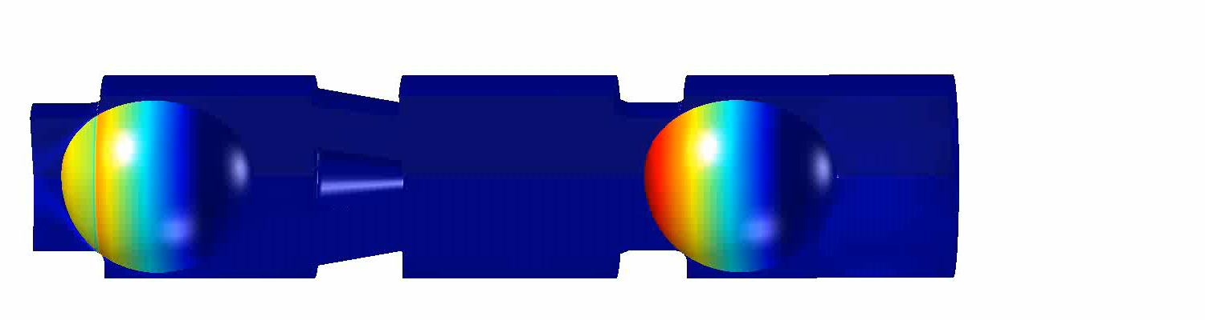
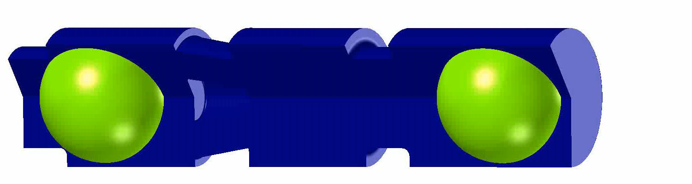
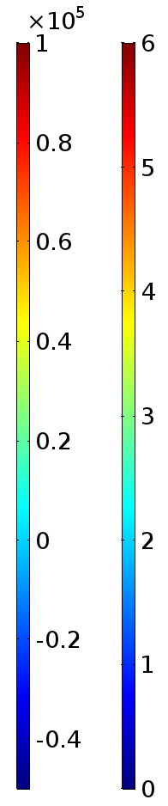
Real
Ideal
N/m^2
m/s

Slide 17
conclusion
First FE model for studying FSI of a pair of coupled ball check valves
Moving boundaries
Implemented using ALE and Global Equations node
Large variations (> 60 times) in geometry in time handled by COMSOL
Real case pumping scenarios can be simulated
The model is a helpful tool for pump design

Slide 19

XTRIBOLOGY
ACKNOWLEDGEMENT
The topics presented are based on research projects carried out at the “Excellence Centre of Tribology” (AC2T research GmbH, Wiener Neustadt, Austria) with the support by the Austrian program (Project XTribology, no. 849109) and by the concerned program management institutions, viz the Austrian Research Promotion Agency (Österreichische Forschungsförderungs-Gesellschaft mbH), on behalf of the Federal Government, as well as by the Government of Niederösterreich, Wien, and Vorarlberg.
We are as well grateful to the involved company partners and scientific partners for their financial support and for the fruitful cooperation.

Slide 20
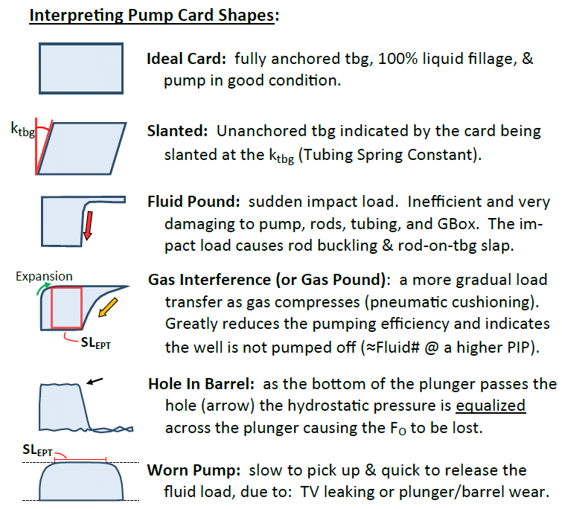
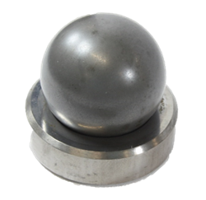
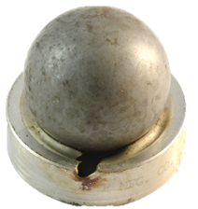
Non-ideal pump operation
Typical real pump-card
WC
A good model should capture non-ideal scenarios
Relative valve opening/closing states
Pump/Valve
Damage
Undamaged valve
www.downholediagnostics.com
Coupled valves model
Damaged seat

Slide 21





Dynamics of the valve balls
Artificial repulsive force model
Hydrodynamic drag and gravitational force
$$F$$
$$m_{b}g$$
Ball dynamics
$F$: hydrodynamic drag
(surface integral of stress in vertical direction)
$m_{b}g$: force due to gravity
Ref: COMSOL
Application ID: 12655
$ε_{R}$: critical cut-off gap
$k_{R}$: sensitivity parameter
Force $R$ is similar to …
Penalty factor in contact mechanics
Regularising force in elasto-hydrodynamic lubrication theory

Slide 22
Coupled equations for pump kinematics
Coupled system of ODEs solved by Global Equations node
Solves ball kinematics
Solves plunger kinematics

Slide 23
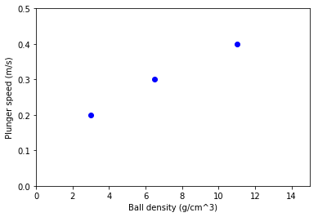
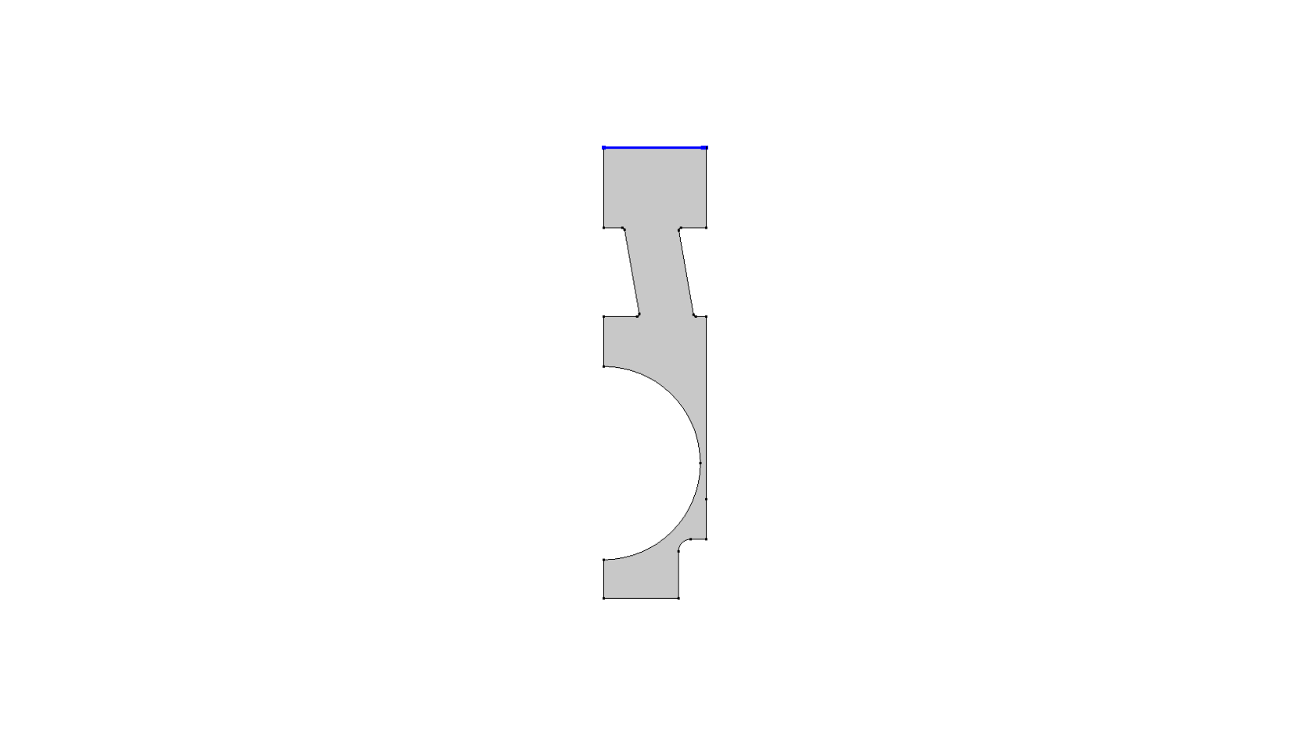
Parametric study of critical plunger speed
Constant flow rate boundary condition
A constant flow rate was imposed
Simulation was carried out to find the final position of the ball starting from an almost closed valve
Critical plunger speeds (boundary between partial opening and full opening) for various ball densities were computed.
Fully open valve
Drag
Partially open valve

Slide 24
conclusion
First FE model for coupled valves
Fluctuation in plunger speed can lead to sudden pressure drop → danger of
gas formation/cavitation and
mid-cycle valve c
Constant flow rate simulations
Boundary between partial and complete opening of valve

Slide 25
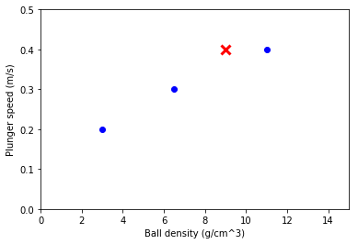
Parametric study of critical plunger speed
Constant flow rate boundary condition
A constant flow rate was imposed
Simulation was carried out to find the final position of the ball starting from an almost closed valve
Critical plunger speeds (boundary between partial opening and full opening) for various ball densities were computed.
Actual pump card data
Drag

Slide 26
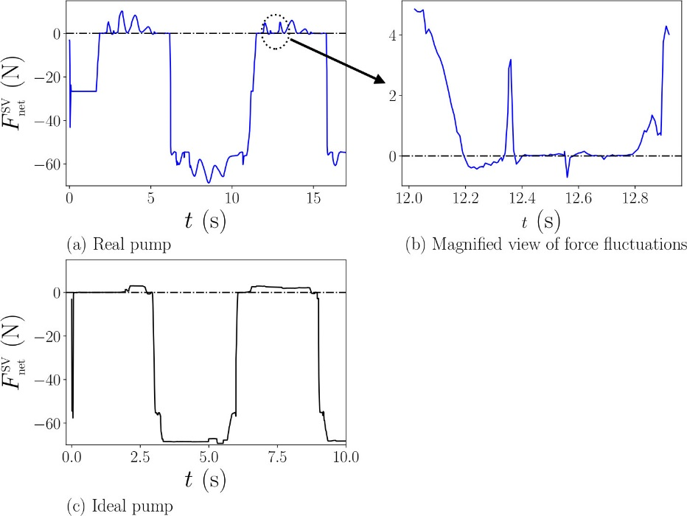
Results (real pump card)

Slide 27
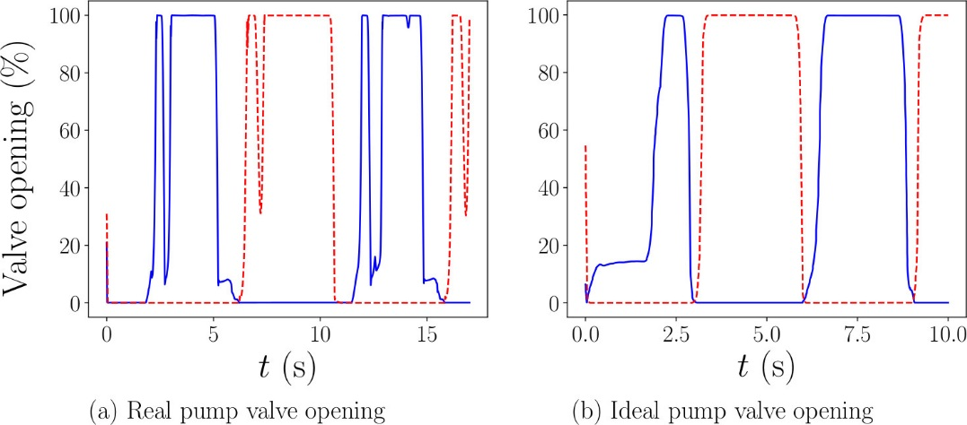
Results (real pump card)

Slide 28

Gap pressure
Time dependent gap between ball and seat using General Extrusion
Ball
Seat
Gap pressure computed at the mid-distance of the shortest line joining the ball and the seat

Slide 29
Valve closure model

Slide 30
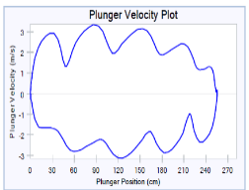
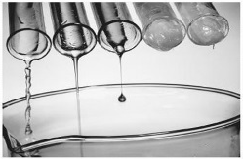
Simulation flow chart
Plunger motion
Liquid properties
Pump geometries
00
Simulation of fluid flow in down hole pump
Hydrodynamic pressure and forces on ball and pump
Opening/closing of pump valves

Slide 31
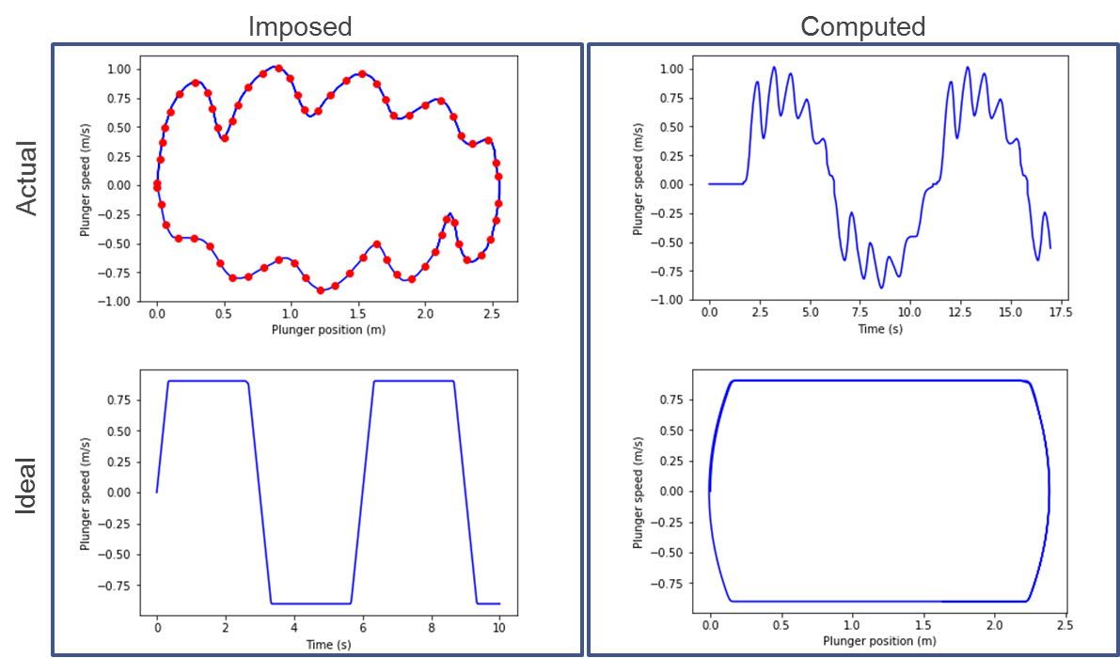
Plunger motion
Plunger motion
Any pump card can be given as input to the model
Ideal motion of the plunger can also be used for certain parametric studies

Slide 32
Assumptions of liquid
Liquid properties
Constant density and viscosity of the liquid
Single phase of the fluid
Newtonian fluids

Slide 33
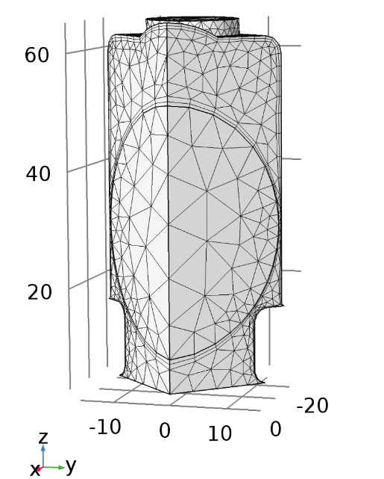
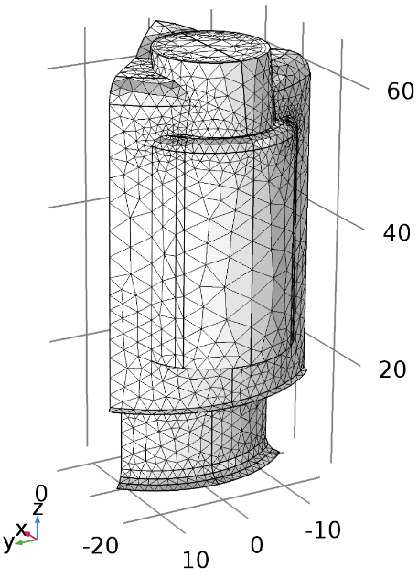
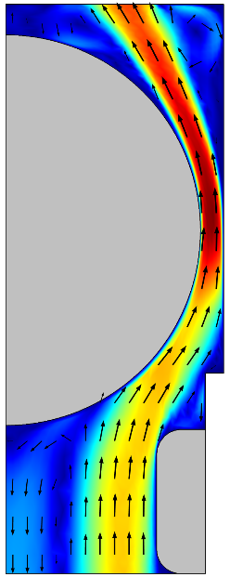
Simplification from 3D to 2D
3D
2D
Pump geometries
Ball
Ball
Seat
Seat
Full 3D geometry is used to develop an equivalent 2D geometry that can approximately reproduce the hydrodynamic forces on the ball

Slide 34
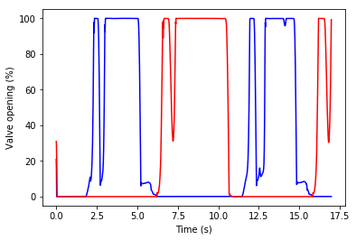

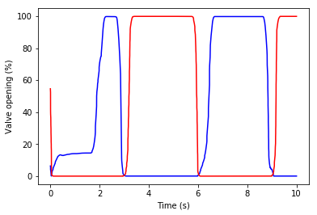
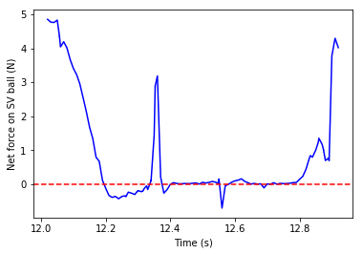
Real vs ideal pump card
Gap pressure
TV
SV
Real
Real
Mid-cycle valve closure
Ideal
Ideal
Hydrodynamic pressure and forces on ball and pump
Opening/closing of pump valves
Force on the ball

Slide 35
Ideal pump card:
Real pump card (note the mid-cycle valve closure!):
N/m^2
m/s

Slide 36
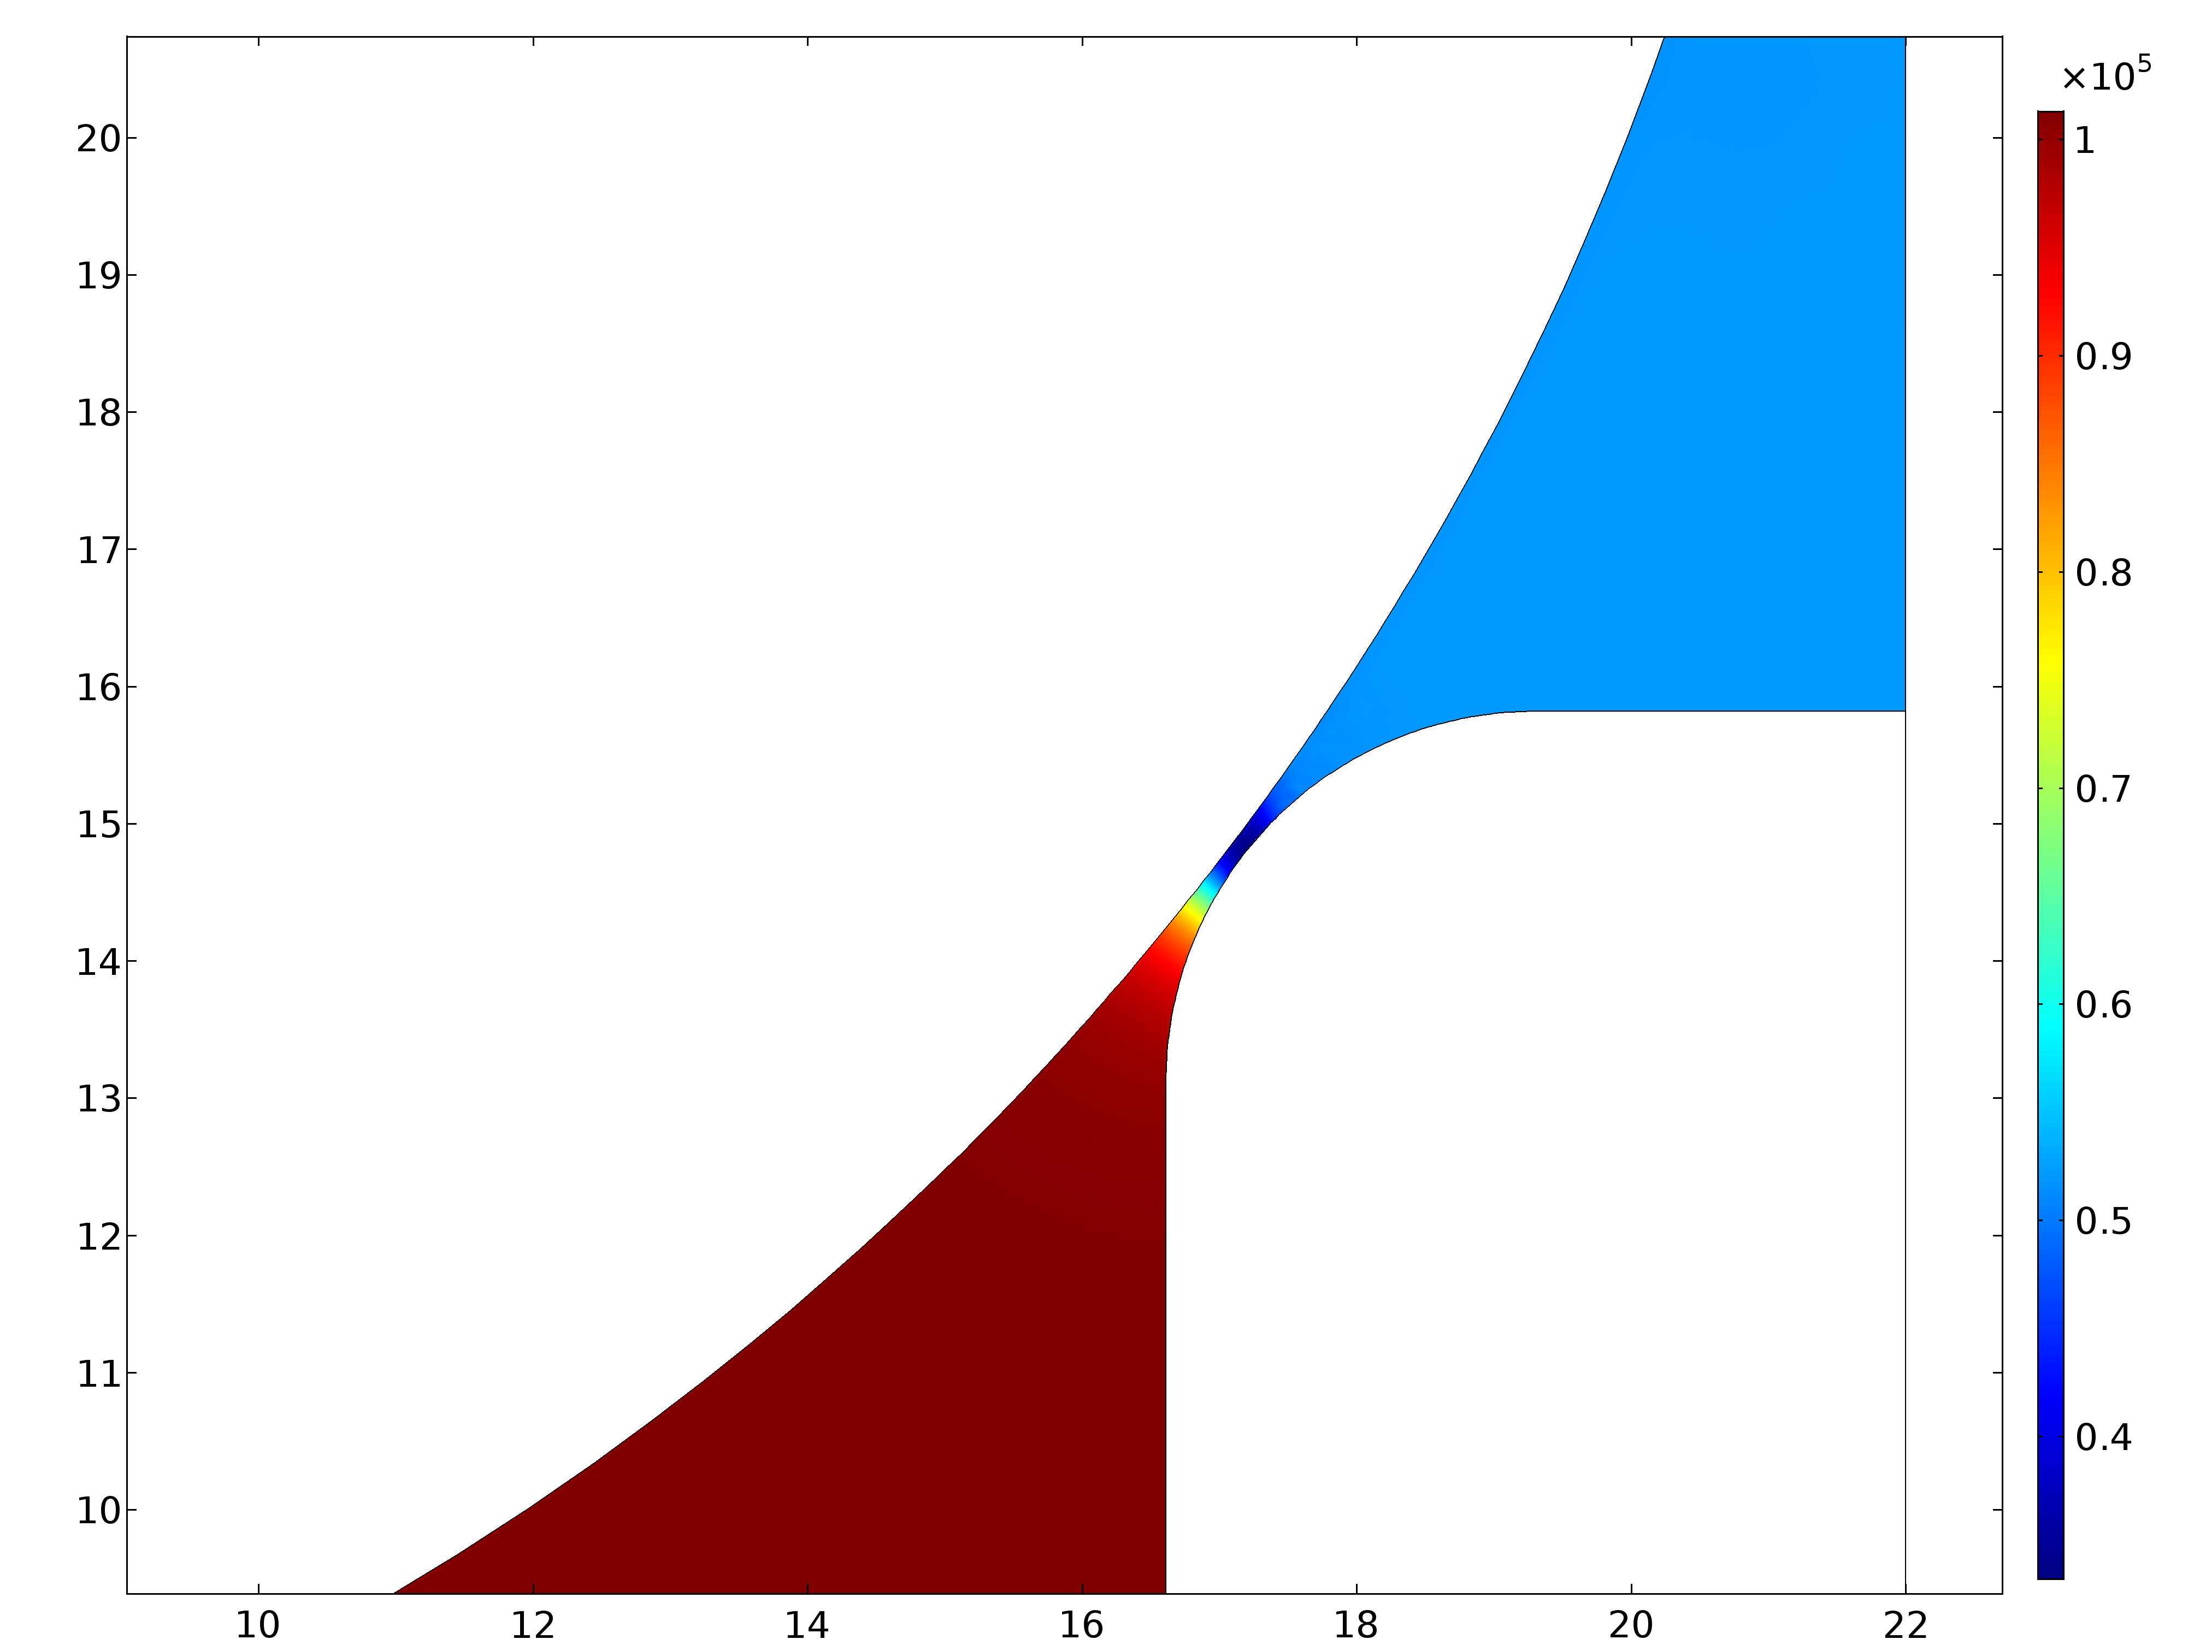





fixed Narrow gap simulations
$$P_{inlet}$$
Ball
$$P_{gap}$$
$$P_{outlet}$$
Gap
Pressure along the gap (Gap = 0.15mm, Plunger Velocity = 0.12m/s)
Seat
gap width [a.u.]
Micro-bubbles?
Pressure field (Gap = 0.15mm, Plunger Velocity = 0.12m/s)
plunger velocity [a.u.]

Slide 37
Parametric study of critical plunger speed
Constant flow rate BC
A constant flow rate was imposed
Simulation was carried out to find the final position of the ball starting from an almost closed valve
Critical plunger speeds (boundary between partially opening and fully opening) for various ball densities were computed.
Actual pump card data
Drag

Slide 38

Seat failure via impact?
Is Seat Failure via Impact Possible?
Depends on the Co-content (~9-14wt%) and the grain size of the microstructure (~1µm = “fine”)
For “low” impact velocity (~0.7 m/s) ➔ unlikely
For “high” impact velocity (~1.3 m/s) ➔ possible
14wt% Co ➔ transverse rupture strength ~3 GPa ➔ ductile failure
14wt% Co and fine microstructure ➔ compressive strength ~4.5 GPa ➔ brittle failure

Slide 39
The upshot
Can open/closed states of valves be self-consistently reproduced based on plunger kinematics? ➔ yes
Can mid-cycle valve closure occur? ➔ yes, if the plunger velocity drops below a critical value and the ball is too heavy
Can the associated pressure drop in the gap be enough to cause micro gas bubbles to form and collapse, causing damage outside of the ball/seat contact reagion? ➔ yes, this seems likely
Is WC seat failure by pure mechanical impact possible? ➔ For impact velocities >1 m/s: possible ➔ this can be kept to a minimum by keeping the Co binder content between 8–14wt% and the grain size between 1–10 µm

Slide 40
Possible studies and extensions
Possible studies using the current model
Simulate 3-4 commercially available cage geometries ➔ differences?
Suppression of mid-cycle valve closure ➔ longer service life?
Higher pump efficiency?
Better valve opening/closing / more stable valve behaviour?
Calculate minimum plunger speed for several pump diameters
Possible extensions to the model
Simplified pump model
Use detailed simulation results of the valves to build a lumped force model of the pump
Multi-phase flow
Include effects of multi-phase fluid (e.g., water and oil)

Slide 41

Sucker-rod pump operation (ideal conditions)
Ideal pump-card
COMSOL Model
Schematic of down-hole pump

Slide 42


Ball dynamics (Net force)
Actual
Net force = (Drag due to fluid flow) – (weight of the ball)
Ideal

Slide 43
Ball dynamics (Net force)
Actual
Fluctuations in net force on the SV ball for actual pump card data due to fluctuations in plunger speed; whereas steady force on the ball in the ideal case
Zoom plot shows that net force goes below zero (indicating downward force on the ball) in regions where ideally it should be steady
These regions of negative net force can lead to mid-cycle valve closure!
Ideal

Slide 44
Valve opening
TV
SV
Actual
Mid-cycle valve closure is indeed observed!
Ideal

Slide 45


Valve opening
TV
SV
The valve closure correlates to a fluctuation in plunger speed
Actual
Ideal

Slide 46

Gap pressure
TV
SV
Real
As expected, a mid-cycle valve closure results in a sudden pressure drop in the gap (second dip in the zoomed plot)
The first dip is due to the valve opening process, and is also present in the ideal case
This presents danger of gas/vapour formation
Ideal

