Slide 1



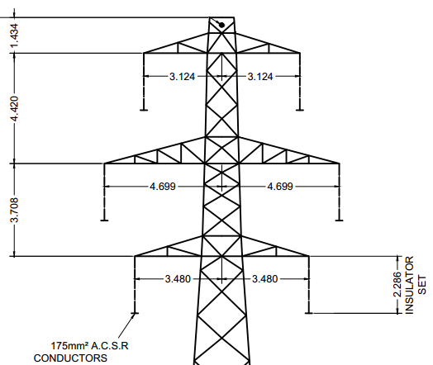
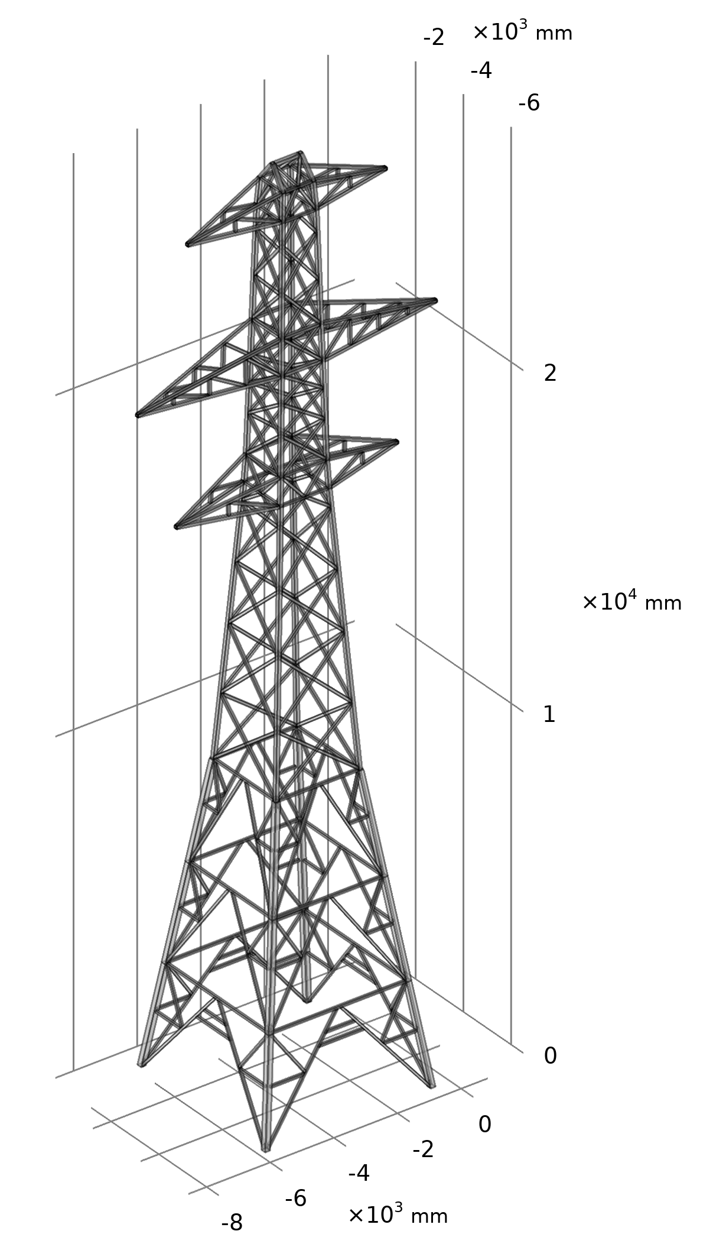
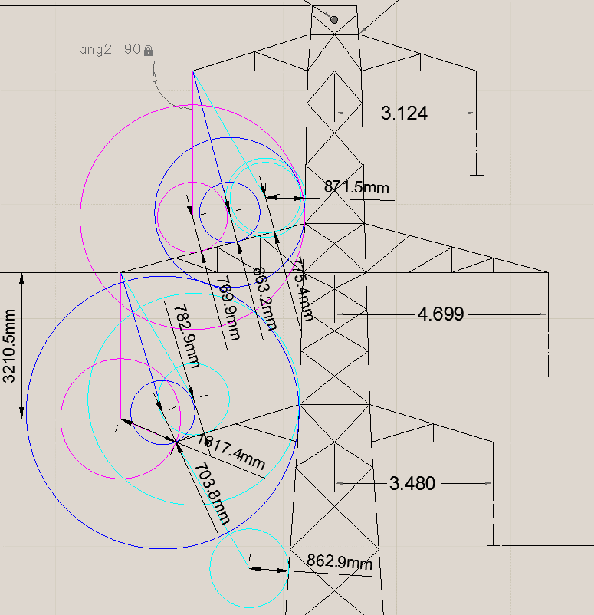
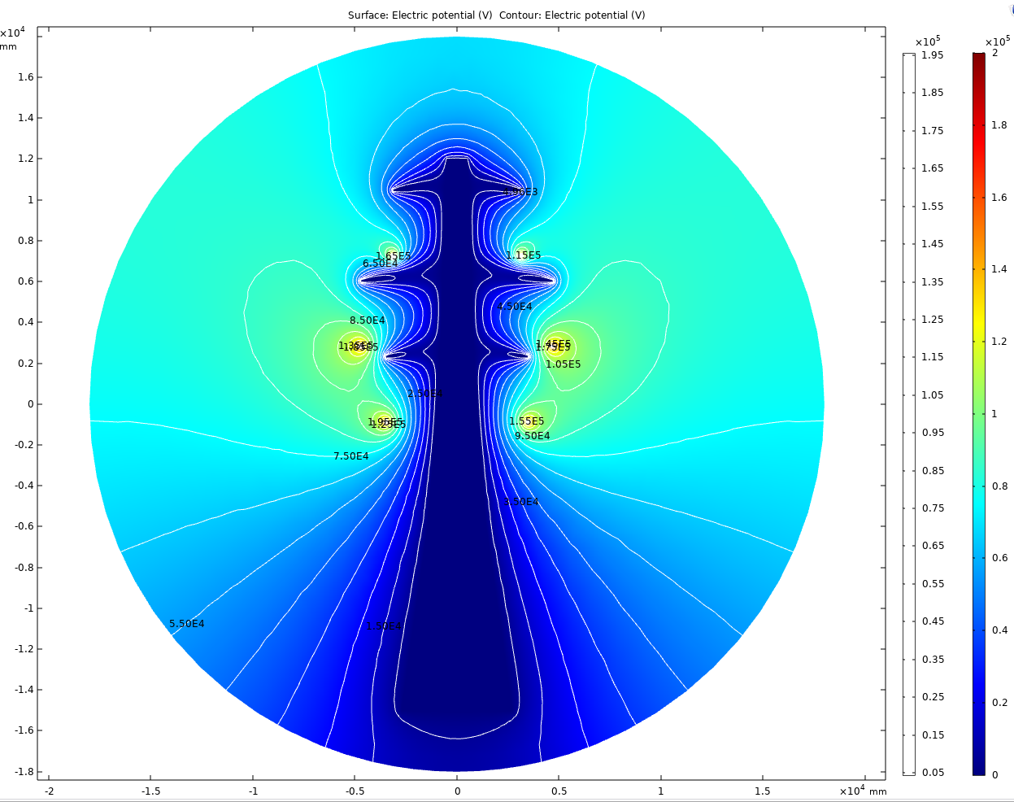
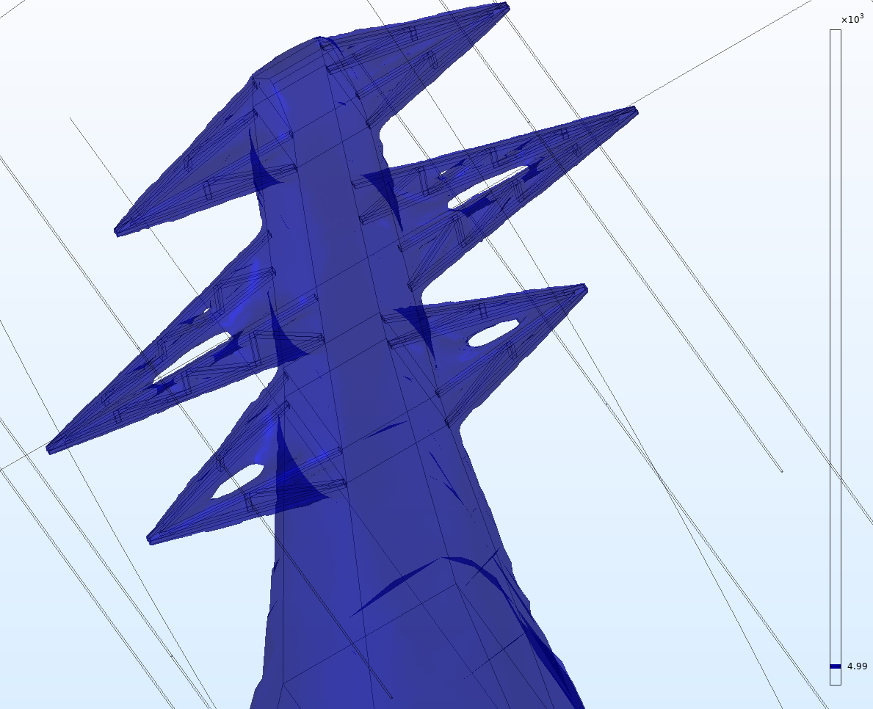
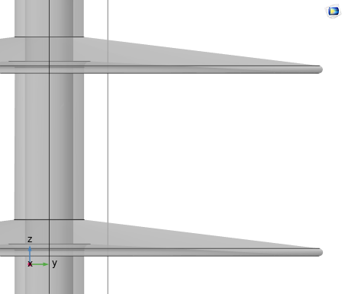
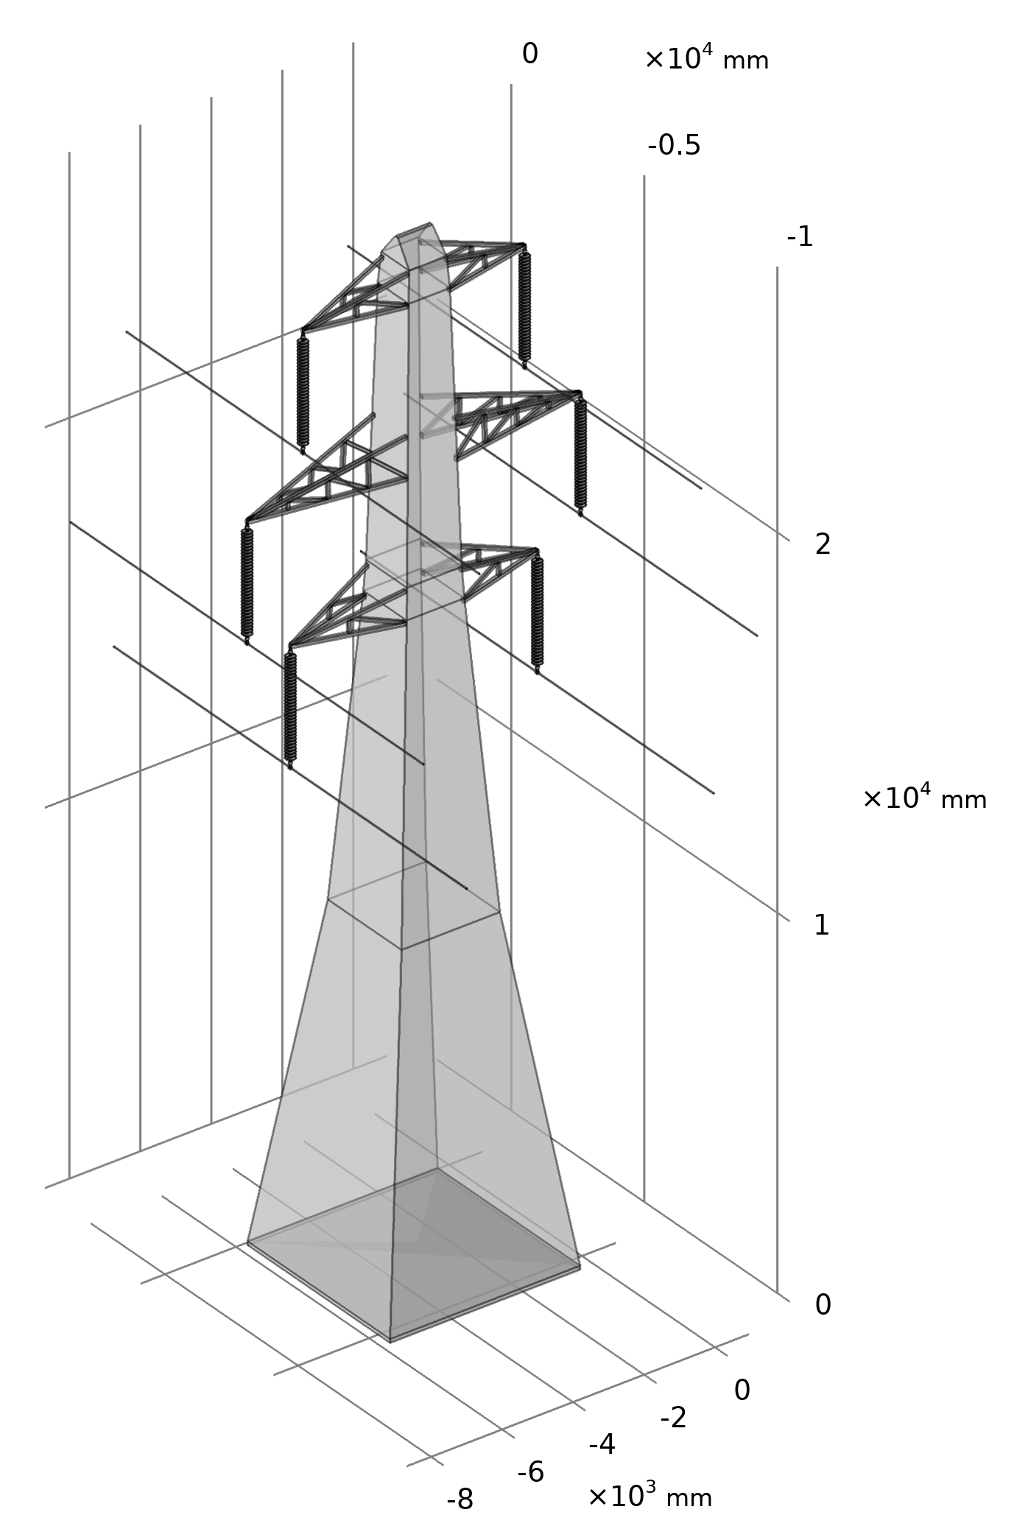
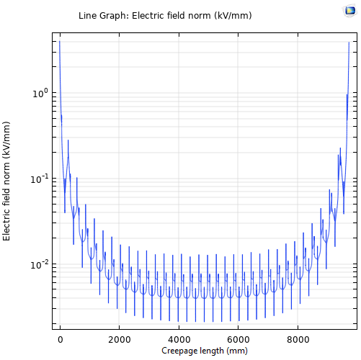
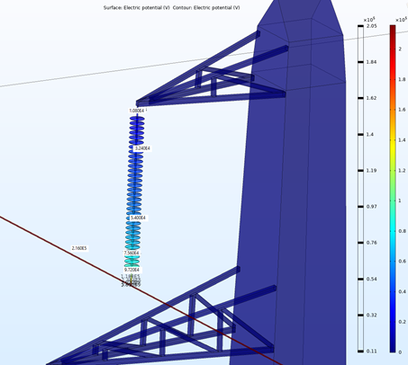
Voltage Gradient Study of HVDC Overhead Line Suspension Insulation
D. Pinzan¹, D. Clark¹, M.E.A. Slama¹, A.M. Haddad¹
1. Advanced High Voltage Engineering Research Centre, Cardiff University, United Kingdom
INRODUCTION: The electricity consumption has traditionally been increasing. The electrification of transportation and heating will contribute to continue this trend. The need to increase the power system transmission capability is clear. To do so, one of possible solutions is to convert an existing line for HVDC use. This poster and its paper aim is to optimize the HVDC Line Model trade-off between computational speed and accuracy, and to assess the corona performance of a newly designed insulator.
RESULTS: The Results are presented in the same schematic order of Figure 1. The arrows show what is the necessary input to produce a specific Result.
A.
B.
C.
D.
β.
γ.
δ.
ε.
A.
2D Tower Drawing
B.
Clearance Optimisation
C.
Insulation Design
D.
Voltage Gradient along Creepage
β.
3D Tower Drawing
γ.
Equipotential Surface Study on Metallic Cross Arm
δ.
HVDC Insulated and Simplified Line
ε.
Voltage Gradient on 3D Insulator Surface
METHOD: the comprehensive Flow Chart is provided.
22
62.5
42
32
7°
3°
Figure 2. All the Results deriving from the Flow Chart of Figure 1
CONCLUSIONS: By following the Flow Chart of Figure 1, it was possible to simplify the SSE L7 Tower Model. The trade-off between accuracy of results and computational speed has been optimised and the Voltage Gradient distribution along the insulator Creepage Length has been obtained. It is possible to conclude that the implementation of corona rings is needed for this newly designed insulator. Therefore, further studies are needed to assess the efficacy of such application. The simulation of insulation shall include the modelling of the wet-polluted layer.
This paper also opens the way to assess the feasibility of alternative insulation arrangements for this and other towers.
Figure 1. Comprehensive Flow Chart for the realization and simplification of the Model
LINE MODELING: The Line has been realized and simplified with the AC/DC Module. The CAD Import Module has facilitated the 3D modeling of the tower. The insulator axisymmetry has been exploited to maximise computational speed.
REFERENCES:
P. Lundberg, B. Jacobson, K. Vinothkumar, K. Gaurav-Kumar, M.S. Shanthakumar, A. Kumar, “Convert from AC to HVDC for higher power transmission,” ABB, Ludvika, Sweden, 2018
K. N. I. Mbangula, “An Investigation into the Impact of HVDC Schemes on ESKOM HV Network Transient Stability,” University of Kwazulu-Natal, 2015
P. Sidenvall et al., “Methodology of Modern E-Field Calculations - Case Study for Insulated Cross-Arm,” presented at the IEEE Conf. on El. Ins. and Diel. Phen., 2013
D. Pinzan et al., “Insulation Solutions for HVAC to HVDC Conversion of a High Voltage Transmission Overhead Line: the L7 Tower Case Study,” presented at the International Symposium on High Voltage Engineering, Budapest, 2019
Excerpt from the Proceedings of the 2019 COMSOL Conference in Cambridge

