Slide 1
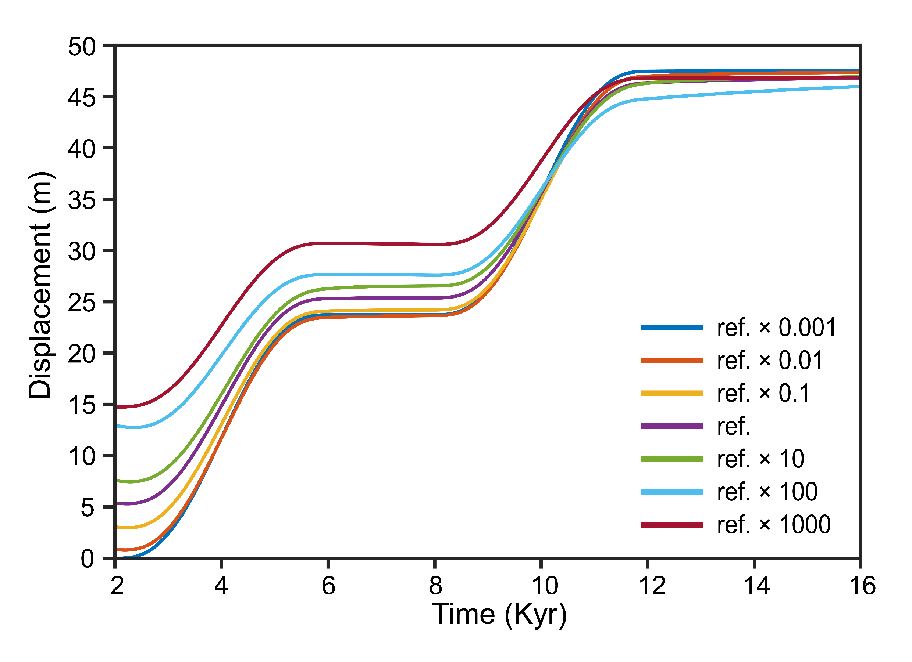
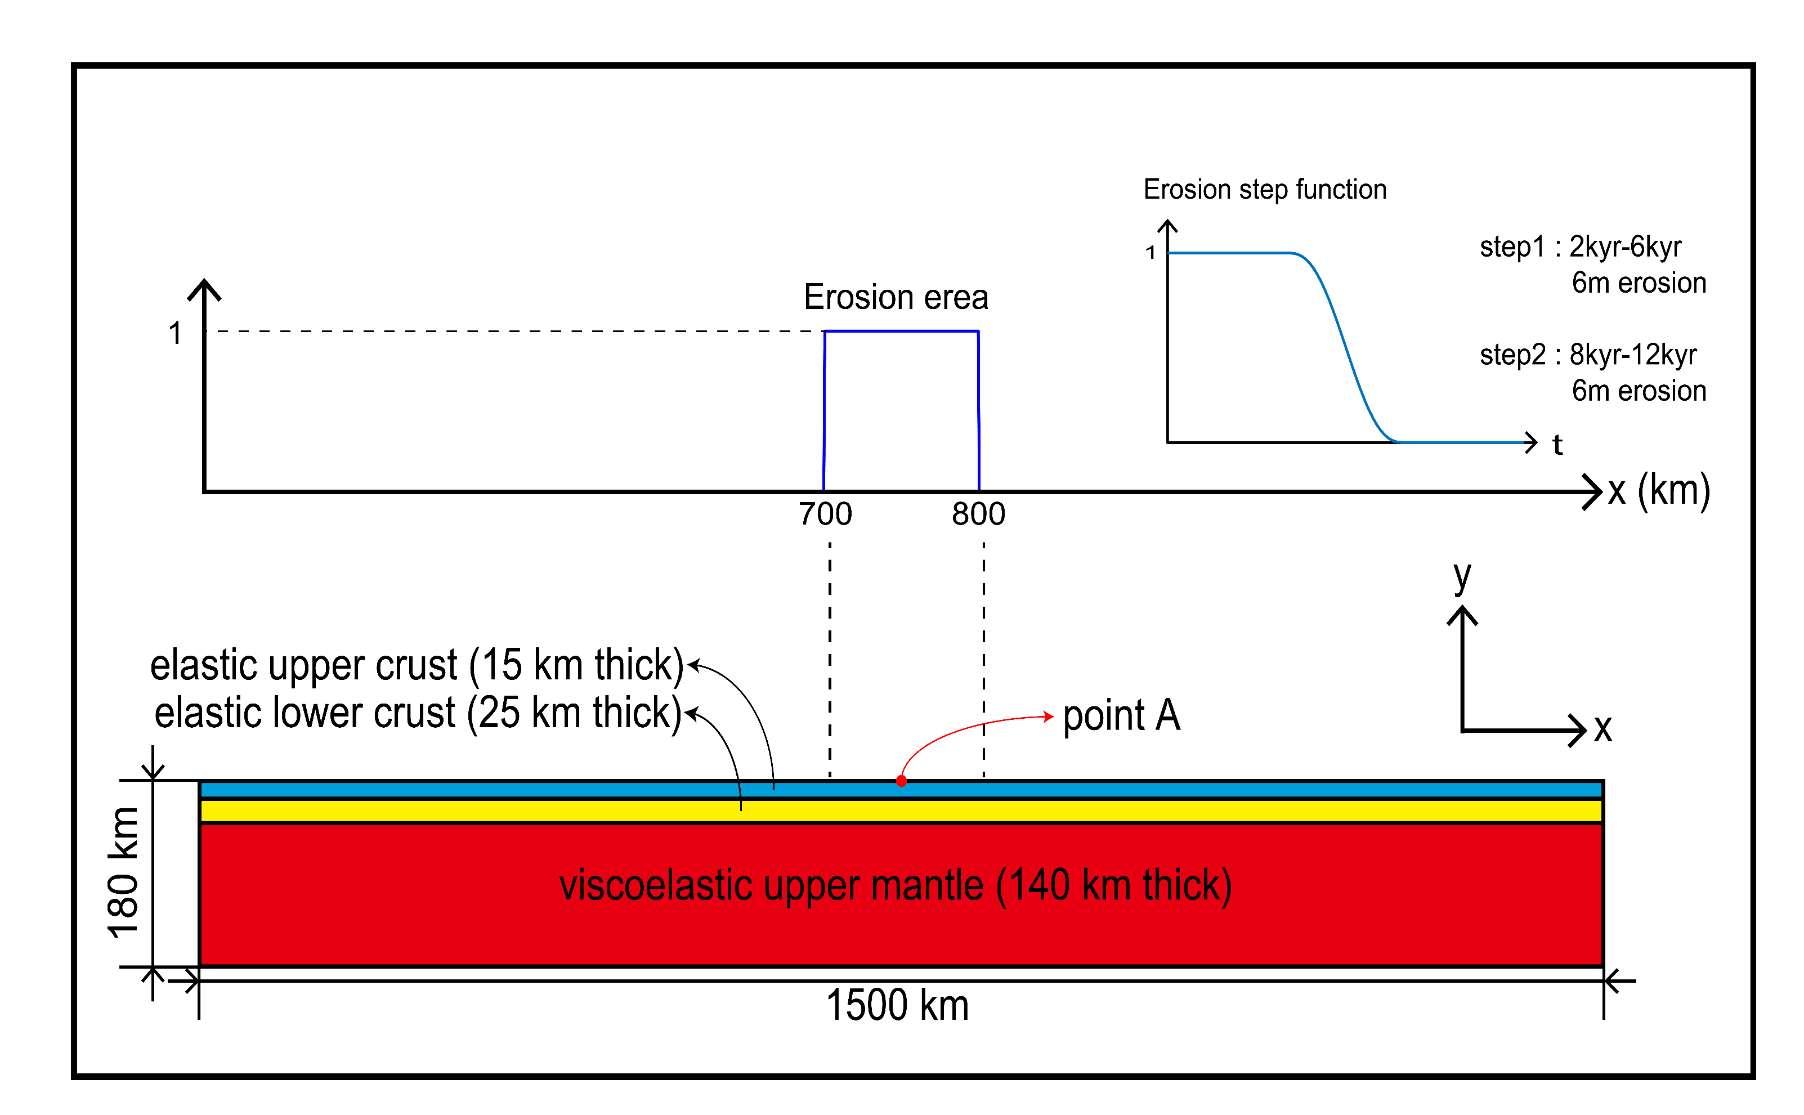
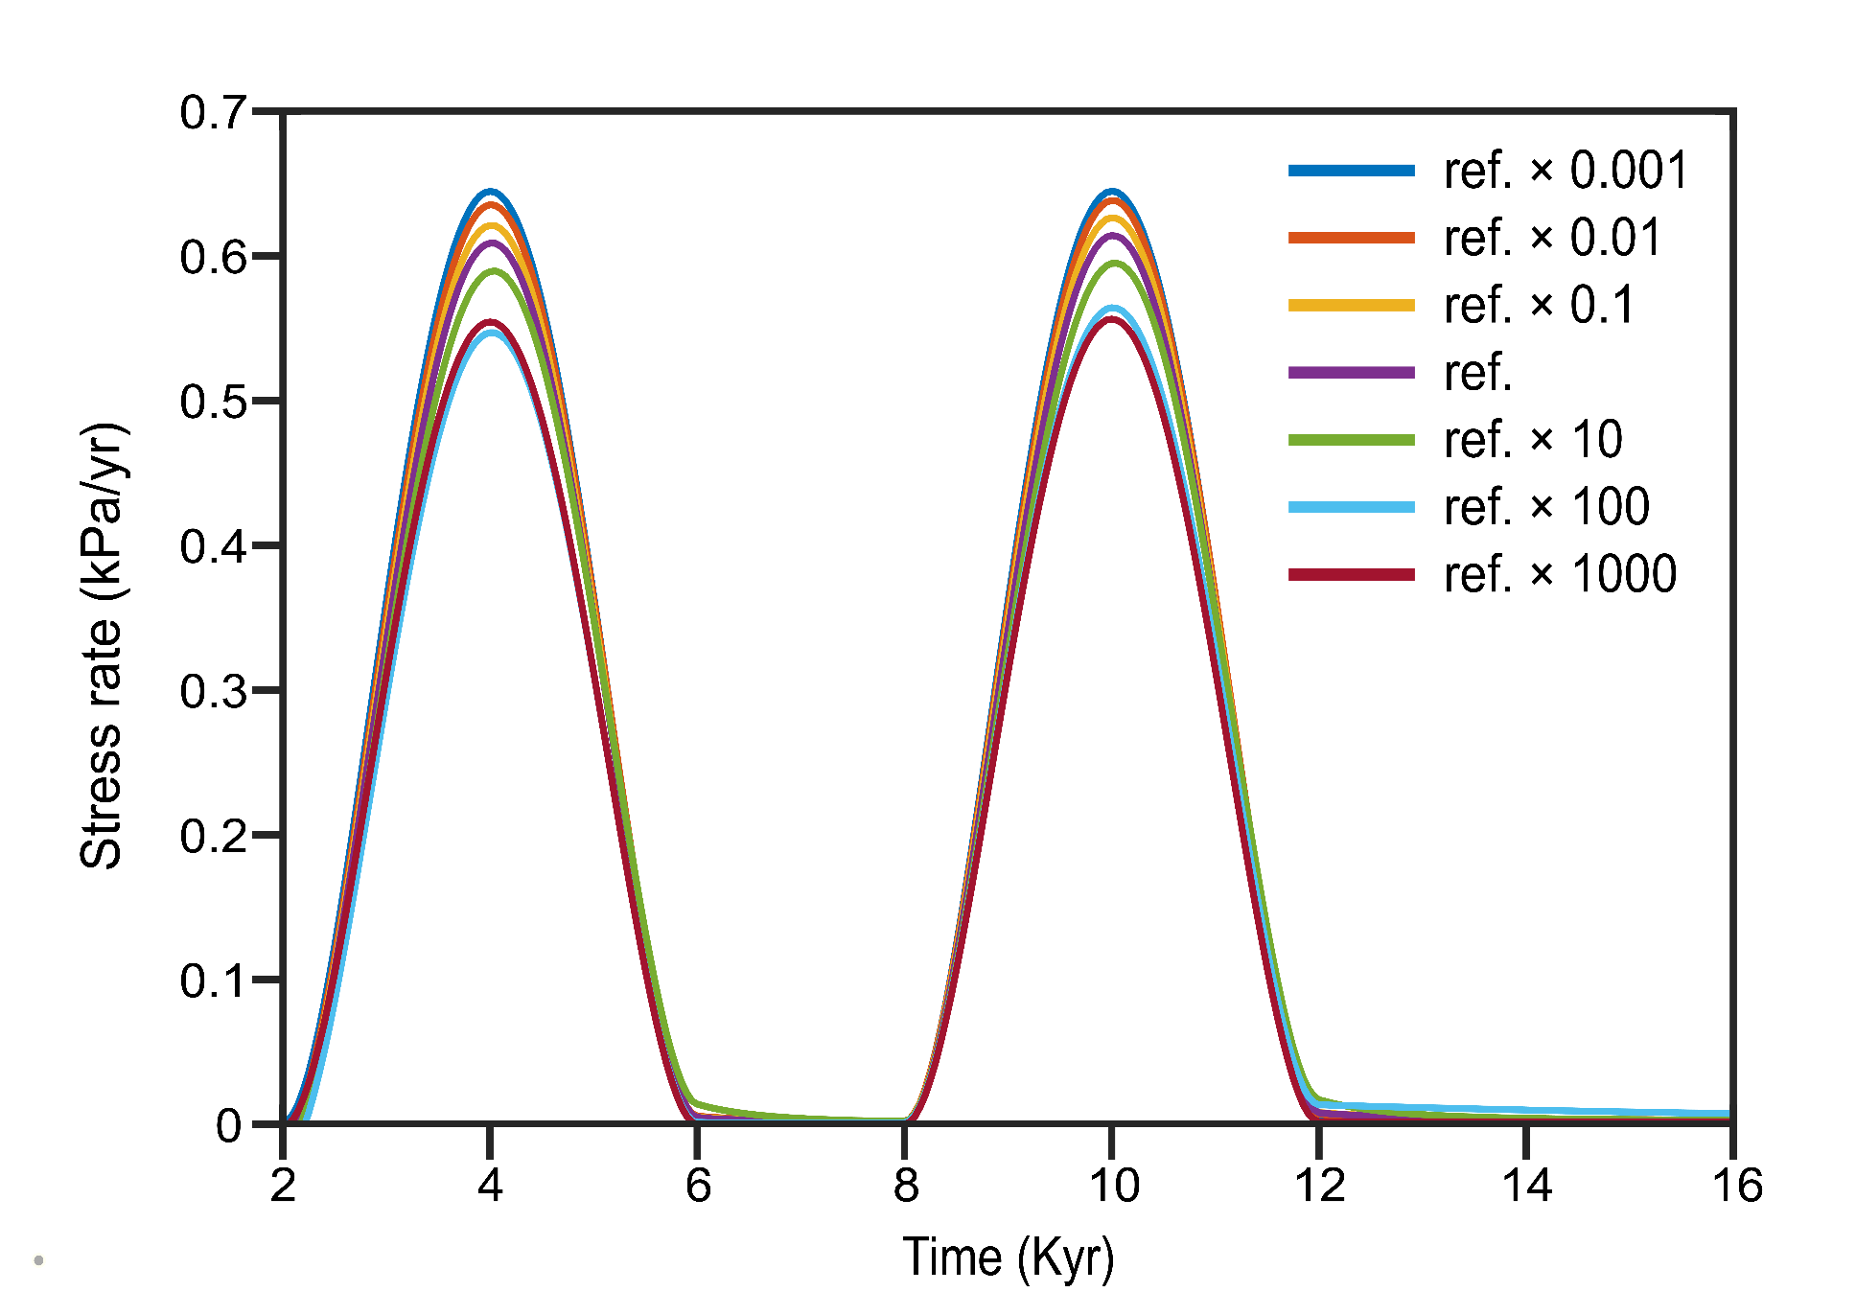
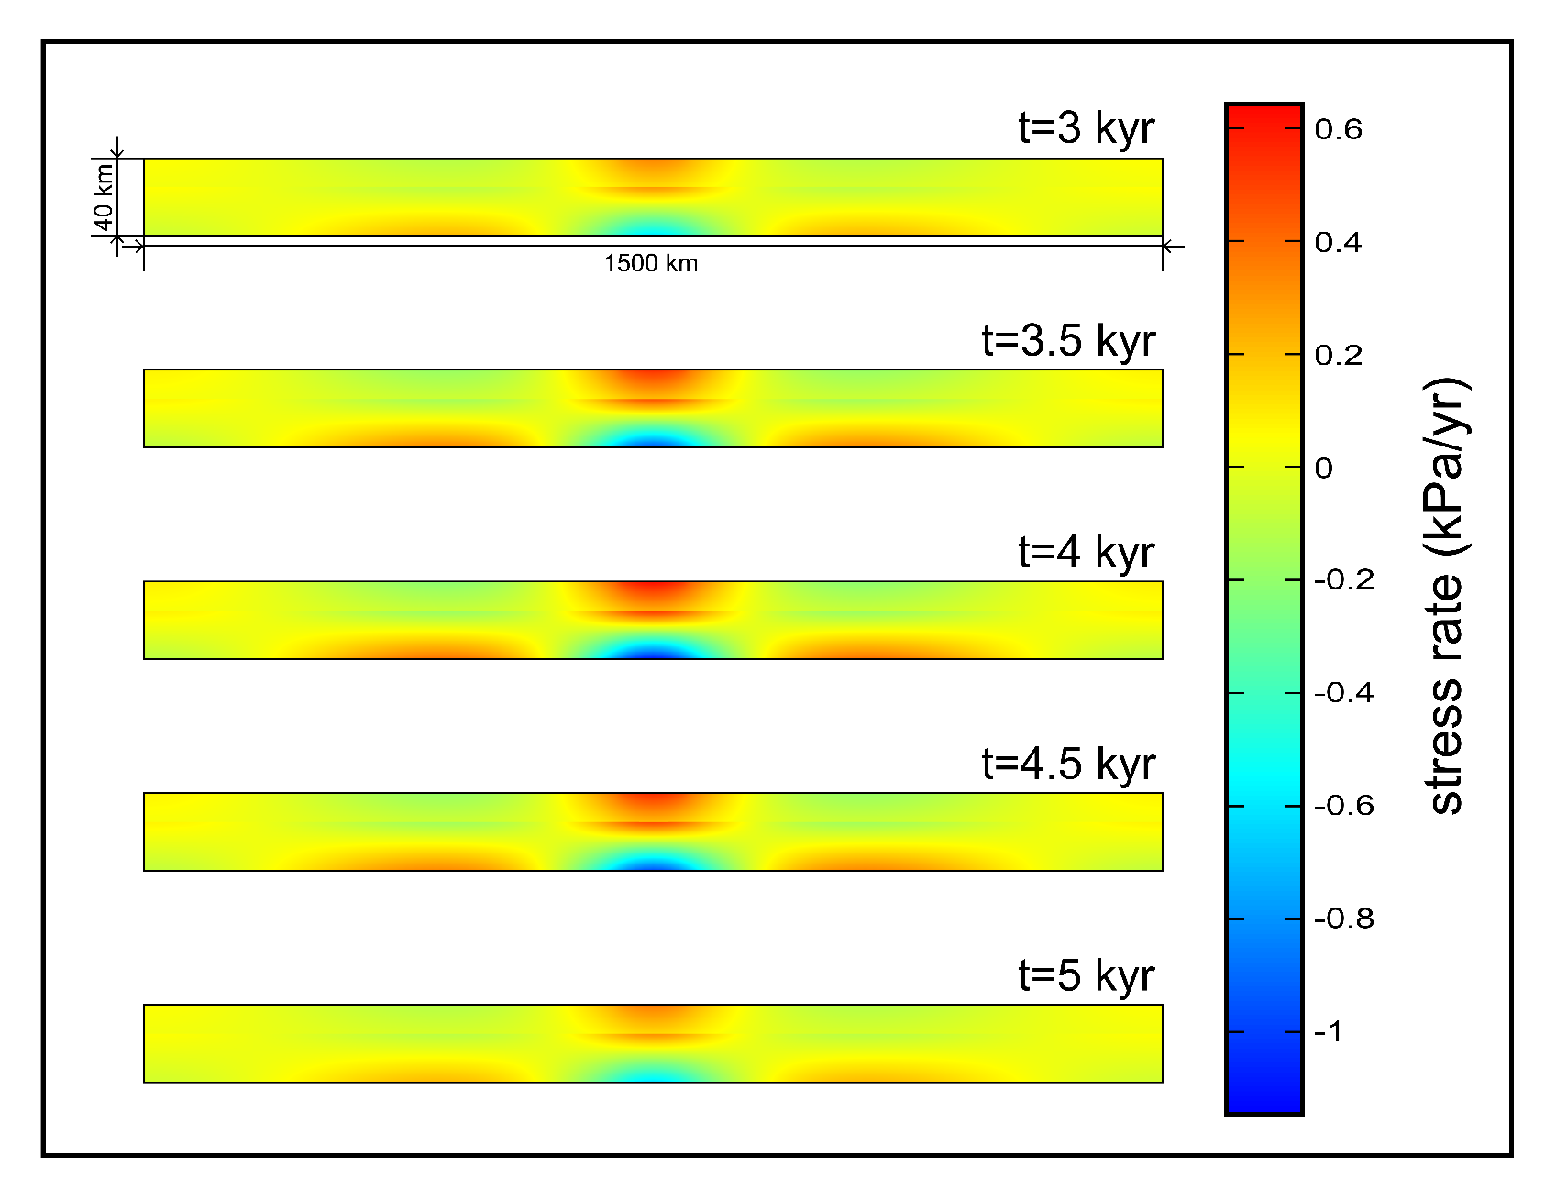
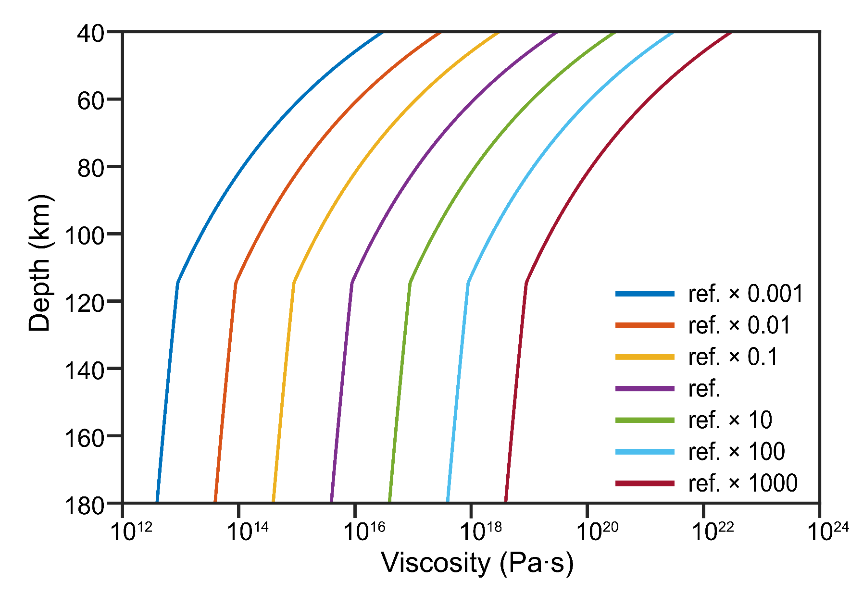
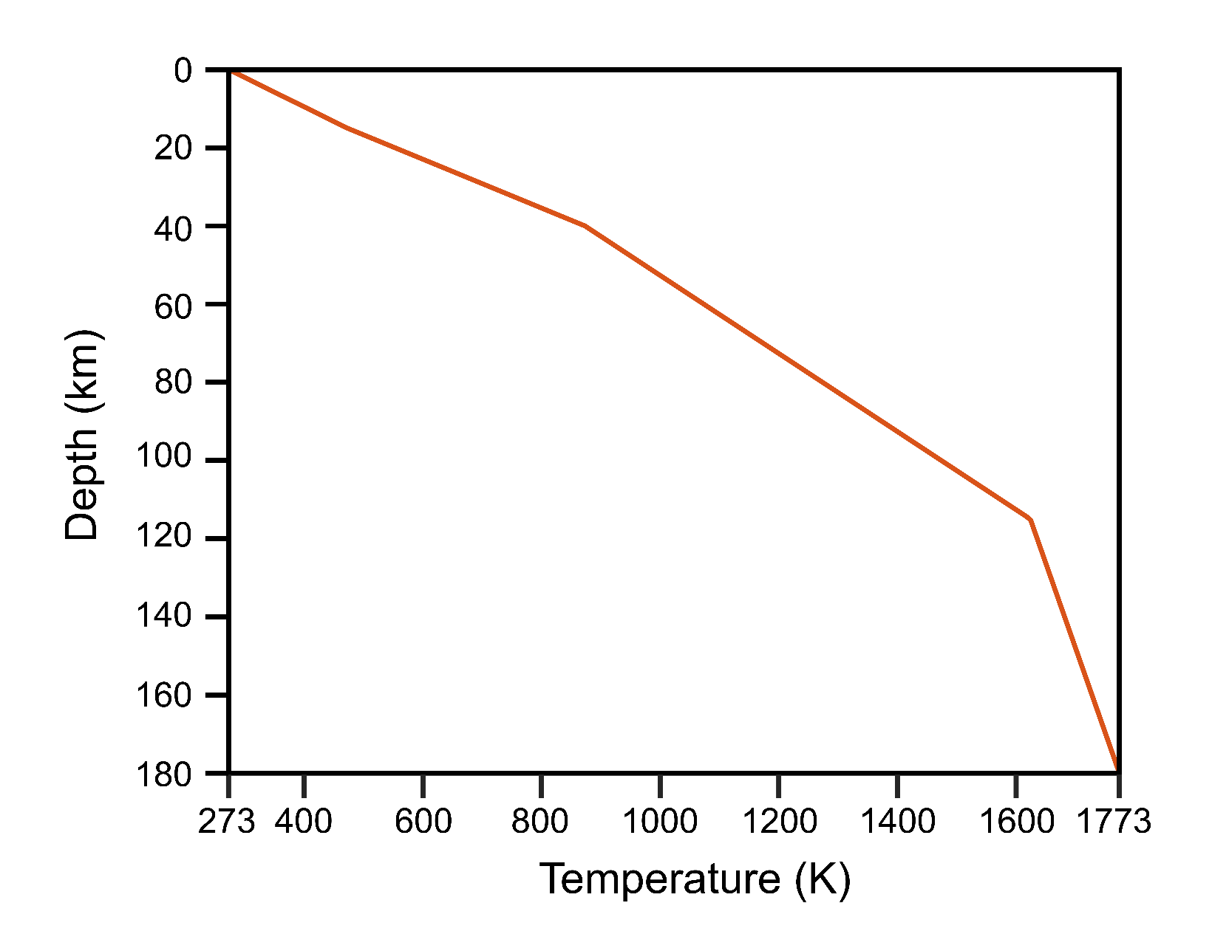
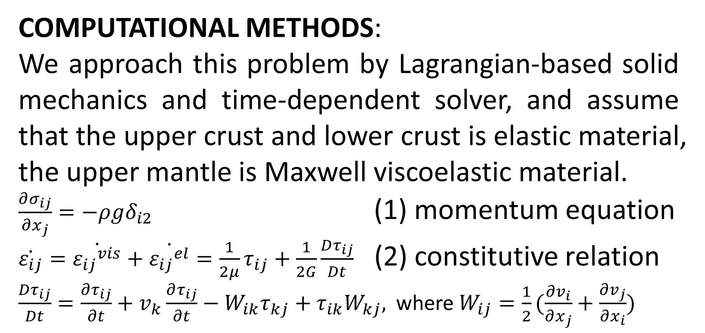
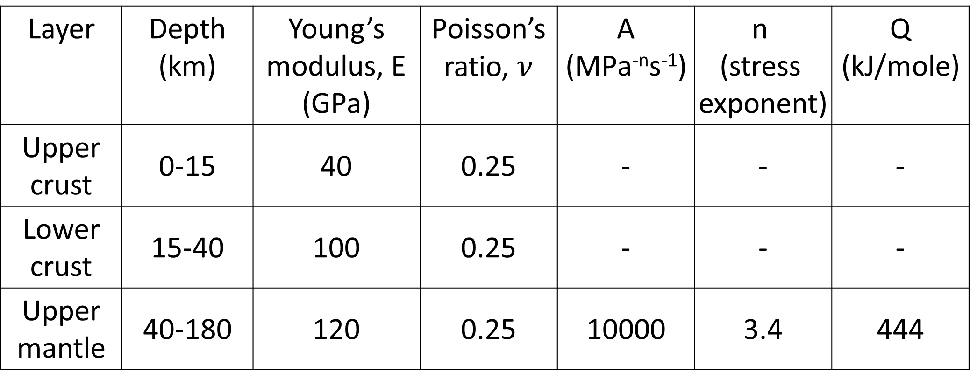
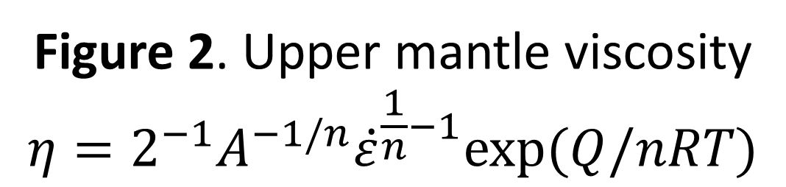
Numerical Simulations of Near-Surface Stress Perturbation Caused by Erosion-Induced Isostatic Rebound of Viscoelastic Lithosphere
Hyeok-Jae Lee¹, Byung-Dal So¹
1. Department of Geophysics, Kangwon National University, Chuncheon, Gangwon-do 24341, South Korea
INTRODUCTION: In plate tectonics, the relative motion between plates at a plate boundary generates tectonic stress, and most earthquakes occur at these plate boundaries. However, only a small proportion of earthquakes occur in plate interiors, which are called intraplate earthquakes. In this study, we simulated the stress perturbation at the surface caused by erosion-induced isostatic rebound among the mechanisms by which intraplate earthquake occurs.
Layer | Depth (km) | Young’s modulus, E (GPa) | Poisson’s ratio, $ν$ | A (MPa^{-n}s⁻¹) | n (stress exponent) | Q (kJ/mole)
Upper crust | 0-15 | 40 | 0.25 | - | - | -
Lower crust | 15-40 | 100 | 0.25 | - | - | -
Upper mantle | 40-180 | 120 | 0.25 | 10000 | 3.4 | 444
Table 2. Elastic and power-law parameters used in the models
RESULTS: Our model showed that the mantle viscosity affects the magnitude of the displacement and stress rate at the surface. For instance, the models with 0.001 and 1,000 times of the reference case exhibit displacement ~47.5 m (~0.64 kPa/yr) and ~32.1 m (~0.55 kPa/yr), respectively.
COMPUTATIONAL METHODS:
We approach this problem by Lagrangian-based solid mechanics and time-dependent solver, and assume that the upper crust and lower crust is elastic material, the upper mantle is Maxwell viscoelastic material.
$\frac{∂σ_{ij}}{∂x_{j}}=−ρgδ_{i2}$ (1) momentum equation
$\dot{ε_{ij}}=\dot{{ε_{ij}}^{vis}}+\dot{{ε_{ij}}^{el}}=\frac{1}{2μ}τ_{ij}+\frac{1}{2G}\frac{Dτ_{ij}}{Dt}$ (2) constitutive relation
$\frac{Dτ_{ij}}{Dt}=\frac{∂τ_{ij}}{∂t}+v_{k}\frac{∂τ_{ij}}{∂t}−W_{ik}τ_{kj}+τ_{ik}W_{kj},$where $W_{ij}=\frac{1}{2}(\frac{∂v_{i}}{∂x_{j}}+\frac{∂v_{j}}{∂x_{i}})$
Table 1. Discriptions of symbols
Figure 4. Vertical displacement at the surface (point A) over time
Figure 5. Horizontal stressing rate at the surface (point A) over time
Figure 6. Horizontal stressing rate at the upper crust and lower crust
CONCLUSIONS: Our results show that the displacement and stress variation rates at the surface are consistent with previous studies, which indicates that stress variations with a small magnitude can be accurately simulated using COMSOL Multiphysics®. Our model has the potential to predict mantle viscosity with geophysical and geodetic observations of surface displacement.
Figure 1. Model set up
ACKNOWLEDGEMENTS: This research was supported by the National Research Foundation of Korea (NRF-2014R1A6A3A04055841)and Ministry of the Interior and Safety as Earthquake Disaster Prevention Human resource development Project.
Figure 2. Upper mantle viscosity $$η=2^{−1}A^{−1/n}{\dot{ε}}^{\frac{1}{n}−1}exp⁡(Q/nRT)$$
Figure 3. Temperature distribution over depth
REFERENCES:
Calais et al., Triggering of New Madrid seismicity by late-Pleistocene erosion., Nature, 466, 608-611 (2010)
Wu and Paul, Can deglaciation trigger earthquakes in N. America?., Geophysical Research Letters, 27, 1323-1326, (2000)
Freed, Earthquake triggering by static, dynamic, and postseismic stress transfer., Annu. Rev. Earth Planet. Sci., 33, 335-367 (2005)
Excerpt from the Proceedings of the 2019 COMSOL Conference in Cambridge

