Slide 1
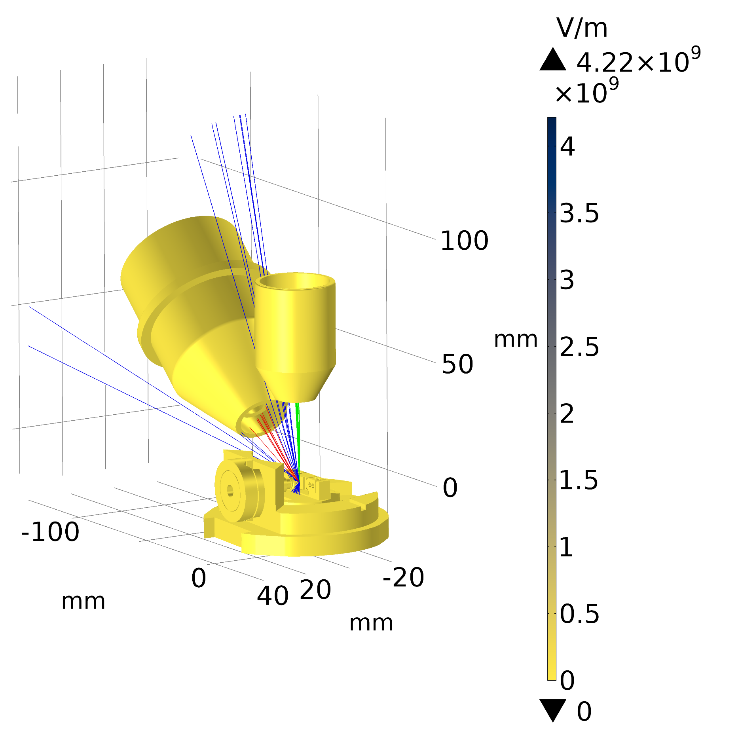
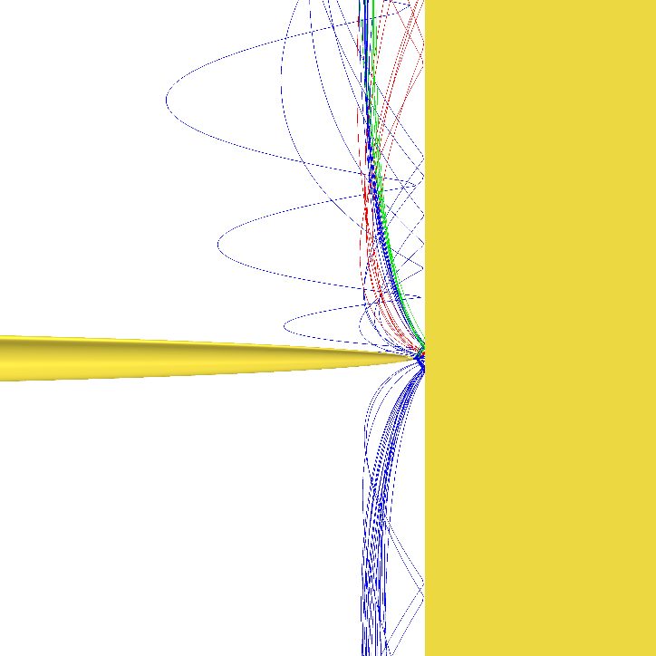
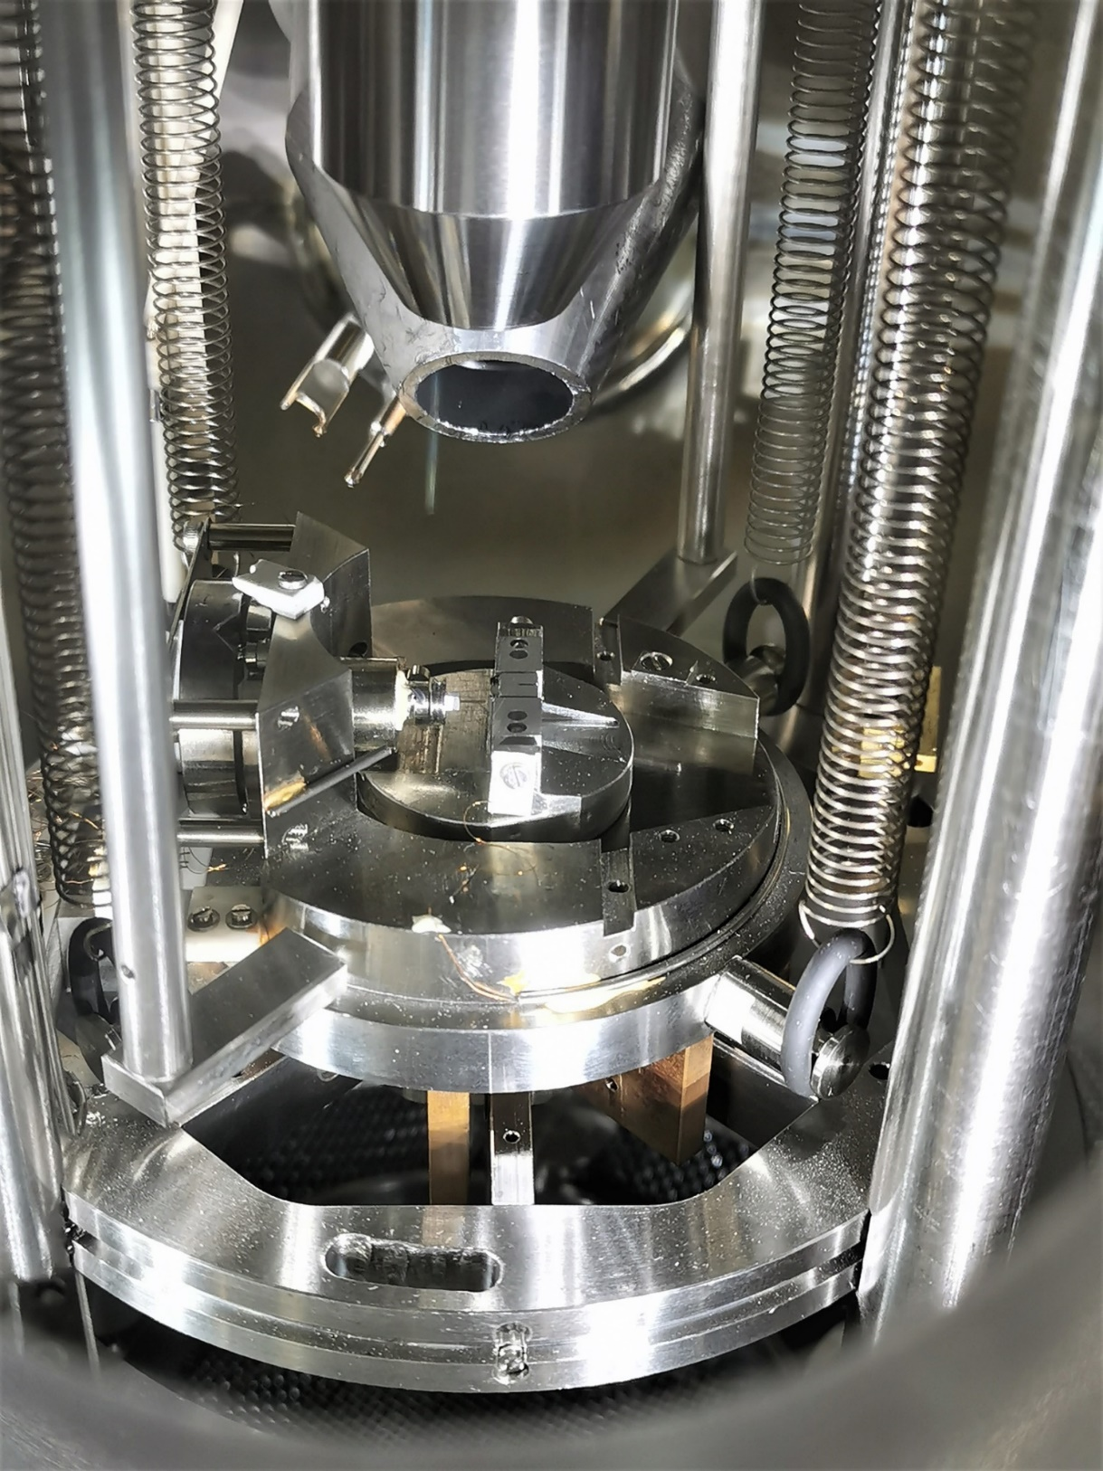
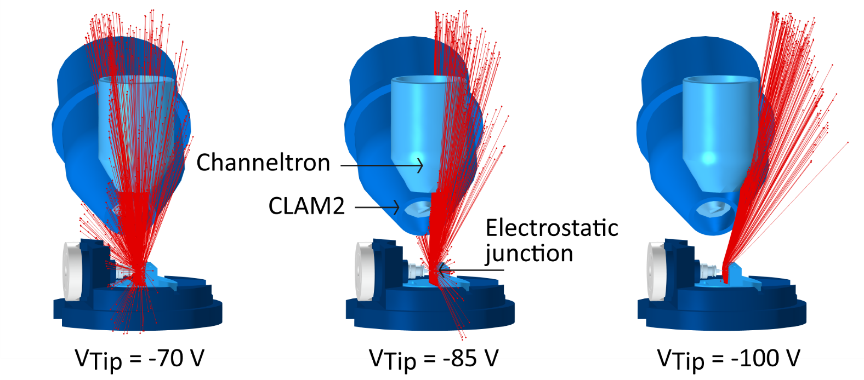
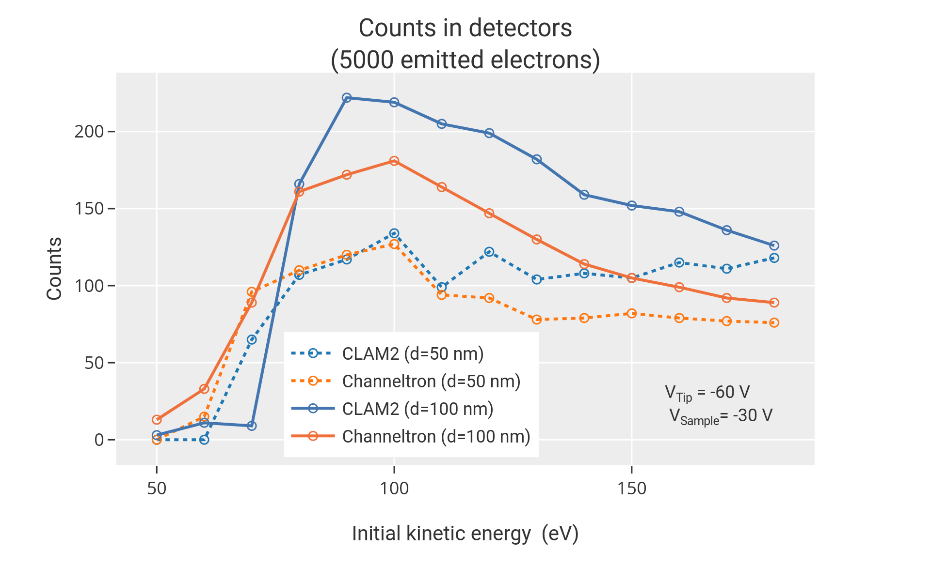
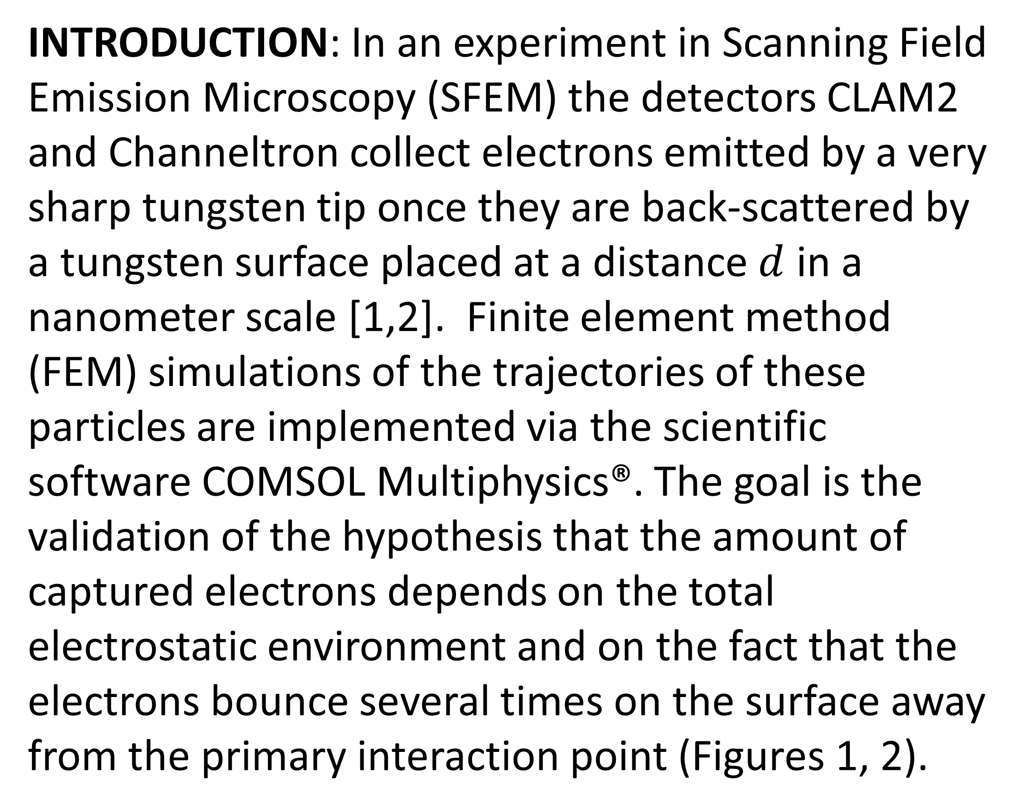
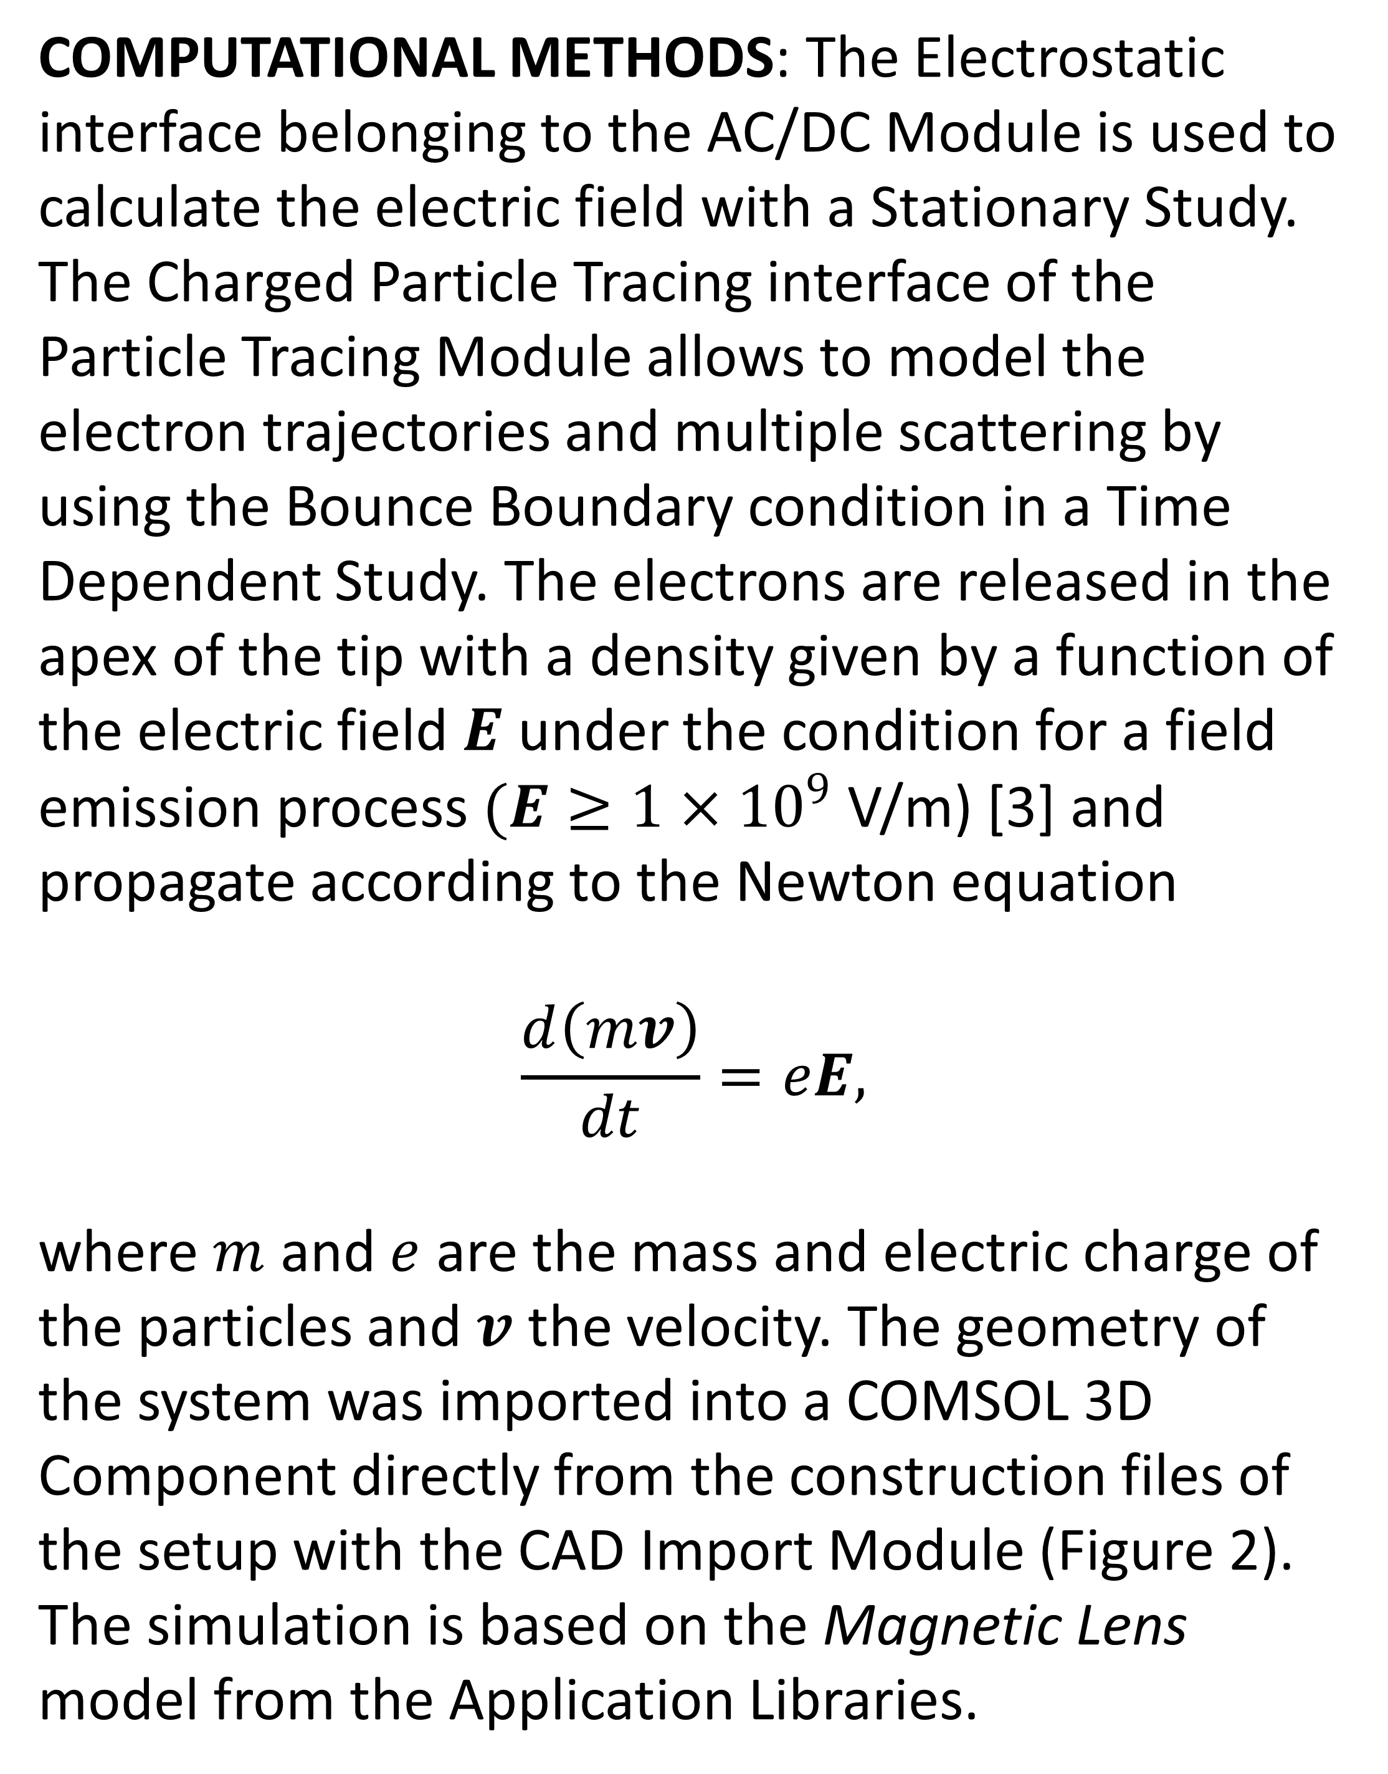
Studies of the Yield of Back-Scattered Electrons
in Scanning Field Emission Microscopy
H. Cabrera¹, G. Bertolini¹ and D. Pescia¹
1. Laboratory for Solid State Physics, ETH Zürich, 8003 Zürich, Switzerland
INTRODUCTION: In an experiment in Scanning Field Emission Microscopy (SFEM) the detectors CLAM2 and Channeltron collect electrons emitted by a very sharp tungsten tip once they are back-scattered by a tungsten surface placed at a distance $d$ in a nanometer scale [1,2]. Finite element method (FEM) simulations of the trajectories of these particles are implemented via the scientific software COMSOL Multiphysics®. The goal is the validation of the hypothesis that the amount of captured electrons depends on the total electrostatic environment and on the fact that the electrons bounce several times on the surface away from the primary interaction point (Figures 1, 2).
Sample
Tip
d = 20 nm
Color scale: Electric field
Figure 2. Simulated graphics of the model and experimental setup
RESULTS: Counters installed in the detectors with the Particle Counter feature provide the yield of back-scattered electrons depending on the electrostatic variables (Figure 3).
Figure 1. Electron trajectories for different tip voltages
COMPUTATIONAL METHODS: The Electrostatic interface belonging to the AC/DC Module is used to calculate the electric field with a Stationary Study. The Charged Particle Tracing interface of the Particle Tracing Module allows to model the electron trajectories and multiple scattering by using the Bounce Boundary condition in a Time Dependent Study. The electrons are released in the apex of the tip with a density given by a function of the electric field $E$ under the condition for a field emission process$(E≥1×{10}^{9}$ V/m) [3] and propagate according to the Newton equation
$$\frac{d\left(mv\right)}{dt}=eE,$$
where $m$ and $e$ are the mass and electric charge of the particles and $v$ the velocity. The geometry of the system was imported into a COMSOL 3D Component directly from the construction files of the setup with the CAD Import Module (Figure 2). The simulation is based on the Magnetic Lens model from the Application Libraries.
Figure 3. Electrons in the CLAM2 and Channeltron
CONCLUSIONS: Some electrons escape from the electrostatic junction parallel to the target surface and reach the detectors. This relevant finding is consistent with the observed resolution of the SFEM technology and requires more research to explain the processes involved in the electron scattering and also in the production of secondary electrons.
REFERENCES:
Young, R., Ward, J. & Scire, F. The Topografiner: An Instrument for Measuring Surface Microtopography. Review of Scientific Instruments 43, 999-1011 (1972)
Zanin, D., De Pietro, L., Peter, Q., Kostanyan, A., Cabrera, H., Vindigni, A., Bähler, Th., Pescia, D. & Ramsperger, U. Thirty per cent contrast in secondary-electron imaging by scanning field-emission microscopy. Proc. R. Soc. A 472 (2016)
Knápek, A., Methods of Preparation and Characterization of Experimental Field-Emission Cathodes, Short Thesis Faculty of Electrical Engineering and Communication, Department of Physics, 16-22 (2013)
Excerpt from the Proceedings of the 2019 COMSOL Conference in Cambridge

