Slide 1


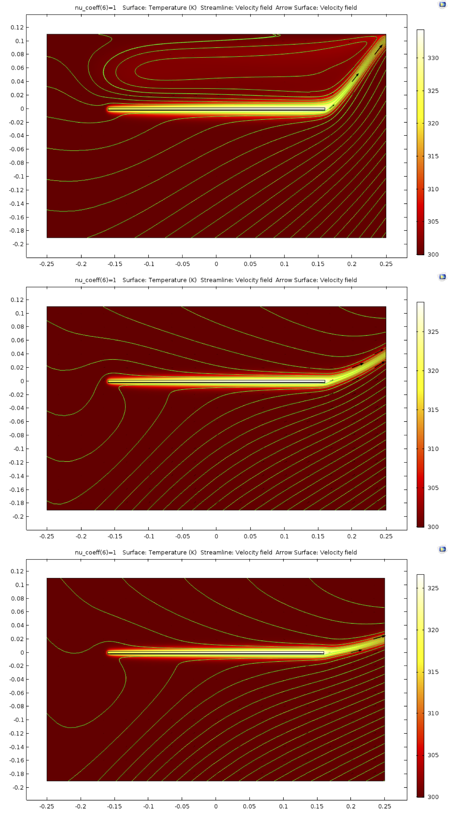
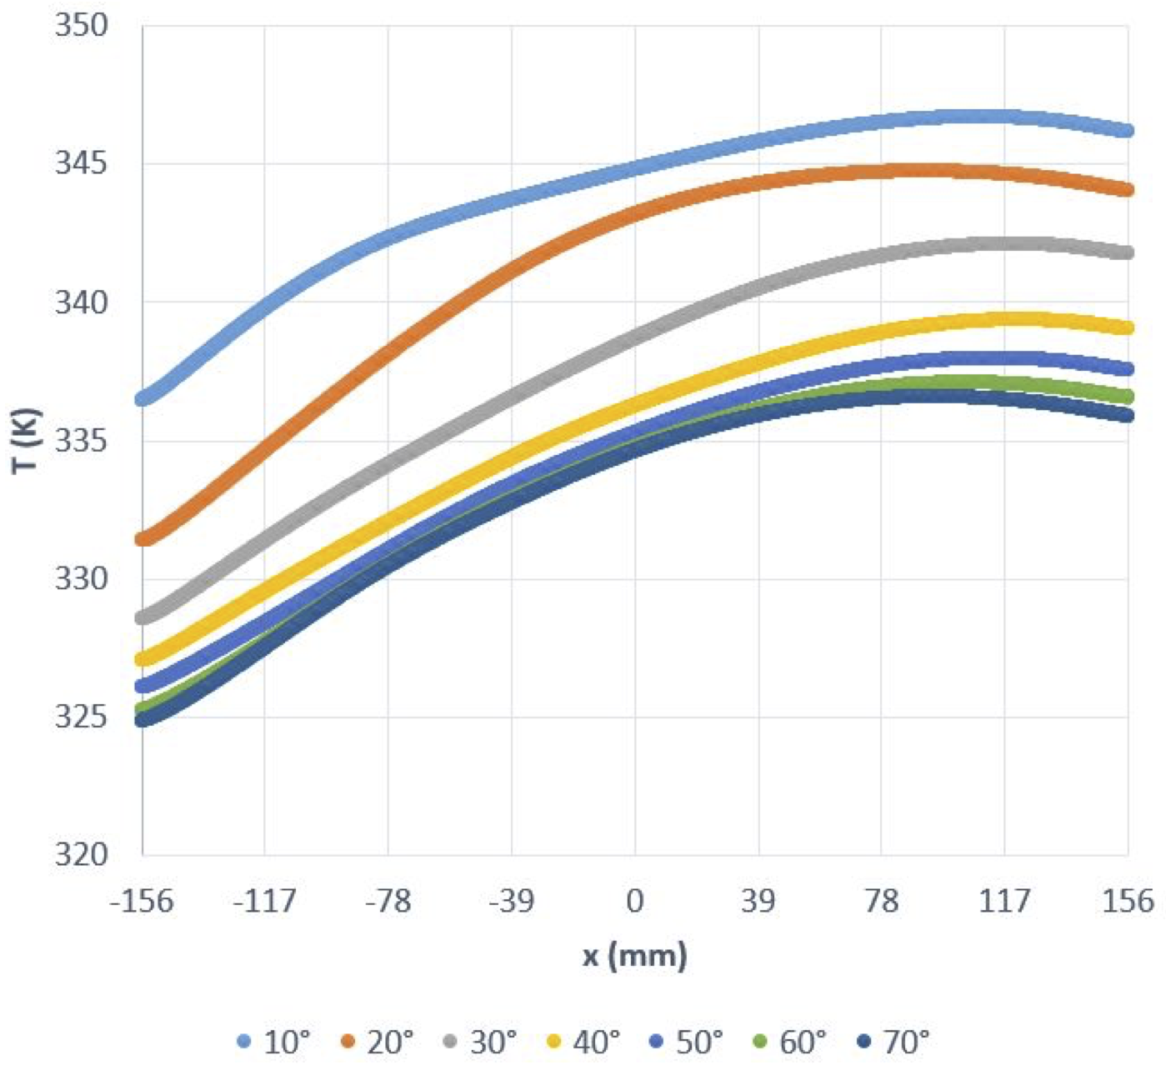
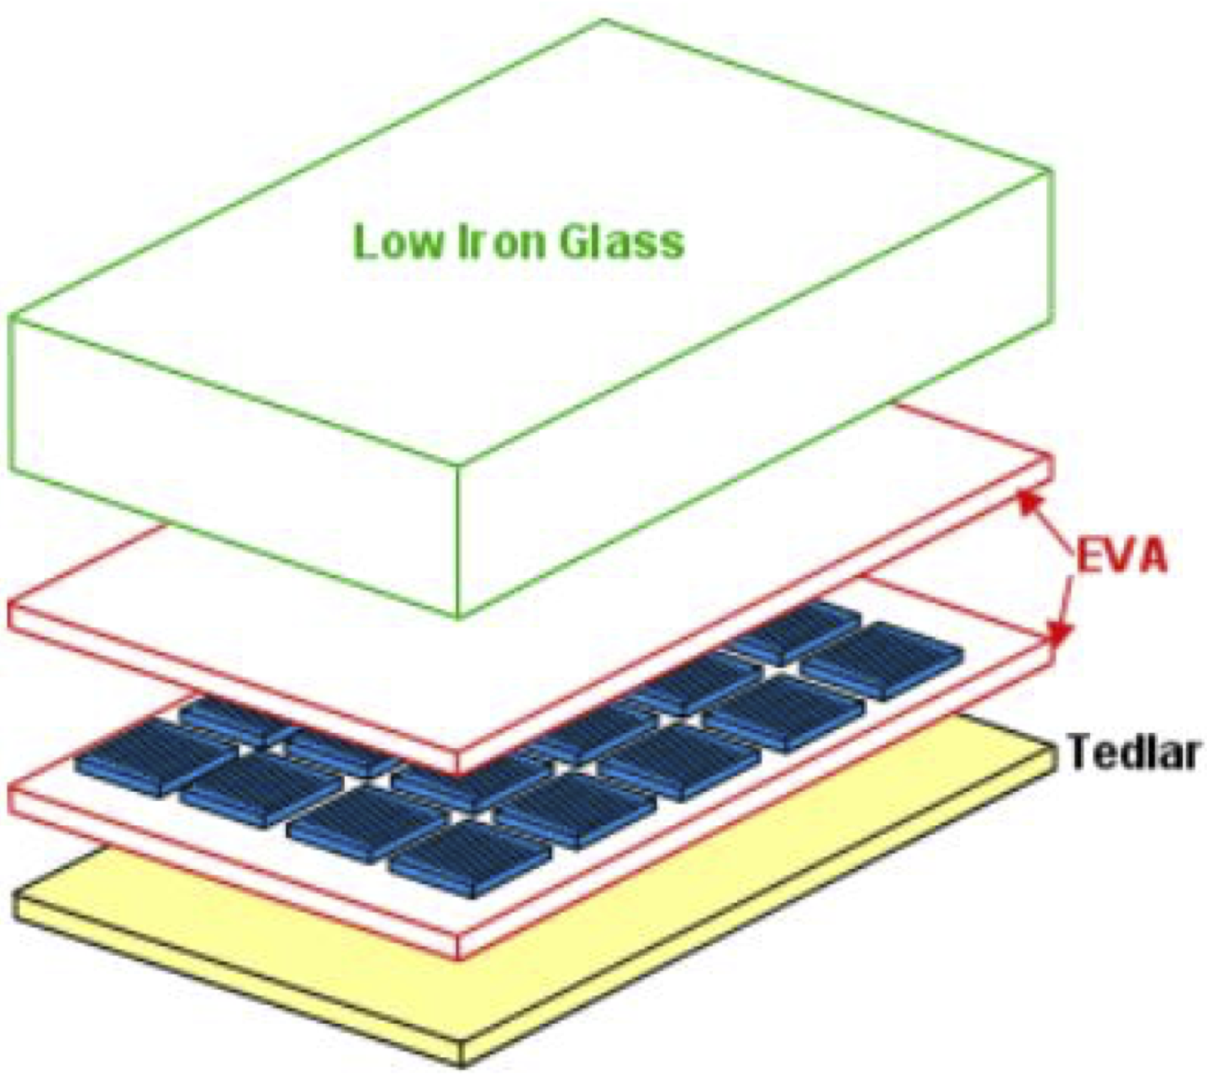
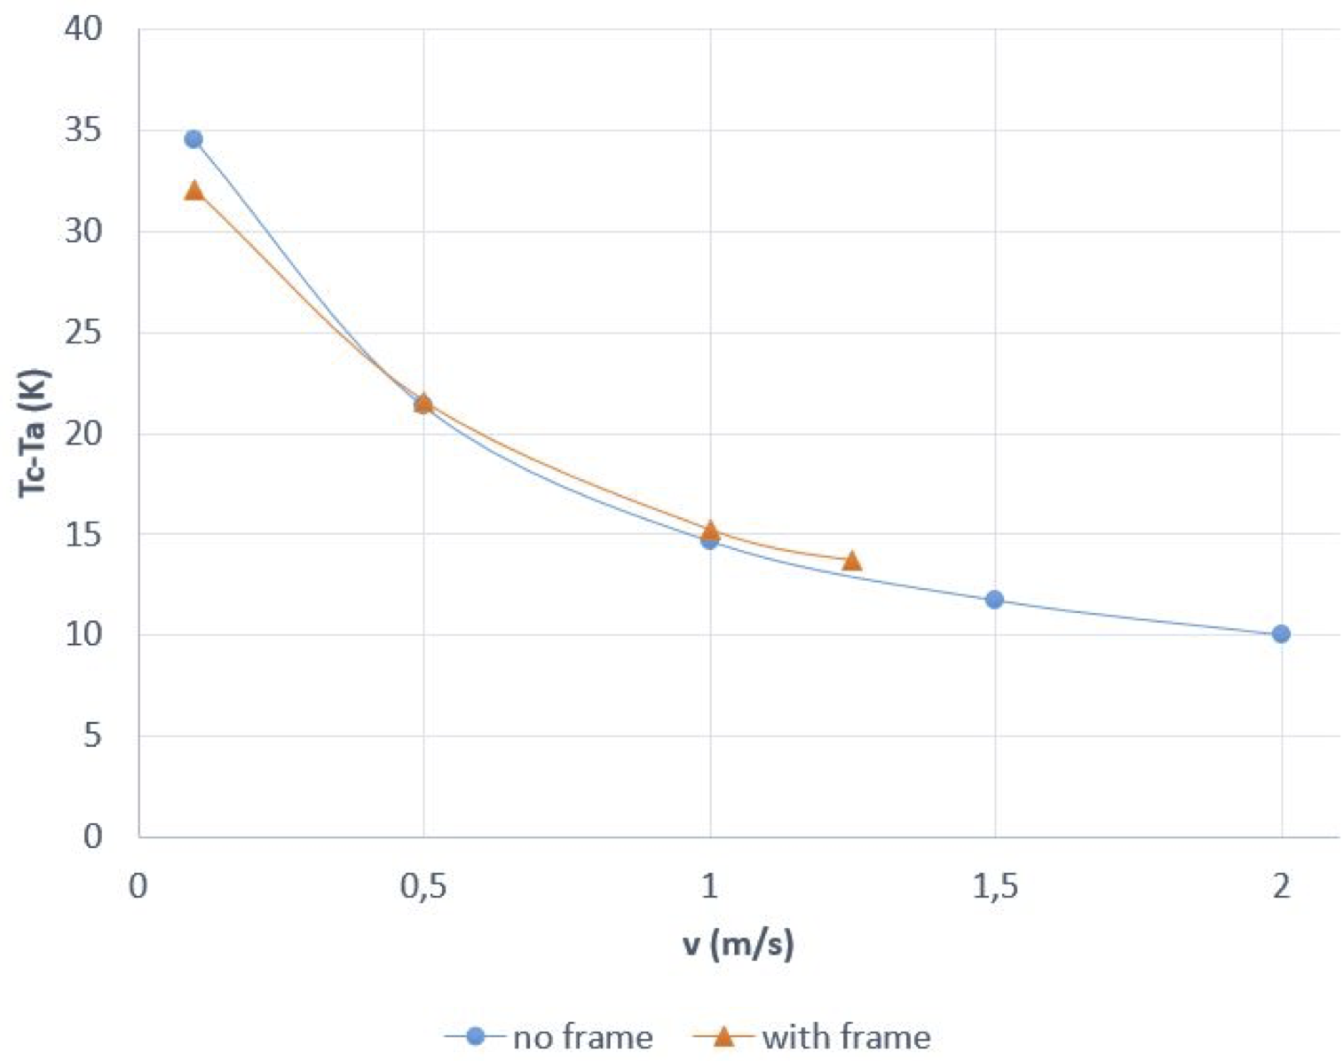
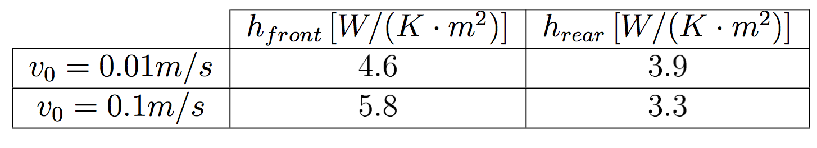
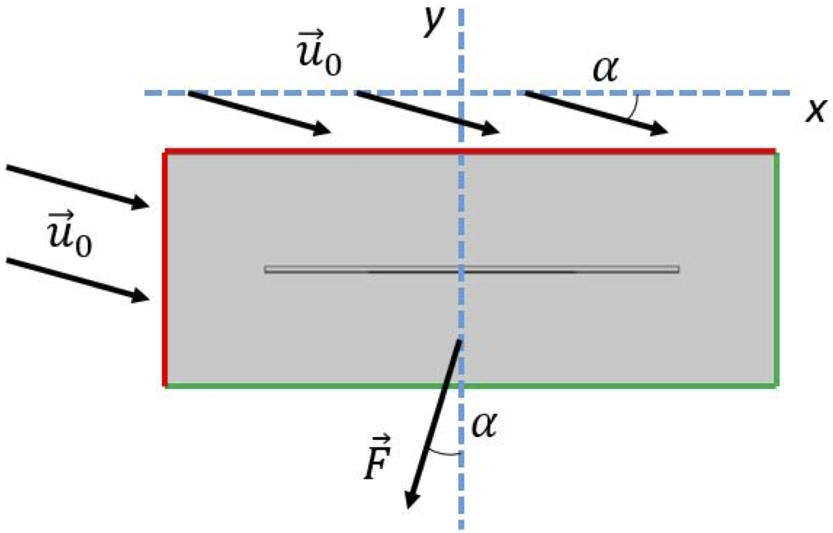
Photovoltaic Module Design and Mounting for Operation at Elevated Ambient Temperatures
A. G. Zubiría, A. Fragaki, I. Khan
University of Central Lancashire, Preston, Lancashire, PR1 2HE, UK
INRODUCTION: Irradiance is fundamental in the energy production of photovoltaic (PV) modules and models can be developed using just irradiance data. However, module temperature has also significant impact on the power output. In locations with high ambient temperatures PV module performance can be significantly reduced. The aim of this work is to explore ways, using COMSOL Multiphysics®, in which natural ventilation can be enhanced and passive cooling can be achieved at increased wind speeds.
RESULTS:
Figure 4. (Top) Temperature
Distribution across surface of
silicon cell for varying tilt
angles.
Figure 3. Temperature and velocity
field for varying tilt angles, increasing
from top to bottom (10º, 30º to 50º).
Figure 5. Temperature at varying
wind speeds.
Figure 1. Typical encapsulation structure of bulk silicon PV module.
COMPUTATIONAL METHODS: A 2D model of an elevated PV module to study the thermal efficiency, using the COMSOL Multiphysics® simulation, is presented. The stationary laminar flow conjugate heat transfer COMSOL® module is used for this model. This module is ideal for solving conservation of energy, mass and momentum in fluids as well as conduction in solids. In order to solve these equations the module automatically includes the heat transfer in solids, heat transfer in fluids and laminar flow packages. A stationary PARDISO solver is used together with adaptive mesh refinement in order to reconcile edge effects. Dimensions of the PV module are based on literature (e.g. [1] and [2]).
Table 1. (Left) Heat transfer
coefficients.
CONCLUSIONS: Tilt angle has an important impact on the module temperature. It has been shown that there is more than 10K decrease in the cell temperature when the tilt angle of the module varies from 10º to 70º. The change is larger for small tilt angles than for large angles, with the temperature of the upper edge being, in all cases, higher than that of the lower edge as expected. Similar behaviour has been observed in related research. As expected when the wind speed rises, the temperature decrease is stronger in the module without frame.
REFERENCES:
P. Nyanor, E.K. Oman, S. Kudadze, and A. Deku. 3D Finite Element Method Modeling and Simulation of the Temperature of Crystalline Photovoltaic Module. International Journal of Research in Engineering and Technology, 04(09):378 384, September 2015.
G. Acciani, O. Falcone, and S. Vergura. Analysis of the Thermal Heating of poly-si and a-si Photovoltaic cell by means of FEM. International Conference on Renewable Energies and Power Quality (ICREPQ'10), 2010.
Figure 2. Outer boundary conditions for tilt angle velocity
and volume force.
Excerpt from the Proceedings of the 2019 COMSOL Conference in Cambridge

