Slide 1

September 24th 2019
In-Air Fault Detection for Medical Ultrasonic Transducers
Dr Colin Chung¹ & Dr Prashant Verma²
Xi Engineering Consultants Ltd. (1)
with Sheffield Teaching Hospitals NHS Foundation Trust (2)

Slide 2

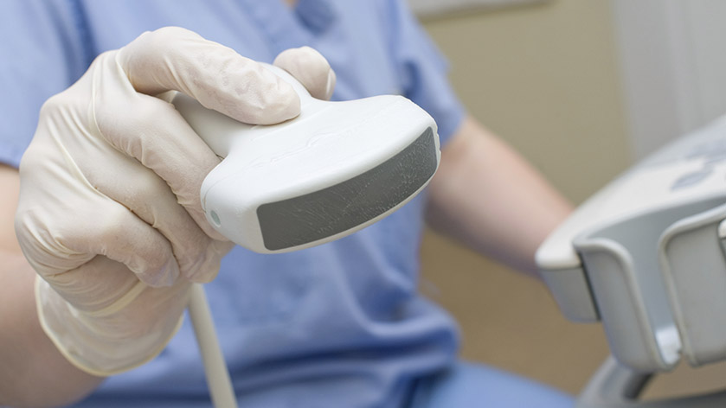
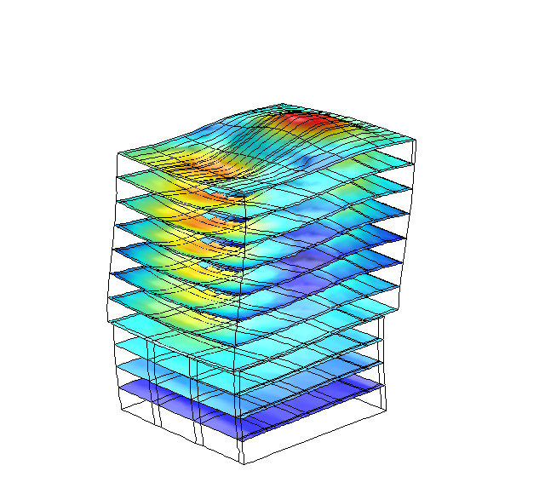
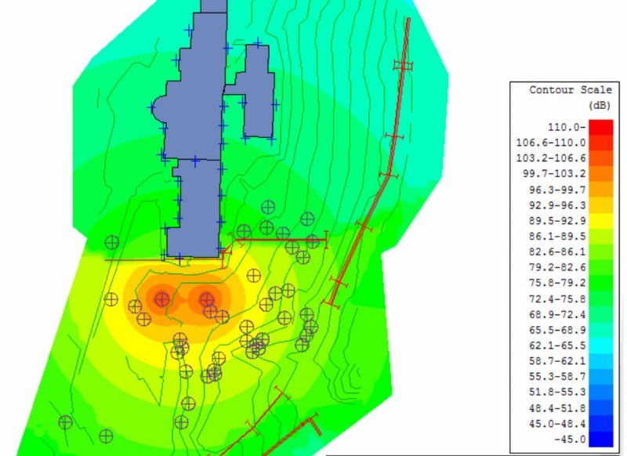
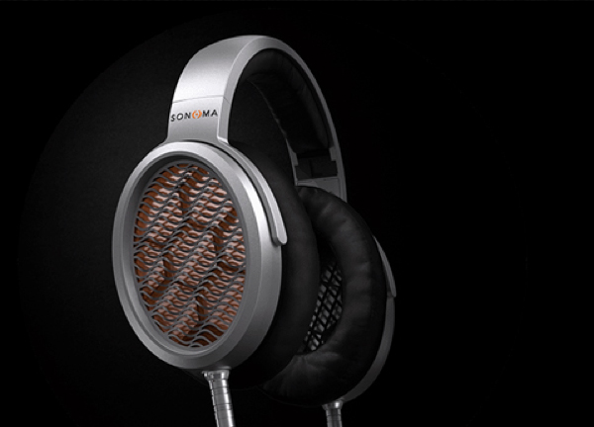
September 24th 2019
In-Air Fault Detection
Xi Engineering Consultants

Slide 3
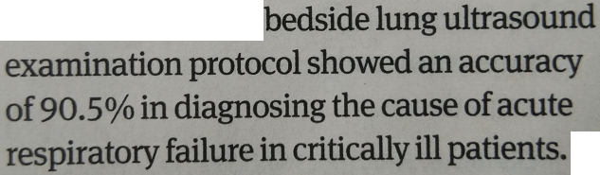

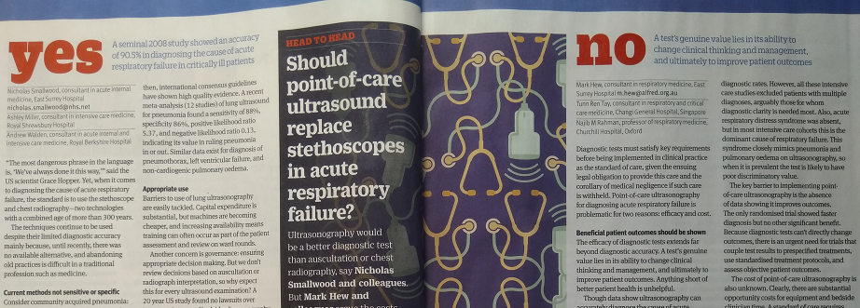
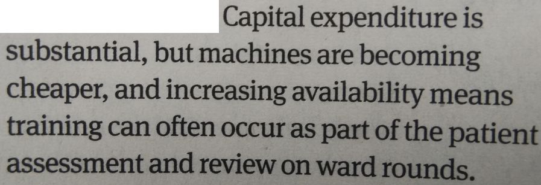
September 24th 2019
In-Air Fault Detection
Motivation
NHS Long Term Plan (January 2019) highlights the need for improvement in the early diagnosis of cancer
Ultrasound imaging can play a key role in the diagnostic pathway of some cancers

Slide 4
September 24th 2019
In-Air Fault Detection
Motivation
Need to minimise incorrect diagnosis due to faulty ultrasound transducers
Regular maintenance schedules currently required
Removes good transducers and creates an unnecessary financial burden
In-air reverberation tests recommended for the front line
National guidance on quality assurance for ultrasound transducers (Institute of Physics & Engineering in Medicine, Report 102)
No clear understanding exists for many in-air reverberation patterns
Clinical implications are unknown
Modelling the in-air reverberation test can help to pin-point the origin of transducer defects
NHS Sheffield approached Xi with this objective
Supported by an IPEM grant

Slide 5
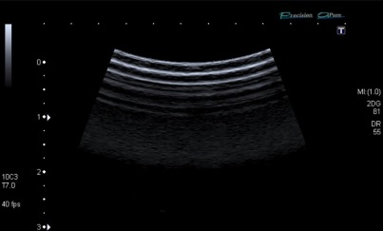
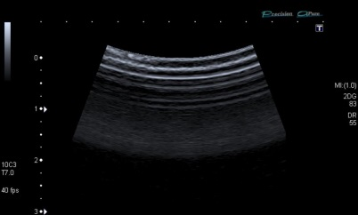
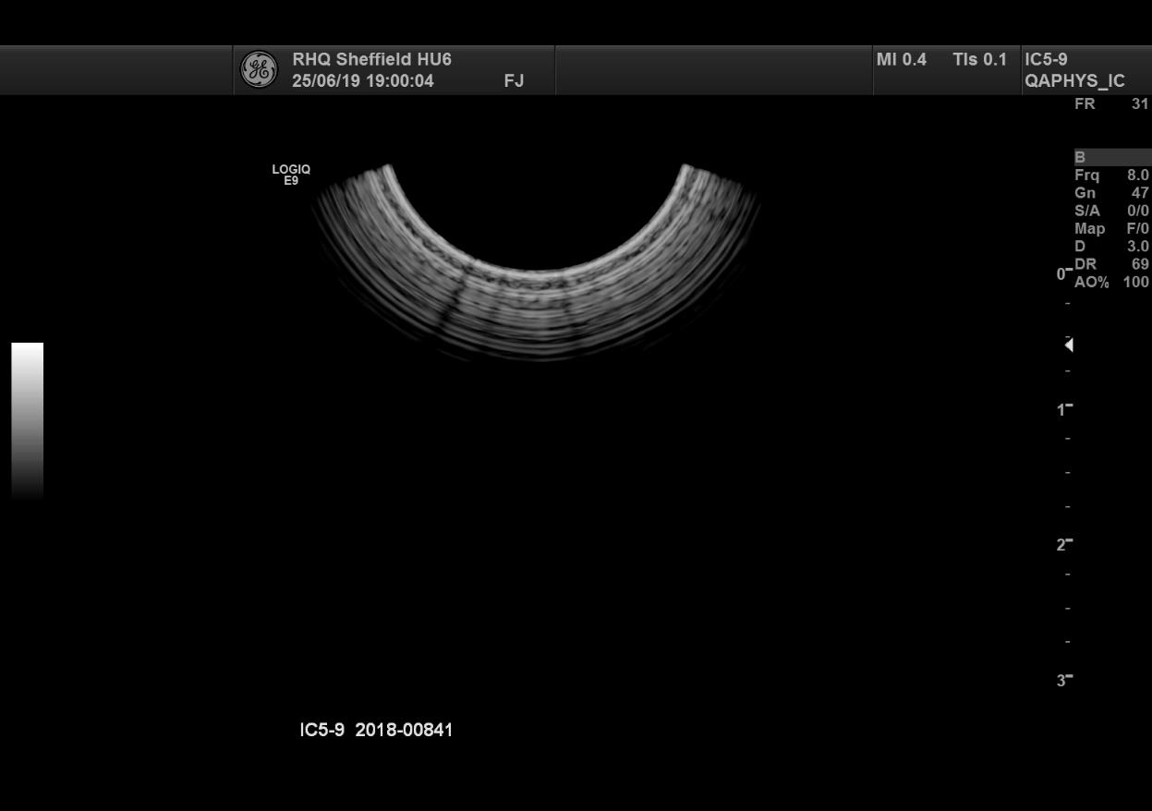
September 24th 2019
In-Air Fault Detection
Motivation
In-air reverberation images from healthy and unhealthy transducers

Slide 6
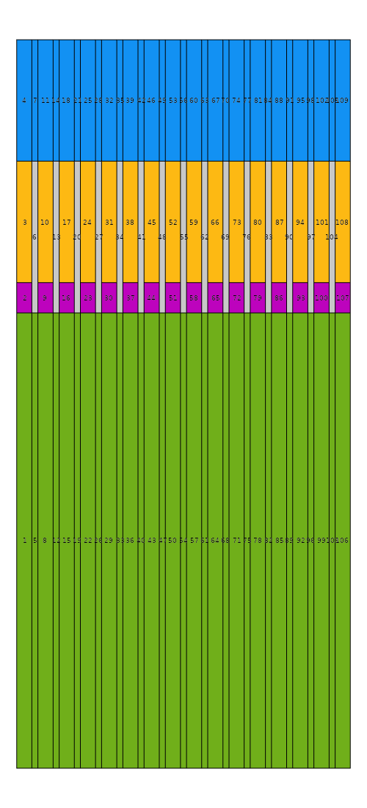
September 24th 2019
In-Air Fault Detection
Geometry
Ultrasound waves are created by a piezoelectric crystal
Backing material provides support and prevents excessive vibration
Matching provides an intermediate acoustic impedance to reduce reflection
Acoustic lens provides focusing in the slice direction
Kerf (grey) provides isolation between adjacent elements
Typically 128+ elements in an array
Lens
Matching
Crystal
Backing

Slide 7
September 24th 2019
Free
In-Air Fault Detection
Physics
Piezoelectric Multiphysics
Solid Mechanics
P and S waves evaluated
Damping applied throughout
Free boundary for lens (air)
Introduce stiffness
Electrostatics
Single 4 MHz cycle applied at 300 V_{p}
Ground switched and Floating Potentials applied for sensing (Two-Step Study)
Piezoelectric
Material
+V
GND
GND
Sense
Fixed Constraint

Slide 8
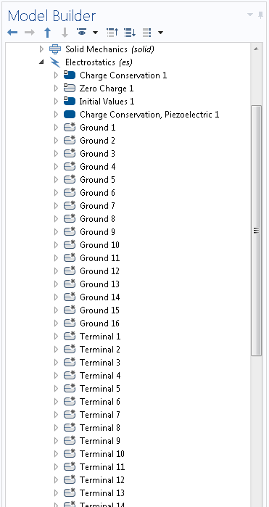
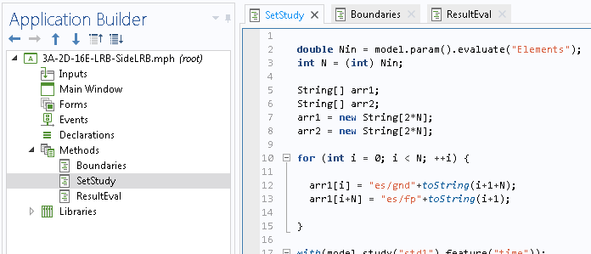
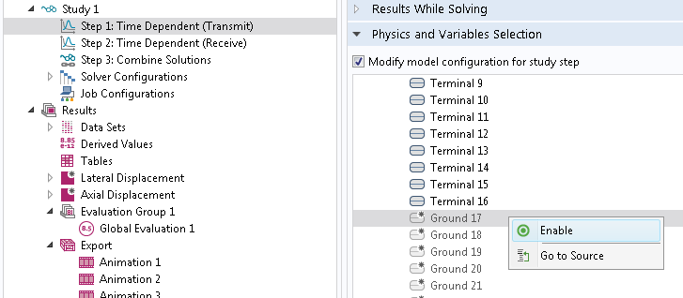
September 24th 2019
In-Air Fault Detection
Methods
Customisable firing sequences required independent configuration of up to 128 elements
(Very!) Laborious GUI tasks made possible by automation with scripted Methods

Slide 9
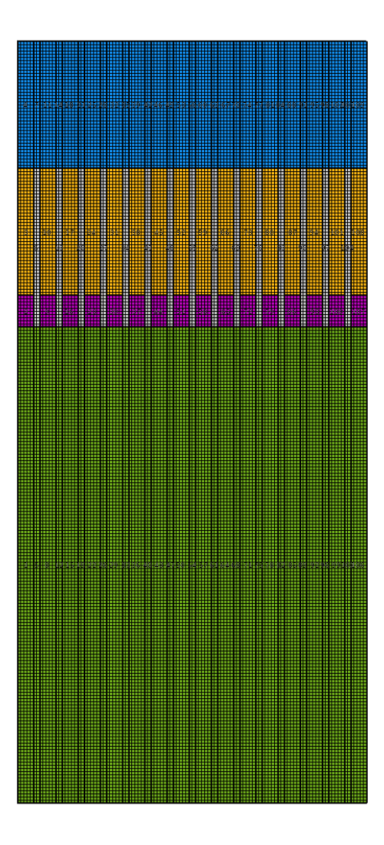

September 24th 2019
In-Air Fault Detection
Mesh
50 µm mesh element size
Geometry dictates the mesh required in this case
Over 9 mesh elements per wavelength

Slide 10
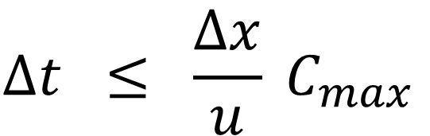
September 24th 2019
In-Air Fault Detection
Physics
Important to consider the explicit time stepping required
CFL (Courant-Friedrichs-Lewy) condition is necessary for numerical stability, in 1D : where Δt is the time step, Δx is the element size, u is the wave velocity and C_{max} is the Courant number which typically equals 1 for an explicit solver
P-waves determine the maximum time step allowed
Time step of 10 ns selected for these simulations
Strictly speaking the 2D CFL condition is required – limits reflection angle
$$∆t ≤ {\frac{∆x}{u} C}_{max}$$
Material | P-Wave Velocity (m/s) | Δt_{max} (ns)
Backing | 3,133 | 16.0
Matching | 3,276 | 15.3
Lens | 1,865 | 26.8

Slide 11
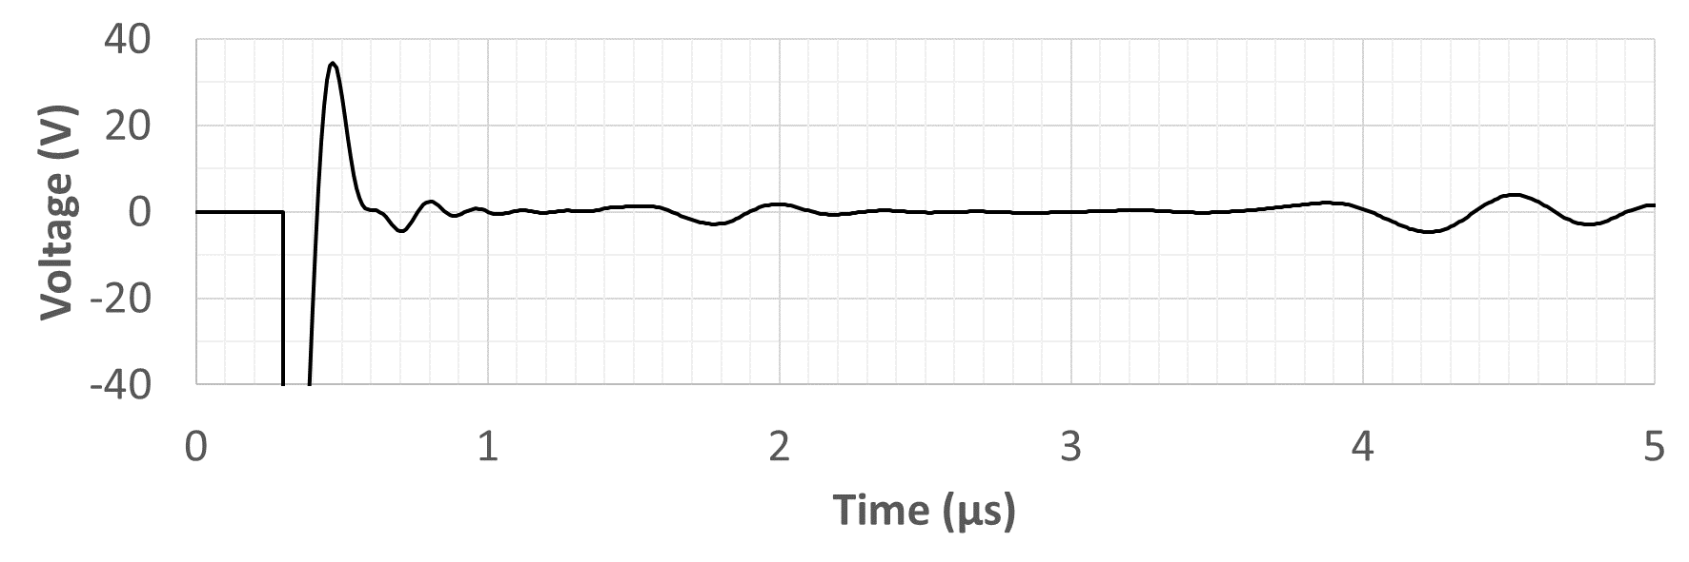
September 24th 2019
In-Air Fault Detection
Transducer Element
Axial displacement magnitude, left (P-waves)
Lateral displacement magnitude, right (S-waves)
Lens
Matching
Crystal
Backing

Slide 12
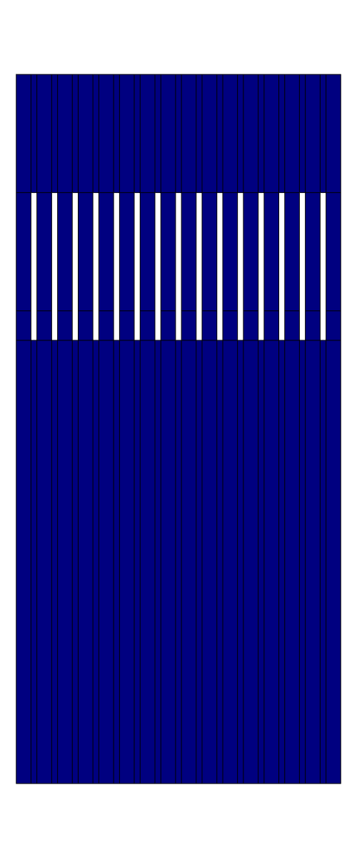
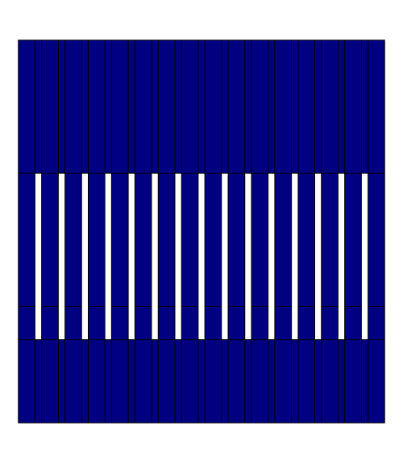

September 24th 2019
In-Air Fault Detection
16-Element Transducer Array
Low Reflecting Boundary
Axial Displacement Magnitude
0 µs
Matching - Lens
Lens - Air
5 µs

Slide 13


September 24th 2019
In-Air Fault Detection
128-Element Transducer Array
Model easily scales up to 128 elements on a typical desktop computer
Iterative solver is well suited to this task and minimises the memory footprint
Left image displays a healthy transducer
Right image simulates eight faulty elements in the centre with 1/3rd Young’s modulus for the matching layer
Qualitatively similar to fault modes observed in reality

Slide 14
September 24th 2019
In-Air Fault Detection
Conclusions & Future
In-air reverberation patterns simulated in 2D
Images can be created to understand failure through bulk mechanical properties
Hardware capability limits 3D modelling
Need to perform physical failure analysis and validate the model
Is a purely acoustic formulation good enough? (c.f. 3D)
Can the model help us determine signs of early-onset hardware failure?

Slide 15
September 24th 2019
Thank you for your time
Xi Engineering Consultants
CodeBase, Argyle House 3 Lady Lawson Street
Edinburgh, EH3 9DR
tel: +44 (0) 131 290 2250
www.xiengineering.com

Slide 16
September 24th 2019
In-Air Fault Detection
16-Element Transducer Array
Low Reflecting Boundary
Lateral Displacement Magnitude
0 µs
Matching - Lens
Lens - Air
5 µs

