Slide 1
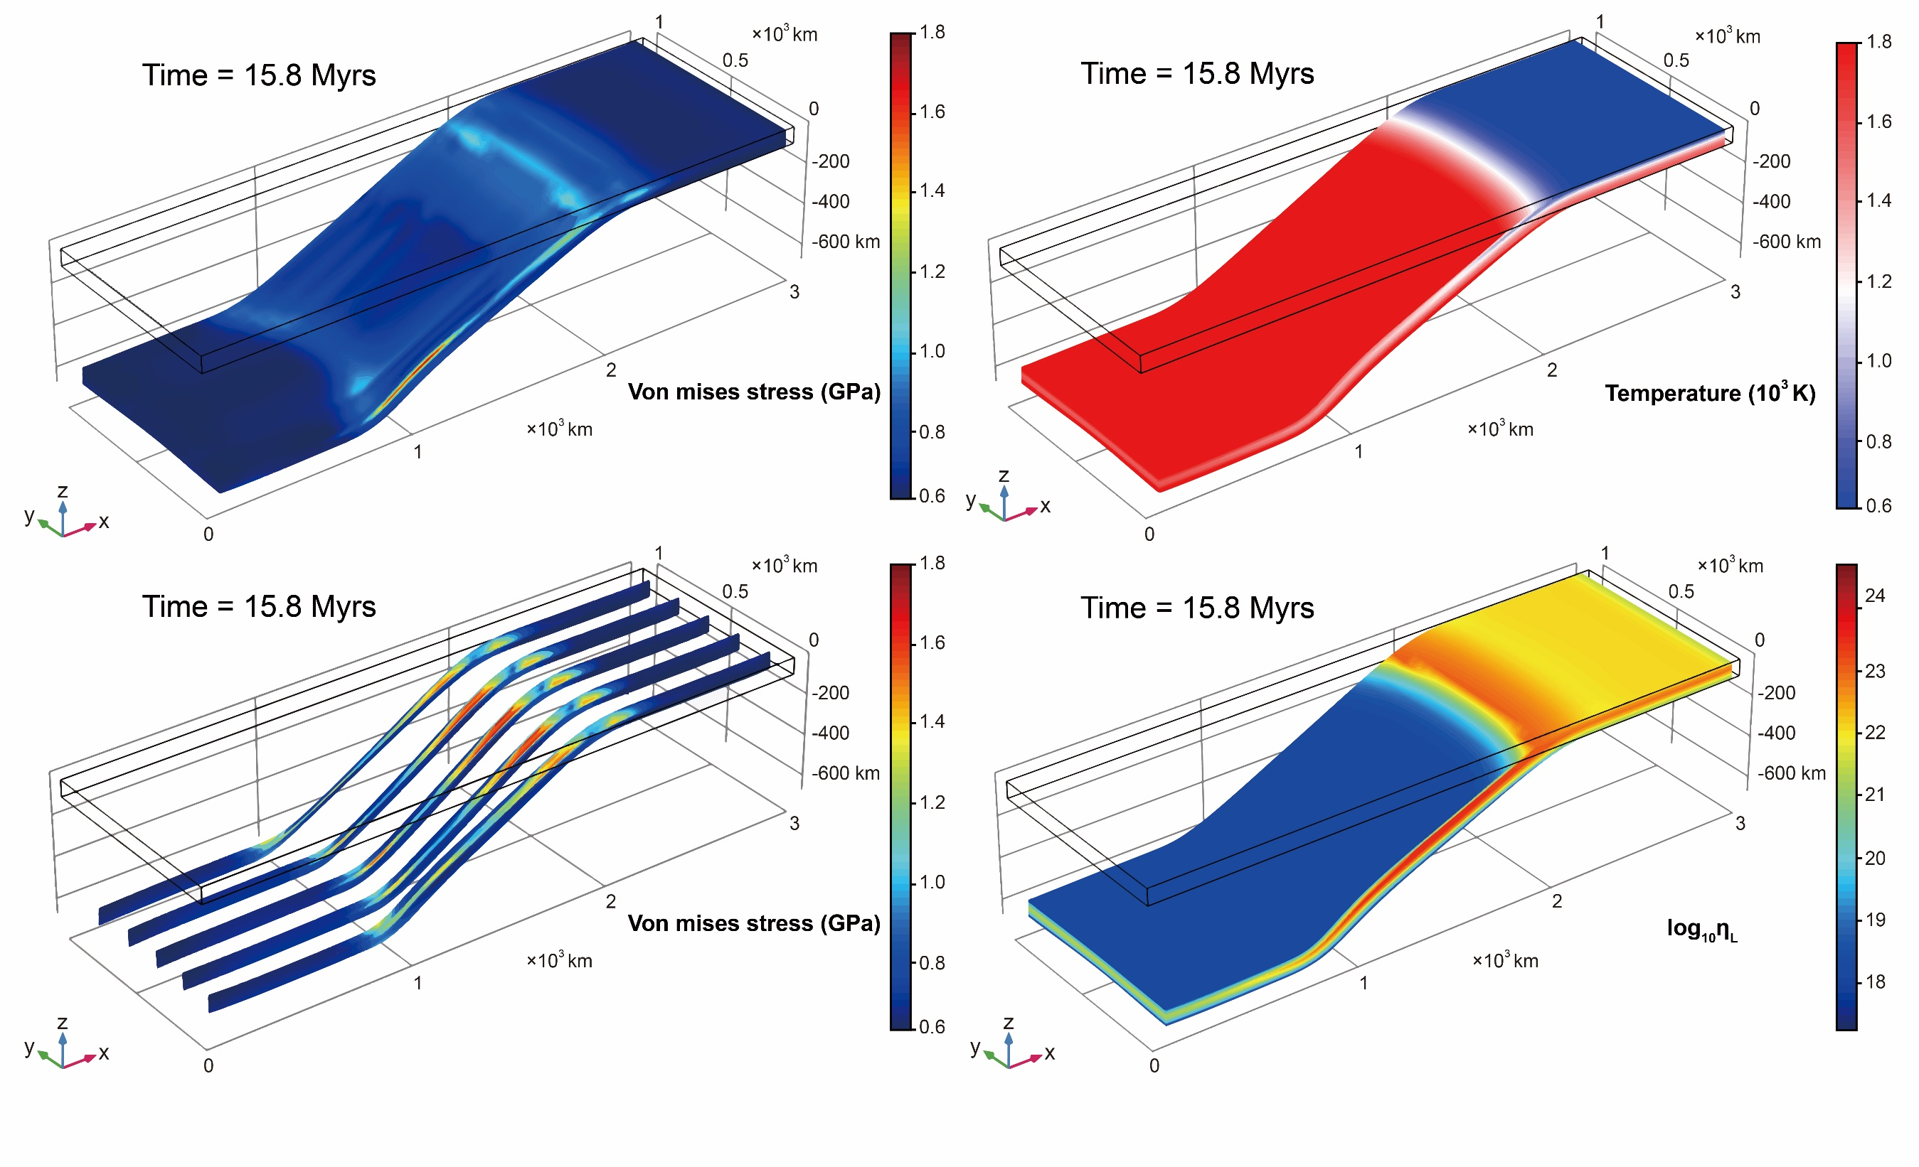
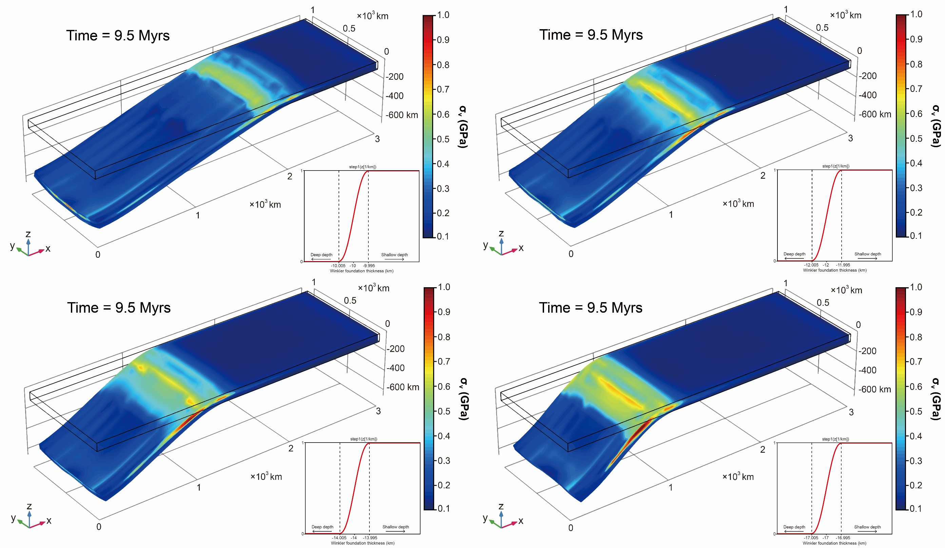
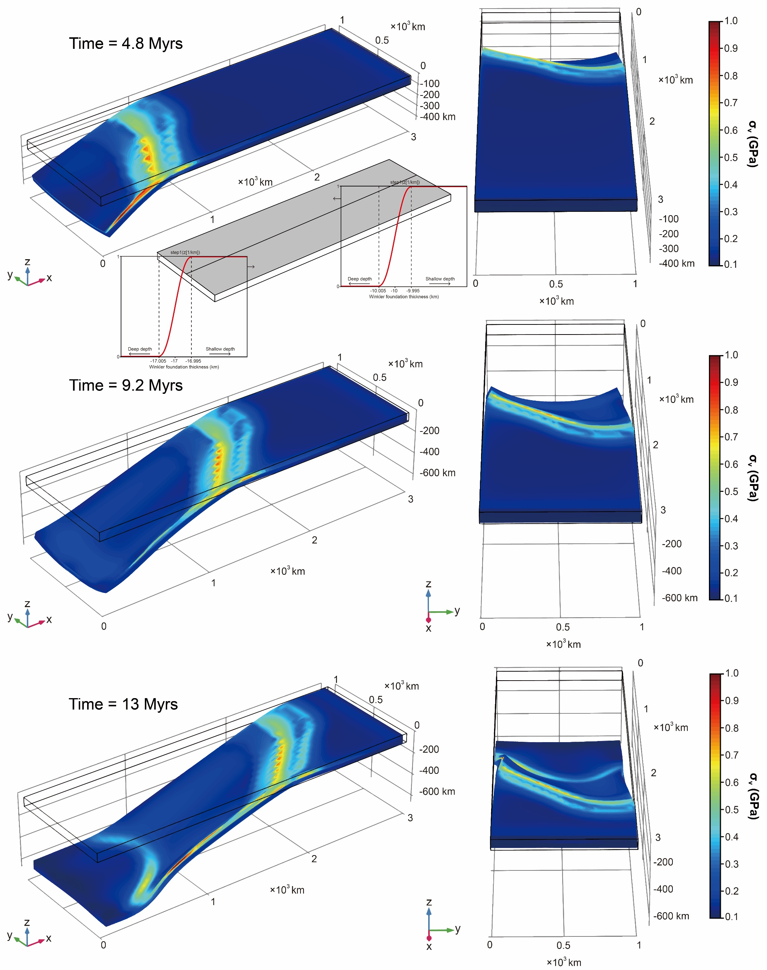
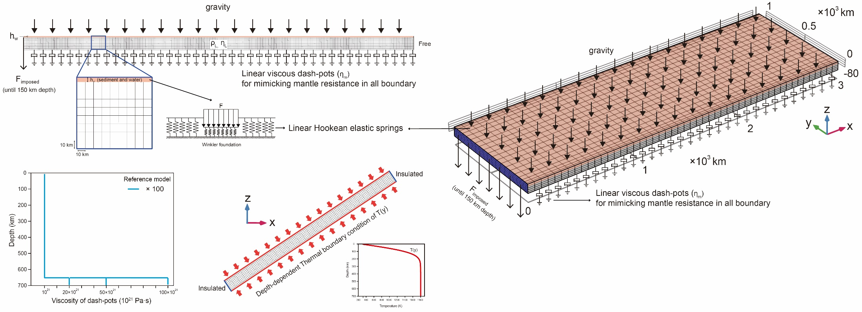
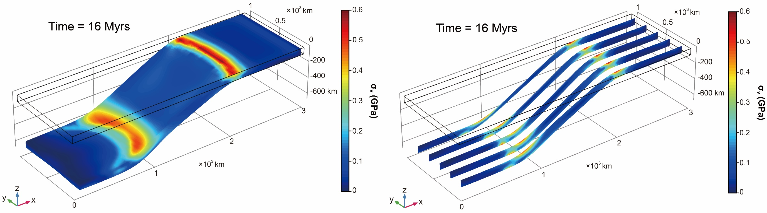
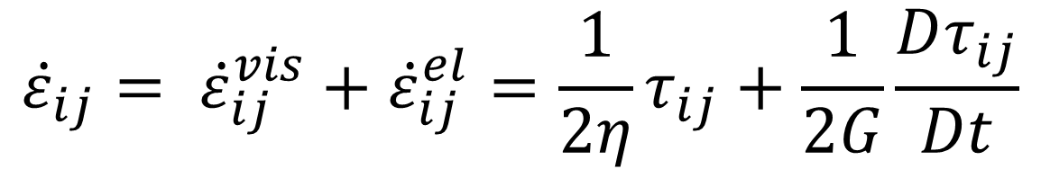
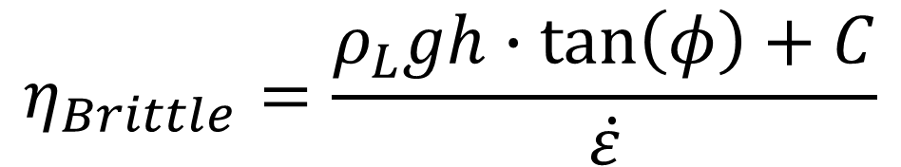
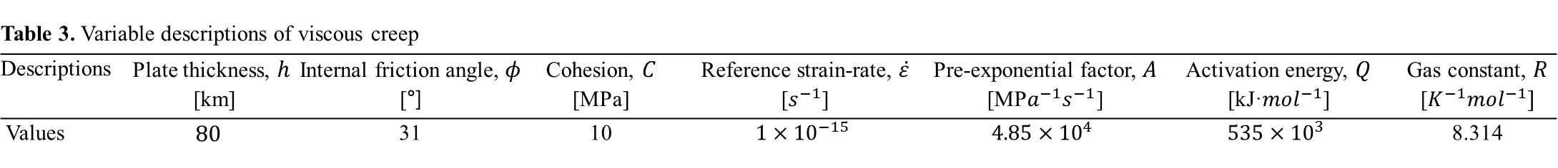
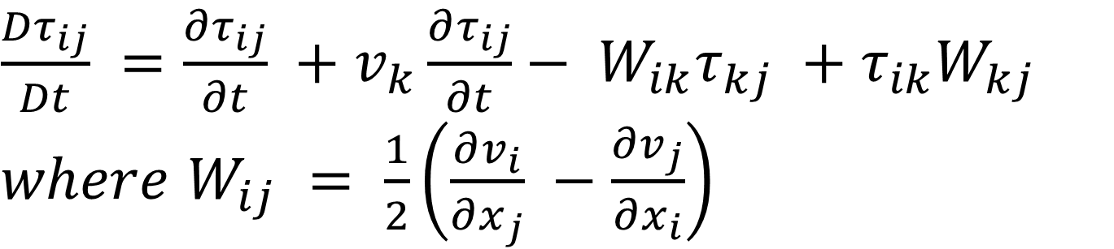

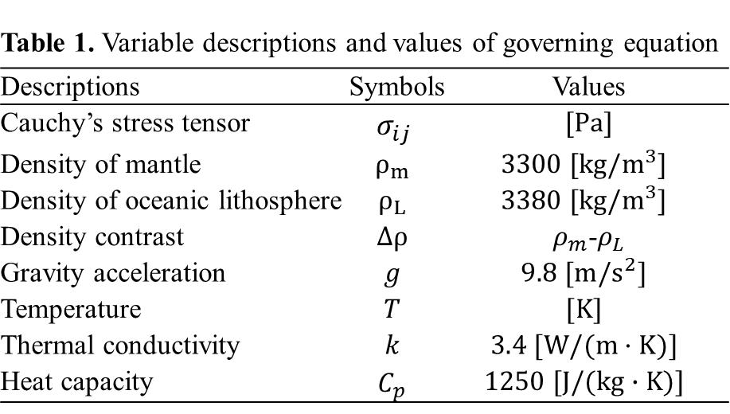
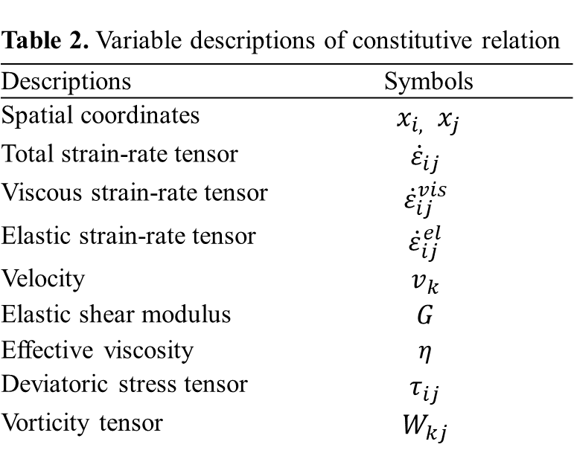
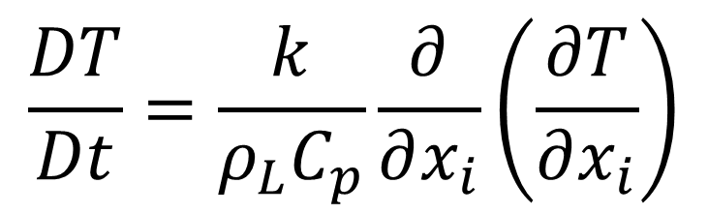
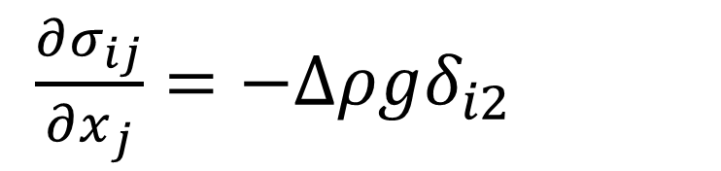
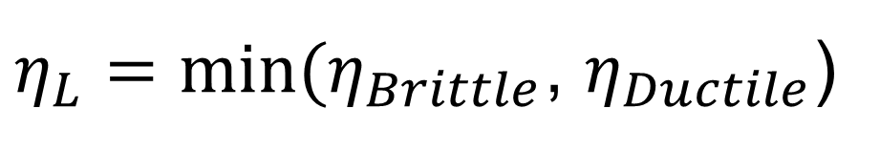

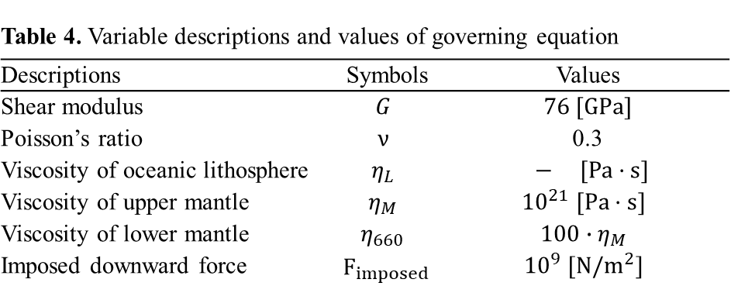
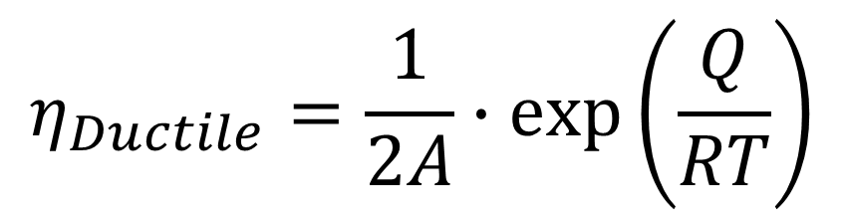
Lagrangian free subduction model based on viscoelastic material using Comsol Multiphysics®
Jae Yoon Keum¹, Byung-Dal So¹
1. Department of Geophysics, Kangwon National University, Chuncheon, Gangwon-do 24341, Republic of Korea
Introduction: In subduction dynamics, role of the Winkler foundation, used to mimic the isostatic restoring force caused by the low density of trench infill material (e.g., sediment and water), is still unclear. We quantified the effect of the Winker foundation due to its nature as an essential analytical element in the Lagrangian free subduction model.
Computational Methods
Figure 3. Spatial distribution of $σ_{v,}$ $T$ and viscosity
in subducting slab with creep rheology
Governing equation
Table 1. Variable descriptions and values of governing equation
Descriptions | Symbols | Values
Cauchy’s stress tensor | $$σ_{ij}$$ | $$[Pa]$$
Density of mantle | $$ρ_{m}$$ | $$3300 [kg/m^{3}]$$
Density of oceanic lithosphere | $$ρ_{L}$$ | $$3380 [kg/m^{3}]$$
Density contrast | $$∆ρ$$ | $ρ_{m}$-$ρ_{L}$
Gravity acceleration | $$g$$ | $$9.8 [m/s^{2}]$$
Temperature | $$T$$ | $$[K]$$
Thermal conductivity | $$k$$ | $$3.4 [W/(m·K)]$$
Heat capacity | $$C_{p}$$ | $$1250 [J/(kg∙K)]$$
$\frac{∂σ_{ij}}{∂x_{j}}=−∆ρgδ_{i2}$
1) Momentum
$$\frac{DT}{Dt}=\frac{k}{ρ_{L}C_{p}}\frac{∂}{∂x_{i}}\left(\frac{∂T}{∂x_{i}}\right)$$
2) Energy
Constitutive relation (Maxwell viscoelasticity)
$${\dot{ε}}_{ij}= {\dot{ε}}_{ij}^{vis}+{\dot{ε}}_{ij}^{el}=\frac{1}{2η}τ_{ij}+\frac{1}{2G}\frac{Dτ_{ij}}{Dt}$$
Table 2. Variable descriptions of constitutive relation
Descriptions | Symbols
Spatial coordinates | $x_{i,}$ $x_{j}$
Total strain-rate tensor | $${\dot{ε}}_{ij}$$
Viscous strain-rate tensor | $${\dot{ε}}_{ij}^{vis}$$
Elastic strain-rate tensor | $${\dot{ε}}_{ij}^{el}$$
Velocity | $$v_{k}$$
Elastic shear modulus | $$G$$
Effective viscosity | $$η$$
Deviatoric stress tensor | $$τ_{ij}$$
Vorticity tensor | $$W_{kj}$$
Figure 4. Stress distribution and morphology of subducting slab
in different Winkler foundation thickness
$\frac{Dτ_{ij}}{Dt} =\frac{∂τ_{ij}}{∂t} +v_{k}\frac{∂τ_{ij}}{∂t}− W_{ik}τ_{kj} +τ_{ik}W_{kj}$
$where$ $W_{ij} = \frac{1}{2}\left(\frac{∂v_{i}}{∂x_{j}} −\frac{∂v_{j}}{∂x_{i}}\right)$
Viscous creep
$$η_{Ductile}=\frac{1}{2A}∙exp\left(\frac{Q}{RT}\right)$$
$$η_{Brittle}=\frac{ρ_{L}gh∙\tan\left(φ\right)+C}{\dot{ε}}$$
$η_{L}=min⁡(η_{Brittle}$, $η_{Ductile}$)
Table 3. Variable descriptions of viscous creep
Descriptions | Plate thickness, $h$ [km] | Internal friction angle, $φ$ [°] | Cohesion, $C$ [MPa] | Reference strain-rate, $\dot{ε}$ [$s^{−1}$] | Pre-exponential factor,$A$ [MP$a^{−1}s^{−1}$] | Activation energy, $Q$ [kJ·${mol}^{−1}$] | Gas constant, $R$ [$K^{−1}{mol}^{−1}]$
Values | $$80$$ | 31 | 10 | $$1×{10}^{−15}$$ | $$4.85×{10}^{4}$$ | $$535×{10}^{3}$$ | 8.314
Table 4. Variable descriptions and values of governing equation
Descriptions | Symbols | Values
Shear modulus | $$G$$ | $$76 [GPa]$$
Poisson’s ratio | $$ν$$ | 0.3
Viscosity of oceanic lithosphere | $$η_{L}$$ | $$− [Pa·s]$$
Viscosity of upper mantle | $$η_{M}$$ | $${10}^{21} [Pa·s]$$
Viscosity of lower mantle | $$η_{660}$$ | $$100∙η_{M}$$
Imposed downward force | $${ F}_{imposed}$$ | $${10}^{9} [N/m^{2}]$$
Results
Figure 1. Model setup
Figure 5. Time evolution of $σ_{v}$ in different Winkler foundation
thickness along trench axis
Conclusions: Our results, including the geodynamic implication that the Earth’s surface process contributes to subduction physics, are expected to improve the understanding of the structure of deep subduction.
Figure 2. Stress distribution of free subduction model with iso-viscosity
References
1. F. Funiciello, G. Morra, K. Regenauer-Lieb, D. Giardini, Dynamics of retreating slabs: 1. Insight from two-dimensional numerical experiments, Journal of Geophysical Research, 108, B4, (2003)
2. F.A. Capitanio, G. Morra, S. Goes, Dynamic models of downgoing plate-buoyancy driven suduction: Subduction motions and energy dissipation, Earth and Planetary Science Letters, 262, 284-297, (2007)
Acknowledgement
This research was supported by the National Research Foundation of Korea (NRF-2014R1A6A3A04055841)and Ministry of the Interior and Safety as Earthquake Disaster Prevention Human resource development Project.
Excerpt from the Proceedings of the 2019 COMSOL Conference in Cambridge

