Slide 1
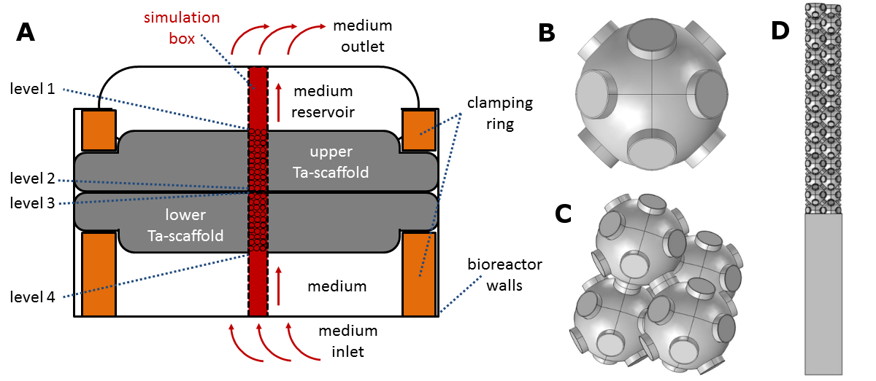
Simulation of the Oxygen Supply of Osteoblastic Cells
in Dynamic 3D Cell Cultures
P. Elter¹
1. University of Applied Sciences Mittelhessen THM, Institute for Biomedical Engineering, Wiesenstraße 14, Gießen, Germany
INRODUCTION: Cells are frequently grown on scaffolds with a three-dimensional channel structure that is perfused with a nutrient medium to supply the cells inside the structure. However, cells often do not grow confluent into the interior of the structure.
Therefore, the oxygen supply inside a MG-63 osteoblast-populated complex 3D-tantalum-foam-scaffold was analyzed at different medium flow rates with COMSOL Multiphysics®.
RESULTS: The simulation results demonstrate that without flow, a critical oxygen depletion occurs in the interior regions of the scaffold. When the medium flow rate is increased, the critically depleted area shifts towards the outflow of the scaffold channels.
COMPUTATIONAL METHODS: A section of the scaffold (channel radius: 80-250 µm) and the surrounding reservoir was reconstructed in the Model Builder. A confluent cell colonization of the channel walls was represented by a surface layer in the geometry.
medium
cells
Figure 2. Oxygen concentration distribution within the scaffold section for different medium flow rates³. Dark blue areas indicate an oxygen deficiency.
For the simulated channel geometry, an adequate oxygen supply is only possible at such high flow rates, where pathological shear rates occur.
Figure 1. The simulation box³. (A) The cell reactor with the scaffold (gray). The channel structure is perfused with the medium from below. Above and below the scaffold is a reservoir. The red region displays the simulation box. (B-D) Construction of the simulation box.
The local oxygen concentration and shear forces were calculated for different medium flow rates by simulating the balance of oxygen consumption by the cells (in the outer layer of the structure) and oxygen supply by flow and diffusion (in the inner layer of the structure)³.
The simulation was carried out by a combination of the Laminar Flow and Transport of Diluted Species physics interfaces. All boundaries except walls, inlet and outlet were realized via Periodic Flow conditions. Oxygen consumption was achieved by a reaction rate R with Michaelis-Menten kinetics^{1,2,3}:
Figure 3. Local shear rates as a function of the flow rate³.
CONCLUSIONS: The simulations explain the results of cell culture experiments³ and indicate that a sufficient oxygen supply inside a confluent populated scaffold cannot be achieved by direct flow, since the flow rate would have to be so high that the generated shear stress would be pathological.
REFERENCES:
F. Coletti, S. Macchietto, and N. Elvassore, Mathematical modeling of three-dimensional cell cultures in perfusion bioreactors, Ind. Eng. Chem. Res. 45, 8158(2006).
P. Buchwald, FEM-based oxygen consumption and cell viability models for avascular pancreatic islets, Theor. Biol. Med. Model. 6, 5 (2009).
C. Bergemann, P. Elter, R. Lange, V. Weißmann, H. Hansmann, E.-D. Klinkenberg, B. Nebe, Cellular Nutrition in Complex Three-Dimensional Scaffolds: A Comparison between Experiments and Computer Simulations, Int. J. Biomater. 2015, 584362 (2015).
All model parameters are listed in Ref. 3 in detail.
Excerpt from the Proceedings of the 2019 COMSOL Conference in Cambridge

