Slide 1
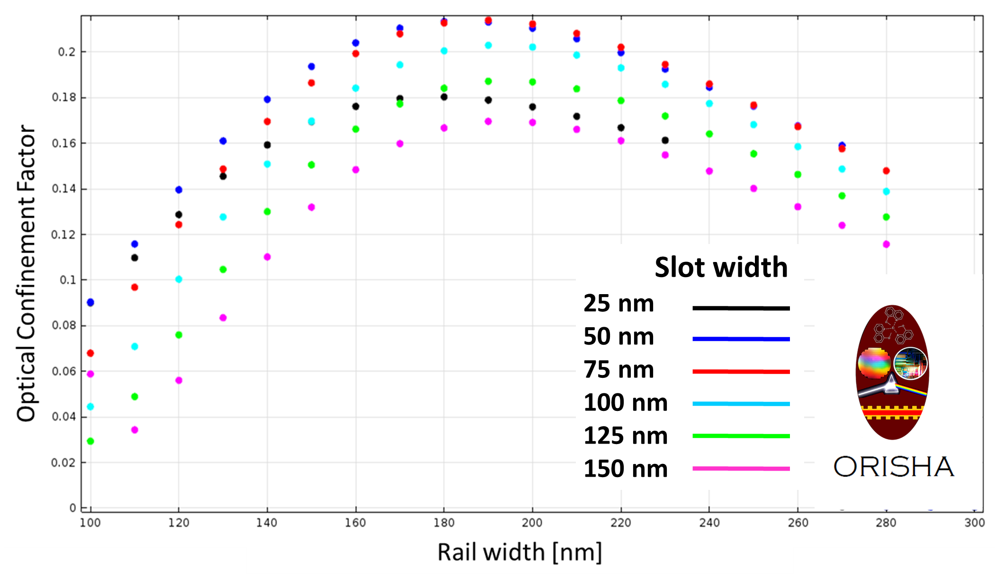
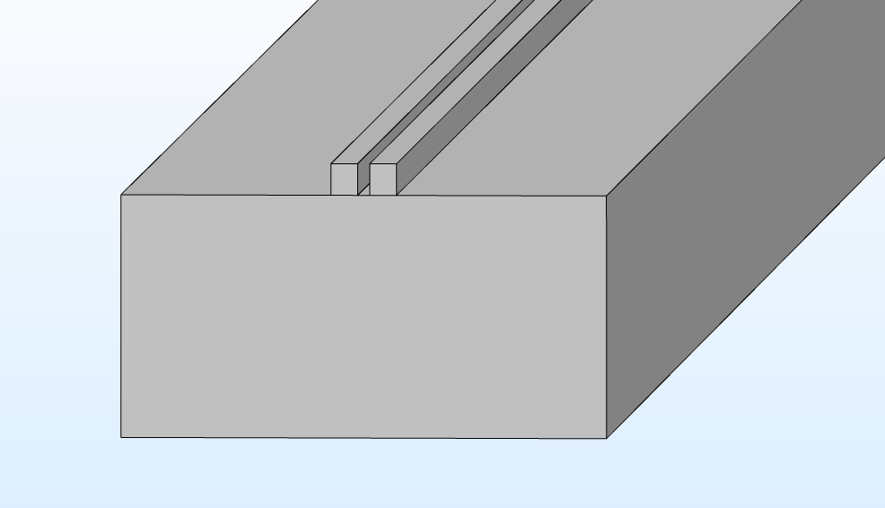
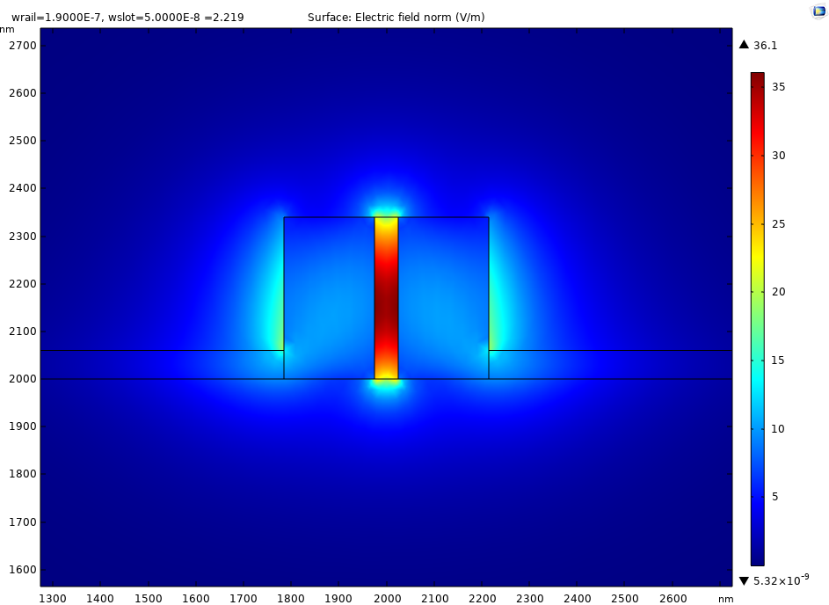
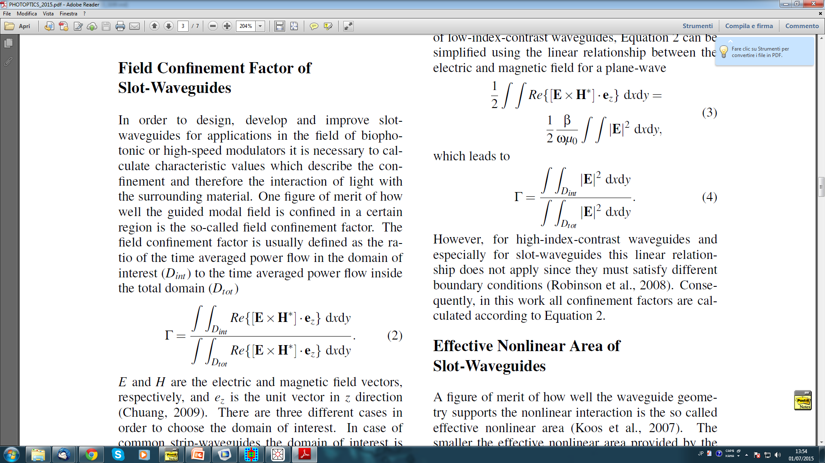
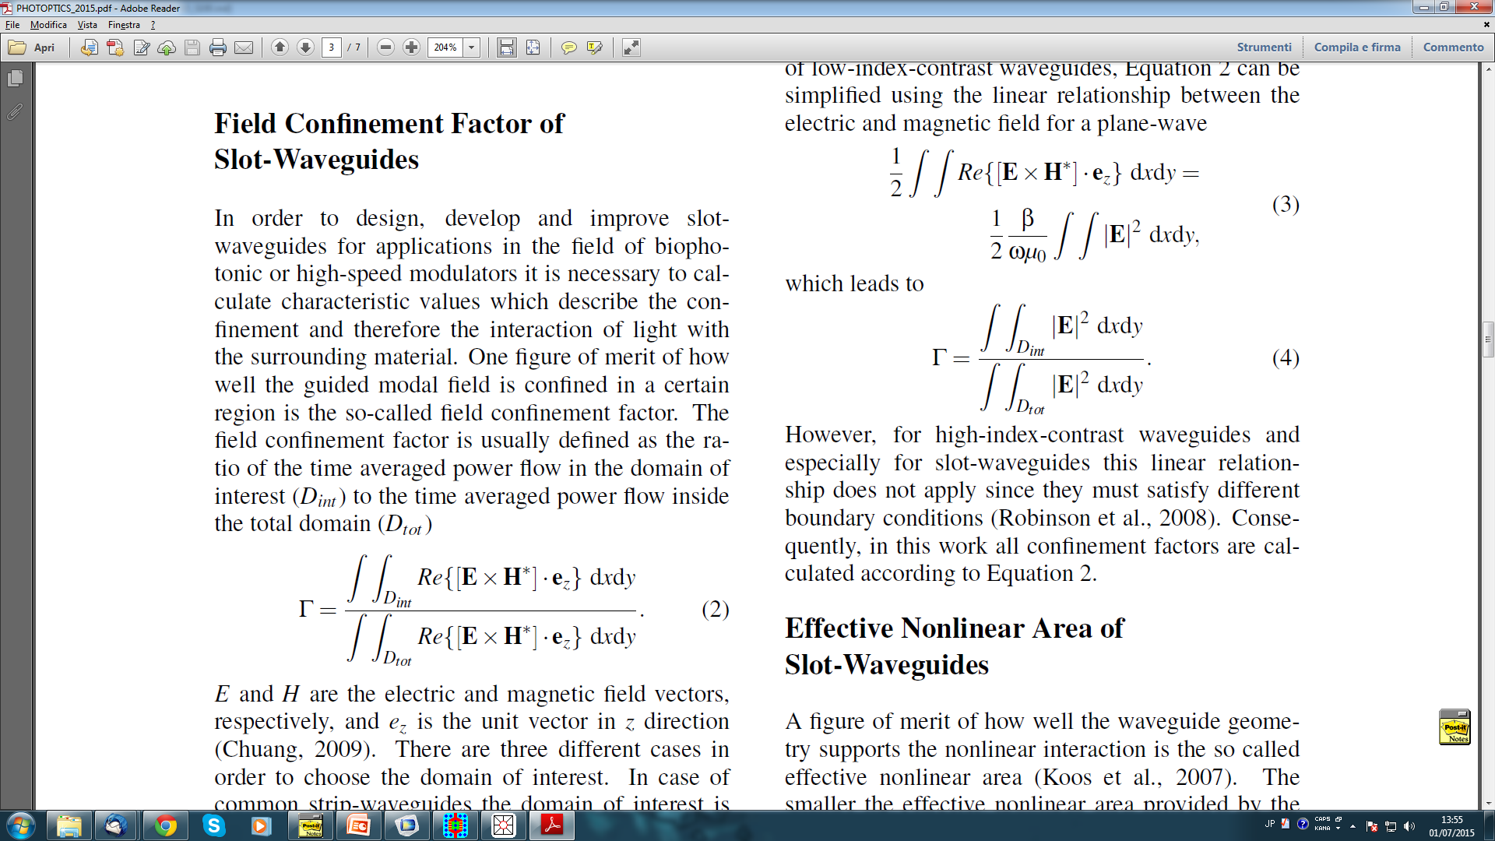
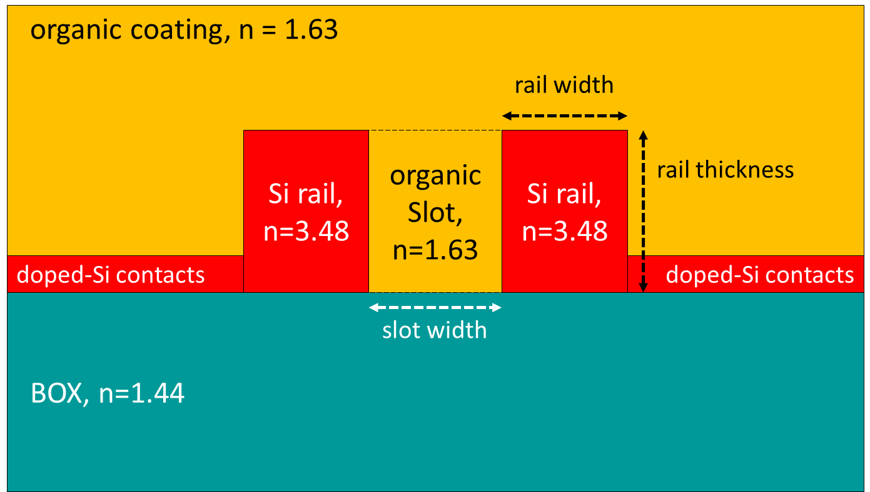
Design of an Erbium-organic slot waveguide on Silicon on Insulator
for C band optical amplification
Stefano Penna¹, Gianpaolo Susanna^{1,2}, Luigi Salamandra^{1,2}, Andrea Reale²
1. Istituto Superiore delle Comunicazioni e delle Tecnologie dell’Informazione (ISCOM), Ministero dello Sviluppo Economico, Rome, 00144, Italy
2. Department of Electronic Engineering, University of Rome Tor Vergata, Rome, 00133, Italy
INTRODUCTION: Silicon photonics require for easy integration of devices on Silicon platforms. Slot waveguides [1][2], consisting of two parallel Silicon rails grown on a Buried silicon Oxide (BOX) and coated by organic dielectric material, allow for light to be guided into the organic slot between the two rails. Solution-processed infrared-emitting organic coating [3] enables the low cost amplification of the optical signal travelling along the waveguide, when confined into the organic slot. Maximization of the optical field confinement into the slot, that depends on the geometrical features of the device, is a mandatory target to achieve the amplification capability of the waveguide.
RESULTS: The results of the parametric sweep on the geometrical features shown in Figure 2 are related to a ready on-the-shelf 340 nm thick SOI wafer, that fixes the upper limits thickness of both the rails and the slot. Maximum confinement of the optical field into the slot is achieved with slot width at 50 nm and rail width at 190 nm.
Figure 1. 3D View of the slot waveguide
Figure 3. Plot of Γ for rail width and slot width combinations,
with rail and slot thickness set at 340 nm
COMPUTATIONAL METHODS: Electromagnetic Waves, Frequency Domain interface of the Wave Optics Module was used to derive the optimal set of geometrical features of the device layout able to maximize the optical field confinement factor Γ into the slot, given by:
with D_{int} being the spatial domain of the organic slot and D_{tot} being the whole spatial domain.
Parametric sweep of the geometrical features of the device layout was used. Side n-doped Silicon strip contacts, needed for electrical supplying of the waveguide, were included into the design to evaluate their possible effect on the optical field.
Slot width (nm) | Max Γ (%) | Rail width (nm)
25 | 18.03 | 180
50 | 21.33 | 190
75 | 21.27 | 190
100 | 20.05 | 190
125 | 18.41 | 190
150 | 16.96 | 190
Table 1. Maximum Γ vs slot width and rail width (thickness = 340 nm)
Figure 4. Optical field distribution
of the layout providing
maximum Γ in Table 1
CONCLUSIONS: Parametric analysis allowed for optimization of the design of the slot waveguide in terms of maximum achievable optical confinement into the slot, considering the features of a SOI wafer available on-the-shelf for device processing by EBL. Future works will consider optimization of the optical propagation along the waveguide, the optimization of the fiber-to-strip light incoupling (inverted tip) and the following strip-to-slot mode converter by BEM analysis in Wave Optics.
REFERENCES:
Almeida et al., Guiding and confining light in void nanostructure, Opt. Lett., 29, 1209-1211 (2004)
Serna et al., Potential for large optical gain improvement of erbium doped slot waveguide amplifiers in silicon photonics, J. Opt- Soc. Am. B, 31, 2021-2028 (2014)
Penna et al., Near-infrared photoluminescence of erbium tris (8-hydroxyquinoline) spin-coated thin films induced by low coherence light sources, App. Phys. Lett., 91, 021106-1-3, (2007)
Figure 2. Layout of the slot waveguide showing the geometrical parameters and the materials distribution with refractive index values at the operating wavelength 1550 nm
Excerpt from the Proceedings of the 2019 COMSOL Conference in Cambridge

