Slide 1
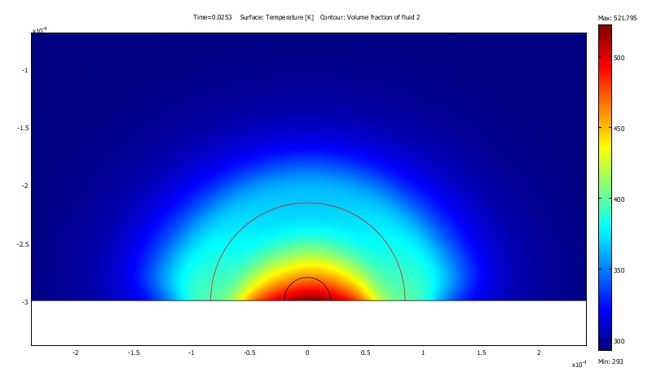
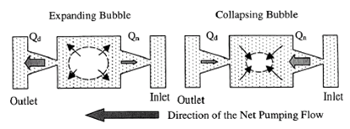
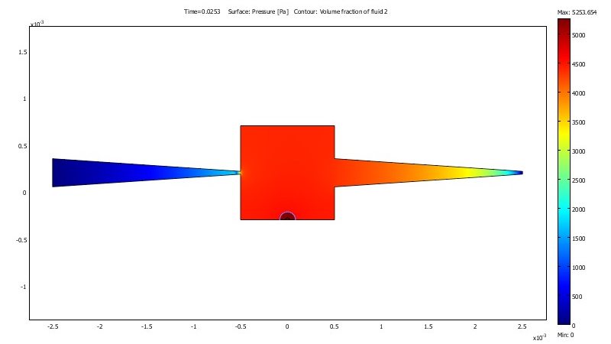
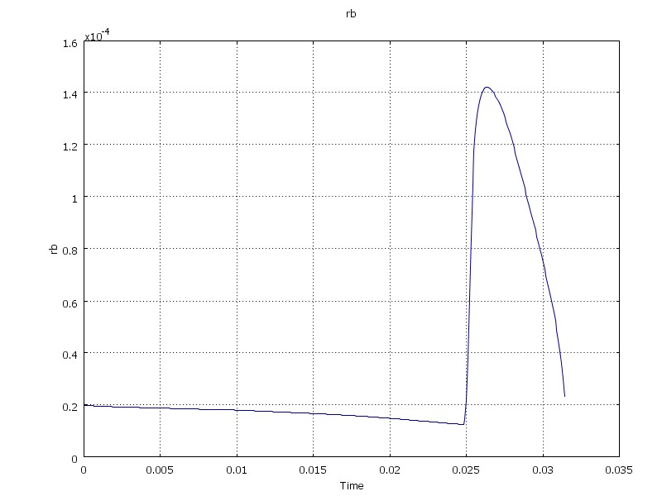
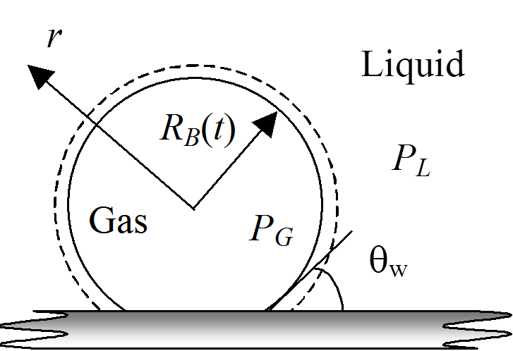
Numerical Analysis of Bubble Powered Micropump
G. A. Pinhasi¹, Matan Pe'er^{1,2} and Amos Ullmann²
Dept. of Chemical Engineering, Ariel University, ISRAEL
School of Mechanical Engineering, Tel Aviv University ISRAEL
INRODUCTION: Development of micro-pumps allows the minimization of many bio-engineered and electrical systems, for example, controlled drug delivery systems or liquid cooled microprocessors. The development of such system is facing two major challenges: the design of actuation mechanism and the flow direction control.
In the present work a numerical model is being developed to simulate the operation of a micro-pump driven by bubble formation and growth after Tsai and Lin (2002) design^{1,2}.
RESULTS:
RESULTS: The actuation mechanism comes from periodically nucleating and collapsing thermal bubbles. A net flow is generated from the nozzle to the diffuser by the nozzle-diffuser flow controller
Current
interface
Current
interface
Heating Plate
Figure 3. Bubble Growth: Temperature map
Figure 1. Nozzle-diffuser based bubble pump¹: principle and drawing
Outlet
Inlet
COMPUTATIONAL METHODS: The analysis is made with finite element software-COMSOL Multiphysics using COMSOL-MATLAB code. The Level-Set method used, to represent the gas-liquid interface.
The model consisted of sub-models, :
Initial liquid heating
Formation of a critical bubble³, Nucleation model
Bubble growth and Liquid flow through the nozzles system.
Conservation Equations:
Continuity
Momentum (Navier-Stokes, NS)
Energy: Convective Heat transfer
Level-Set (ϕ=0 vapor; ϕ=1 Liquid)
Heat and Mass relation at the Interface
Figure 4. Bubble Pump: Pressure map.
Heating period
1 [MW/m²]
Bubble Radius [m]
Bubble growth stage
0.14mm
Bubble
Collapse
stage
Bubble growth stage
0.14mm
Inlet Fluid 1
Time[ms]
Figure 2. Bubble interface
Figure 4. Bubble Size History- Single Cycle.
Interface
n
φ
Vapor
Liquid
Figure 5. Pump Characteristics (Flow-rate, Head)
1
R_{B}
δ
REFERENCES:
Tsai, J.H. and Lin, L. "A thermal-bubble-actuated micronozzle–diffuser pump", J. Microelectromech. Syst., 11, 665–671 (2002) .
Jung, J.Y. and Kwak, H.Y., "Fabrication testing of bubble powered micropumps using embedded microheater", J. Microfluid Nanofluid, 3, 161-169 (2007) .
Pinhasi, G.A., Dayan, A. and Ullmann, A., "Modeling of Flashing Two-Phase Flow", Reviews in Chemical Engineering, 21(3-4), 133-264 (2005) .
r
Figure 2. Level-set
Excerpt from the Proceedings of the 2019 COMSOL Conference in Cambridge

