Slide 1

Numerical Analysis of Bubble Powered Micropump
Gad A. Pinhasi
Matan Pe’er and Amos Ullmann
COMSOL CONFERENCE 2019
Cambridge, September 24–26

Slide 2
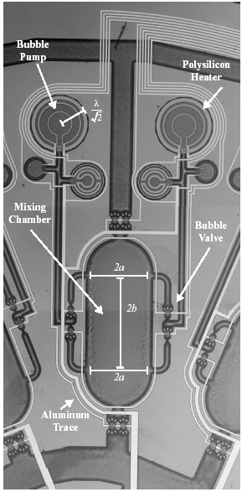
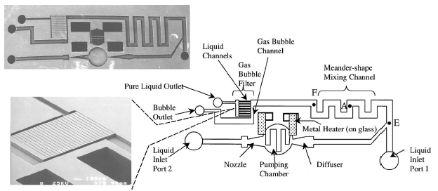
Micro Pump
A lab-on-a-chip (LOC)
Micro Fluidic Pumps
Insulin Pump (drug delivery)
Electronics cooling, Ink Printers, …
φ1mm
Micro-channels and Pump
(Lin and Tsai, 2002)
Active Mixer (Evans et al., 1997)

Slide 3
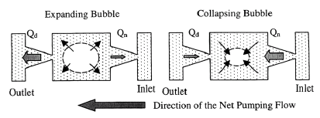
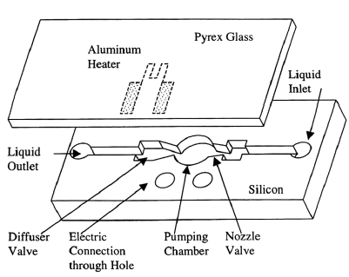
Bubble Micro-Pump
Driving force
Bubble formation, growth and collapse
Vapor volume change
Flow control
Diffuser/Nozzle
Unsteady Pumping flow
Pulsing flow
No moving parts
Tsai and Lin (2002)
Jung and Kwak (2007)

Slide 4
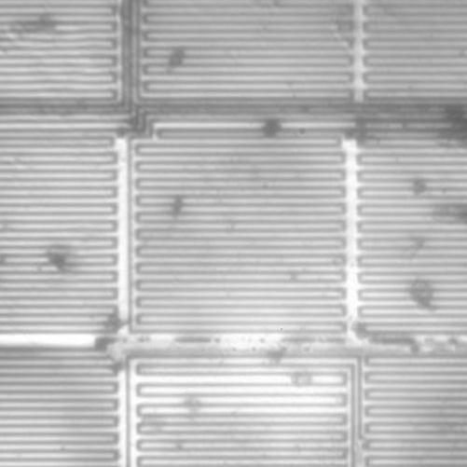
Bubble Lifetime Cycle
Heating
“Waiting” Time
Bubble formation:
Stable bubble criterion
Nucleation
Bubble growth
Inertia Controlled
Diffusion Controlled
Collapse
Problem: Discontinuity in the flow field in time
Deniray and Kim (2004)

Slide 5
The Objective
Developing a numerical model to simulate the operation of a micro-pump driven by bubble formation and growth.
Sub-models:
Initial liquid heating,
Formation of a critical bubble,
Bubble growth and collapse
The liquid flow through the nozzles system.

Slide 6
Basic Assumptions
t_{h}
Laminar flow
Heating with constant heat flux.
Duty cycle (= 80%)
Initial liquid temperature: Ambient
Initial Hemispherical critical bubble on the wall
Case Study:
Displacement Pump: 2D, 3D analysis
Bubble growth simulation: 2D spherical
Bubble Pump: 2D analysis
DC=t_{h}/Tc
q”
Tc
t

Slide 7
Conservation Equations
Continuity
Momentum: NS Eq.
Heat Eq.: Convection
Heat and Mass Transfer at the Boundary
Phase Change
Moving boundary
Liquid
Vapor
Heat
q”
Evaporation
m_{e}”

Slide 8
Liquid-Vapor Boundary Representation
Level Set Method
Fluid interface representation
Level-set Parameter
φ [0,1], φ=0.5
Fixed Grid
Interface
n
Vapor
Liquid
φ
R_{B}
1
δ
r

Slide 9
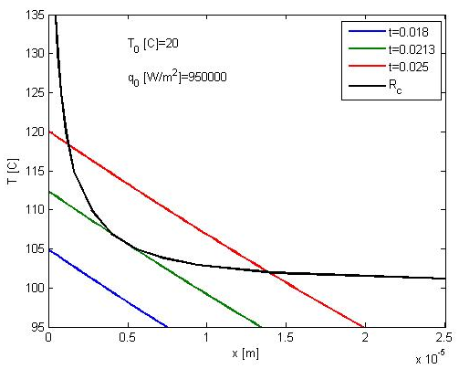
Bubble Formation Criterion
Wall heating
Semi-infinite body
Constant heat flux
Critical Radius
Nucleation
A
Liquid Heating
t
Critical Radius
B
Heating
Plate
R_{B}
Hsu (1962)
Bubble

Slide 10
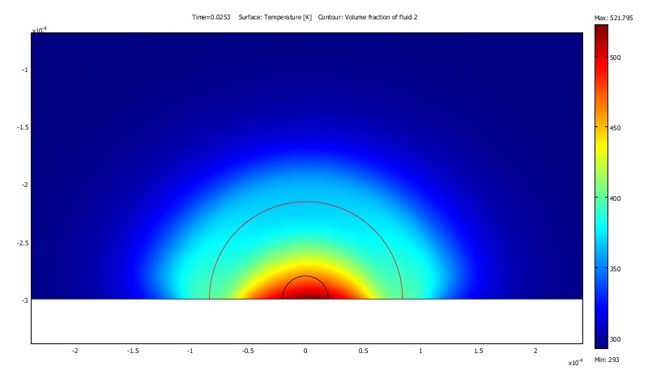
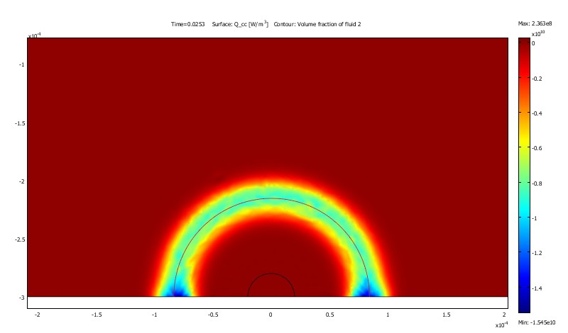
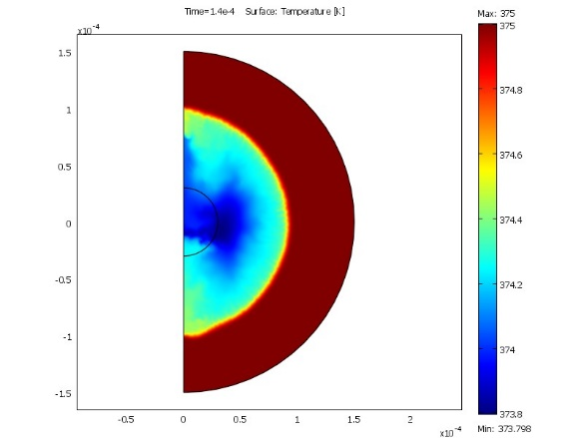
Liquid
Liquid Heating Model
Bubble Nucleation Criterion
No
Heating surface
t+dt
Yes
Interface formation
Bubble formation
Bubble Growth Model
Bubble Collapse Criterion
No
Bubble growth
t+dt
Yes
Bubble Removal
Liquid

Slide 11
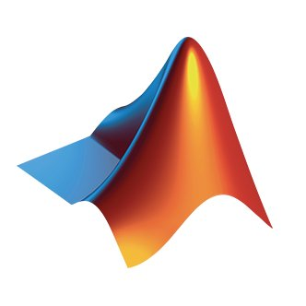

The CFD Tools
MATLAB Based
Main program
Script (MATLAB)
COMSOL Multiphysics
Physics:
Laminar flow
Heat Transfer
Fixed Grid Boundary problem: Level set
Grid generator
Solver
Post Proceeding
COMSOL Multiphysics and the LiveLink for MATLAB
Combine user code and software functions and solvers:

Slide 12
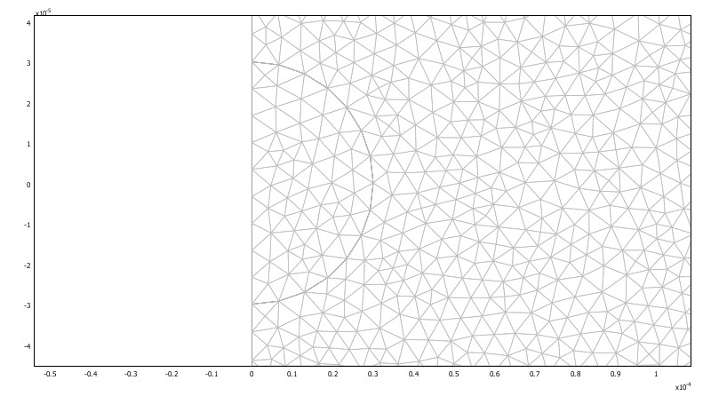
Results
Diffuser/Nozzle Characteristics
Displacement Pump
Bubble growth
Bubble pump

Slide 13
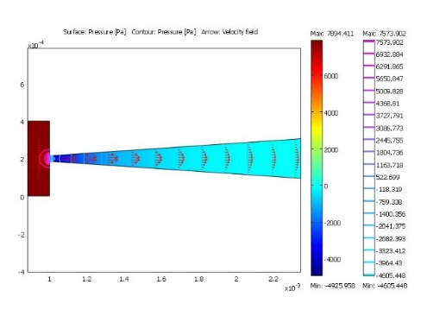
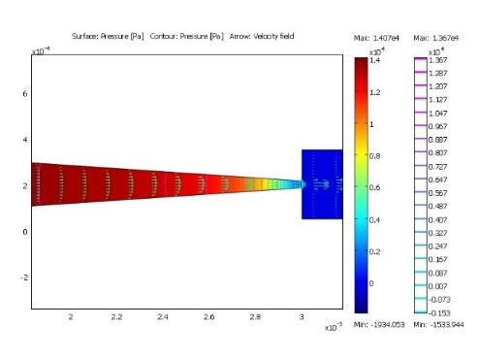
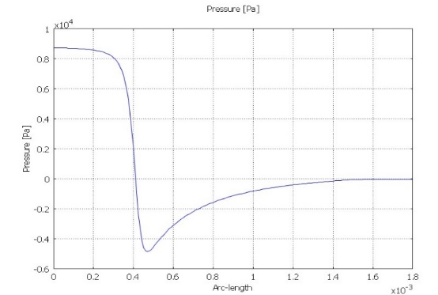
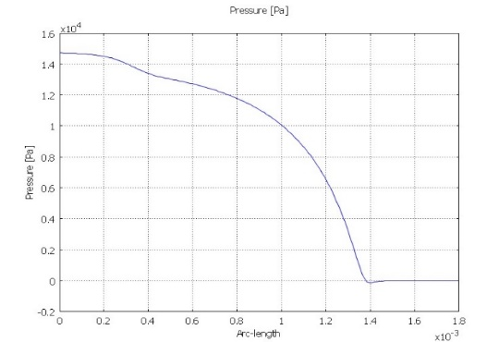
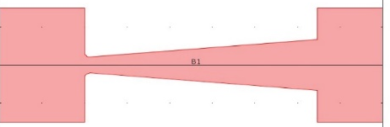
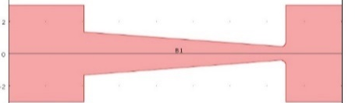
Diffuser/Nozzle Characteristics
Steady state flow
Minor losses Coef.: K
Effectiveness η
High η, directed flow
Diffuser Nozzle

Slide 14
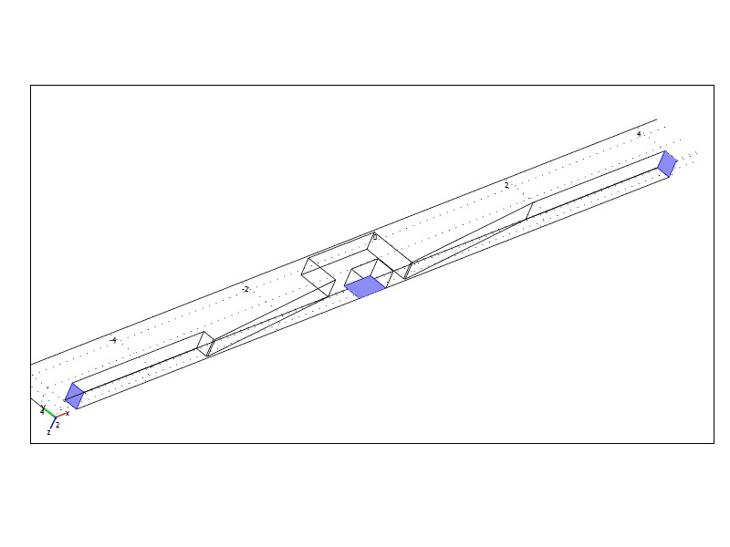
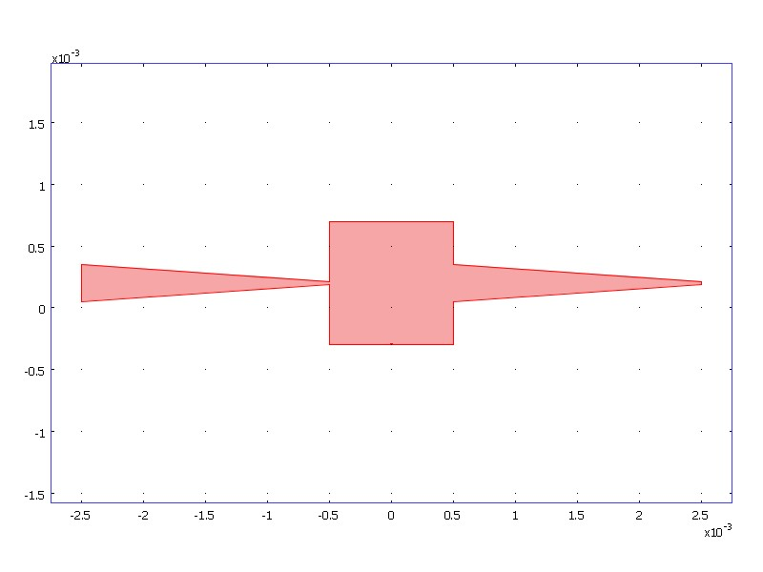
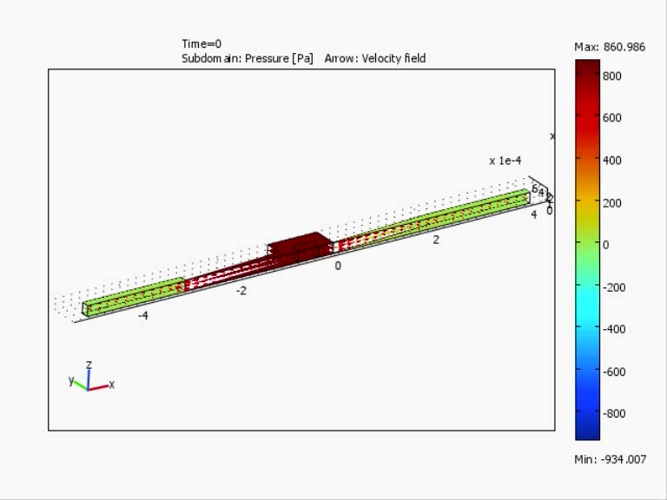
3D Displacement Pump
v

Slide 15
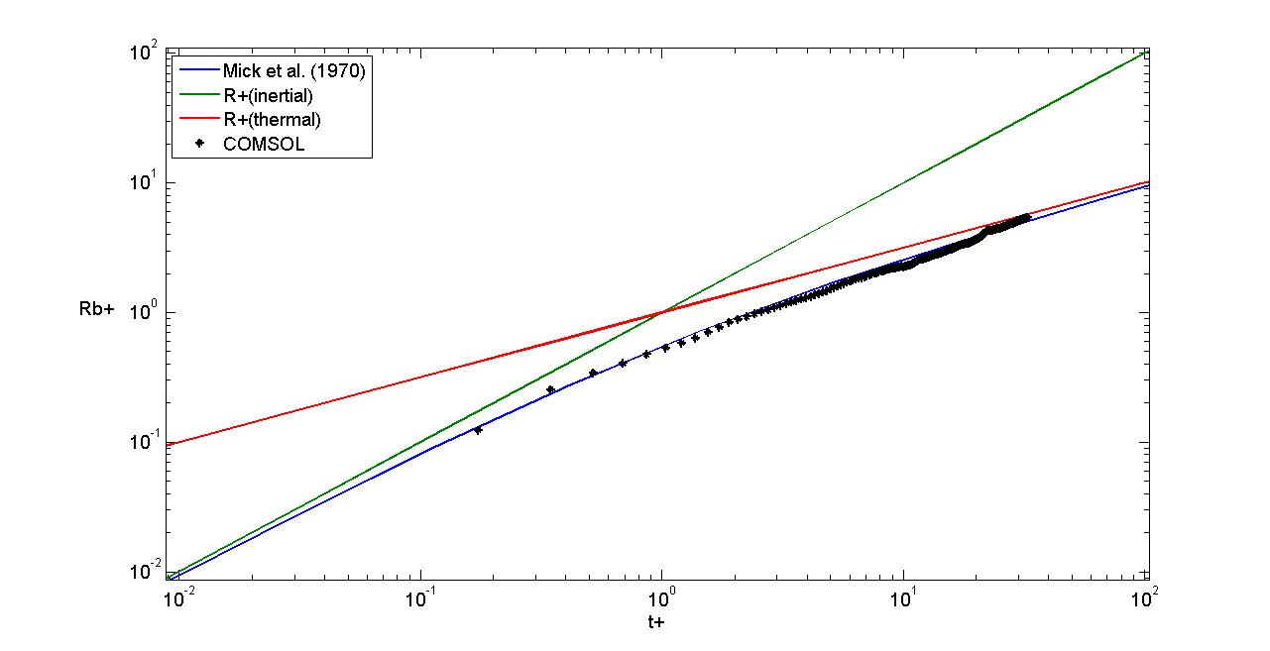
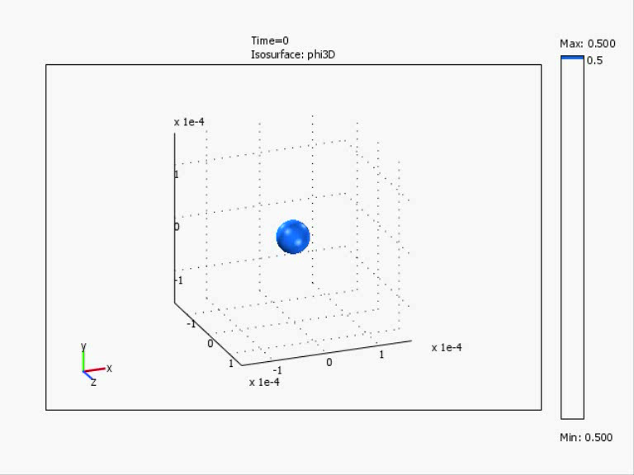
Spherical Bubble Growth
Bubble radius time history
3D Analysis
Axial symmetry
Comparison against analytical models
Diffusion Controlled
Inertia Controlled

Slide 16
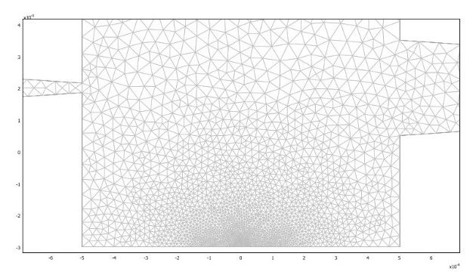
Bubble Pump
t_{h}
DC=t_{h}/T
q”
Boundary conditions
Pressure drop
Heater segment
Initial Conditions:
Initial temperature: 298K
Contact angle 90°
Hemispherical liquid domain
T
t
1 mm
2 mm
0.03 mm
1 mm
0.3 mm
0.18 mm
Heating
Plate

Slide 17
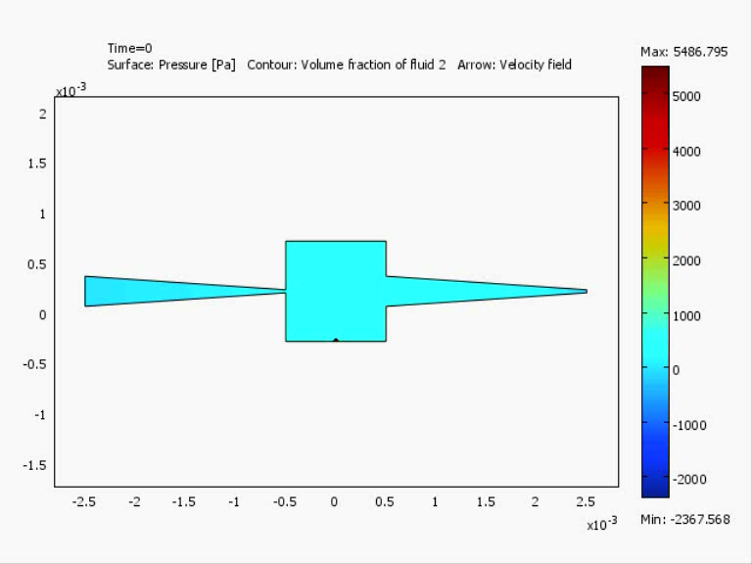
Bubble Growth Stage
Velocity-Pressure map

Slide 18
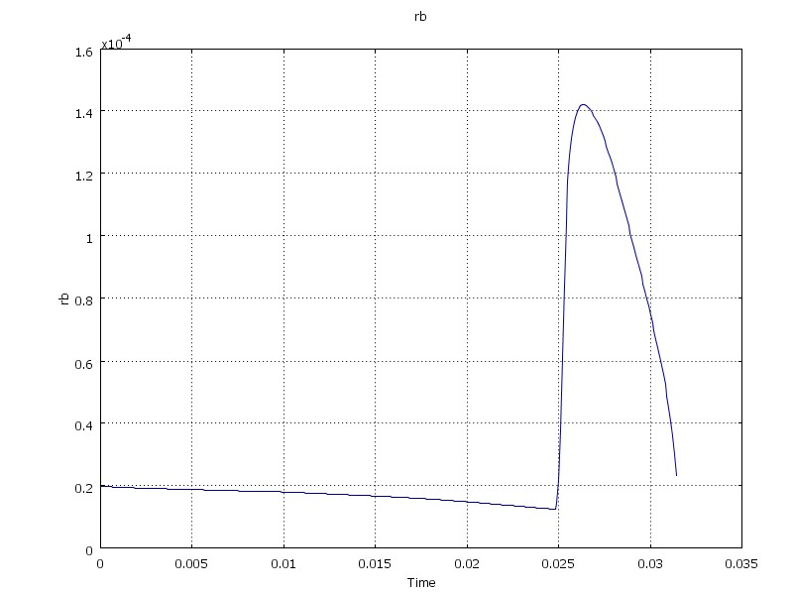
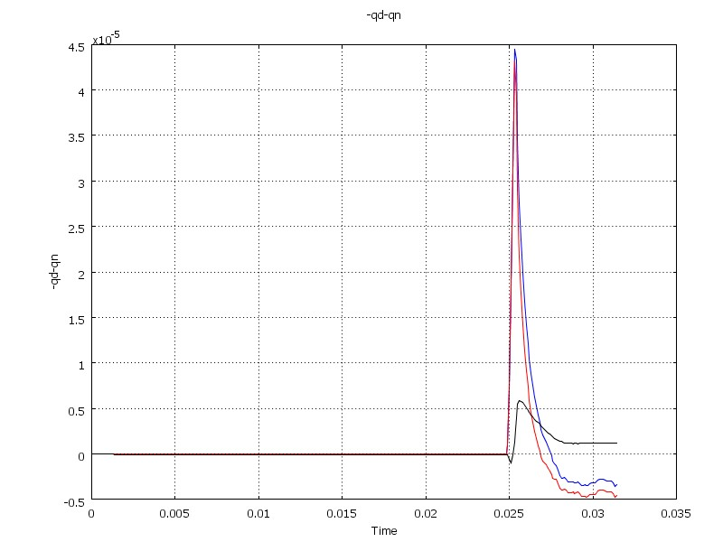
Velocity and flow rate
Bubble Pump
Net flow rate
3.81E⁻⁷ [m²/s]
9.14 [µl/min]
Bubble radius
Bubble Growth R = 0.14mm
Bubble Collapse
Net Flow Rate
[m²/s]
Bubble Radius [m]
Duty cycle = 80%
Heat Flux in = 1M [W/m²]
Heat Flux out = 10k [W/m²]
Time [s]
Time [s]

Slide 19
Head and Efficiency
Bubble Pump

Slide 20
Summery
A numerical model was developed to simulate the operation of a micro-pump driven by bubble formation and growth.
The model solves the time dependent conservation equation for viscid fluid: mass, momentum and convection heat transfer.
The Level-Set method is being used to represent the gas-liquid interface.
The analysis is made by using finite element software-COMSOL Multiphysics.
The model was tested against analytical model for diffusive bubble growth.

Slide 21
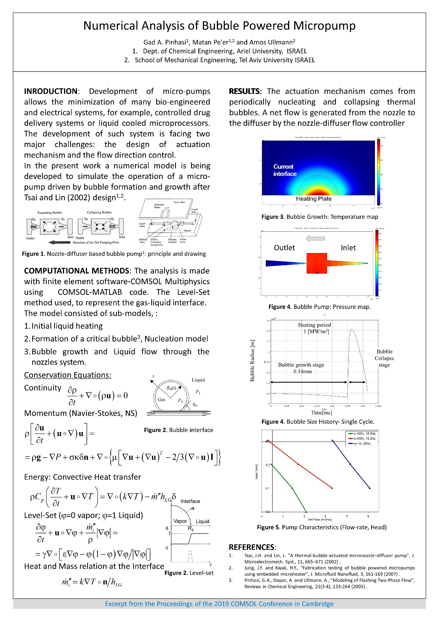
Pinhasi, G.A., Pe'er, M. and Ullmann, A. (2019) “Numerical Analysis of Bubble Powered Micropump”, Proceedings of COMSOL Conference 2019, Cambridge, September 24–26.

Slide 22


