Slide 1


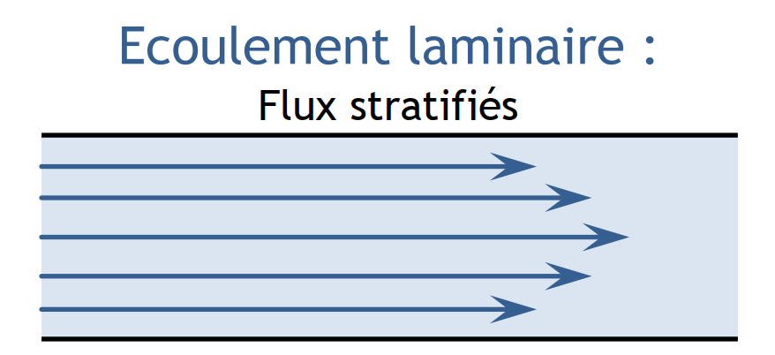
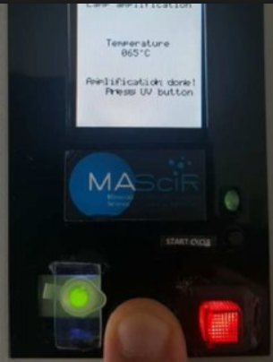
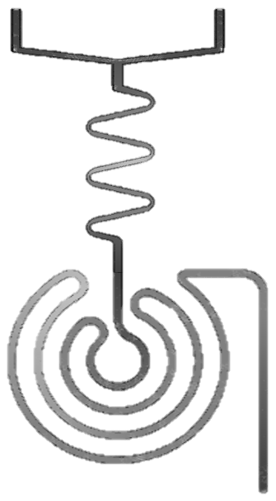
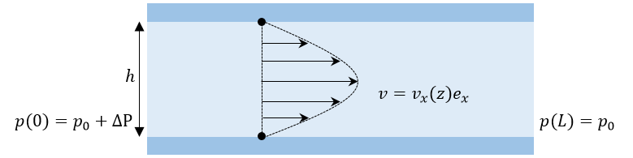
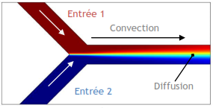
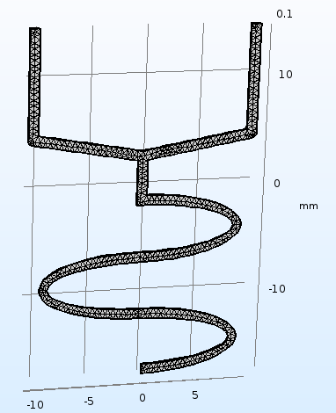
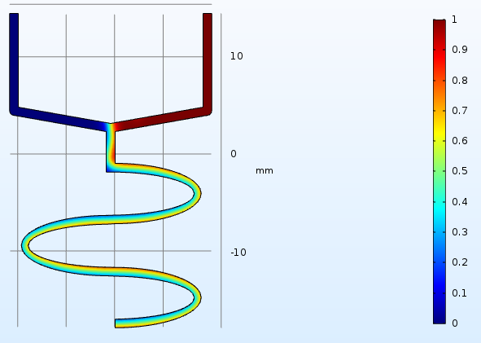
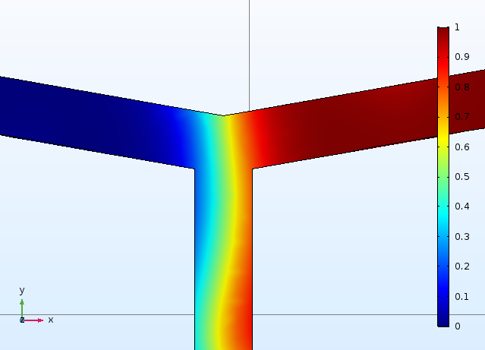
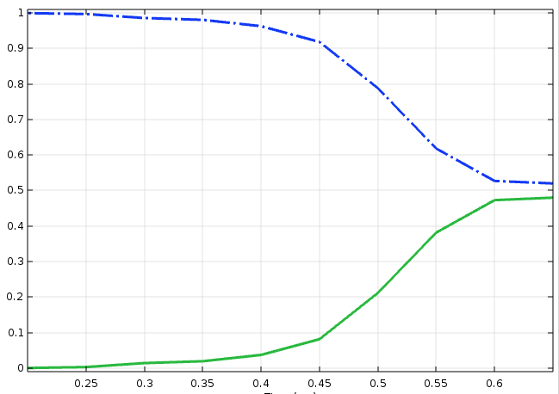
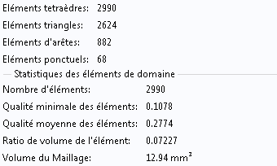
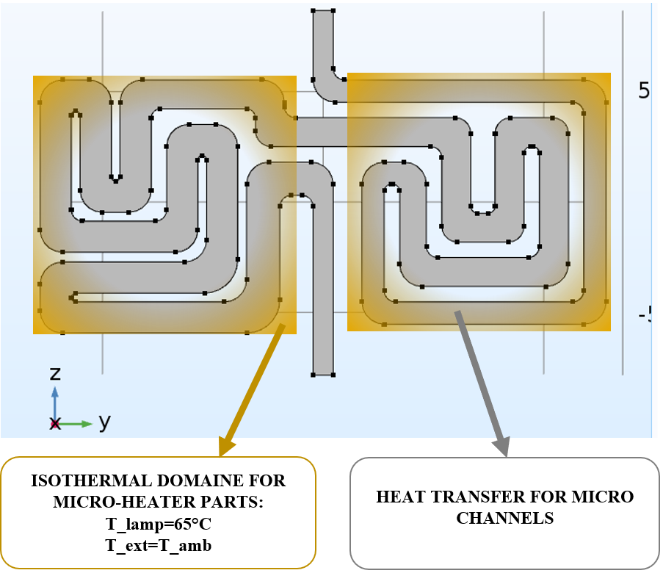
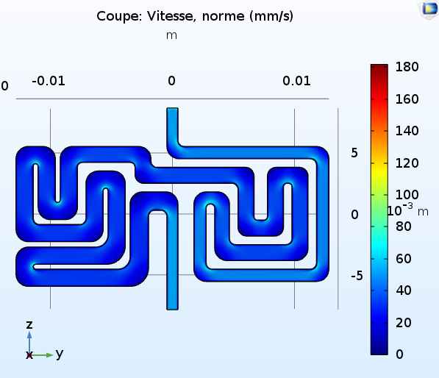
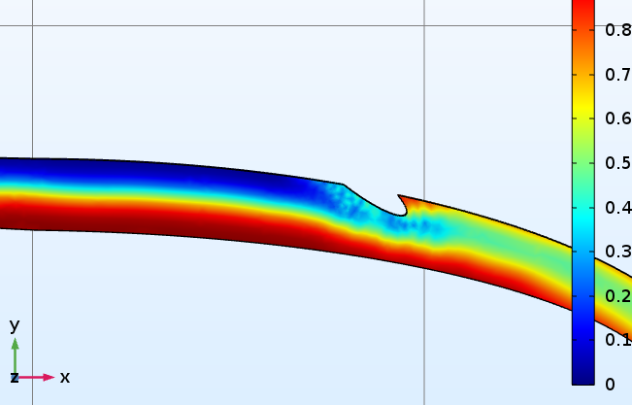
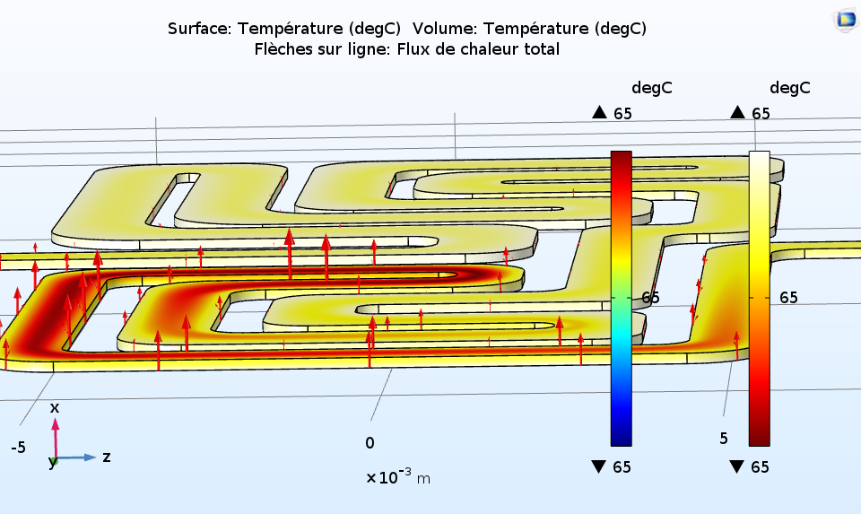
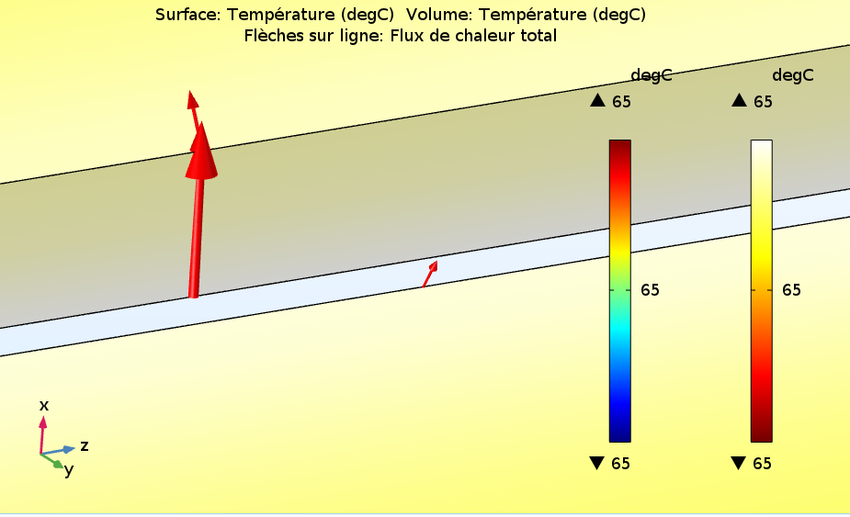
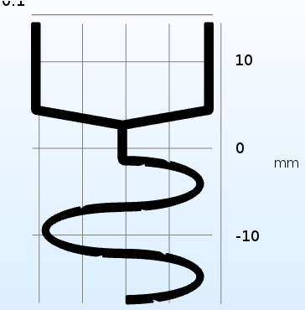
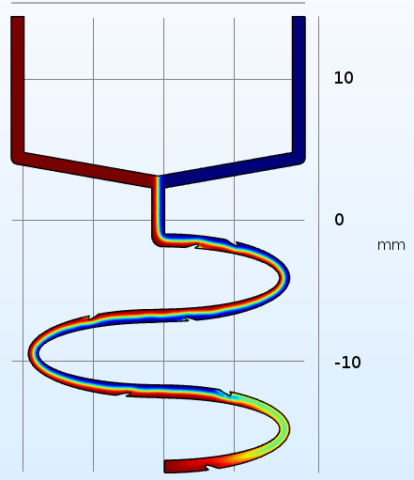
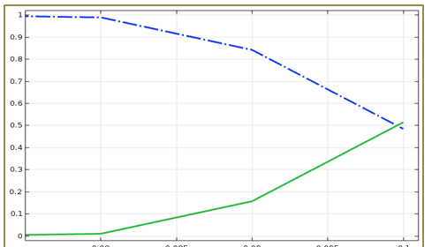
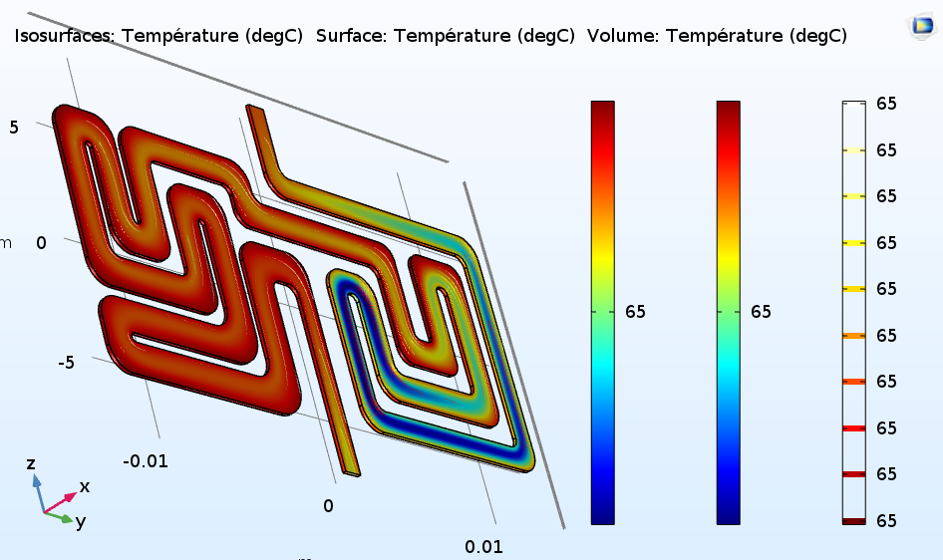
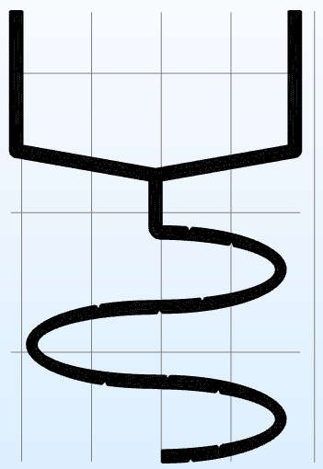
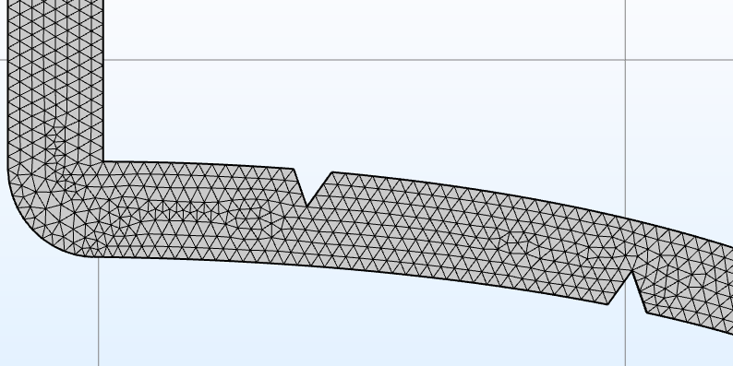









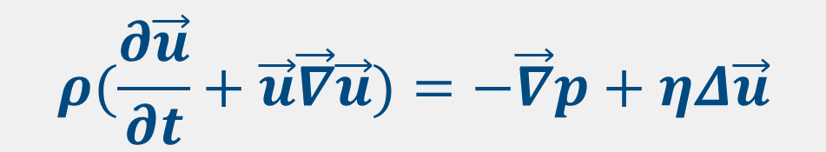


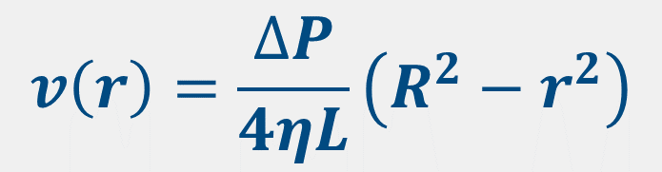


A Microfluidics Computational Simulation for Clinical POC LOC Applications
Jafrane ${LAMIAA.}^{1,3,4}$, Frederik Vreys.^{1,2}, Thoelen R. ^{1,2} , TAHRI D. ⁴ , Ressami E.M$\text{3}$, Lakssir B.³, A.Benhassou H.³
¹Institute for Materials Research (IMO), Hasselt University, Diepenbeek, Belgium
²IMOMEC, IMEC vzw, Diepenbeek, Belgium
³Moroccan Foundation for Advanced Science, Innovation and Research (MAScIR), 10100 Rabat, Morocco
⁴Université Sidi Mohamed Ben Abdellah, Faculté des Sciences et Techniques, B.P. 2202 Fès, Morocco
Introduction
A technological revolution of Point-Of-Care (POC) devices is becoming essential, especially infectious diseases diagnosis for vulnerable population. It can be achieved by upgrading the existing Lab on Card device which is based on Electronic Embedded System. Within this device the reaction and the detection is conducted by an Eppendorf tube as a biological sample holder, hence upgrading this device requires the manufacturing of microfluidics channels within Lab On Chip device, which is an important step to control and optimize the biological samples flowing. Thus a computational simulation on COMSOL Multiphysics 5.3 is conducted to study and visualize: The mixing of interaction distribution between the liquefied sputum of Mycobacterium Tuberculosis patient with other biological reagents, fluid flow pressure, velocity and the design of the whole microfluidic flow pattern is observed.
Microfluidics-Basics
The existing Lab On Card device:
The Improved Lab On Chip device:
1. Reynolds Number:
$$Re=\frac{ρ V L}{η}$$
Laminar Flow
$ρ$: Density
$V$ : Velocity
$L$: Length
$η$ : Viscosity
Sputum
Master Mix
$$0.0001<Re<0.5$$
2. Navier-stockes Equation:
$$ρ(\frac{∂\vec{u}}{∂t}+\vec{u}\vec{∇}\vec{u})=−\vec{∇}p+ηΔ\vec{u}$$
The term of inertia is negligible
$ρ :$Density
$p$ : Pressure
$\vec{u}$ : $Velocity field$
$η$ : Viscosity
Passif Micro-Mixer
$$η∇^{2}u=∇P$$
85mm
3. Poiseuille Flow:
$$v\left(r\right)=\frac{∆P}{4ηL}\left(R^{2}−r^{2}\right)$$
P : Pressure
v: Velocity field
$L$ : Channel Length
$η$ : Viscosity
R : Maximal ray
LAMP Reaction
$$\left\{\begin{aligned}Convection \\ or \\ Diffusion\end{aligned}\right.$$
$$Pe=\frac{L_{c}V}{D}$$
$L_{c}$: Characteristic length
$V$ : Velocity
$D$: Diffusion coefficient
N
?
P
Detection
4. Péclet Number:
55mm
Lab On Card
Lab On Chip
Results
II. Heating Part:
Mixing Part:
The heating part represents the reaction zone in which the DNA react with Biological reagents under LAMP Temperature (Isothermal nucleic acid amplification technique in which isothermal amplification is carried out at a constant temperature, and does not require a thermal cycler)
① Inlet number 1: Presents the input of Sputum of Mycobacterium Tuberculosis patient.
② Inlet number 2: Presents the input of Biological reagents.
1
2
Mixing Results:
Fig.1 Meshing
Fig.2 Volumic fraction of Volumicfluids
Mixing efficiency = 90%
Optimization
Fig.6 Velocity
To optimize the mixing efficiency some obstacles are added to create turbulence to favorize the mixing efficiency.
Fig. 5 Heating Principe
Mixing Results:
Mixing efficiency = 100%
Fig.7 Temperature (ht)
Perspectives : Simulation On going
Fig.3 Meshing
Fig.4 Volumic fraction of fluids
Fig.8 Isothermes (ht)
Acknowledgement
Conclusion
In this work I gratefully thank the financial support of the special research fund BOF of Hasselt University and VLIRUOS project MA2018TEA467A104.
The Multiphysics simulation allow us to control the fluids flow at the micron scale, to optimize the microfluidics circuit shape in order to fit with our goal which is the detection of MTB in the near term & other infectious diseases long-range goal.
COMSOL Conference 2019 in Cambridge

