Slide 1
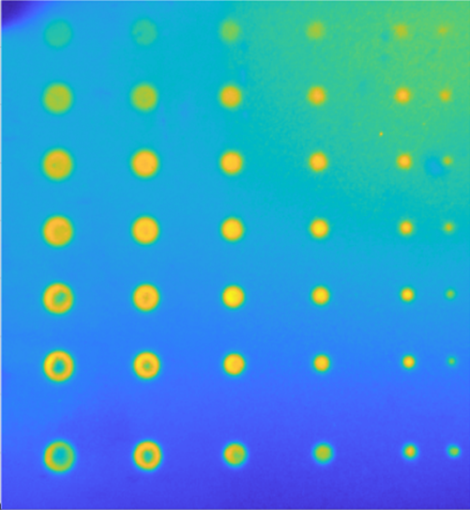
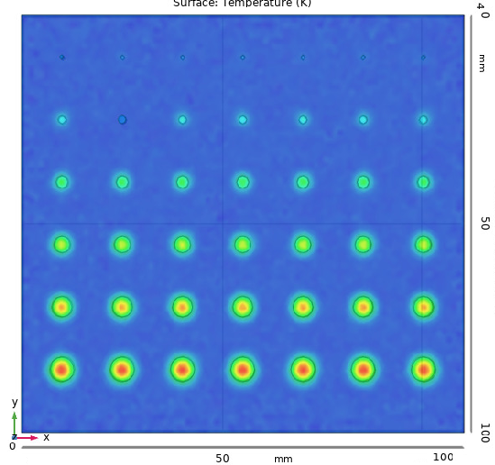
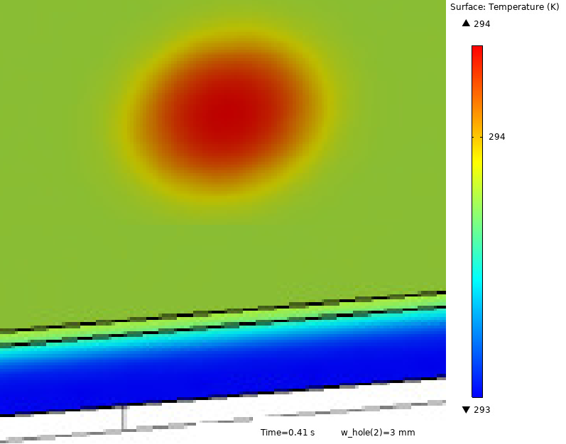
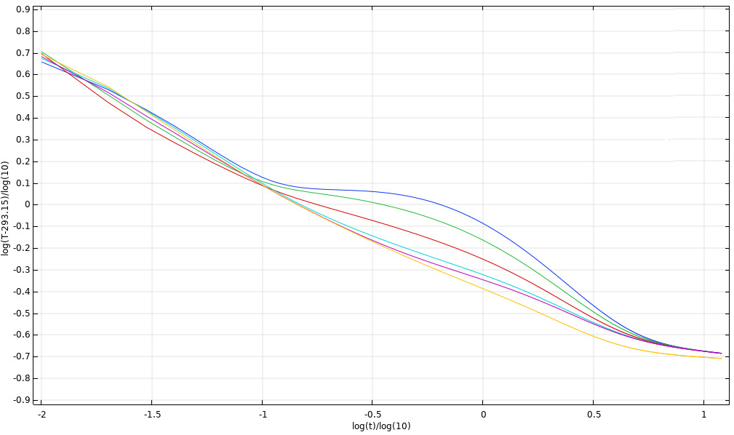


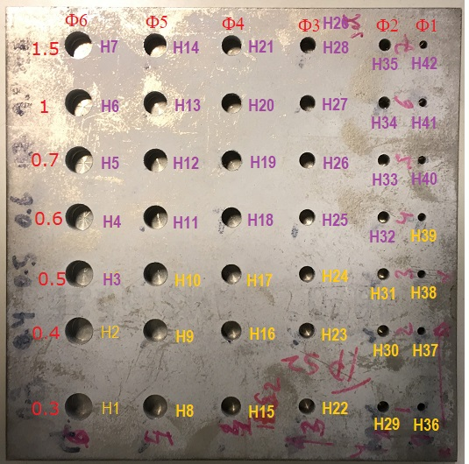
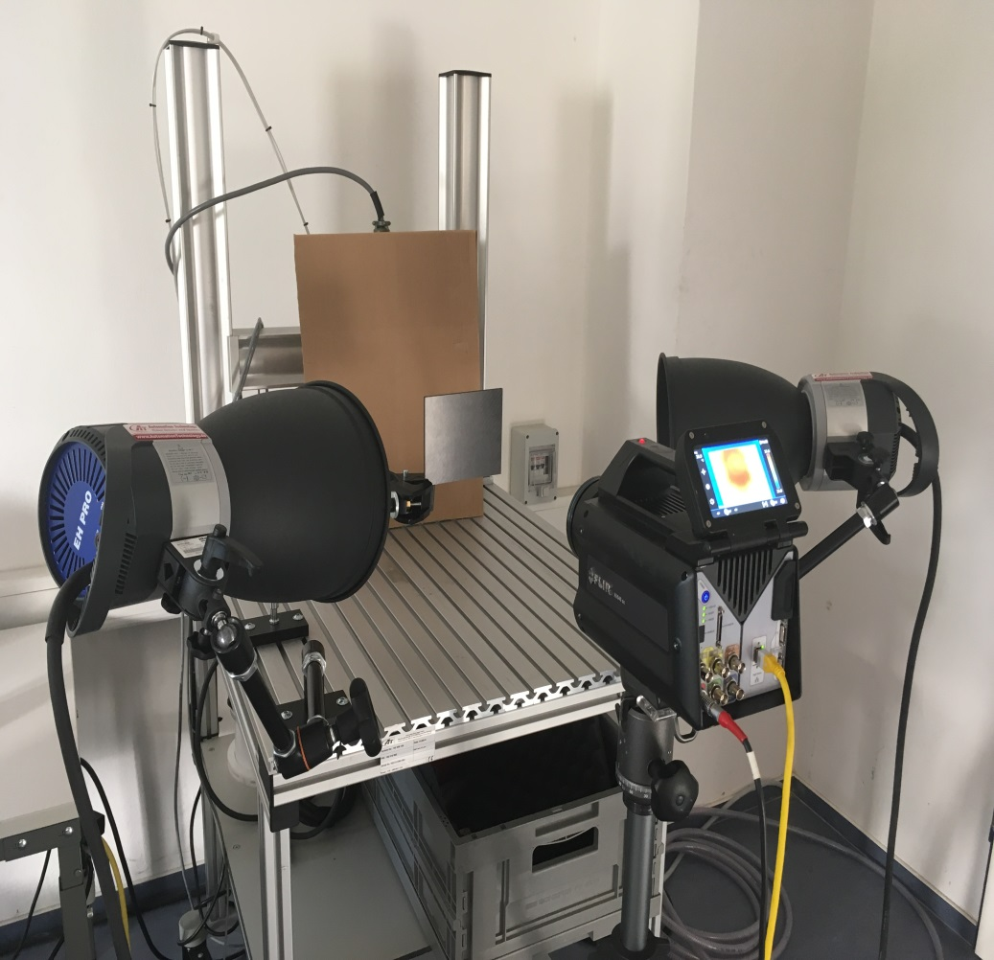
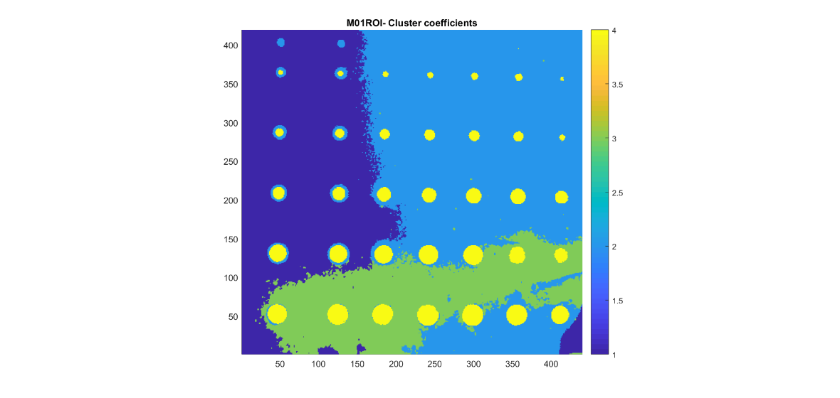
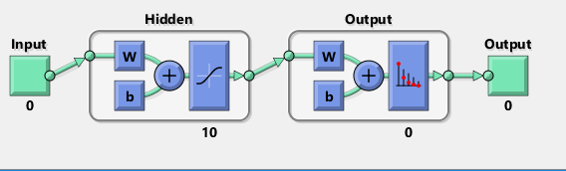

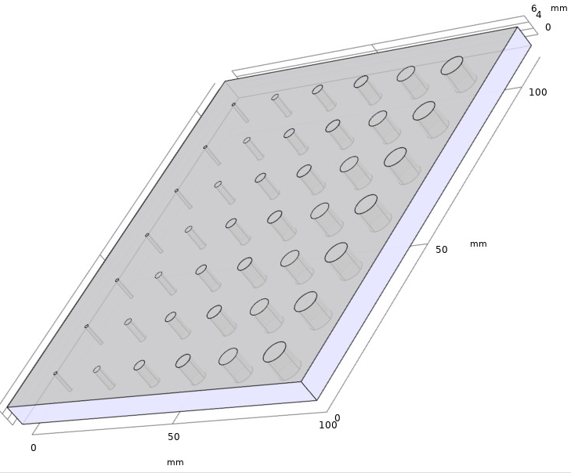
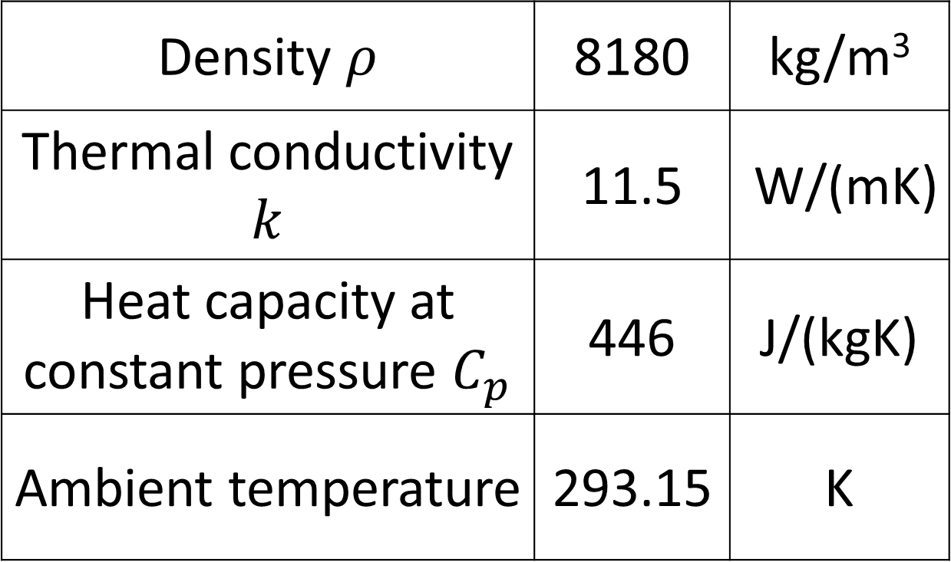
Towards Automatic Defect Recognition using Active Infrared Thermography, COMSOL Multiphysics and Machine Learning
P. Tudosa¹, D. Billson ^{2,} D.A. Hutchins ²
1.University of Warwick, School of Engineering, Coventry CV4 7AL,United Kingdom, P.Tudosa@warwick.ac.uk
2. University of Warwick, School of Engineering, Coventry CV4 7AL,United Kingdom
INTRODUCTION: Active Infrared Thermography is a family of non-destructive testing techniques used for the detection of surface and buried defects in a wide range of materials¹. The method is robust and sensitive enough to be used even in harsh industrial environments. However, the automatic detection and sizing of real defects can still be challenging, as the fabrication of physical calibration blocks with artificial defects that correctly represent the large variety of real defects is expensive and can be difficult, if not impossible, for many cases.
RESULTS: Temperature data have been obtained from the experimental thermograms and from the simulations. The temperature variations in the thermograms are due to the fabrication tolerance for defects and the clamping of the specimen.
EXPERIMENTAL METHODS: A Ni-based alloy base metal and bond coating calibration block, containing 42 flat bottom holes (FBHs), has been fabricated. The FBHs represent artificial defects of varying depths and sizes, with diameters between 1 and 6 mm and depths from the surface between 0.3 and 1 mm. A pulsed thermography system was used to capture and analyse the thermograms. The system used two flash lamps as excitation source and a FLIR SC7000 thermal camera as detector.
Figure 3. Thermogram from physical calibration block
Figure 4. Surface temperature COMSOL model for artificial calibration block
Temperature data have been extracted at selected points starting in the centre of the 3 mm diameter FBH, with 1 mm spacing.
Thermography System
Flash lamp | 2 x 6 kJ | 5 m s / pulse
FLIR SC7000 | 125 Hz | 640 x 513 pixels
Figure 5. Detail of thermal map; Positions of points; Thermal curves
K-means clustering methods can be used on post-processed data for defect recognition in a non-supervised manner. Furthermore, Artificial Neural Networks (ANNs) can be further trained to recognise and size any type of defects ².
Figure 1. Physical calibration block
Figure 2. Thermography experimental setup
Table 1. Thermography system parameters
COMPUTATIONAL METHODS: The model uses the COMSOL Multiphysics® Heat Transfer module to create an artificial calibration block identical to the physical one, excited by a heat pulse of 8kJ.
Heat Transfer equation:
$ρC_{p}\frac{∂T}{∂t}+$ $ρC_{p}u∙∇T+∇\left(−k∇T\right)=Q+Q_{ted}$
Figure 5. Non-supervised k-means classification map using four clusters with the FBHs shown in yellow cluster
Figure 6. Two-layer feed forward neural network with 10 neurons in the hidden layer
Ni-based alloy
Density $ρ$ | 8180 | kg/m³
Thermal conductivity $k$ | 11.5 | W/(mK)
Heat capacity at constant pressure $C_{p}$ | 446 | J/(kgK)
Ambient temperature | 293.15 | K
CONCLUSIONS: The combined procedures of modelling and experimental validation can create extensive training sets for ANNs and sizing via Machine Learning for any type of defect, reducing or eliminating the need for physical models.
42 FBHs
REFERENCES:
1. Vavilov V., Thermal NDT: historical milestones, state-of-the-art and trends, Quantitative InfraRed Thermography Journal, 11:1, 66-83 (2014)
2. Vallerand S., Maldague X., Defect characterization in pulsed thermography: a statistical method compared with Kohonen and Perceptron neural networks, NDT&E International, 33, 307-315 (2000)
Figure 3. Artificial calibration block and detail of mesh
Table 2. Material properties
Excerpt from the Proceedings of the 2019 COMSOL Conference in Cambridge

