Slide 1
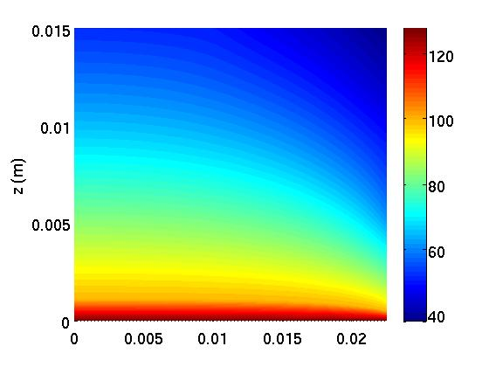
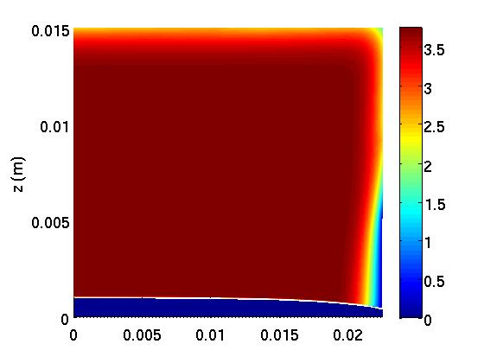
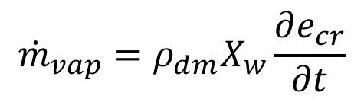

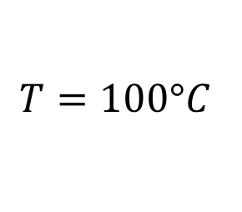
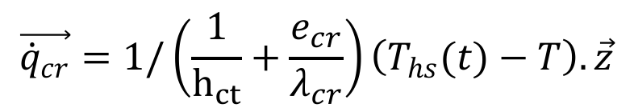

Numerical study of heat and mass transfer
during contact heating of potato slices
T. Vine, D. Flick, B. Broyart
UMR Ingénierie Procédés Aliments, AgroParisTech, INRA, Université Paris-Saclay, 91300, Massy, France
INRODUCTION:
Studies concerning the contact heating of food products remain relatively rare in the literature despite the importance of this mode of heat transfer in many industrial and domestic operations such as grilling or pan-frying. In this work, a 2D mathematical model was developed and used to better understand heat and mass transfer during contact heating of a particular product, the potato.
RESULTS:
Simulated results are compared to experimental data obtained using the experimental device. Results are shown for a constant heating power of 3.2 kW.m⁻², 6.4 kW.m⁻² and 9.6 kW.m⁻² with and without the presence of an oil layer below the product.
With oil
Without oil
Figure 1. Experimental setup
GOVERNING EQUATIONS:
Given the high temperature of the heating surface, the formation and moving of a boiling front at the bottom surface of the product is assumed. This boiling front is described using a moving interface that divides the product in two regions: the moist region and the dry region (the crust).
Free convection, radiation & water evaporation
Figure 3. Simulated and experimental results. Temperature profiles
at three locations in the product and water loss kinetics.
z
Moist
region
$$\left\{\begin{aligned}ρ_{dm}\frac{∂X_{w}}{∂t}+ \vec{∇}.\vec{{\dot{m}}_{w}}=0 \\ ρ_{dm}\frac{∂\hat{H}}{∂t}+ \vec{∇}.\vec{\dot{H}}=0\end{aligned}\right.$$
Free convection, radiation & water evaporation
Crust
Boiling front:
r
$$T=100°C$$
+ water evaporation
Contact heat transfer
+ Thermal conduction
in the crust
Vapour emission
(no resistance)
$${\dot{m}}_{vap}=ρ_{dm}X_{w}\frac{∂e_{cr}}{∂t}$$
+ heat balance equation
$$\vec{{\dot{q}}_{cr}}=1/\left(\frac{1}{h_{ct}}+\frac{e_{cr}}{λ_{cr}}\right)\left(T_{hs}(t)−T\right).\vec{z}$$
$${\dot{m}}_{vap}L_{v}=\left(\vec{{\dot{q}}_{cr}}−λ_{mo}\vec{∇}T\right).\vec{z}$$
Figure 4. Example of simulation results. Temperature and
water content field obtained after 15 min of heating (3.2 kW.m⁻² with oil).
Figure 2. Governing equations
CONCLUSIONS:
The model was validated by showing good agreements between measured and calculated values of product temperature and water loss. Experimental characterization of the structure of the crust (porosity, permeability) is planned to improve model accuracy (especially for high heating power).
GEOMETRY & MODEL IMPLEMENTATION:
COMSOL Multiphysics 5.2
2D axisymmetric geometry
Coefficient Form PDE for the moist region
Boundary ODE for the boiling front and the crust
Deformed geometry for the moving interface
Free triangular mesh (4268 elements)
Excerpt from the Proceedings of the 2019 COMSOL Conference in Cambridge

