Slide 1
3D Modeling of Polymer Nanocomposite under High Voltage
MD AFZALUR RAB
Norfolk State University

Slide 2
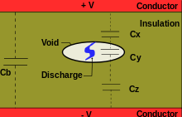
HIGH VOLTAGE RELATED ISSUES IN TRANSMISSION LINE
Power is transmitted at high voltages is to increase the efficiency of transmission line over a long distance.
At a relatively high voltage, regions of "space charge“ build up in the material.
High voltage causes partial discharge (PD), which is a localized dielectric breakdown (DB) of a small portion of a solid or fluid electrical insulation (EI) system under high voltage (HV) stress, which does not bridge the space between two conductors
Localized Electric Field is maximized and distorted which is not expected and need to reduce
Materials degradation occur under high voltages
Electrical treeing can cause Power systems failure under a certain high voltage.
Figure1: Partial Discharge

Slide 3
Nanocomposite : Application of Nanoparticles in Polymeric Insulation
Features of Nanoparticle
Types on Samples used
Cloisite 20A° Natural Montmorillonite clay incorporated in polypropylene-
PP+N0%,
PP+N2%,
PP+N6%
Synthetic Tetrasilisic fluro mica incorporated in polypropylene-
PP+S0%,
PP+S1%, PP+S2%,
PP+S4%, PP+S8%
Aspect ratio of natural nanoparticle is <286 and Aspect ratio of synthetic nanoparticle is <6000.
Interface zones are formed between nanoparticle and polymer matrix. Lower the aspect ratio, higher the area of interface zone.
Homogeneous nanoparticle dispersion and strong interfacial bonding are required for better performance. Compatabilizers are used.
Nanoparticle has higher permittivity than base polymer.

Slide 4
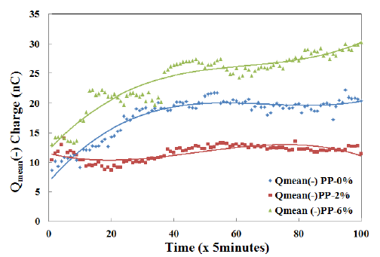
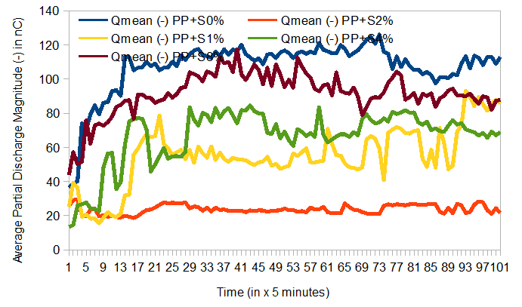
Average Discharge During Long Term Aging under HV
Percolation limit of Nanoparticles affect the mean discharge magnitude
Reduction in the amount of space charge injection was observed in samples with nanoparticle below the percolation threshold.
But, above the percolation threshold, the movement of space charges is enhanced due to diffused double layer charge clouds appearing around Nanoparticles.
Figure: Mean discharge magnitude for natural nanofilled sample (top) and synthetic nanofilled sample (bottom)

Slide 5
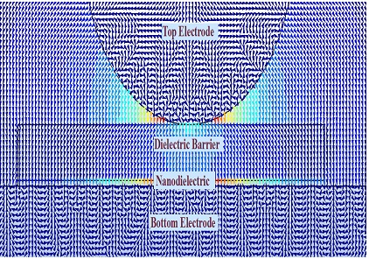
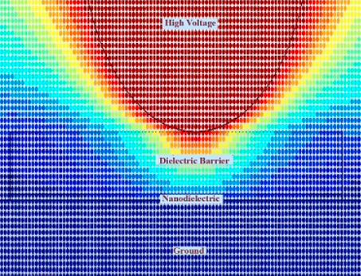
Simulation of Field direction and Voltage Scatter
Figure 1: Electric-field arrow in nanofilled polypropylene
Figure 3(a). Voltage Scatter under Applied Voltage

Slide 6
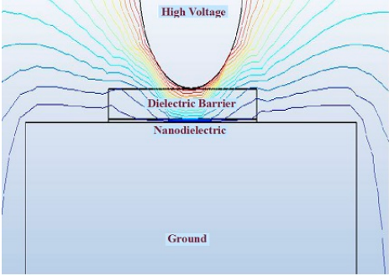
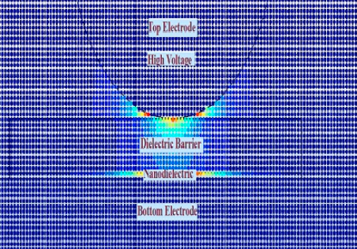
Voltage Contour and E-field Density
Figure 3(b). Electric Field Density under Applied Voltage
Figure 3(c). Voltage Contour under Applied Voltage

Slide 7
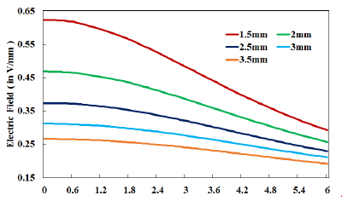
Computed Electric Field from Rod Tip to Sample Center for various dielectric barrier thickness
Figure 1: Electric-field arrow in nanofilled polypropylene
Figure 4. Electric Field simulation for various thickness of dielectric barrier or distance from rod tip (of top electrode) to sample surface

Slide 8
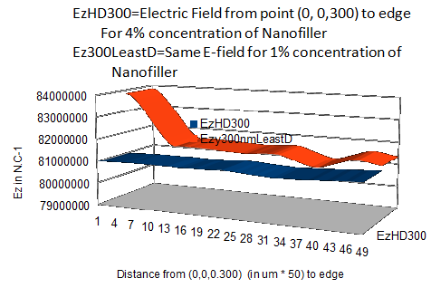
Figure 6. Electric Field for nanoparticle concentration of 1% and 4%

Slide 9
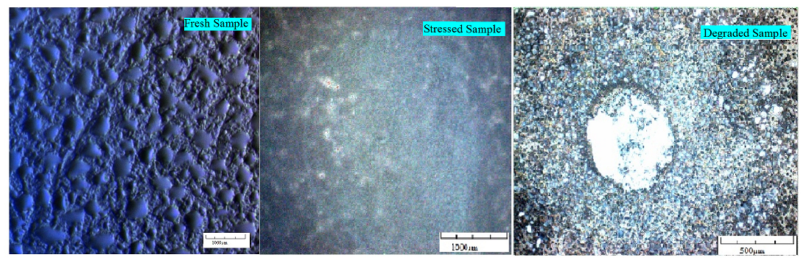
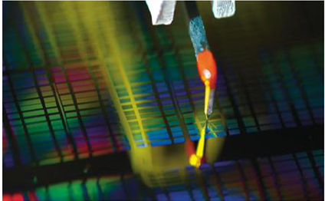
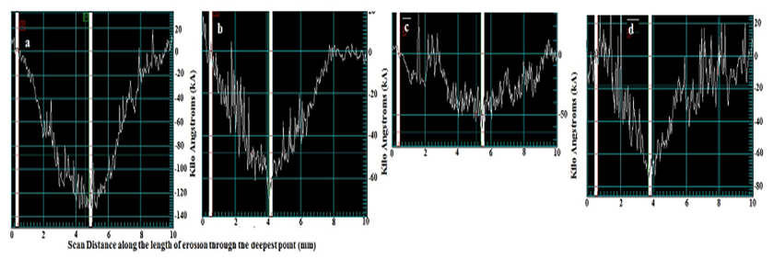
Surface Degradation due to High Voltage
Figure: Degraded sample (left) and Profilometer tip)
Figure: Measurement of degradation (filler concentration increases from left to right)

Slide 10
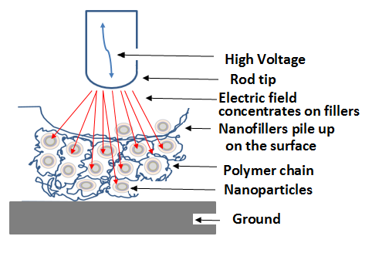
Mechanism to prevent Discharge and localized field
Figure: Mechanism to prevent Discharge and localized field
Erosion is caused by direct bombardment by ions that are produced by partial discharges, local heating due to high temperature gases and changes in structure by chemical reactions[1].
Firstly, nanosegmentation offers improved PD resistance . Because, inter-filler spaces which consist of mainly polymer materials , will be reduced by 3D nanosegmentation[4]
Secondly, electric field in nanofilled PP film will be concentrated mainly on nanoparticles because of their higher permittivity than base polymer[3].
Thirdly, nanofillers can get released from filler-polymer interface zones , during aging process under high electrical stress[3].

Slide 11
References
T. Tanaka," Internal Partial Discharge And Material Degradation", IEEE Transactions on Dielectric and Electrical Insulation, Volume:EI-21 , Issue: 6 , Dec. 1986
N. Fuse, M. Kozako, T. Tanaka, S. Murase and Y. Ohki, “Possible Mechanism of Superior Partial- Discharge Resistance of Polyamide Nanocomposites”, Annual Rept. IEEE-CEIDP 17-20 Oct. 2004 ,pp. 322-325.
Toshikatsu Tanaka and Tomonori Iizuka Waseda University ,"Generic PD Resistance Characteristics of Polymer Nanocomposites" Annual Report Conference on Electrical Insulation and Dielectric Phenomena, 17-20 Oct. 2010, West Lafayette, IN, pp. 1 - 4.
Masahiro Kozakol, Ryoichi Kidol, Norikazu Fuse2, Yoshimichi Ohki, Tatsuki Okamoto, and Toshikatsu Tanaka "Difference in Surface Degradation due to Partial Discharges between Polyamide Nanocomposite and Microcomposite", Annual Report Conference on Electrical Insulation and Dielectric Phenomena,17-20 Oct. 2004,pp. 398 - 401.
Norikazu Fuse, Yoshimichi Ohki and Toshikatsu Tanaka, “Comparison of Nano-structuration Effects in Polypropylene among Four Typical Dielectric Properties”, IEEE Trans on Dielectrics and Electrical Insulation, Vol.17, No.3; June 2010.
Md Afzalur Rab, Rohitha Dhara, Prathap Basappa, “Role of type and content of nanoparticle on certain dielectric characteristics of polypropylene nanocomposites”, Journal of Nanophotonics, SPIE, Vol. 9, Issue 1, 2015.
Anil B. Poda, Rohitha Dhara, Md. Afzalur Rab, Prathap Basappa, “Evaluation of aging in nanofilled polypropylene by surface discharges”, IEEE Transactions on Dielectrics and Electrical Insulation, Volume 23, Issue 1, pp. 275-283, 2016.
Md Afzalur Rab, Rohitha Dhara, Anil B. Poda, Prathap Basappa, “Effect of variation in main field and nanoparticle content on the partial discharge characteristics of polypropylene nanocomposites”, Journal of Nanophotonics, SPIE, Vol. 9, Issue 1, 2015.

Slide 12
Thank You for Being Present

