Slide 1
Multiphysics Simulation of Internal Discharge in Nanodielectrics
FARZANA ALAM

Slide 2
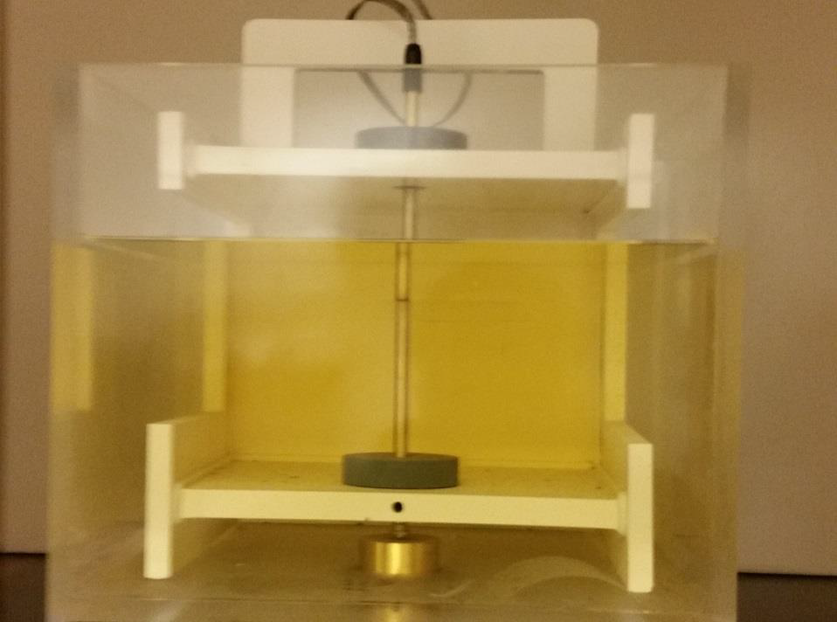
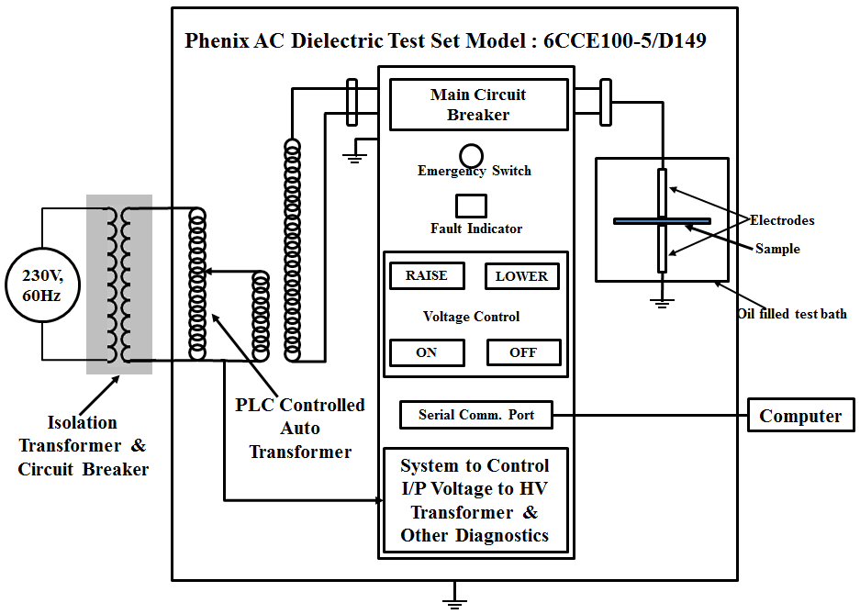
Experimental Set Up for Measuring Internal Discharge
Figure : Internal Discharge and Breakdown Strength Measurement

Slide 3
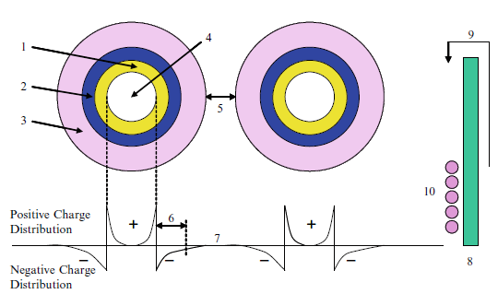
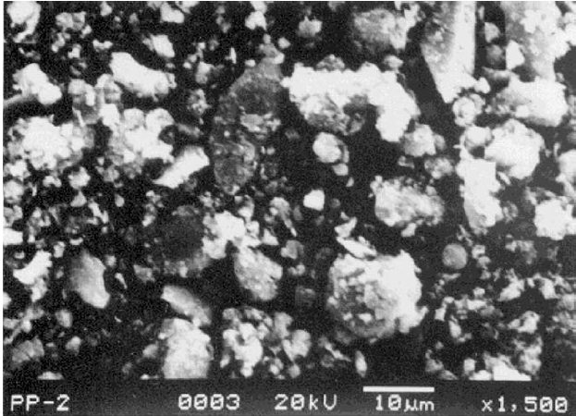
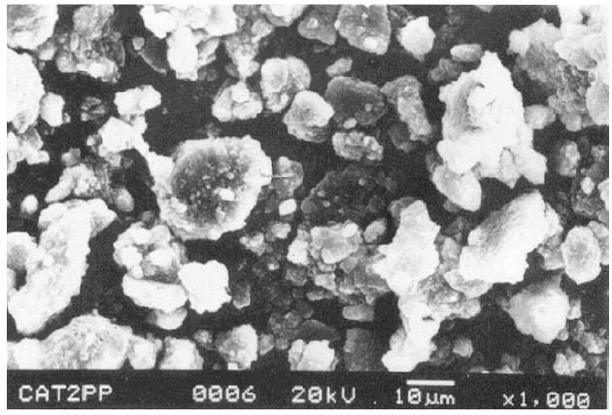
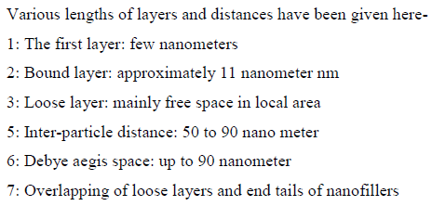
Internal Structure of Nanodielectric
Figure: SEM image of natural (top) and synthetic (bottom) nanofilled
Figure: Internal structure of Nanodielectric

Slide 4
2D Representation of Internal field in Nanodielectric
Figure 2(a). Field Arrow in 2D Model of Nanodielectrics in plane-plane electrode system
Figure 2(b). E-Field Scatter in nanoparticle filled (4%) sample

Slide 5
Simulation of Internal Discharge Model
Top Electrode
Top Electrode
Sample
Figure 1: Meshing in Nanofillled polypropylene under HV with (a) 4% Nanoparticle and (b) 1% Nanoparticle

Slide 6
Field Scatter in Nanoparticle
Top Electrode
Sample
Figure 3(a). Electric Field Scatter in (a) 4% nanofillled sample
Figure 3(b). Electric Field Density under Applied Voltage

Slide 7
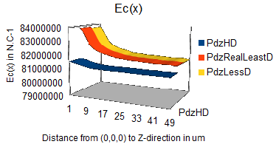
Electric Field with respect to Nanofiller Content
(From Center of Sample to edge)
Figure 4(a). Electric Field with the presence of space charge under the Applied Voltage

Slide 8
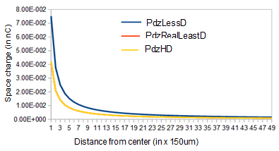
Space Charge with respect to Nanofiller Content
(From Center of Sample to edge)
Figure 4(b). Space charge under the Applied Voltage

Slide 9
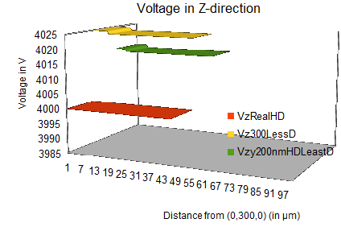
Voltage with respect to Nanofiller Content
(From Center of Sample to edge)
Figure 5(a). Voltage from (0, 0,300nm) to Z-directions in samples in presence of space charge

Slide 10
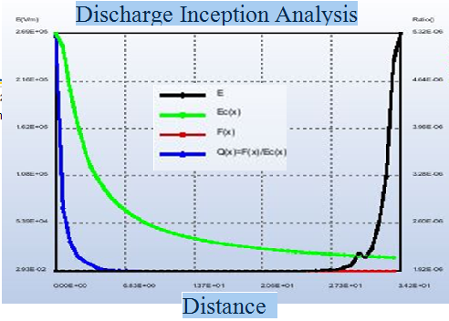
Discharge and Electrostatic Force
Figure: Plot Charge vs Distance from center and Force vs Distance from center

Slide 11
Physical Mechanism
In unfilled nanofillled samples, space charges occur under high electrical stress. These space charges tend to distort main applied field and enhance it which is not expected. In order to reduce the local field enhancement it is required to find a mechanism to reduce space charges. Nanoparticle introduces a mechanism by introducing traps in nanofillled dielectric
Trap is a location that restricts movement of carriers- electrons or holes. Trap consists of either a chemical impurities or an imperfection of regular spacing of atoms that make up solid. In our unfilled polypropylene samples, traps are generated by physical or chemical defects[5][6]. In nanofillled samples, Interface zone between nanoparticle and polymer generates a new potential barrier. This interacts with original trap sites in polymer, results to an increase in deep traps in nanocomposites. Both trap density and energy of trap increase with controlled increase in nanofiller.
These deep traps distribute from internal layer to outside layer of nanoparticle-polymer interface zone. In this way, nanoparticle acts as nucleating agents to alter the morphology of polymer and increase in deep traps[2][3]. Since, traps restrict carrier movement, increased deep traps leads to a reduced conduction in nanofillled insulation. Such it decrease charge mobility, suppress space charge accumulation, decrease the mean free path that the electrons accelerate [7][8].
Since, space charges are reduced by traps, local electric field distortion is reduced significantly and in some case vanish it. This enhances the potential resistivity of the material against partial discharge attack. Also, it is one of the reasons why breakdown strength increased in nanofillled samples.

Slide 12
References
T. Tanaka," Internal Partial Discharge And Material Degradation", IEEE Transactions on Dielectric and Electrical Insulation, Volume:EI-21 , Issue: 6 , Dec. 1986
N. Fuse, M. Kozako, T. Tanaka, S. Murase and Y. Ohki, “Possible Mechanism of Superior Partial- Discharge Resistance of Polyamide Nanocomposites”, Annual Rept. IEEE-CEIDP 17-20 Oct. 2004 ,pp. 322-325.
Toshikatsu Tanaka and Tomonori Iizuka Waseda University ,"Generic PD Resistance Characteristics of Polymer Nanocomposites" Annual Report Conference on Electrical Insulation and Dielectric Phenomena, 17-20 Oct. 2010, West Lafayette, IN, pp. 1 - 4.
Masahiro Kozakol, Ryoichi Kidol, Norikazu Fuse2, Yoshimichi Ohki, Tatsuki Okamoto, and Toshikatsu Tanaka "Difference in Surface Degradation due to Partial Discharges between Polyamide Nanocomposite and Microcomposite", Annual Report Conference on Electrical Insulation and Dielectric Phenomena,17-20 Oct. 2004,pp. 398 - 401.
Norikazu Fuse, Yoshimichi Ohki and Toshikatsu Tanaka, “Comparison of Nano-structuration Effects in Polypropylene among Four Typical Dielectric Properties”, IEEE Trans on Dielectrics and Electrical Insulation, Vol.17, No.3; June 2010.
Md Afzalur Rab, Rohitha Dhara, Prathap Basappa, “Role of type and content of nanoparticle on certain dielectric characteristics of polypropylene nanocomposites”, Journal of Nanophotonics, SPIE, Vol. 9, Issue 1, 2015.
Anil B. Poda, Rohitha Dhara, Md. Afzalur Rab, Prathap Basappa, “Evaluation of aging in nanofilled polypropylene by surface discharges”, IEEE Transactions on Dielectrics and Electrical Insulation, Volume 23, Issue 1, pp. 275-283, 2016.
Md Afzalur Rab, Rohitha Dhara, Anil B. Poda, Prathap Basappa, “Effect of variation in main field and nanoparticle content on the partial discharge characteristics of polypropylene nanocomposites”, Journal of Nanophotonics, SPIE, Vol. 9, Issue 1, 2015.

Slide 13
Thank You!

