Slide 1


A 3-Dimensional Borehole Numerical Modeling for Single and Double U-tube Ground-Coupled Heat Pump
Ali H. Tarrad
Université de Lorraine, CNRS, LEMTA, Nancy, France
October 2020

Slide 2
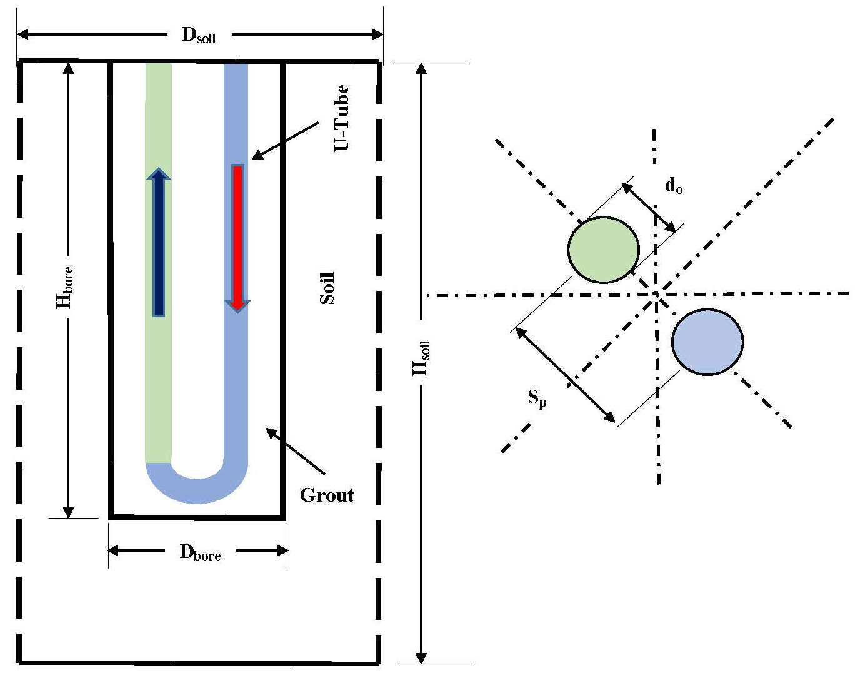
Single U-Tube Orientation

Slide 3
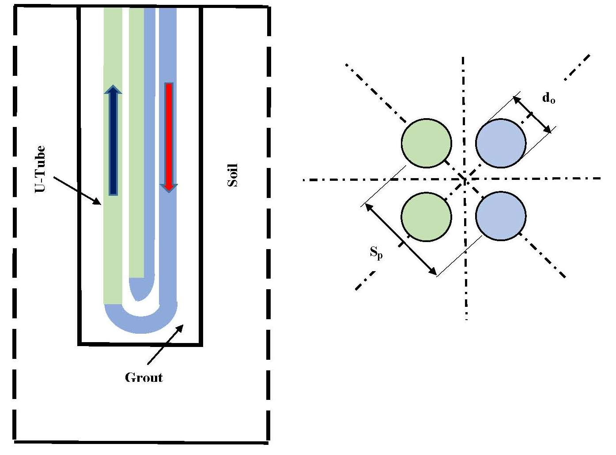
Double U-Tube Orientation

Slide 4
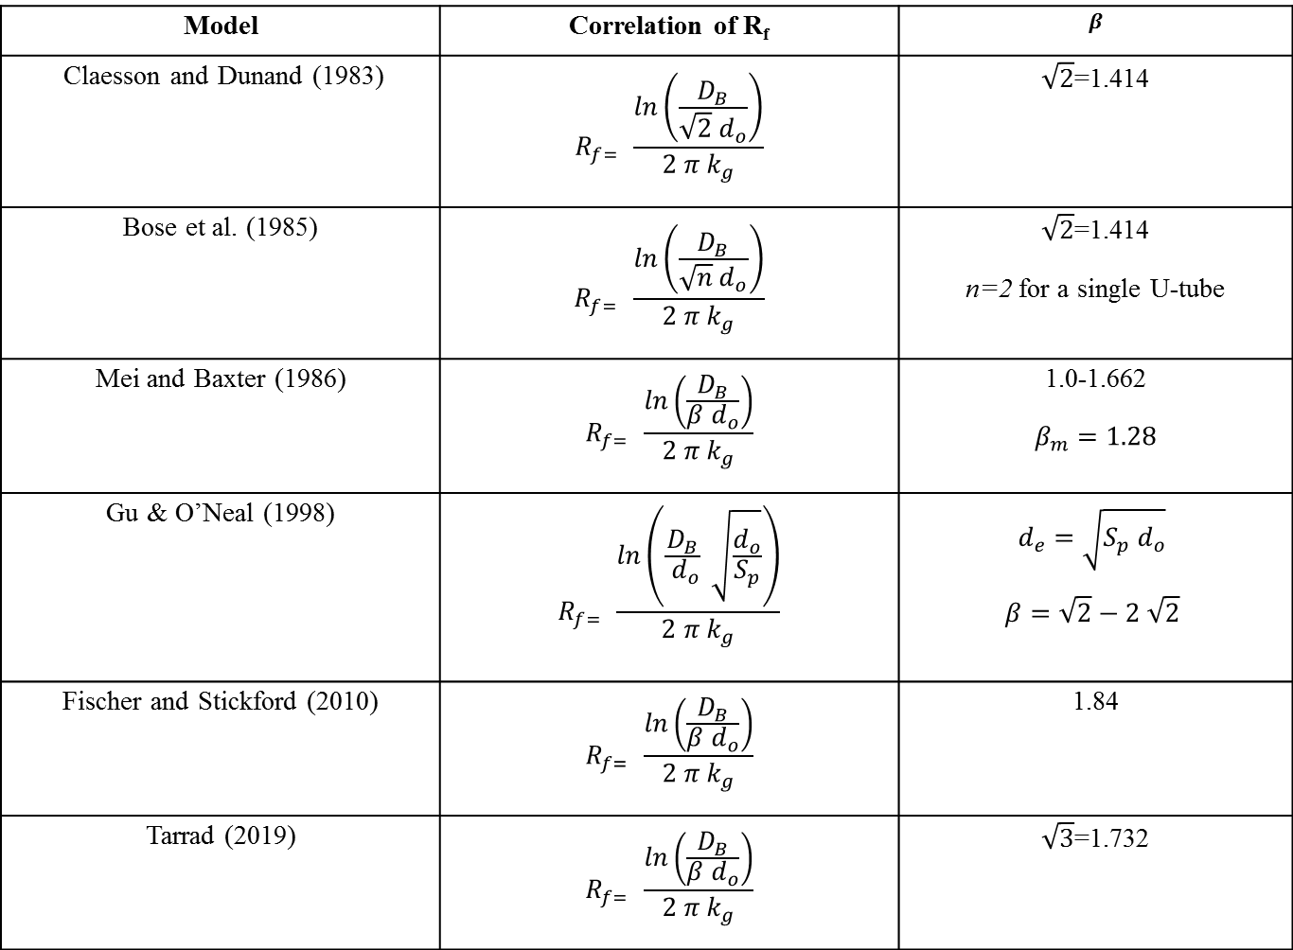
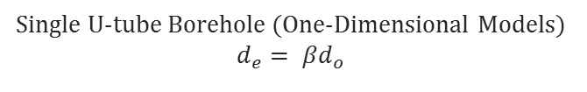
Single U-tube Borehole (One-Dimensional Models)
$d_{e}= βd_{o}$
Model | Correlation of R_{f} | $$β$$
Claesson and Dunand (1983) | $$R_{f= } \frac{\ln\left(\frac{D_{B}}{\sqrt{2} d_{o}}\right)}{2 π k_{g}}$$ | $\sqrt{2}$=1.414
Bose et al. (1985) | $$R_{f= } \frac{\ln\left(\frac{D_{B}}{\sqrt{n} d_{o}}\right)}{2 π k_{g}}$$ | $\sqrt{2}$=1.414 n=2 for a single U-tube
Mei and Baxter (1986) | $$R_{f= } \frac{\ln\left(\frac{D_{B}}{β d_{o}}\right)}{2 π k_{g}}$$ | 1.0-1.662 $$β_{m}=1.28$$
Gu & O’Neal (1998) | $$R_{f= } \frac{\ln\left(\frac{D_{B}}{ d_{o}} \sqrt{\frac{d_{o}}{S_{p}}}\right)}{2 π k_{g}}$$ | $$d_{e}=\sqrt{S_{p} d_{o}}$$ $$β=\sqrt{2}−2 \sqrt{2}$$
Fischer and Stickford (2010) | $$R_{f= } \frac{\ln\left(\frac{D_{B}}{β d_{o}}\right)}{2 π k_{g}}$$ | 1.84
Tarrad (2019) | $$R_{f= } \frac{\ln\left(\frac{D_{B}}{β d_{o}}\right)}{2 π k_{g}}$$ | $\sqrt{3}$=1.732

Slide 5
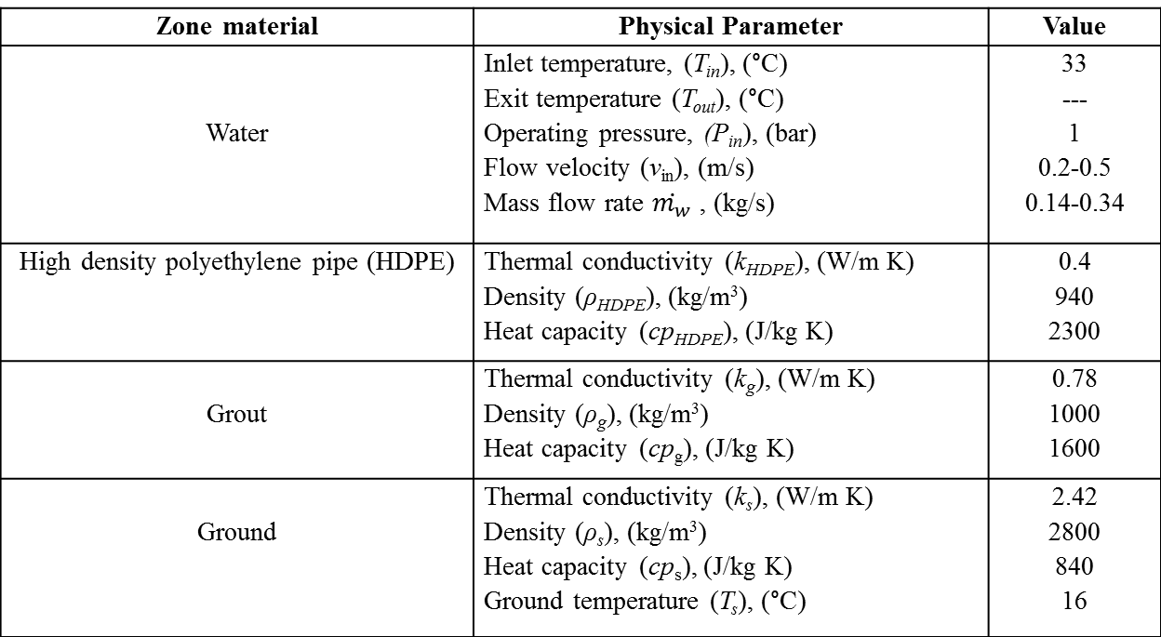
Case Study
Table 1. Properties and operating conditions of the geothermal system
Zone material | Physical Parameter | Value
Water | Inlet temperature, (T_{in}), (°C) Exit temperature (T_{out}), (°C) Operating pressure, (P_{in}), (bar) Flow velocity (v_{in}), (m/s) Mass flow rate $\dot{m_{w}}$ , (kg/s) | 33 --- 1 0.2-0.5 0.14-0.34
High density polyethylene pipe (HDPE) | Thermal conductivity (k_{HDPE}), (W/m K) Density (ρ_{HDPE}), (kg/m³) Heat capacity (cp_{HDPE}), (J/kg K) | 0.4 940 2300
Grout | Thermal conductivity (k_{g}), (W/m K) Density (ρ_{g}), (kg/m³) Heat capacity (cp_{g}), (J/kg K) | 0.78 1000 1600
Ground | Thermal conductivity (k_{s}), (W/m K) Density (ρ_{s}), (kg/m³) Heat capacity (cp_{s}), (J/kg K) Ground temperature (T_{s}), (°C) | 2.42 2800 840 16

Slide 6
A Single U-Tube Dimensions
Table 2. Physical dimensions of different zones
Zone Material | Physical Parameter | Value
High density polyethylene pipe (HDPE) | Outside diameter (d_{o}), (mm) Inside diameter (d_{i}), (mm) Pipe thickness (tp), (mm) Wall factor (WF), (---) U-tube leg spacing (S_{p}), (mm) U-tube depth (H_{U-tube}), (m) | 33.4 29.5 2.0 17 66.8 50
Borehole (Grout) | Diameter (d_{b}), (mm) Depth (H_{b}), (m) | 120 50.1
Ground | Diameter (d_{s}), (m) Depth (H_{s}) (m) | 5.0 52.5

Slide 7
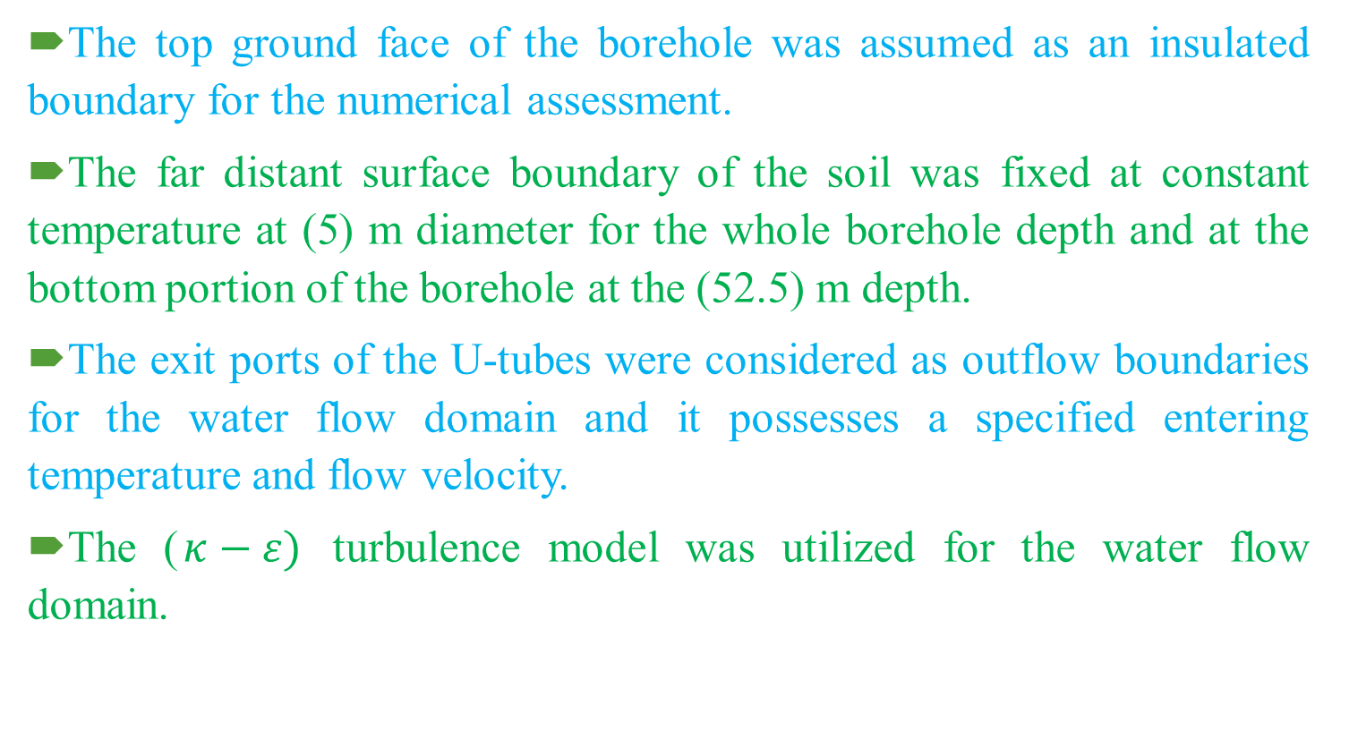
Boundary Conditions and Numerical Analysis Method
The top ground face of the borehole was assumed as an insulated boundary for the numerical assessment.
The far distant surface boundary of the soil was fixed at constant temperature at (5) m diameter for the whole borehole depth and at the bottom portion of the borehole at the (52.5) m depth.
The exit ports of the U-tubes were considered as outflow boundaries for the water flow domain and it possesses a specified entering temperature and flow velocity.
The ($κ−ε)$ turbulence model was utilized for the water flow domain.

Slide 8
Materials
The thermal properties of all domain materials were specified according to user defined category, table 1 except water domain.

Slide 9
Geometry Meshing
The meshing process of the geometry model was conducted by implementing the tetrahedral element type.
The water domain was meshed according to the fluid dynamic predefined finer element size.
The ground or soil domain was meshed with the predefined coarser element size.
The grout and tube metal domain meshing were performed according to the custom element sizes, which were conducted with a specified element sizes.

Slide 10

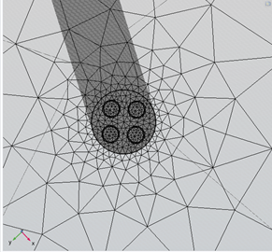
Geometry Meshing
Figure 2.a. Grout and U-tube Meshing
Figure 2.b. Soil Meshing

Slide 11
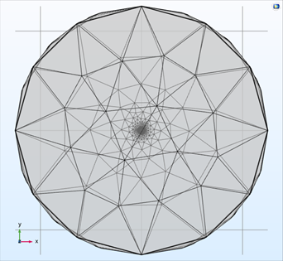
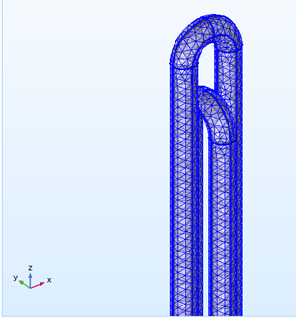
Geometry Meshing
Figure 3. Elements Size
Figure 4: U-Tube Meshing

Slide 12
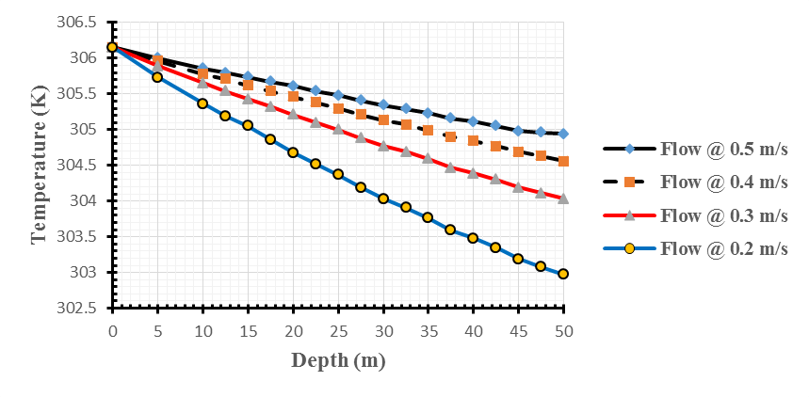
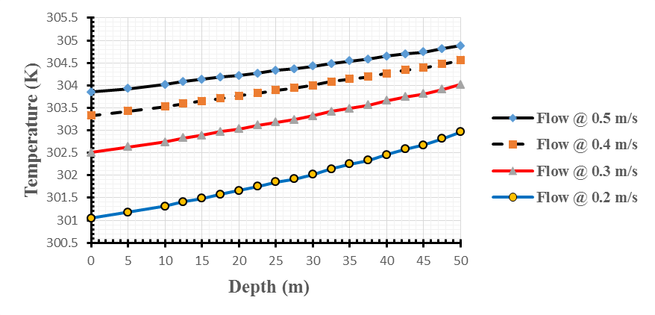
Single U-tube
Water temperature distribution comparison at different flow velocities for the single U-tube
Downward Water Flow
Upward Water Flow

Slide 13
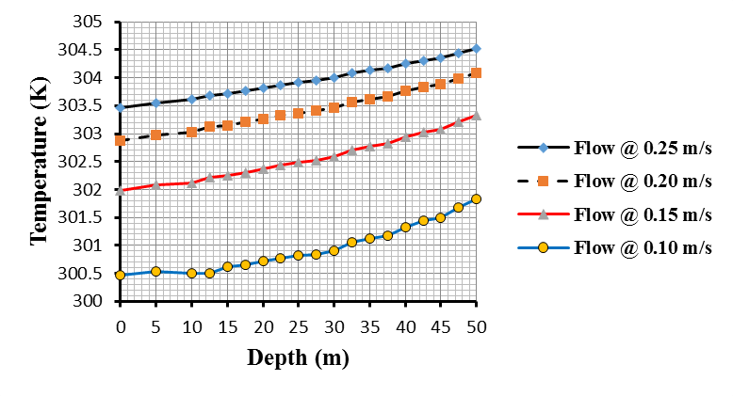
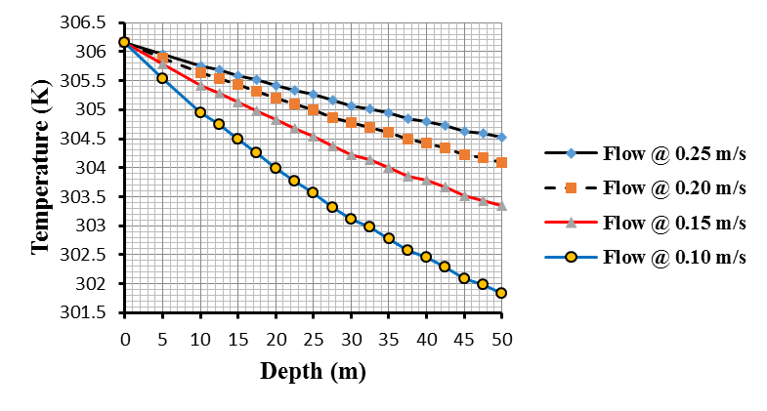
Double U-Tube
Water temperature distribution comparison at different flow velocities for the half loading double U-tube
Downward Water Flow
Upward Water Flow

Slide 14
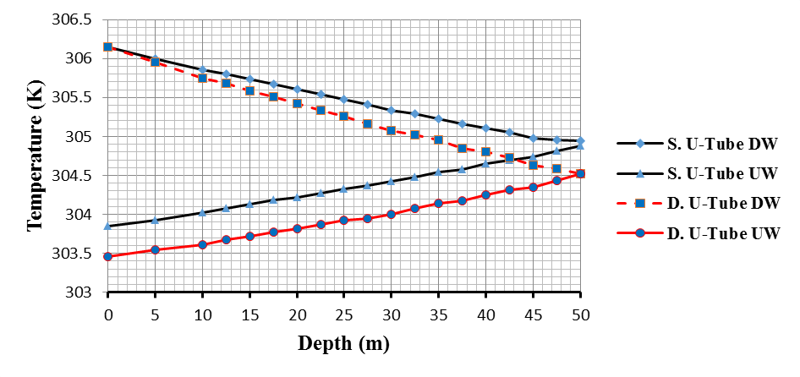
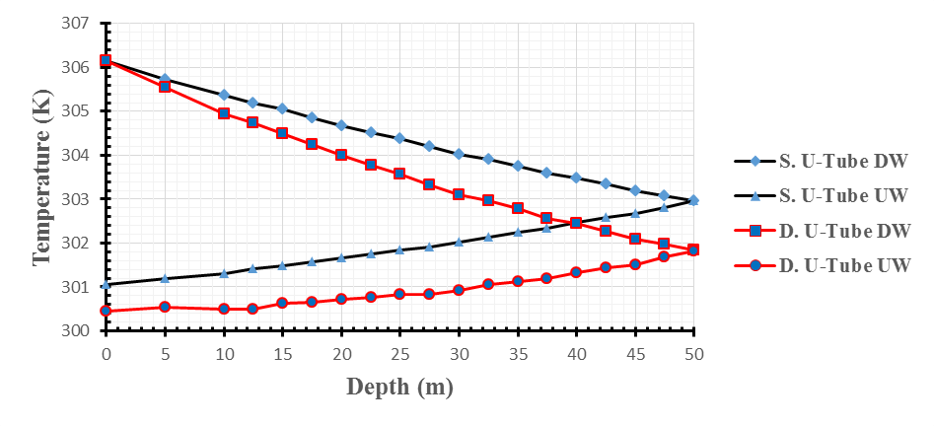
Results Comparison
Comparison of water temperature variation with depth for the single and double U-tube heat exchangers
Water Flow Velocity of 0.5 m/s
Water Flow Velocity of 0.2 m/s

Slide 15
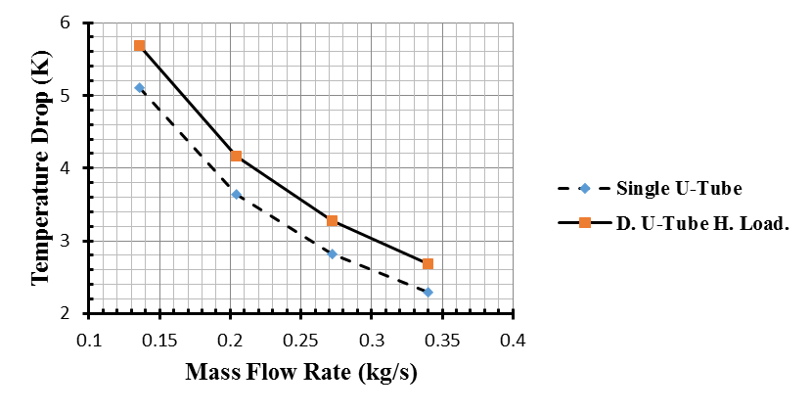
Water Temperature Difference
The highest temperature difference between the inlet port and exit side of water was experienced at the lowest examined mass flow rate, that is (0.136) kg/s which corresponds to (0.2) m/s.
It was (5) °C and (5.7) °C for the single and half-loading double U-tube heat exchangers respectively at (0.2) m/s.
The double U-tube heat exchanger has showed a higher water temperature drop than that of the single U-tube one by (10.4) % to (14.5) % for the investigated operating conditions.

Slide 16
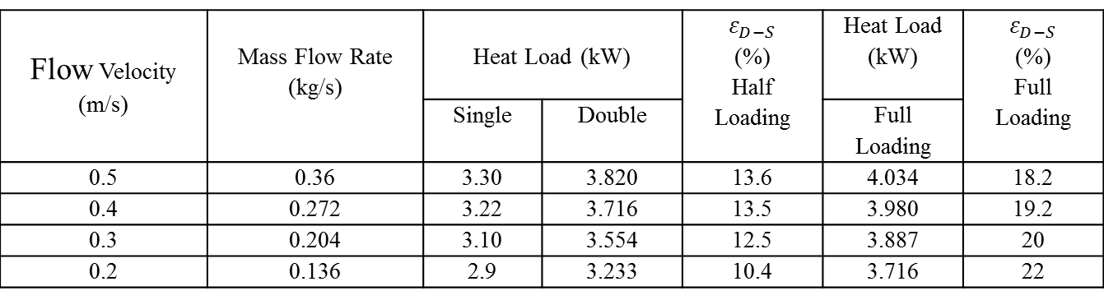
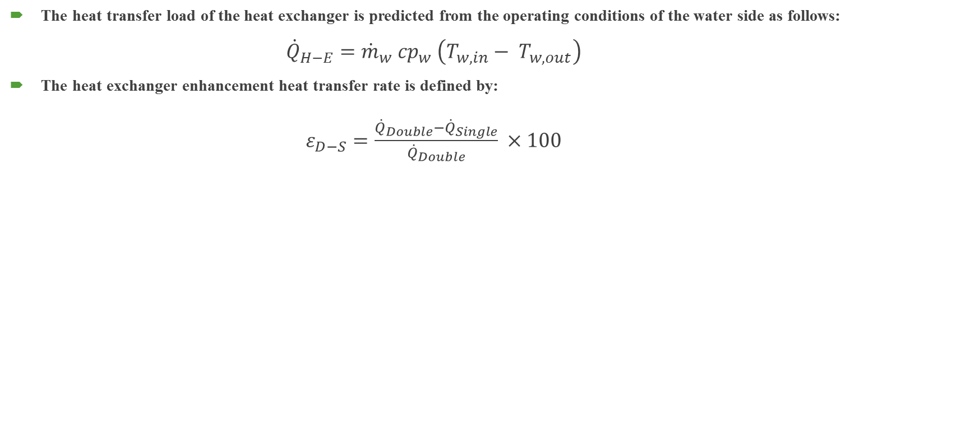
Heat Transfer Rate
The heat transfer load of the heat exchanger is predicted from the operating conditions of the water side as follows:
${\dot{Q}}_{H−E}={\dot{m}}_{w} {cp}_{w} \left(T_{w, in}− T_{w, out}\right)$
The heat exchanger enhancement heat transfer rate is defined by:
$ε_{D−S}=\frac{{\dot{Q}}_{Double}−{\dot{Q}}_{Single}}{{\dot{Q}}_{Double}} ×100$
Table 3. Heat transfer rate enhancement factor of double U-tube heat exchanger
Flow Velocity (m/s) | Mass Flow Rate (kg/s) | Heat Load (kW) |  | $$ε_{D−S}$$ (%) Half Loading | Heat Load (kW) | $$ε_{D−S}$$ (%) Full Loading
 |  | Single | Double |  | Full Loading
0.5 | 0.36 | 3.30 | 3.820 | 13.6 | 4.034 | 18.2
0.4 | 0.272 | 3.22 | 3.716 | 13.5 | 3.980 | 19.2
0.3 | 0.204 | 3.10 | 3.554 | 12.5 | 3.887 | 20
0.2 | 0.136 | 2.9 | 3.233 | 10.4 | 3.716 | 22

Slide 17
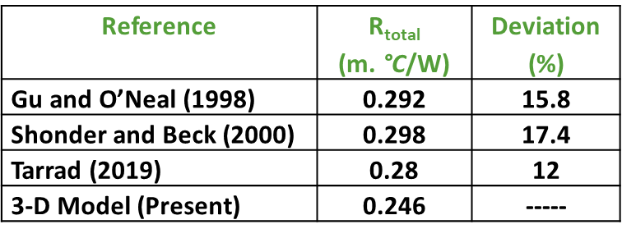
Comparison with Single U-Tube Correlations
All of these correlations overestimated the total thermal resistance by (15.8) %, (17.4) % and (12) % respectively.
These numerical magnitudes illustrate that Tarrad (2019) correlation predicted a closer value to that of the present 3-dimensional model results.

Slide 18
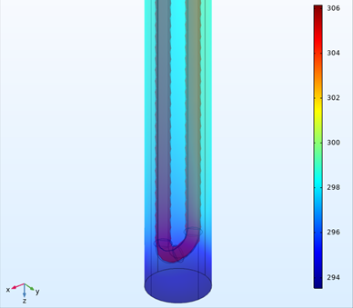
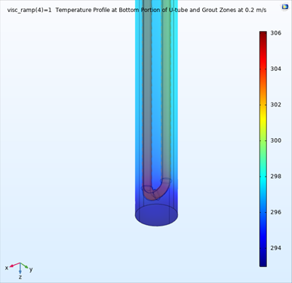
COMSOL MULTIPHYSICS
(Single U-Tube ) Post-Processing
Water velocity of (0.5) m/s
Water velocity of (0.2) m/s

Slide 19
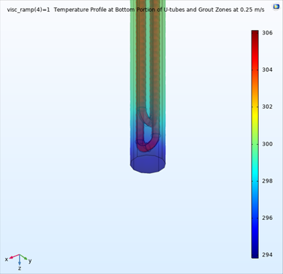
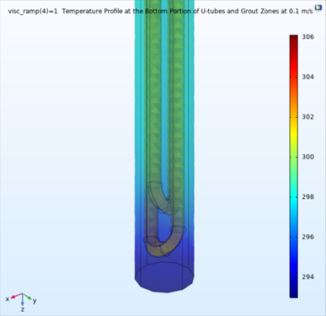
COMSOL MULTIPHYSICS
(Double U-Tube ) Post-Processing
Water velocity of (0.25) m/s
Water velocity of (0.1) m/s

Slide 20
Conclusion
A 3-dimensional steady state model for a single and double U-tube borehole heat exchangers of a ground –heat pump integrated system was built.
The heat transfer rate for the double U-tube arrangement was higher than that of the single U-tube one by the range of (10) % and (14) % for flow velocity of (0.2) m/s and (0.5) m/s respectively.
The single U-tube thermal resistance was higher than that of the double U- tube by about (14.6) %.
Downward water flow experiences higher temperature drop than that of the upward stream for both heat exchangers. Its range fell within (53-66) % and (60-76) % of the total temperature drop (ΔT_{t}) for the single and double U-tube boreholes respectively.
The double U-tube heat exchanger has showed a higher water temperature drop (ΔT_{t}) than that of the single U-tube one by (10.4) % to (14.5) % for the investigated borehole operating conditions.
The temperature distribution at the borehole surface didn’t show a significant circumferential variation. Hence, it is essentially independent of the circumferential angle.
The utilization of full loading scheme for the double U-tube showed a higher heat transfer rate enhancement than that of the half loading one. The performance enhancement fell in the range of (18) % and (22) % when compared to that of the single U-tube one.

Slide 21
Thank you for Listening

