Slide 1
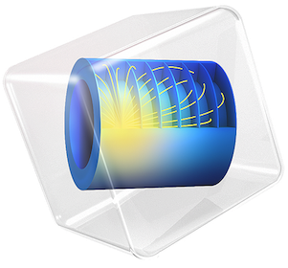
COMSOL Conference 2020
14 - 16 Oct 2020
Grenoble, France
R410A GAS INSULATED DISTRIBUTION TRANSFORMER DESIGN
Under the guidance of: Presented by:
Dr. Okan ÖZGÖNENEL Ezgi GÜNEY
Professor Prelector

Slide 2
Contents
Introduction
Definition of the R410A GIT Model
Simulation Results
  Electrostatic Analysis
  Analysis Under Lightning Impulse Voltage
  Heat Analysis
  Conclusion
  References

Slide 3
Introduction
In recent years, the gas insulating principle has been used in high-voltage equipment in terms of reliability, breakdown strength and working life.
Gas insulated transformers (GITs) are widely used in underground and indoor substations in urban areas. This plays an even more important role in locating distribution transformers at the closest locations to the load (consumer points) for technical and economic reasons.
In this study, the required design criteria of R410A gas insulated transformers will be achieved with the aim of meeting today’s energy needs in an economical way.
Notes:
Son satıra alternatif ? This study helps to determine the preliminary information required for the design of R410A gas insulated transformers in order to meet the distribution transformers, one of the most important equipment of energy systems, in the most economical and environmentally friendly way.

Slide 4
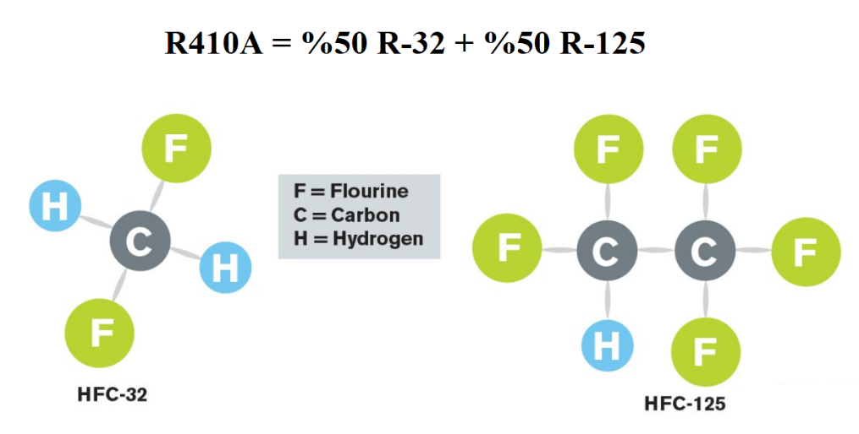
What is R410A ?
R410A is an azeotropic refrigerant
mixture of equal parts of R32 and R125 that meets the needs of the industry in many new air conditioning systems.
Since it does not contain chlorine, it is an environmentally friendly gas with zero ozone consumption coefficient.
R410A gas has good potential in terms of
Non-flammability
Non-toxicity,
No ODP,
Low GWP,
its availability in the market, and economical cost.
CH₂F₂(Diflorometan)
HF₂c-CF₃(Petraflorometan)
Note: Chlorine ions act as a catalyst and cause the ozone layer to become thinner by converting ozone molecules into oxygen molecules.

Slide 5
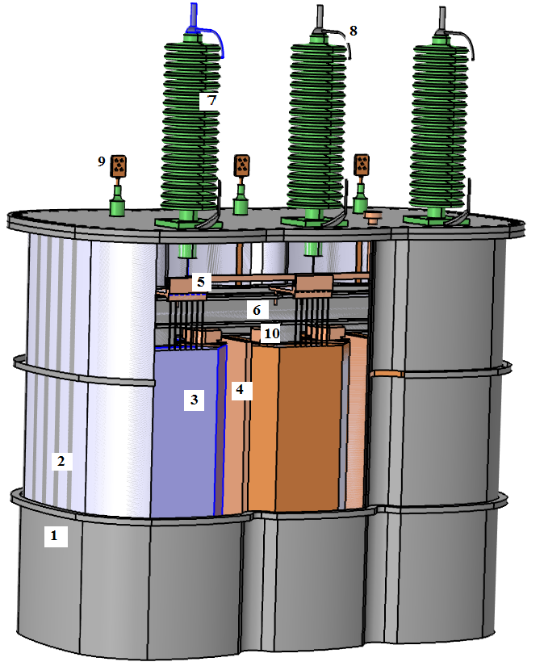
3D Modeling of GIT in AutoCAD Environment
A real transformer model of 50 kVA, 34.5/0.4 kV is studied in this work.
The design is cylindrical in order to withstand high pressure and to distribute the gas homogeneously.
Transformer core and windings are both insulated and cooled with R410A gas.
High voltage outputs are made through bushings.
The tank is hermetic and safe to the touch.
If for any reason an R410A gas leak occurs, the hazard is minimized as it is an inert gas and not flammable.
Tank
R410A
HV insulation
Dielectric Barrier
Tap Changer
Yokes
Bushing Insulators
Arc Sparking Gap
LV Bushing
Supporting Woods
Figure 2. R410A GIT of 50kVA for major details

Slide 6
The design of the tank and the cooling element are similar to oil-insulated transformer design.
All the details are included for the model,such as tank, highvoltage (HV) and low voltage(LV) bushings, R410A, yokes, core, supporting woods, arc sparking gap, and tap changer on the HV side.

Slide 7
Electrostatic Analysis of 50 kVA GIT
3D Modeling of GIT in AutoCAD Environment
COMSOL Multiphysics 5.2a is used for computer simulations in this work. Four different materials are used to model the R410A GIT in the simulation environment. These are;
wood with εr 3,
copper,
soft iron,
R410A with εr 2.0.
As the boundary condition, the peak value of the phase-earth voltage to the HV and LV windings is defined. Since the tank and yoke parts of the transformer are at ground potential, the earth boundary condition was chosen.

Slide 8
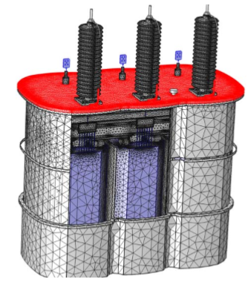
Simulation Results
The most important step of this project is to obtain;
  tank pressure,
  heat effects ,
  Breakdown curves
  at homogeneous and inhomogeneous electric fields on complex 3-D transformer models.

Slide 9
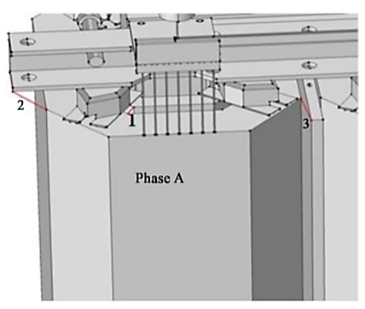
Electrostatic Analysis of 50 kVA GIT
Line 1: Between the outer corner of the LV winding and the inner corner of the HV coil
Line 2: Between the HV coil and the closest corner of the dielectric barrier
Line 3: Between the HV coil and the closest corner of the yoke
Figure 3. The lines (1,2 and 3) under electrostatic analysis.

Slide 10
In the figure, three critical lines are shown in red for Phase A windings, according to their importance level.
The parts where the distances are the shortest are the outer corner of the low voltage winding and the inner corner of the high voltage winding. Also, the area between the high voltage winding and the yoke can be critical in terms of jumping.

Slide 11
Electrostatic Analysis of 50 kVA GIT
Critical points in transformer windings have been determined in order to obtain the breakdown strength of R410A gas.
If the potential distributions and electrical stress values at critical points are calculated, it will be possible to prevent partial discharges and possible failures.
Critical points

Slide 12
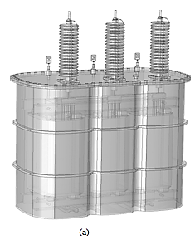
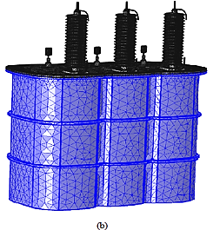
Meshing Procedure
The meshing procedure consists of tetrahedral elements for the analyzed models.
A meshing procedure with small elements has been applied to the regions where electric field concentrates in models.
In order to reduce the computation time,
  the network of the sections that are not very critical in terms of space is divided into a less frequent network,
  the critical areas such as windings and gas insulation sections are divided into a much more dense network.
Figure 3. Figure 1. 50 kVA, 34.5/0.4 kV R410A gas-insulated distribution transformer, a) general view, b) meshed view
Notes:
It is the most general meshing technique using tetrahedral elements and does not pose any limitations on the structure of the geometry.

Slide 13
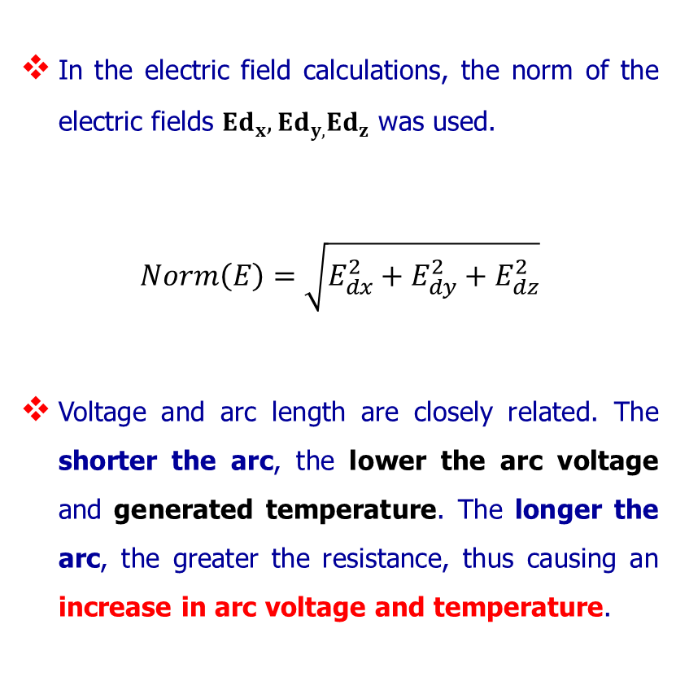
Electrostatic Analysis of 50 kVA GIT
Figure 4. Voltage levels at points 1, 2 and 3 according to arc length for phase A
Line 1: between LV - HV winding
Line 2: HV - dielectric barrier
Line 3: HV - between the yoke

Slide 14
The breaking voltages and electric field strengths between these three lines are calculated using electrostatic solutions.

Slide 15
Electrostatic Analysis of 50 kVA GIT
?
The value of simulated electric fields for Figures 5–7 is below the Edmax curve. For Figure5, the value of the simulated electric field (125.05 kV/cm) is under the Edmax curve at 231 atm × cm. At this point, SF6 gas pressure is equal to 1.59 atm inside the tank. Therefore, any SF6 gas pressure inside the tank above the Edmax curve is desirable. For instance, if SF6 gas pressure is selected at 1.59 atm (231 atm × cm), the breakdown voltage will be 191.05 kV, which is much more than the peak value of lightning overvoltage (170 kV).
Figure 5. Simulated electric field for point 1 for Phase A

Slide 16
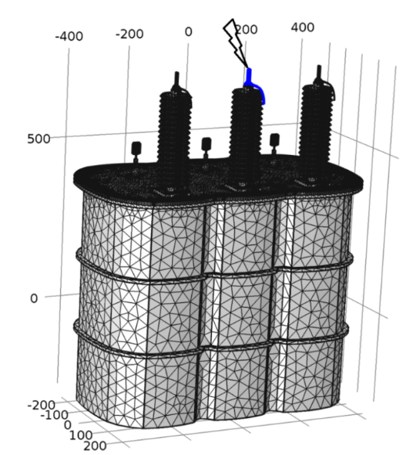
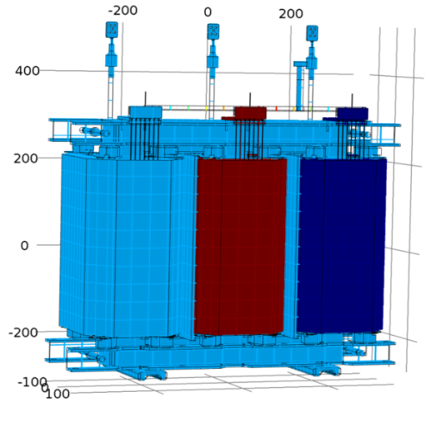
Analysis under lightning impulse voltage for 50-kVA R410A GIT
In this particular example, it is assumed that Phase B is exposed to lightning over voltages during the normal operating condition as seen in Figure 6. Figure 7 shows the electric potentials of all the windings at the time of peak voltages.
Figure 6. Transformer under lightning voltage during normal operation (according to IEC 660076-3)
Figure 7. Surface graph of peak electric potentials during lightning impulse

Slide 17
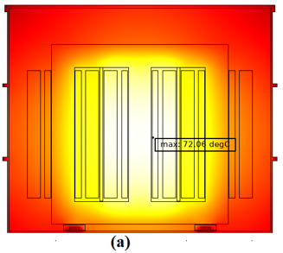
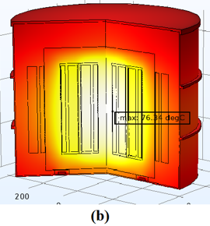
Heat Analysis of 50kVA Distribution Transformer
Thermal analysis is required for transformers under nominal load to identify the location of the maximum temperature in the tank.
Low voltage (LV) windings are assumed to operate at nominal load (50kVA with 0.9 power factor) and modeled as heat sources.
Since the LV windings are heated with full load current, the heat generated is transported to the environment through conduction, convection and radiation.
Figure 9. Temperature distribution (hot points) inside the tank. (a) 2D and (b) 2D axial symmetry analysis
Notes:
The reason for the different temperatures in the two figures; It is the analysis for the whole region in figure a and for its symmetrical half in figure b.

Slide 18
As a result of the analysis, the maximum temperatures in the tank were calculated as 72.06 ℃ for 2D analysis and 76.34 ℃ for 2D axial symmetry analysis.

Slide 19
Conclusion
This work handles the opportunity of gas-insulated distribution transformers in the theoretical study describing the flow behavior of fluids (R410A, air and transformer oil).
In this study, the potential and electric field distribution of a three-phase transformer with R410A gas insulation was investigated using the finite element method.
In the time-dependent analysis, firstly, three-phase gas insulated transformer was modeled in 3-D in its real dimensions, transformer materials and boundary conditions were defined.
Notes:
İlk cümleye alternatif : This study helps to determine the preliminary information required for the design of R410A gas insulated transformers in order to meet the distribution transformers, one of the most important equipment of energy systems, in the most economical and environmentally friendly way.

Slide 20
Conclusion
Electrostatic analysis is performed on 3-D models, whereas the heat analysis is achieved on the 2-D models due to heavy computational burden.
According to the results of the analysis, it has been observed that the electric field values are at levels that will not create an excessive strain on the transformer in the operating voltage of this transformer.
The computer simulations presented by the authors are believed to give accurate estimations with a reasonable accuracy and will be pioneers for the real time implementations to optimize the transformer design with respect to hot spots.

Slide 21
References
O. Ozgonenel, D. Thomas, Modeling and simulation of 2.5 MVA SF6-gas–insulated transformer, Turkish Journal of Electrical Engineering & Computer Sciences, pp. 3475-3485 (2017)
IEEE. IEEE. Guide for Loading Mineral-Oil Immersed Transformers. IEEE Std. C57.91-1995. New York, NY, USA: IEEE, 1995.
P. 3. P. Bolin, H. Koch, Introduction and applications of gas insulated substation (GIS). In: IEEE Power Engineering Society General Meeting, San Francisco, CA, USA. New York, NY, USA: IEEE, pp. 920-926 (2005)
E. A. Mackenzie, J. Crossey, A. De Pablo, W. Ferguson, Online monitoring and diagnostics for power transformers, Electrical insulation (ISET) conference record of the 2010 IEEE international symposium, pp. 1-5 (2010)
B. Khan, J. Saleem, F. Khan, G. Faraz, R. Ahmad, N. U. Rehman, Z. Ahmad, Analysis of the dielectric properties of R410A Gas as an alternative to SF6 for high-voltage applications, High Voltage, pp. 41-48 (2018)

Slide 22
References
F. E. Brito, A. N. Gurova, U. V. Mardolcar, C. N. De Castro, Dielectric constant of the nearly azeotropic mixture R410A, International Journal of Thermophysics, pp. 415-427 (2000)
C. Meurer, G. Pietsch, M. Haacke, Electrical properties of CFC-and HCFC-substitutes, International Journal of Refrigeration, 24(2), 171-175 (2001)
X. Chen, J. Yang, C. Liu, J. Chen, Heating performance comparison of R410A and its substitutions in air-to-water heat pumps with vapor injection, International Journal of Refrigeration, pp. 78-87 (2018)
B. Khan, J. Saleem, F.Khan, G. Faraz, N. U. Rehman, Finite Element Analysis of Electric Field Distribution in the Dielectric Gas R410A as an Alternative to SF 6 for High Voltage Applications, In 2018 International Conference on Applied and Engineering Mathematics (ICAEM) IEEE, pp. 1-6 (2018)
K. M. Takami, H. Gholnejad, J. Mahmoudi, Thermal and hot spot evaluation on oil immersed power transformers by FEMLAB and MATLAB software’s, In 2007 International Conference on Thermal, Mechanical and Multi-Physics Simulation Experiments in Microelectronics and Micro-Systems. EuroSime, IEEE, pp. 1-6 (2007)

Slide 23
Thank you
Okan ÖZGÖNENEL
Engineering Faculty
Department of Electrical and Electronic Engineering
Ondokuz Mayıs University
Samsun, Turkey
okanoz@samsun.edu.tr
Ezgi GÜNEY
Vocational High School
Department of Electrical and Energy
Sinop University
Sinop, Turkey
eguney@sinop.edu.tr

