Slide 1

Thermal Analysis of DED process and COMSOL feasibility in Mechanical Modeling of AM process
Vaibhav Nain^{*1}, Muriel Carin², Thierry Engel³, Didier Boisselier¹, Christophe Cordier³
¹ IREPA LASER, Parc d’Innovation, 67400 Illkirch, France
² Univ. Bretagne Sud, UMR CNRS 6027, IRDL, F-56100 Lorient, France
³ Institut National des Sciences Appliquées, 67000 Strasbourg, France
Grenoble, 14-15 Oct 2020

Slide 2
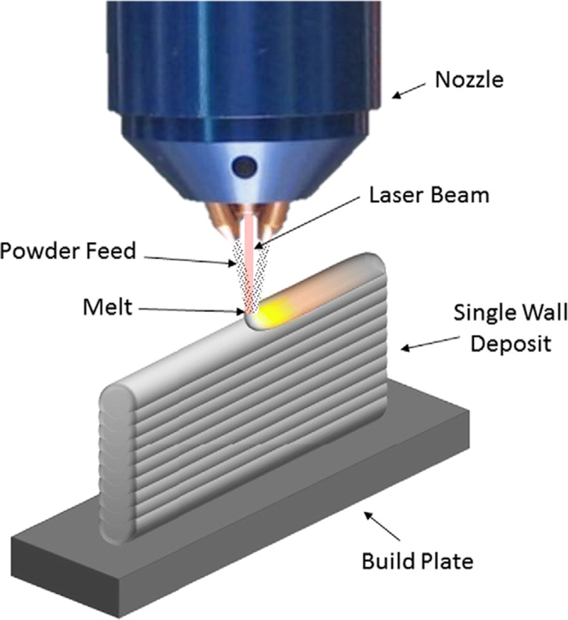
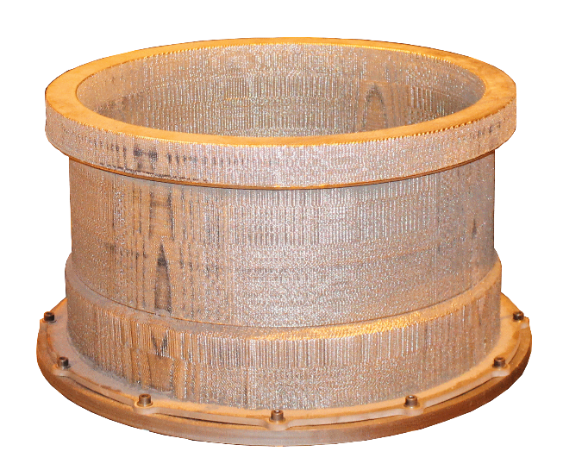


Directed Energy Deposition (DED)
Powder DED (P-DED): Process Principle
DED System
  Co-axial nozzle with focused laser and a stream of powder, both intersecting at a common focal point generally in an inert environment
Process Physics
  The energy density generated at a particular point leads to the melt pool formation and incoming powder is fed in the melt-pool leading to the formation of a bead
DED Advantages
  Fabrication of large parts possible
  Minimum powder wastage
Figure 1: DED process schematic [1]
Figure 2: DED part fabrication
(Height: 500mm; Ø: 600 mm)
[1] X. Guan and Y. F. Zhao, “Modeling of the laser powder–based directed energy deposition process for additive manufacturing: a review,” Int J Adv Manuf Technol, vol. 107, no. 5, pp. 1959–1982, Mar. 2020, doi: 10.1007/s00170-020-05027-0.

Slide 3
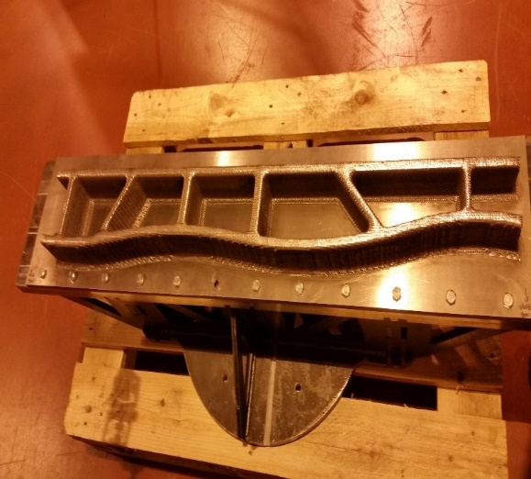
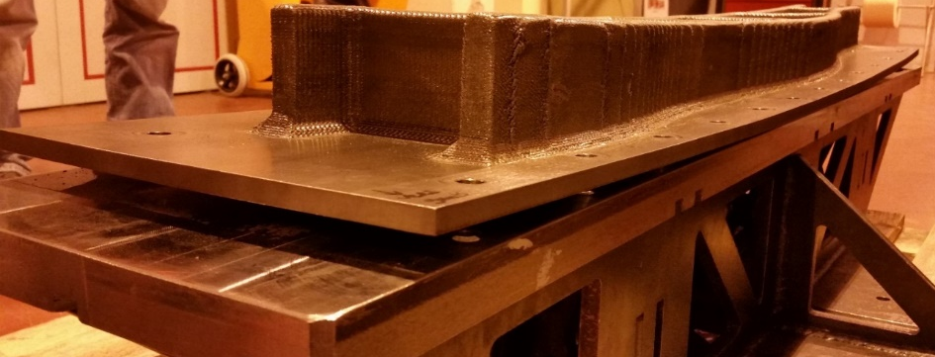

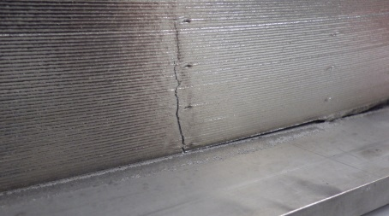
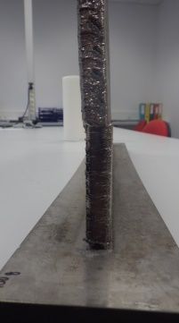
Why model P-DED process ?
Distortion & Residual Stresses
DED Process
  Due to the complex thermal cycles in DED process, it leads to the generation & accumulation of unwanted levels of distortion & residual stresses
DED Disadvantages
  Unwanted levels of distortion & residual stresses
  Leads to crack formations, misalignment & failure of parts
DED Process still not understood due to
  It involves complex multiple heat cycles
  Lack of understanding of accumulation of distortion & residual stress
  Complicated evolution of microstructure of build materials
Modeling can help to
  Develop the better understanding of process physics
  Predict & minimize deformation & residual stresses
  Achieve the objective FABRICATE PART FIRST TIME RIGHT
(a) Fabrication
(b) Distortion
Figure 3: Large Scale DED fabricated part & Distortion accumulation leading to rejection of part (Fabricated part length: 1100mm)
(a) Crack
(b) Mismatch
Figure 4: DED fabricated part failure due to crack generation & misalignment during & after deposition

Slide 4
Numerical Model
Development of the model for P-DED
Thermal Model
Equivalent Heat Source
Numerical Material Deposition
Heat Losses
Material Properties f(T)
Transient Thermal
Model Results
Mechanical Model
Input
Accurate transient 3D Thermal Model is a pre-requisite to develop Thermo-Mechanical model for P-DED.
So, in the present work a transient 3D Thermal Model is developed in COMSOL Multiphysics® 5.5.

Slide 5
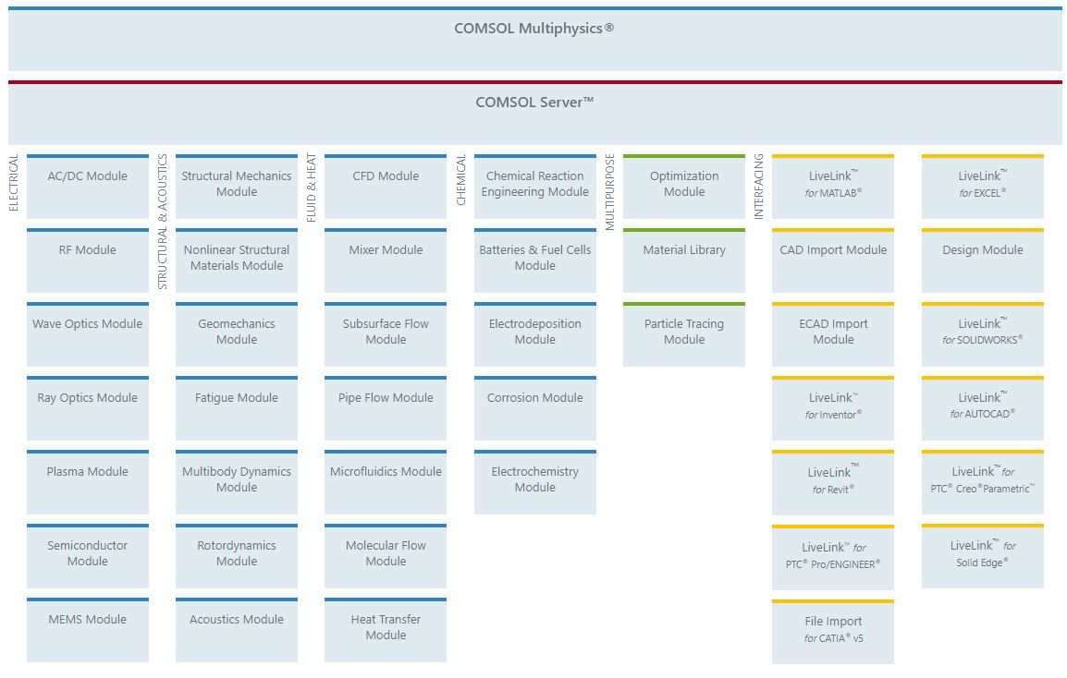
Thermal Model for P-DED
Use of COMSOL Multiphysics® 5.5
Use of COMSOL for Thermal Model for DED

Slide 6
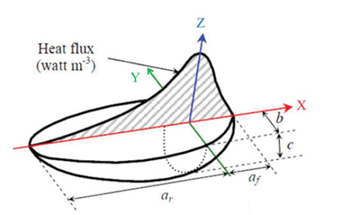
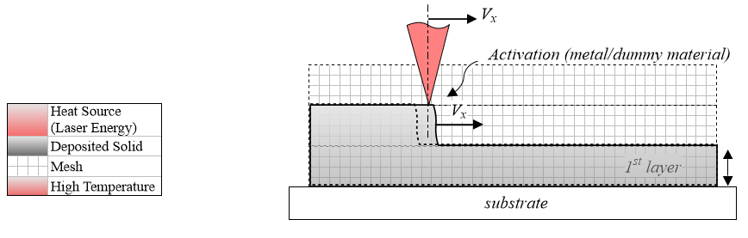

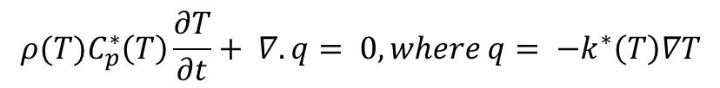
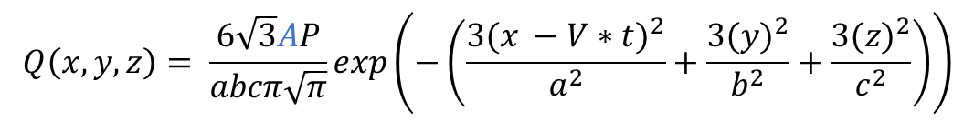

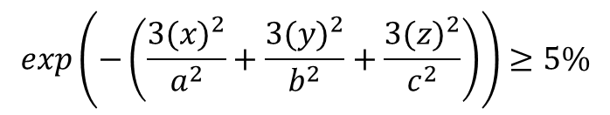
Thermal Model for P-DED
Numerical Model Development
PROCESS PHYSICS
NUMERICAL MODEL
Equivalent Numerical Heat Source
LASER
$$+$$
POWDER SPRAY
$$Q\left(x,y,z\right)= \frac{6\sqrt{3}AP}{abcπ\sqrt{π}}exp\left(−\left(\frac{3{(x −V∗t)}^{2}}{a^{2}}+\frac{3{(y)}^{2}}{b^{2}}+\frac{3{(z)}^{2}}{c^{2}}\right)\right)$$
Figure 5: Intensity Distribution
Goldak Double Ellipsoid Source
MELTING
Numerical Material Addition/Deposition
  Quiet/Active Element Activation
  Quiet Elements: Weak Thermal Properties
  Active Elements: Temperature dependent Thermal properties (Metal)
  Activation Criterion:
Moving Heat Source
MELT POOL & SOLIDIFICATION
Dynamics
Heat transfer
Static Mesh
$$exp\left(−\left(\frac{3{(x)}^{2}}{a^{2}}+\frac{3{(y)}^{2}}{b^{2}}+\frac{3{(z)}^{2}}{c^{2}}\right)\right)≥5\%$$
Active
Elements
Quiet Elements
Heat Equation
Activated Elements
CONDUCTION
$$ρ{(T)C}_{p}^{∗}\left(T\right)\frac{∂T}{∂t}+ ∇.q= 0, where q= −k^{∗}\left(T\right)∇T$$
Figure 6: Schematic of Quiet/Active Element Activation method
BUILD PART AND SUBSTRATE
HEAT LOSS
Heat Losses
$$Q_{loss}= {−h}_{FC}\left(T_{s}−T_{a}\right)− εσ\left(T_{s}^{4}−T_{a}^{4}\right)$$

Slide 7
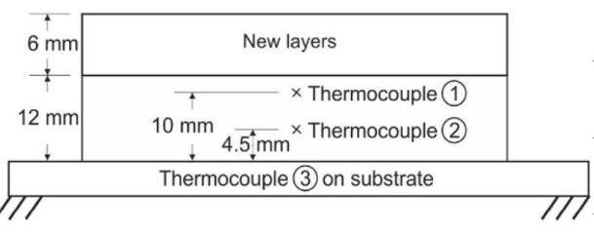
Thermal Model for P-DED
Experiment results (from literature [2])
Experiment Set-Up
Process Parameters
Deposition Pattern
Thermocouple Location & Measurement
Process Parameter | Value
Feedstock Type
Substrate & Feedstock Material | Stainless Steel 316L
Mass feed rate | 7.5 g/min
Dimensions
Substrate | 100×30×8 mm³
Deposited Layer | 65×1.2×0.6 mm³
Number of Layers | 30
Mass feed rate | 7.5 g/min
Laser Parameters
Laser Power | 400 Watt
Laser Scan Speed | 600 mm/min
Laser Spot Radius | 0,6 mm
Patterned Layers
Substrate
Figure 7: Zig-Zag Deposition Pattern
Table 1: Process parameters [2,3]
Figure 8: Thermocouple location [2]
[2] M. Biegler, B. Graf, and M. Rethmeier, “In-situ distortions in LMD additive manufacturing walls can be measured with digital image correlation and predicted using numerical simulations,” Additive Manufacturing, vol. 20, pp. 101–110, Mar. 2018, doi: 10.1016/j.addma.2017.12.007.
[3] M. Biegler, A. Marko, B. Graf, and M. Rethmeier, “Finite element analysis of in-situ distortion and bulging for an arbitrarily curved additive manufacturing directed energy deposition geometry,” Additive Manufacturing, vol. 24, pp. 264–272, Dec. 2018, doi: 10.1016/j.addma.2018.10.006.

Slide 8
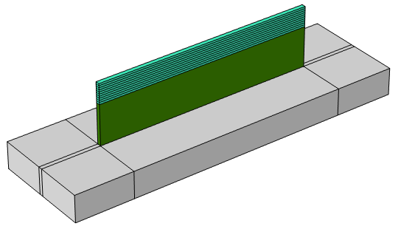
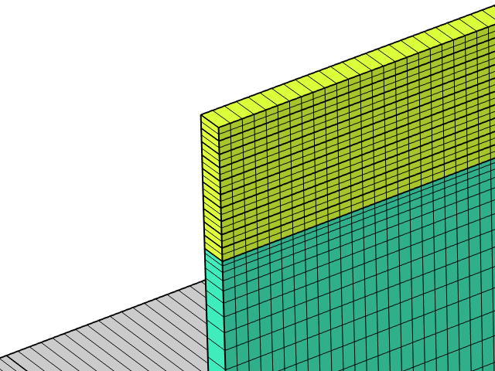
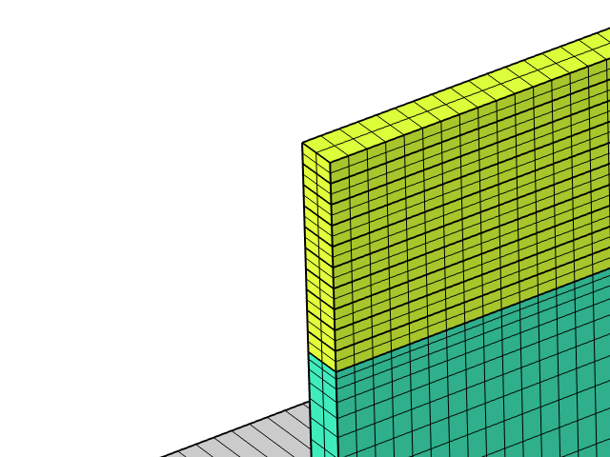
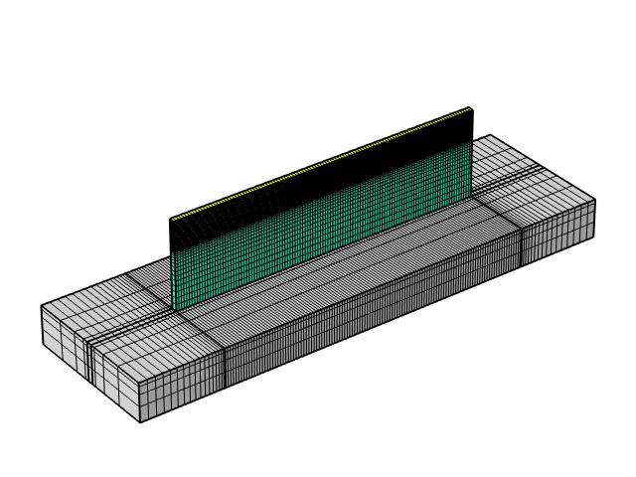
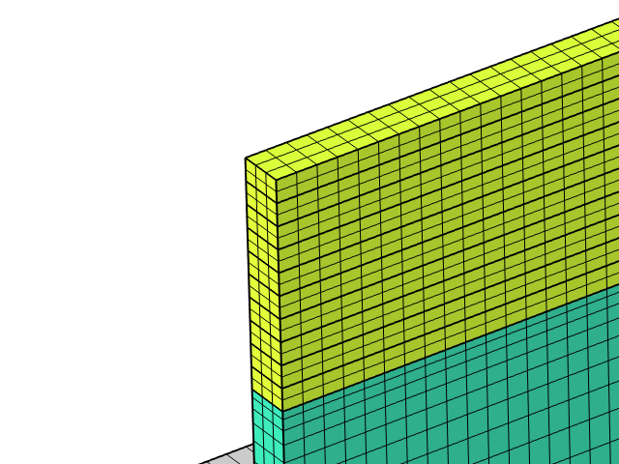
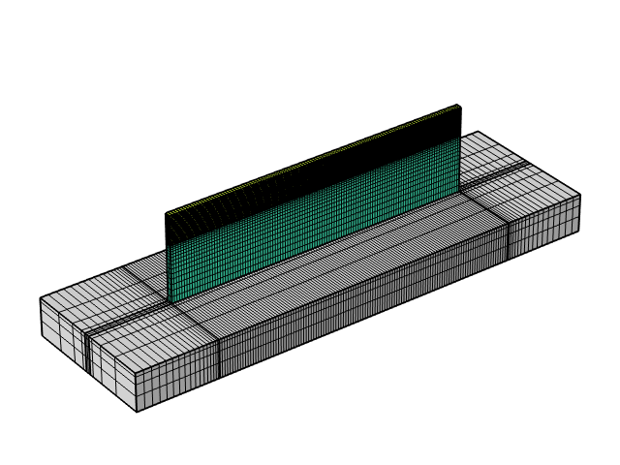
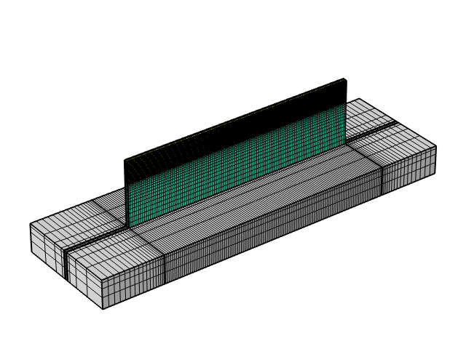
Thermal Model for P-DED
Numerical Model Set-Up
Model Definition
CAD Design
Material Properties
Mesh Strategy
New Layers (10)
Pattern Layers (20)
Substrate
(a) Thermal Properties [2]
Figure 9: CAD design done in Comsol Design Module
(b) Mechanical Properties [2]
Figure 10: Temperature dependent Material Properties [2]
(a) Original Mesh
(b) Single Refinement
(c) Double Refinement
Figure 11: Original Mesh & Mesh Refinement along the width of track

Slide 9
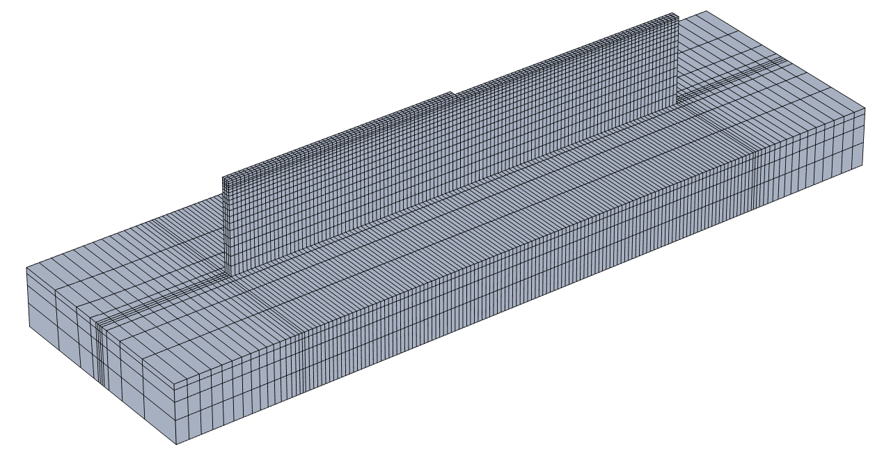
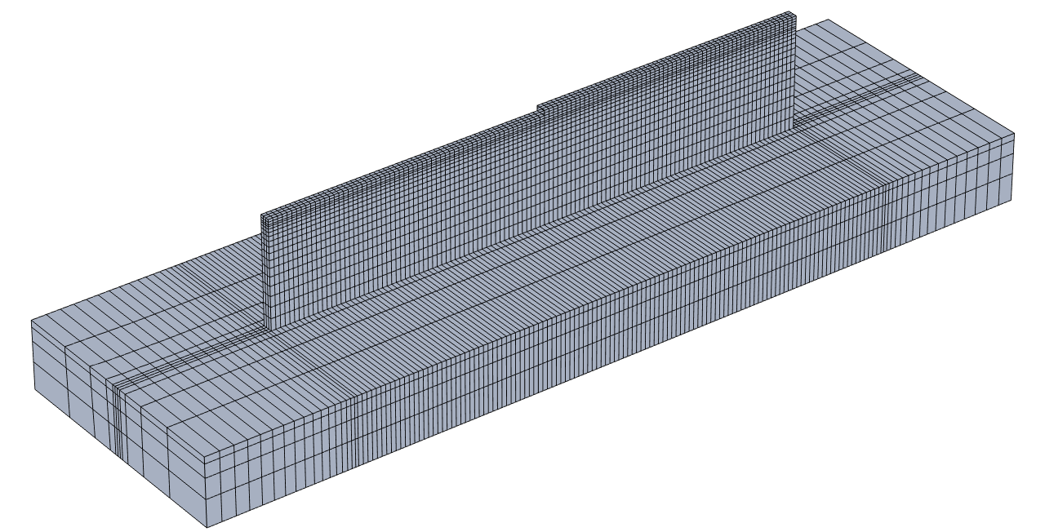
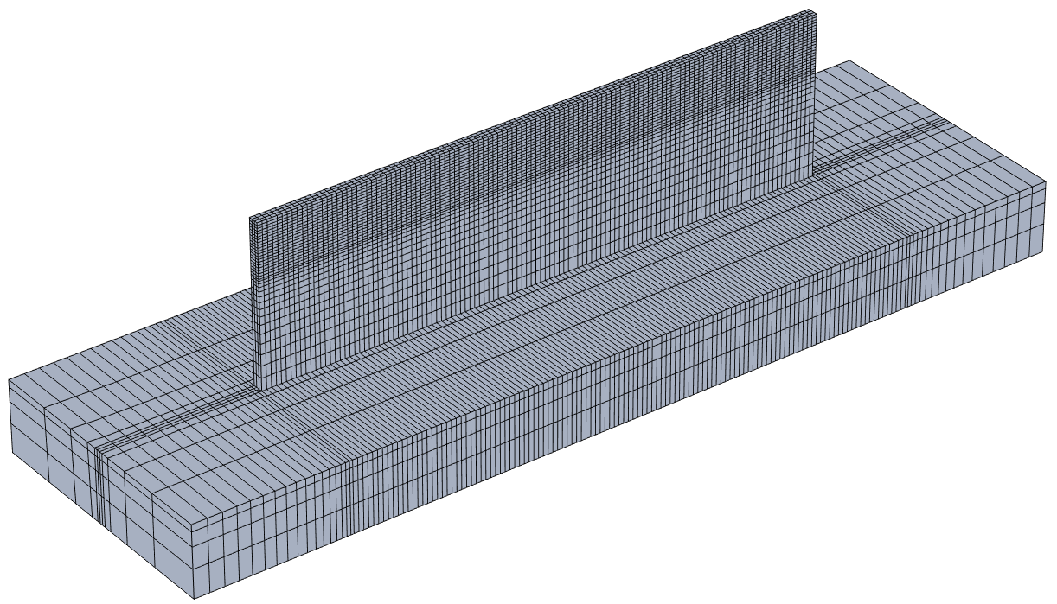

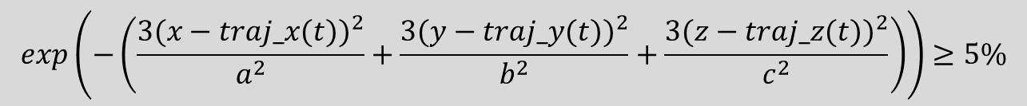
Thermal Model for P-DED
Numerical Model Implementation
Model features
Material Addition
Heat Transfer Analysis
Mesh Strategy
(a) Layer 1 Deposition
(b) Layer 2 Deposition
COMSOL modules used
Design Module
Heat Transfer in solids
  Heat Source
  Heat flux (convective heat flux)
  Surface-to-ambient radiation
Structural Mechanics
  Linear Elastic Material
    Activation
(d) Deposition process finishes
(c) Layer 10 Deposition
Activation Criteria COMSOL:
Figure 12: Quiet/Active method material activation
$$exp\left(−\left(\frac{3{(x−traj_x(t))}^{2}}{a^{2}}+\frac{3{(y−traj_y(t))}^{2}}{b^{2}}+\frac{3{(z−traj_z(t))}^{2}}{c^{2}}\right)\right)≥5\%$$

Slide 10
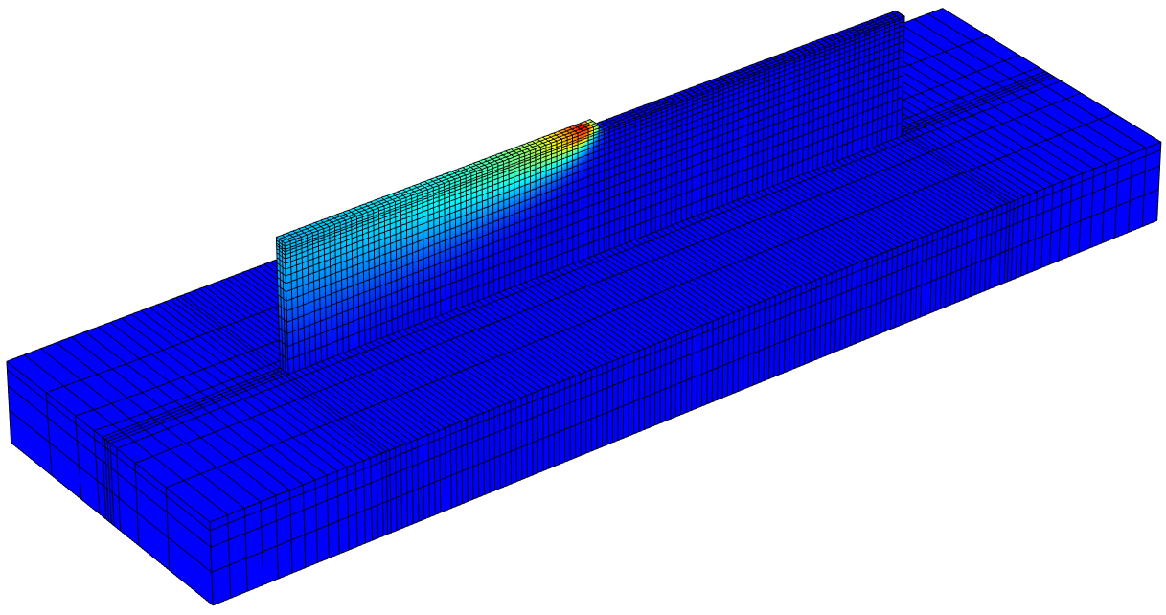
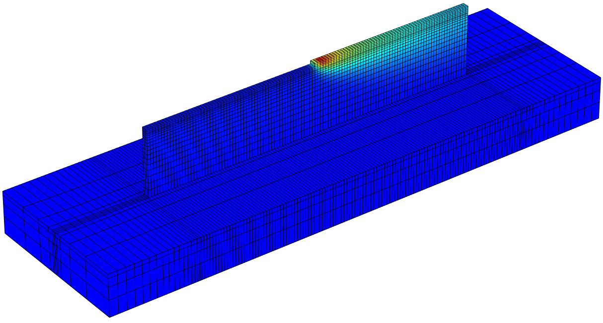
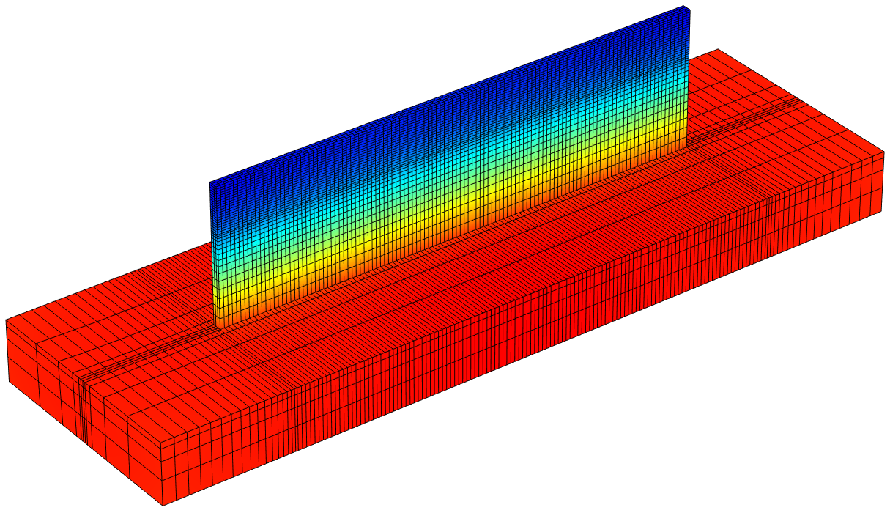
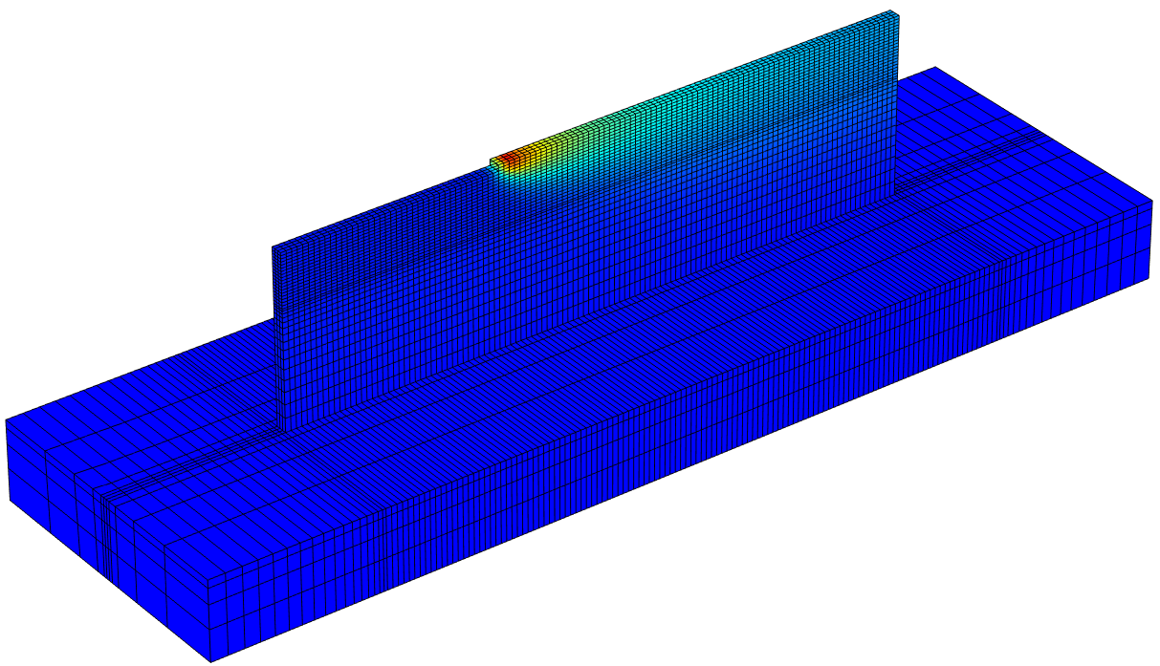
Thermal Model for P-DED
Numerical Model Implementation
Model features
Material Addition
Heat Transfer Analysis
Mesh Strategy
(a) Heat Transfer analysis during Layer 1 Deposition
(b) Heat Transfer analysis during Layer 2 Deposition
COMSOL modules used
Design Module
Heat Transfer in solids
  Heat Source
  Heat flux (convective heat flux)
  Surface-to-ambient radiation
Structural Mechanics
  Linear Elastic Material
    Activation
(d) Fabrication process finishes
(c) Heat Transfer analysis during Layer 10 Deposition
Figure 13: Heat Transfer Analysis during P-DED process

Slide 11
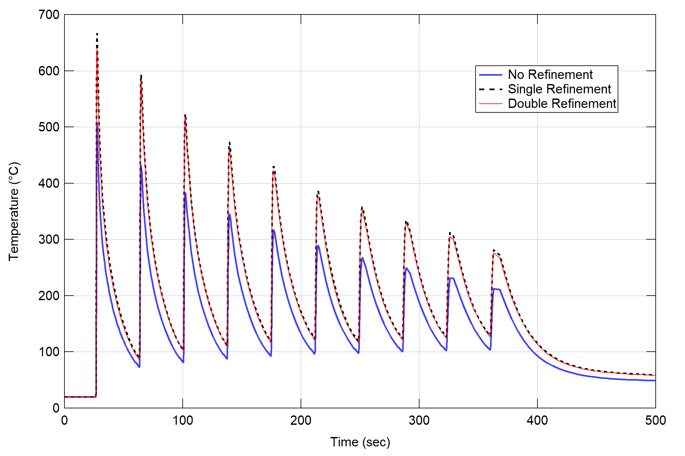
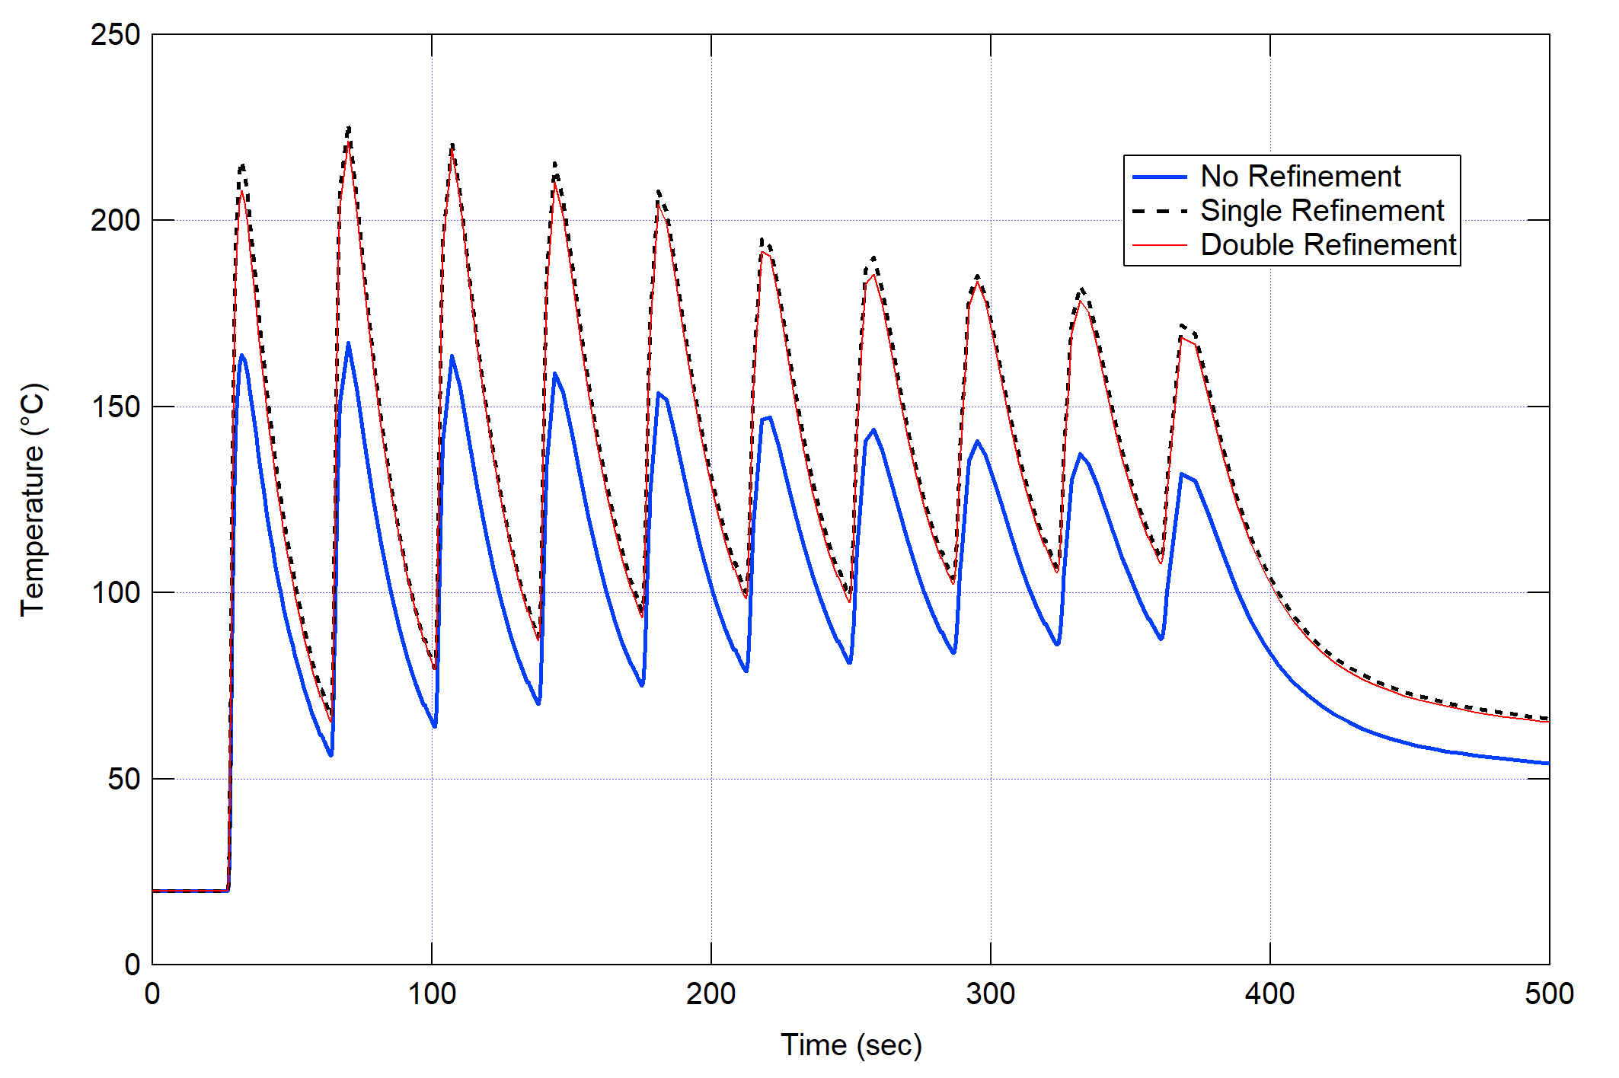



Thermal Model for P-DED
Numerical Model Implementation
Model features
Material Addition
Heat Transfer Analysis
Mesh Analysis
Mesh Type | No. of elements | Dof (solved for) | Computation time
Original Mesh | 9602 | 73440 | 1 hour
Single Refinement | 14340 | 97920 | 1 hour 56 min
Double Refinement | 19078 | 122400 | 2 hour 35 min
(a) TC 1
(b) TC 2
Figure 14: Temperature evolution at TC 1 and TC 2 with different mesh refinement
(a) No refinement
(b) Single refinement
(c) Double refinement
Figure 15: Effect of Mesh Refinement on Accuracy of Heat Transfer (Layer 1 deposition)

Slide 12
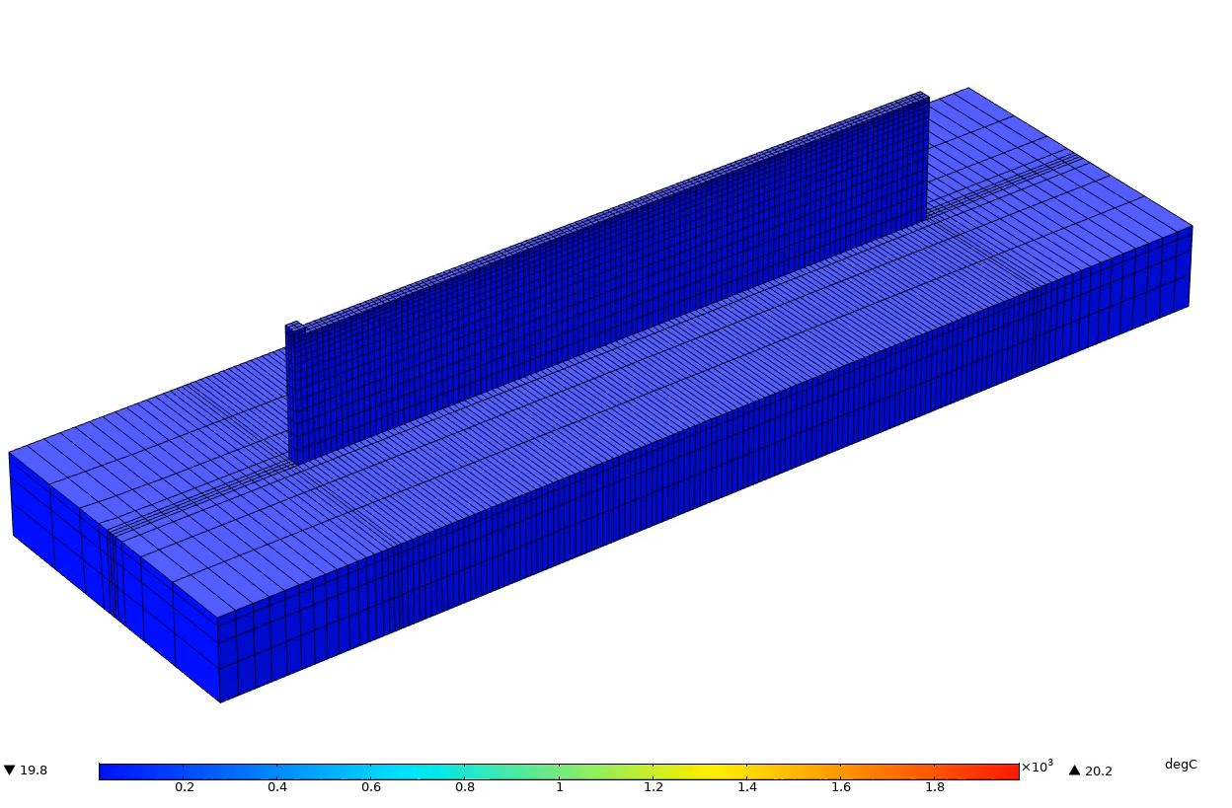
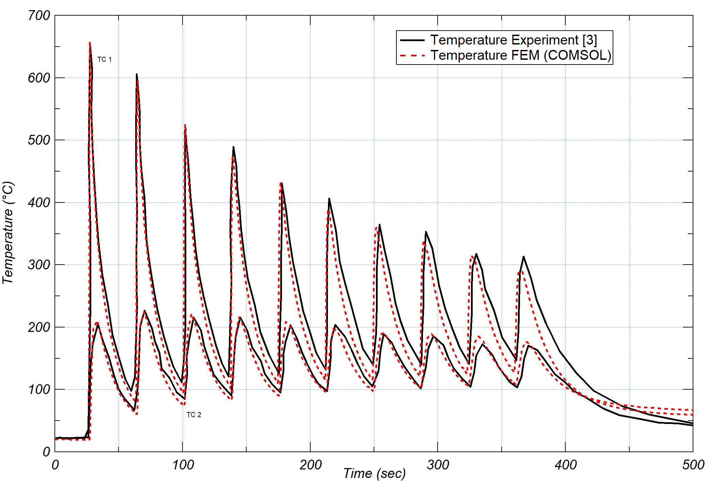
Thermal Model for P-DED
Numerical Model Validation
Temperature Results
Process Simulation
Comparison b/w experimental & numerical results
Animation 1: P-DED Thermal Model process simulation
Figure 16: Comparison b/w Experimental & Numerical results
Numerical model shows good agreement with experimentally measured trends of temperature evolution during the process

Slide 13
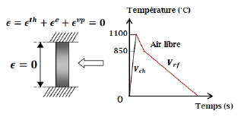
Mechanical Model for Additive Manufacturing (AM)
COMSOL Feasibility Test
SATOH Test: Software benchmarking (Complex Thermo-Mechanical behaviour)
COMSOL modules used
Design Module
Heat Transfer in solids
  Temperature
Structural Mechanics
  Linear Elastic Material
    Viscoplasticity
Multiphysics
Figure 17: Conditions of Mechanical constraints & temperature cycle of SATOH test
Figure 18: Comparison of experiment results with numerical results obtained with different software
Advantage of SATOH: To represent AM process heating & cooling cycle and validate material properties & mechanical behaviour law
EVP: Elasto Viscoplasticity Model
[4] L. Depradeux, “Simulation numérique du soudage - Acier 316L : validation sur cas tests de complexité croissante,” These de doctorat, Lyon, INSA, 2004.
[5] G. Tran Van, “Détermination d’un critère de fissuration à chaud par liquation en fonction de la teneur en bore et de sa localisation pour l’acier inoxydable austénitique 316L.,” These de doctorat, Lorient, 2018.

Slide 14
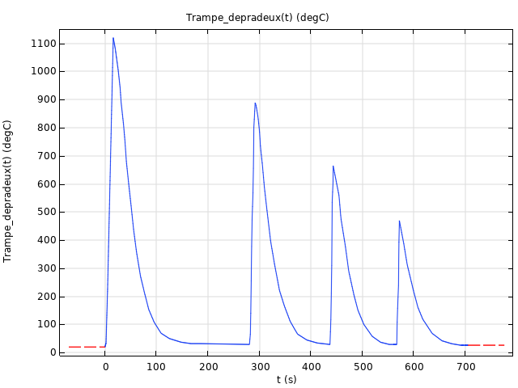
Mechanical Model for Additive Manufacturing (AM)
COMSOL Feasibility Test
SATOH Test: Software benchmarking (Complex Thermo-Mechanical behaviour)
COMSOL modules used
Design Module
Heat Transfer in solids
  Temperature
Structural Mechanics
  Linear Elastic Material
    Viscoplasticity
    Elastoplasticity
Multiphysics
Figure 19: Conditions of temperature loading & unloading cycle [4]
Figure 20: Comparison of experiment results with numerical results obtained from COMSL with different material model & hardening laws
EVP: Elasto Viscoplasticity Model
EP: Elastoplasticity Model
COMSOL Multiphysics demonstrates its feasibility in modeling Additive Manufacturing (AM) process by predicting the stress behaviour due to complex heating and cooling cycle (same type of cycle in AM) with different material plasticity laws & material properties

Slide 15
Future Work
Development of Thermo-Mechanical Model for P-DED
  Transient Thermal Model validation for different material
    Ti-6Al-4V
    Inconel 718
    Inconel 625
  Development of Quasi-Static Mechanical Model
    Comparison of Numerical results obtained with different material hardening laws
    Validation of Mechanical Model with experiment results

Slide 16
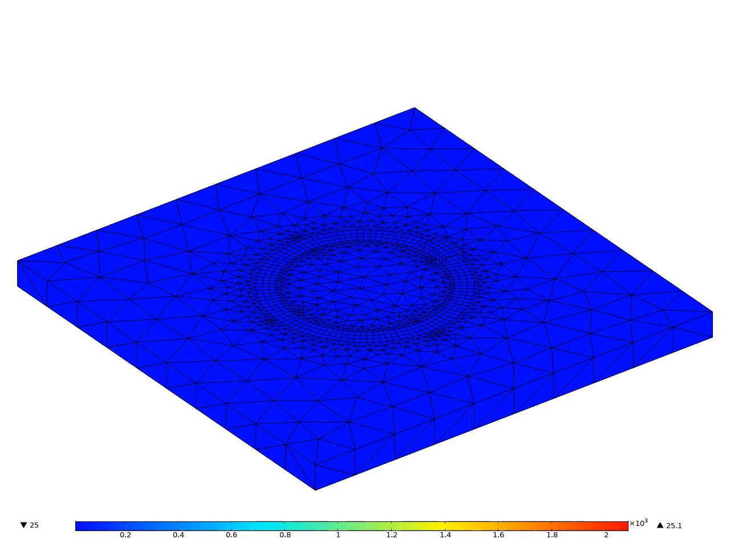
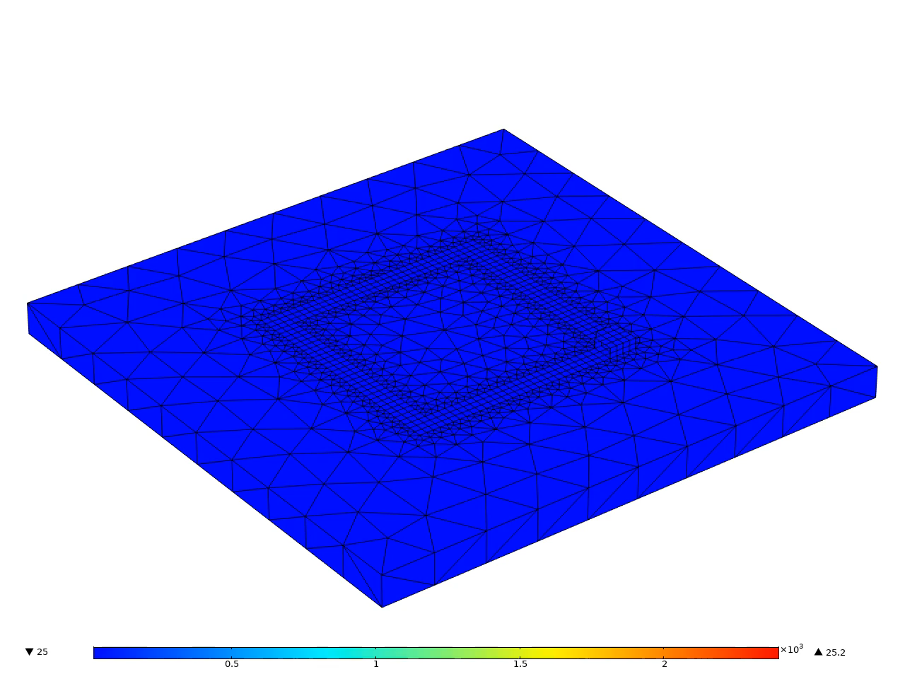

Contact: vn@irepa-laser.com
Thankyou

