Slide 1



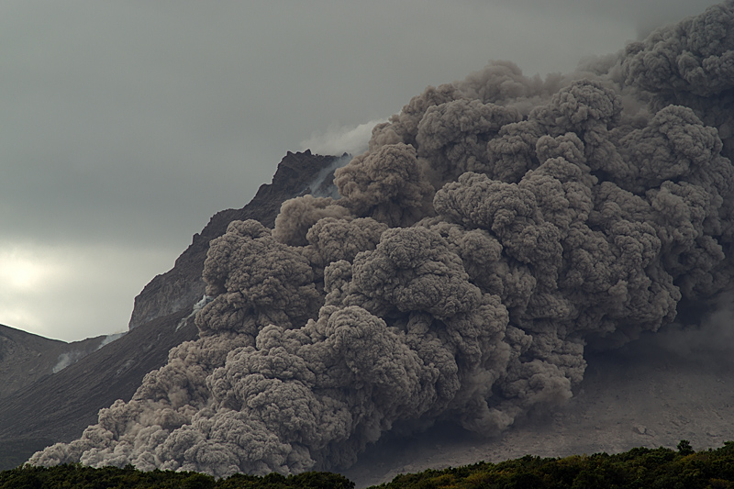
Development of Simulation Model for Pyroclastic Flows using COMSOL Multiphysics®
Mauro Iacuaniello, Andrea Montanino, Daniela De Gregorio, Giulio Zuccaro

Slide 2

CONTENTS
Volcanic risk,
Volcanic risk in the Neapolitan area,
Actions and effects on the buildings of the different volcanic phenomena,
Exposure assessment of the red and yellow areas of the Campi Flegrei and Vesuvius,
Vulnerability assessment,
Mitigation strategies,
Conclusions and perspectives

Slide 3
INTRODUCTION TO THE VOLCANIC RISK
RISK = HAZARD x EXPOSURE x VULNERABILITY
HAZARD is the probability that, in a specific area, a specific event occurs during a specific time.
EXPOSURE is the extension, the quantity and the quality of different anthropic elements which characterize the examined area (population, buildings, facilities, etc.), whose conditions and/or functioning can be damaged, altered or destroyed by a volcanic event.
VULNERABILITY is the tendency of people, buildings, activities and property to show damage or changes under effect of volcanic events

Slide 4
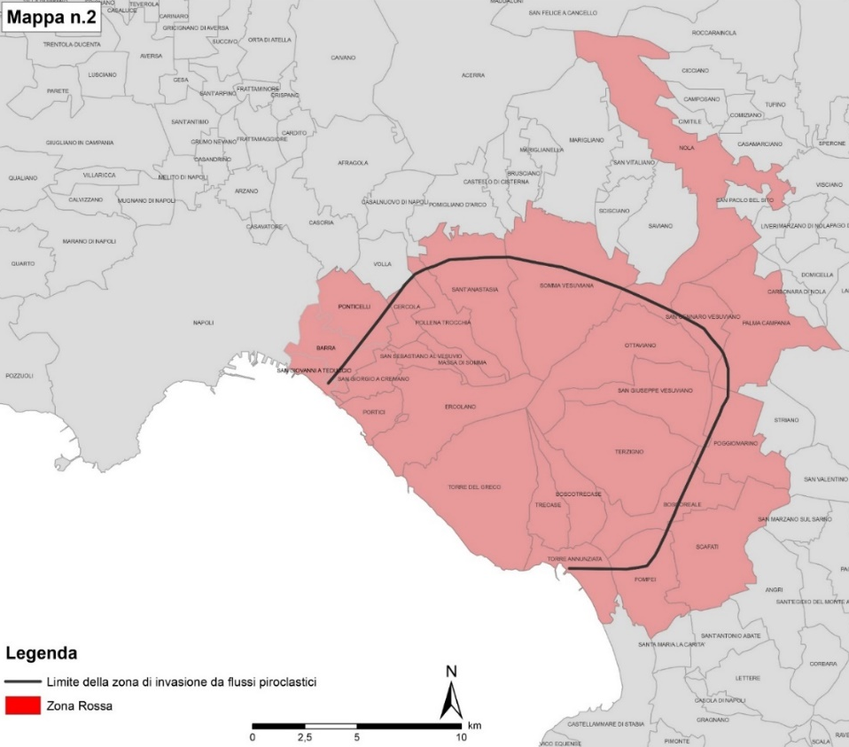
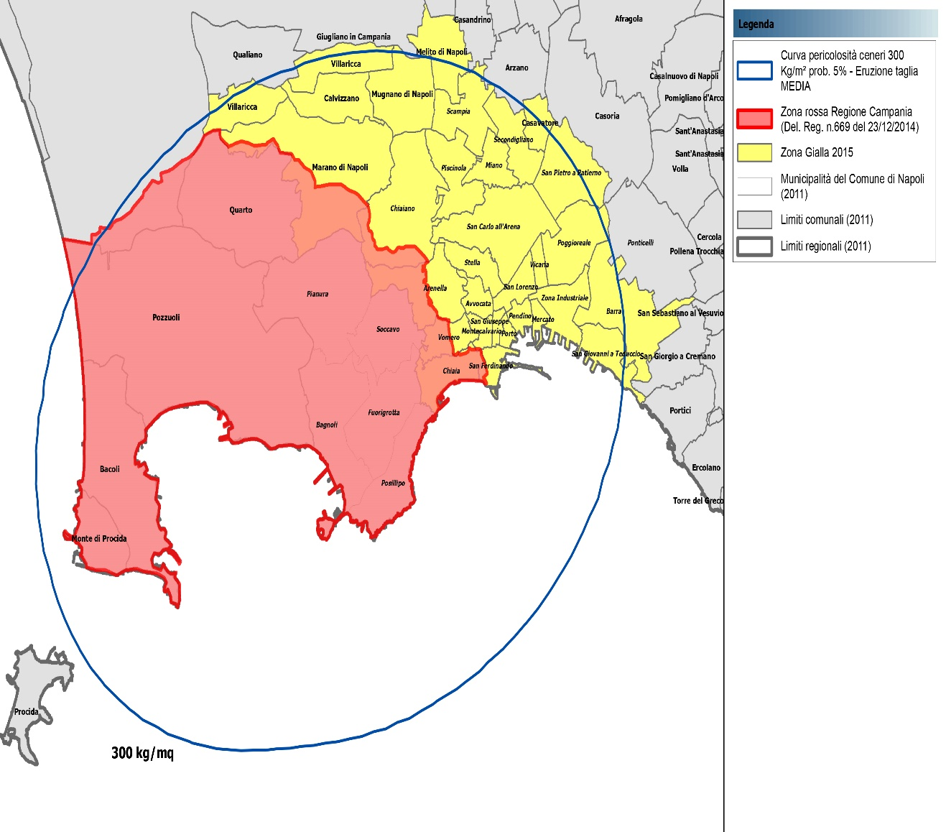
REFERENCE SCENARIO: VESUVIUS AND CAMPI FLEGREI
SOURCE: Department of Civil Protection
«Scenari Eruttivi e Livelli di Allerta per il Vesuvio» (2010)
SOURCE: Department of Civil Protection
«Scenari Eruttivi e Livelli di Allerta per Campi Flegrei» (2012)
the formation of a sustained eruptive column 18 km high and with a total erupted mass of 5.0 e¹¹ kg;
the fall of volcanic bombs and blocks in the immediate vicinity of the crater and smaller particles (ash and lapilli) even several tens of kilometres away;
the formation of pyroclastic flows that would flow along the slopes of the volcano for several kilometres.
the formation of a sustained eruptive column 12 km high and with a total erupted mass of 1,2 e¹¹ kg;
the fall of volcanic bombs and blocks in the immediate vicinity of the crater and smaller particles (ash and lapilli) even several tens of kilometres away;
the formation of pyroclastic flows that would flow along the slopes of the volcano for several kilometres.

Slide 5
ACTIONS AND EFFECTS
EARTHQUAKES (EQ)
Horizontal and vertical cyclic action proportional to masses
Damage to structures and/or non-structural elements
Damage to structures and/or non-structural elements,
Opening up,
Fire damage inside.
PYROCLASTIC FLOWS (PF)
Non-cyclical impact surface action (0.5-17 kPa),
Thermal stress (150/400 °C).
ASH FALL (AF)
Collapse of the roofing slabs
Uniform vertical static pressure on roofs
Damage to structures and/or non-structural elements especially on the ground floor
Non-cyclical impact surface action (20/90 kPa),
Temperature effect (<100°C).
LAHAR (LH)
SOURCE: Spence R., Zuccaro G., Petrazzuoli S., Baxter P.J., (2004b). The resistance of buildings to pyroclastic ﬂows: theoretical and experimental studies in relation to Vesuvius.

Slide 6
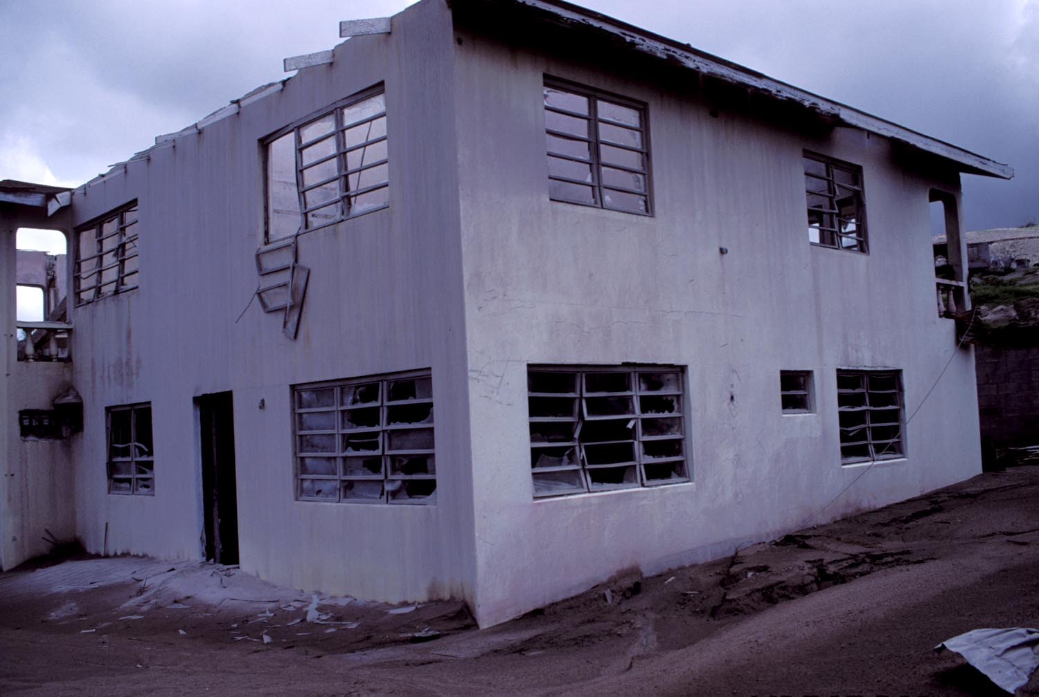
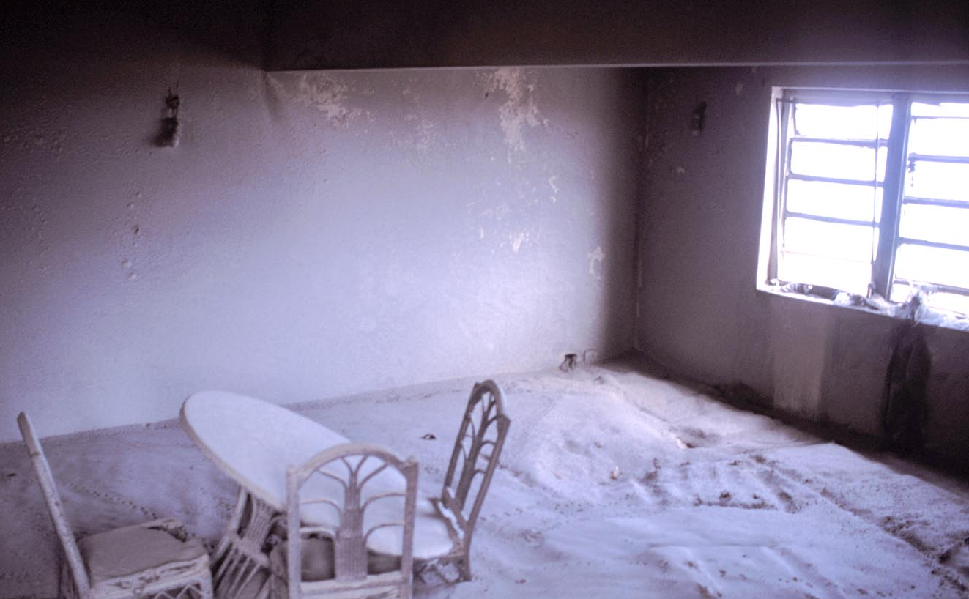
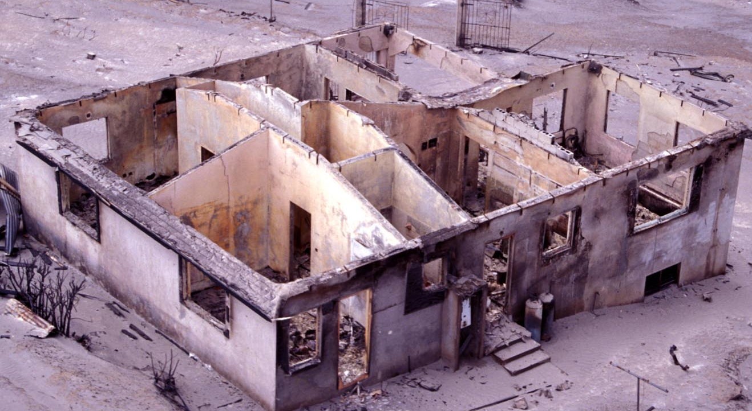
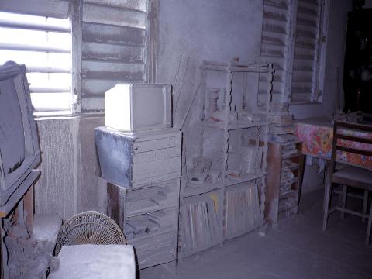
EXPERIENCE IN MONSERRAT
Effects of pyroclastic flows
Photo by Peter Baxter

Slide 7
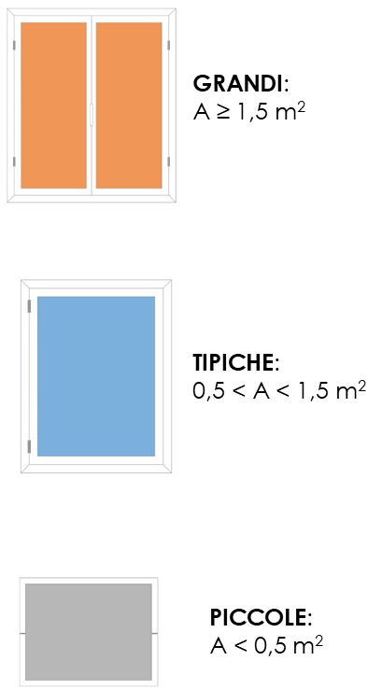
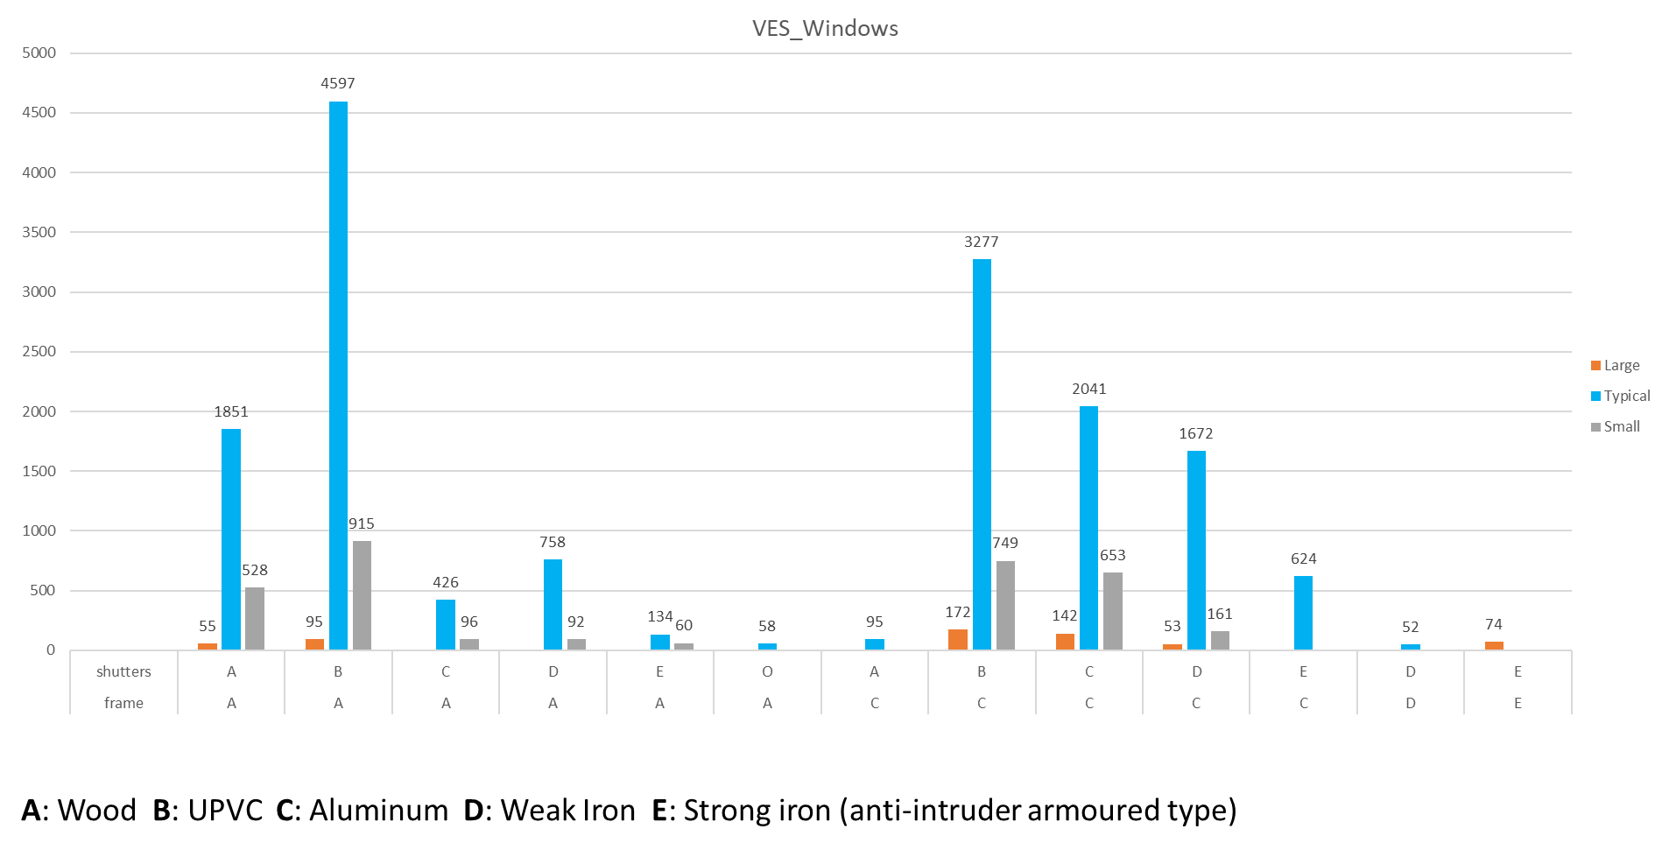
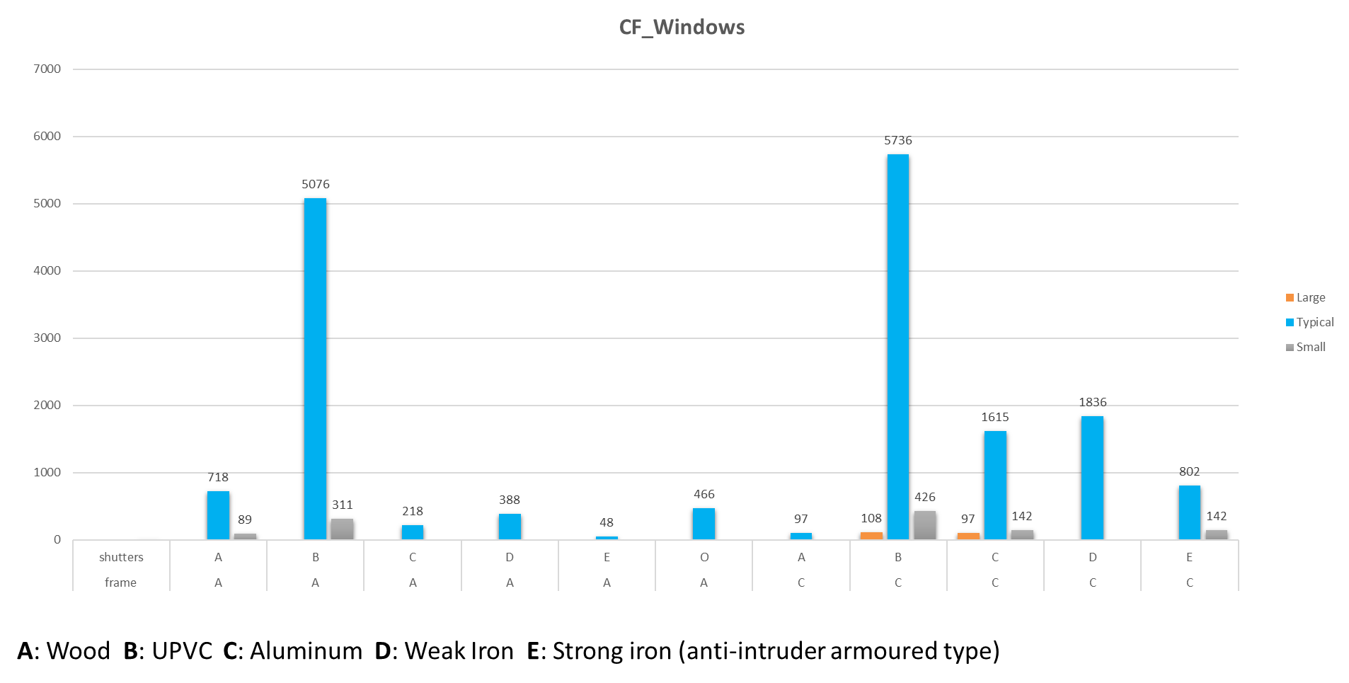
TYPOLOGICAL AND STRUCTURAL IDENTIFICATION OF ELEMENTS EXPOSED TO RISK
LARGE
TYPICAL
SMALL

Slide 8
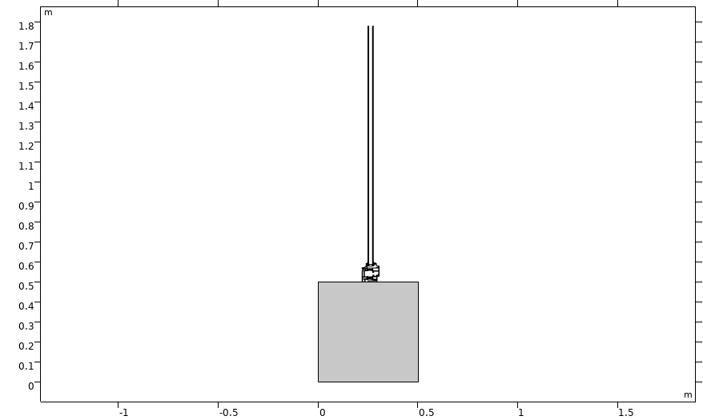
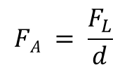



MECHANICAL ASSESSMENT
Aluminium EN-AW 6060 (Thermal Break)
Density | 2700 [kg/m³]
Elastic modulus | 70000 [MPa]
Ultimate Stress | 160 [MPa]
Poisson Coefficient | 0.33
Specific heat capacity | 900 [J/kgK]
Thermal conductivity | 238 [W/mK]
Thermal expansion | 3,7 e⁻⁷ [1/K]
(C)
(B)
1. Solid Mechanics
$$0 = ∇ ∙ {(FS)}^{T} + F_{V}$$
$F_{V} = I + ∇_{u}$
Applied load
$$S ∙ n = FA$$
$$FA = \frac{F_{L}}{d}$$
(A)
F_{L} = 1[kN/m] * para
para = range (0,0.1,10)
Stop Condition
comp1.StressMax > 40[MPa]
Geometrical model :
Fixed Constraint, B) External Front,
C) Symmetry condition

Slide 9
MECHANICAL ASSESSMENT: BREAK LOAD
Frame |  | Aluminium
Glass |  | Soda Lime
Large
4mm | 5mm |  | 6mm
0,6 kPa | 1 kPa |  | 1,3 kPa
Typical
4mm | 5mm |  | 6mm
2 kPa | 3 kPa |  | 4,3 kPa
Small
5,3 kPa | 8 kPa |  | 10,33 kPa

Slide 10
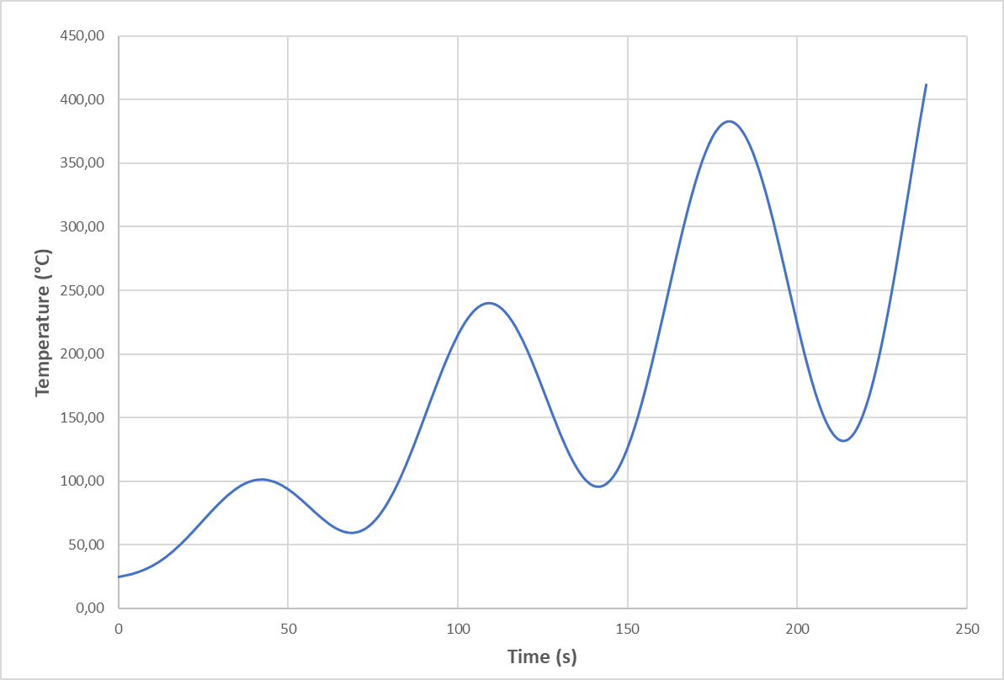
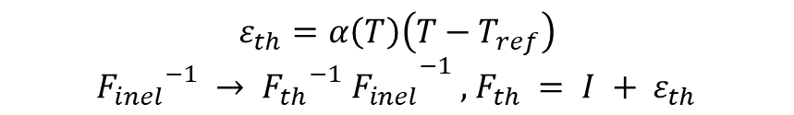

THERMAL ASSESSMENT
2. Thermal Stress
Heat transfer in solid
$d_{z}ρC_{p}\frac{δT}{δt}+ d_{z}ρC_{p}u ∙ ∇T+ ∇ ∙q= d_{z}Q+ q_{0}+ d_{z}Q_{ted}$
(C)
Thermal expansion
(B)
$ε_{th}=α\left(T\right)\left(T−T_{ref}\right)$
${F_{inel}}^{−1} → {{{F_{th}}^{−1} F}_{inel}}^{−1} ,$ $F_{th} = I + ε_{th}$
Applied temperature
$T= T_{i} + sin(T) ∗ t ∗ P$
(A)
Geometrical model :
Fixed Constraint, B) External Front,
C) Symmetry condition

Slide 11
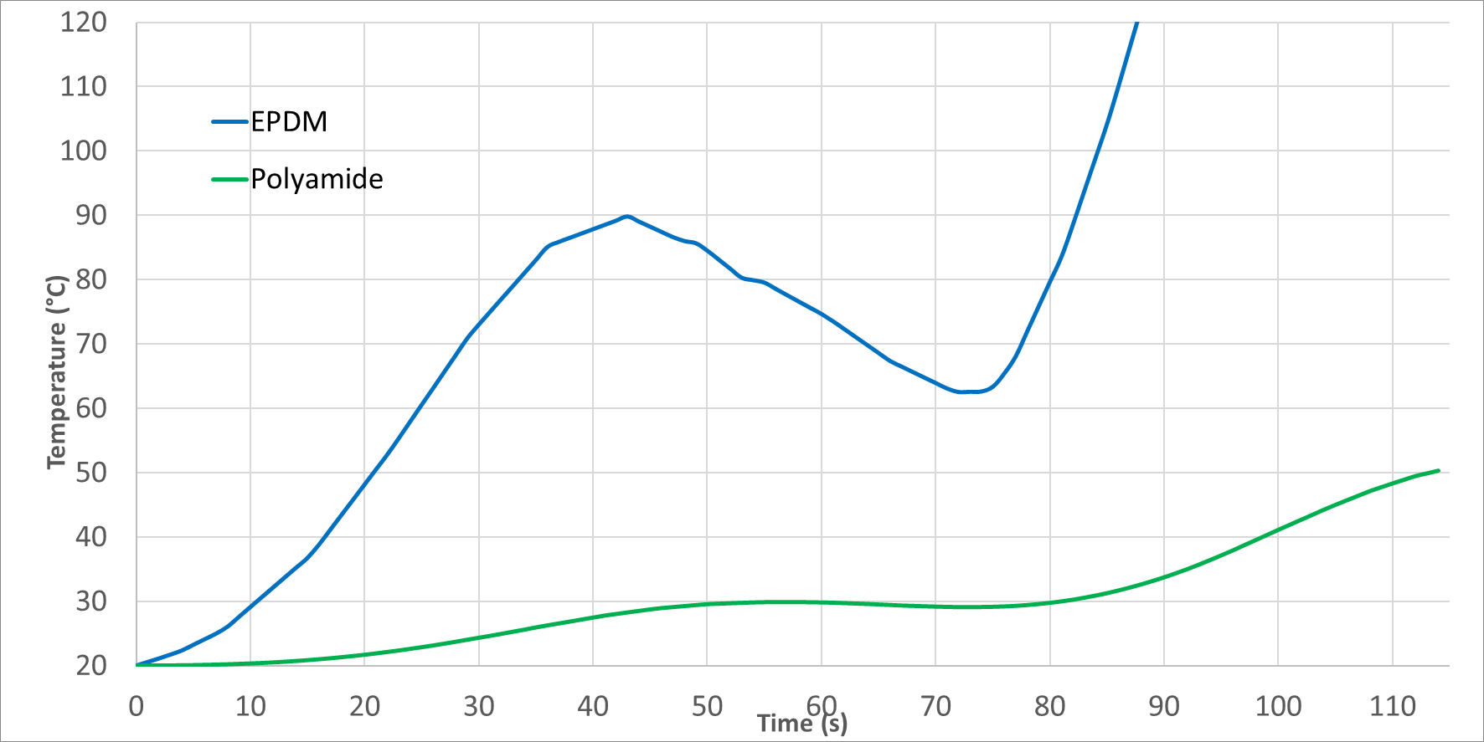
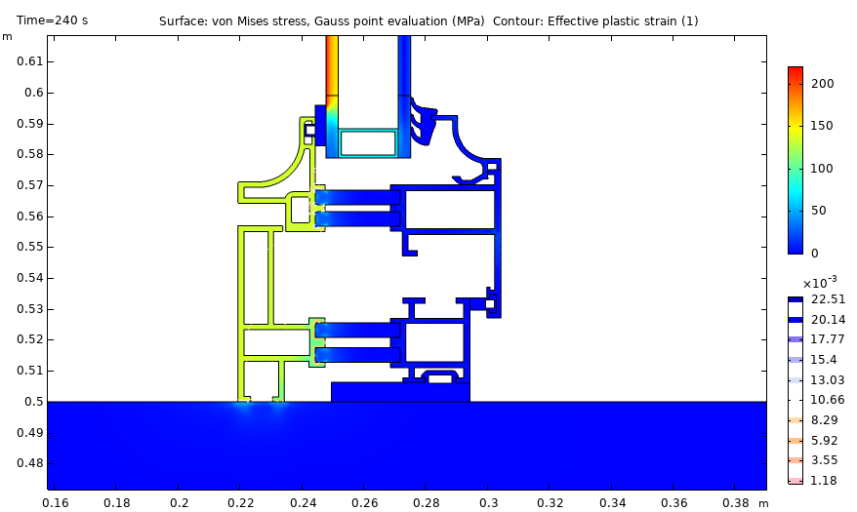
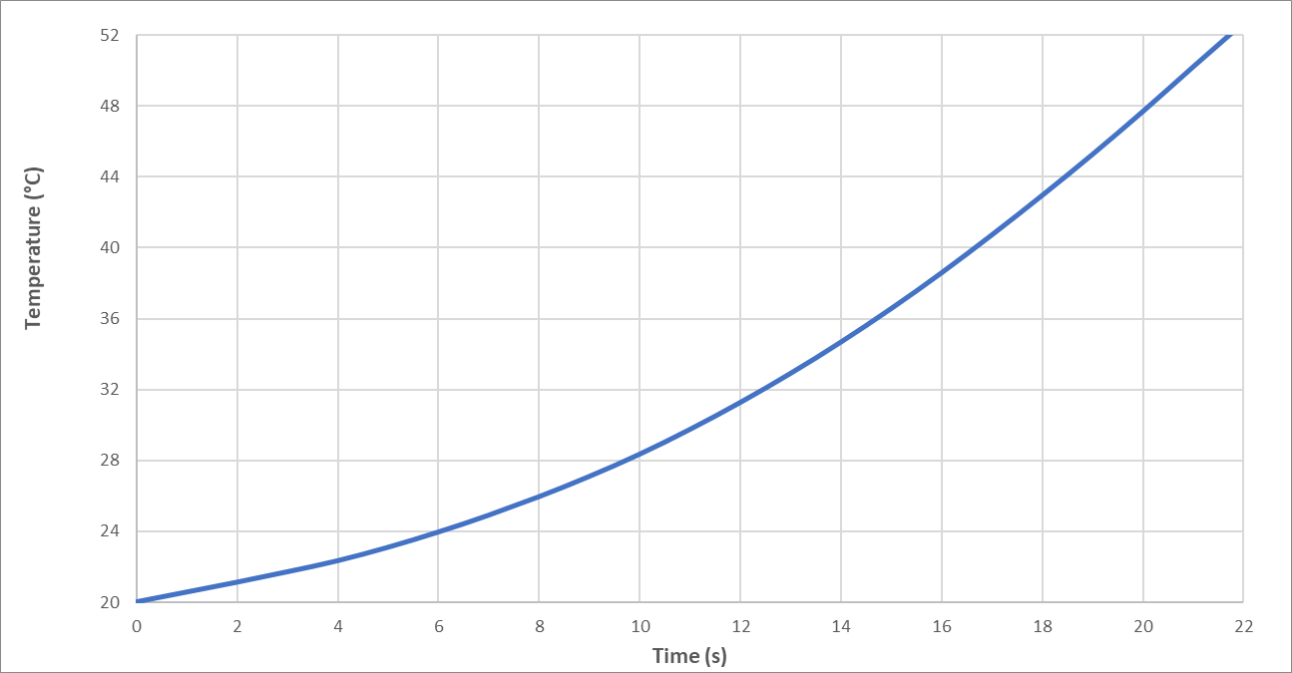
THERMAL ASSESSMENT
Maximum temperature of polyamide and EPDM
Von Mises stress
Maximum temperature of soda-lime glass

Slide 12
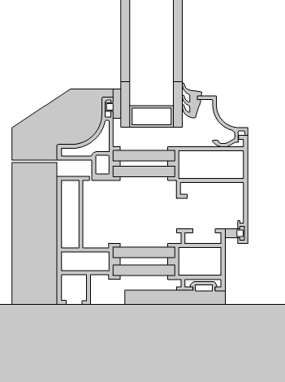
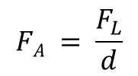

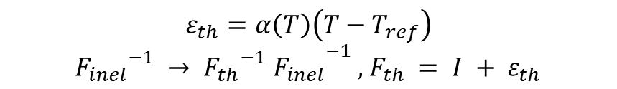

MECHANICAL AND THERMAL ASSESSMENT
1. Thermal Stress
Heat transfer in solid
$d_{z}ρC_{p}\frac{δT}{δt}+ d_{z}ρC_{p}u ∙ ∇T+ ∇ ∙q= d_{z}Q+ q_{0}+ d_{z}Q_{ted}$
Thermal expansion
$ε_{th}=α\left(T\right)\left(T−T_{ref}\right)$
${F_{inel}}^{−1} → {{{F_{th}}^{−1} F}_{inel}}^{−1} ,$ $F_{th} = I + ε_{th}$
Applied temperature
$T= T_{i} + sin(T) ∗ t ∗ P$
2. Solid Mechanics
Applied load
$$S ∙ n = FA$$
$$FA = \frac{F_{L}}{d}$$
F_{L} = 1[kN/m] * para
para = range (0,0.1,10)
Stop Condition
comp1.StressMax > 180[MPa]

Slide 13
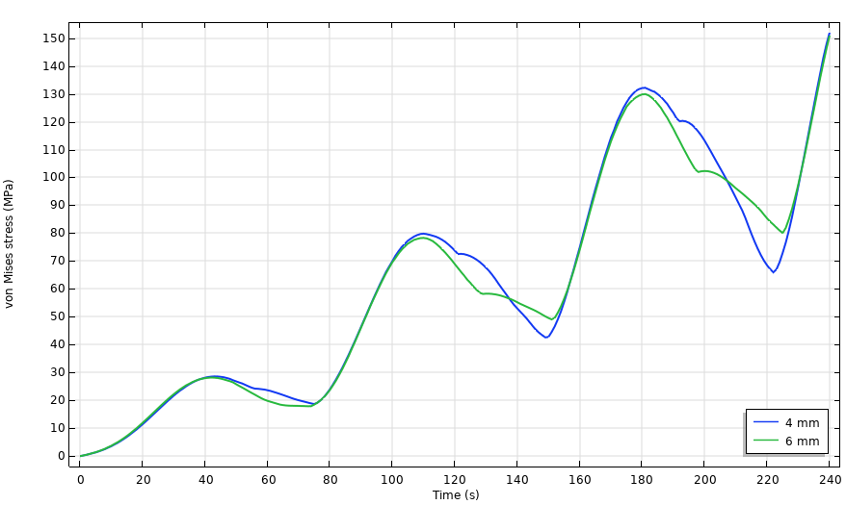
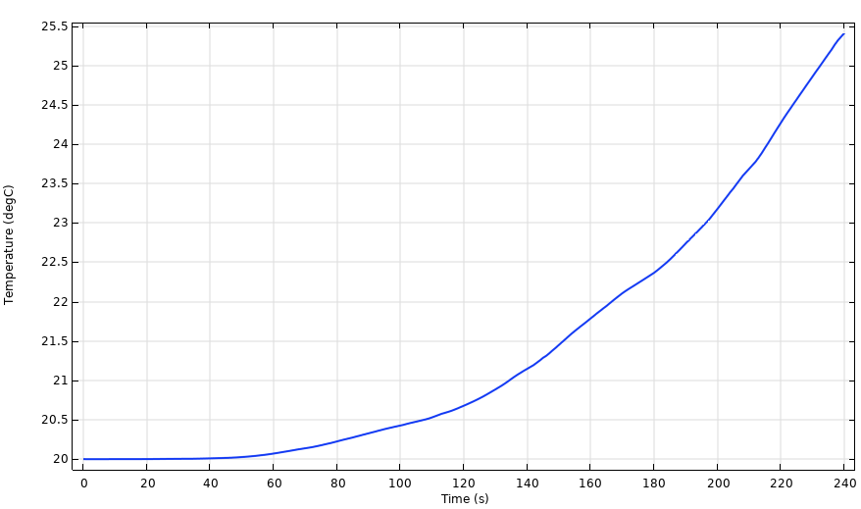
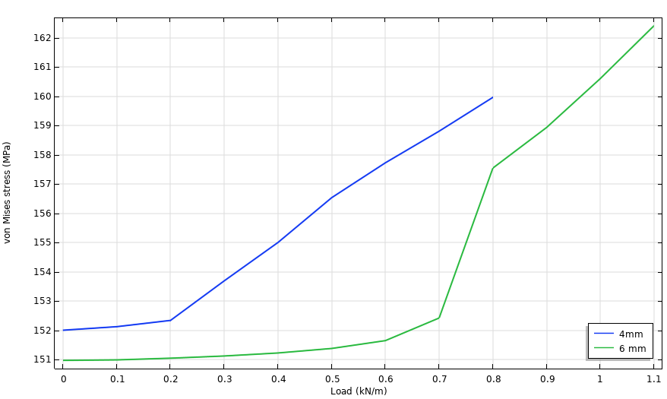
MECHANICAL AND THERMAL ASSESSMENT
Thermal stress for 4- and 6-millimeter glass
Maximum temperature of polyamide
Break load for 4- and 6-millimeter heated glass

Slide 14
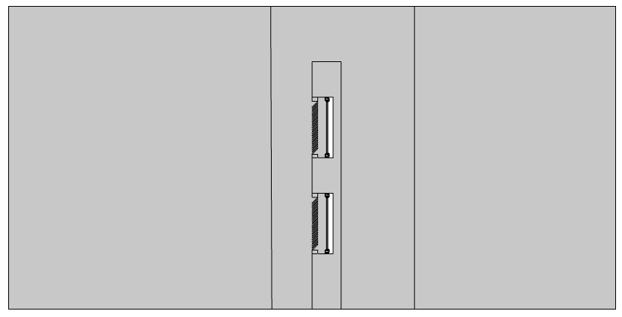
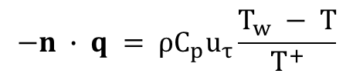


FLUID DYNAMICS ASSESSMENT
Inlet
Outlet
$u_{fluid}$ = 25 m/s
1. Turbolent Flow (k-ε)
$ρ(u_{fluid} ∙ ∇)u_{fluid}$ = $∇∙[−pI$ + K] + F (4.1)
$p∇∙ u_{fluid}$ = 0
2. Nonisothermal Flow
$$−n ∙ q = ρC_{p}u_{τ}\frac{T_{w} − T}{T^{+}}$$

Slide 15
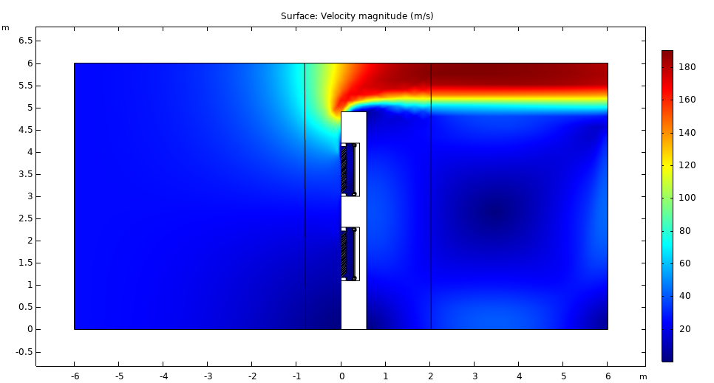
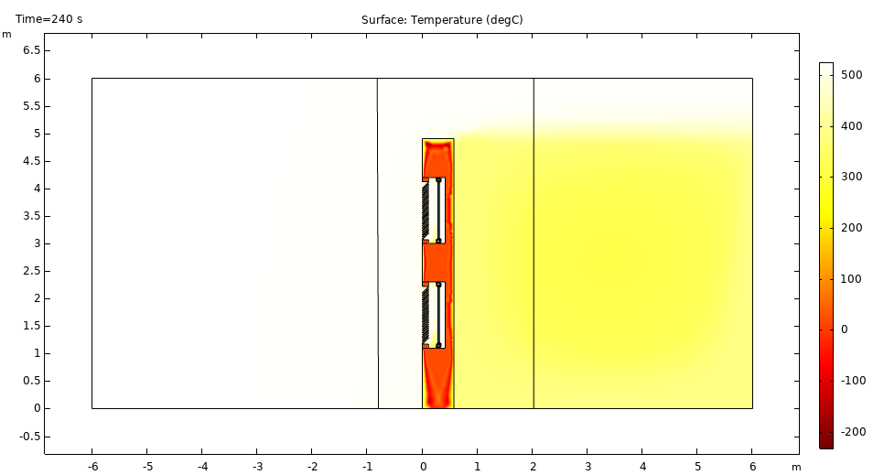
FLUID DYNAMICS ASSESSMENT
Velocity
Temperature

Slide 16
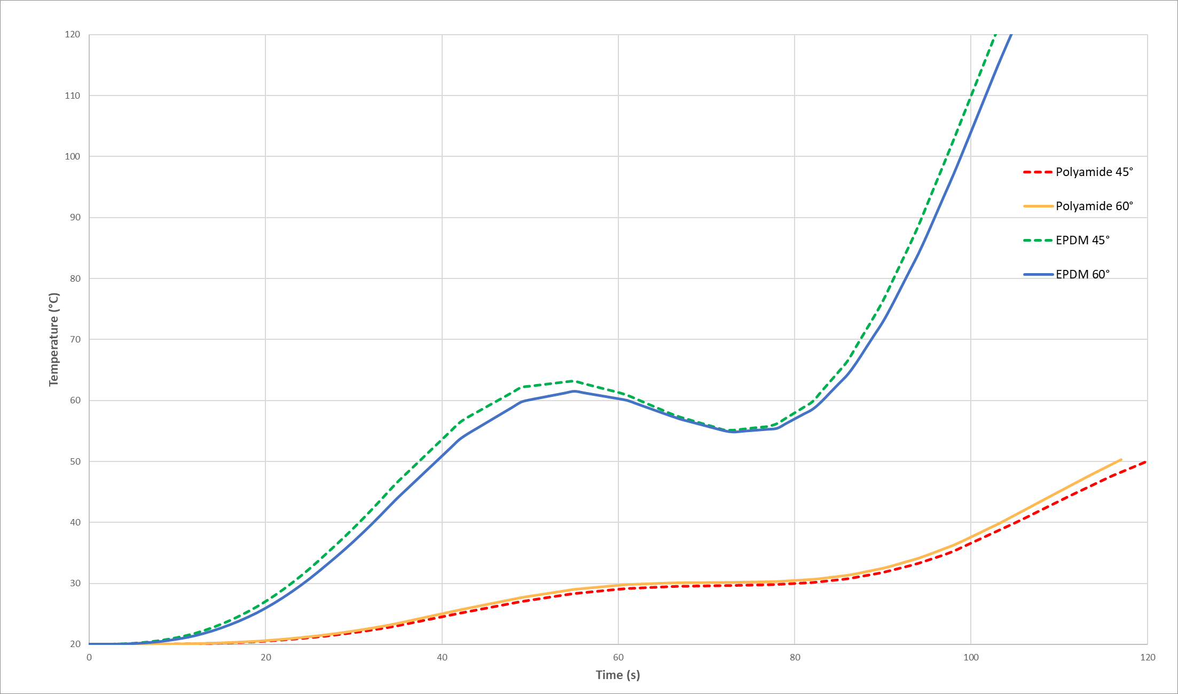
FLUID DYNAMICS ASSESSMENT
Maximum temperature of polyamide and EPDM (CFD)

Slide 17
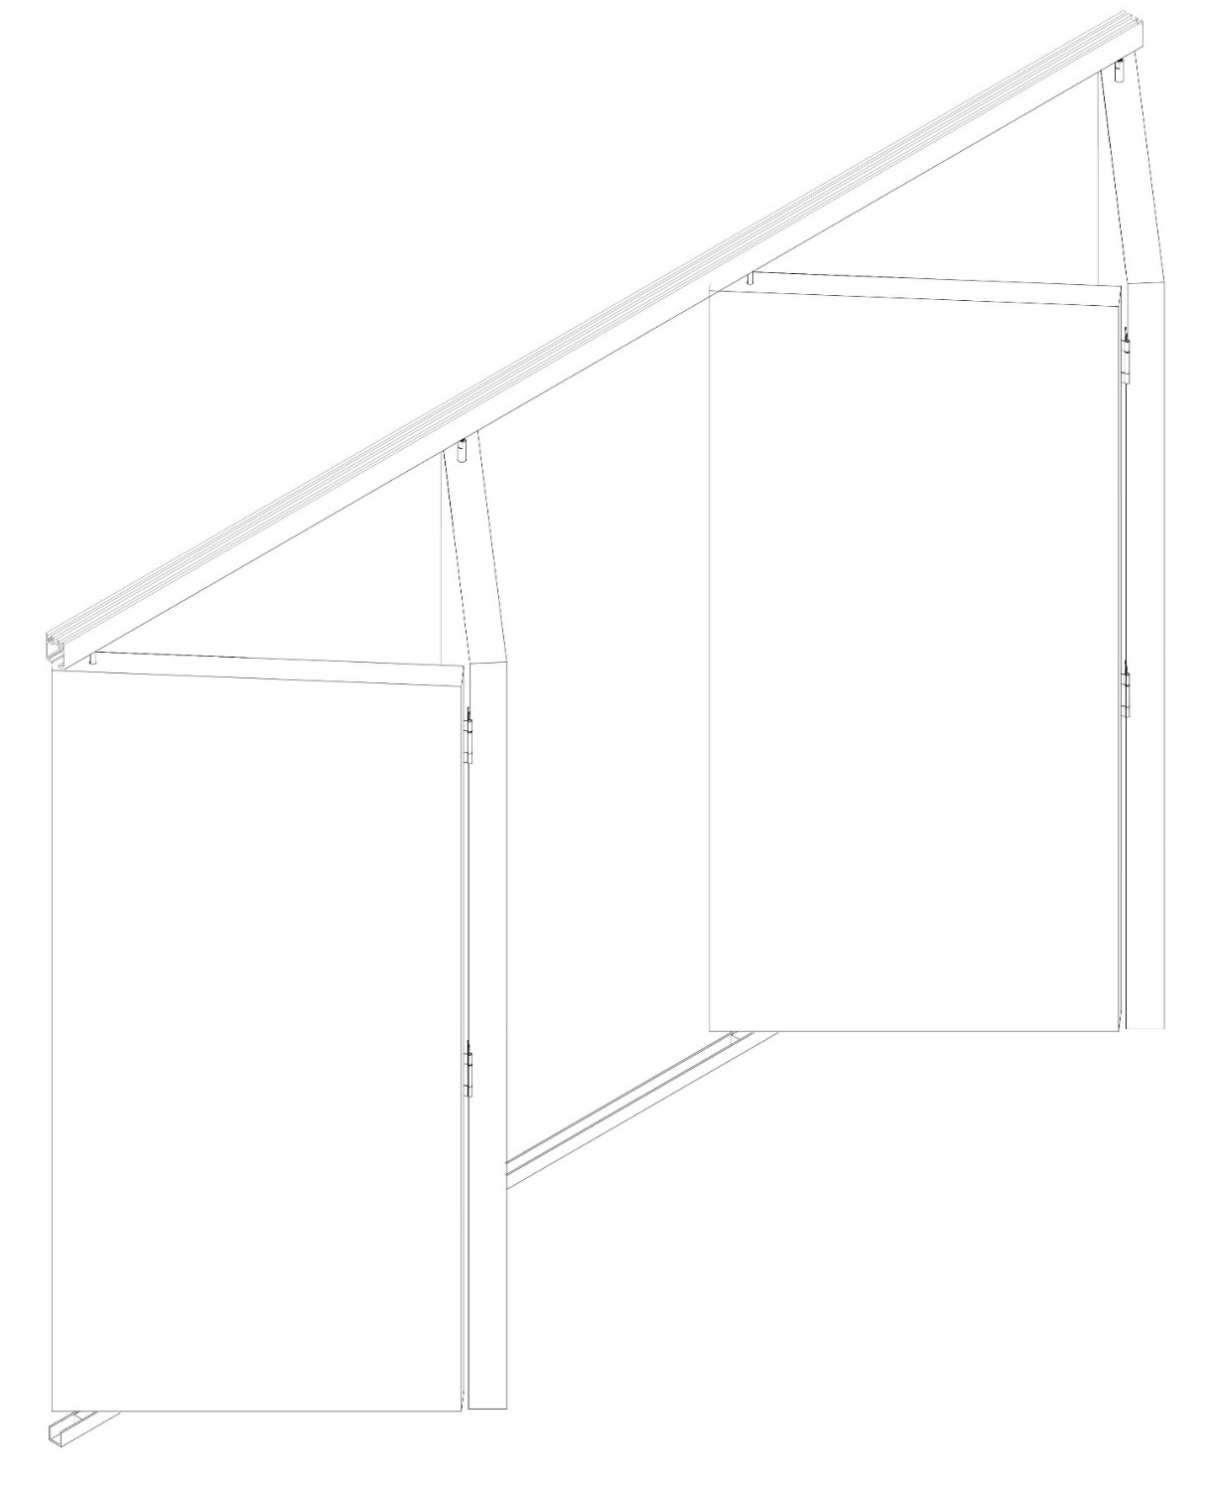
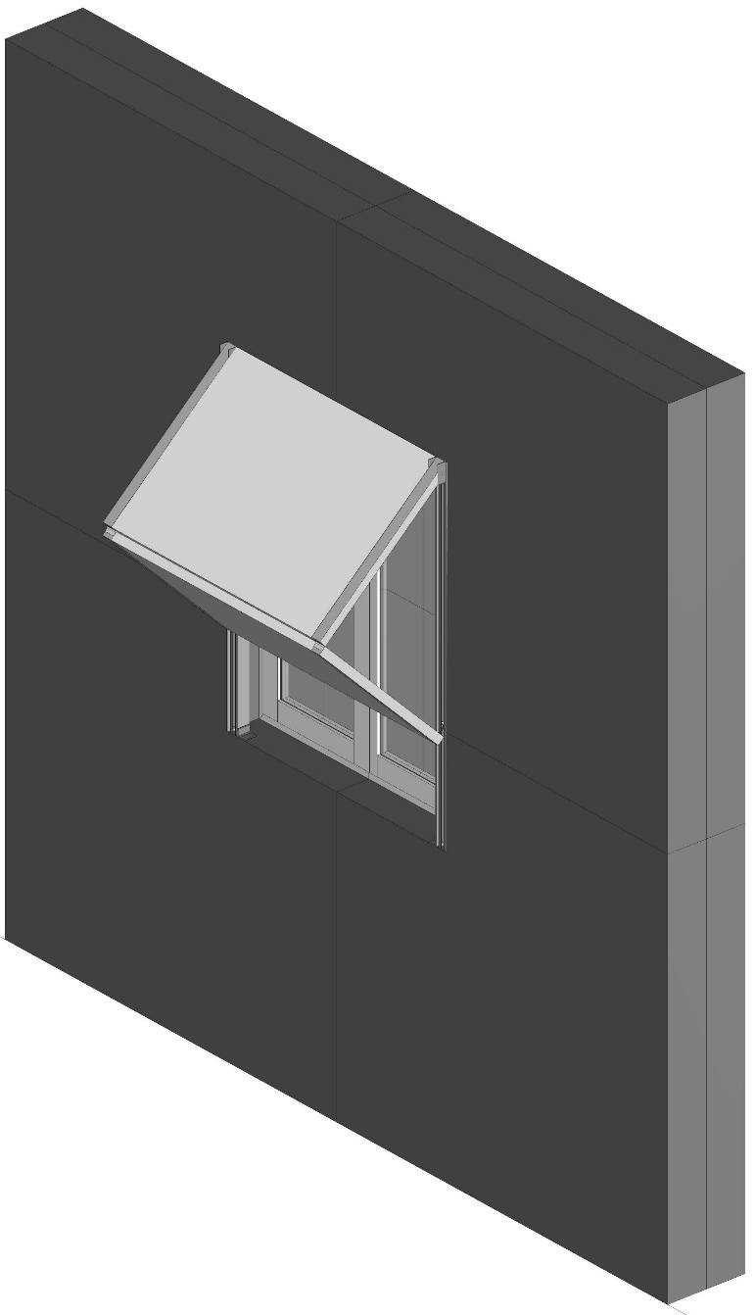
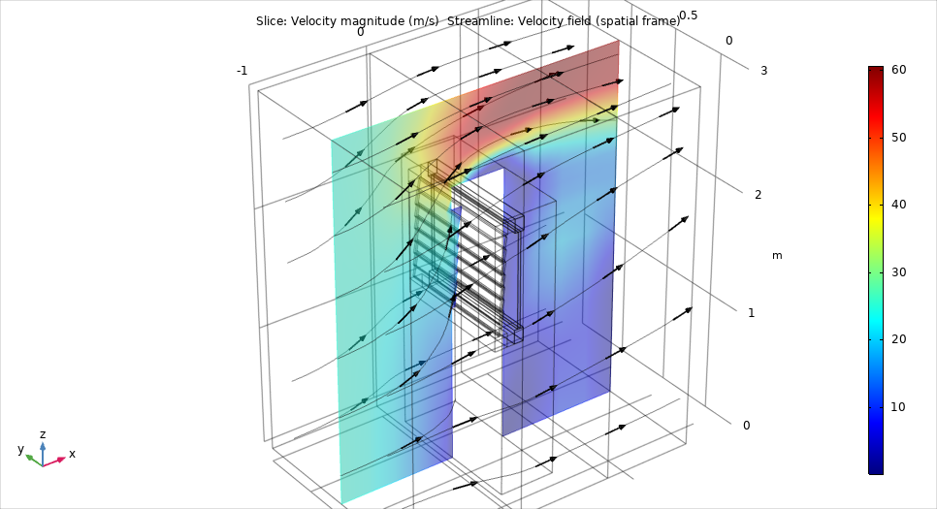
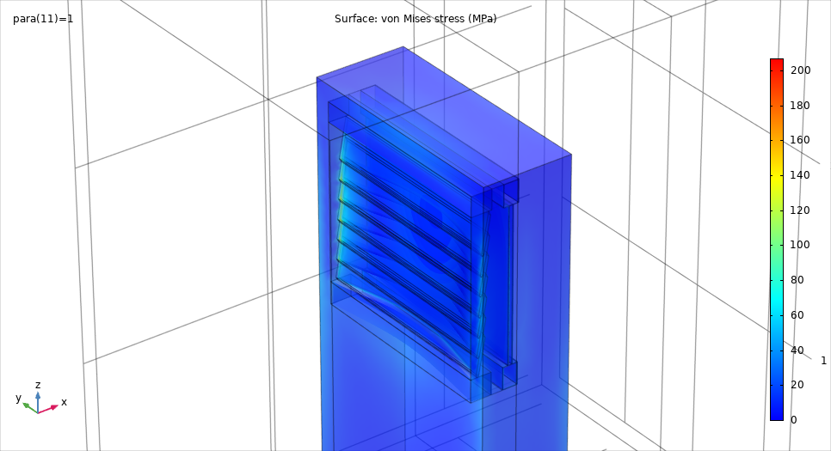
PERSPECTIVES

Slide 18
THANK YOU FOR YOUR KIND ATTENTION
© Stromboli online · J. Alean · R. Carniel · M. Fulle

