Slide 1
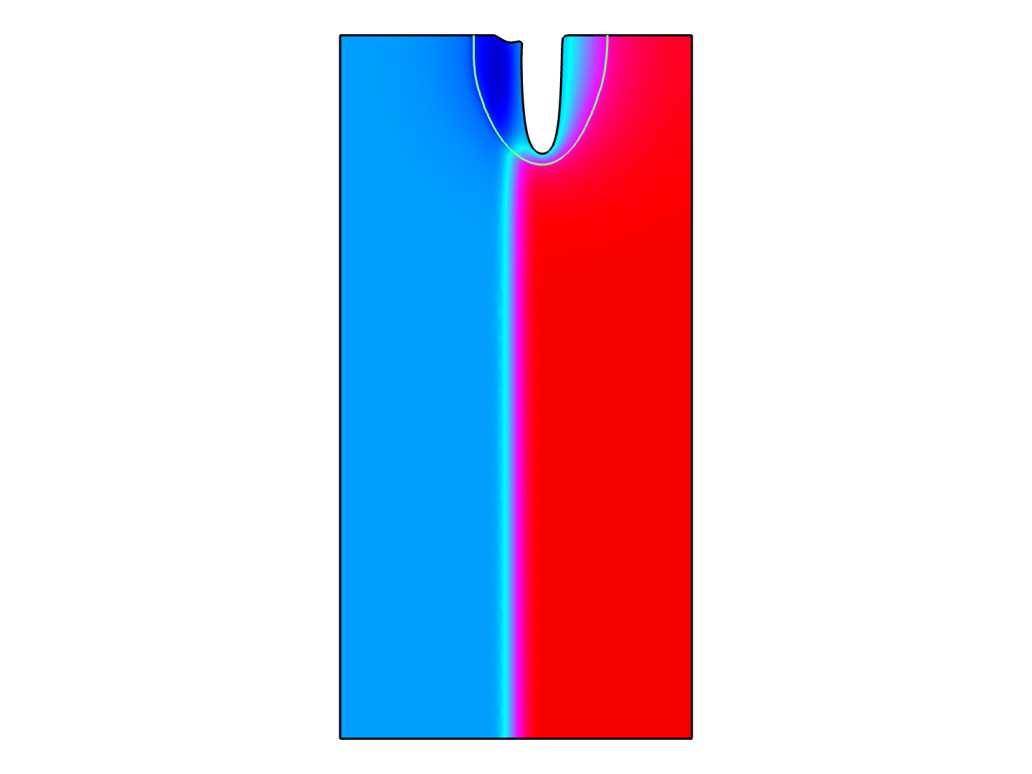
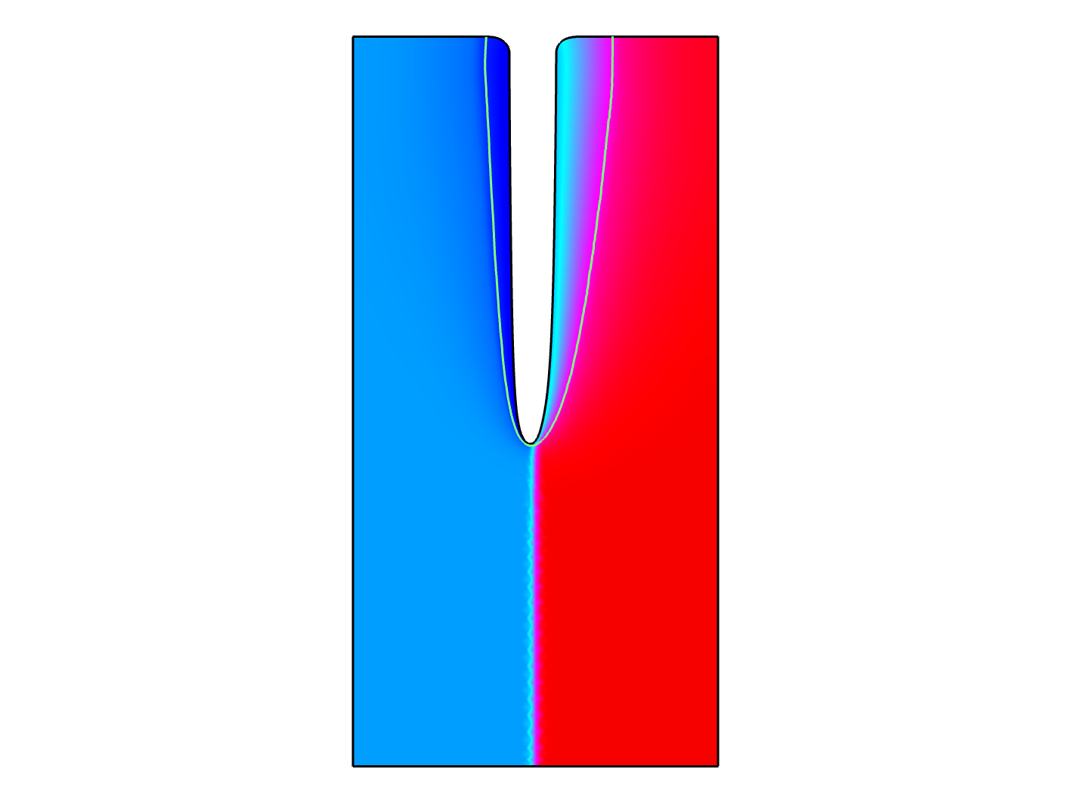
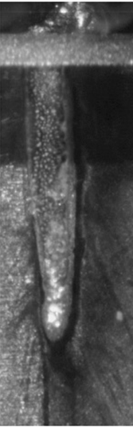
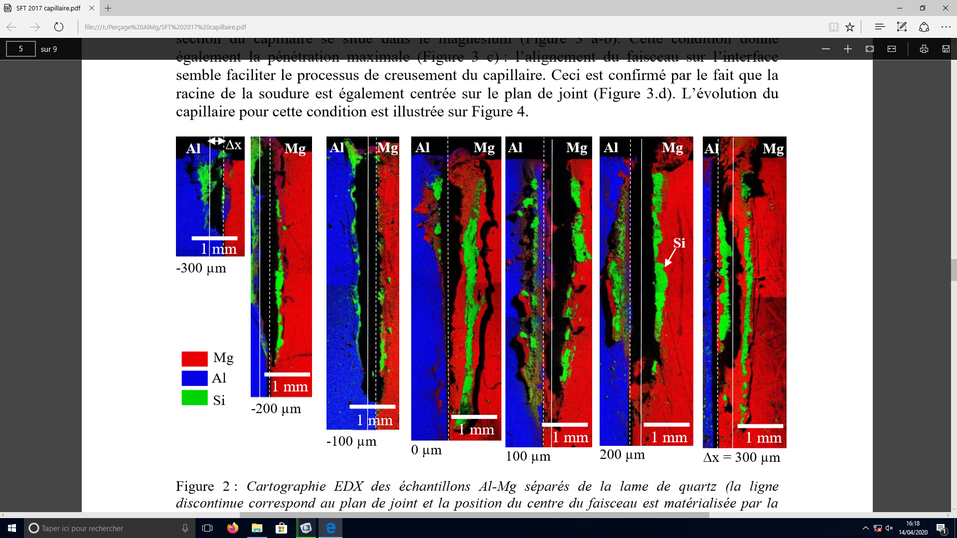
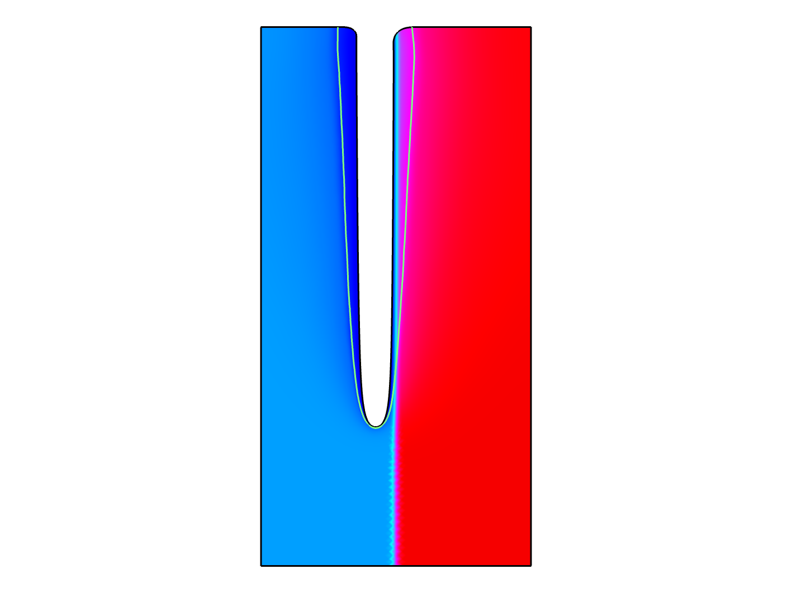
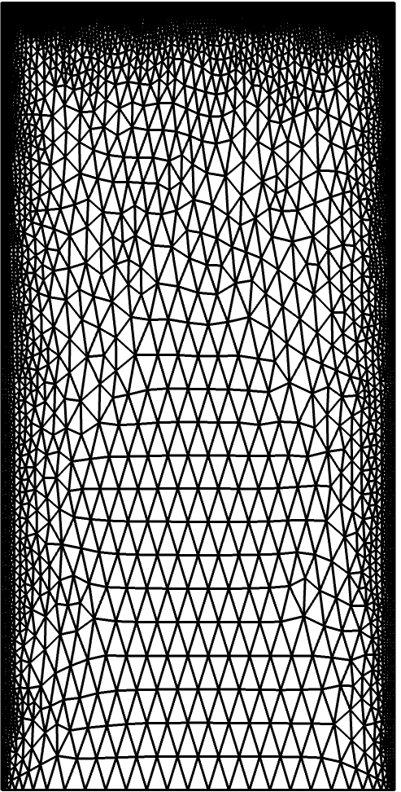
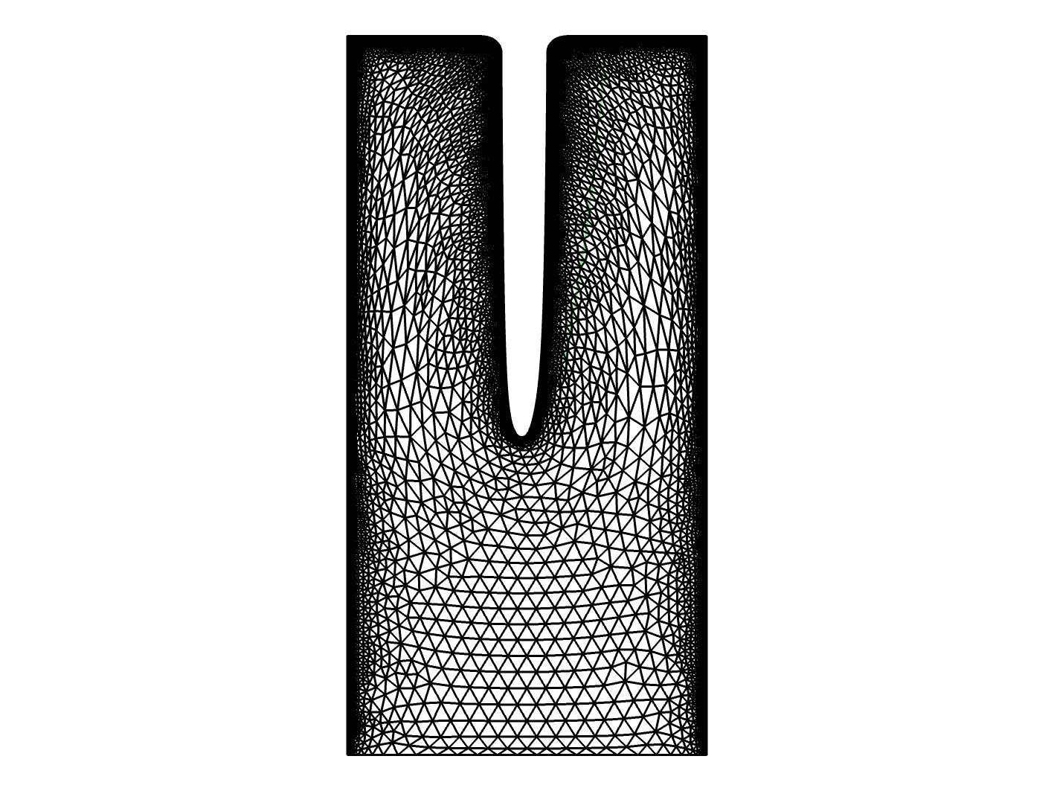
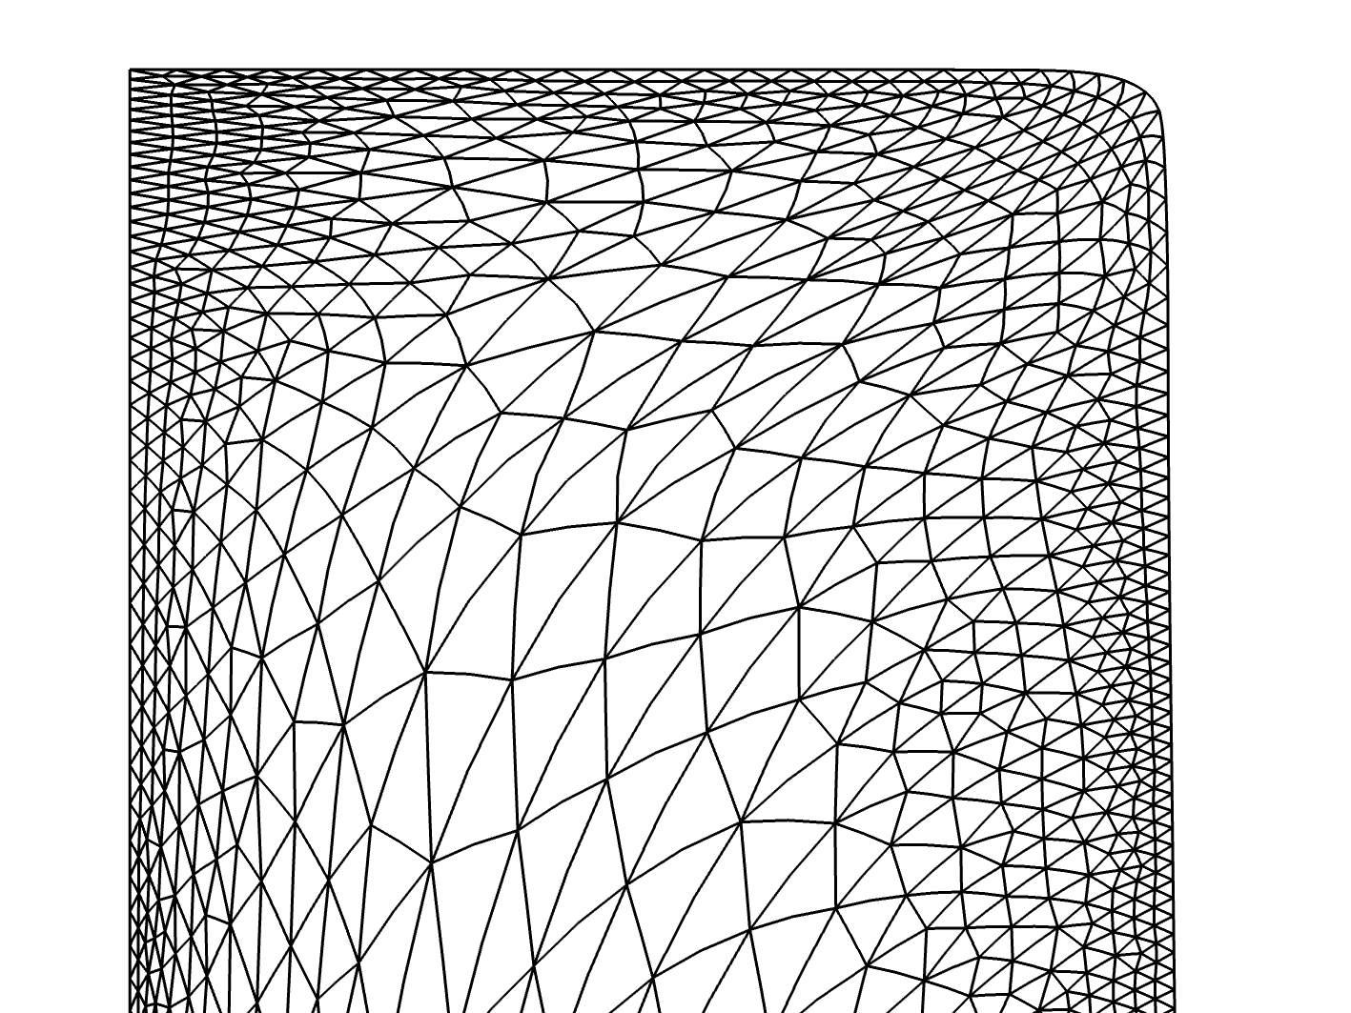
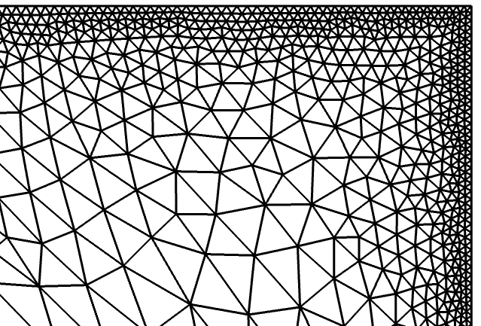
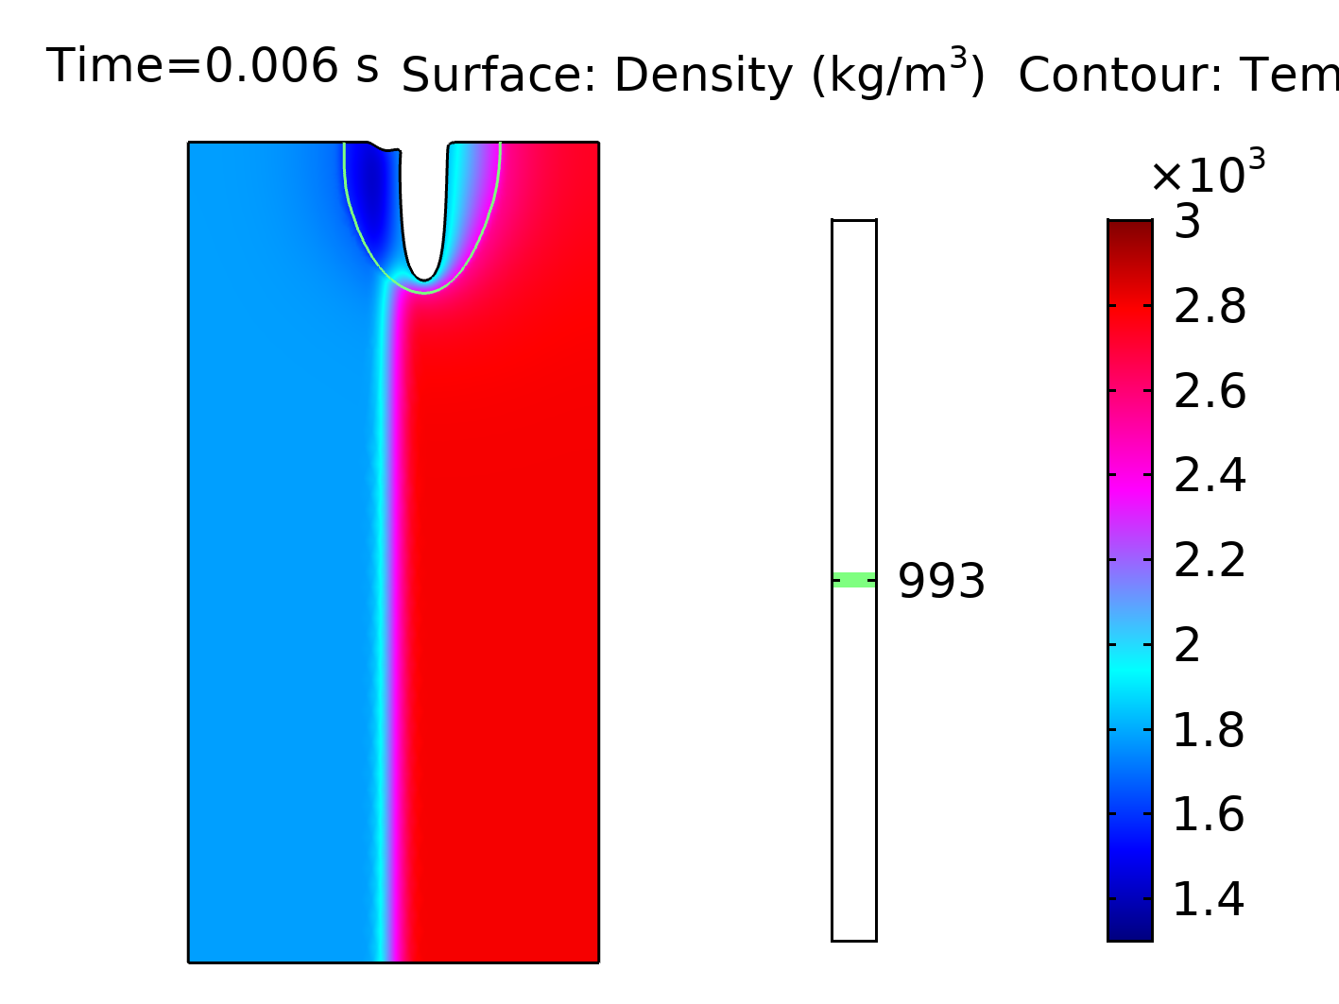
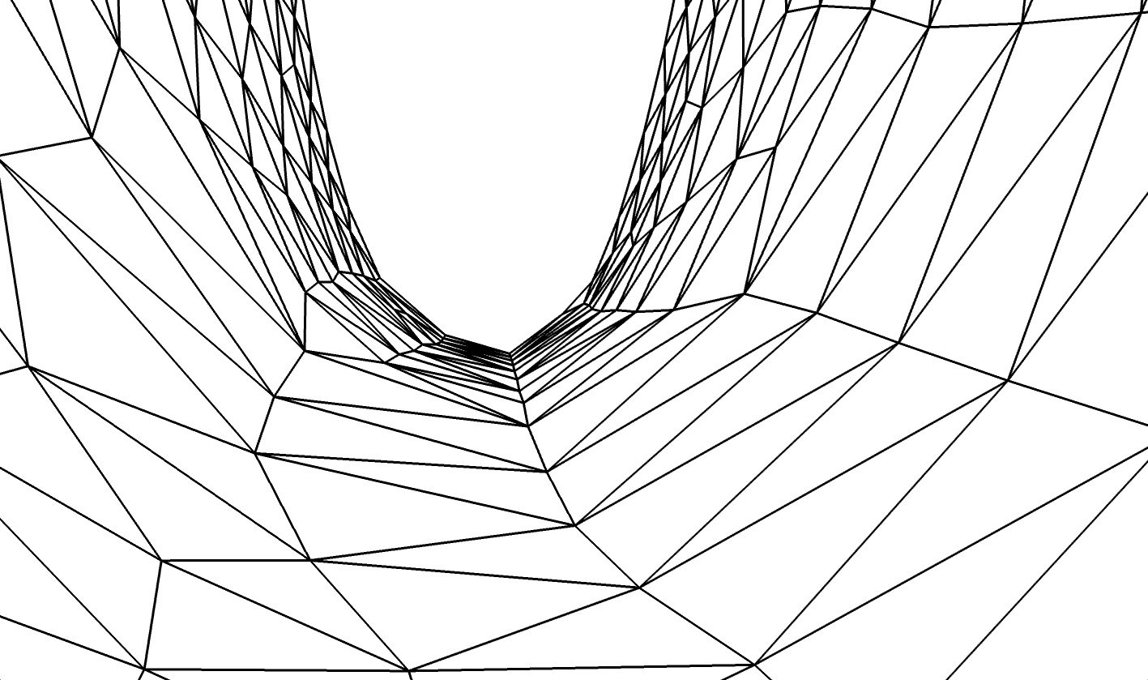
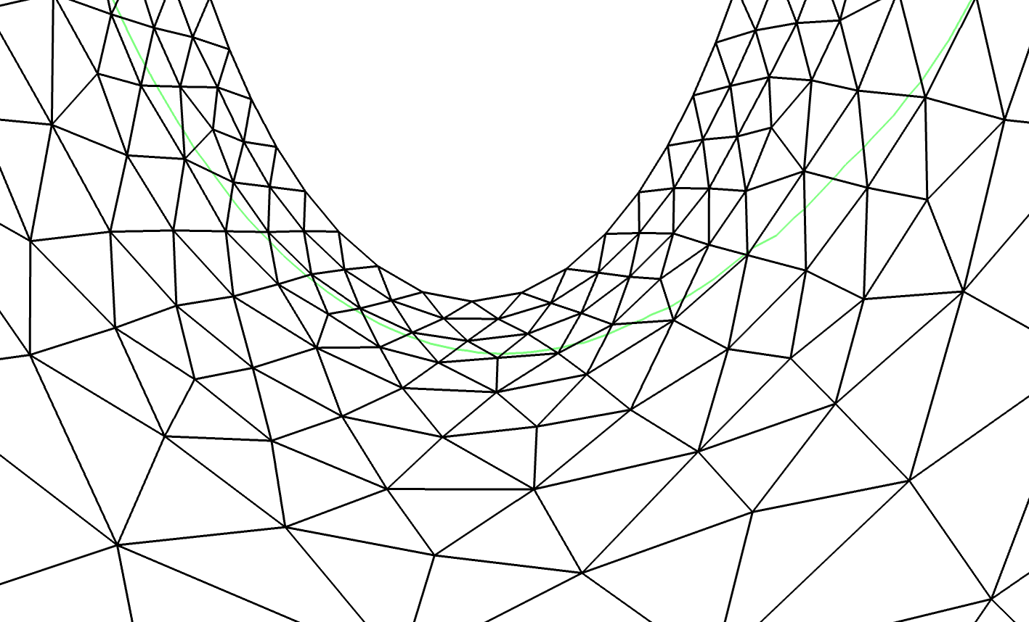



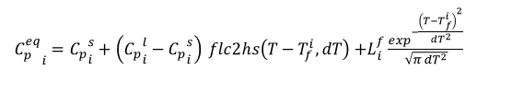




The modeling of keyhole digging during ablative laser beam interaction with aluminum/magnesium joint
I. Tomashchuk^{1*}, M. Mostafa^{2,3}, P. Sallamand¹, M. Duband¹
1. Laboratoire Interdisciplinaire Carnot de Bourgogne, UMR 6303 CNRS - Université de Bourgogne – Franche Comté, Le Creusot, France
2. Physics Department, College of Science, Jouf University, Sakaka, Saudi Arabia
3. Laser Tech & Environment Lab, Faculty of Science, South Valley University, Quena, Egypt
INTRODUCTION: During the dissimilar welding of metals with high power laser sources, the mismatch in their physical properties can lead to an asymmetry of the keyhole. This phenomenon was observed for the metals having a strong mismatch in vaporization temperatures and in the case of strong reflectivity of one of materials. To predict the keyhole shapes observed in aluminum/magnesium joints, a simplified 2D model of thermal ablation was developed. The main numerical achievement of this work consists in the simulation of keyhole with high depth to width ratio thanks to the adaptive mesh stiffening used in deformed geometry formulation.
RESULTS: The calculated keyhole profiles were compared to the ablated areas formed at aluminum/magnesium joints after Nd:YAG laser pulse (P = 2.5 kW, t = 6 ms, ∅_{beam} = 0.4 mm) that were observed by SEM-EDX and high speed imaging. The keyhole aspects in case of full laser beam offset on aluminum side (Δ = -0.3 mm) as well as in case of centered beam position and full laser beam offset on magnesium side (Δ = 0.3 mm) were globally reproduced.
Δ =-0.3 mm
Δ =0 mm
Mg
Al
Mg
COMPUTATIONAL METHODS: The present 2D model involves Heat Transfer in Solids and Deformed Geometry modules that are strongly coupled.
Heat transfer :
Al
$$ C_{p}^{eq}\frac{∂T}{∂t}=\vec{∇}⋅\left(k\vec{∇ }T\right)$$
Laser heat source:
Evaporative heat loss:
EDX
$$q_{laser}= \frac{2 a P}{π R^{2}}\exp^{−2\frac{{\left(x−∆\right)}^{2}}{R^{2}}}$$
$$q_{evap}=h\left(T_{vap}−T\right)$$
MZ
limit
Deformed geometry: local Yeoh stiffening
EDX:
Al
Mg
Velocity of keyhole digging :
Δ = 0.3 mm
1 mm
$$V=V_{1}+\left(V_{2}−V_{1}\right) flc2hs\left(0−x, dx\right)$$
$$V_{i}=\frac{q_{evap}}{ρ_{i}L_{i}^{vap}}$$
where
Al
Mg
joint line
No stiffening Local Yeoh
M1 M₂
Figure 1. Initial and deformed geometry with details on elements quality before and after the application of local stiffening.
Materials properties: across the joint line
EDX
$$M=M_{1}+\left(M_{2}−M_{1}\right) flc2hs\left(0−x, dx\right)$$
where
$M: T_{vap}, a,ρ,C_{p}^{eq}$, $k$
Figure 2. A comparison between calculated and experimental (EDX mappings, HSI image) interaction zones in aluminum/magnesium joint.
Melting phase change :
$$k_{i}=k_{i}^{s}+\left(k_{i}^{l}−k_{i}^{s}\right) flc2hs\left(T−T_{f}^{i}, dT\right)$$
CONCLUSIONS:
Easy convergence thanks to local Yeoh stiffening.
The mismatch in vaporization temperatures induces the preferential formation of deep and thin keyhole on magnesium side.
$$ρ_{i}=ρ_{i}^{s}+\left(ρ_{i}^{l}−ρ_{i}^{s}\right) flc2hs\left(T−T_{f}^{i}, dT\right)$$
${C_{p}^{eq}}_{i}={C_{p}}_{i}^{s}+\left({C_{p}}_{i}^{l}−{C_{p}}_{i}^{s}\right) flc2hs\left(T−T_{f}^{i}, dT\right){+L}_{i}^{f}\frac{\exp^{−\frac{{\left(T−T_{f}^{i}\right)}^{2}}{{dT}^{2}}}}{\sqrt{π{ dT}^{2}}}$
Excerpt from the Proceedings of the 2020 COMSOL Conference

