Slide 1
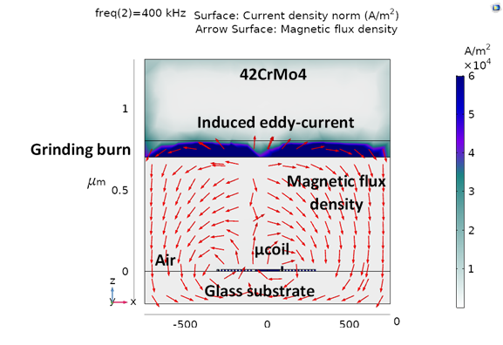
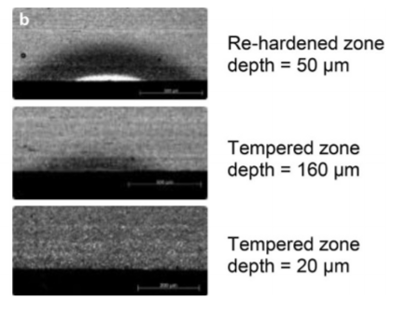
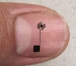
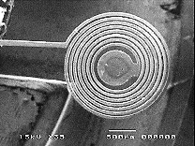
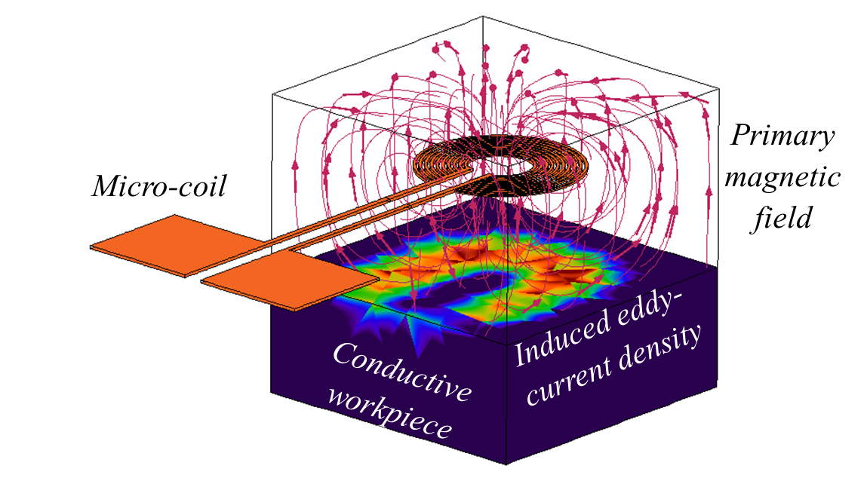
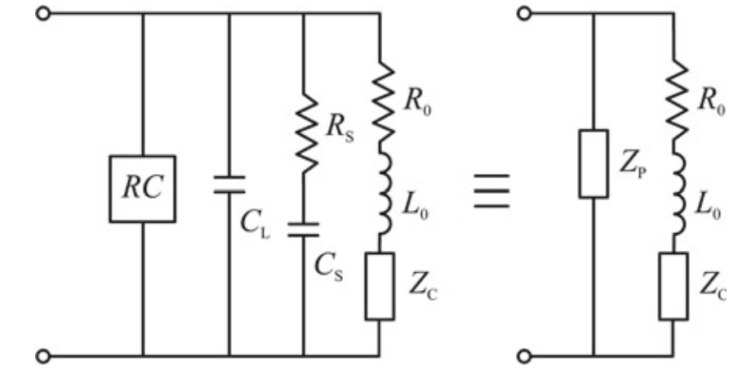
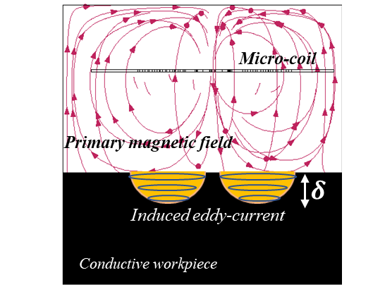
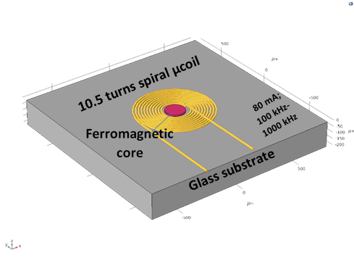
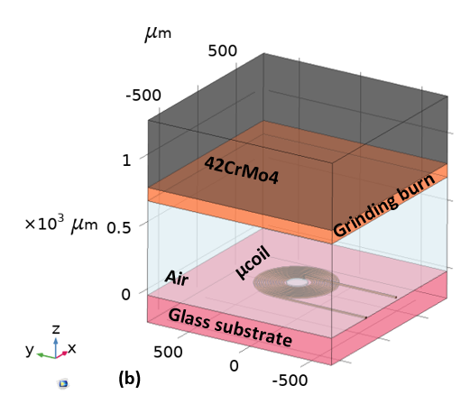


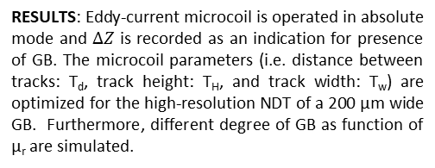



Optimization of Microfabricated 2D Planar Spiral Microcoils for the Micro Non-Destructive Testing of Grinding Burn
Isman Khazi, Andras Kovacs, Rui Zhu, Ulrich Mescheder
Institute for Microsystem Technology (iMST), Furtwangen University, 78120 Furtwangen, (BW) Germany
E-Mail: kmi@hs-furtwangen.de , kov@hs-furtwangen.de
INTRODUCTION: Grinding burn (GB) occurs in the workpiece during the grinding process, in case of sub-optimal operating conditions, which lays an enormous financial burden on the production costs. Therefore, to realize real-time in situ non-destructive testing (NDT) for occurrence of GB during the grinding process, the use of microfabricated eddy-current sensors is proposed, which can not only be easily integrated in the grinding machine (owing to their compact size), but also provide a high resolution detection of GB.
RESULTS: Eddy-current microcoil is operated in absolute mode and $∆Z$ is recorded as an indication for presence of GB. The microcoil parameters (i.e. distance between tracks: T_{d}, track height: T_{H}, and track width: T_{w}) are optimized for the high-resolution NDT of a 200 µm wide GB. Furthermore, different degree of GB as function of µ_{r} are simulated.
Figure 4. Simulated surface plot
Figure 5. Influence of T_{d} on ∆𝑍
(a)
(b)
(c)
Figure 1. (a) Cross section of workpiece showing the different degrees of grinding burn [1], and (b-c) Microfabricated eddy-current sensor having circular spiral geometry.
COMPUTATIONAL METHODS: AC/DC Module with Magnetic and Electric fields physics interface is used to compute the impedance (Z) of the microcoil using a workpiece with and without GB. GB is defined as the change in the relative permeability (µ_{r}) of the workpiece.
Figure 6. Influence of T_{T} on $∆Z$
Figure 7. Influence of T_{W} on $∆Z$
Microcoil
Workpiece
(a)
(b)
Figure 8. Influence of degree of GB on $∆Z$
$$B=µH ; µ=µ_{0}µ_{r}$$
$$δ=\frac{1}{\begin{aligned}\sqrt{πfσμ} \\ ∆Z=Z−Z_{GB}\end{aligned}}$$
CONCLUSIONS: Simulation results showed the feasibility of using microfabricated planar microcoils for the NDT of GB. The impedance difference changed as the function of presence of GB, with a higher impedance change occurring at higher frequencies. Thereby, showing the superficial nature of the GB. The degree of GB can be correlated to the change in impedance difference of the microcoil.
(c)
Figure 2. (a) Simulated surface profile showing the induced eddy-current in workpiece, (b) the circuit equivalent for induction of eddy-current in workpiece [2], and (c) schematic showing the penetration of eddy-current in workpiece (i.e. skin effect).
µ_{r}=500
Acknowledgement:
This research work is funded by the state government of Baden-Württemberg, Germany in association with the European Regional Development Fund (EFRE), within the framework of the funding “HAWKMU” (Ref: 32-7545.20/27/57).
(a)
µ_{r}=50
Figure 3. Simulation construction (a) showing the microcoil with circular spiral geometry, and (b) the complete 3D simulation construction with workpiece and GB.
(b)
REFERENCES:
[1] Seidel, Martin W.; Grinding burn inspection, In Forsch Ingenieurwes 82 (3), 2018, pp. 253–259
[2] N. Bowler, Eddy-Current Nondestructive Evaluation, Springer New York, 2019
Excerpt from the Proceedings of the 2020 COMSOL Conference

