Slide 1







Implementation of a cathode directed streamer model in Air under different voltage stresses.
– Electrostatic and Dielectric Materials team –
Grenoble Electrical Engineering Lab (G2Elab)
14 – 16TH October, 2020
By: Francis BOAKYE-MENSAH
Collaborators: Nelly BONIFACI, Rachelle HANNA, Innocent NIYONZIMA
francis.boakye-mensah@g2elab.grenoble-inp.fr
Notes:
1

Slide 2
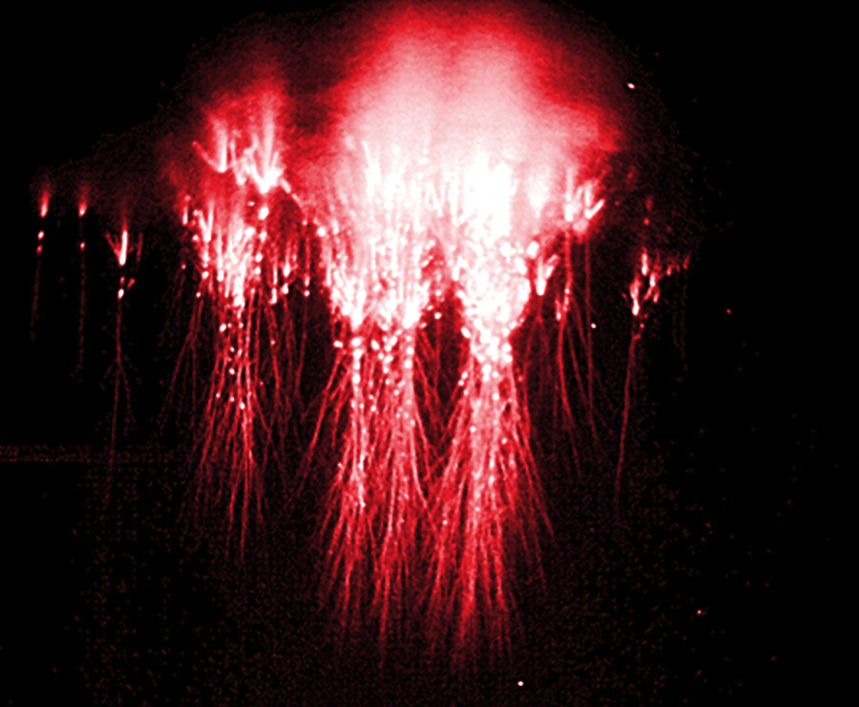
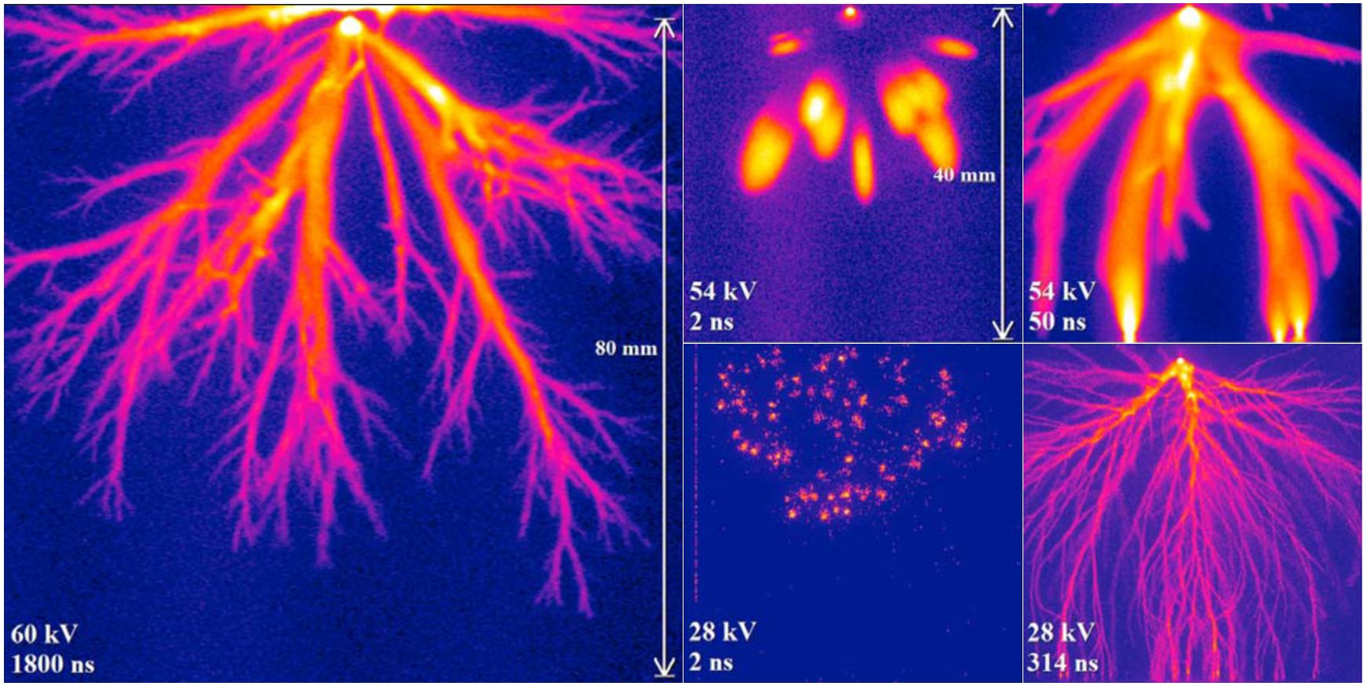
Introduction
Motivation
Streamers in nature (sprites)
Experimental streamers in lab
Notes:
2

Slide 3
Outline
Background
Overview of Streamer Physics
Streamer Modelling
Model Implementation
Results and Analysis
Model Validation
Streamers in Air
Conclusion
Notes:
3

Slide 4
Background
Implementation
Results
Conclusion
Electron Avalanche
ANODE
e⁻
e⁻
e⁻
e⁻
e⁻
e⁻
e⁻
e⁻
e⁻
e⁻
e⁻
e⁻
d
E
e⁻
e⁻
e⁻
CATHODE
Notes:
4

Slide 5
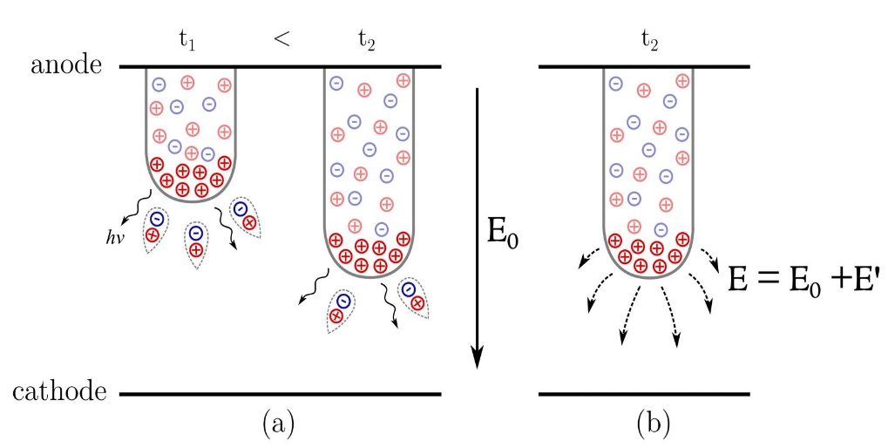
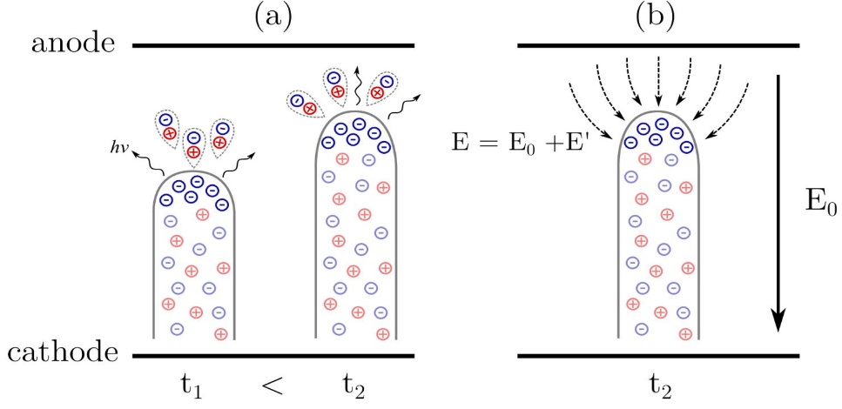
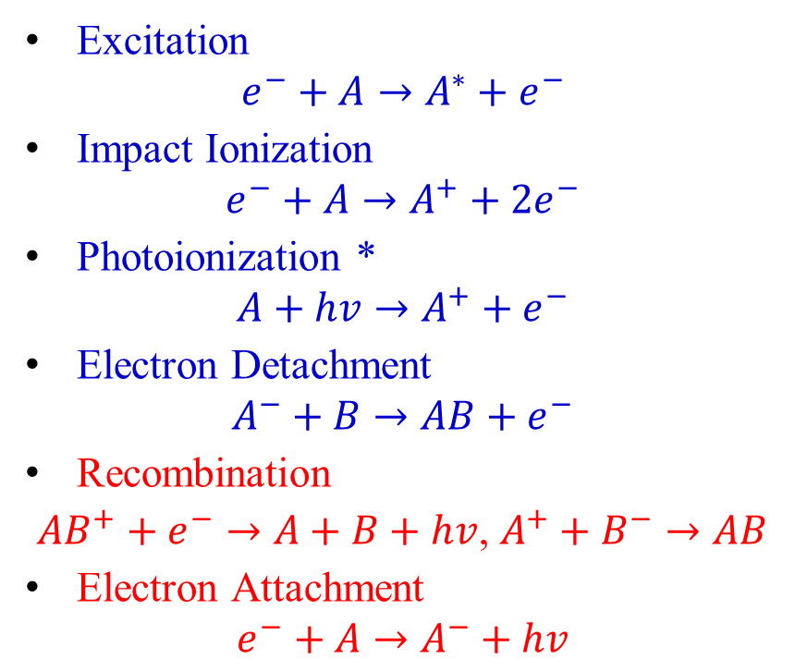
Background
Implementation
Results
Conclusion
Types of Streamers
Excitation
$$e^{−}+A→A^{∗}+e^{−}$$
Impact Ionization
$$e^{−}+A→A^{+}+{2e}^{−}$$
Photoionization *
$$A+hv→A^{+}+e^{−}$$
Electron Detachment
$$A^{−}+B→AB+e^{−}$$
Recombination
${AB}^{+}+e^{−}→A+B+hv$, $A^{+}+B^{−}→AB$
Electron Attachment
$$e^{−}+A→A^{−}+hv$$
Positive Streamer
Negative Streamer
* Photoionization necessary for positive streamer propagation.
Notes:
5

Slide 6
Background
Implementation
Results
Conclusion
Streamer Modelling – Model Types
Model types:
Kinetic
Fluid Model
Hybrid
Discretization:
Finite Element Method (FEM)
Finite Volume Method (FVM)
Solver Type / Configuration:
Mesh Refinement
Stabilization
Boundary Conditions
Notes:
6

Slide 7
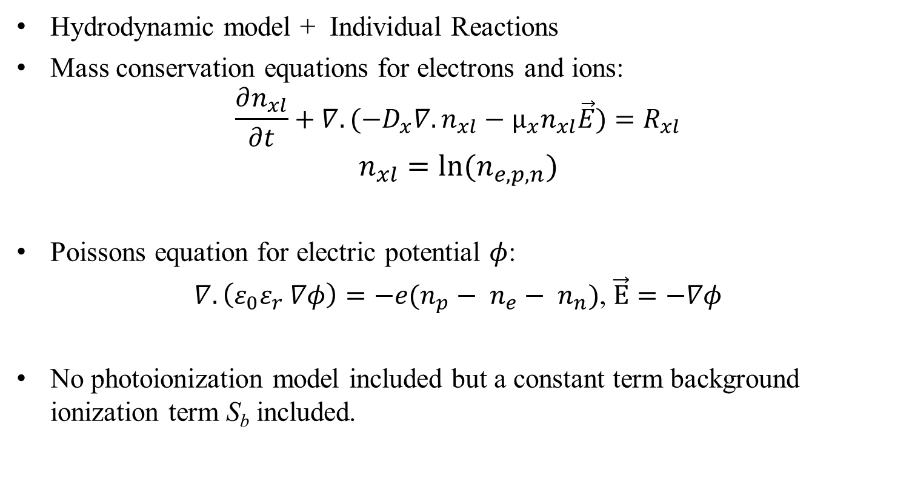
Background
Implementation
Results
Conclusion
Streamer Modelling – Plasma Fluid Model
Hydrodynamic model + Individual Reactions
Mass conservation equations for electrons and ions:
$$\frac{∂n_{xl}}{∂t}+∇.(−D_{x}∇.n_{xl}−µ_{x}n_{xl}\vec{E})=R_{xl}$$
$$n_{xl}=ln⁡(n_{e,p,n})$$
Poissons equation for electric potential $φ$:
$∇.\left(ε_{0}ε_{r} ∇φ\right)=−e(n_{p}− n_{e}− n_{n})$, $\vec{E}=−∇φ$
No photoionization model included but a constant term background ionization term S_{b} included.
Diffusion
Drift
Rate Processes
Space Charge
Notes:
7

Slide 8
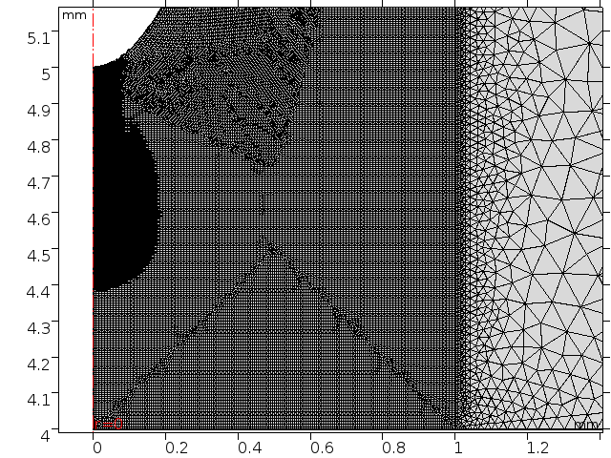
Background
Implementation
Results
Conclusion
Model Implementation
COMSOL® (FEM) ➔ Plasma Module
Log Formulation
Point to Plane Geometry
Appropriate Boundary Conditions
Nano-second timescale ➔ AMR
Time stepping: BDF
Solver: Direct, Fully Coupled
For r < 1 mm; 2 µm ≤ mesh size ≤ 8 µm
Notes:
8

Slide 9
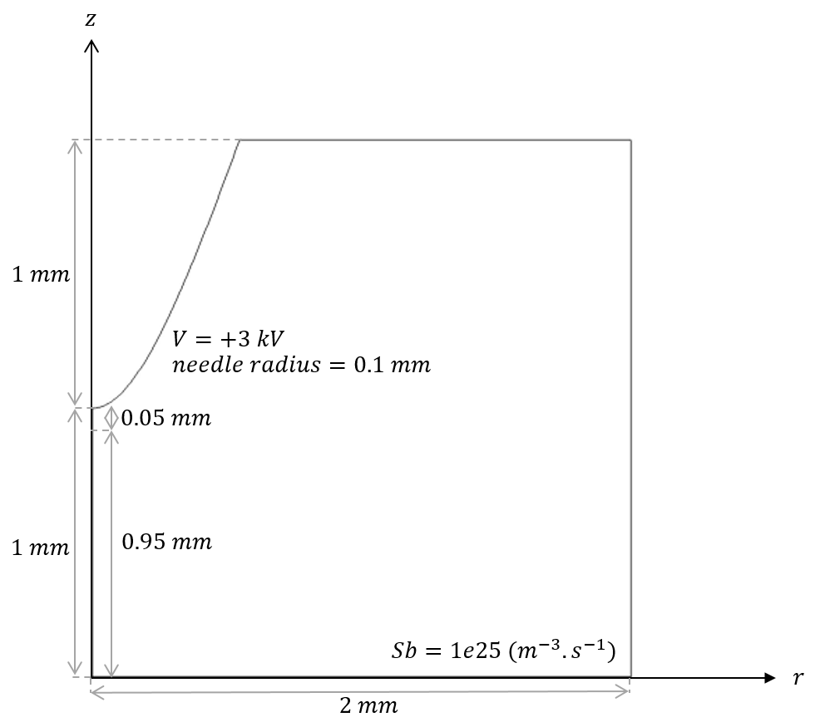
Background
Implementation
Results
Conclusion
Model Implementation
Axial Line
Standard Temperature and Pressure
Single Discharge using axial symmetry
Two study cases:
1 mm gap length (3 kV for validation)
5 mm gap length (15 kV)
Needle
Instantaneous
Air
Background Ionization,
Plane
*Parameters from Ducasse et al, Critical analysis on two dimensional point-to-plane streamer simulations using finite element and finite volume methods (2007).*
Notes:
9

Slide 10
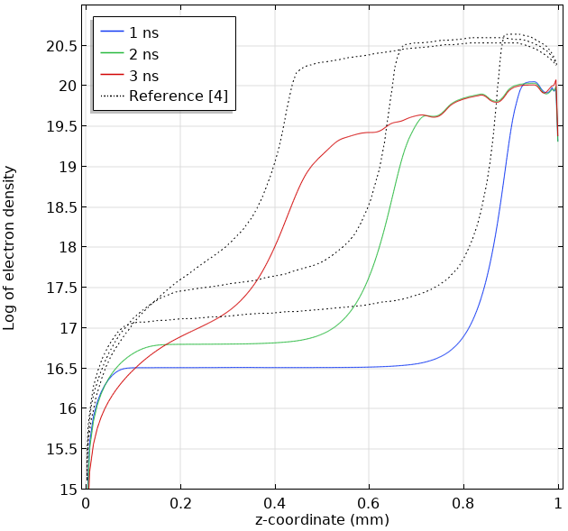
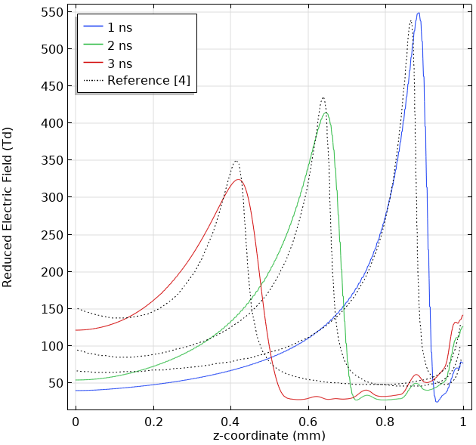
Background
Implementation
Results
Conclusion
Model Validation
V₀ = +3 kV, d = 1 mm, Sb = 3e25 (1/m³.s)
§Variations can be attributed to grid refinement techniques and background ionization term.§
Notes:
10

Slide 11
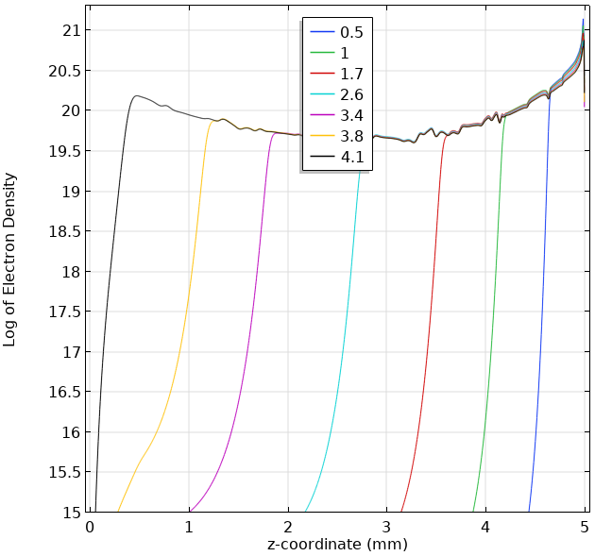
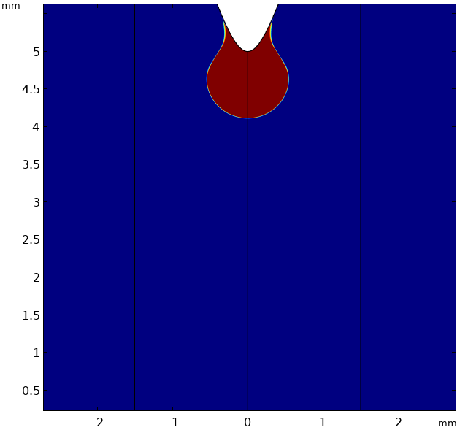
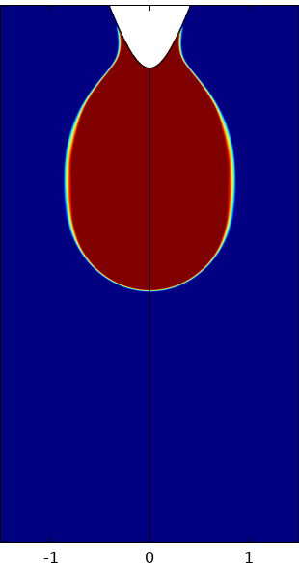
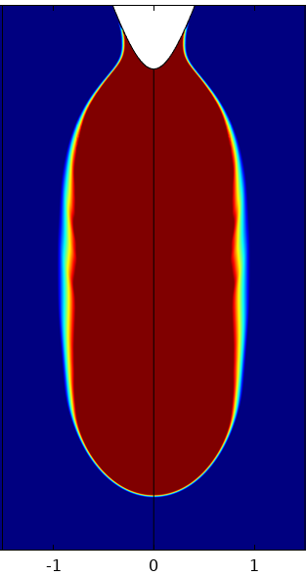
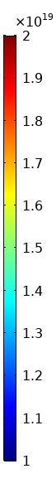
Background
Implementation
Results
Conclusion
Streamer in Air (5 mm gap)
V₀ = +15 kV, d = 5 mm, Sb = 1e23 (1/m³.s)
1 ns
2.5 ns
3.9 ns
§Two phases: Initiation and Radial Expansion phase; Propagation phase. Electron density in streamer head between 10¹⁹ and 10²⁰ m⁻³§
Notes:
11

Slide 12
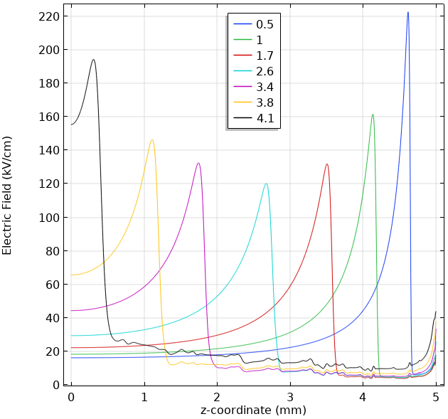
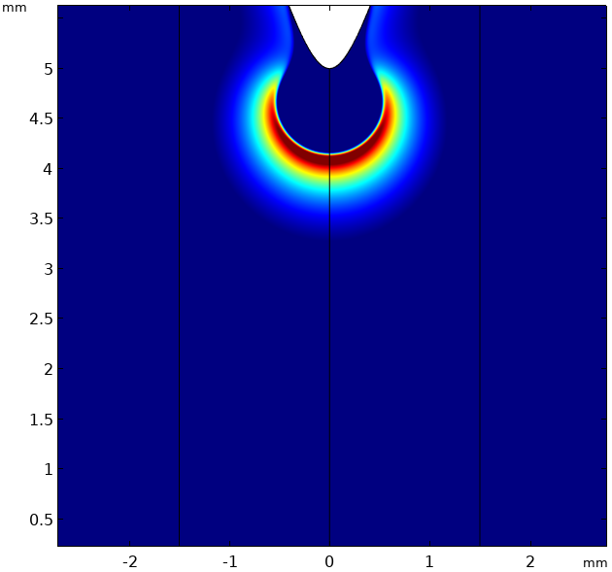
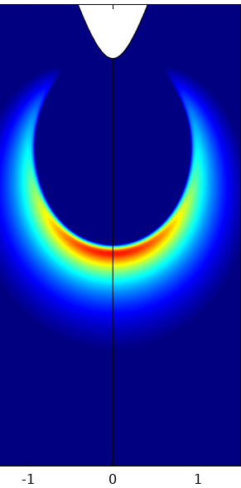
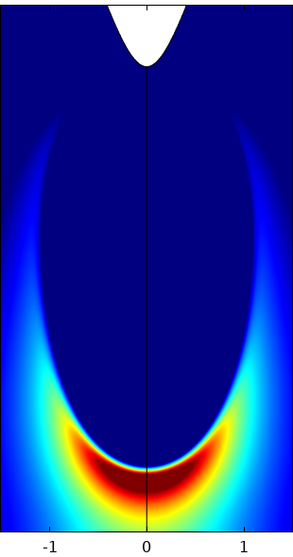
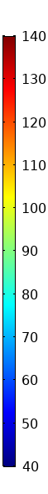
Background
Implementation
Results
Conclusion
Streamer in Air (5 mm gap)
V₀ = +15 kV, d = 5 mm, Sb = 1e23 (1/m³.s)
1 ns
2.5 ns
3.9 ns
§Electric field in streamer head between 120 and 150 kV/cm. Streamer interaction with cathode results in increase in electric field. Channel radius of ~600 µm and streamer velocity 1.2 mm/ns§
Notes:
12

Slide 13
Background
Implementation
Results
Conclusion
Transport phenomena of charges can be solved efficiently with mathematical simplifications.
On summarising:
Plasma fluid model for streamer discharges in air for short gaps has been implemented.
Comparable results between model in commercial software and homemade code.
Notes:
13

Slide 14
References
Comsol, AB, COMSOL multiphysics user’s guide, 2018.
C. M. v. 5.4, Plasma Module User Guide, 2018.
O. Ducasse et al, Critical analysis on two dimensional point-to-plane streamer simulations using finite element and finite volume methods, IEEE Transactions on Plasma Science, 2007.
R. Morrow and J. J. Lowke, Streamer propagation in air., Journal of Physics D: Applied Physics, 30(4), 614., 1997
Y. Serdyuk, Propagation of cathode-directed streamer discharges in air, Proc. COMSOL Conf., Rotterdam, The Netherlands, 2013
A. Luque, V. Ratushnaya and U. Ebert, Positive and negative streamers in air: modelling evolution and velocities, J. Phys. D: Appl. Phys. 41, 2008.
T. M. P. Briels, J. Kos, G. J. J. Winands, E. M. van Veldhuizen and U. Ebert, Positive and negative streamers in ambient air: measuring diameter, velocity and dissipated energy., Journal of Physics D: Applied Physics, 41(23), 234004, 2008.
Notes:
14

Slide 15

Notes:
15

