Slide 1
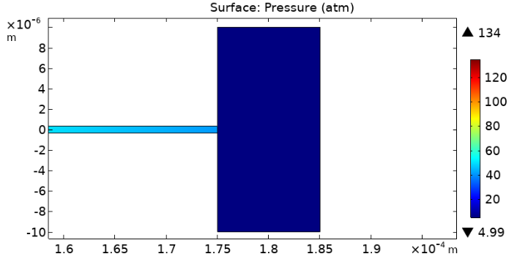
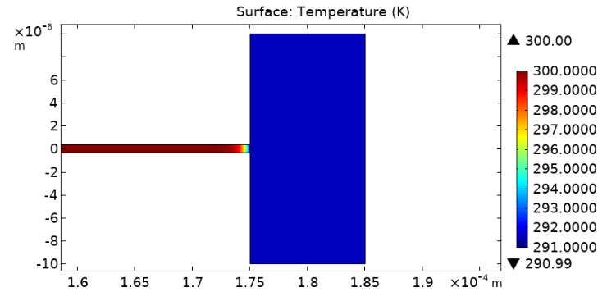
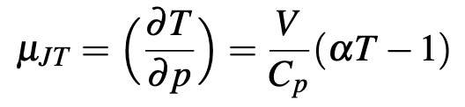
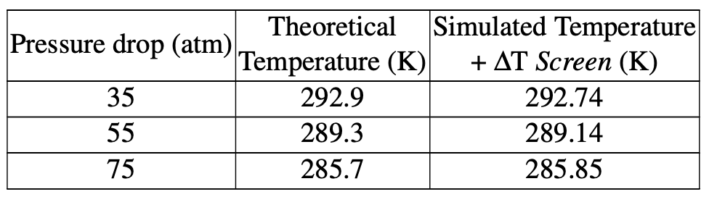
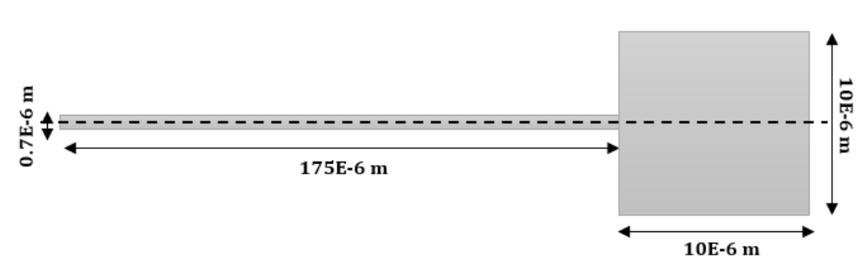
Modeling Joule-Thomson Effect With COMSOL Multiphysics®
C. García Albela¹
1. Thermal Analysis, ASML, Veldhoven, NB, The Netherlands
INTRODUCTION: Joule-Thomson effect describes a change of temperature in a fluid due to a sudden change of pressure under adiabatic conditions. This effect is often neglected, as the involved change in temperature could be very small. However, the new industries in which millikelvin accuracy is needed, have motivated further studies on the topic. The aim of this study is to reproduce Joule-Thomson effect when an incompressible gas flows through a narrow pipe connecting two tanks at different pressures. Being the cross section of the arrival tank much higher than the pipe's, gas suddenly expands, inducing a reduction of temperature.
Figure 2. Pressure drop
COMPUTATIONAL METHODS: Selecting 3D geometry, the pipe and the arrival tank are modeled. Since the problem involves fluid-dynamics and temperature, CFD Laminar Flow and Heat Transfer in Fluids modules are selected. Coupling them through the Multiphysics Nonisothermal Flow, it is possible to study how the pressure and gas temperature vary. For an adiabatic system, the inlet is defined through the mass flow and the initial fluid temperature. The outlet is defined thought the arrival tank pressure. The Screen condition is applied in the pipe's outlet. Working as thin permeable barrier, it allows to impose the desired pressure drop without adding extra complexity as Porous Media physics or geometry variations. Nitrogen gas simulations are run for different pressure drops. For each case, Joule-Thomson coefficient is obtained from Nitrogen T-s diagram.
You may want to introduce the geometry and describe the conditions that define the problem.
Figure 3. Total temperature drop
It is ended that the error is induced by the Screen condition. To deal with it, a first possibility could be refined the mesh around the Screen surroundings, but the computational time would dramatically increases.
Working with a more affordable mesh, a second alternative is presented. Firstly, running a simulation without JT effect, the Screen condition induced temperature drop ∆T_1 is obtained. Then, a second simulation with JT effect is launched. Combining them, the magnitude of interest is calculated as ∆T_JT=∆T_2+∆T_1, presenting almost identical values to the theoretical ones. A study of the phenomenon under ideal gas assumption is performed too.
Table 1. Joule-Thomson induced temperature drop
CONCLUSIONS: After all, it is concluded that COMSOL Multiphysics® can model Joule-Thomson effect with a high level of accuracy. Nevertheless, the software presents some set up disadvantages that have to be overtaken by an extra computational effort. An improvement in the topic performance could be expected in future COMSOL Multiphysics® software versions, according with the increasing necessity of accuracy and quick response demanded by the actual industrialized world.
Figure 1. 3D geometry
RESULTS: A priori, results seem promising showing a temperature reduction in all cases. However, it is observed that the modeled ∆T are larger than the theoretical ones, increasing the error as larger the pressure drop was. Working with an adiabatic system, in which energy exchange can not take place with the exterior, the origin of the unexpected temperature drop must be in the set up stage.
REFERENCES:
A.Gross, Micro-scale heat-exchangers for joule-thomson cooling, Sandia National Lab.(SNL-NM), 2014
Excerpt from the Proceedings of the 2020 COMSOL Conference

