Slide 1
Finite Element Analysis on Induction-balance Magnetic MEMS Sensor
Dr. Krishnapriya. S (Muthoot Institute of Technology, Cochin, India),
Dr. Suja K J ( National Institute of Technology, Calicut, India)
Dr. Rama S Komaragiri (Bennett University, Noida, India)
In
COMSOL Conference 2020 Europe
14th – 15th October 2020

Slide 2
Contents
Introduction
Sensors based on Micorcoils
Spiral and Non-spiral microcoils
COMSOL Simulation Setup
Simulation Results
Conclusions

Slide 3
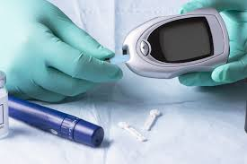
Introduction
Point of care testing is realized by portable biomedical instruments such as Lab-on-chip (LoC) devices.
Immunomagnetic assay: magnetically labeled antibody interacts with the target of a biosensor
  Target of a biosensor: Antigen of a pathogen or toxin under detection
Magnetic labels in biosensors have the unique advantages of magnetic sensing techniques.
Magnetic beads sticking to target antigens
Magnetic beads flush out
Other Antigens flush out
Antibodies
Target Antigen
Magnetic beads

Slide 4
Biosensors Based on Planar Microcoils
Planar microcoils allow easy integration of biosensors based on magnetic phenomena into microfluidic chip.
Advantages of planar microcoil based magnetic sensors:
  Permanent magnets are not required
  Miniaturization of sensor is possible
  Improved portability and sensitivity^{1, 2}
  Microcoil can be used as a source and detector of a magnetic field
Literature provides work based on planar microcoil sensors are based on conventional planar spiral microcoils
1.J. Geng, L. Zhang, C. Zhu, L. Dai, X. Shi and H. Qian, "An Oscillator-Based CMOS Magnetosensitive Microarray Biochip with On-Chip Inductor Optimization Methodology," IEEE Transactions on Microwave Theory and Techniques, no. 66(5), pp.2556-2569 (2018)
2. Y. Zheng, N. Shang, P. Haddad and M. Sawan, "A microsystem for magnetic immunoassay based on planar microcoil array," IEEE transactions on biomedical circuits and systems, no. 10(2), pp. 477-486 (2016)

Slide 5
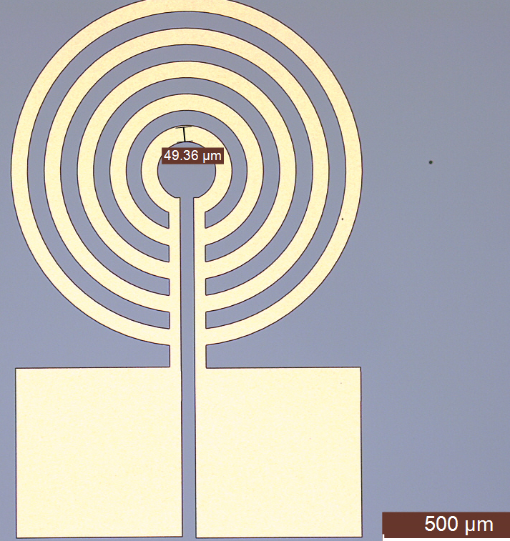
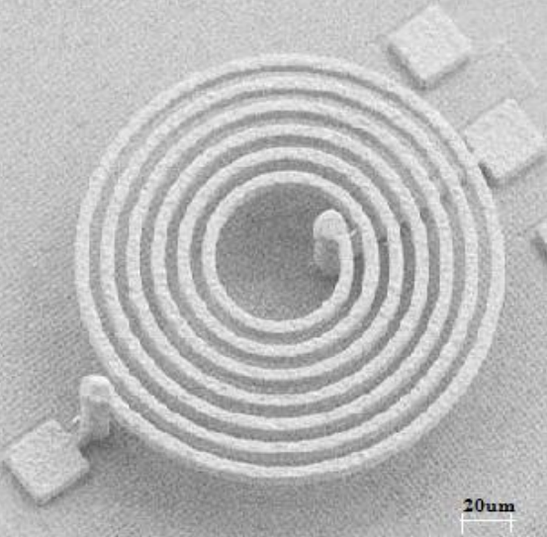
Spiral and Non-spiral Planar Microcoils
Spiral planar microcoil
Non-spiral planar microcoil
In a non-spiral planar microcoil both contact leads are coplanar
  Requires only a single metal layer for microfabrication, reduces fabrication complexity
  Low series resistance → reduced Joule heating losses
Alternative to spiral microcoil
In a spiral microcoil contact pads are non-coplanar
  Metal via is required to connect the center turn to the contact lead.
3. J. Geng et al. IEEE Transactions on Microwave Theory and Techniques, no. 66(5), pp. 2556-2569, 2018.

Slide 6
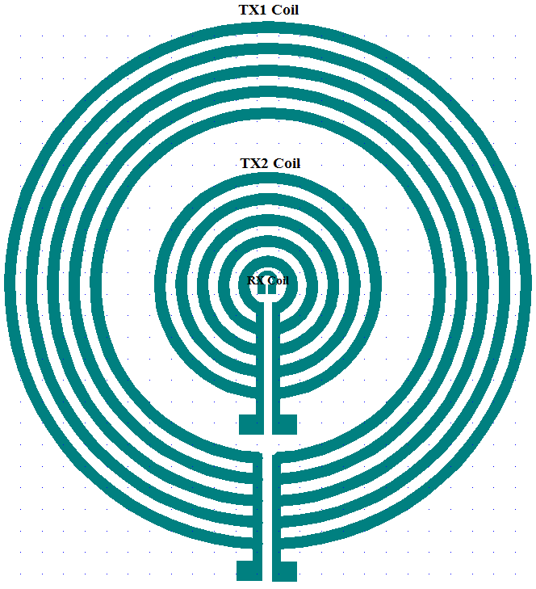
Non-spiral Planar Microcoil Based Magnetic Sensor
Two transmitting planar microcoils (TX1 and TX2)
One receiving microcoil (RX)
Magnetic field lines of the coil are concentrated towards the inner coil
  increases particle detection sensitivity of the sensor
Working principle of proposed biosensor⁴: Non-spiral planar microcoils arranged in an induction-balance configuration to sense the magnetic microparticles
4.Krishnapriya S, Rama S Komaragiri, Suja K J, "Fabrication, Characterisation, and Modelling of a Novel via-less Single Metal Level Magnetic Microcoil Sensor for Biosensing Applications", Sensors and Actuators A: Physical, 290, pp.190-197 (2019

Slide 7
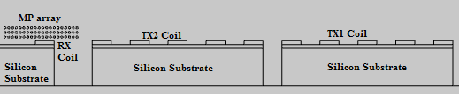
Simulation Setup in COMSOL
small solid rectangular cross-sections represent coil turns
Model is a low-frequency electromagnetic problem
  Coil based physics inside the AC/DC module
Homogenized multi-turn option is selected under ‘Coil’ physics
Electrical conductivity σ is set to zero in the dielectric regions
  No induced current density
To simulate coil-based sensor
  2D axi-symmetric modeling is used
  Ferromagnetic microparticles are modeled as circular domains filled with Iron oxide material

Slide 8
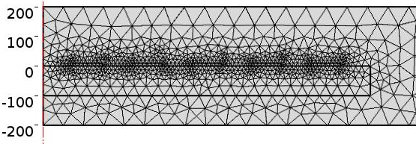
Material Selection and Meshing
Material library feature available in COMSOL is used
  The permeability of iron oxide is set to 6000
  Aluminum is used to from coil domains (coil metal)
  Conductivity of Aluminum is 3.77×10⁷ S/m
  Silicon for substrate and SiO₂ for the dielectric layer on top of the Silicon
  Surroundings are filled with air
Fine physics-based meshing is applied to the entire geometry

Slide 9
Simulation Inputs
A current I_{coil} is applied to the transmitting coils
The "external current density" feature under the "magnetic field" physics is used
Resultant external current density (J_{e}) in the direction of the coil turns is given by
Input current: 100 µA at 10 kHz
  N is the number of turns of the coil
  A is the total cross-section area of the coil domain

Slide 10
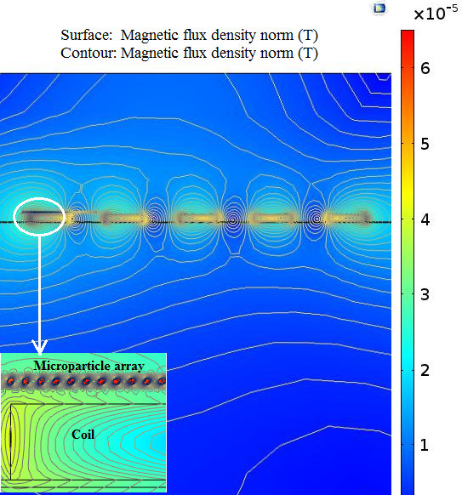
Simulation Results
Magnetic field distribution in the sensor for an input excitation direct current of 100 µA is shown.
Magnetic flux density is of the order of micro Tesla at the interface of microparticle array and exciting coils are observed
The magnetization of iron oxide beads is about 50 A/m, much lower than the saturation magnetization level.
Saturation magnetization levels are of the order of kA/m for iron oxide microbeads

Slide 11
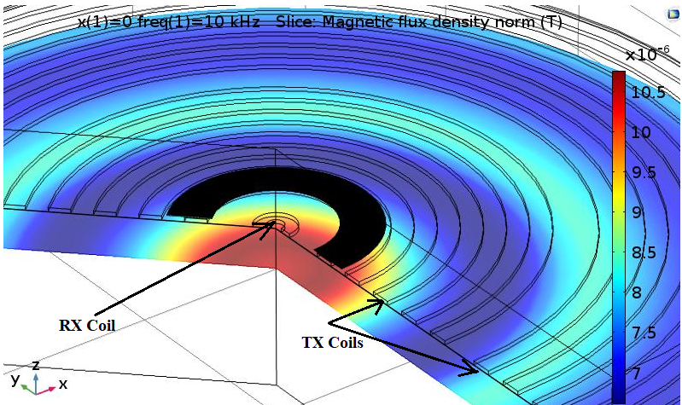
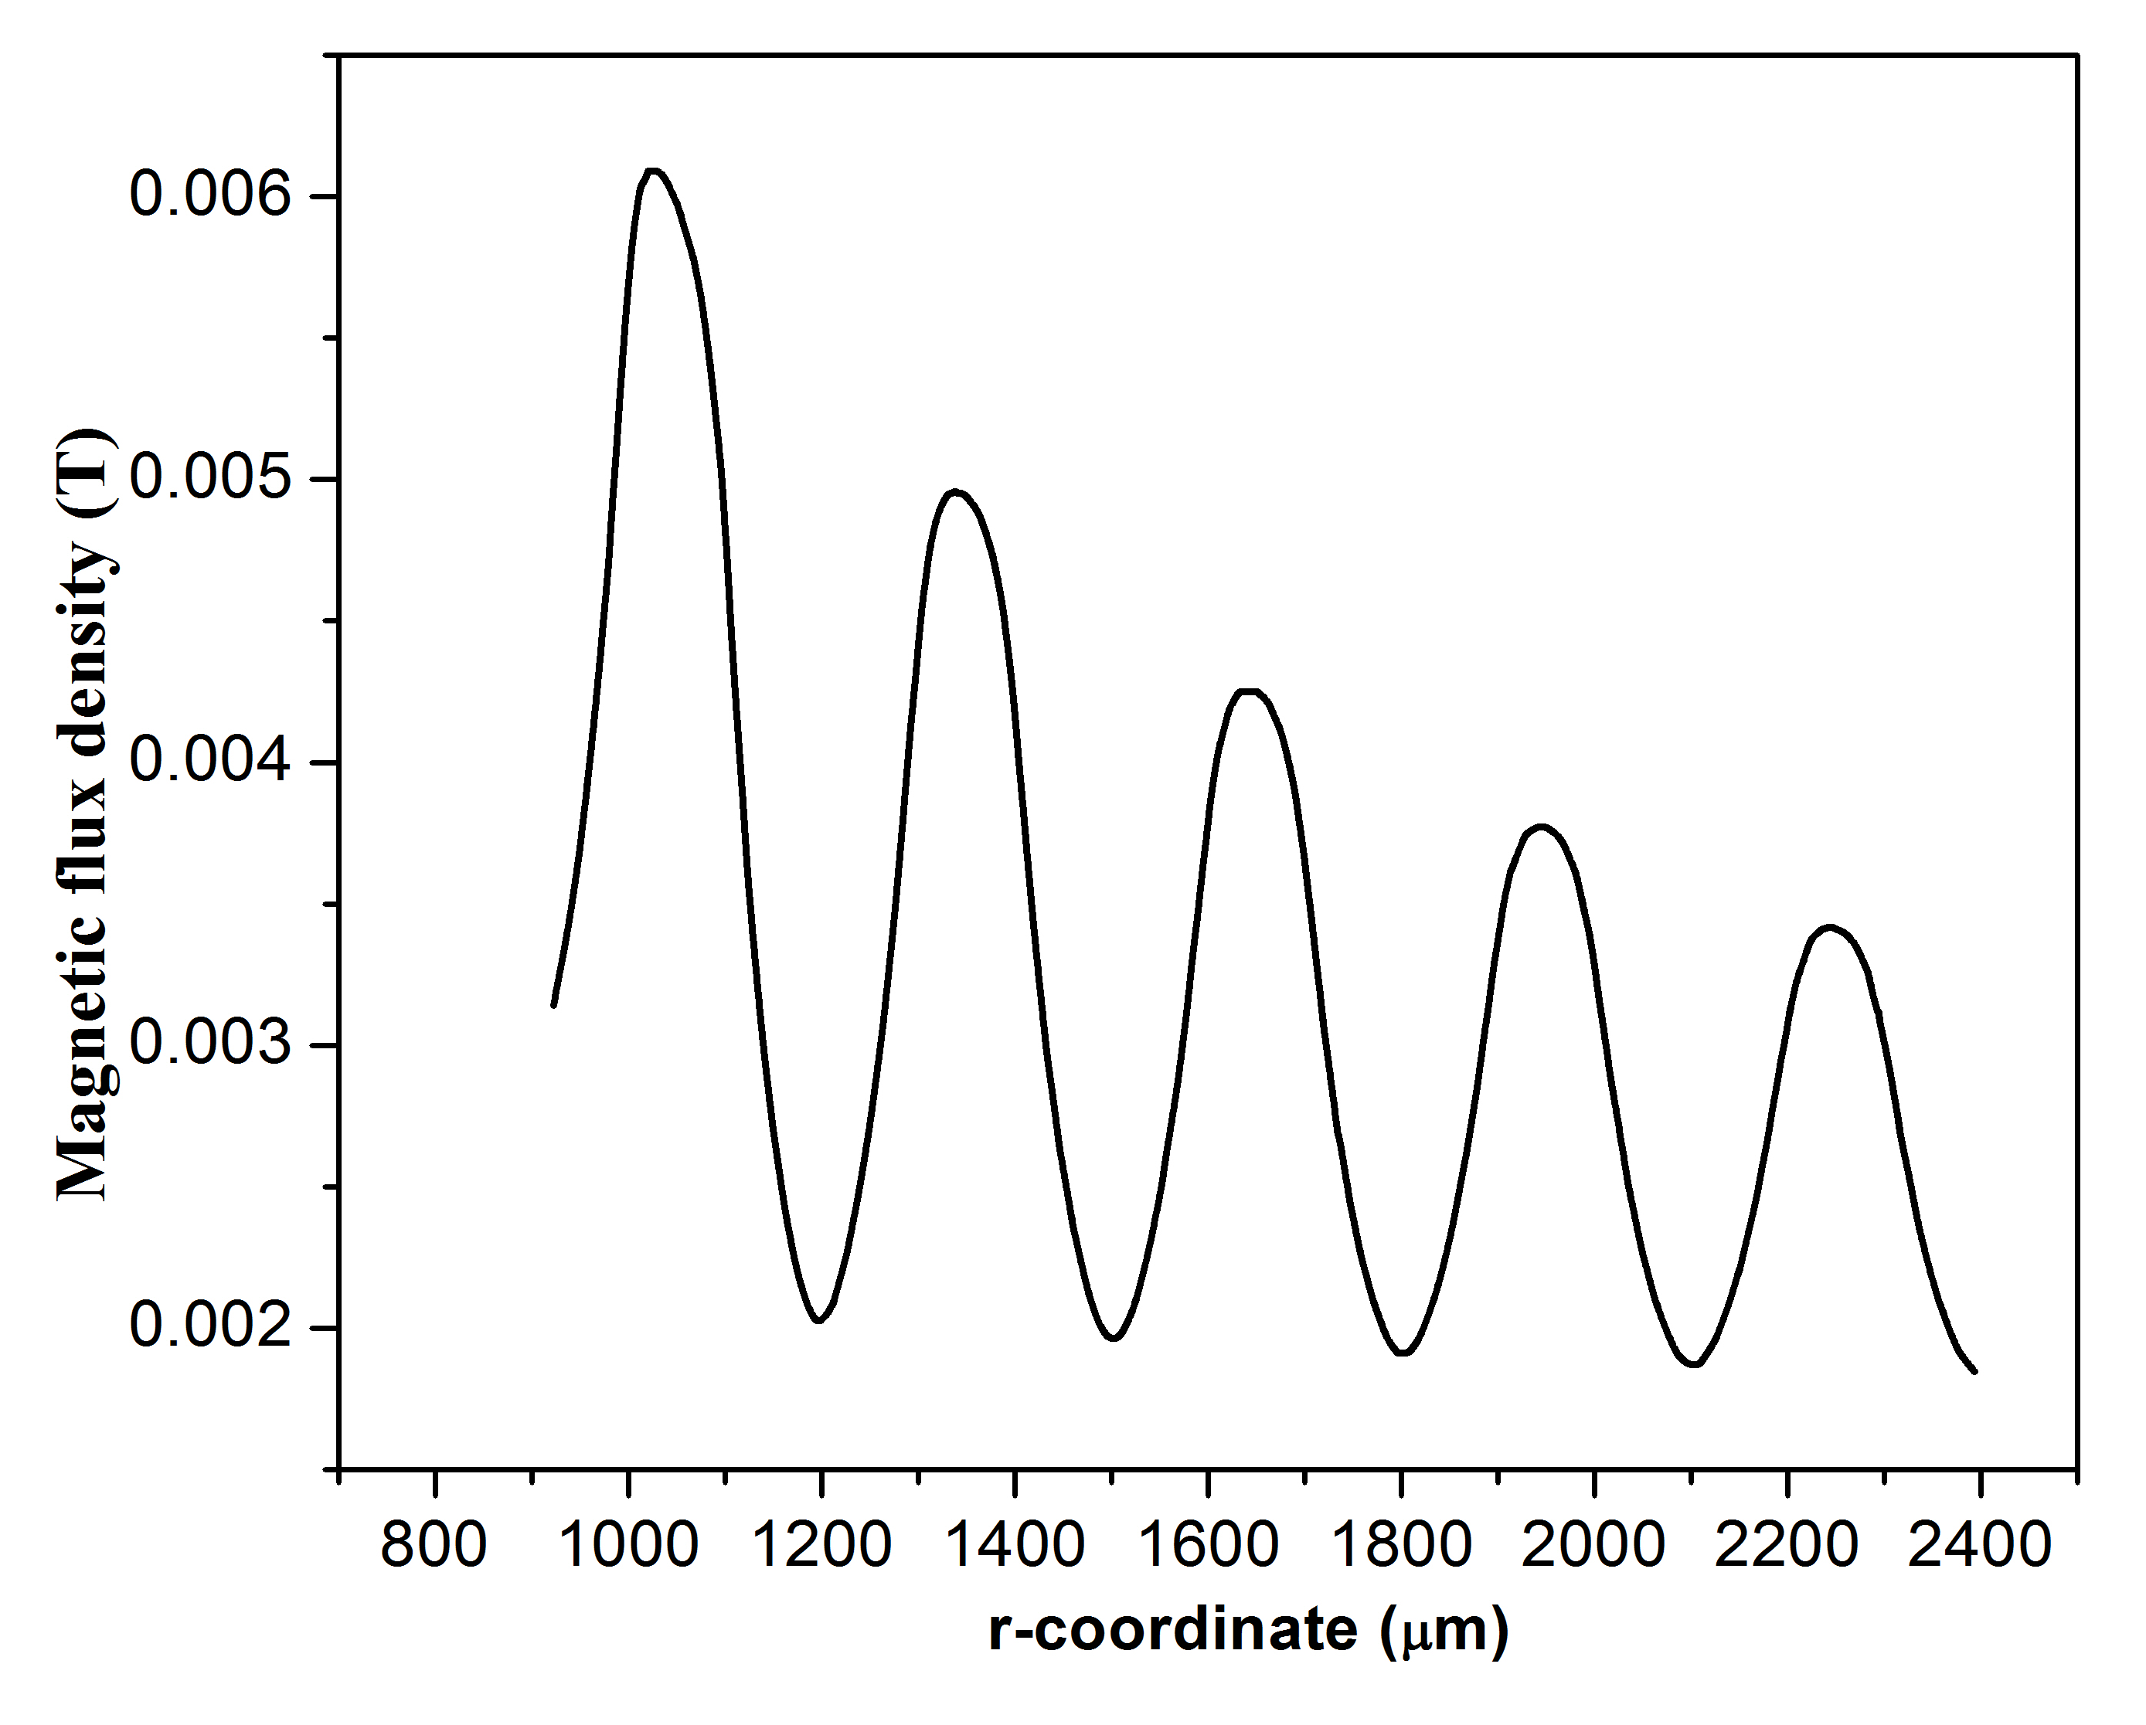
Simulation Results (cont. …)
The induced magnetic field is observed to be maximum at the edge of the innermost turn.
The field gradually decreases towards outer turns
  due to the current division in non-spiral planar microcoils
  Significantly different from the conventional spiral planar microcoils (no current division)

Slide 12
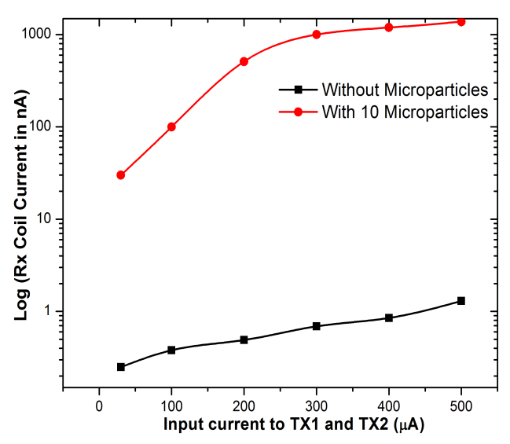
Simulation Results (cont. …)
The current in the RX coil is simulated by applying microparticles over the coil surface
Input currents are varied from 10 μA to 500 μA, and current in the RX coil is simulated
The presence of microparticles is found to induce current in the RX coil.
Magnetic microparticles modulated the induced current by more than two orders of magnitude

Slide 13
Comparative Studies
Type of sensor | N_{M} | Magnetic Particle used | r_{p} | S | L_{D}
Spiral coil-based LC coupled oscillator [3] | 3 | IgG-coated microbead | 0.75 | 0.1 μA | 20-30
Resonant spiral coil [10] | 3 | Dynal M-280 | 1.4 | 0.4 μA | 10⁵
Spiral coils in Bridge configuration [11] | 4 | Estapor® | 0.15 - 0.25 | 100 pg/mL of the antibody | 10³
This work | 1 | Fe₂O₃ | 0.5 | 0.1 μA | 10
r_{p}: the particle radius in μm; N_{M} : the number of metal layers required to fabricate the sensor
Induction-balance sensor
  provides a better limit of detection (L_{D}) compared to other planar microcoil based sensors
  reduced N_{M}
The limit of detection(S) is 0.1 μA
3. Y. Zheng, et al., IEEE transactions on biomedical circuits and systems, no. 10(2), pp. 477-486 (2016)
10. Richardson J et al., Biosensors and Bioelectronics, 16(9-12):1127-32 (2001)
11.Tamanaha CR et. al, Biosensors and Bioelectronics, 24(1):1-3 (2008)

Slide 14
Conclusions
Non-spiral planar microcoil based magnetic sensor using induction balance is designed and simulated
By applying current to transmitting coils, the resulting magnetic field distribution and output current in the receiving coil are analyzed
Presence of iron micro particles modulates the magnetic field which can be used to detect pathogens
The induction-balance sensor is found to produce the highest sensing currents of the order of micro Amperes with at an improved detection limit of 10 particles
Fabrication easiness is an advantage as the induction-balance sensor requires only a single metal level for the microfabrication

Slide 15
References
1. J. Geng, L. Zhang, C. Zhu, L. Dai, X. Shi and H. Qian, "An Oscillator-Based CMOS Magnetosensitive Microarray Biochip with On-Chip Inductor Optimization Methodology," IEEE Transactions on Microwave Theory and Techniques, no. 66(5), pp.2556-2569 (2018)
2. J. Llandro, J. Palfreyman, A. Ionescu and C. Barnes, "Magnetic biosensor technologies for medical applications: A review," Medical & biological engineering & computing, no. 48(10), pp. 977-998, (2010)
3. Y. Zheng, N. Shang, P. Haddad and M. Sawan, "A microsystem for magnetic immunoassay based on planar microcoil array," IEEE transactions on biomedical circuits and systems, no. 10(2), pp. 477-486 (2016)
4. Krishnapriya S, Rama S Komaragiri, Suja K J, "Fabrication, Characterisation, and Modelling of a Novel via-less Single Metal Level Magnetic Microcoil Sensor for Biosensing Applications", Sensors and Actuators A: Physical, 290, pp.190-197 (2019)
5. Makiranta, J. Jarkko and J. O. Lekkala, "Modeling and simulation of magnetic nanoparticle sensor," in IEEE Engineering in Medicine and Biology 27th Annual Conference, 2006.
6. J. Geng, L. Zhang, C. Zhu, L. Dai, X. Shi and H. Qian, "An Oscillator-Based CMOS Magnetosensitive Microarray Biochip with On-Chip Inductor Optimization Methodology," IEEE Transactions on Microwave Theory and Techniques, no. 66(5), pp. 2556-2569, 2018.
7. Krishnapriya S, Rama S Komaragiri, Suja K.J, "Detection of Magnetic Particles Using Induction-Balance Microsensor Based on Non-Spiral Planar Microcoils," Proceedings of IEEE SENSORS 2018, 28th -31st October 2018, Pullman Aero City, New Delhi, India, pp. 1-4.
8. D. Ambruš, D. Vasic and V. Bilas, "Automatic compensation of primary field coupling for a frequency-domain electromagnetic induction sensor. Instrumentation and Measurement Technology Conference," in IEEE International Instrumentation and Measurement Technology Conference (2017).
9. Lacharme, F, C. Vandevyver, M. A. M. Gijs. "Magnetic beads retention device for sandwich immunoassay: comparison of off-chip and on-chip antibody incubation." Microfluidics and nanofluidics 7.4, p.479 (2009)
10. Richardson J, Hill A, Luxton R, Hawkins P. "A novel measuring system for the determination of paramagnetic particle labels for use in magneto-immunoassays". Biosensors and Bioelectronics, 16(9-12):1127-32 (2001)
11.Tamanaha CR, Mulvaney SP, Rife JC, Whitman LJ. "Magnetic labeling, detection, and system integration," Biosensors and Bioelectronics, 24(1):1-3 (2008)

Slide 16
THANK YOU
Acknowledgement: The authors would like to acknowledge the National Program on Micro and Smart Systems (NPMaSS) for providing licenses of COMSOL Multiphysics 5.3.

