Slide 1
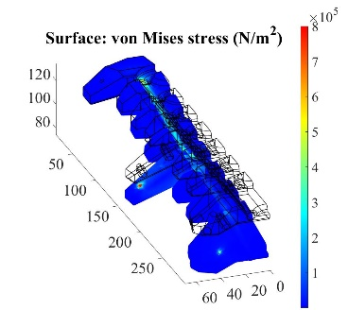
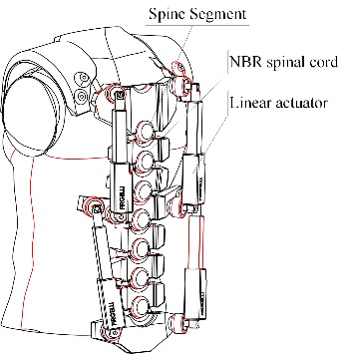
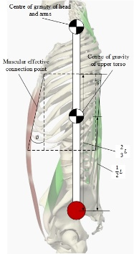
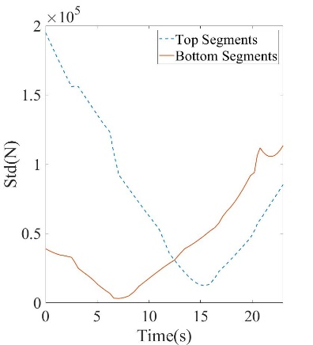
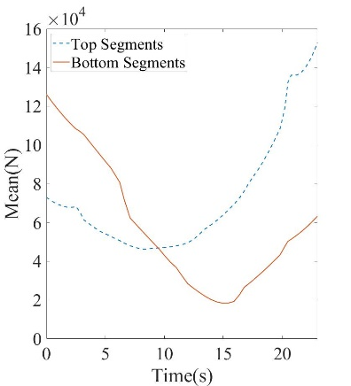
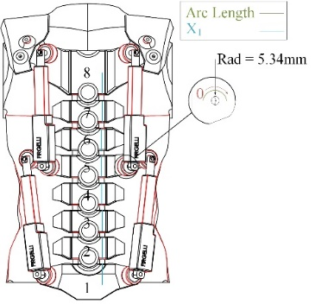


The use of 3D printed material for trunk exoskeleton
M. Dickinson¹,² M. Stables¹, E. Sanderson¹
School of Engineering, University of central Lancashire, Preston, Lancashire, UK
MedTech Group, University of central Lancashire, Preston, Lancashire, UK
INTRODUCTION: The trunk exoskeleton is a relatively new area of research within the world of exoskeleton development. The technology offers huge potential to aid in the process of rehabilitation. The skeleton is designed to reduce spine loading, the technology offers the potential to reduce patent injury [1–6]. In most cases this technology can prove to be quite costly, cost reducing materials can be considered as an alternative, this work studies the effects of using 3D printed material (polylactic acid) as a support geometry in a new novel design (Figure 1 A).
RESULTS: To establish the most accurate representation of the human body creating resistance to the system while rising to a sitting positon. The actuator places a direct force into the segment of the assembly, this is then converted to a mathematical moment that acts upon the body. Within the simulation the NBR was presumed to be static and the maximum capacitor of the actuator was applied, these results were transferred to the skeleton set-up.
As shown if Figure 3 the material operates well with the mechanical limits of the system. The model was broken into two sections upper sections 5-8 and lower sections 1-4 this enablable the study of the upper and the lower groups of the trunk system while in motion, this showed forces across the lower back.
Figure 3 Trunk results from body resistance
COMPUTATIONAL METHODS: This work studies a human trunk moving from a lying into a sitting position with no muscular assistance provided.The forces applied when the trunk is moving to a sitting positon from an original lying position (Figure 1 B.) where given as:
Where W_{h} and W_{t} are the weight of the upper torso relative to the centre of the spine and the weight of both head and arms respectively. As the system utilisers hyper-elastic material as a spinal cord, this was calculated using Mooney-Rivlin method, the two parameters C₁₀ and C₀₁ where defined by the parameters of Nitrile rubber (NBR).
You may want to introduce the geometry and describe the conditions that define the problem.
Figure 1 A. Trunk design B. Human trunk forces calculations
$$F_{g}=W_{t}sin∅+W_{h}sin∅+F_{p}cosθ$$
(1)
Figure 4 upper and lower response
$$Ψ\left(C_{10},C_{01},κ\right)=C_{10}\left(I_{1}^{∗}−3\right)+C_{01}\left(I_{2}^{∗}−3\right)+{\frac{κ}{2}\left(J−1\right)}^{2}$$
CONCLUSIONS: The work showed that 3D printed materials can serve as a possible alternative to medical exo-skeleton geometric structures. The work did also identify force distribution from the actuator should be re-examined.
(2)
REFERENCES:
E.P. Lamers, A.J. Yang and K.E. Zelik, , Feasibility of a Biomechanically-Assistive Garment to Reduce Low Back Loading During Leaning and Lifting, Transactions on Biomedical Engineering, Page 65 (2018)
A.S. Koopman, S. Baltrusch, C. Rodriguez-Guerrero, B. Vanderborght and D. Lefeber, Passive Back Support Exoskeleton Improves Range of Motion Using Flexible Beams, Front. Robot. AI , Page 5, (2018)
P.R. Stegall, D.P. Roye and S.K. Agrawal, Robotic Spine Exoskeleton (RoSE): Characterizing the 3-D Stiffness of the Human Torso in the Treatment of Spine Deformity, IEEE Transactions on Neural Systems and Rehabilitation, Page 1026-1035 (2018)
T. Petrič, K. Mombaur, I. Kingma, J. Bornmann, J. González-Vargas , SPEXOR: Design and development of passive spinal exoskeletal robot for low back pain prevention and vocational reintegration, Page 262 (2019)
S. Toxiri, M.B. Näf, M. Lazzaroni, J. Fernández, M. Sposito, T. Poliero, An Overview of Technological Advances and Trends, IISE Transactions on Occupational Ergonomics and Human Factors 7, Page 237-249, (2019)
Y. Regmi, A.P. Johnson, B. Dai and D. Novak, A Pilot Study of Varying Thoracic and Abdominal Compression in a Reconfigurable Trunk Exoskeleton During Different Activities, IEEE Transactions on Biomedical Engineering , Page 1585–1594 (2020)
Figure 2 Trunk design with segment numbering
Excerpt from the Proceedings of the 2020 COMSOL Conference

