Slide 1
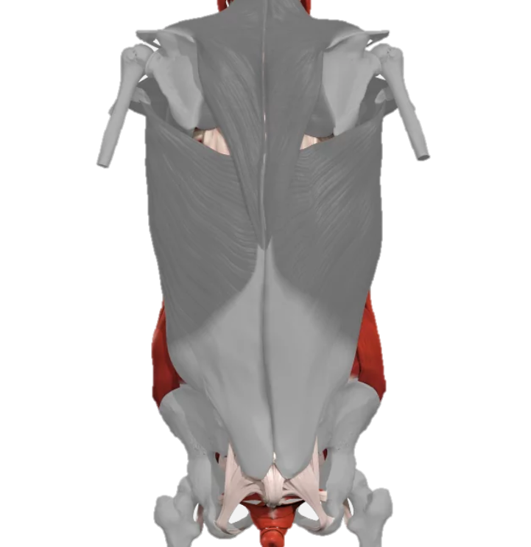
The use of 3D printed material for trunk exoskeleton
Dr Matthew Dickinson
Email: mdickinson1@uclan.ac.uk
Medtech Group
University of Central Lancashire Preston UK
MDickinson1@uclan.ac.uk

Slide 2
Contents
Introduction
Trunk Exoskeleton design
Computational Methods
Results
Conclusion & Further work

Slide 3
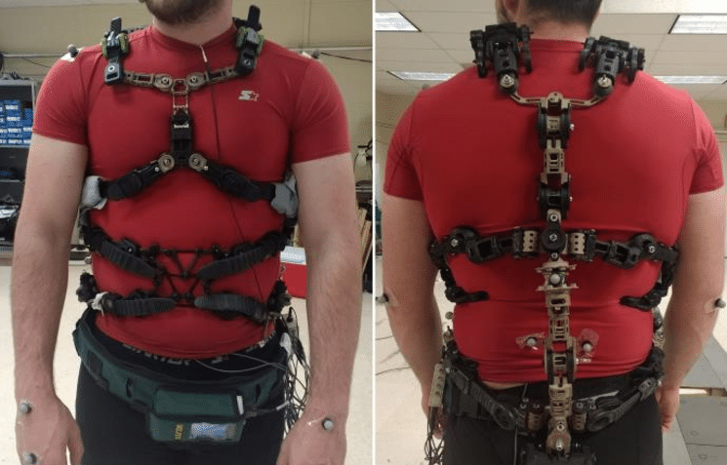
Introduction
The trunk exoskeleton is a relatively new area of research within the world of exoskeleton development. The technology offers huge potential to aid in the process of medical applications. The skeleton is designed to reduce spinal loading [1–6]. In most cases this technology can prove to be quite costly. Since the introduction of additive layer manufacturing, this process has been a large topic of discussion with the research community's as to its ability to act as an alternative to prosthetic applications [7-9].
Trunk exoskeleton [1]

Slide 4
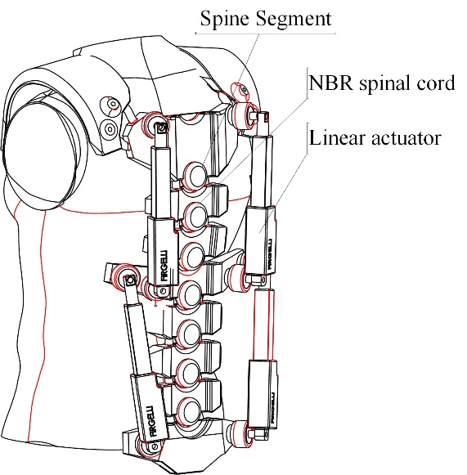
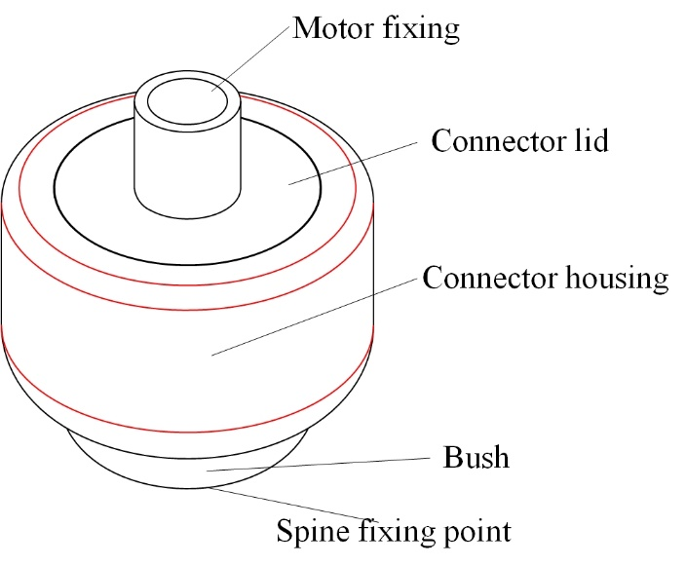
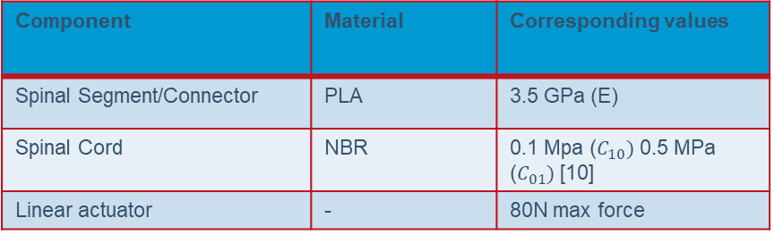
Trunk Exoskeleton design
Single action of sitting up
Component | Material | Corresponding values
Spinal Segment/Connector | PLA | 3.5 GPa (E)
Spinal Cord | NBR | 0.1 Mpa ($C_{10})$ 0.5 MPa ($C_{01})$ [10]
Linear actuator | - | 80N max force

Slide 5
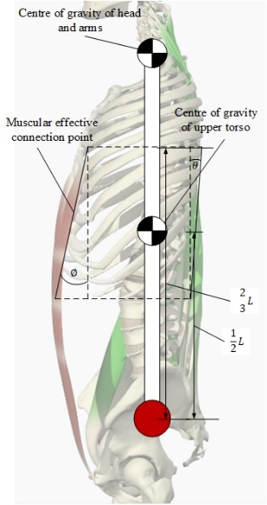
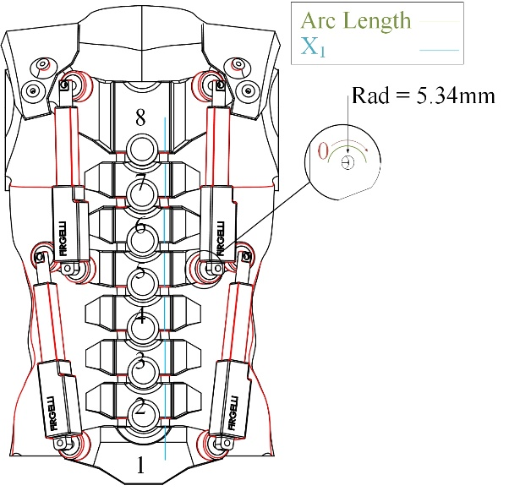



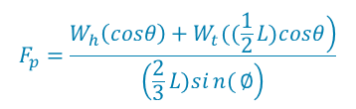

Computational Methods
Single action of sitting up
$$F_{p}=\frac{\left.W_{h}\left(cosθ\right)+W_{t}((\frac{1}{2}L)cosθ\right)}{\left(\frac{2}{3}L)sin{(}∅\right)}$$
Pelvis Net force
Base of spine force
Hyper-elastic material
As the system utilisers hyper-elastic material as a spinal cord, this was calculated using Mooney-Rivlin method, the two parameters C₁₀ and C₀₁.
$$F_{g}=W_{t}sin∅+W_{h}sin∅+F_{p}cosθ$$
$${ W}_{h}=\text{weight} \text{of} \text{the} \text{upper} \text{torso}$$
$W_{t}$= weight of both head and arms
$$Ψ\left(C_{10},C_{01},κ\right)=C_{10}\left(I_{1}^{∗}−3\right)+C_{01}\left(I_{2}^{∗}−3\right)+{\frac{κ}{2}\left(J−1\right)}^{2}$$
$L$ = head and arms centre of gravity
$$θ=\text{bending} \text{angle}$$
$∅$ = angle of the muscle

Slide 6
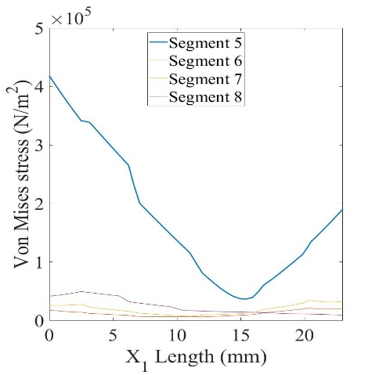
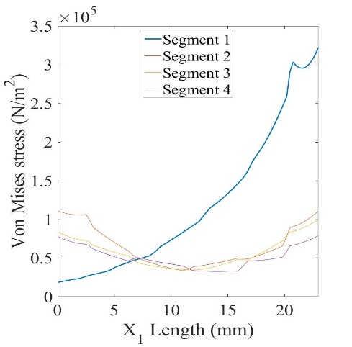
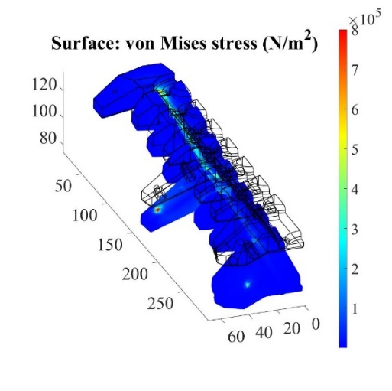
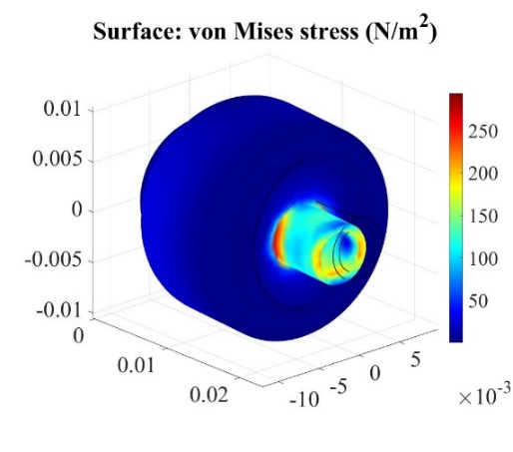
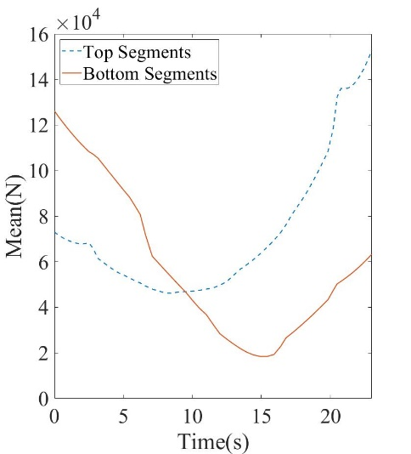
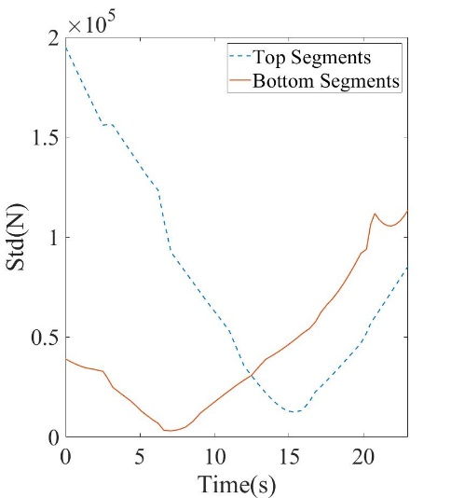
Results
Segments 1 displays the largest stress rising to over 3 N/m2
Segments 5 display the largest stress rising to over 4 N/m²
Top Segments distribution of loading through means of standard deviation and mean.

Slide 7
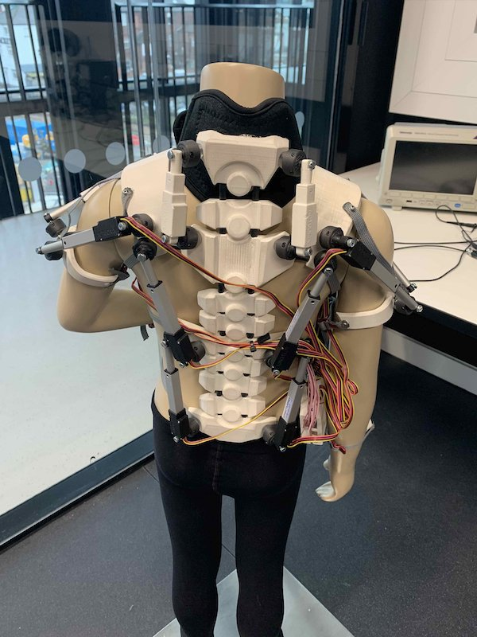
Conclusion & Further work
The work that has been presented has shown possible use of polylactic acid as an alternate to conventional materials for medical exoskeleton design.
Price could be dropped by a factor of 10, with maintenance cost on average of a £1
Study into antimicrobial resistant PLA
Mechanical Material testing data
Human to machine interface

Slide 8
References
[1] E.P. Lamers, A.J. Yang and K.E. Zelik, Feasibility of a Biomechanically-Assistive Garment to Reduce Low Back Loading During Leaning and Lifting, IEEE Transactions on Biomedical Engineering 65 (2018), pp. 1674–1680.
[2] M.B. Näf, A.S. Koopman, S. Baltrusch, C. Rodriguez-Guerrero, B. Vanderborght and D. Lefeber, Passive Back Support Exoskeleton Improves Range of Motion Using Flexible Beams, Front. Robot. AI 5 (2018), .
[3] J.-H. Park, P.R. Stegall, D.P. Roye and S.K. Agrawal, Robotic Spine Exoskeleton (RoSE): Characterizing the 3-D Stiffness of the Human Torso in the Treatment of Spine Deformity, IEEE Transactions on Neural Systems and Rehabilitation Engineering 26 (2018), pp. 1026–1035.
[4] J. Babič, T. Petrič, K. Mombaur, I. Kingma, J. Bornmann, J. González-Vargas et al., SPEXOR: Design and development of passive spinal exoskeletal robot for low back pain prevention and vocational reintegration, SN Appl. Sci. 1 (2019), pp. 262.
[5] S. Toxiri, M.B. Näf, M. Lazzaroni, J. Fernández, M. Sposito, T. Poliero et al., Back-Support Exoskeletons for Occupational Use: An Overview of Technological Advances and Trends, IISE Transactions on Occupational Ergonomics and Human Factors 7 (2019), pp. 237–249.
[6] M. Goršič, Y. Regmi, A.P. Johnson, B. Dai and D. Novak, A Pilot Study of Varying Thoracic and Abdominal Compression in a Reconfigurable Trunk Exoskeleton During Different Activities, IEEE Transactions on Biomedical Engineering 67 (2020), pp. 1585–1594.
[7] E. Wojciechowski, A.Y. Chang, D. Balassone, J. Ford, T.L. Cheng, D. Little et al., Feasibility of designing, manufacturing and delivering 3D printed ankle-foot orthoses: a systematic review, Journal of Foot and Ankle Research 12 (2019), pp. 11.
[8] R. Xu, Z. Wang, Z. Ren, T. Ma, Z. Jia, S. Fang et al., Comparative Study of the Effects of Customized 3D printed insole and Prefabricated Insole on Plantar Pressure and Comfort in Patients with Symptomatic Flatfoot, Med Sci Monit 25 (2019), pp. 3510–3519.
[9] A. Manero, P. Smith, J. Sparkman, M. Dombrowski, D. Courbin, A. Kester et al., Implementation of 3D Printing Technology in the Field of Prosthetics: Past, Present, and Future, Int J Environ Res Public Health 16 (2019), .
[10] F.D.B. de Sousa, G.L. Mantovani and C.H. Scuracchio, Mechanical properties and morphology of NBR with different clays, Polymer Testing 30 (2011), pp. 819–825.

