Slide 1

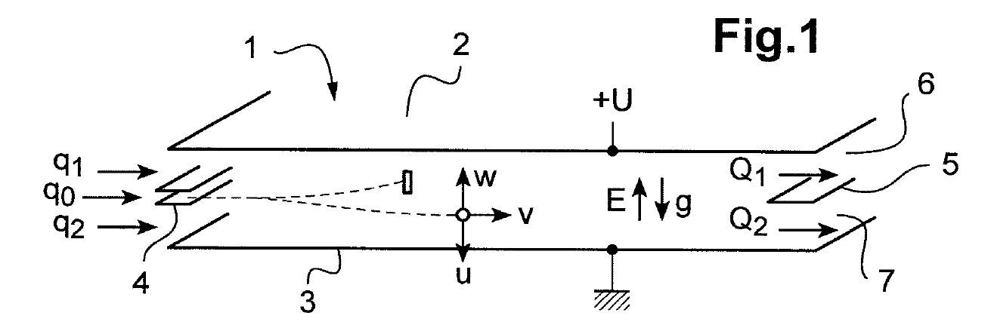
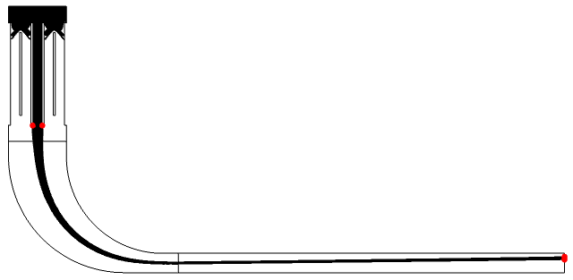
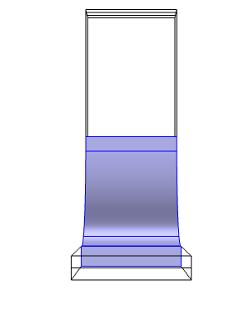
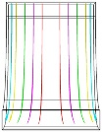
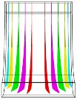
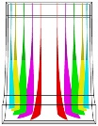
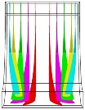
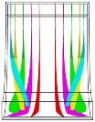
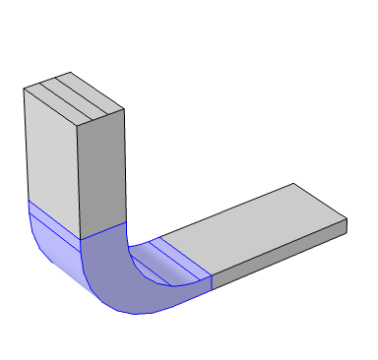
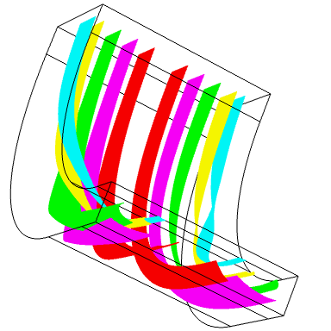
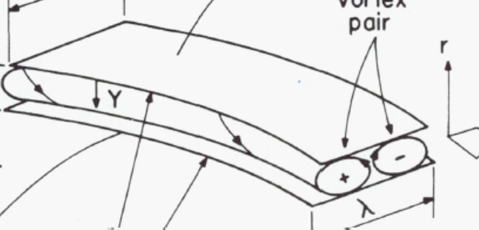

Flow of air in a plate differential mobility analyser: how Comsol revealed a geometry-induced effect
Ph. Berne, S. Clavaguera, M. Pourprix
Univ. Grenoble Alpes, 38054, Grenoble, France – CEA-LITEN, 38054, Grenoble, France
INTRODUCTION:
Plate Differential Mobility Analyser (DMA): 2 parallel plates between which aerosol-laden air flows. Particles are previously given an electric charge.
Voltage difference between the plates allows to separate particles according to mass/charge/mobility.
COMPUTATIONS:
Modules used: “laminar flow” + “particle tracking”
Full 3D geometry but internal details of the electrostatic precipitator simplified
Transient calculation.
“Finer” mesh quality found sufficient.
Figure 1. Principle of plate DMA ¹
Device built, coupled to electrostatic precipitator producing a thin “beam” of particles in a sheath of clean air, to improve separation. For practical reasons, connection by elbow pipe.
Figure 4. Geometry and boundary conditions
RESULTS:
As a function of flowrate, a pair of counter rotating vortices appears in the pipe bend
They are similar to Dean vortices
Dean number in the pipe bend is estimated at 30
Transient calculation shows that the vortices are stable
Back to the geometry of the actual device, the shape of the particle beam at the inlet of the DMA is deformed => accounts for wider-than-expected transfer function.
Charged aerosol in
Electrostatic precipitator
Aerosol beam
Applied voltage
Pipe bend
Clean air flow
Beam deviation
Figure 5. Flow lines in pipe bend as a function of flow rate: front view (from left to right: 0.1, 0.25, 1, 2, 6 L/min)
DMA
Figure 2. Constructed device with electrostatic precipitator and elbow pipe
But – measured transfer function (ratio of particle number out/in as a function of plate voltage) is much wider than expected:
Figure 6. Comparison with “Dean vortices” ²
Figure 3. Measured vs. expected transfer function
Figure 7. “Poincaré section” of particles at the entrance of the DMA
Why?
Unequal number of charges on the particles.
Effect of 2D velocity profile in the DMA.
Effect of 2D electric potential profile in the DMA.
Flow dynamics in the pipe bend.
=> Investigated with Comsol.
CONCLUSIONS:
One reason for non-optimal performance confirmed.
Modifications of the electrostatic precipitator proposed (and planned to be tested).
REFERENCE:
S. Clavaguera, M. Pourprix, Patents WO 2019 073009 and WO 2019 07006
2. Ligrani PM. A study of dean vortex development and structure in a curved rectangular channel with aspect ratio of 40 at dean numbers up to 430. 1994
ACKNOWLEDGEMENTS: This work is supported by the Plan de Recherche et Développement Amiante (PRDA) from the French Ministry for the Ecological and Inclusive Transition under the Selfi project.
Excerpt from the Proceedings of the 2020 COMSOL Conference

