Slide 1

Finite element modelling of three-phase non-isothermal flow in heavy oil reservoirs- case study SAGD
Taofik H. Nassan

Slide 2
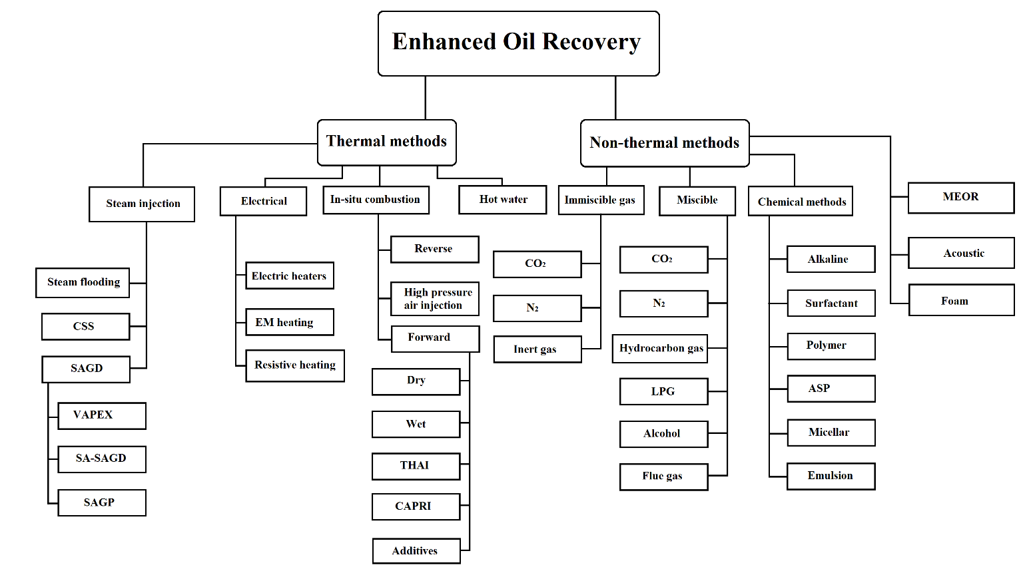
Finite element modelling of three-phase non-isothermal flow in heavy oil reservoirs- case study SAGD
Introduction
Today nearly 50 % of crude oil produced by EOR techniques is attributed to steam injection
(EOR methods classification ,By Taofik Nassan)

Slide 3
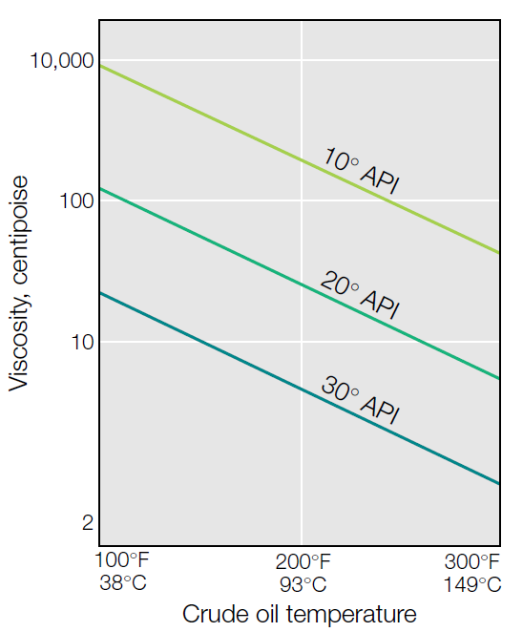
Finite element modelling of three-phase non-isothermal flow in heavy oil reservoirs- case study SAGD
Introduction to TEOR by steam injection
Temperature effect on viscosity
API classification of crude
Crude type | API° | Viscosity, cp | Remarks
Light/Conventional oil | >22° | <100
Heavy oil | <22° | >100
Extra-Heavy crude | <10° | >10,000
Natural bitumen | <10° | >1000,000 | also called Tar or Oil sands
(source: www.api.org)
The empirical relationship of crude oil viscosity and temperature depends on oil composition (Adapted after L.W. Lake 1989)
Notes:
The higher the viscosity of the oil, the greater the effect of heat

Slide 4
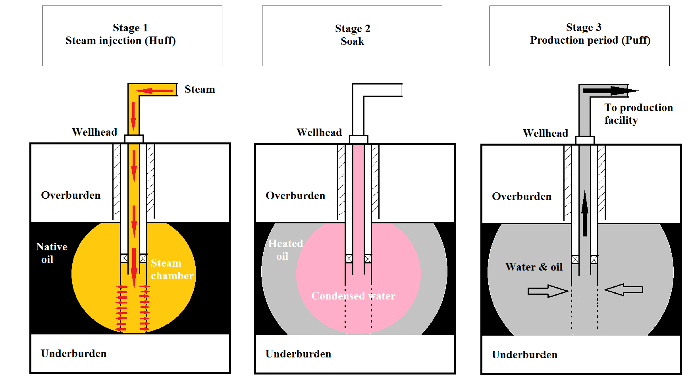
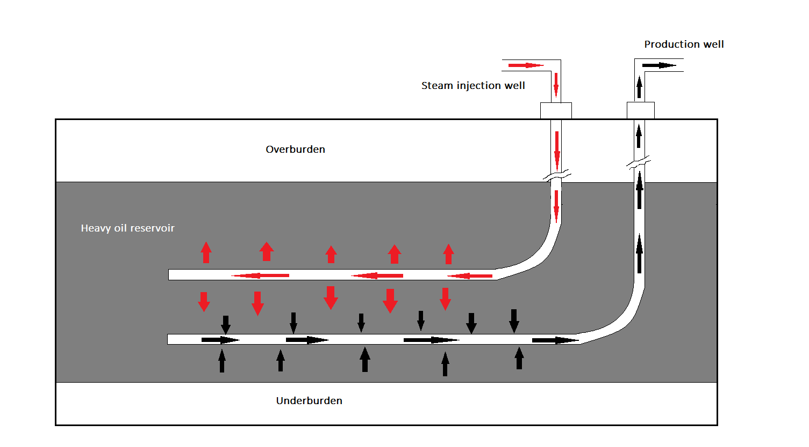
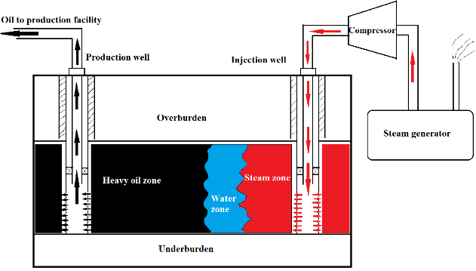
Finite element modelling of three-phase non-isothermal flow in heavy oil reservoirs- case study SAGD
Introduction to TEOR by steam injection
Steam flooding
SAGD
Huff &Puff
CSS
(All figures sketched by Taofik Nassan)
SAGD
Steam flooding

Slide 5
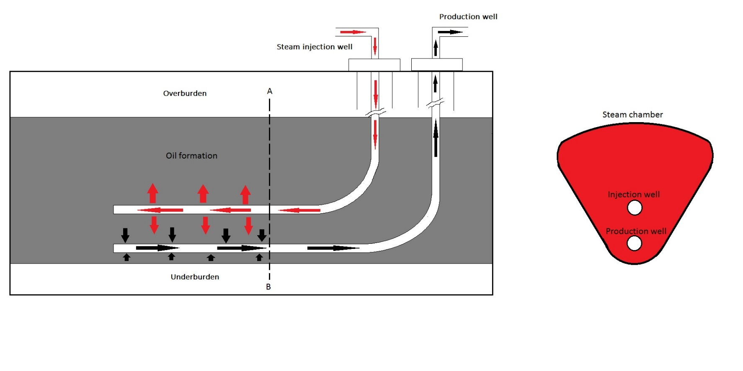
Finite element modelling of three-phase non-isothermal flow in heavy oil reservoirs- case study SAGD
SAGD configuration
(SAGD configuration ,By Taofik Nassan)

Slide 6
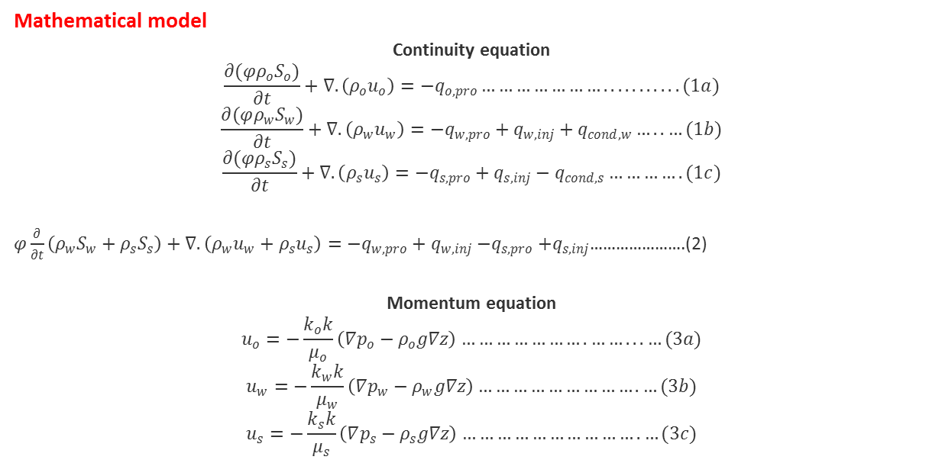
Finite element modelling of three-phase non-isothermal flow in heavy oil reservoirs- case study SAGD
Mathematical model
Continuity equation
$$\frac{∂(φρ_{o}S_{o})}{∂t}+∇. \left(ρ_{o}u_{o}\right)={−q}_{o,pro}…………………...........(1a)$$
$$\frac{∂(φρ_{w}S_{w})}{∂t}+∇. \left(ρ_{w}u_{w}\right)={−q}_{w,pro}+q_{w,inj}+q_{cond,w}…..…(1b)$$
$$\frac{∂(φρ_{s}S_{s})}{∂t}+∇. \left(ρ_{s}u_{s}\right)={−q}_{s,pro}+q_{s,inj}−q_{cond,s}………….(1c)$$
$φ\frac{∂}{∂t}\left(ρ_{w}S_{w}+ρ_{s}S_{s}\right)+∇. \left(ρ_{w}u_{w}+ρ_{s}u_{s}\right)={−q}_{w,pro}+q_{w,inj}{−q}_{s,pro}+q_{s,inj}$………………….(2)
Momentum equation
$$u_{o}=−\frac{k_{o}k}{μ_{o}}\left(∇p_{o}−ρ_{o}g∇z\right)………………….……...…(3a)$$
$$u_{w}=−\frac{k_{w}k}{μ_{w}}\left(∇p_{w}−ρ_{w}g∇z\right)……………………….…(3b)$$
$$u_{s}=−\frac{k_{s}k}{μ_{s}}\left(∇p_{s}−ρ_{s}g∇z\right)………………………….…(3c)$$

Slide 7
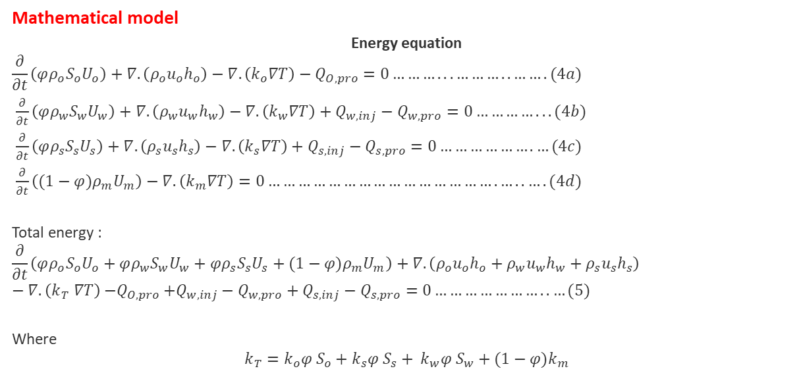
Finite element modelling of three-phase non-isothermal flow in heavy oil reservoirs- case study SAGD
Mathematical model
Energy equation
$$\frac{∂}{∂t}\left(φρ_{o}S_{o}U_{o}\right)+∇.\left(ρ_{o}u_{o}h_{o}\right)−∇.\left(k_{o}∇T\right)−Q_{O,pro}=0………...………..…….(4a)$$
$\frac{∂}{∂t}\left(φρ_{w}S_{w}U_{w}\right)+∇.\left(ρ_{w}u_{w}h_{w}\right)−∇.\left(k_{w}∇T\right)+Q_{w, inj}−Q_{w,pro}=0…………...(4b)$
$\frac{∂}{∂t}\left(φρ_{s}S_{s}U_{s}\right)+∇.\left(ρ_{s}u_{s}h_{s}\right)−∇.\left(k_{s}∇T\right)+Q_{s, inj}−Q_{s,pro}=0……………….…(4c)$
$\frac{∂}{∂t}\left((1−φ{)ρ}_{m}U_{m}\right)−∇.\left(k_{m}∇T\right)=0……………………………………….…..….(4d)$
Total energy :
$$\frac{∂}{∂t}\left(φρ_{o}S_{o}U_{o}+φρ_{w}S_{w}U_{w}+φρ_{s}S_{s}U_{s}+(1−φ{)ρ}_{m}U_{m}\right)+∇.\left(ρ_{o}u_{o}h_{o}+ρ_{w}u_{w}h_{w}+ρ_{s}u_{s}h_{s}\right)−∇.\left(k_{T} ∇T\right){−Q}_{O,pro}+Q_{w, inj}−Q_{w,pro}+Q_{s, inj}−Q_{s,pro}=0…………………..…(5)$$
Where
$$k_{T}=k_{o}φ S_{o}+k_{s}φ S_{s}+ k_{w}φ S_{w}+(1−φ)k_{m}$$

Slide 8
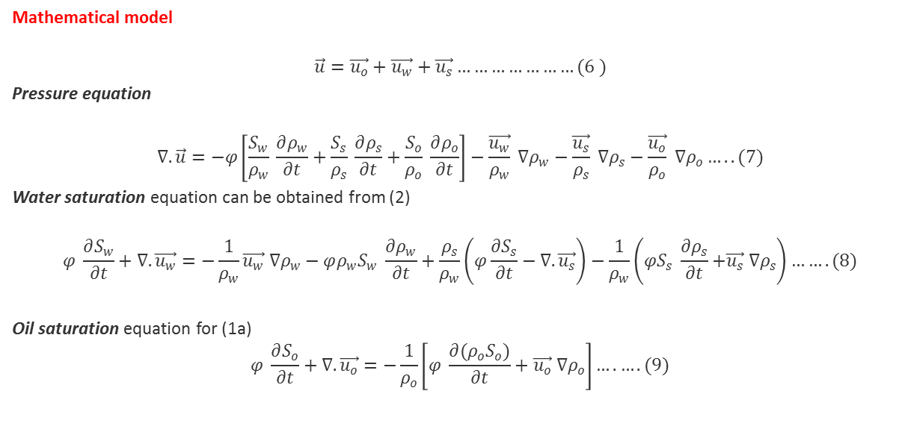
Finite element modelling of three-phase non-isothermal flow in heavy oil reservoirs- case study SAGD
Mathematical model
$$\vec{u}=\vec{u_{o}}+\vec{u_{w}}+\vec{u_{s}}…………………(6 )$$
Pressure equation
$$∇. \vec{u}=−φ\left[\frac{S_{w}}{ρ_{w}} \frac{∂ρ_{w}}{∂t}+\frac{S_{s}}{ρ_{s}} \frac{∂ρ_{s}}{∂t}+\frac{S_{o}}{ρ_{o}} \frac{∂ρ_{o}}{∂t}\right]−\frac{\vec{u_{w}}}{ρ_{w}} ∇ρ_{w}−\frac{\vec{u_{s}}}{ρ_{s}} ∇ρ_{s}−\frac{\vec{u_{o}}}{ρ_{o}} ∇ρ_{o}…..(7)$$
Water saturation equation can be obtained from (2)
$$φ \frac{∂S_{w}}{∂t}+∇. \vec{u_{w}}=−\frac{1}{ρ_{w}}{\vec{u_{w}} ∇ρ}_{w}−φρ_{w}S_{w} \frac{∂ρ_{w}}{∂t}+\frac{ρ_{s}}{ρ_{w}}\left(φ\frac{∂S_{s}}{∂t}−∇. \vec{u_{s}}\right)−\frac{1}{ρ_{w}}\left({φS}_{s} \frac{∂ρ_{s}}{∂t}{+\vec{u_{s}} ∇ρ}_{s}\right)…….(8)$$
Oil saturation equation for (1a)
$$φ \frac{∂S_{o}}{∂t}+∇. \vec{u_{o}}=−\frac{1}{ρ_{o}}\left[φ \frac{∂{(ρ}_{o}S_{o})}{∂t}+{\vec{u_{o}} ∇ρ}_{o}\right]….….(9)$$

Slide 9
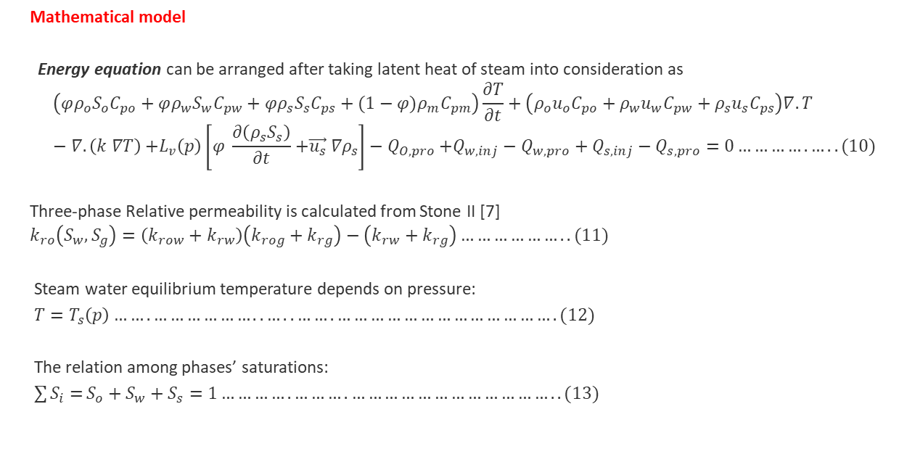
Finite element modelling of three-phase non-isothermal flow in heavy oil reservoirs- case study SAGD
Mathematical model
Energy equation can be arranged after taking latent heat of steam into consideration as
$$\left(φρ_{o}S_{o}C_{po}+φρ_{w}S_{w}C_{pw}+φρ_{s}S_{s}C_{ps}+(1−φ{)ρ}_{m}C_{pm}\right)\frac{∂T}{∂t}+\left(ρ_{o}u_{o}C_{po}+ρ_{w}u_{w}C_{pw}+ρ_{s}u_{s}C_{ps}\right)∇.T−∇.\left(k ∇T\right){+L_{v}\left(p\right)\left[φ \frac{∂\left(ρ_{s}S_{s}\right)}{∂t}{+\vec{u_{s}} ∇ρ}_{s}\right]−Q}_{O,pro}+Q_{w, inj}−Q_{w,pro}+Q_{s, inj}−Q_{s,pro}=0………….…..(10)$$
Three-phase Relative permeability is calculated from Stone II [7]
$$k_{ro}\left(S_{w},S_{g}\right)=\left(k_{row}+k_{rw}\right)\left(k_{rog}+k_{rg}\right)−\left(k_{rw}+k_{rg}\right)………………..(11)$$
Steam water equilibrium temperature depends on pressure:
$T=T_{s}\left(p\right)…….………………..…..…….………………………………….(12)$
The relation among phases’ saturations:
${\sum{S_{i}=}S}_{o}+S_{w}+S_{s}=1………….……….………………………………..(13)$

Slide 10
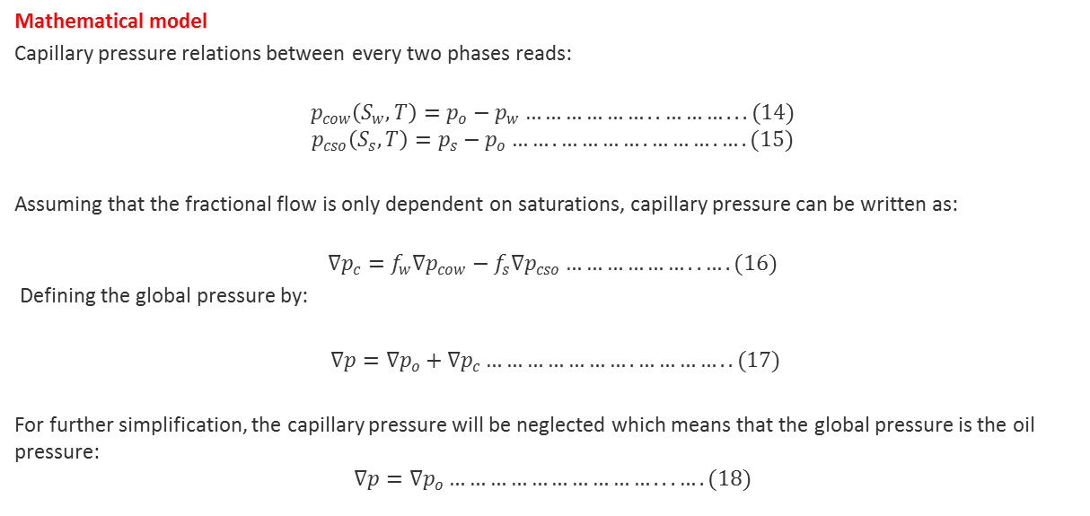
Finite element modelling of three-phase non-isothermal flow in heavy oil reservoirs- case study SAGD
Mathematical model
Capillary pressure relations between every two phases reads:
$$p_{cow}\left(S_{w},T\right)=p_{o}−p_{w}………………..………...(14)$$
$$p_{cso}\left(S_{s},T\right)=p_{s}−p_{o}…….………….……….….(15)$$
Assuming that the fractional flow is only dependent on saturations, capillary pressure can be written as:
$$∇p_{c}=f_{w}∇p_{cow}−f_{s}{∇p}_{cso}………………..….(16)$$
Defining the global pressure by:
$∇p=∇p_{o}+{∇p}_{c}………………….…………..(17)$
For further simplification, the capillary pressure will be neglected which means that the global pressure is the oil pressure:
$$∇p=∇p_{o}…………………………...….(18)$$

Slide 11
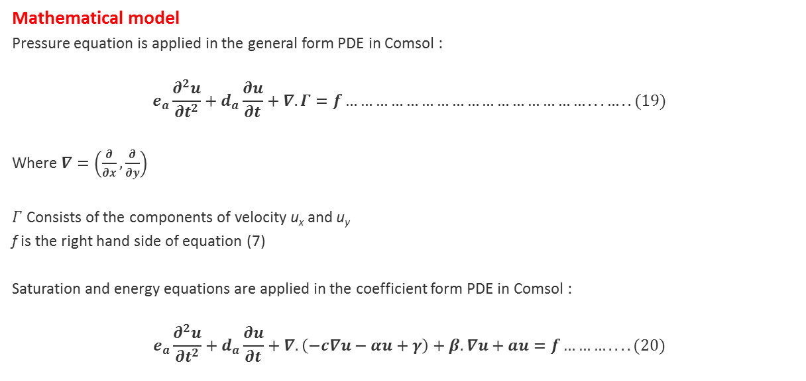
Finite element modelling of three-phase non-isothermal flow in heavy oil reservoirs- case study SAGD
Mathematical model
Pressure equation is applied in the general form PDE in Comsol :
$$e_{a}\frac{∂^{2}u}{{∂t}^{2}}+d_{a}\frac{∂u}{∂t}+∇.Γ=f…………………………………………...…..(19)$$
Where $∇=\left(\frac{∂}{∂x},\frac{∂}{∂y}\right)$
$Γ$ Consists of the components of velocity u_{x} and u_{y}
f is the right hand side of equation (7)
Saturation and energy equations are applied in the coefficient form PDE in Comsol :
$$e_{a}\frac{∂^{2}u}{{∂t}^{2}}+d_{a}\frac{∂u}{∂t}+∇.\left(−c∇u−αu+γ\right)+β.∇u+au=f………....(20)$$

Slide 12
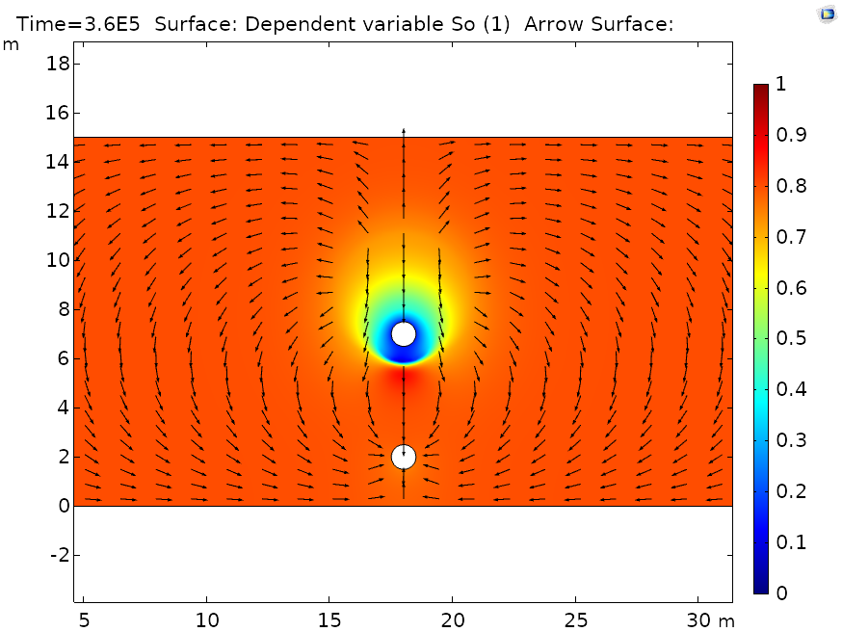
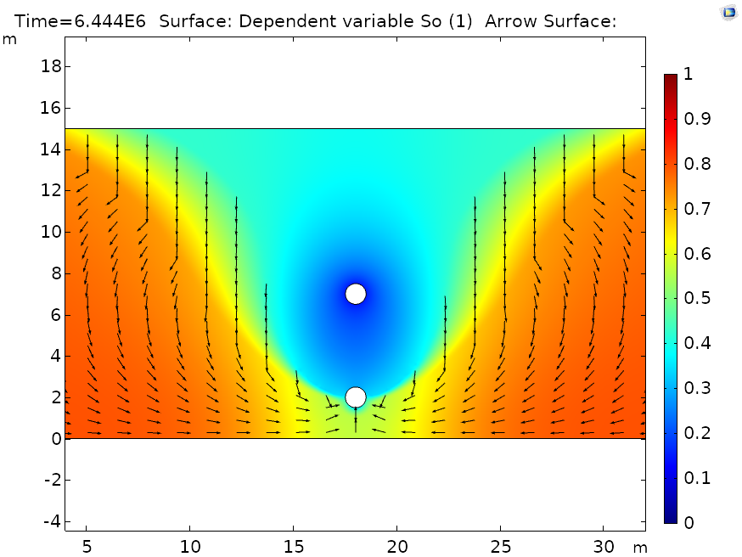
Finite element modelling of three-phase non-isothermal flow in heavy oil reservoirs- case study SAGD
Results
Oil saturation after 4 days
Oil saturation after 75 days

Slide 13
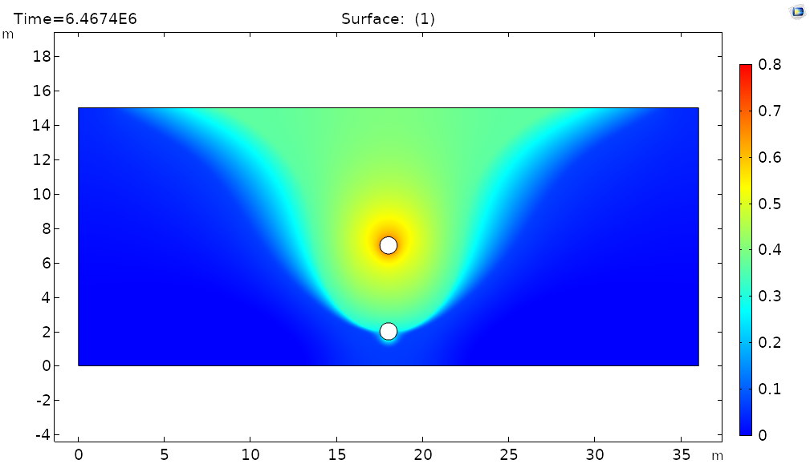
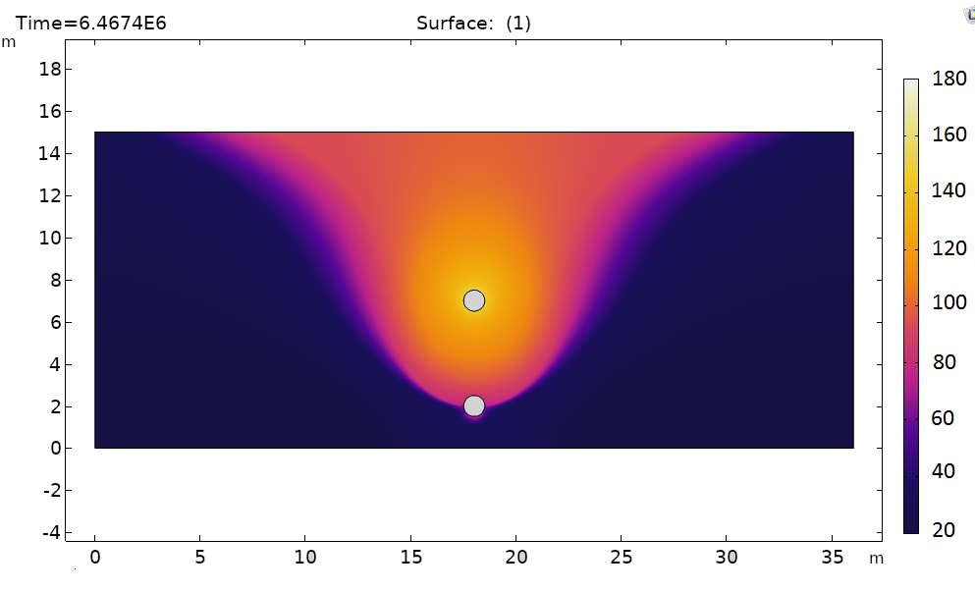
Finite element modelling of three-phase non-isothermal flow in heavy oil reservoirs- case study SAGD
Results
Steam saturation after 75 days
Temperature distribution after 75 days

Slide 14
Finite element modelling of three-phase non-isothermal flow in heavy oil reservoirs- case study SAGD
Conclusions
Suitable formulation of three phase non-isothermal flow in porous media is introduced
Finite element method is applied to the model through a simple 2D-SAGD model which is solved efficiently using COMSOL 5.5”
Saturation and heat distribution are shown as results

Slide 15
Finite element modelling of three-phase non-isothermal flow in heavy oil reservoirs- case study SAGD
Thank you

