Slide 1
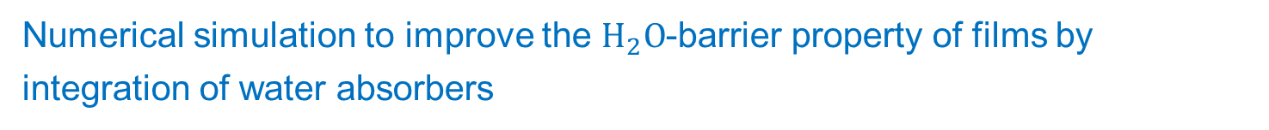
Numerical simulation to improve the $H_{2}O$-barrier property of films by integration of water absorbers
M.Sc. Jing Tang
Dr. Oliver Miesbauer

Slide 2
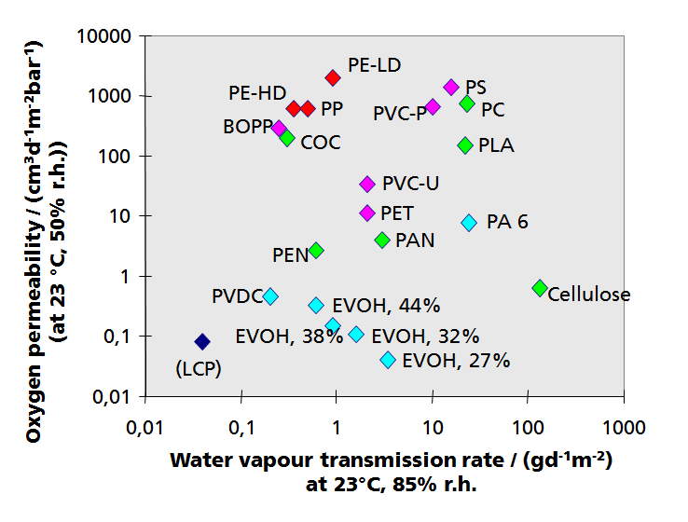
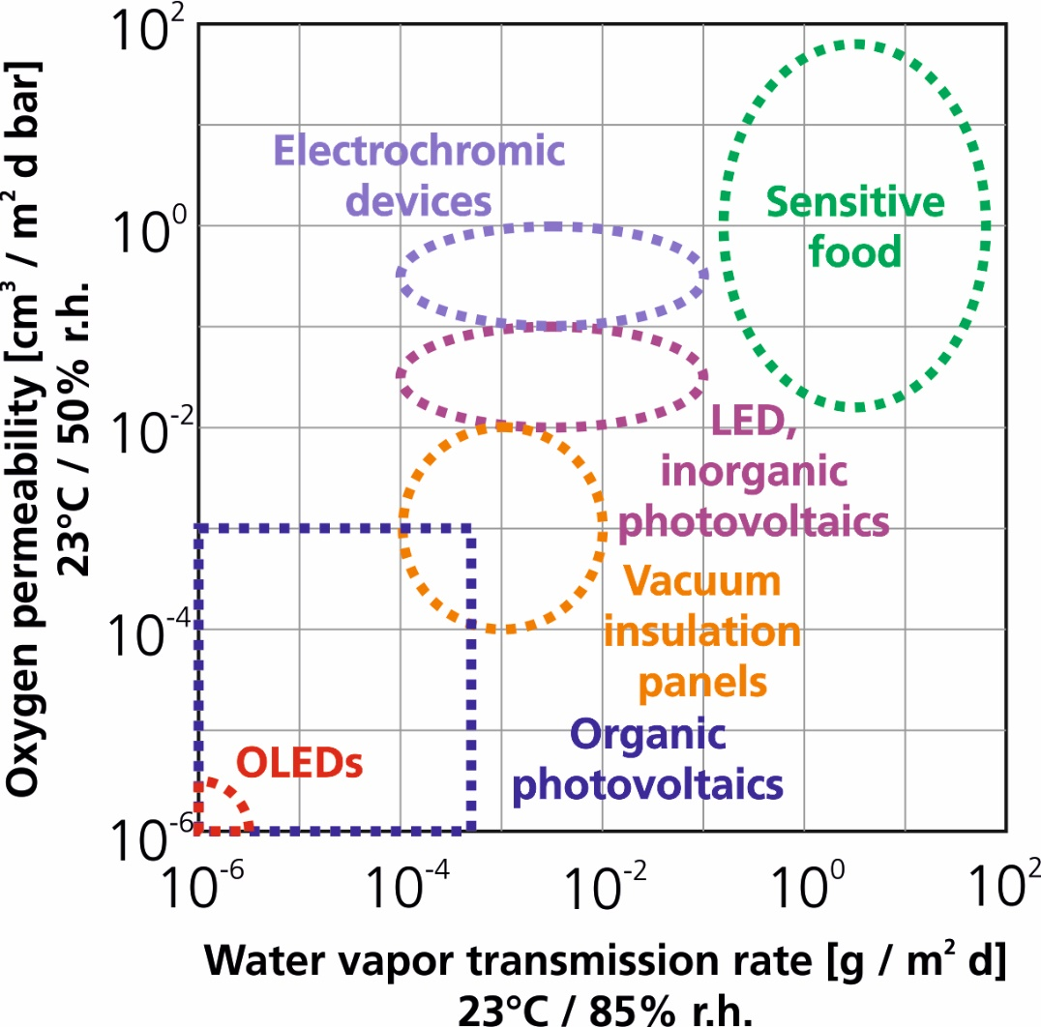
Barrier requirements of technical products
permeance
Barrier performance of polymer films of thickness 100 μm
Source: Fraunhofer IVV

Slide 3
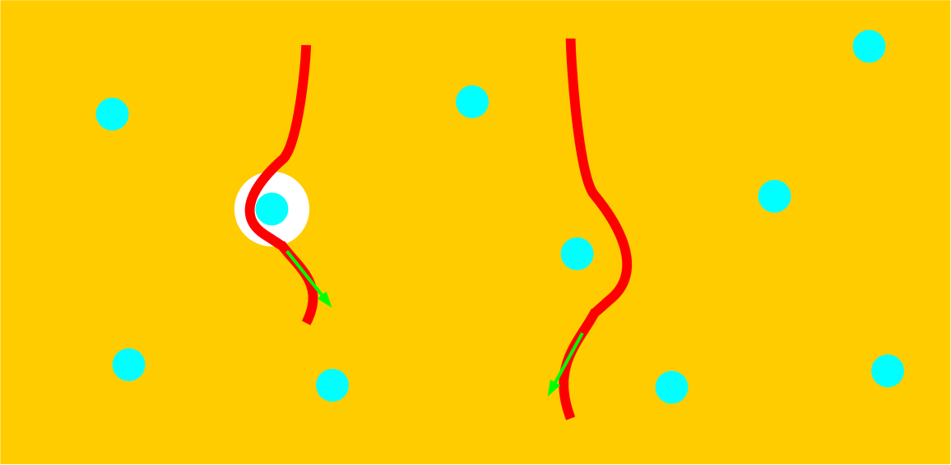
Permeation through polymer/nano-particle composites
Effects of impermeable particles dispersed in a permeable matrix
Reduction of free volume for dissolution and diffusion of molecules, reduction of diffusion cross-section area
Hindrance to diffusion ⇒ tortuous and therefore extended diffusion paths

Slide 4
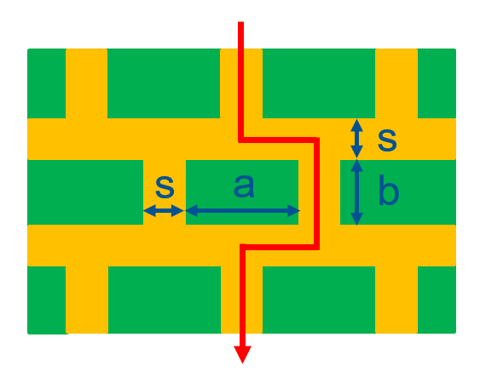
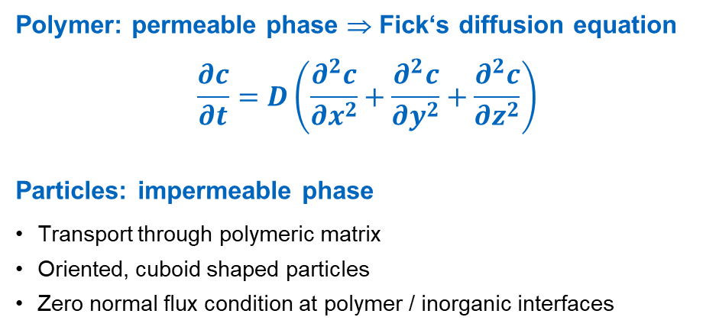
Models for barrier structures
Oliver Miesbauer, Analytische und numerische Berechnungen zur Barrierewirkung von Mehrschichtstrukturen, Dissertation, 2017
Polymer: permeable phase ⇒ Fick‘s diffusion equation
$$\frac{∂c}{∂t}=D\left(\frac{∂^{2}c}{∂x^{2}}+\frac{∂^{2}c}{∂y^{2}}+\frac{∂^{2}c}{∂z^{2}}\right)$$
Particles: impermeable phase
Transport through polymeric matrix
Oriented, cuboid shaped particles
Zero normal flux condition at polymer / inorganic interfaces

Slide 5
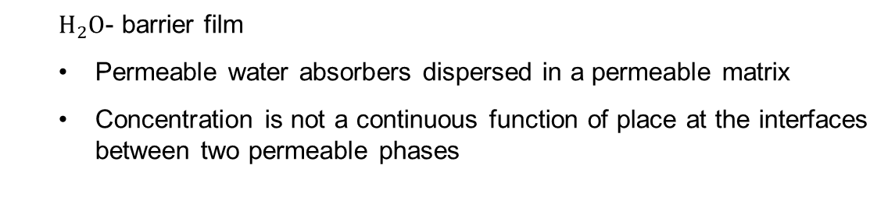
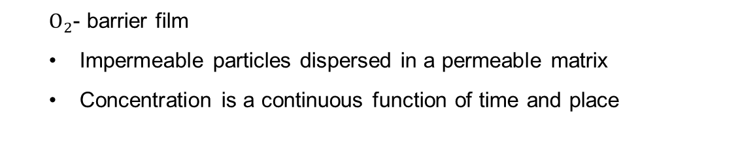
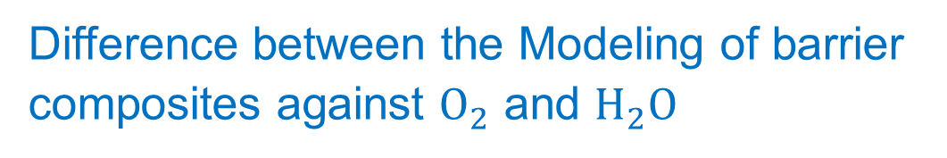
Difference between the Modeling of barrier composites against $O_{2}$ and $H_{2}O$
$O_{2}$- barrier film
Impermeable particles dispersed in a permeable matrix
Concentration is a continuous function of time and place
$H_{2}O$- barrier film
Permeable water absorbers dispersed in a permeable matrix
Concentration is not a continuous function of place at the interfaces between two permeable phases

Slide 6
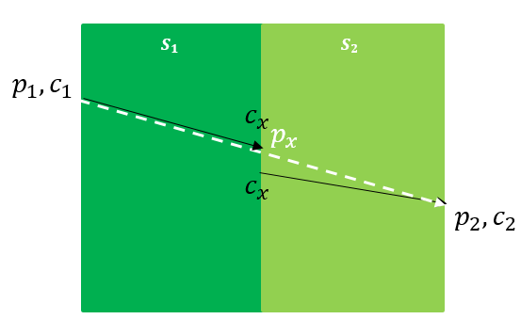


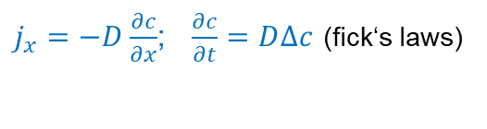
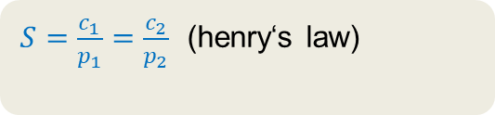
Modeling of polymer/water absorber composite
Theoretical basis
$j_{x}=−D\frac{∂c}{∂x}$; $\frac{∂c}{∂t}=D∆c$ (fick‘s laws)
$S=\frac{c_{1}}{p_{1}}=\frac{c_{2}}{p_{2}}$ (henry‘s law)
linear isotherm
$$S\frac{∂p}{∂t}=DS∆p$$
Simple model for the water vapour transport (diffusion and sorption) in the layer ($p_{1}>p_{2}$ or $c_{1}>c_{2}$ and $S_{1}{>S}_{2}).$

Slide 7
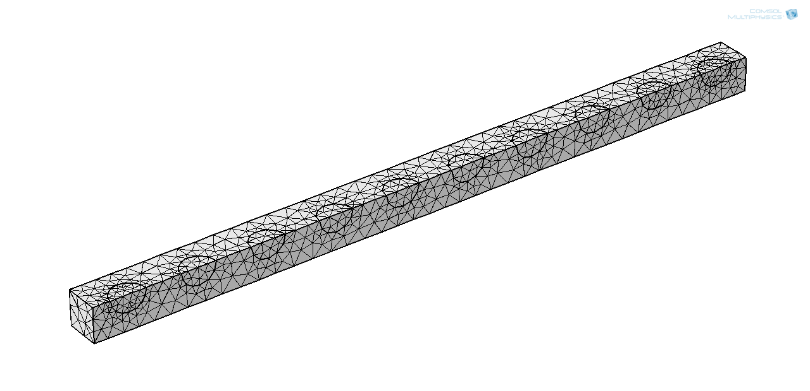
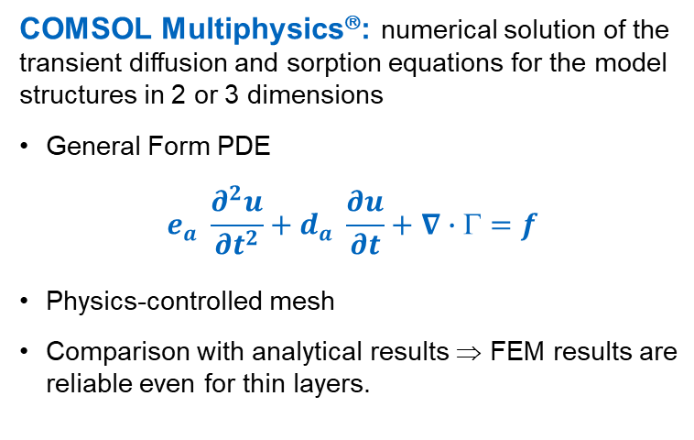
Finite element simulation
COMSOL Multiphysics®: numerical solution of the transient diffusion and sorption equations for the model structures in 2 or 3 dimensions
General Form PDE
$$e_{a} \frac{∂^{2}u}{∂t^{2}}+d_{a} \frac{∂u}{∂t}+∇∙Γ=f$$
Physics-controlled mesh
Comparison with analytical results ⇒ FEM results are reliable even for thin layers.
Example: physics-controlled mesh for polymeric layer with water absorbers

Slide 8
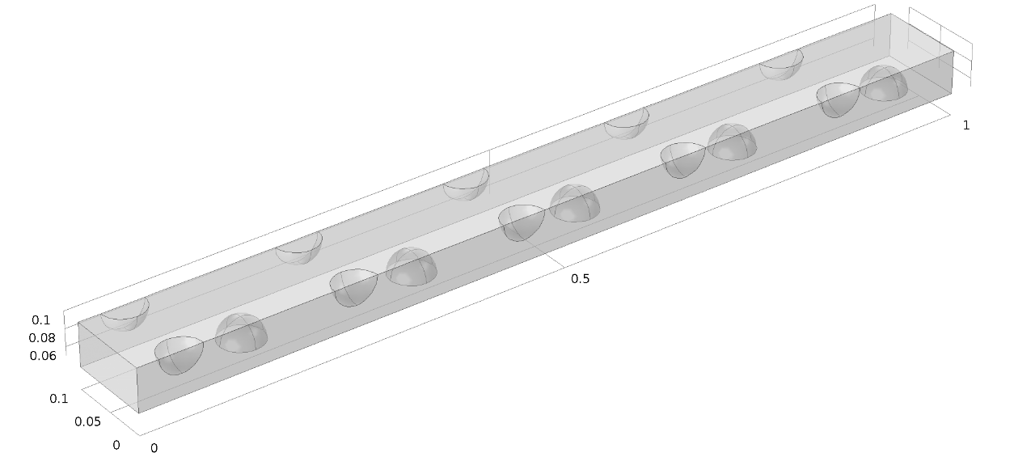
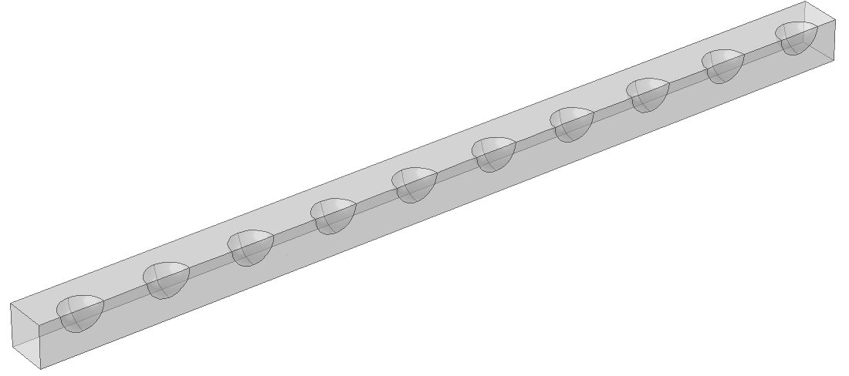

3-dimensional model
Two different polymer matrices with particles
Thickness: $h$
Relative Thickness: $x_{n0}=0$ to $x_{nh} = h_{r}=\frac{h}{h}= 1$.
Relative radius: $r_{n}=\frac{r}{h}$
Relative solubility coefficient: $S_{pr}=\frac{S}{S_{0}}$
Relative diffusion coefficient: $D_{pr}=\frac{D}{D_{0}}$
Dimensionless: described by relative length
M1: matrix with shifted particles
(b) M2: matrix with unshifted particles
transparent geometries for two different matrices with 10 rows of uniform dispersed, permeable and spherical particles with a relative radius $r_{n}=0.025$

Slide 9
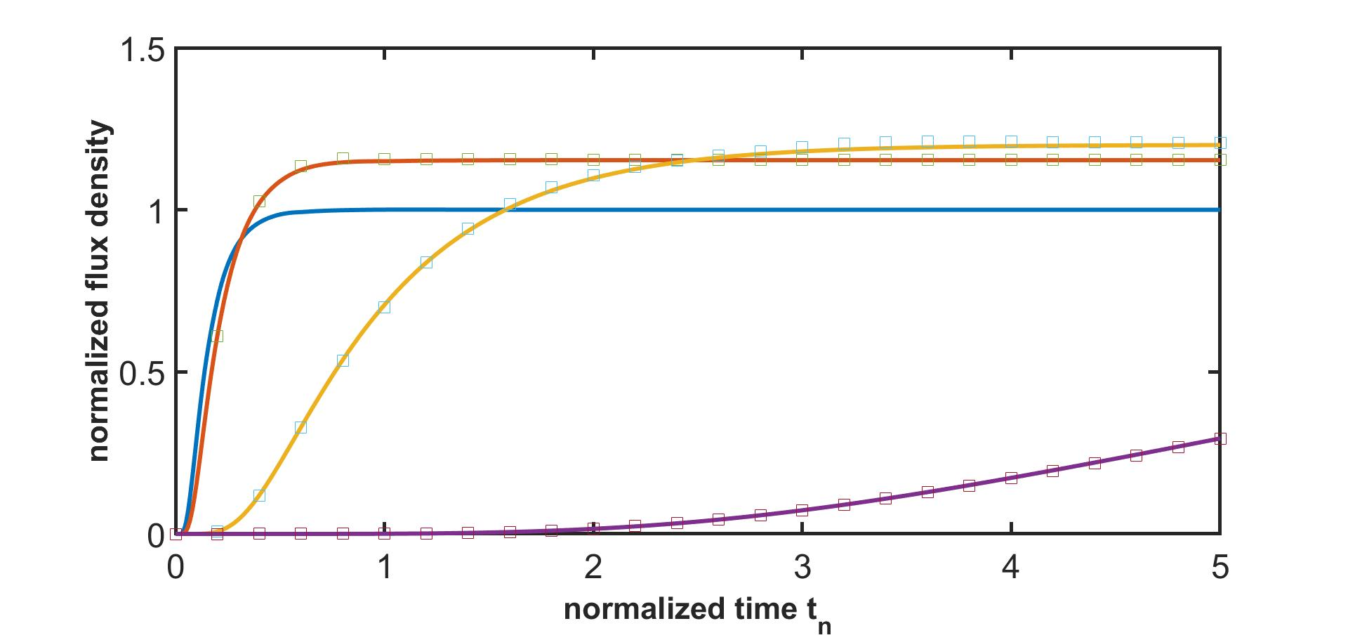
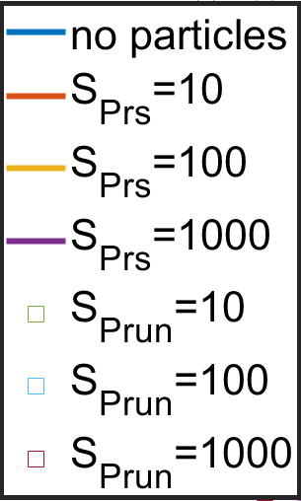
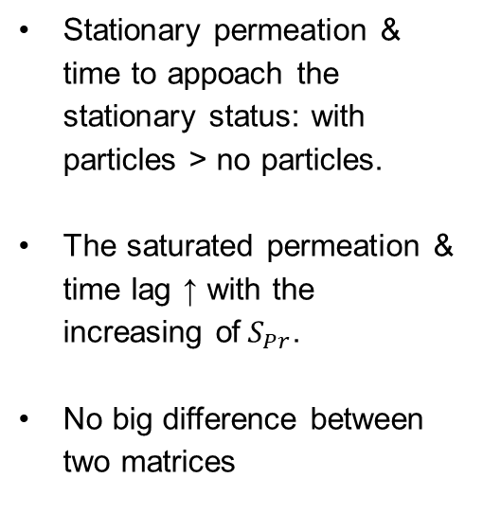

Comparison of results of two different matrices
Influence of solubility coefficient: $S_{Pr}=10, 100, 1000$
$$r_{n}=0.025$$
Stationary permeation & time to appoach the stationary status: with particles > no particles.
The saturated permeation & time lag ↑ with the increasing of${ S}_{Pr}$.
No big difference between two matrices
Comparison diagram for M1 and M2 with particles with different solubility coefficients but same size.

Slide 10
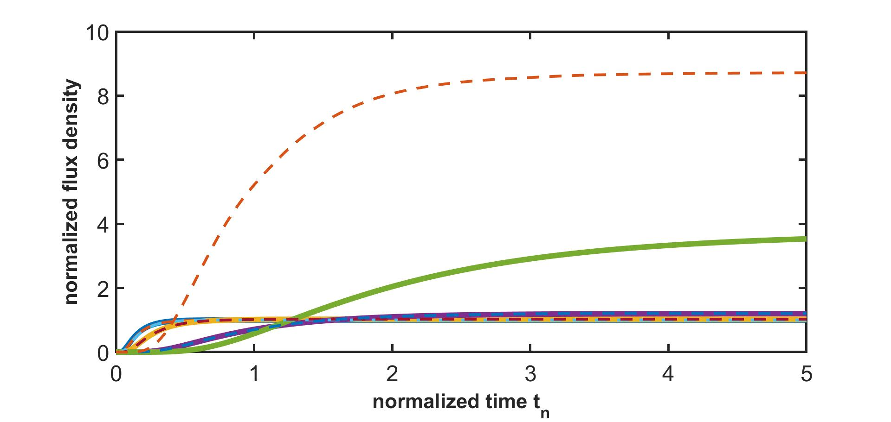
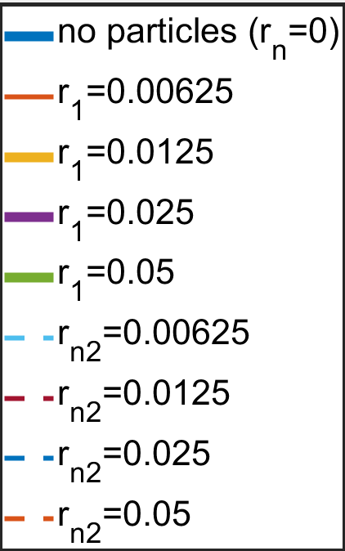
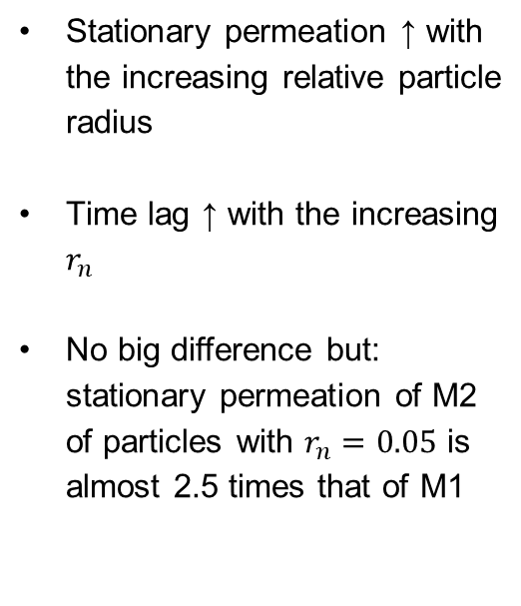


Comparison of results of two different matrices
Influence of size of particles: $r_{n}$
Stationary permeation ↑ with the increasing relative particle radius
Time lag ↑ with the increasing $r_{n}$
No big difference but: stationary permeation of M2 of particles with $r_{n}=0.05$ is almost 2.5 times that of M1
$$S_{Pr}=100$$
8.72
3.52
Comparison diagram for M1 and M2 of particles with same solubility coefficient but different sizes.

Slide 11
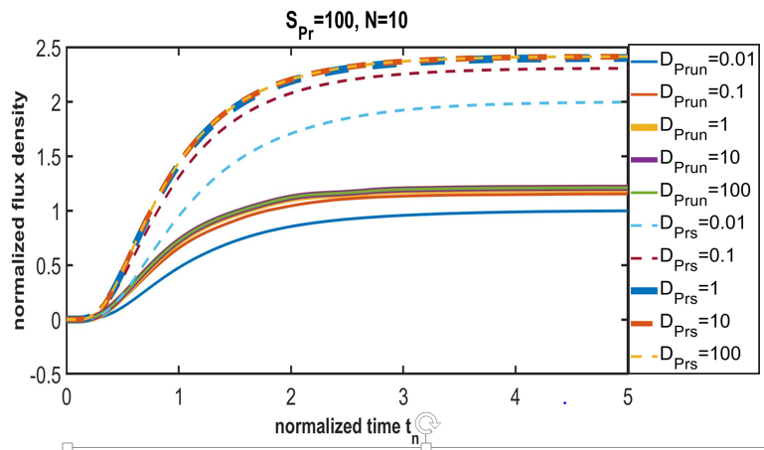

Comparison of results of two different matrices
Influence of diffusion coefficient of particles
The stationary permeation ↑ with the increasing $D_{Pr}$
time to approach the state of stationary permeation ↓ with increasing particle diffusion coefficient.
Permeability for M1: 2x of M2
Time lag for M1: longer than M2
Comparison diagram for the two arrangements of particles with different diffusion coefficients

Slide 12

Other influencing factors
Particle row number
Number of particles at a fixed filling degree
Shapes of the particles…
Important influencing factors for $O_{2}$- barrier films
Aspect ratio of particles
Volume fraction of polymer matrix
Spatial distribution of particles
Orientation: rotation of particles
$≠$ for $H_{2}O$-barrier film

Slide 13
Thank you for your attention
M.Sc. Jing Tang
Chair of brewing and beverage technology
TUM School of Life Sciences
Technical University of Munich
Tel: +49 8161 71 4379
Email: jing1.tang@tum.de

