Slide 1


Thermal and Heat Transfer Modelling of a Lithium-ion Battery Module during the Discharge Cycle
BY
Thamasha Samarasinghe

Slide 2

Background
Electric Vehicles (EVs) and Hybrid Electric Vehicles (HEVs)
The performance of EVs and HEVs depends on the energy storage systems
The battery performance depends on various factors
Reliability of EVs and HEVs
Battery life cycle
Cost of batteries
Durability

Slide 3
Many researches can be found related to temperature distribution of Li-ion battery packs
However, it can be found that, there is less number of investigations have been conducted in terms of different cell arrangements and inter cell distance aspects
Therefore, this study investigates the designs of cell arrangements and inter-cell for the battery module applied in high power Li-ion battery pack

Slide 4


Analytical model for Li-ion battery single cell temperature distribution
In 1995, Newman et al, published the first equation related to the Li-ion battery module heat transfer.
Heat generate due to
Enthalpy changes
Resistive heating inside the cell
Electrochemical polarization
The energy balance equation
 | $$ρC_{p}\frac{∂T}{∂t}=\frac{1}{r}\frac{∂}{∂r}\left(k_{r}r\frac{∂T}{∂r}\right)+\frac{1}{r^{2}}\frac{∂}{∂φ}\left(k_{a}\frac{∂T}{∂r}\right)+\frac{∂}{∂z}\left(k_{z}\frac{∂T}{∂z}\right)+\dot{Q}$$
 | $$ρC_{p}\frac{∂T}{∂t}=hA\left(T−T_{amb}\right)+\dot{Q}$$

Slide 5
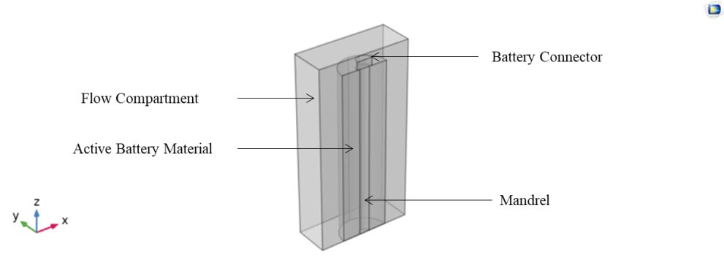
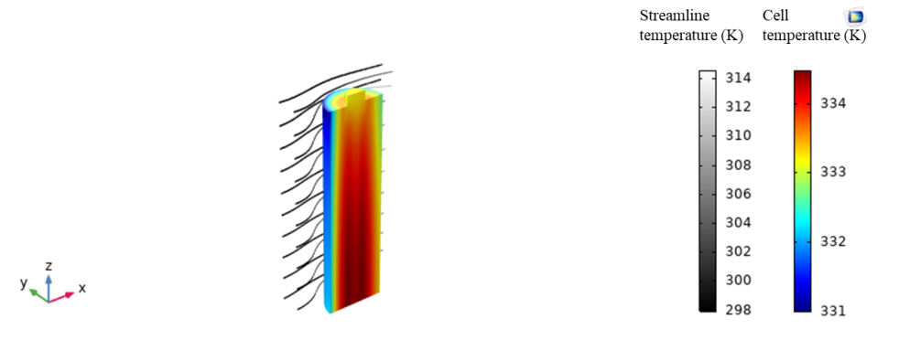
Thermal modelling of Li-ion battery module
The 3D simulation model was developed as a CFD model by using COMSOL Multiphysics 5.5
Model contains 1D model and a 3D model
As boundary conditions, both inlet and initial temperature are set to 298.15 K in the model
The airflow velocity is taken as 0.1 m/s at the inlet for x direction and pressure 1 atm is considered
A square wave function which has 7.5 C discharge rate is also used

Slide 6
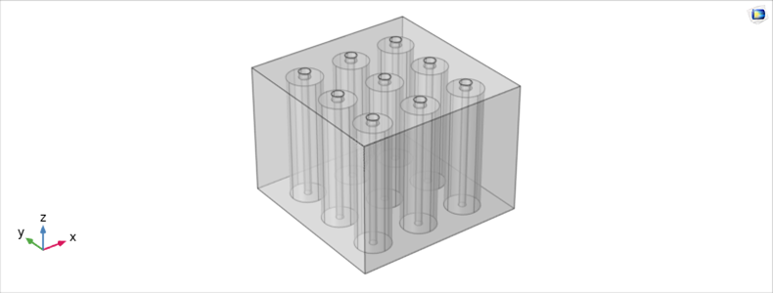
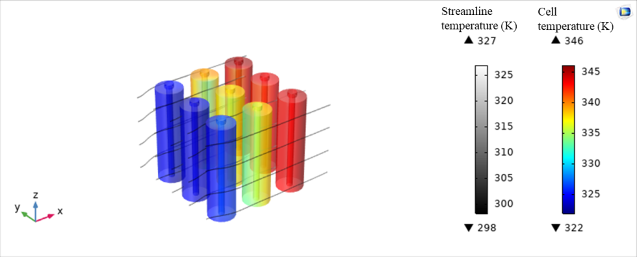
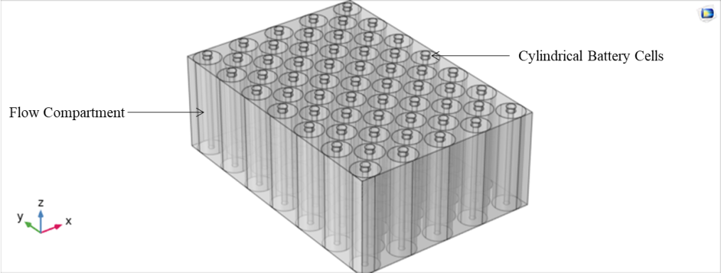
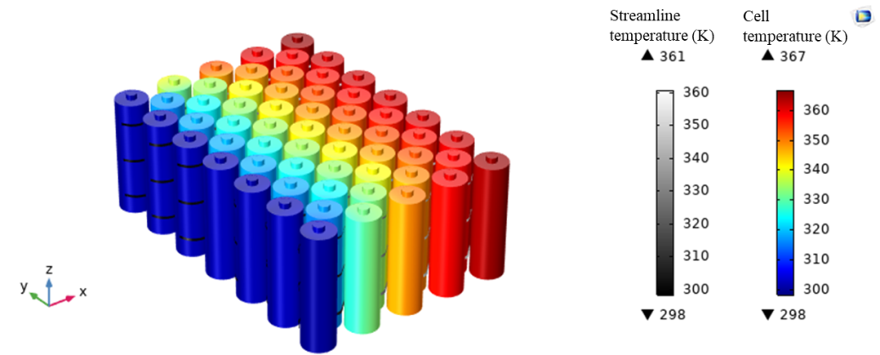
The matrix was then expanded to the battery module
Module consists of 59 cells and cells are ordered in a zigzag form

Slide 7
Temperature distribution of Li-ion battery module with different cell structures
Simulations were conducted considering 24 battery cells in different cell arrangements
Four different cell structures were considered including 1×24, 3×8, 4×6 rectangular arrays and 19 cells of hexagonal arrangement
19 cells hexagonal arrangement was selected to investigate the space utilisation effect

Slide 8
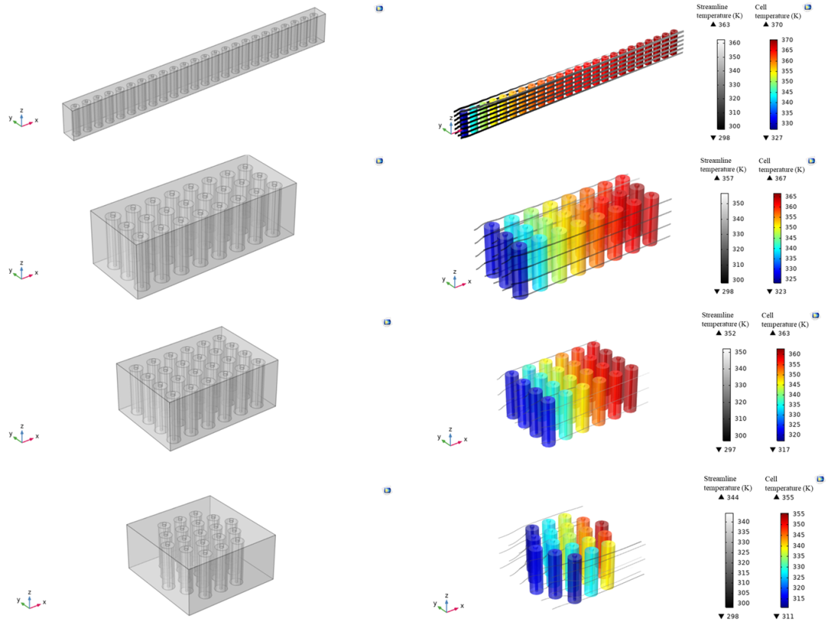

Slide 9
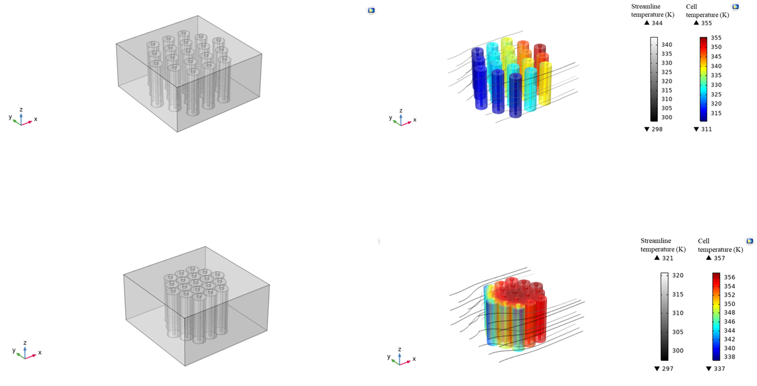
Effect on inter-cell distance
In order to investigate the effect of inter-cell distance, a 19-cell hexagonal arrangement was used
The inter-cell distance of the cell arrangement was changed from 0.027 m to no-gap situation by keeping all other boundary conditions as constant and simulations were conducted

Slide 10
Conclusions
In this study, the thermal performance of Li-ion battery module is discussed by considering both analytical and simulation methods
Assumptions of the lumped model are applied in the analytical method of a single cell
Thermal performance analyses are performed for different cell structures and the arrangement structures include 1×24, 3×8, 4×6 arrays rectangular arrangements and 19 cell hexagonal arrangement
Among all structures discussed in the study, 4×6 cubic structure is identified as the best choice in terms of the cooling capability
Results confirmed that the having a gap between battery cells reduces the mutual heating effect and increases the cooling effectiveness

Slide 11
Acknowledgement
This publication was made possible by the sponsorship and support of Lloyd’s Register Foundation. The work was enabled through, and undertaken at, the National Structural Integrity Research Centre (NSIRC), a postgraduate engineering facility for industry-led research into structural integrity established and managed by TWI through a network of both national and international universities.

Slide 12
Thank You !!!

