Slide 1

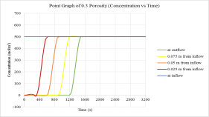
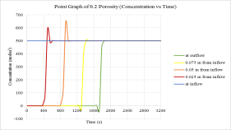
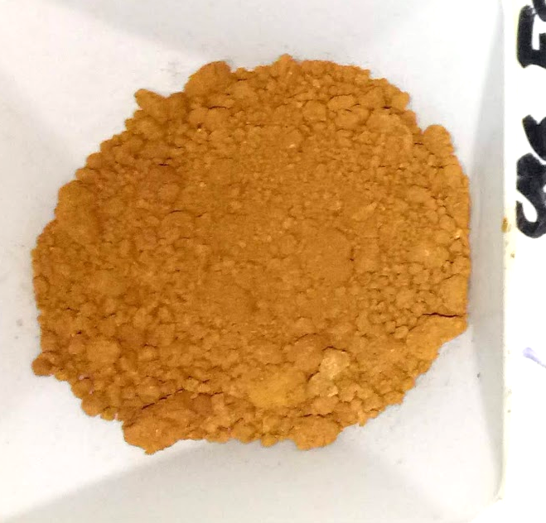
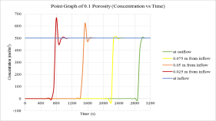
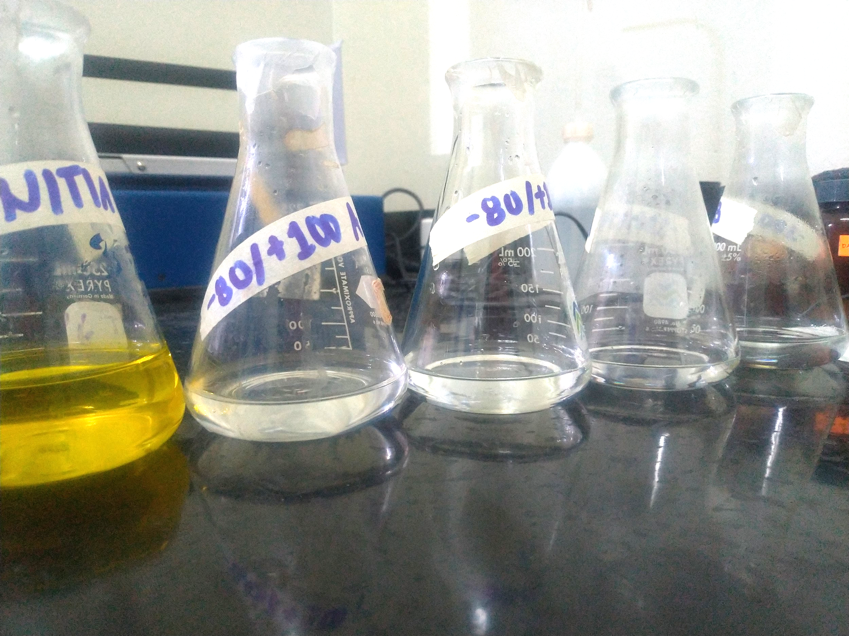
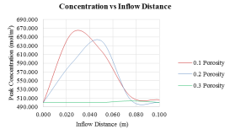

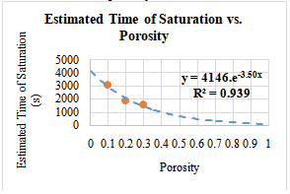
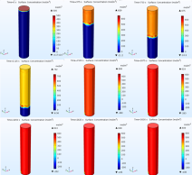
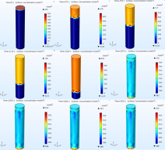
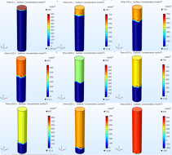
Filtration Column Design of a Fixed Bed Goethite-rich Nickel Laterite as Adsorbent of Hexavalent Chromium [Cr (VI)] in Mine Wastewater Treatment
J. R. Cirio, R. M. Daza, F. C. Luistro, C. C. Mercado
Department of Mining, Metallurgical, and Materials Engineering, University of the Philippines Diliman,
Quezon City, Philippines
INTRODUCTION: Mining produces wastewater which may contain toxic heavy metals that can have adverse impacts on the environment at high concentrations. Based on an experimental previous study on the effective adsorption of hexavalent chromium using nickel laterite soil, we simulate a single-component wastewater filtration system.
RESULTS:
Overall trend was an increase in the distance from the inflow (bed depth) increased the time needed for the onset of adsorption.
P= 0.3
P= 0.2
Figure 1. Experimental runs from previous study; Laterite sample filtration column results (Nacomel, et al 2019)
Laterite
P= 0.1
Figure 3. Point graph of column adsorption at 0.3, 0.2, and 0.1 porosity
Increase in the porosity resulted to decrease in time needed for the onset of adsorption (increase surface area).
Influent
Adsorption
Effluent
(80/100)
(80/100)
(100/140)
(100/140)
Figure 4. Concentration vs. Inflow distance
COMPUTATIONAL METHODS: The Transport of Diluted Species in Porous Media (TDS) was the physics interface. Time Dependent study was chosen since the progression of the fluid and the adsorption gradient were observed over time.
Conditions:
Soil [solid] was set to be the porous medium
Porosity was user-defined (0.3, 0.2, 0.1)
Convection velocity was set with its magnitude patterned to the soil infiltration
No accumulated fluid, only continuous dripping inflow , like in heap leaching (McBride et al. 2018)
Relationship between the porosity and convective velocity was assumed to be linear
Langmuir isotherm was chosen as the adsorption model
Langmuir constant and the adsorption maximum was set from the Langmuir adsorption model of the relationship between laterite soil grains and hexavalent chromium (Syama et al. 2015; Sunil et al. 2015).
Increasing porosity shifted peak concentration farther away from the inflow location porosity effect on exposure time of the fluid; slower flow rate yields longer exposure; lower porosities have higher surface area, adsorption capacity increases (Wang and Shadman 2013).
Convection velocity (flow velocity) was assumed to be directly proportional to the porosity of the particles in the fixed-bed because for a higher porosity, there would be a faster rate of transport; more available surface area in the fixed-bed.
Time, s
Figure 5. Relationship of porosity with respect to the estimated time of saturation.; useful in determining the time of saturation for other porosity values.
Porosity
CONCLUSIONS:
The study simulated the relationships of porosity and inflow distance to time of saturation, and adsorption. Relation of porosity with the onset of adsorption, and the time of saturation are both inversely proportional. As for the relationship of adsorption time with the concentration of adsorbed species, and with the inflow distance (bed depth), they were found to be directly proportional. The simulation of a single-component wastewater filtration system is a step towards the development of in-site efficient filtration.
P= 0.3
P= 0.2
P= 0.1
REFERENCES:
1. Nacomel, Justine B., Kezia Charity E. Rosero, and Vinz V. Punongbayan. 2019. Adsorption and Desorption of Hexavalent Chromium on In-Situ Laterite Ore from Dinapigue, Isabela. Quezon City: UP DMMME.
2. Syama, I, Arun Thalla, and D Manu. 2015. “Performance of Laterite Soil Grains as Adsorbent in the Removal of Chromium.” Current World Environment 10 (1): 270–80. https://doi.org/10.12944/cwe.10.1.33.
3. Sunil, B.M., and Saifiya Faziludeen. 2015. “Removal of Hexavalent Chromium Cr (VI) by Adsorption in Blended Lateritic Soil.” Advances in Environmental Research 4 (3): 197–210. https://doi.org/10.12989/aer.2015.4.3.197.
4. Wang, Hao, and Farhang Shadman. 2013. “Effect of Particle Size on the Adsorption and Desorption Properties of Oxide Nanoparticles.” AIChE Journal. https://doi.org/10.1002/aic.13936.
Figure 2. Column Simulation various porosity from 0 s to 3000s at 375 s intervals
Excerpt from the Proceedings of the 2020 COMSOL Conference

