Slide 1




Numerical study of effective thermal conductivity (ETC) of periodic complex structures to be used in concentric distillation column
COMSOL Conference 2020 Europe (14 & 15 October 2020)
By: Yousef Al-Maqaleh (PhD student at INP Toulouse)
Supervisors: David Rouzineau (INP Toulouse)
Michel Meyer (INP Toulouse)
Nathalie Raimondi (Paul Sabatier University)

Slide 2
Outline
Objective of the study
Studied geometries
Model
Computational domain
Boundary conditions
Calculation of effective thermal conductivity (ETC)
Results
Mesh convergence study
Domain size sensitivity study
ETC versus porosity
Conclusion

Slide 3
Objective of the study
The goal of this study : heat transfer by conduction performance only
Evaluate the effective thermal conductivity (ETC) in W/m/K of different geometries
Discriminate the best geometry based on their ETC
Good indicator of thermal performance
Calculate a correlation of ETC wrt porosity
Liquid flow
Internal wall
Radial Heat flux
Stripping zone
Stripping zone
Rectifying zone
Gas flow

Slide 4
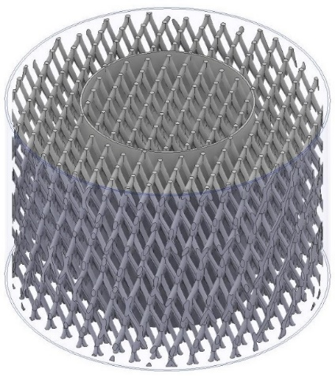
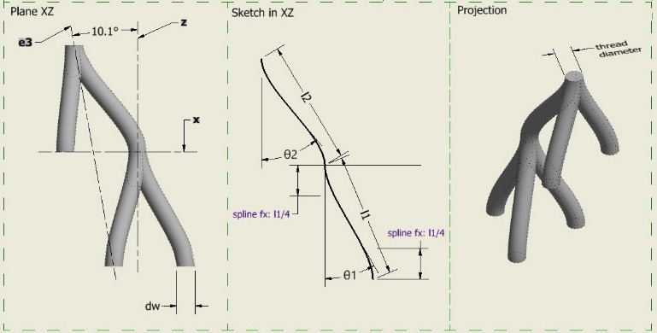
Studied geometries
Tetra-Spline (TS) Lattice geometry Patented (tested on normal distillation column)
Mass transfer ✓
capacity ✓
heat transfer ?
Internal wall
TS elementary unit design
Photo from Autodesk Inventor
TS packing bloc design with a consolidated internal wall for concentric column
(Photo from Autodesk Inventor)

Slide 5
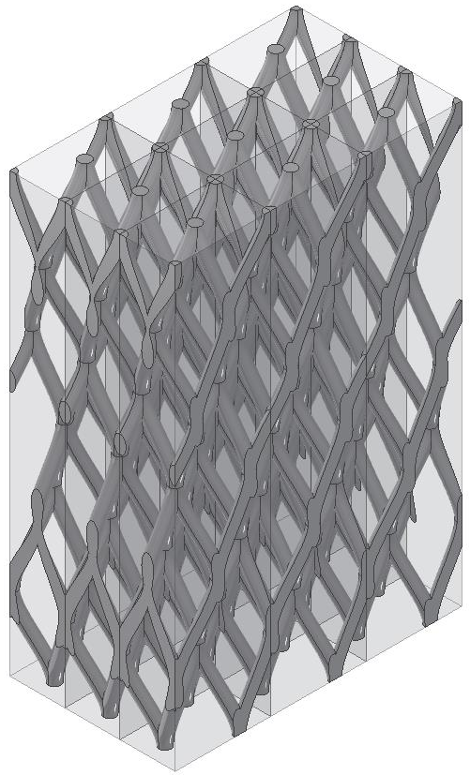
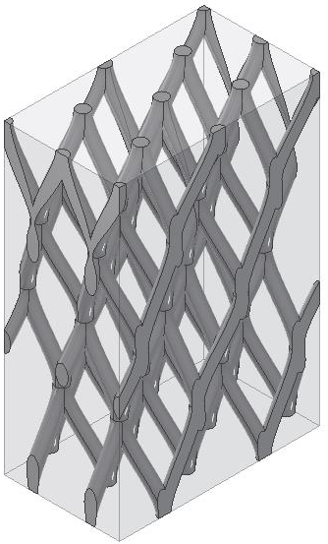
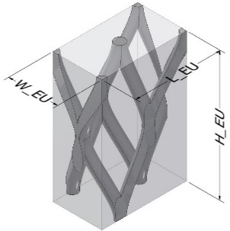
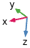

Model : computational domain
Specifics about TS geometry
perfectly periodic horizontally (x and y)
not periodic vertically (in z direction)
Important parameters of TS geometry
The porosity (ϵ) varies with:
Strand diameter d_{s} (mm) – variable
Strand length l₁=l₂ (mm) – variable
Angles of both tetrahedrons θ₁ =30° and θ₂ =40°
$${\text{ϵ}}_{ domain}=\frac{V_{packing}}{V_{domain}} (\%)$$
$V_{domain}=\left(L_{EU}∗W_{EU}∗H_{EU}\right)∗n^{3}$ (m³)
n=1:6
*EU=elementary unit
n=1 n=2 n=3

Slide 6
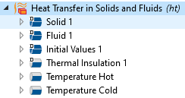

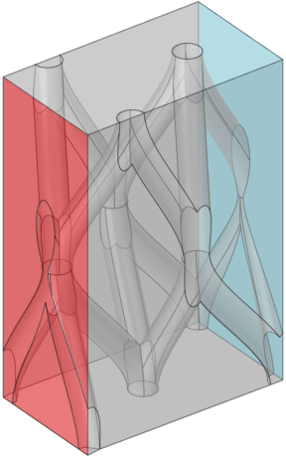
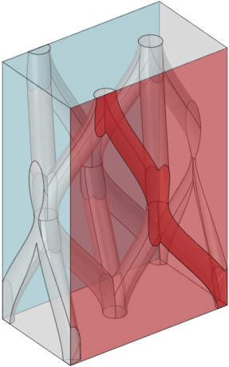
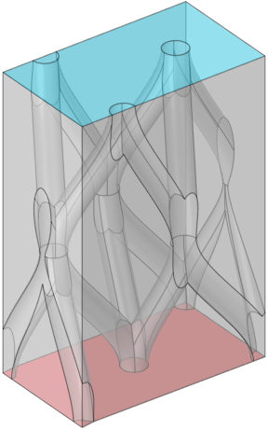
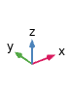
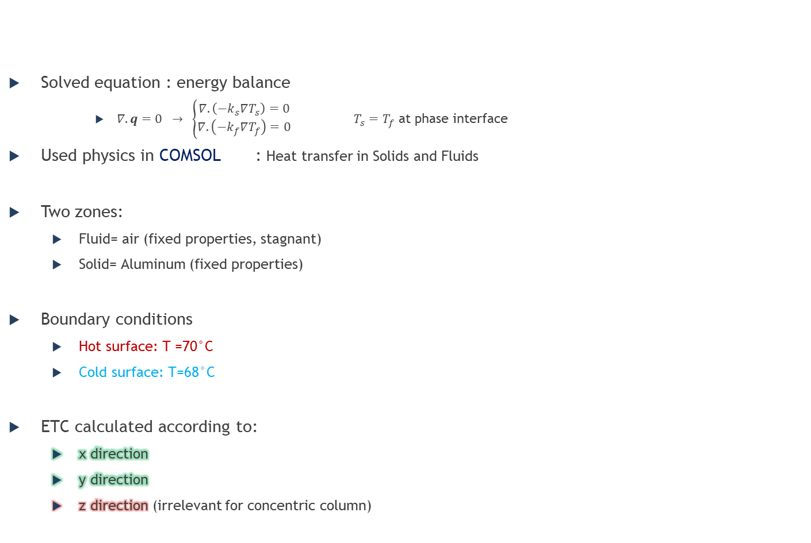
Model: boundary conditions
Solved equation : energy balance
$∇.q=0 → \left\{\begin{matrix}∇.\left(−k_{s}∇T_{s}\right)=0 \\ ∇.\left(−k_{f}∇T_{f}\right)=0\end{matrix}\right.$ $T_{s}=T_{f}$ at phase interface
Used physics in COMSOL : Heat transfer in Solids and Fluids
Two zones:
Fluid= air (fixed properties, stagnant)
Solid= Aluminum (fixed properties)
Boundary conditions
Hot surface: T =70°C
Cold surface: T=68°C
ETC calculated according to:
x direction
y direction
z direction (irrelevant for concentric column)
Fixed Physical property | Al | Air
Thermal conductivity – λ (W/(K.m)) | 238 | 0.0295
Heat capacity – Cp (J/(kg.K)) | 900 | 1008.5
Density – ρ (kg/m³) | 2700 | 1.025
Boundary condition placement for 1 EU domain
ETC_{x} ETC_{y} ETC_{z}

Slide 7
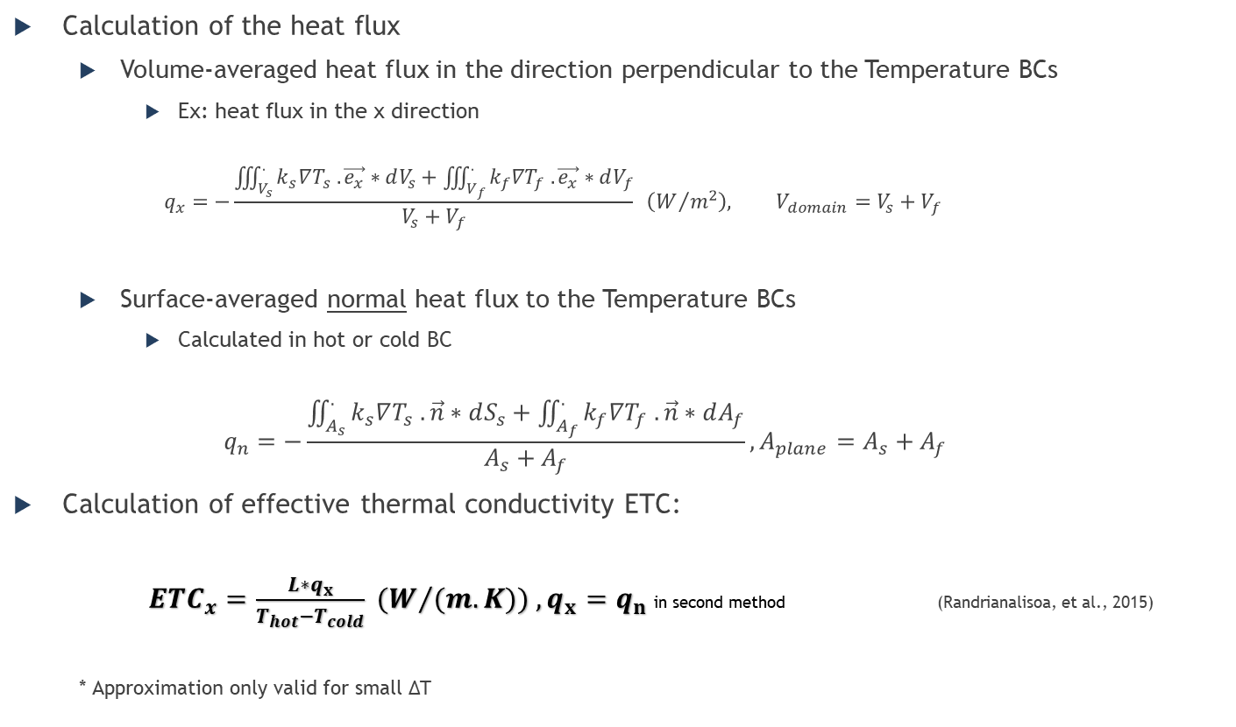
Model: Calculation of ETC
Calculation of the heat flux
Volume-averaged heat flux in the direction perpendicular to the Temperature BCs
Ex: heat flux in the x direction
$$q_{x}=−\frac{\iiint_{V_{s}}^{.}{k_{s}∇T_{s} .\vec{e_{x}}∗dV_{s}}+\iiint_{V_{f}}^{.}{k_{f}∇T_{f} .\vec{e_{x}}∗dV_{f}}}{V_{s}+V_{f}} \left(W/{m^{2}}\right), V_{domain}=V_{s}+V_{f}$$
Surface-averaged normal heat flux to the Temperature BCs
Calculated in hot or cold BC
$$q_{n}=−\frac{\iint_{A_{s}}^{.}{k_{s}∇T_{s} .\vec{n}∗dS_{s}}+\iint_{A_{f}}^{.}{k_{f}∇T_{f} .\vec{n}∗dA_{f}}}{A_{s}+A_{f}}, A_{plane}=A_{s}+A_{f}$$
Calculation of effective thermal conductivity ETC:
${ETC}_{x}=\frac{L∗q_{x}}{T_{hot}−T_{cold}} {(W}/{(m.K)) ,q_{x}=q_{n}}$in second method (Randrianalisoa, et al., 2015)
* Approximation only valid for small ΔT
Either
Or

Slide 8
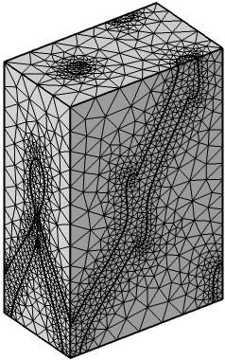
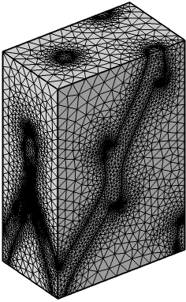
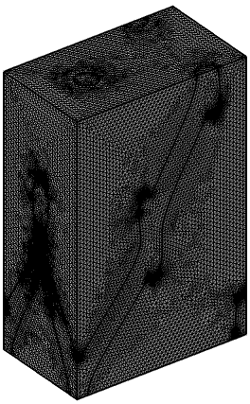

Results: mesh convergence study
Mesh convergence study done on one TS geometry with:
d_{s}=2.25mm _ l₁=l₂=15.35mm _ ϵ=89%,
Domain n=1 EU*
Results: between the coarse mesh and extremely fine mesh, there is only 0.75% relative deviation for ETC_{x}
The model converge easily with a coarse mesh, chosen mesh: 15 nodes/mm³
Modification was made to refine packing meshing (by modifying minimum element size)
Model is insensible to the relative tolerance value set in the study :
Relative tolerance used=1e-3 (by default)
Coarse | Optimal | Extremely fine
2 Nodes/mm³ | 15 Nodes/mm³ | 59 Nodes/mm³
56149 Tetrahedrons | 375792 Tetrahedrons | 1534790 Tetrahedrons
*EU=elementary unit

Slide 9
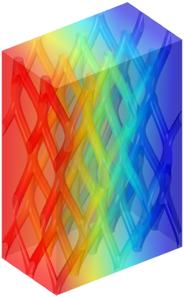
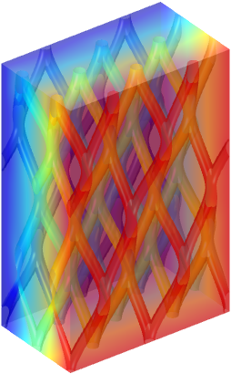
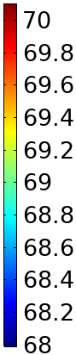
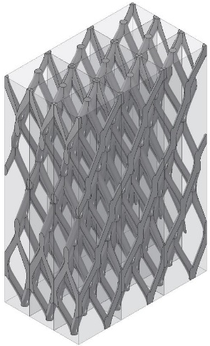
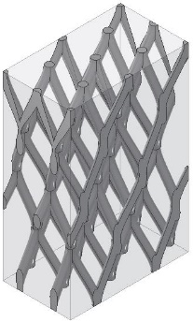

Results: Domain size sensitivity study
The domain size was changed from 1³ to 6³ EU* for TS geometries with different parameters:
Naming code: TS-material_ds_l1=l2_ϵ_SpecificArea direction of ETC (x or y)
Results: no need to simulate a TS domain size larger than 2³ EU
Note: Calculation time varied from 2 minutes to 2 hours depending on the domain size
Surface: Temperature (°C)
Horizontal heat flux
n=1 n=2 n=3
*EU=elementary unit

Slide 10
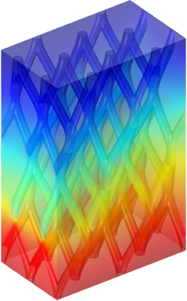
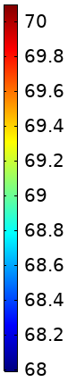

Results : ETC versus porosity
ETC _{horizontal (x} _{and y avg)} versus porosity >0.85% for TS geometry
Results: TS geometry is not efficient in horizontal (radial) heat transfer by conduction
Note:
ETC_{x,y} (TS_2.25_15.35_89) = 4.8 W/(m.K)
ETC_{z} (TS_2.25_15.35_89) =18.5 W/(m.K) $⇨$ orientation of the geometry is vital
Surface: Temperature (°C)
Vertical Heat flux
Horizontal heat flux

Slide 11
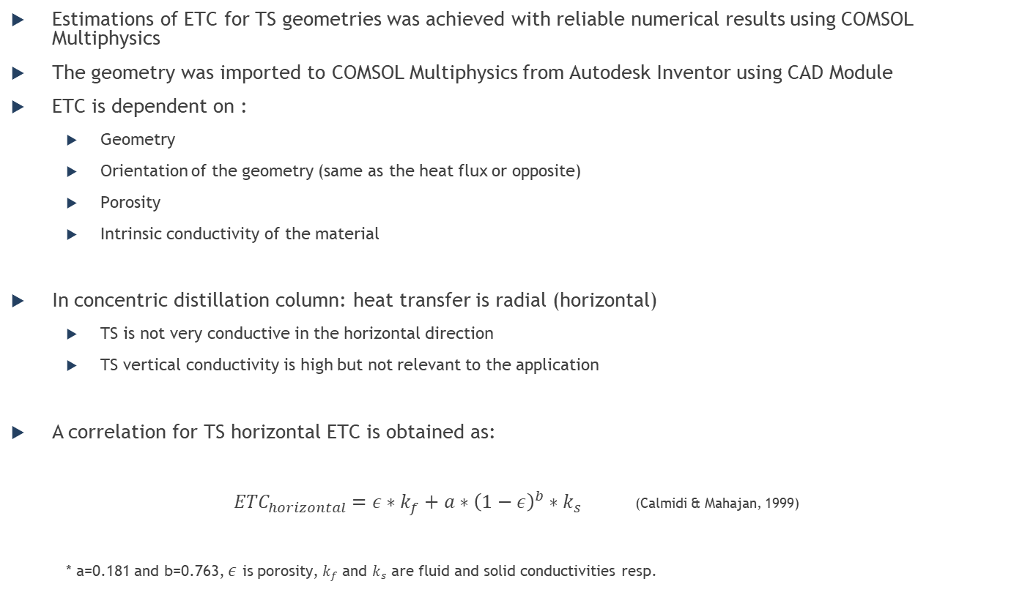
Conclusions
Estimations of ETC for TS geometries was achieved with reliable numerical results using COMSOL Multiphysics
The geometry was imported to COMSOL Multiphysics from Autodesk Inventor using CAD Module
ETC is dependent on :
Geometry
Orientation of the geometry (same as the heat flux or opposite)
Porosity
Intrinsic conductivity of the material
In concentric distillation column: heat transfer is radial (horizontal)
TS is not very conductive in the horizontal direction
TS vertical conductivity is high but not relevant to the application
A correlation for TS horizontal ETC is obtained as:
${ETC}_{horizontal}=ε∗k_{f}+a∗{\left(1−ε\right)}^{b}∗k_{s}$ (Calmidi & Mahajan, 1999)
* a=0.181 and b=0.763, $ε$ is porosity, $k_{f}$ and $k_{s}$ are fluid and solid conductivities resp.

Slide 12
Thank you for your attention

Slide 13
References
Calmidi, V. V. & Mahajan, R. L., 1999. The effective thermal conductivity of high porosity fibrous metal foams. Journal of Heat Transfer, 121(2), pp. 466-471
Randrianalisoa, J., Baillis, D., Martin, C. L. & Dendievel, R., 2015. Microstructure effects on thermal conductivity of open-cell foams generated from the Laguerre-Voronoï tessellation method. International Journal of Thermal Sciences, 17 8, Volume 98, pp. 277-286
Photos were taken from
Autodesk Inventor ® 2020
COMSOL Multiphysics ® 5.5

