Slide 1


Modelling of microstructure parameters in a high temperature and pressure alkaline electrolysis cell
Matteo Lualdi
Morten Siwertsen

Slide 2

Who we are
Contacts:
info@resolvent.dk
www.resolvent.dk
We are a team of dedicated, experienced and enthusiastic experts within Multiphysical simulation, Data Analysis & Machine Learning.
We have strong backgrounds within Chemical & Process Eng., Physics and Mechanical Engineering

Slide 3
Outline
Introduction
Eeehy project
Importance of the study
Modeling approach
Results
Conclusion and next steps

Slide 4
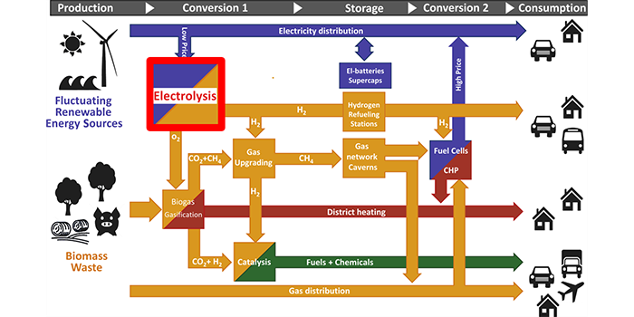

Introduction - EEEHY project
EEEHy: Economic and Efficient Electrolytic Hydrogen production

Slide 5
Importance of the study
Why is microstructure modeling and optimization important?
What is the maximum achievable performance
What is the effect of a specific parameter on the performance
What direction should the development take
Notes:
High temperature and high-pressure alkaline electrolysis is a new technology with low TRL so even electrocatalyst and cell morphology design is need to be outlined almost from scratch so the use of simulation can basically guide development answering questions like: maximum achievable performance, quantify the effect of parameters, guide the direction of the development

Slide 6
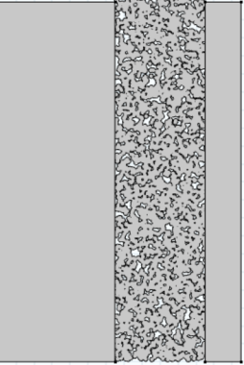
Introduction – physics
Cathode: HER
2H₂O+2e⁻↔2OH⁻+H₂
Anode: OER
4OH⁻ ↔ 4e⁻+O₂ +H₂O
Alkaline electrolytic cell
Electronic transport
Charge transfer reaction (Butler-Volmer)
Ionic transport (migration and diffusion)
Diffusion of the dissolved gas
Bubble nucleation and growth
Bubble release and transport to macropores
Gas diffusion in macropores network
OH⁻
I
Mesoporous matrix with liquid electrolyte
I

Slide 7
Modelling approach-simplifying assumptions
Half-cell steady-state model in 2D
Start as simple as possible
Anode: OER
4OH⁻ ↔ 4e⁻+O₂ +H₂O
Electronic transport
Charge transfer reaction (Butler-Volmer)
Ionic transport (migration and diffusion)
Diffusion of the dissolved gas
Bubble nucleation and growth -> nucleation potential
Bubble release and transport to macropores
Gas diffusion in macropores network
OH⁻
I
Mesoporous matrix with liquid electrolyte
Notes:
Green is taken fully care of
Balck is check with nucleation potential

Slide 8
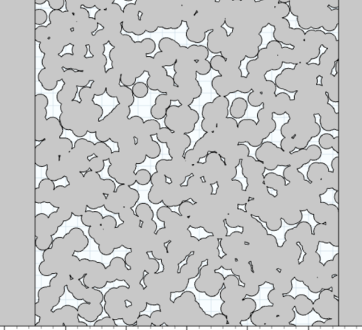

Introduction – physics and length scales
Cathode: HER
2H₂O+2e⁻↔2OH⁻+H₂
Anode: OER
4OH⁻ ↔ 4e⁻+O₂ +H₂O
OH⁻
I
Mesoporous matrix with liquid electrolyte
I
1-10 μm
D_{mesopores}:25-50 nm
10-100 μm
D_{macropores}:1-10 μm
~500μm

Slide 9
Modeling approach-simplifying assumptions
Mesoporosity is
homogenized (ξ, τ, a_{v})
Cathode: HER
2H₂O+2e⁻↔2OH⁻+H₂
Anode: OER
4OH⁻ ↔ 4e⁻+O₂ +H₂O
OH⁻
I
I
I
Mesoporous matrix with liquid electrolyte
I
1-10 μm
D_{mesopores}:25-50 nm
10-100 μm
D_{macropores}:1-10 μm
~500μm

Slide 10
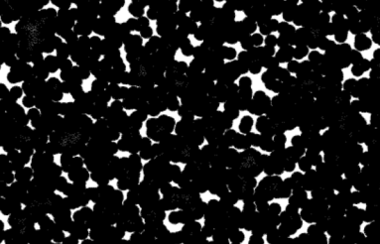
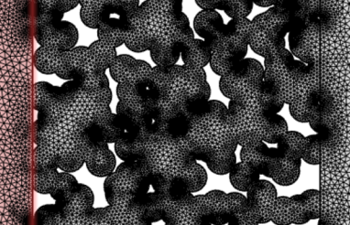
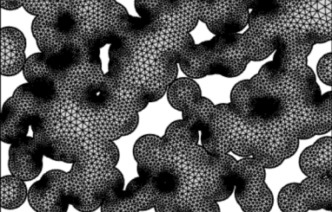
Modeling approach-porous electrode geometry 2D
Random microstructure geometry based on 3 controlling parameters:
Agglomerate size (D)
Electrode thickness
Number of spheres (Aimed porosity)
D=2.5 μm
thickness=100 μm
Aimed porosity=30%
Effective por=20%
D=5 μm
thickness=50 μm
Aimed porosity 30%
Effective por=20%
D=10 μm
thickness=100 μm
Aimed porosity 30%
Effective por=25%

Slide 11
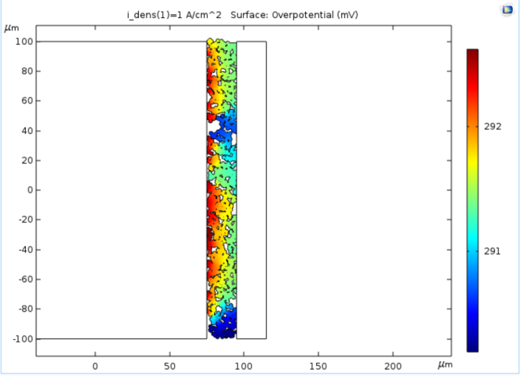
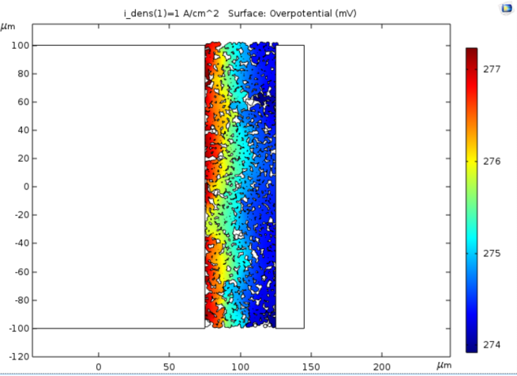
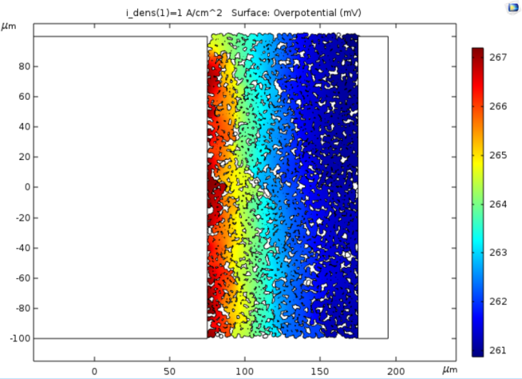
OER – effect of the electrode thickness
Effect of electrode thickness
D=2.5 μm
T=150 °C, P= 30 bar, 1 A/cm2, p_{H2O} = 1.7 bar
σ=100 S/cm
thickness=20 μm
thickness =50 μm
thickness =100 μm
Overpotential decreases when increasing electrode thickness from 20 to 100 μm of ~10%

Slide 12
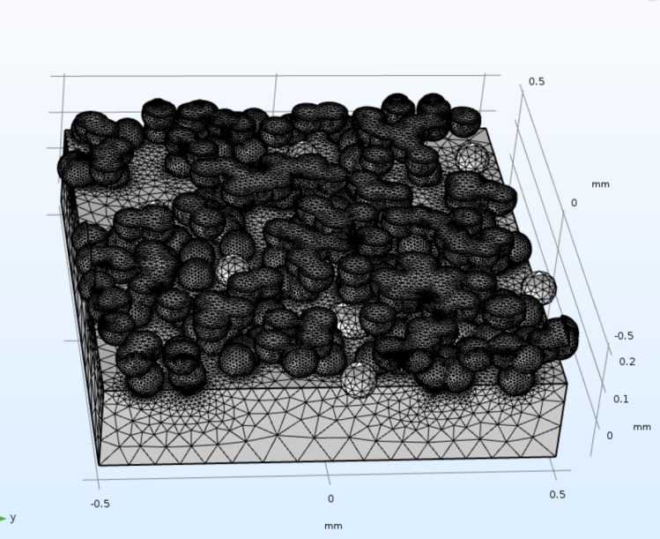
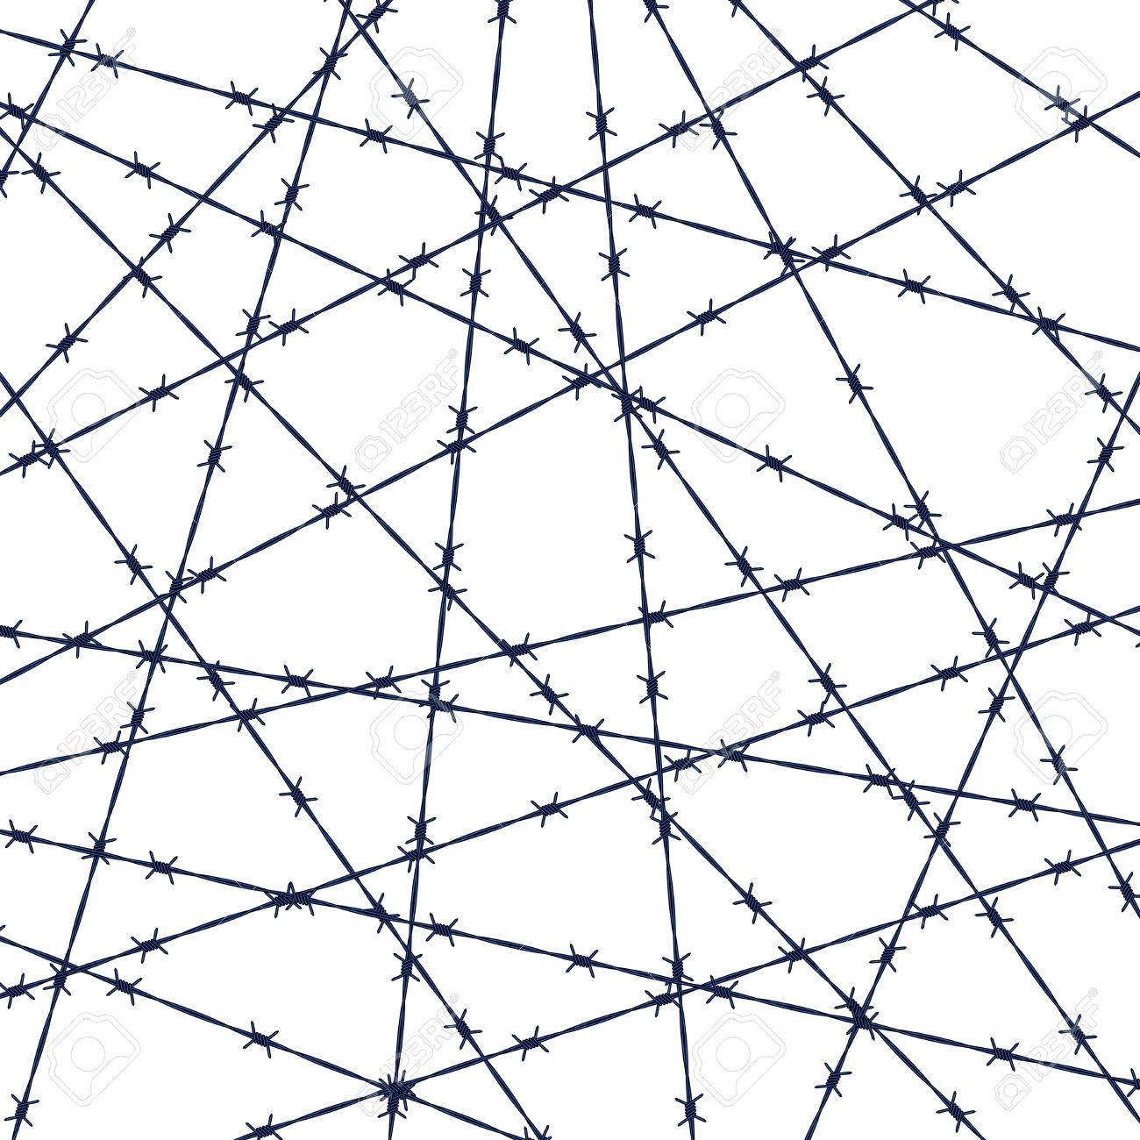

Moving to 3D
Random spheres creates a meshing nightmare

Slide 13
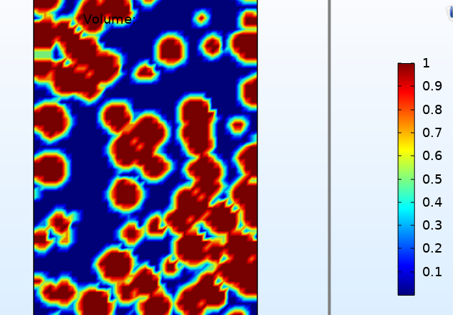
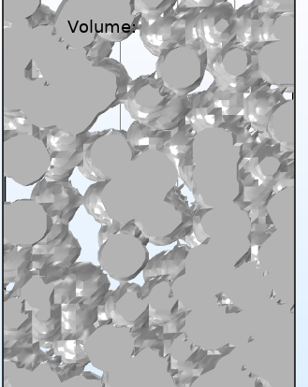
Moving to 3D
Presence of electrode structure taken care at “material level”
“scale” factor (we scale the material properties)

Slide 14
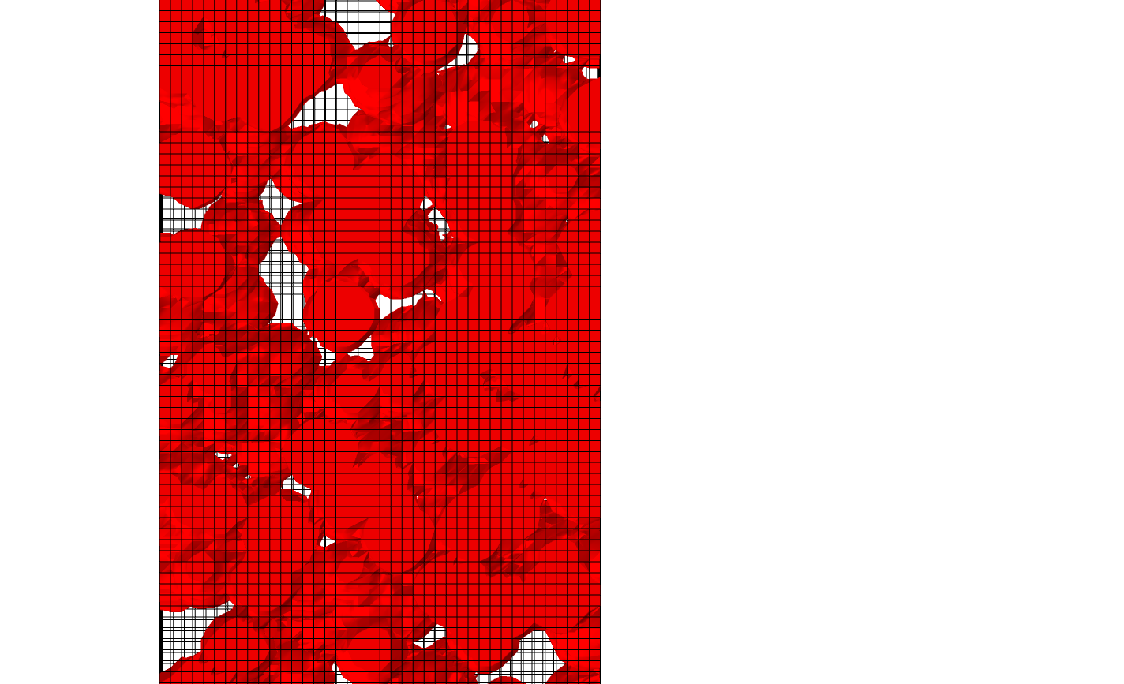
3D Modelling approach
Body fitted mesh
Non-body fitted mesh
Difficult to create a meaningful mesh for spheres with random contact points
Easier to mesh

Slide 15
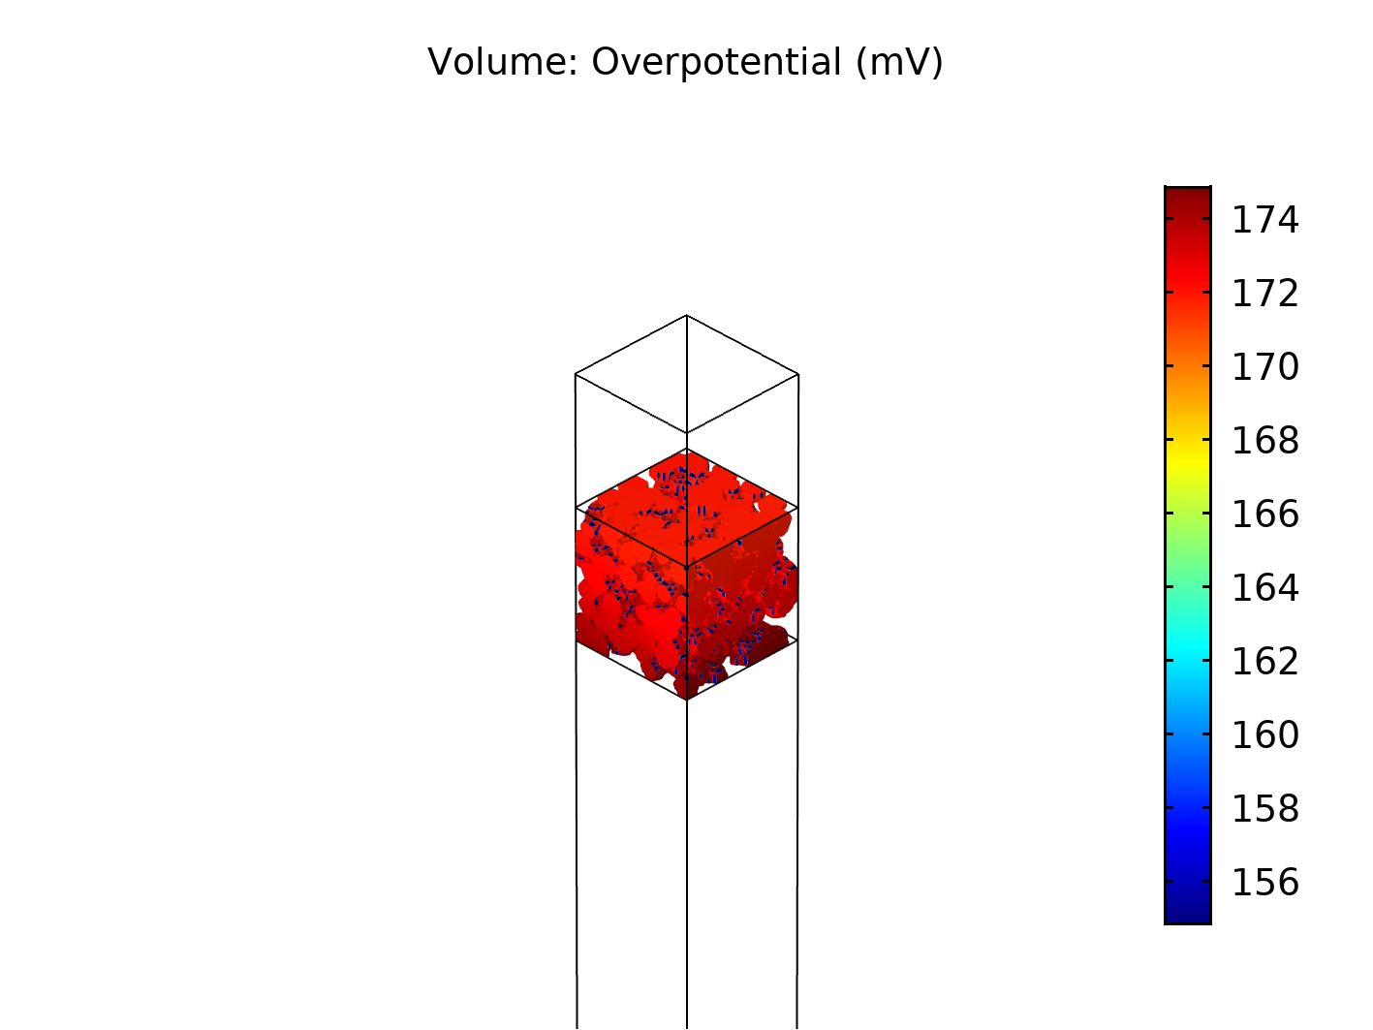
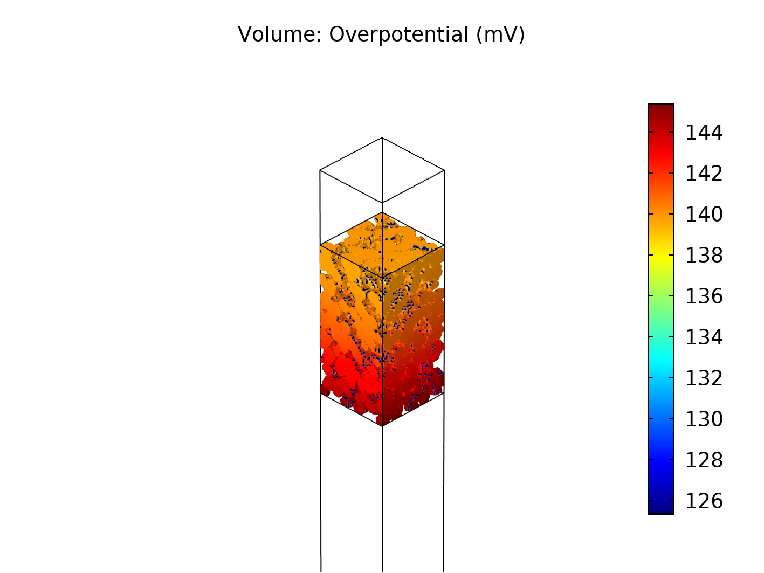
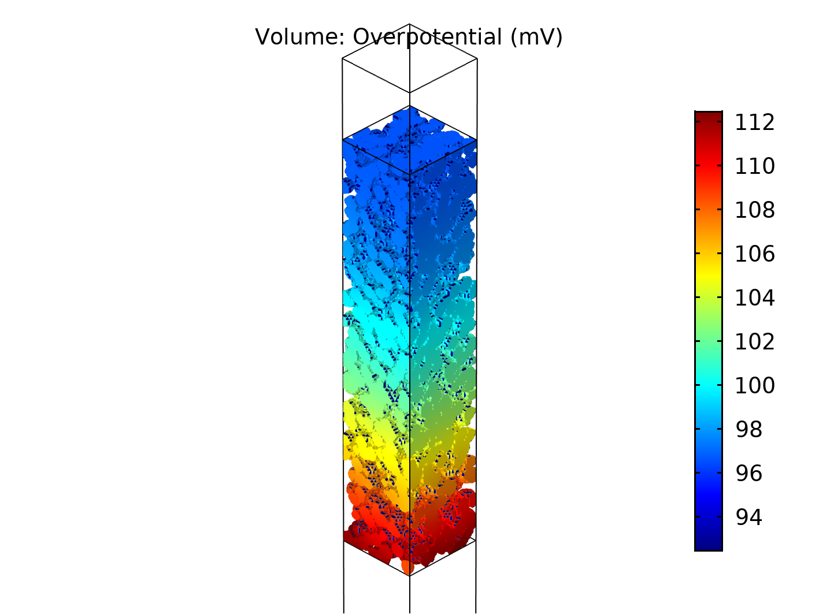
OER –effect of the electrode thickness
Effect of electrode thickness
D=2.5 μm
σ=100 S/cm
Operating conditions :T=150 °C, P= 30 bar, 1 A/cm², C_{KOH}= 45 wt%, p_{H2O} = 1.7 bar
Thickness=10 μm
Thickness=20 μm
Thickness=50 μm
Notes:
Just few word about the porosity, here we aimed at porosity 35 and the porosity of for set 1 and 2 points were 0.31-0.33. For set 3 it was a bit high, 43%

Slide 16
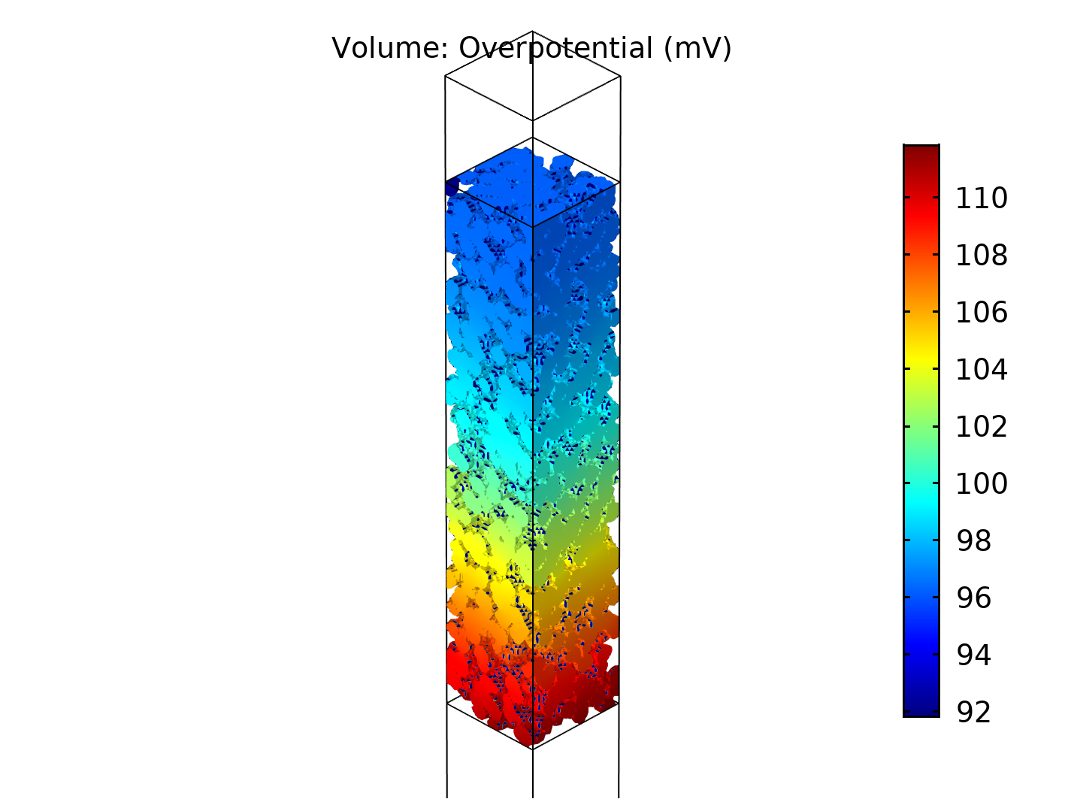
OER –effect of the electrode thickness and operating conditions
Effect of electrode thickness
D=2.5 μm
σ=100 S/cm
Operating conditions
Set1:T=150 °C, P= 30 bar, 1 A/cm², C_{KOH}= 45 wt%, p_{H2O} = 1.7 bar
Set2:T=200 °C, P= 30 bar, 2 A/cm², C_{KOH}= 45 wt%, p_{H2O} = 6 bar
Set3:T=200 °C, P= 30 bar, 0.5 A/cm², C_{KOH}= 45 wt%, p_{H2O} = 6 bar
Notes:
Just few word about the porosity, here we aimed at porosity 35 and the porosity of for set 1 and 2 points were 0.31-0.33. For set 3 it was a bit high, 43%

Slide 17
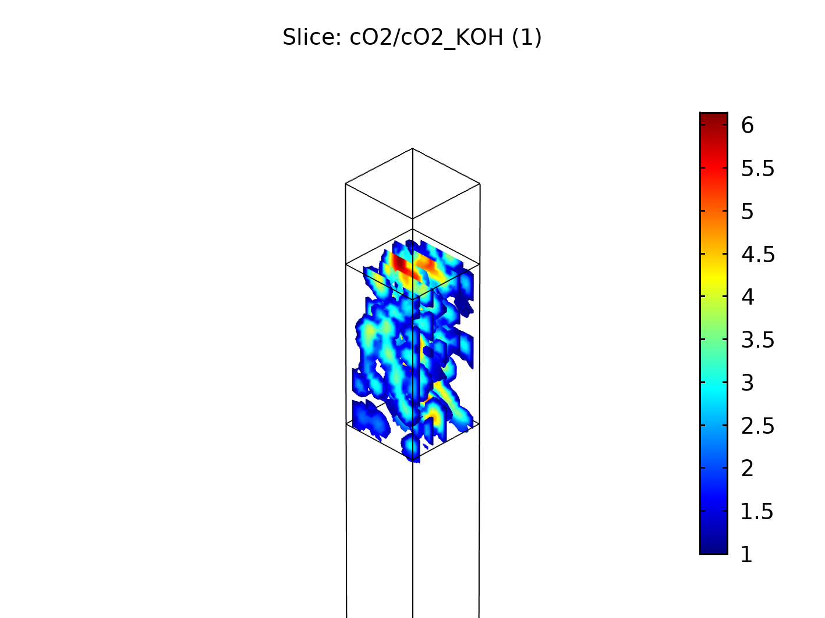
OER –effect of agglomerate diameter
Effect of agglomerate size
Erod_thick=20 μm
σ=100 S/cm
C_{O2}/C_{O2sat} ~300 for bubble nucleation

Slide 18
Conclusion and next steps
Thick electrode (>50μm) would be beneficial
Bubble formation not risk for the agglomerate diameters of interest
Quantification of effect of operating conditions
Validate model against experimental results

Slide 19
Thank you for your attention

