Slide 1



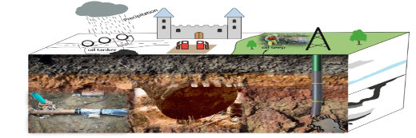
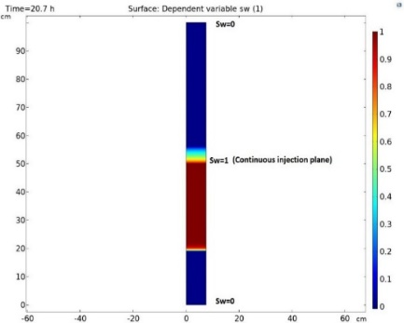
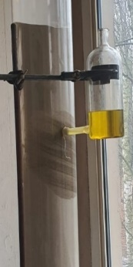
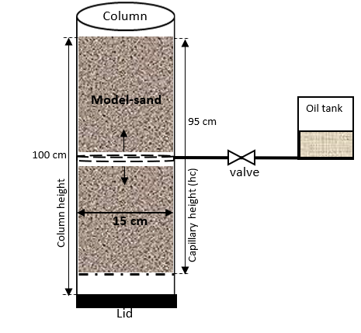
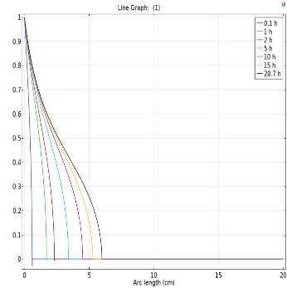
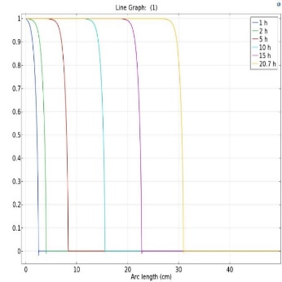
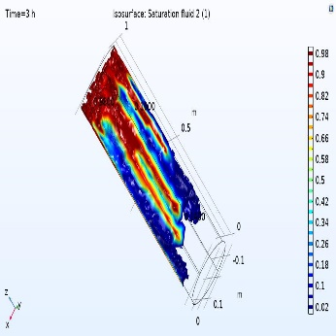
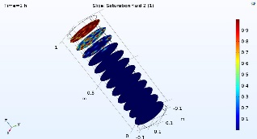
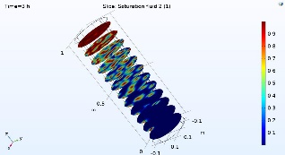
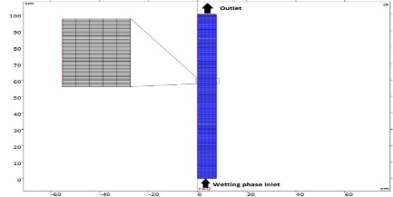
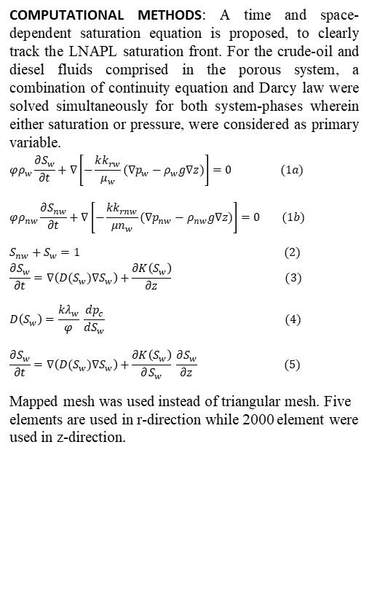
Experimental and Numerical Simulation of Light Non-aqueous Phase Liquids Imbibition in Unconsolidated Porous Media
C. Onaa, T.H. Nassan, M.M. Amro
Institute of Drilling and Fluid Mining Engineering, Freiberg University of Technology and Mining – Germany
Corresponding author contact: onaa@mailserver.tu-freiberg.de
INTRODUCTION: An experiment was set-up to reconstruct the migration of hydrocarbon-leaks, occurring on the earth´s surface and subsurface. Examples includes buried pipelines and underground storage tanks, from where leakages discharge.
RESULTS: Experiments in 2D axisymmetric, 3D, and the saturation propagation of LNAPL, at different time steps, are presented in Figs. 3 and 5. Fluid flow behavior due to soil subsurface characteristics is shown in Fig.6 as fingering.
Figure 1a. Conceptual model
Figure 3. Diesel saturation front in 20-hours of imbibition
Figure 4. Laboratory model of imbibition
(a)
(b)
Figure 1b. Schematic illustrastrating the saturation of model-sand, from the Centre of the profile.
COMPUTATIONAL METHODS: A time and space-dependent saturation equation is proposed, to clearly track the LNAPL saturation front. For the crude-oil and diesel fluids comprised in the porous system, a combination of continuity equation and Darcy law were solved simultaneously for both system-phases wherein either saturation or pressure, were considered as primary variable.
$$φρ_{w}\frac{∂S_{w}}{∂t}+∇\left[−\frac{kk_{rw}}{μ_{w}}(∇p_{w}−ρ_{w}g∇z)\right]=0 (1a)$$
$$φρ_{nw}\frac{∂S_{nw}}{∂t}+∇\left[−\frac{kk_{rnw}}{{μn}_{w}}(∇p_{nw}−ρ_{nw}g∇z)\right]=0 (1b)$$
$S_{nw}+S_{w}=1$ (2)
$$\frac{∂S_{w}}{∂t}=∇\left(D(S_{w})∇S_{w}\right)+\frac{∂K\left(S_{w}\right)}{∂z} (3)$$
$$D\left(S_{w}\right)=\frac{kλ_{w}}{φ} \frac{{dp}_{c}}{{dS}_{w}} (4)$$
$$\frac{∂S_{w}}{∂t}=∇\left(D(S_{w})∇S_{w}\right)+\frac{∂K\left(S_{w}\right)}{∂S_{w}} \frac{∂S_{w}}{∂z} (5)$$
Mapped mesh was used instead of triangular mesh. Five elements are used in r-direction while 2000 element were used in z-direction.
Figure 5. Plot of saturation model showing (a) upwards diffusion and (b) downward diffusion of diesel after 20 hours of imbibition.
Figure 6. Simulation model illustrating crude-oil Fingering and vaporization behaviour.
CONCLUSIONS: The numerical model successfully tracked the LNAPL capillary imbibition and saturation fronts, its robust matching with the laboratory results was a good validation for our experimental model.
REFERENCES:
Onaa, C., Nassan, T. H., & Amro, M., Experimental and numerical evaluation of diffusivity influence on hydrocarbon fluids capillary imbibition – Environmental study. European Oil and Gas Journal. 6. https://doi.org/10.19225/200603 (2020)
Hopmans, J. W., Grismer, M. E., & Chen, J. (n.d.). Parameter Estimation of Two-Fluid Capillary Pressure- Saturation and Permeability Functions (1998)
Nassan, T. H., & Amro, M, Finite Element Simulation of Multiphase Flow in Oil Reservoirs -COMSOL Multiphysics as Fast Prototyping Tool in Reservoir Simulation. Mining Science and Technology. https://doi.org/10.17073/2500-0632-2019-3-220-226 (2020)
Onaa, C., & Amro, M. M, Comparative investigation of vapor expulsion technique (VET: Via N2-treatment) and carbonate-clay based adsorbents as sustainable approaches for oil-leak remediation. Environmental Technology & Innovation. https://doi.org/10.1016/j.eti.2020.101062 (2020)
Figure 2. The axisymmetric domain with fine mesh.
Excerpt from the Proceedings of the 2020 COMSOL Conference

