Slide 1


COMSOL CONFERENCE
2020 EUROPE
Experimental and Numerical Simulation of Light Non-aqueous Phase Liquids Imbibition in Unconsolidated Porous Media
Chux Onaa │ Taofik Nassan │ Mohd Amro

Slide 2
COMSOL EUROPE
October
14 &15
Presentation plan
  Introduction
  Experimental model
  Mathematical model
  Results and Discussion

Slide 3
COMSOL EUROPE
October
14 &15
Introduction
The aim of the current study is to show that LNAPL-subsurface migration significantly reflects its behavior, nature, and distribution as contaminants.
To achieve intended outcome, we reconstruct a field scenario as a laboratory model backed by numerical simulation with COMSOL Multiphysics.
The numerical model enabled the validation of flow characteristics represented in the experimental results: such as the chromatographic behavior, diffusion pattern as well as the interaction of host sediment materials with the invading fluids.
This way, a sustainable a technique was developed for the remediation of contaminated sediment

Slide 4
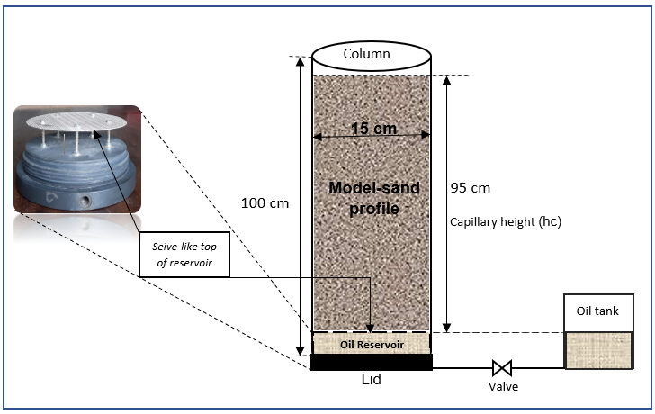
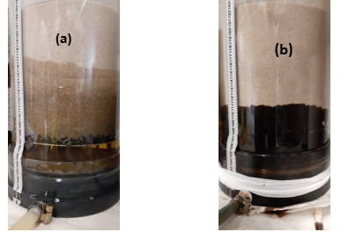
COMSOL EUROPE
October
14 &15
Experimental set-up (1/2)
Fig.1. Schematic illustrating laboratory models of subsurface (a) crude-oil and (b) diesel imbibition

Slide 5
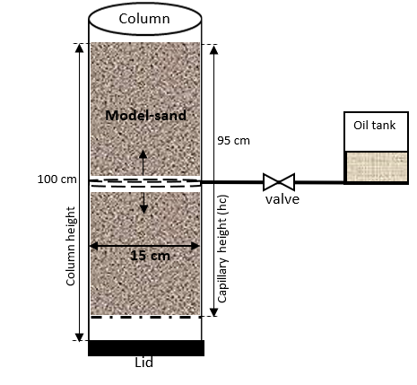
COMSOL EUROPE
October
14 &15
Experimental set-up (2/2)
  Scenario depict a portion of vertical soil profile being invaded by LNAPL leak
  LNAPL enter from a horizontal direction
  set-up allows for better visualize LNAPL flow pattern
  → Help determine which direction – upwards or downwards – that the fluids are more diffused over time.
Fig.2. Mid-Column experiment

Slide 6
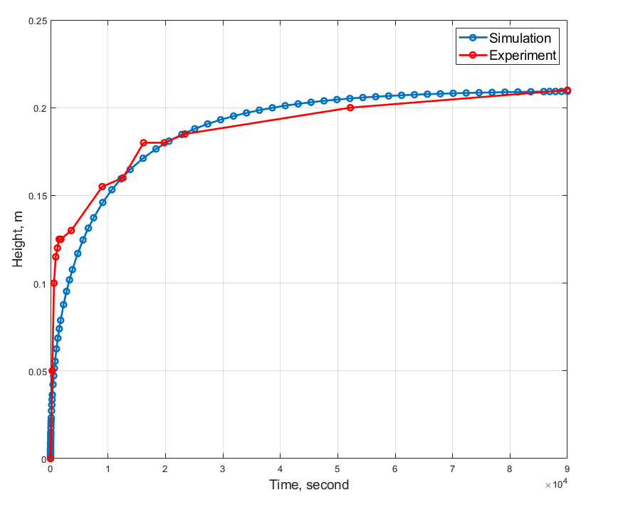
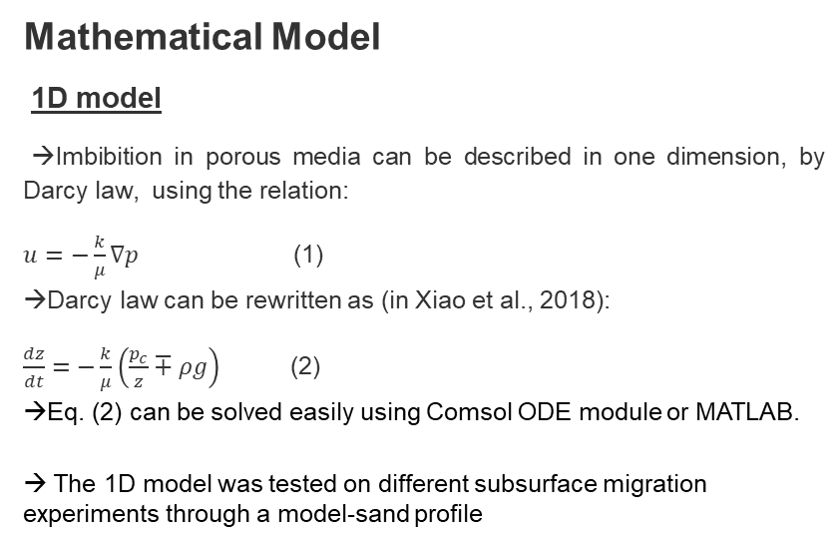
COMSOL EUROPE
October
14 &15
Mathematical Model
1D model
→Imbibition in porous media can be described in one dimension, by Darcy law, using the relation:
$u=−\frac{k}{μ}∇p$ (1)
→Darcy law can be rewritten as (in Xiao et al., 2018):
$\frac{dz}{dt}=−\frac{k}{μ}\left(\frac{p_{c}}{z}∓ρg\right)$ (2)
→Eq. (2) can be solved easily using Comsol ODE module or MATLAB.
→ The 1D model was tested on different subsurface migration experiments through a model-sand profile
Fig.3. Schematic comparing experimental and simulation results of diesel subsurface imbibition in model-sand with 10% carbonate (Onaa et al, 2020)

Slide 7
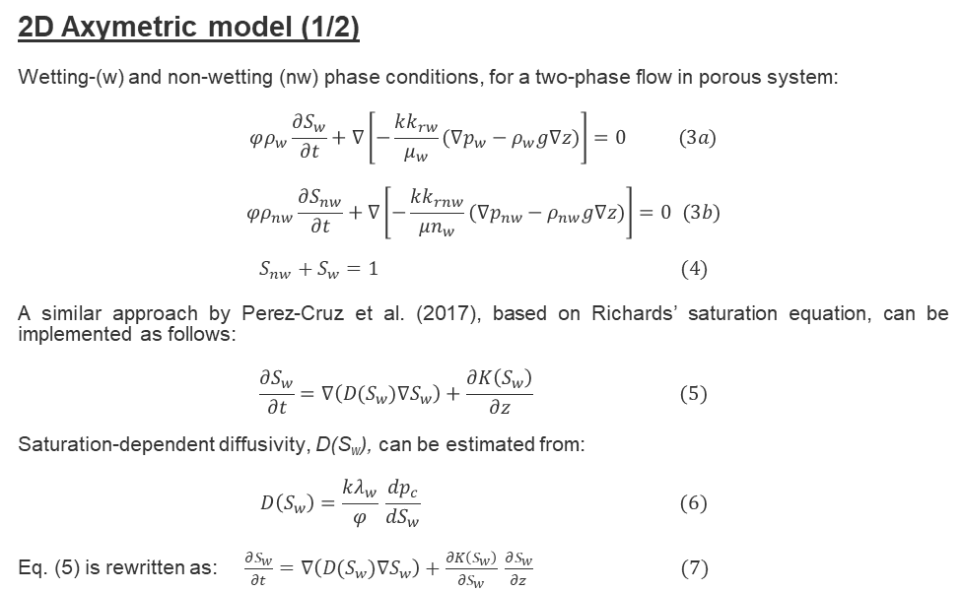
COMSOL EUROPE
October
14 &15
2D Axymetric model (1/2)
Wetting-(w) and non-wetting (nw) phase conditions, for a two-phase flow in porous system:
$$φρ_{w}\frac{∂S_{w}}{∂t}+∇\left[−\frac{kk_{rw}}{μ_{w}}(∇p_{w}−ρ_{w}g∇z)\right]=0 (3a)$$
$$φρ_{nw}\frac{∂S_{nw}}{∂t}+∇\left[−\frac{kk_{rnw}}{{μn}_{w}}(∇p_{nw}−ρ_{nw}g∇z)\right]=0 (3b)$$
$$S_{nw}+S_{w}=1 (4)$$
A similar approach by Perez-Cruz et al. (2017), based on Richards’ saturation equation, can be implemented as follows:
$$\frac{∂S_{w}}{∂t}=∇\left(D(S_{w})∇S_{w}\right)+\frac{∂K\left(S_{w}\right)}{∂z} (5)$$
Saturation-dependent diffusivity, D(S_{w}), can be estimated from:
$$D\left(S_{w}\right)=\frac{kλ_{w}}{φ} \frac{{dp}_{c}}{{dS}_{w}} (6)$$
Eq. (5) is rewritten as: $\frac{∂S_{w}}{∂t}=∇\left(D(S_{w})∇S_{w}\right)+\frac{∂K\left(S_{w}\right)}{∂S_{w}} \frac{∂S_{w}}{∂z} (7)$
Terms
S_{w}, = saturation of the wetting-phase
K(S_{w}) = hydraulic conductivity,
D(S_{w}) = saturation-dependent diffusivity

Slide 8

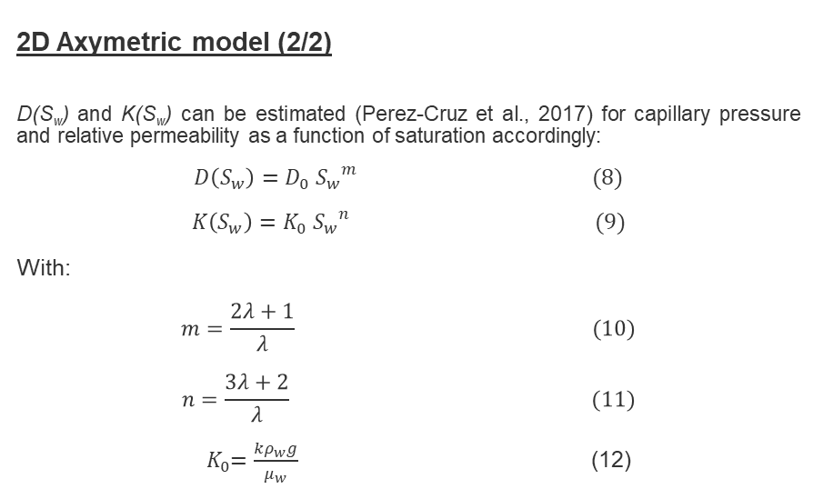
COMSOL EUROPE
October
14 &15
2D Axymetric model (2/2)
D(S_{w}) and K(S_{w}) can be estimated (Perez-Cruz et al., 2017) for capillary pressure and relative permeability as a function of saturation accordingly:
$$D\left(S_{w}\right)=D_{0} {S_{w}}^{m} (8)$$
$$K\left(S_{w}\right)=K_{0} {S_{w}}^{n} (9)$$
With:
$$m=\frac{2λ+1}{λ} (10)$$
$$n=\frac{3λ+2}{λ} (11)$$
${ K}_{0}=\frac{kρ_{w}g}{μ_{w}}$ (12)
Terms
S_{w}, = saturation of the wetting-phase
K(S_{w}) = hydraulic conductivity,
D(S_{w}) = saturation-dependent diffusivity

Slide 9
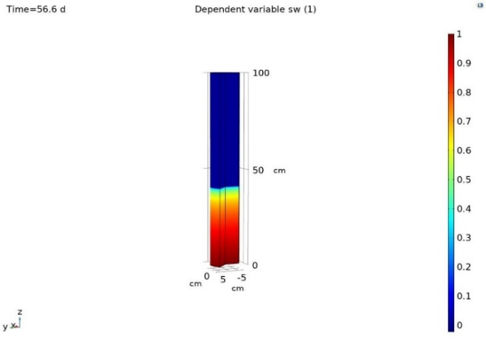
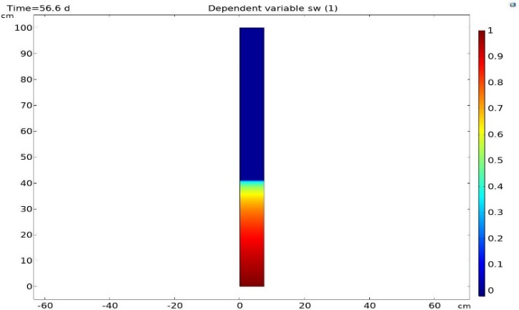
COMSOL EUROPE
October
14 &15
Results and Discussion (1/2)
Fig.4. Three-dimensional model of diesel saturation front in 56 days of imbibition
Fig.5. Two-dimensional model of the diesel saturation front in 56 days of imbibition

Slide 10
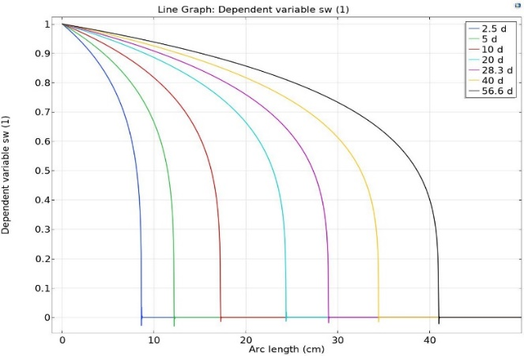
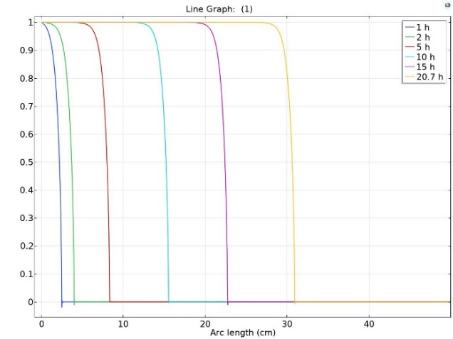
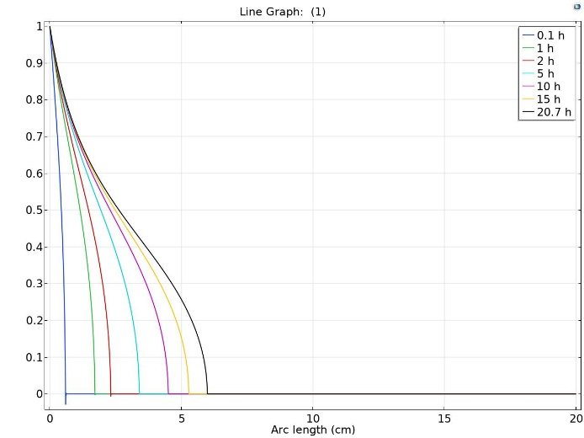
COMSOL EUROPE
October
14 &15
Results and Discussion (2/2)
Fig.6. Plot of diesel saturation in 56 days of imbibition
Fig.7. Plot of saturation model showing downward diffusion of diesel after 20 hours of imbibition
Fig.8. Plot of saturation model depicting upwards diffusions of diesel, after 20 hours of imbibition

Slide 11
COMSOL EUROPE
October
14 &15
Conclusions
Effective characterization of soil and fluids physical properties are essential in the assessment of LNAPL subsurface Migration dynamics.
Accurate physics were described and mathematical model for the numerical simulation developed, based on the sediment and fluid data.
Whereas the numerical model successfully tracked the LNAPL capillary imbibition and saturation fronts, its robust matching with the laboratory results was a good validation for our experimental model.
Thus, the model sufficiently predicted the flow-rate and location of leaking hydrocarbon fluids in the subsurface.

