Slide 1
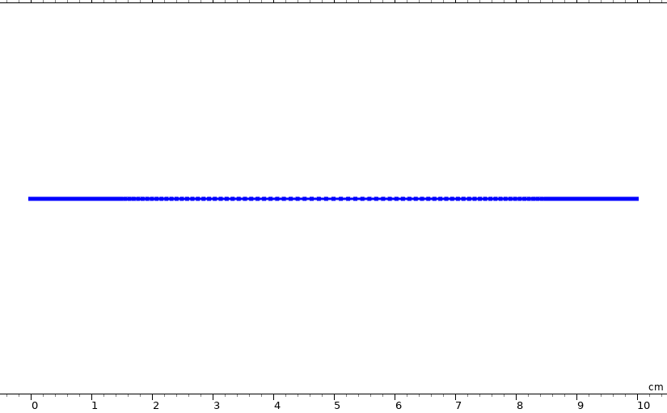
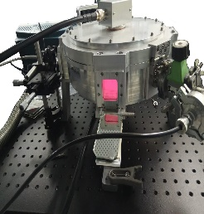
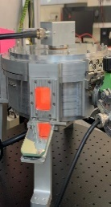
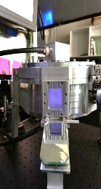
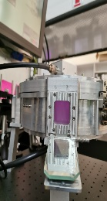
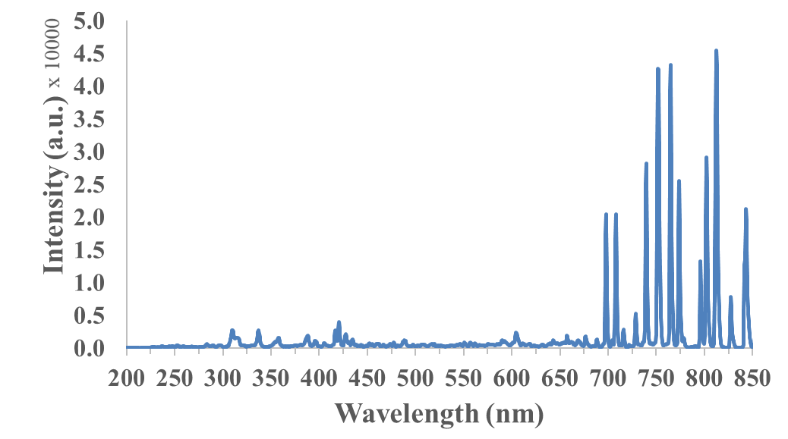
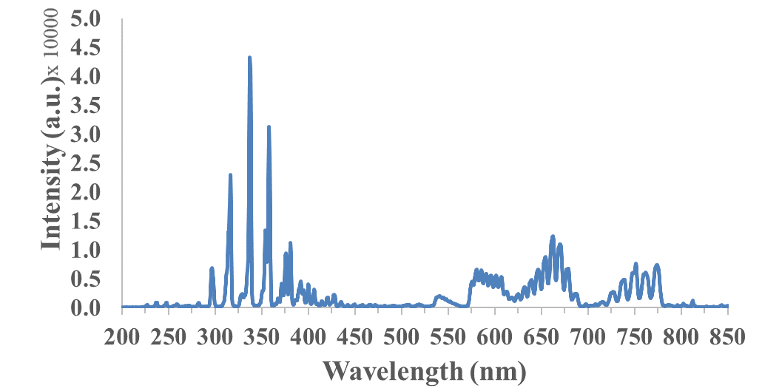
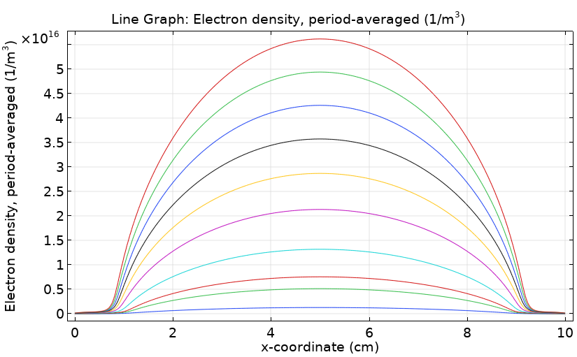
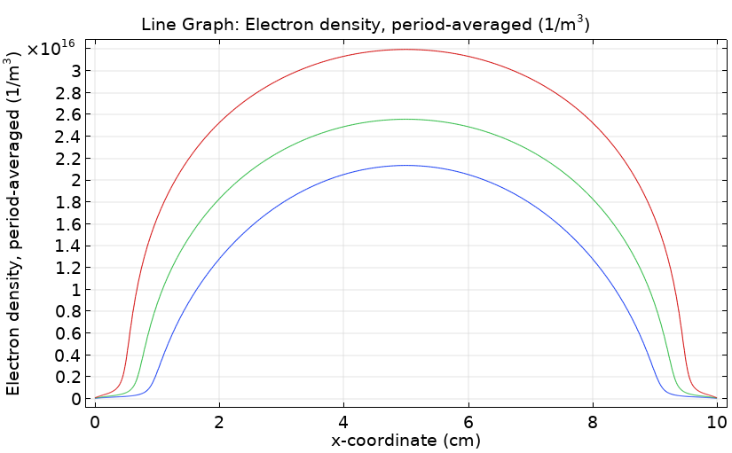
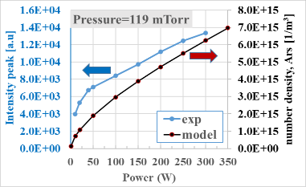
1D Model of Low-Pressure Plasma as a Platform to Study Gas Decomposition Reactions
A. Kaplan¹, S. Atlas^{1,2}, S. Har-Lavan², A. Lerer², I. Rozenberg², J. H. Baraban²
1. Department of Chemical Engineering, Nuclear Research Center Negev (NRCN), Beer-Sheva, Israel
2. Department of Chemistry, Ben-Gurion University of the Negev, Beer-Sheva, Israel
INTRODUCTION: Thermal decomposition of plastic waste results in gas products, mainly hydrocarbon molecules, which cannot be released to the atmosphere for environmental reasons. We are investigating secondary gas treatment to decompose the hydrocarbon gas products into smaller molecules by capacitively-coupled plasma (CCP) generated by a radio-frequency (13.56 MHz) power supply. Our experimental system includes a plasma chamber equipped with in situ spectroscopy tools that allow us to track and identify species (both radicals and ions) under different conditions (such as power and pressure). The study will allow us to understand the fundamental mechanisms of plastic waste decomposition towards improved treatments.
Metal contact as the RF electrode
(x= 0 cm)
Ground
(x= 10 cm)
Figure 2. 1D geometry with 150 predefined elements as the mesh
Table 1. Model parameters
P. | Value | Notes
Prf | 1-350 [W] | Auxiliary sweep
p0 | 0.138, 0.222, 0.370 [Torr] | Parametric sweep
f0 | 13.56 [MHz] | Freq.
Across | 0.053093 [m²] | Cross section area
Ar
N₂
CH₃OH
Ar-H₂O
RESULTS:
Figure 1. Experimental apparatus showing different light emission with different inlet reactant mixtures
COMPUTATIONAL METHODS: We are using the plasma module (plasma-time-periodic [ptp]) of COMSOL to better understand the plasma-chemistry reactions occurring in the plasma chamber. We have constructed a 1D model to explore formation of excited and ionized species under our plasma conditions, while varying input power and pressure. The 1D model contains the RF electrode and the ground electrode as a representation of the plasma chamber, along with its area, and with scattering cross section information imported from the LXCat database (https://nl.lxcat.net). We are also using the time-dependent study function of the plasma module, which allows us to simulate the plasma from ignition to steady-state. At first, we were looking into argon gas plasma to test how our experimental results compare to our model. Eventually we would like to add reaction chemistry for water and hydrocarbons as well.
Figure 3. A typical emission spectra of Argon (left side) and Argon + Nitrogen (right side) under working conditions
0.138 torr
Prf (W)
0.370 torr
0.222 torr
0.138 torr
Prf= 100 W
Plasma chemistry of argon in this model
Figure 4. Modeling results showing electron density number (1/m³) as a function of Power (1-350 W) and as a function of plasma chamber pressure for Argon gas.
A) From cross-section data (collisions with electrons reactions)
R. | Formula | type | Δε(eV) (energy loss) | Notes/other
1 | e+Ar=>e+Ar | Elastic | 0 | e. mass ratio: 0.136E-04
2 | e+Ar=>e+Ar* | Excitation | 11.50
3 | e+Ar*=>e+Ar | Excitation | -11.50
4 | e+Ar=>2e+Ar⁺ | Ionization | 15.8
5 | e+Ar*=>2e+Ar⁺ | Ionization | 4.427
Figure 5. One representative intensity peak of Argon from our experiment, which is compared to the predicted number density of excited Argon from the COMSOL model.
B) Bulk reactions
CONCLUSIONS: As shown here, thus far we have investigated argon gas plasma to compare our modeling to our experimental results. The model allows us to calculate average or maximum values of the number density (1/m³) of the different species in the plasma regime. We have found good correlation between intensity trends from our experimental spectroscopy diagnostics and the 1D model predictions. Recently, we are working on adding water and hydrocarbon reactions as well.
R. | Formula | type | Forward rate constant (K^{f})
6 | Ar*+Ar*=>e+Ar+Ar⁺ | irreversible | 2.3E7 (m³/mol*sec)
7 | Ar*+Ar=>Ar+Ar | irreversible | 1807 (m³/mol*sec)
8 | Ar*=>Ar | irreversible | 5E5 (1/sec)
C) Surface reactions
R. | Formula | Sticking Coefficient | Secondary emission coefficient | Mean energy of secondary electrons (V)
9 | Ar*=>Ar | 1 | 0.07 | 5.8
10 | Ar⁺=>Ar | 1 | 0.07 | 5.8
REFERENCES:
M.A. Lieberman and A.J. Lichtenberg, Principles of Plasma Discharges and Materials, Processing, John Wiley & Sons, 2005.
Excerpt from the Proceedings of the 2020 COMSOL Conference in Grenoble

