Slide 1
Modeling of charged droplet dynamics in an Electric Field using COMSOL Multiphysics®
14th October 2020
M. STURMA¹, P.NAMY², V. BRUYERE², and B. BARBET¹
1. MARKEM-IMAJE Industries BP110 26501 Bourg-Lès-Valence France 2. SIMTEC, 5 rue Felix Poulat 38000 Grenoble France

Slide 2

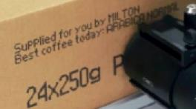


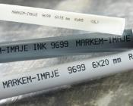
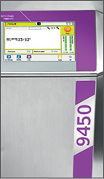




Markem-Imaje
Global manufacturer and distributor of specialized traceability and product identification equipment, for customers in the packaging industry.
50,000 customers worldwide
30 subsidiaries and 180+ partners
250 R&D employees
3,000 employees
7 coding technologies
5 centers of excellence
6 industrial platforms
Impression pose
étiquettes
Jet d’encre
Laser
Logiciels
Consommables

Slide 3

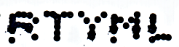
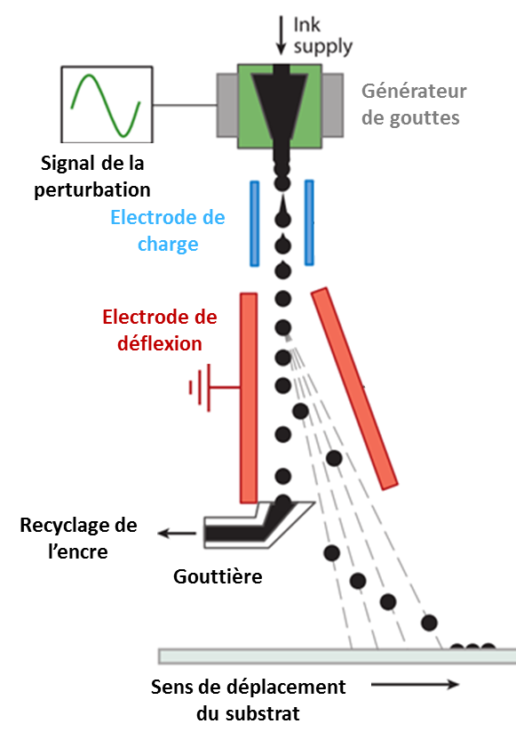
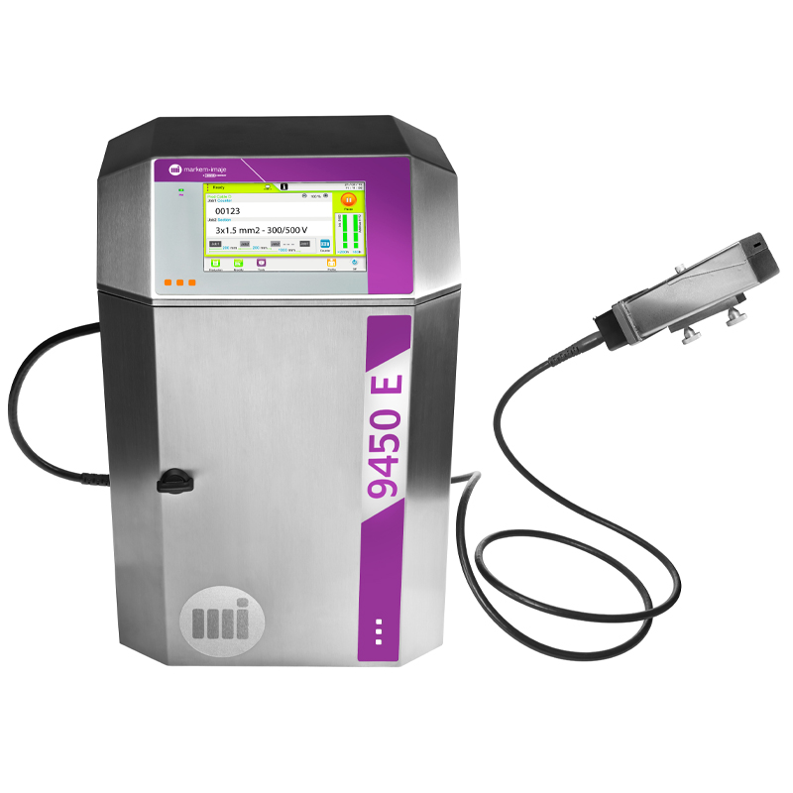

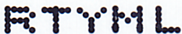
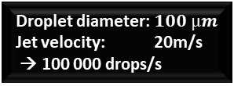
Continious Inkjet (CIJ) technology
Perturbation signal
Droplet generator
Charge electrode
The printing quality depends on drop position determined by:
++ the drop charge
++ the electrostatic field
+ unwanted drops interaction in flight
(electrostatic repulsion and aerodynamic effects).
Deflexion electrode
Ink recycling
Gutter
Gutter
direction of displacement of the printing media (bottle, paper, wire …)
Goal of the numerical study :
compute droplets trajectory to predict droplet positions on the media
Droplet diameter: $100 µm$
Jet velocity: 20m/s
→ 100 000 drops/s

Slide 4

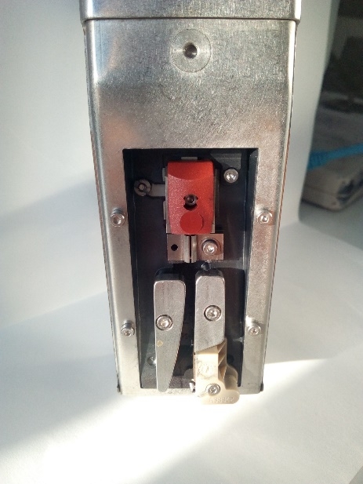
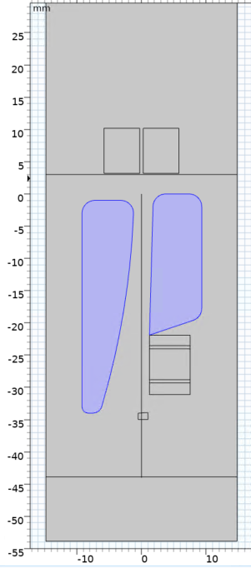
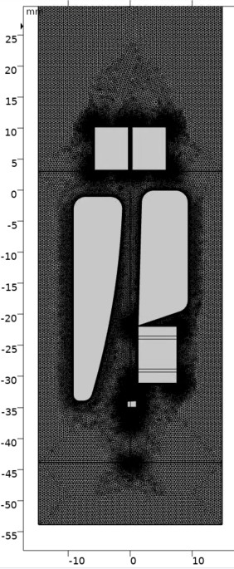
2D COMSOL model
Meshing :
184,399 nodes
Charge electrode
Deflection electrodes
Media

Slide 5
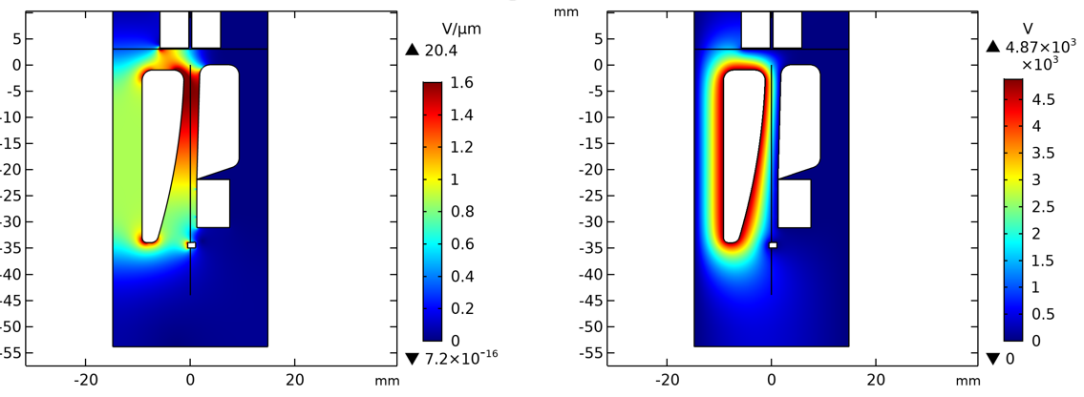
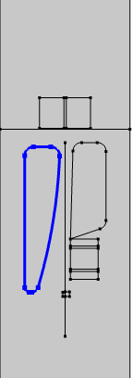
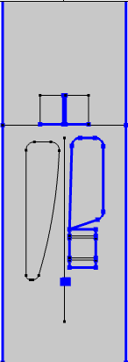


Step 1: Electrostatic study
Ground
V= 0 V
V=4300V
Stationary study
On other boundaries E$.n=0$

Slide 6
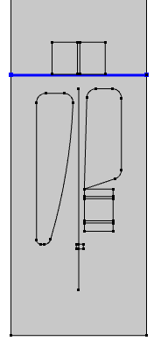
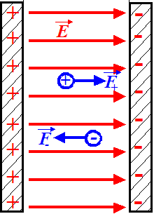

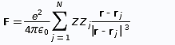
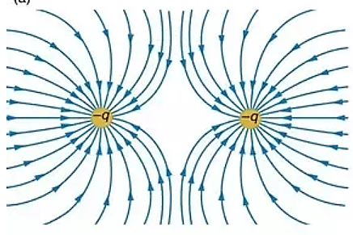
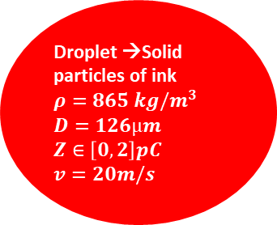
Step 2: Charged particule tracing study
Droplet →Solid particles of ink
$$ρ=865 kg/m^{3}$$
$$D=126µm$$
$$Z∈\left[0,2\right]pC$$
$$v=20m/s$$
Charged particule/electrostastic field interaction
Lorentz force
-
Coulomb force
(N-1)² interaction
Charged particule/particule interaction
-
-

Slide 7
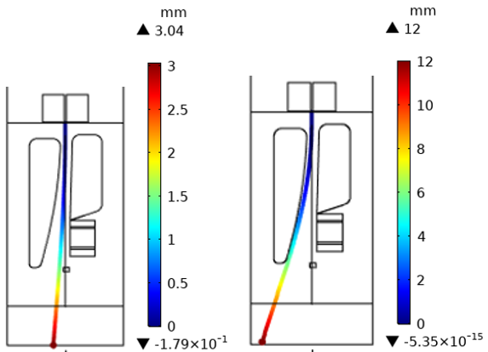
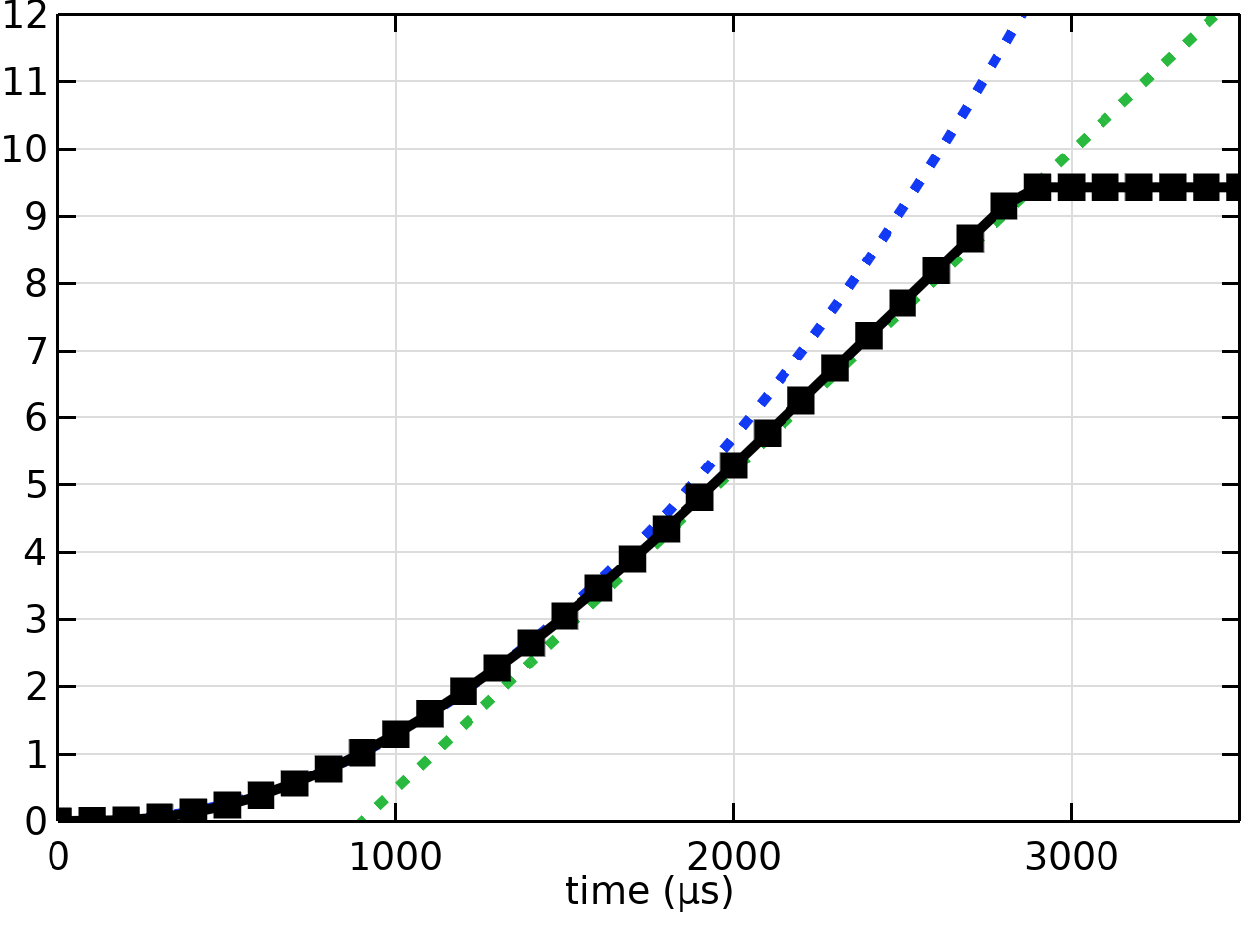
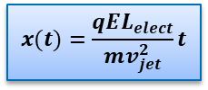
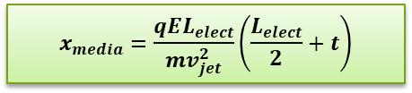
Particule x-axis position
Z=0.48pC
x
x
Electrostatic interaction
→ x-deviation
$$x(t)=\frac{qEL_{elect}}{mv_{jet}^{2}}t$$
Z=1.93pC
No interaction
→ Ballistic flight
$$x_{media}=\frac{qEL_{elect}}{mv_{jet}^{2}}\left(\frac{L_{elect}}{2}+t\right)$$
x
-

Slide 8
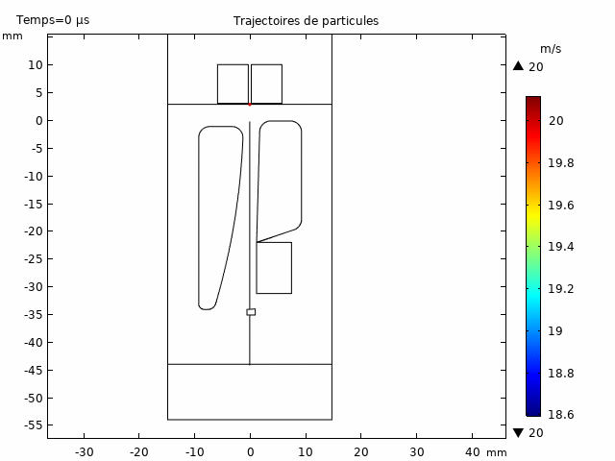
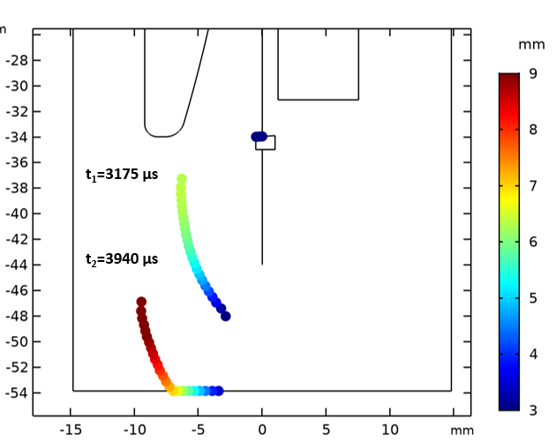
Raster (48 droplets) deviation

Slide 9
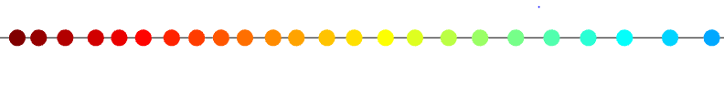

Comparaison with experimental data
Numerical
8,4 mm
Experimental
8,46 mm
Deflection amplitude: correct order of magnitude
Same trend for the local gap between droplet
Droplet positions are not exactly identical →wake effect

Slide 10

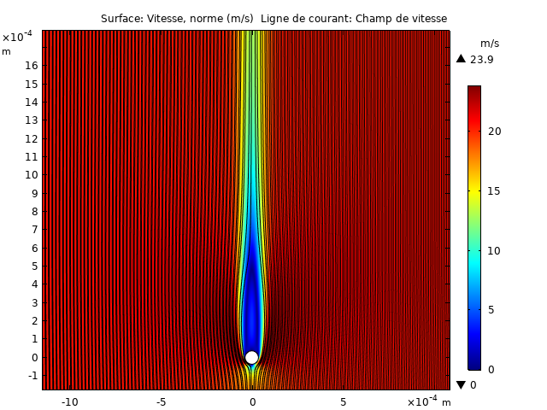
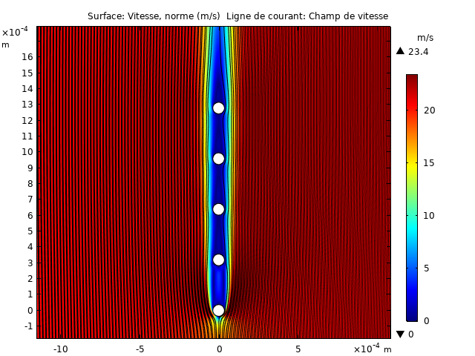
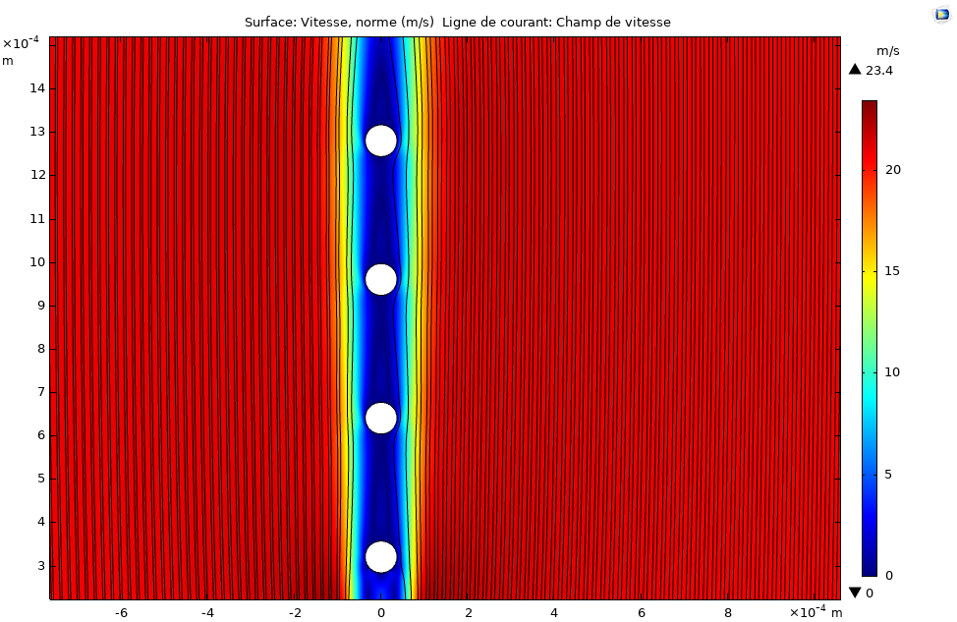
Conclusion & perspectives
Adding wake effect
by strongly coupling this model to a NS calculation to get the air velocity distribution around each droplet
2D model coupling an electrostatic study and a charged particles tracing study (weak coupling)
Simulation of the trajectory of charged droplets rasters into our print head
the repulsion between charged droplets is taken into account
High level of confident thanks do the comparaison with analytical model and experimental data

