Slide 1

Geometric exploration and optimisation of porous ceramic reactors for bioethanol production Jeffrey Gerard¹ and Joe Alexandersen² ¹University of Montpellier, ²University of Southern Denmark
Joe Alexandersen
Assistant Professor
SDU Mechanical Engineering
joal@sdu.dk

Slide 2
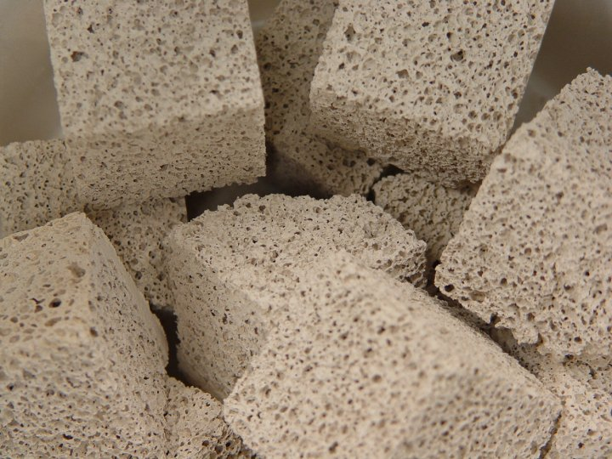
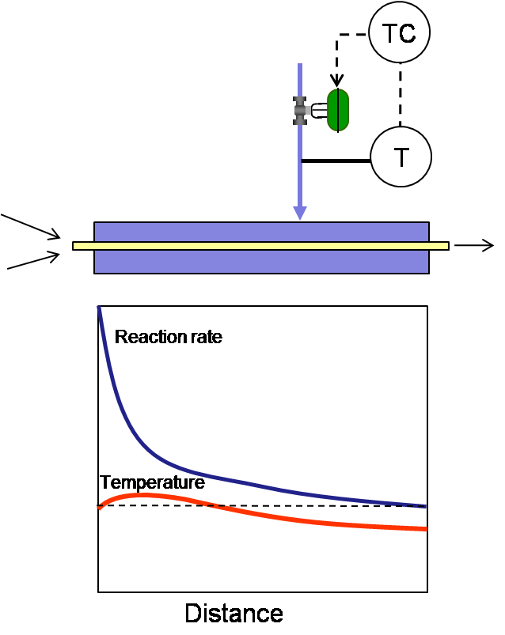
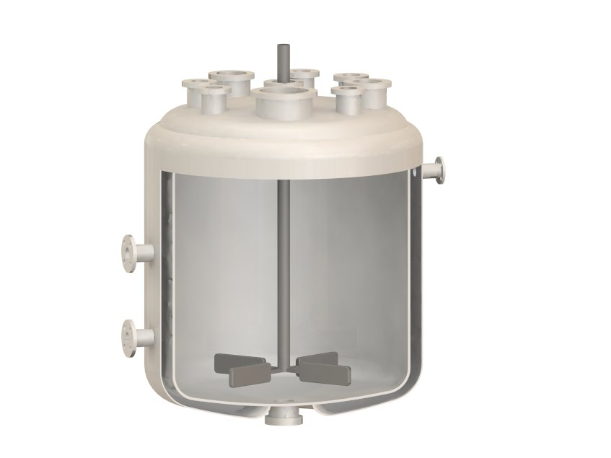
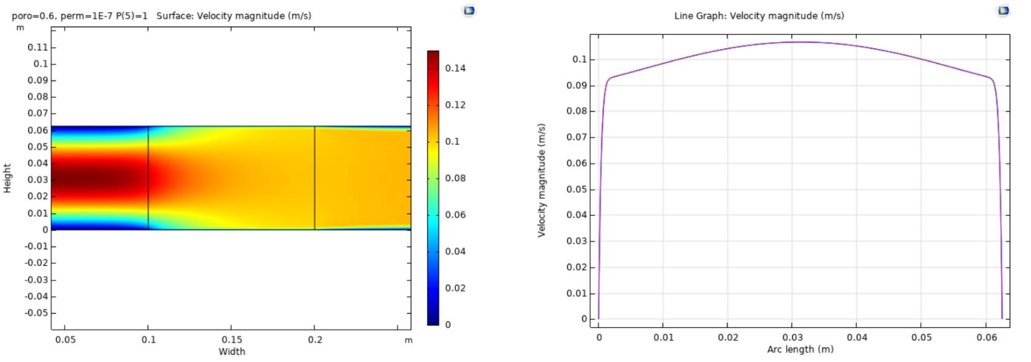
Motivation
Continuous flow bioreactors provide several advantages over batch reactors due to their smaller size:
Easier control over mass and heat transfer
Smaller temperature and reactant gradients
Higher safety
Porous ceramics have advantages for bioreactors:
Flow passes through close to uniformly
Flow moves at a controllable rate
Can be seeded with reactants/catalysts
Porous block has high pressure loss
Can we reduce this while maintaining good reacton rates?
[Wikimedia Commons]
[Wikimedia Commons]

Slide 3
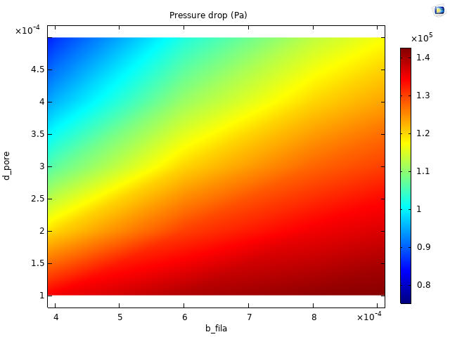
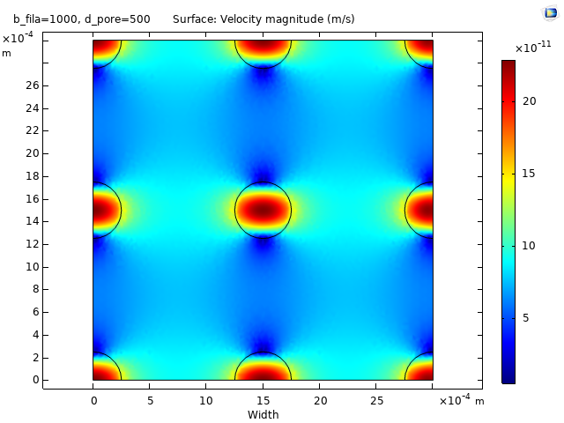
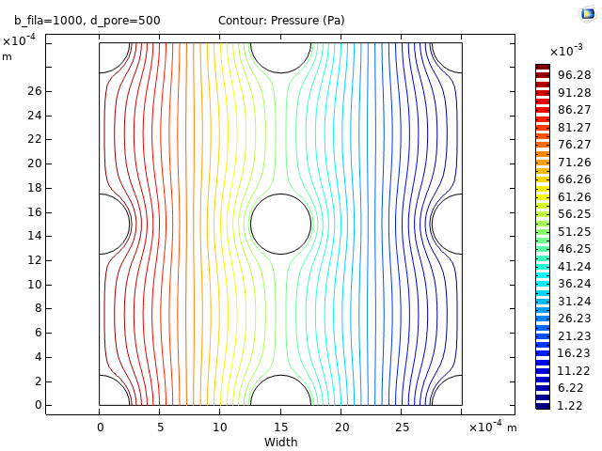
Porosity and permeability
In order to model the flow through the porous ceramic, the porosity and permeability must be known
This was found using homogenisation of a Representative Volume Element (RVE)
Our end goal is to 3D-print the ceramic structures, so we have control over the micropores of the macrostructure
The pressure drop is lowest for the thinnest filament and the largest pore size (less ceramic)

Slide 4
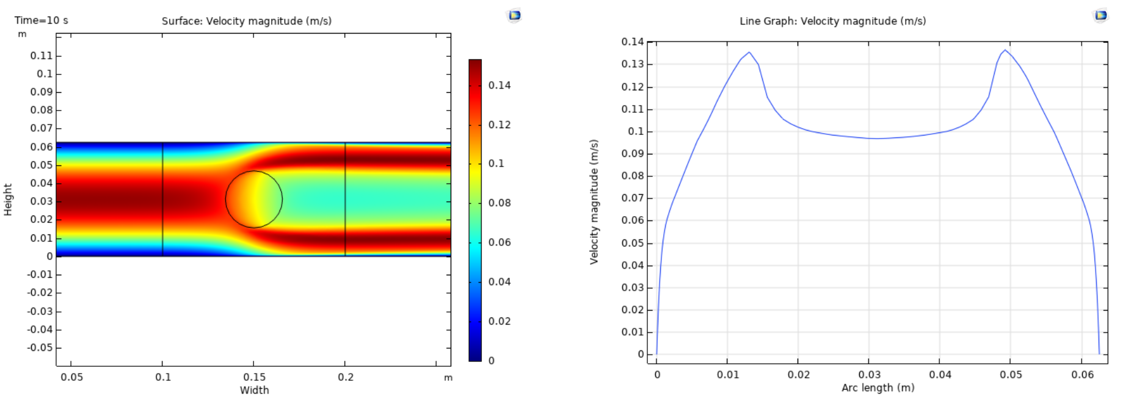
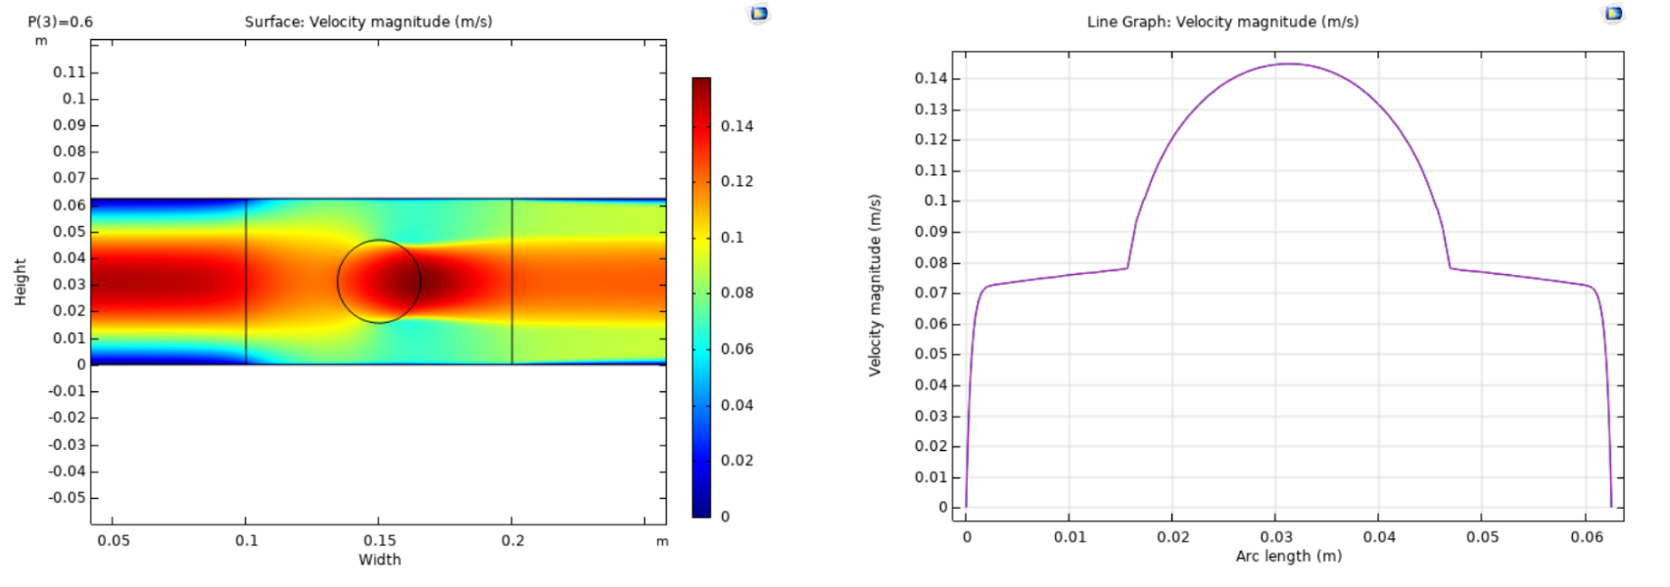
Ceramic obstacles
Reducing to merely a ceramic circle:
Acts basically like a solid cylinder
Some flow passes through but most around it
Inserting macro-pore (fluid circle) into ceramic block:
Reduces the pressure drop
But affects the uniformity of the flow
The less porous material, the lower pressure drop
But what about the reaction?

Slide 5

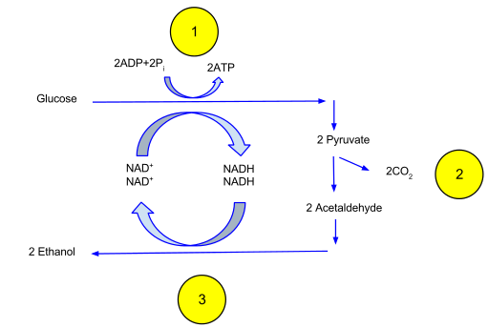

Bioethanol production
Bioethanol based on biological sources
Can be used as fuel source
Less emissions than hydrocarbons
Using the yeast, Saccharomyces cerevisiae, to convert glucose to ethanol
Very complex reaction involving many steps!
For initial purposes, simplified to: where G is glucose, X is yeast and E is ethanol
A lot of informations is needed:
Rate constant of the reaction
Activation energy
Diffusion coefficient
Etc…
[thenounproject.com]
[Wikimedia Commons]
Literature search
[Teusink et al. (1998) doi:10.1128/JB.180.3.556-562.1998]
[Tabah et al. (2015) doi:10.4172/2155-9821.1000232]
Old COMSOL application example: Fermentation in Beer Brewing
[Gee and Ramirez (1994) doi:10.1002/j.2050-0416.1994.tb00830.x]

Slide 6
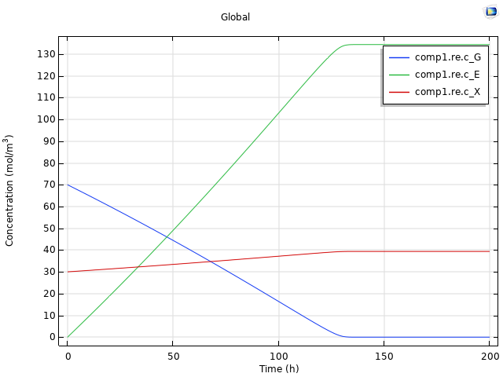
1D reaction model
Reaction Engineering Module:
Quick setup of 1D model (batch reactor)
Easily transferred to a 2D/3D model subsequently
Test of model shows:
Long time scale of reaction!
Amount of yeast grows over time due to consumption of glucose (multiplication)
After around 125 hours, all glucose is gone and ethanol stagnates

Slide 7
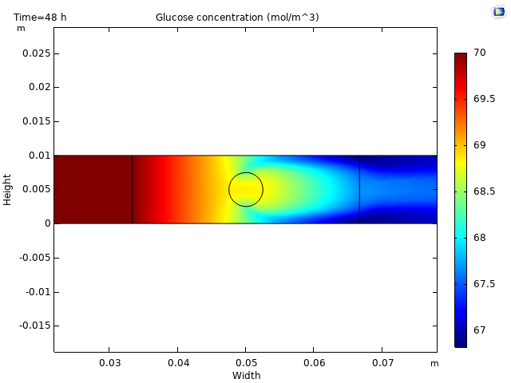
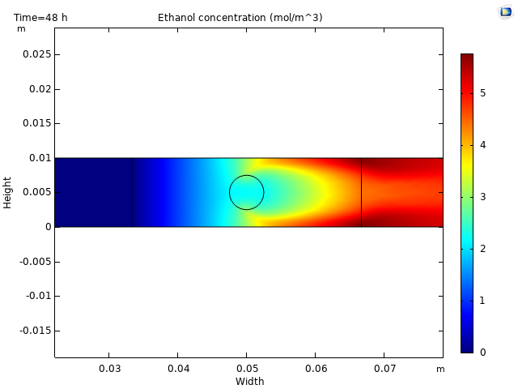
2D reaction model
Reaction Engineering Module:
Quick setup of 1D model (batch reactor)
Easily transferred to a 2D/3D model subsequently
Assumptions:
Yeast is bound to ceramic (no transport)
Reaction active for 48 hours
Fluid macro-pore inside porous ceramic block
Large velocity increase generates a “plume”

Slide 8
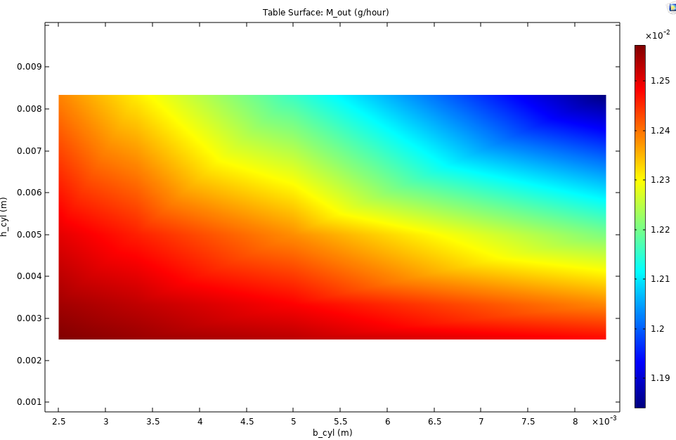
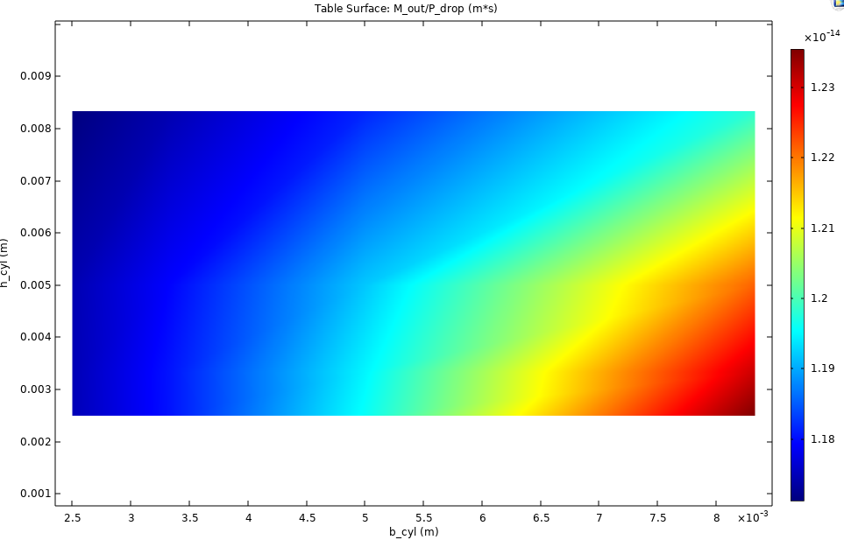


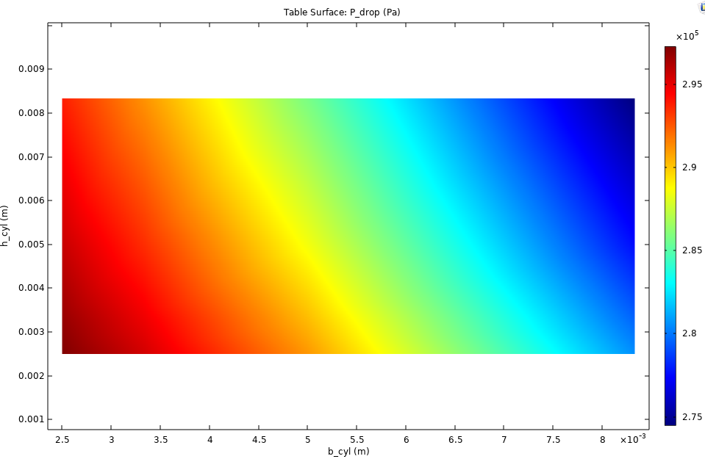
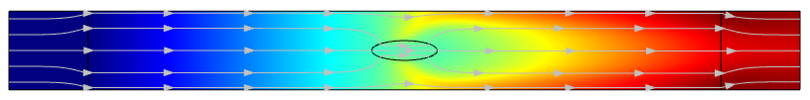
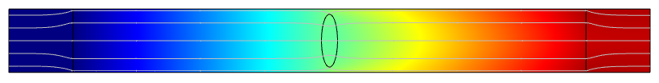
Geometric exploration
Parametric Study:
How does the ethanol production and pressure drop vary with macro-pore size and shape?

Slide 9
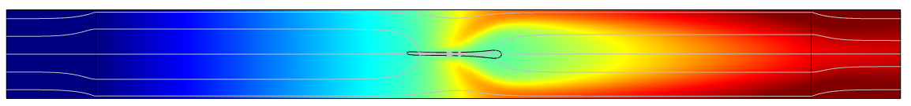
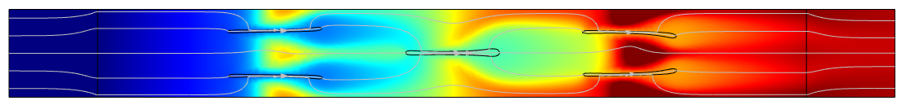
Geometric optimisation
Optimization Module:
Shape optimization of macro-pore to maximise ethanol output per pressure drop
Ethanol output
Pressure drop
E/P
2.1%
2.1%
4.3%
0.4%
25.7%
33.9%

