Slide 1
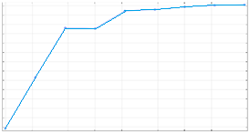
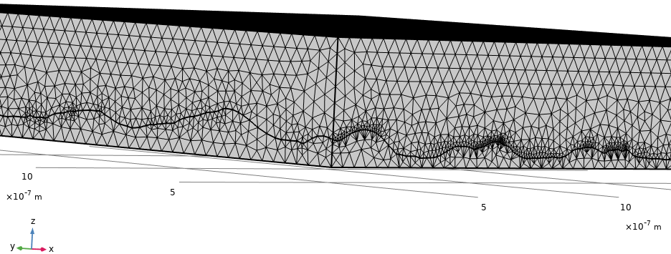



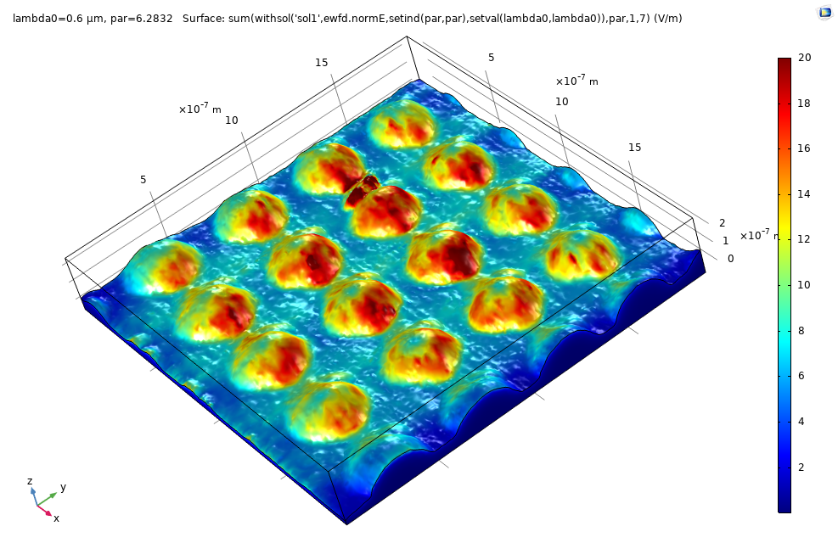
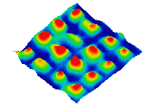
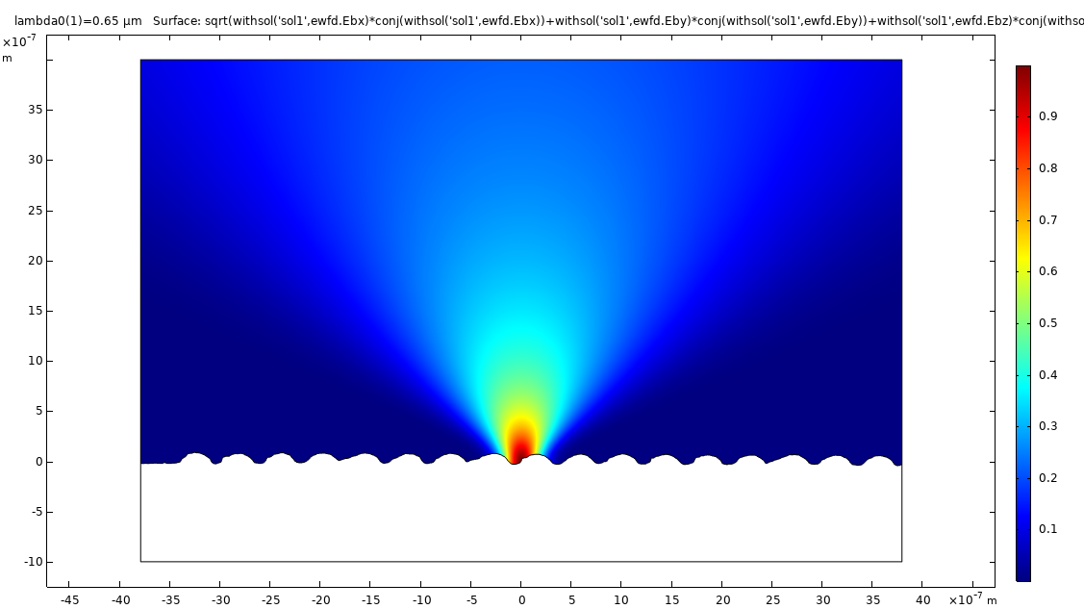
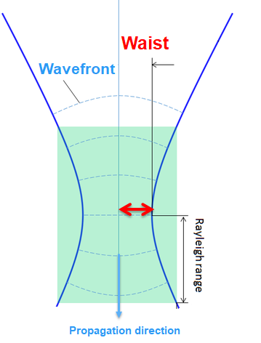
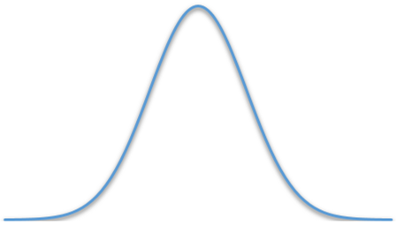

Studying the plasmonics properties of smooth, rough and nanostructured gold surfaces
P. Taugeron¹, N. Delorme¹, J-F. Bardeau¹
1. Institut des Molécules et Matériaux du Mans – CNRS n°6283, Le Mans University, Le Mans, France
INTRODUCTION
To better understand the effect of controlled surface topographical features on SERS (Surface Enhanced Raman Scattering) enhancement factors, simulations of plasmonic properties of different gold surfaces have been carried out (Fig. 1). Atomically flat surface has been simulated with COMSOL and the rough and nanostructured surfaces were imported from AFM data.
RESULTS
Convergence of norm E was verified by varying mesh size with a parametric sweep. For the nanostructured surface, the optimized minimum element size (S_{min}) is 14 Å and the maximum element (S_{max}) size is 40 nm (Figure 3).
a)
b)
Norm E (V/m)
a)
2 µm
b)
280 Å
14 Å
0,56 Å
2 µm
S_{min}
Figure 3. a) Convergence of norm of E for nanostructured surface by varying S_{min} (red line indicates our choice) and b) meshed nanostructured surface.
As expected, the average EM field enhancement is lower for smooth surface than rough and increases for nanostructured surface (Figure 4).
Raman spectra have been recorded at λ=660 nm after immersion of the substrate in a 10⁻⁶ M solution of thiophenol. The average Raman intensity of each surface is reported in Fig. 4 and the Raman intensity map of the nanostructured surface in Figure 5.
2 µm
150 nm
c)
Figure 1. Atomically flat (a), nano-rough (b) and nanostructured [1] (c)
gold surfaces. Image size: 2 µm x 2 µm.
COMPUTATIONAL METHODS
Wave Optics module allows us to simulate a paraxial Gaussian beam. Waist, P₀ (distance to focal plane) and propagation direction vector$\vec{k }$are defined in Figure 2.
The linear polarized incident paraxial Gaussian beam (λ= 660 nm) was focused onto the surfaces. The average EM field enhancement (|E_{scatt}/ E_{inc}|⁴, with E_{scatt} the scattering field and E_{inc} the incoming field) was calculated for each surface and averaged over 360°.
Our mesh is set up with free triangular for the surface and free tetrahedral for gold and air domains.
Figure 4. EM field enhancement and Raman intensity recorded on
different gold surfaces.
Simulation
Raman mapping
a)
b)
Virtual Lense
Gaussian energy distribution
Figure 5. a) Calculated EM field enhancement and b) aman intensity map of thiophenol.
P₀
CONCLUSIONS
Good agreement between simulation and experimental data. Our model can predict SERS efficiency of our patented structures [1]. Comsol will be then useful for testing our more complexes SERS structures.
Air
Gold
REFERENCES
M. Edely, N. Delorme, D. Siniscalco, J.-F. Bardeau, Alternative Strategy Based on Scanning Probe Lithography for Patterning Complex Metallic Nanostrutures on Rigid or Flexible Substrates, Advanced Materials Technologies 1800134 (2018)
Figure 2. Set up model with 2 domains : gold and air. Cases of paraxial Gaussian beam interacting with a nanostructured gold surface.
Excerpt from the Proceedings of the 2020 COMSOL Conference

