Slide 1
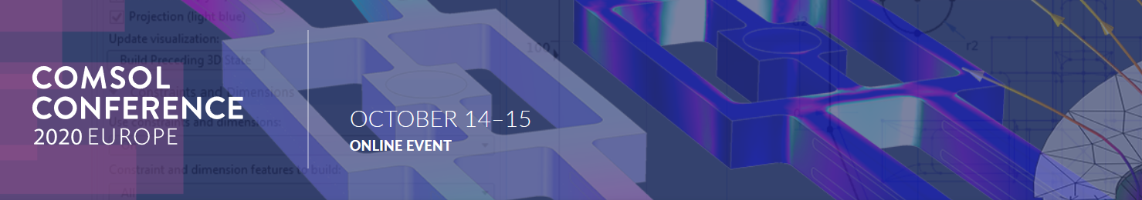


Spectral analysis of thermal emission from melt pool during laser material processing
M. Ćwikła*ª, P. Korubaª, A. Zakrzewskiª, P. Jurewiczª, J. Reinerª
ªFaculty of Mechanical Engineering, Wrocław University of Science and Technology, wybrzeże Stanisława Wyspiańskiego 27, 50-370 Wrocław, Poland
*michal.cwikla@pwr.edu.pl; phone + 48 71 320 27 89

Slide 2


Motivation
When material surface is exposed to high power laser radiation, the material is heated up and thermal emission increases with temperature
Thermal radiation’s spectral range and sensor’s operation spectral range overlap
The knowledge about amount of the thermal radiation that is collected by the sensor is crucial.
Laser processing head
Fig 1. Scheme of confocal chromatic sensor
Ćwikła M et al.., Preliminary design of longitudinal chromatic aberration sensor implemented to laser processing head, Optics and Measurement International Conference 2019 (DOI: 10.1117/12.2542409)

Slide 3
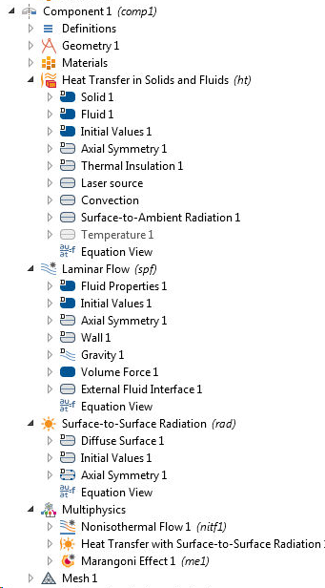
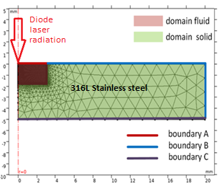
Meltpool formation
The developed model of laser remelting process consists of following components:
Heat transfer model including laser heat source, convection, radiation and phase change phenomena
Melt pool dynamics including buoyancy and Marangoni effect
Calculations of radiation properties for multiple spectral bands
Calculation of free surface - external fluid interface
Fig 2. Meshed axisymmetric model
Fig 3. Melt pool shape depending on surface tension value

Slide 4
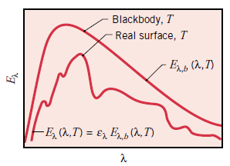
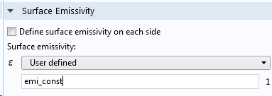
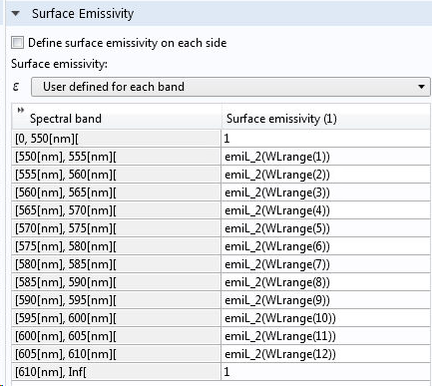
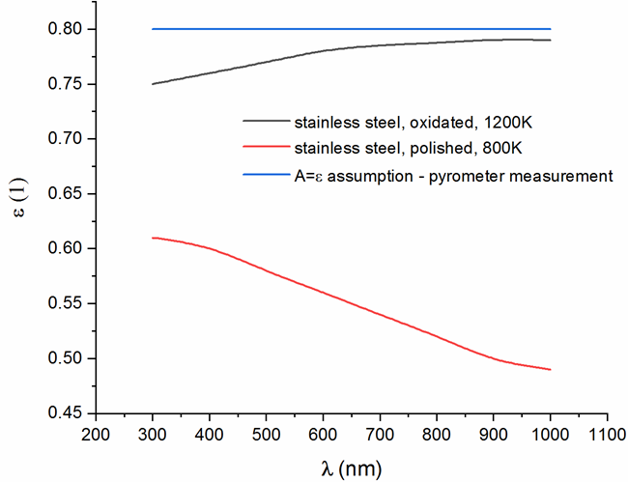


Meltpool radiation
Stefan-Boltzmann law for real surface with defined emission ε to calculate thermal radiation:
Approaches:
$ε=A=const.$
$ε\left(λ,T\right)=A\left(λ,T\right)$
$$q_{r}=ε∗σ∗T^{4}$$
Source: F. P. Incropera, 2007
Melt pool – top view
Fig 5. Surface emissivity defined in Comsol – constant value and emissivity functions from literature.
Fig 4. Areas of the melt pool seen by the sensor – top view

Slide 5
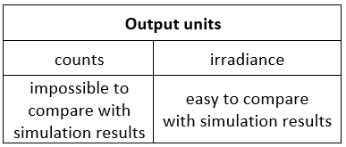
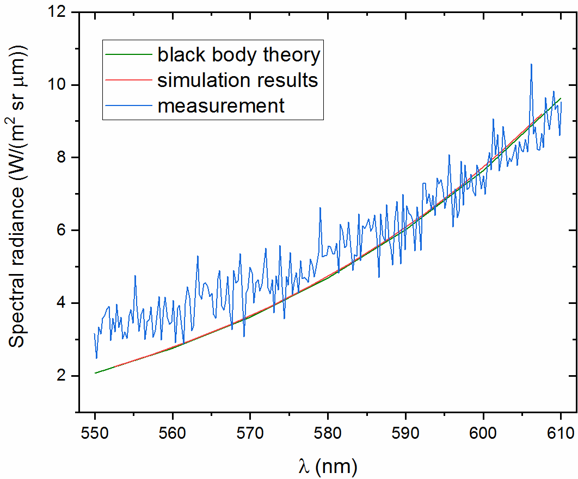
Model validation: Experimental setup
Experimental procedures:
spectrometer calibration using dedicated halogen lamp
verification with black body calibrator – constant temperature 982°C
validation with laser remelting process (laser power 800 W)
Fig 6. Comparison of Radiance results (II) obtained by experimental measurement (blue), theoretical (red) and simulation calculation (green)

Slide 6
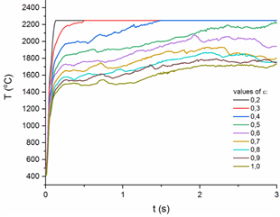
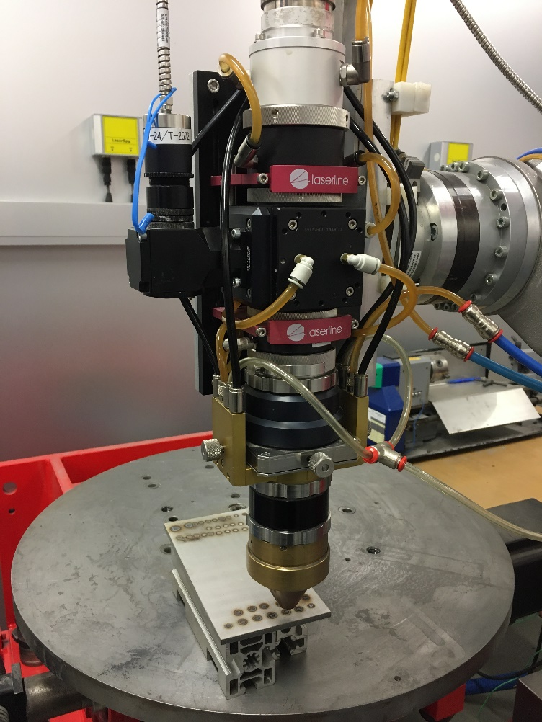
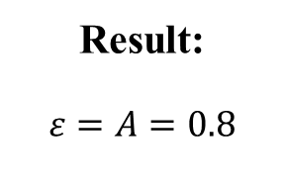
Tuning the simulation
Pyrometer measurements
Problem: Temperature on the surface strongly depends from absorptivity of laser radiation, which is unknown.
Goal of the simulation tuning: Defining correct value for absorptivity of laser radiation for 316L steel
Laser head
Result:
$$ε=A=0.8$$
Simulation with parametric sweep
Pyrometer
Fig 7. Experimental setup for tuning the simulation
Melt pool

Slide 7
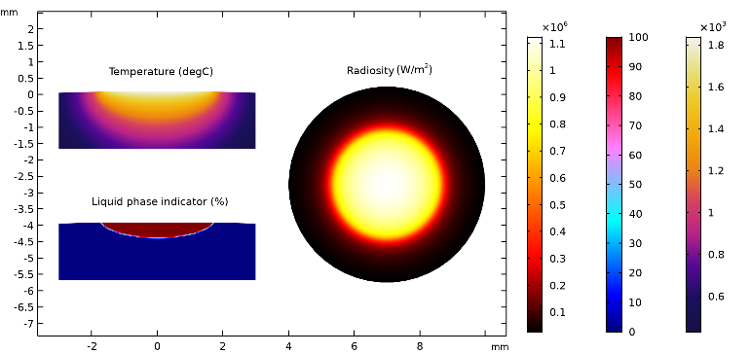
Results and discussion
Fig 8. The simulation results of laser melting process including temperature distribution, liquid phase indicator and surface radiosity
Fig 9. Radiosity results for different emissivity approaches

Slide 8
Conclusions
Developed model allows to calculate thermal radiation from the melt pool created during laser material processing
Our application: confocal chromatic aberration sensor implemented to laser head
Model can help to design any optical system and any sensor in which thermal radiation can affect the readings.
Choosing correct absorptivity and emissivity value are crucial for correct melt pool temperature results, which has great influence on radiosity results (in 4th power). The best method is to tune the simulation with pyrometer measurements.
Developed model can be used for variety of laser material processes.

Slide 9



Thank you for your attention.
Acknowledgments
This research was supported by The National Centre for Research and Development, project No. LIDER/18/0071/L-9/17/NCBR/2018 “Process control of laser material processing using the phenomenon of chromatic aberration”.

