Slide 1



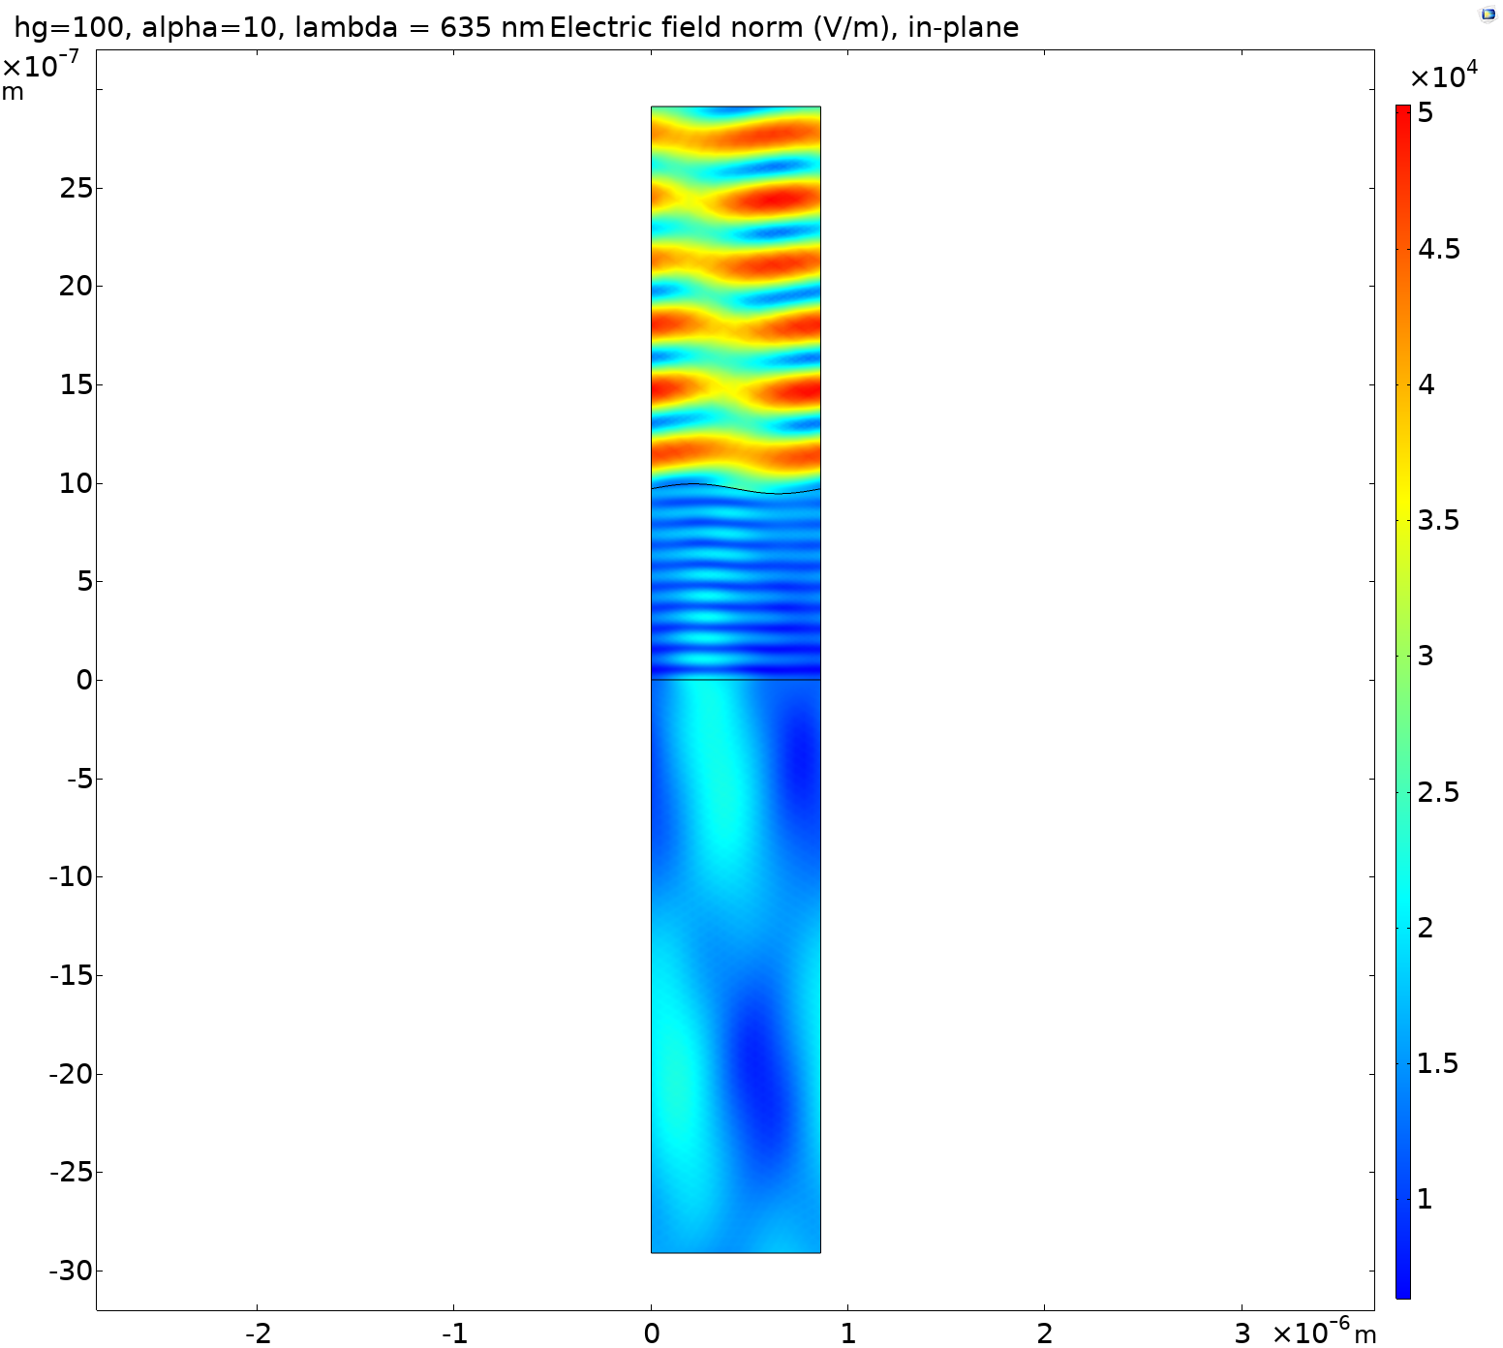
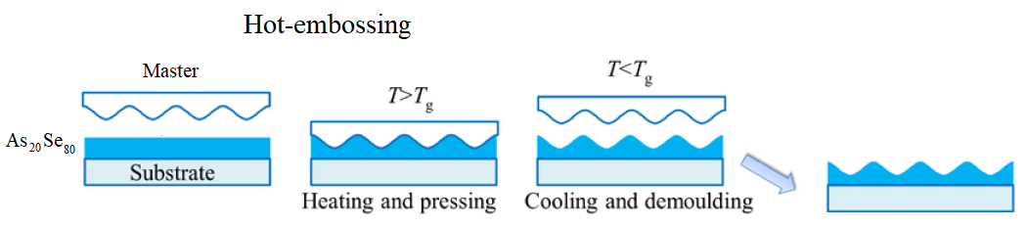
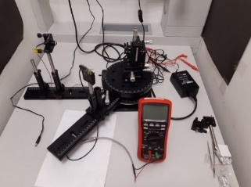
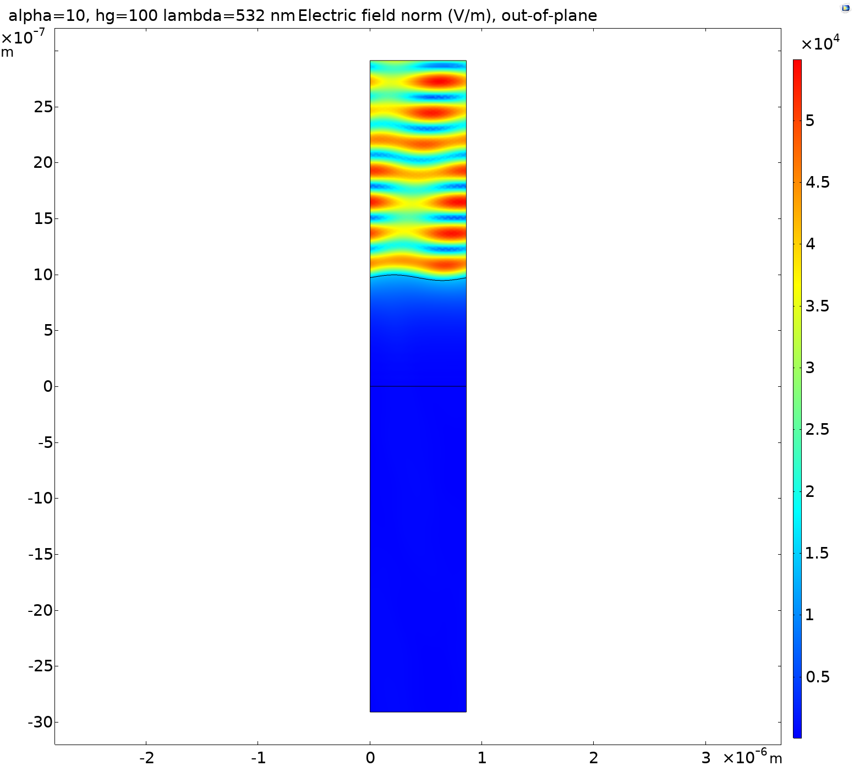
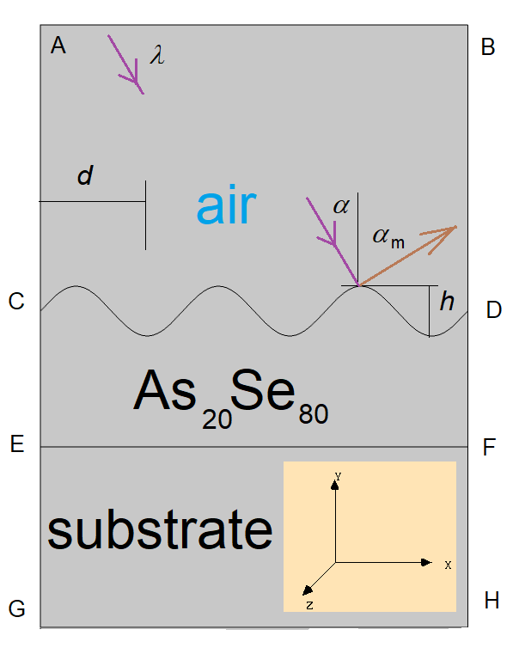




Diffraction Efficiency of Gratings with Sinusoidal Profile
P. Janicek^{1,*}, V. Stepankova¹, M. Kurka¹, K. Palka¹, A. Ventura², J. G. Hayashi²
1. Faculty of Chemical Technology, University of Pardubice, Pardubice, 53210, Czech Republic
2. Optoelectronics Research Centre, University of Southampton, Southampton, SO17 1BJ, UK
*e-mail: petr.Janicek@upce.cz
INTRODUCTION: Investigation of the diffraction efficiency (DE) measurement as a tool to fabricate a diffraction grating with a defined thickness.
RESULTS: Spatial distribution of the electric field and dependence of the reflectance (order 0, -1 and 1) on
the grating depth for three
different angle of incidence.
λ = 635 nm
in-plane
Table 2. input parameters of the model
Variable | Value | Units
Grating period d | 860 | nm
Wavelength λ | 532 and 635 | nm
As₂₀Se₈₀ thickness [EC] | 970 | nm
Angle of incidence α | 0, 5 and 10 | deg
Grating depth h | from 0 to 150 | nm
Figure 1. Schematic diagram of hot-embossing
diffraction grating fabrication process
First step: Comparison between the DE ex-situ measurement and the analytic DE calculation using the Bessel functions of the first kind and m-th order [1]
and results modeled in COMSOL 5.5. using Wave optics module.
λ = 532 nm out-of-plane
$$η_{m}=J_{m}^{2}\left\{\frac{πh}{λ}\left(cosα+cosα_{m}\right)\right\}$$
Figure 5. Spatial distribution of electric field
norm for h = 100 nm, α = 10 deg
Figure 2. Custom-made equipment
for the diffraction efficiency measurement
COMPUTATIONAL METHODS: Similar to Plasmonic Wire Grating application. The aim of our calculation is to obtain electric field vector E for all (x, y, z) by solving the wave equation.
Boundary conditions
[AC], [CE], [EG], [BD], [DF] and [FH]:
[AB]: out-of-plane E = (0, 0, 1) and in plane H = (0, 0, 1) periodic incident wave
Automatic diffraction order reflectance calculation
$$∇×\left(μ_{r}^{−1}∇×\vec{E}\right)−k_{0}^{2}n^{2}\vec{E}=\vec{0}$$
$$k_{0}=ω\sqrt{ε_{0}μ_{0}}=\frac{ω}{c_{0}}$$
$$\vec{E_{tangential}}\left(\vec{r_{B}}\right)=\vec{E_{tangential}}\left(\vec{r_{A}}\right)∙exp\left(−i\vec{k}∙\left(\vec{r_{B}}−\vec{r_{A}}\right)\right)$$
Figure 3. Diffraction grating simulated geometry
Incident
wave
[AB] = d
[CD] parametric curve
Diffracted wave
Figure 6. Comparison of measured and calculated DE for
a) green LED b) red LED
$$x=s \\ y=\frac{h}{2}∙sin\left(\frac{2πs}{d}\right) \\ s∈\left\langle 0;d\right\rangle$$
CONCLUSIONS: Dependence on incident wave orientation increase
with grating depth. Overall quite good agreement between results
from COMSOL, calculation with the Bessel functions and the measurement allows the utilization of measurement of diffraction efficiency as a tool to estimate depth of the grating.
Open questions: Accuracy of the experiment?
Influence of non-zero transmittance for red diode?
Cause of difference in case of green LED?
Figure 4. Optical properties of As₂₀Se₈₀ layer obtained from ellipsometry
Table 1. input parameters of the model
REFERENCES:
P. Hariharan, "Optical Holography: principles, techniques, and applications," Cambridge Studies in Modern Optics, second Edition, p. 47 (1996).
ACKNOWLEDGEMENT: Authors appreciate financial support from grant LM2018103 from the Ministry of Education, Youth and Sports of the Czech Republic and European Regional Development Fund-Project “High-sensitive and low-density materials based on polymeric nanocomposites – NANOMAT” ( CZ.02.1.01/0.0/0.0/17_048/0007376).
Wavelength (nm) | 532 | 635
Refractive index (substrate) | 1.5168 | 1.5132
Excerpt from the Proceedings of the 2020 COMSOL Conference in Grenoble

